Slide 2
Welcome
JP Flores

Slide 3
Song Leader
Nathan Shepard

Slide 4
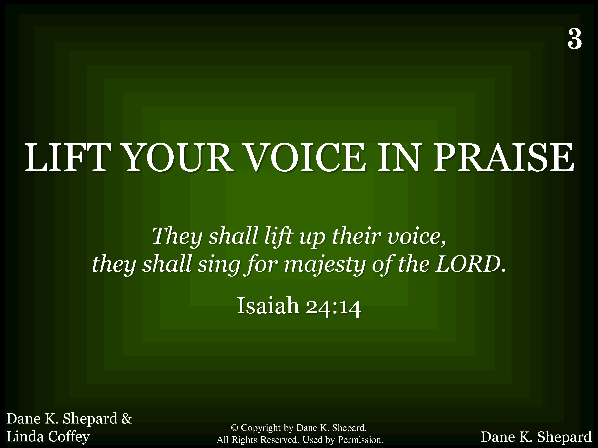
003 - Lift Your Voice In Praise - Title

Slide 5
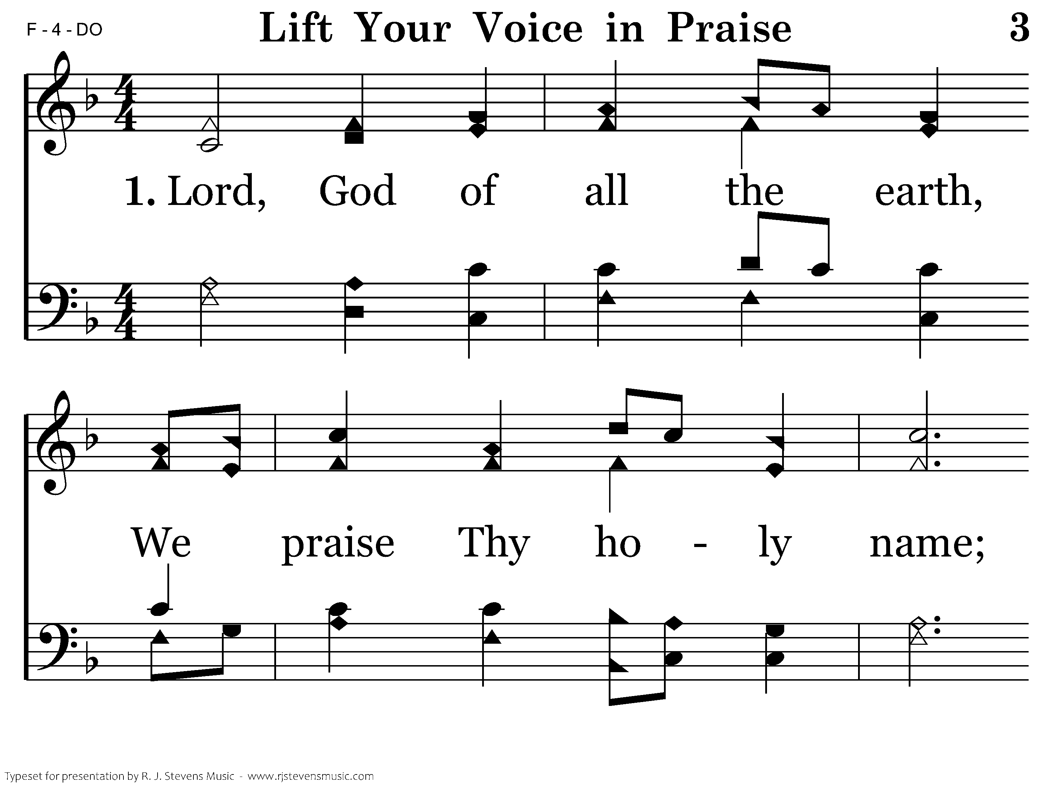
003 - Lift Your Voice In Praise - 1.1

Slide 6
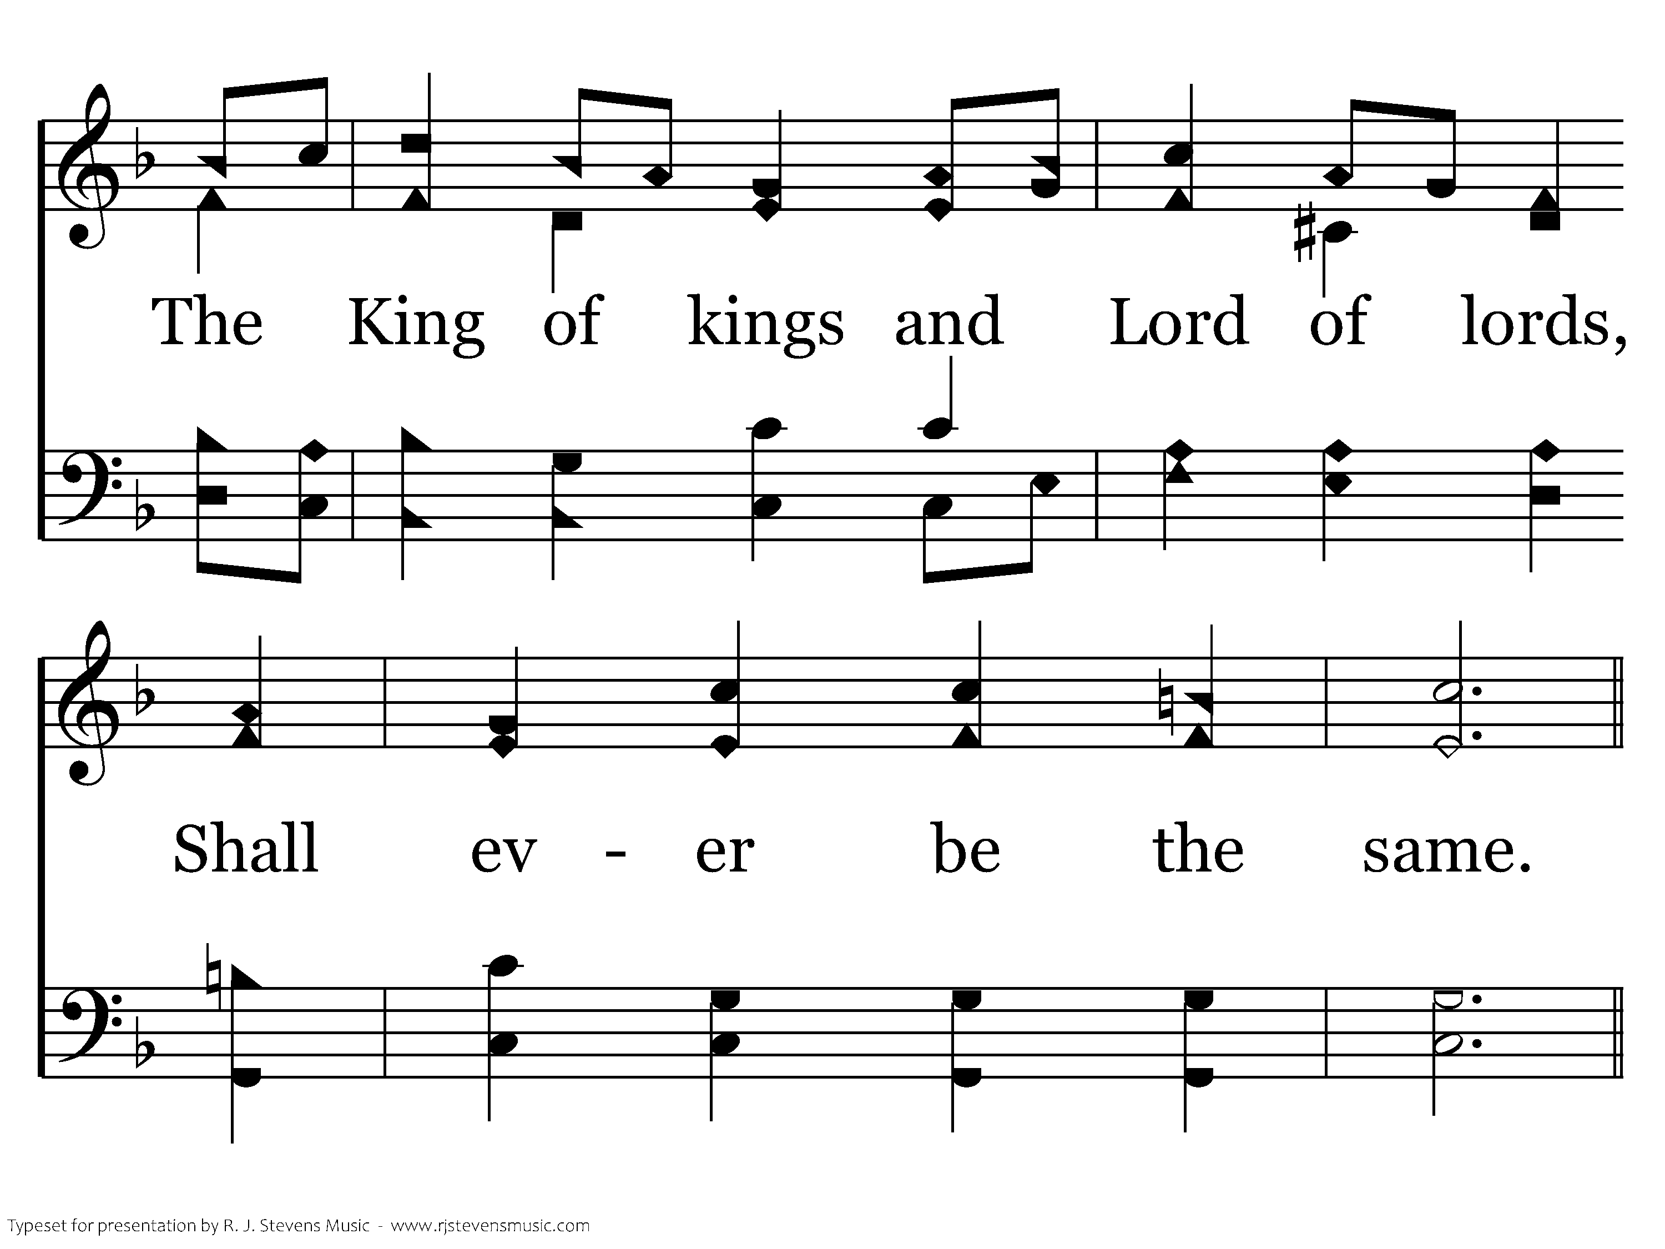
003 - Lift Your Voice In Praise - 1.2

Slide 7
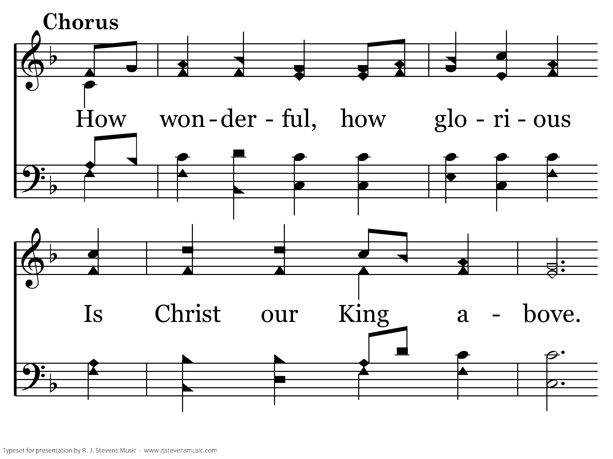
003 - Lift Your Voice In Praise - C.1

Slide 8
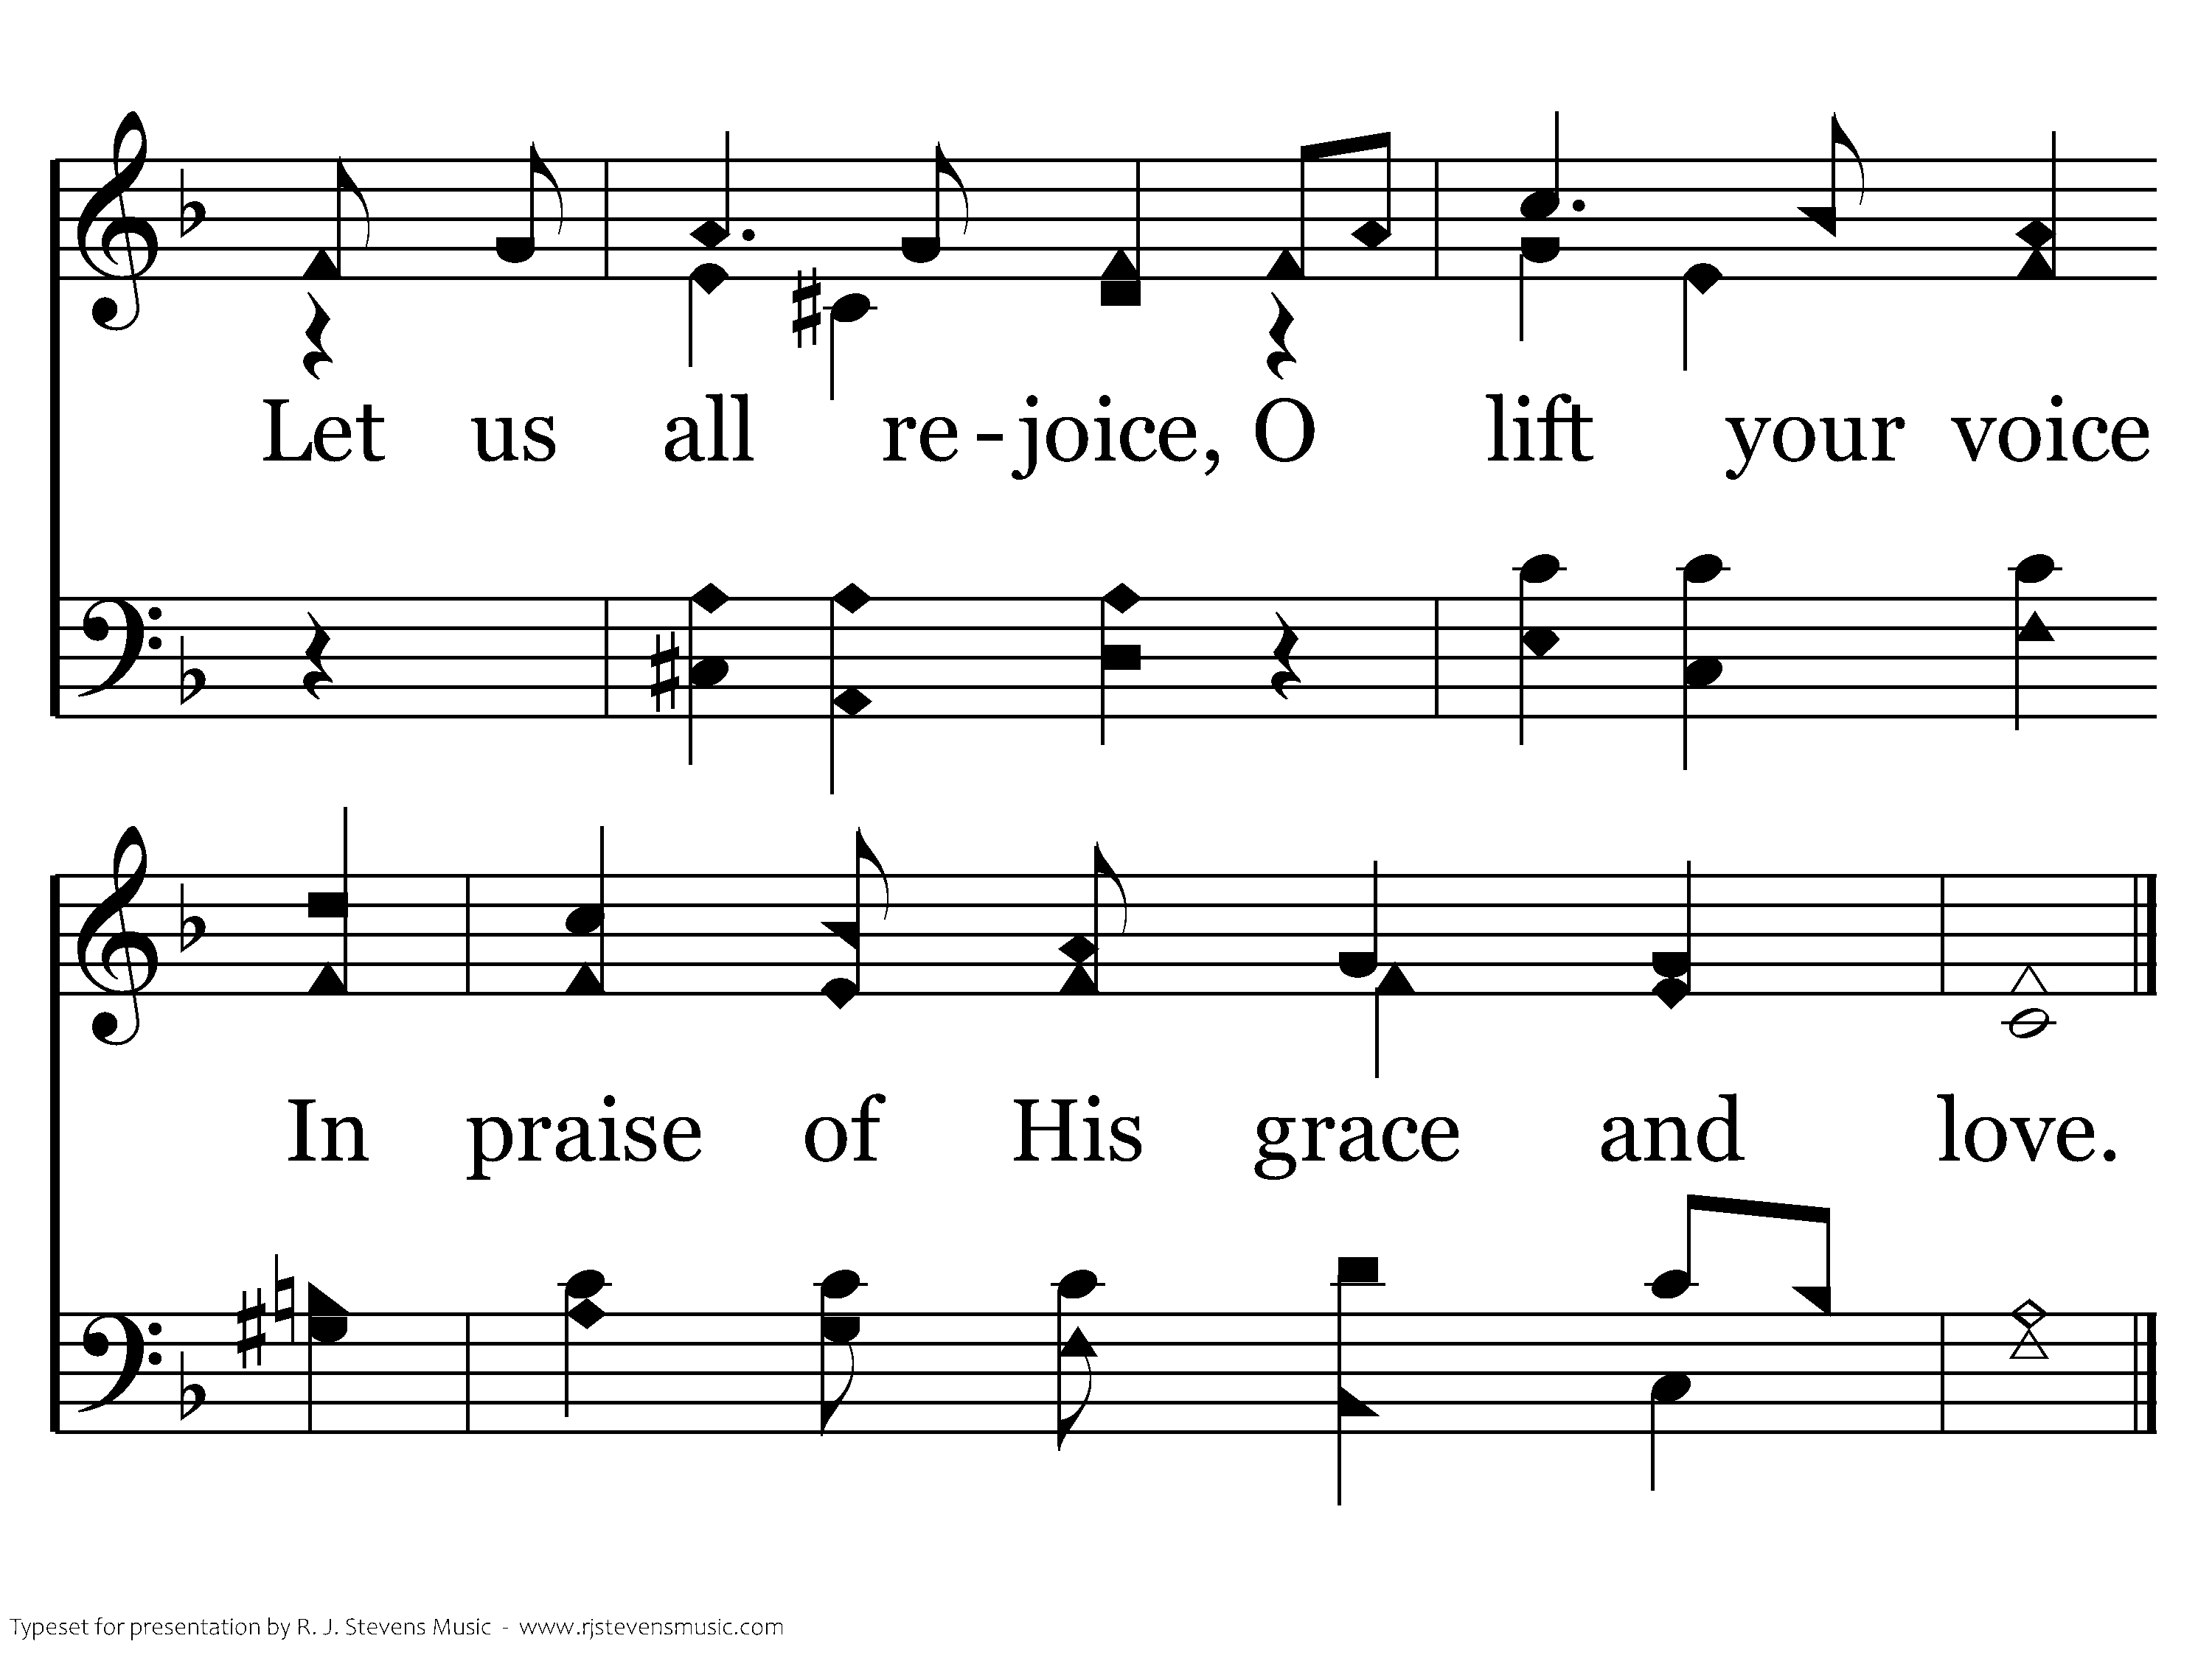
003 - Lift Your Voice In Praise - C.2
End of Verse 1

Slide 9
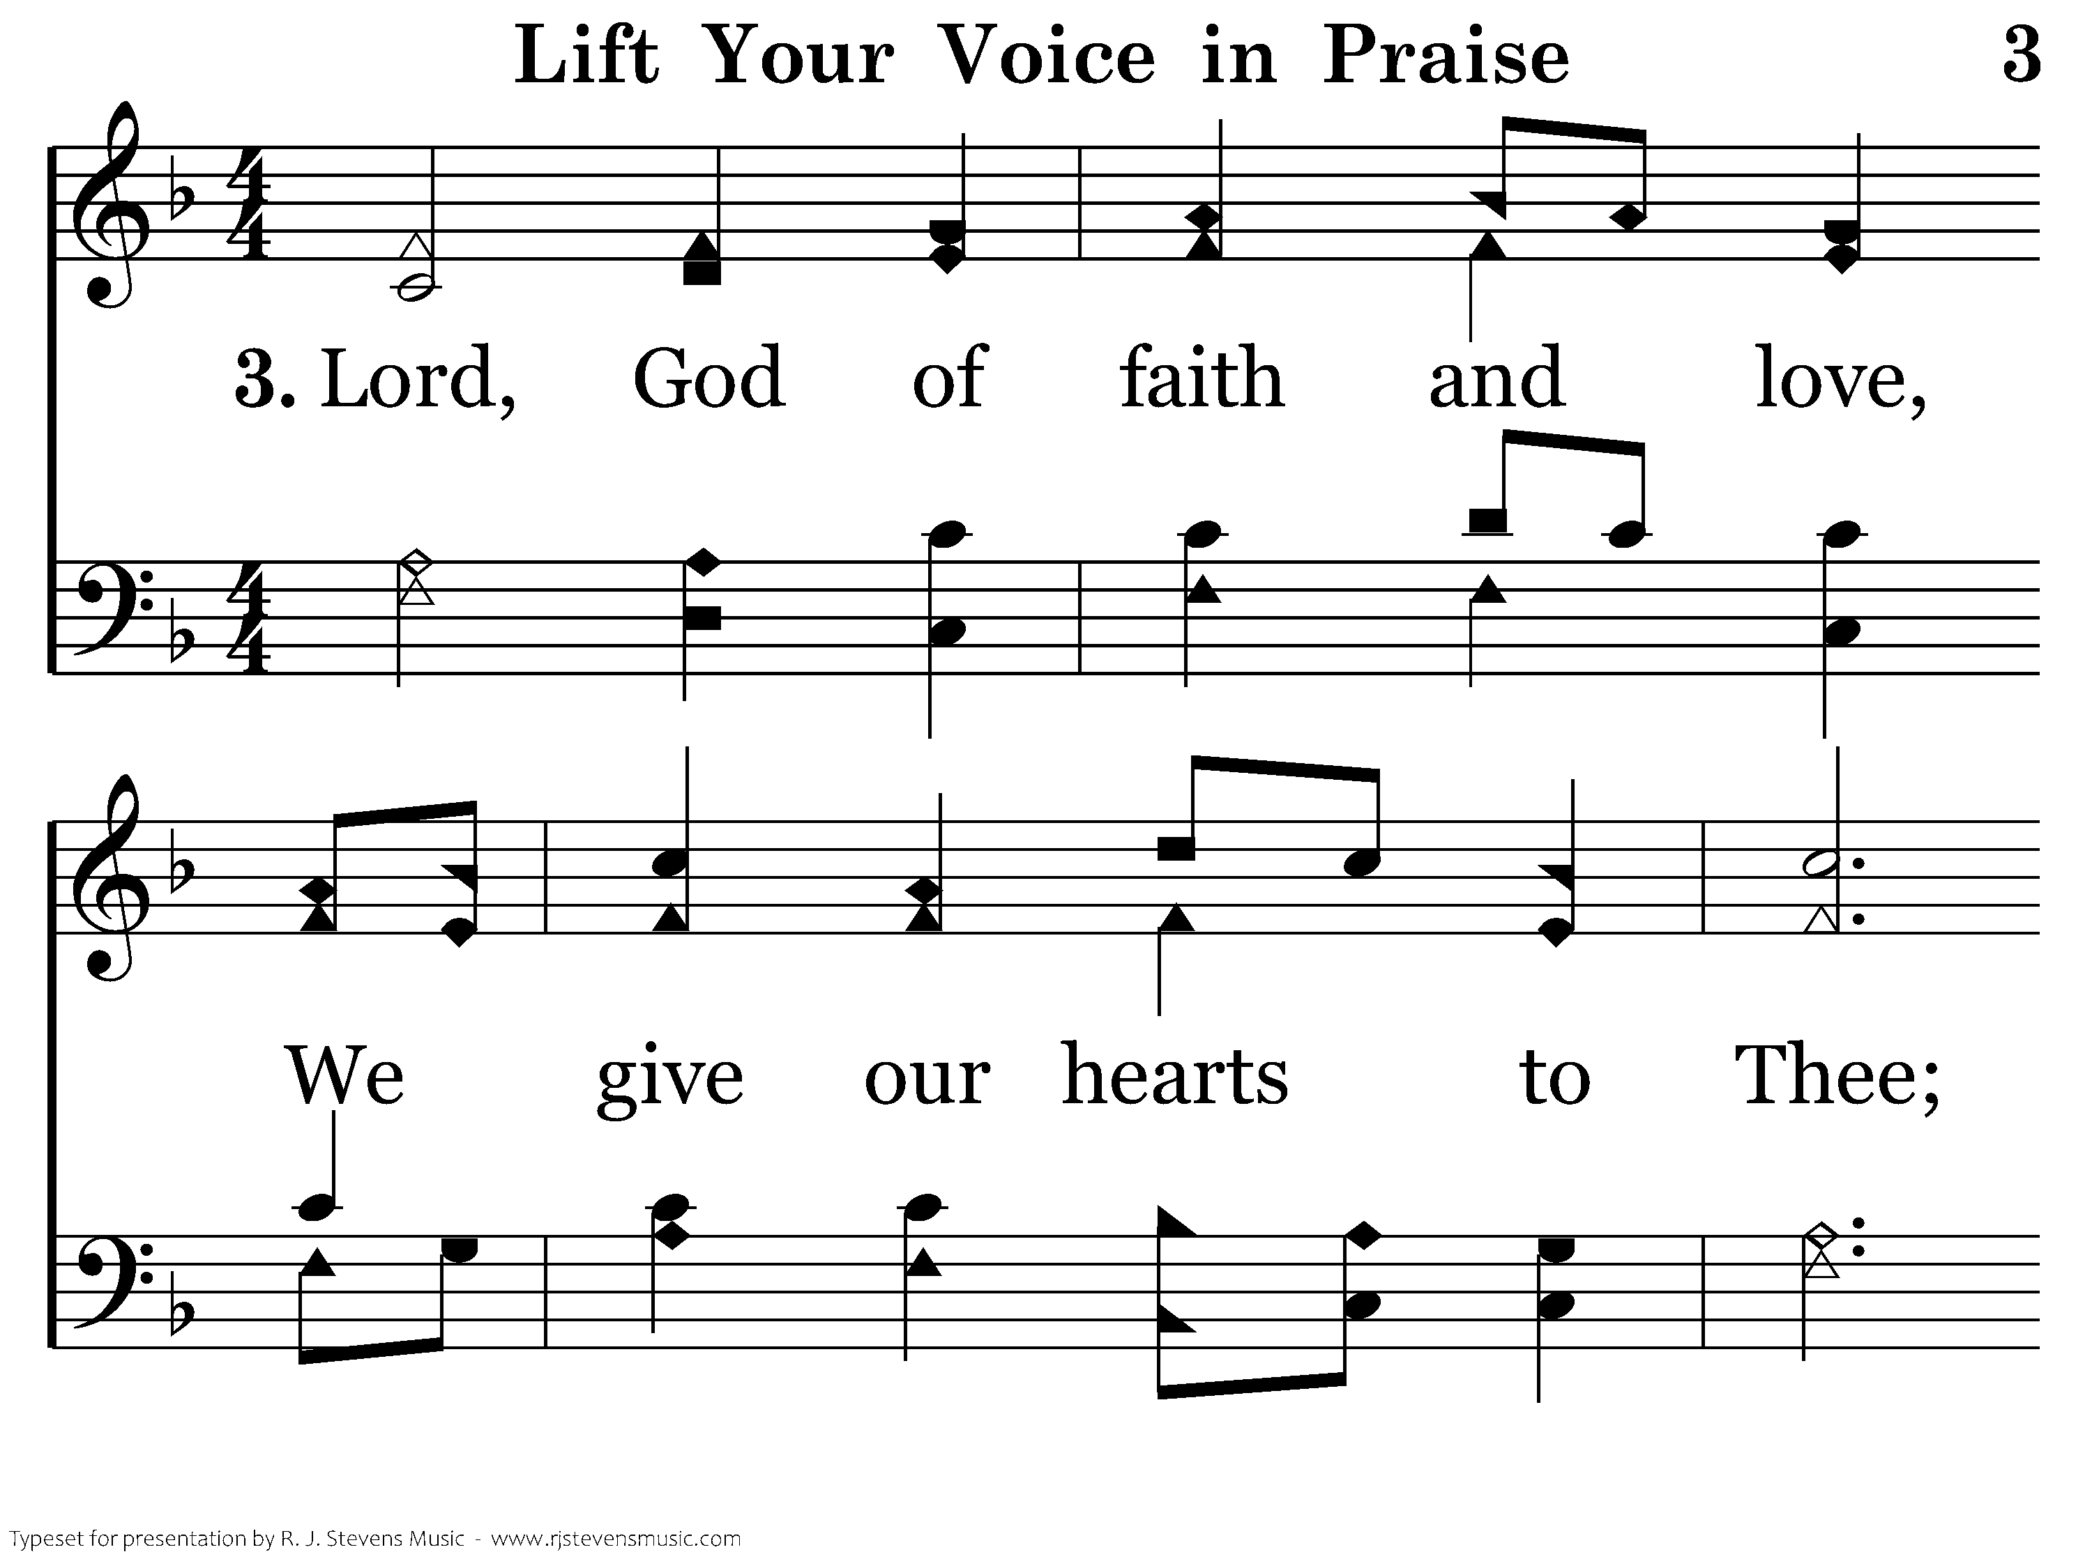
003 - Lift Your Voice In Praise - 3.1

Slide 10
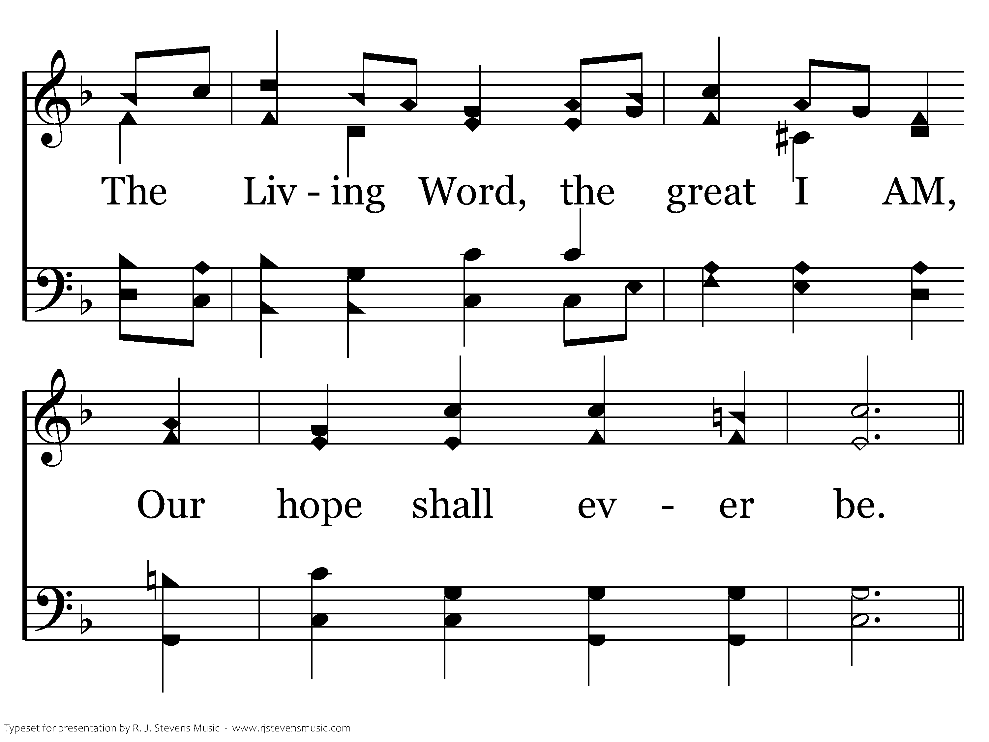
003 - Lift Your Voice In Praise - 3.2

Slide 11
003 - Lift Your Voice In Praise - C.1

Slide 12
003 - Lift Your Voice In Praise - C.2
End of Song

Slide 14
Opening Prayer
Luke Stevens

Slide 16
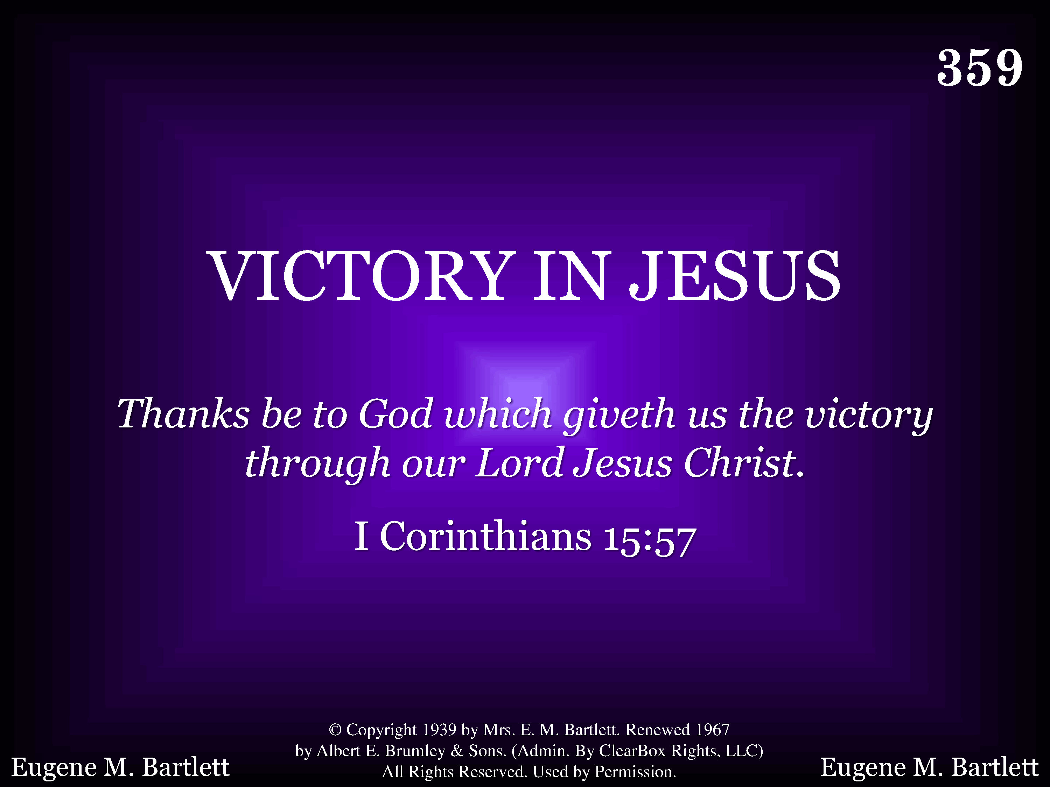
359 - Victory In Jesus - Title

Slide 17
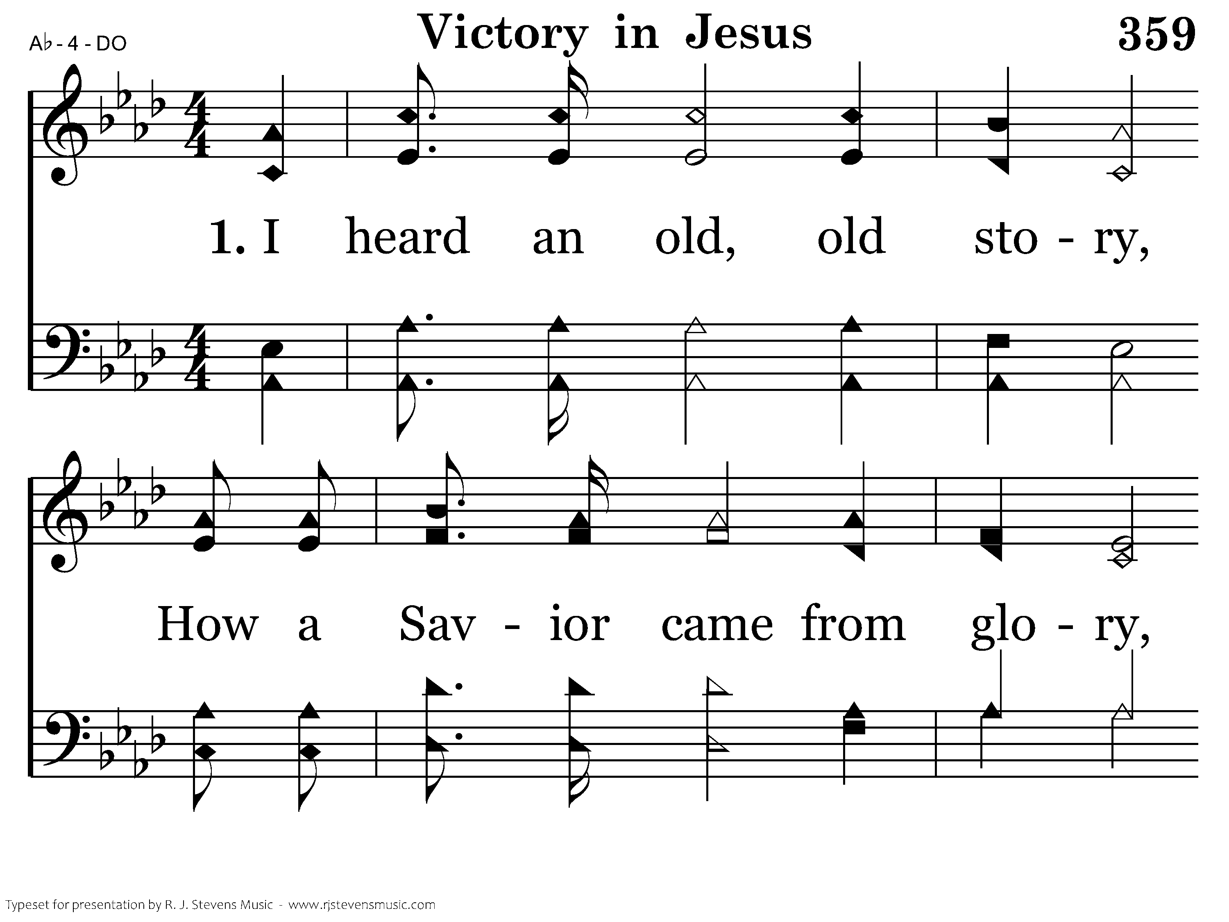
359 - Victory In Jesus - 1.1

Slide 18
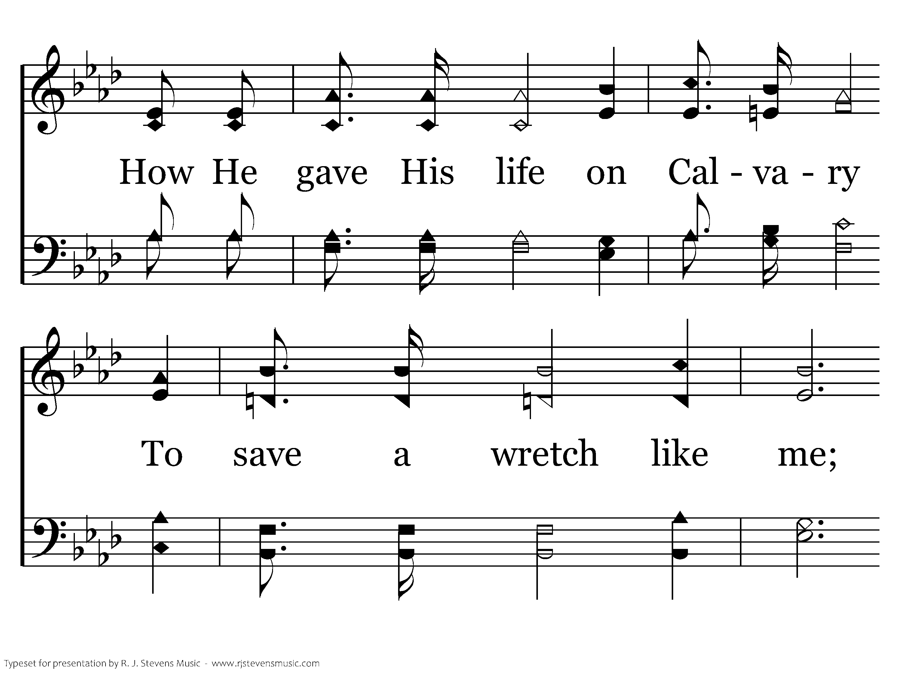
359 - Victory In Jesus - 1.2

Slide 19
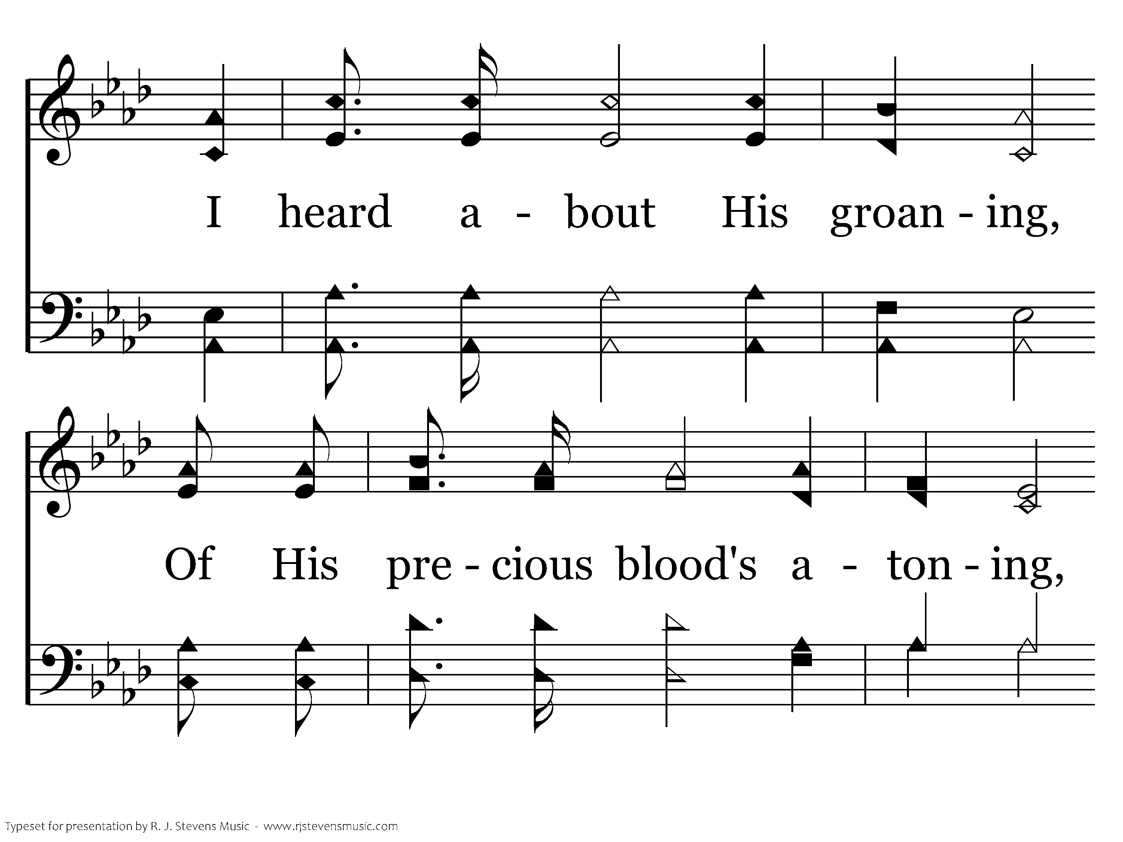
359 - Victory In Jesus - 1.3

Slide 20
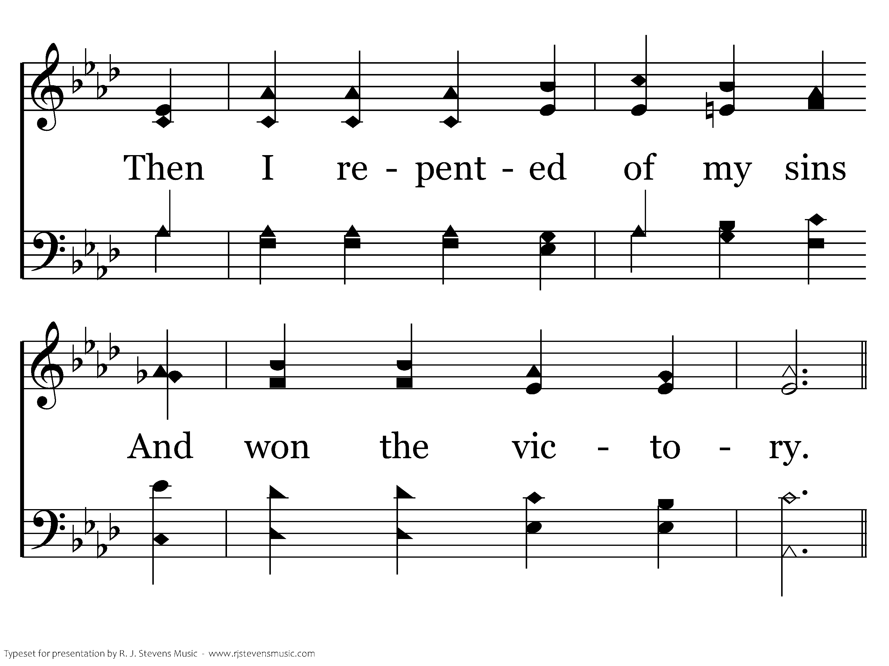
359 - Victory In Jesus - 1.4

Slide 21
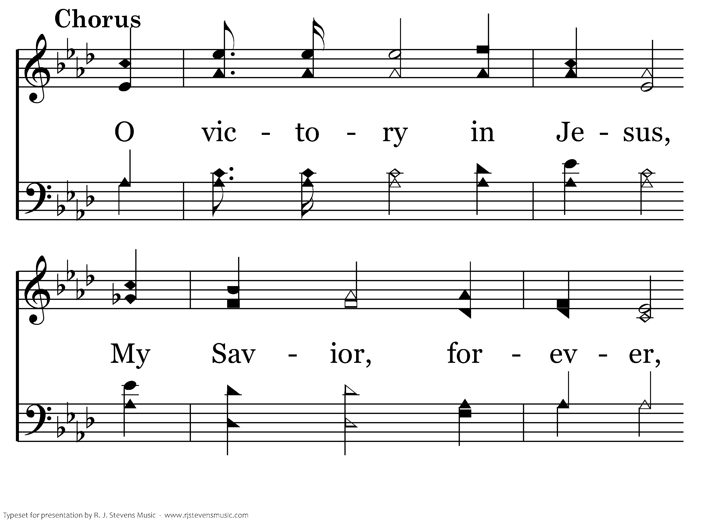
359 - Victory In Jesus - C.1

Slide 22
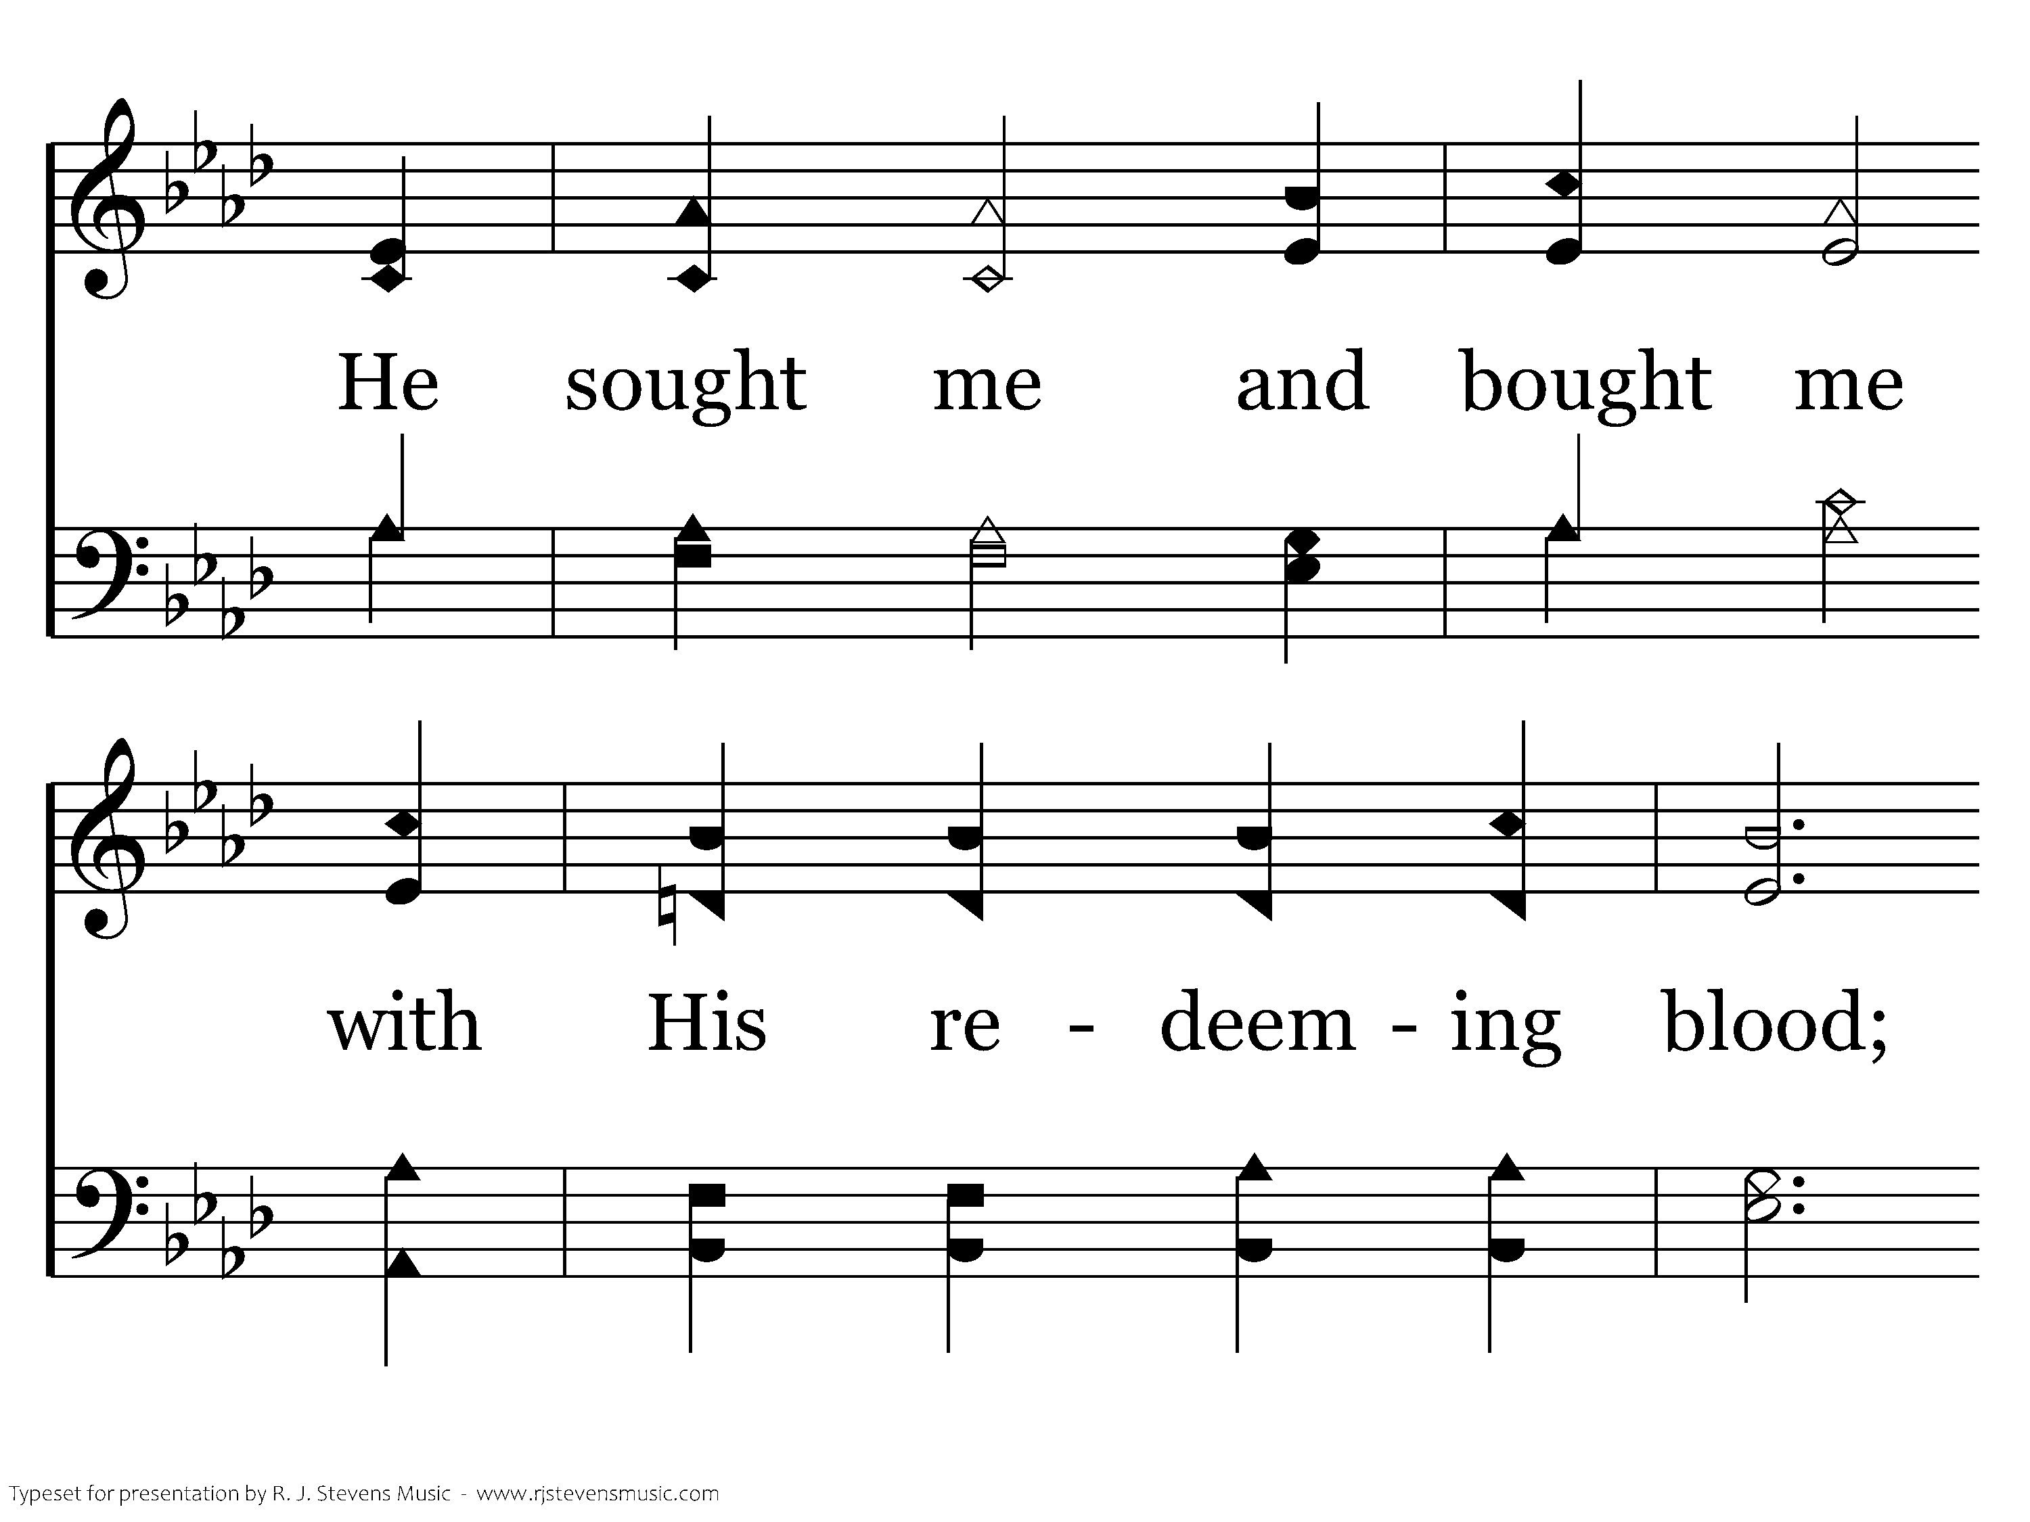
359 - Victory In Jesus - C.2

Slide 23
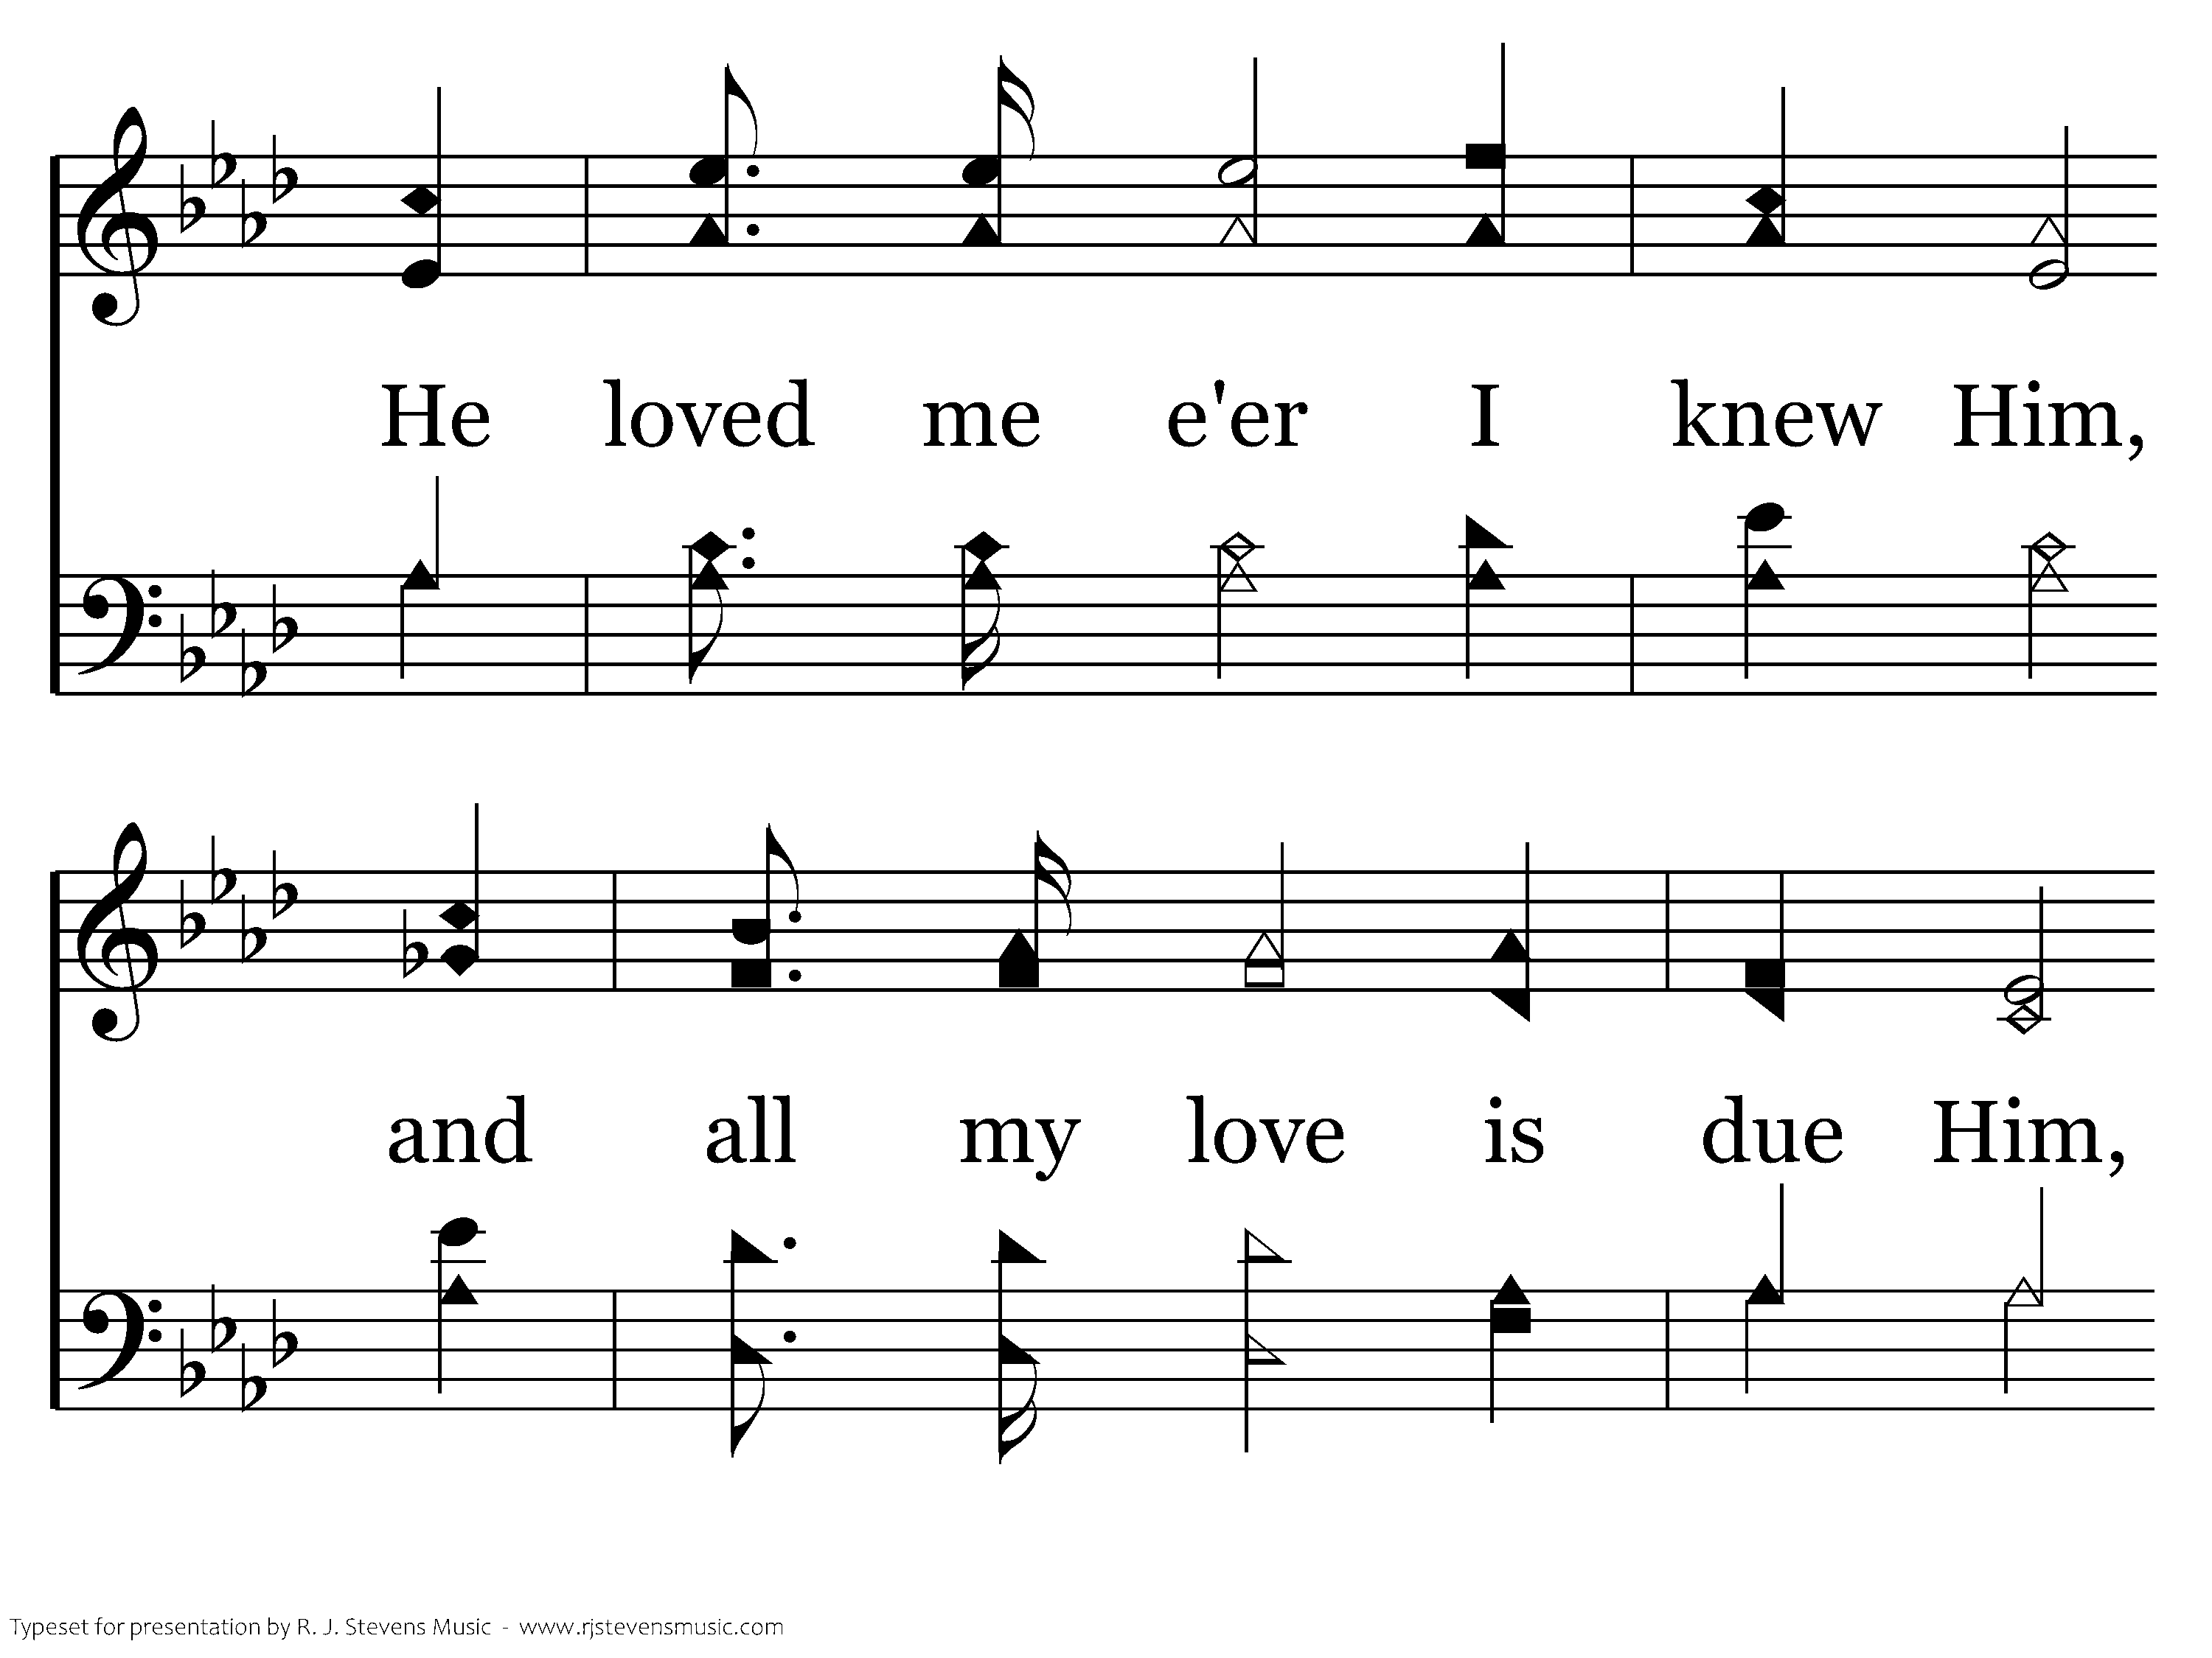
359 - Victory In Jesus - C.3

Slide 24
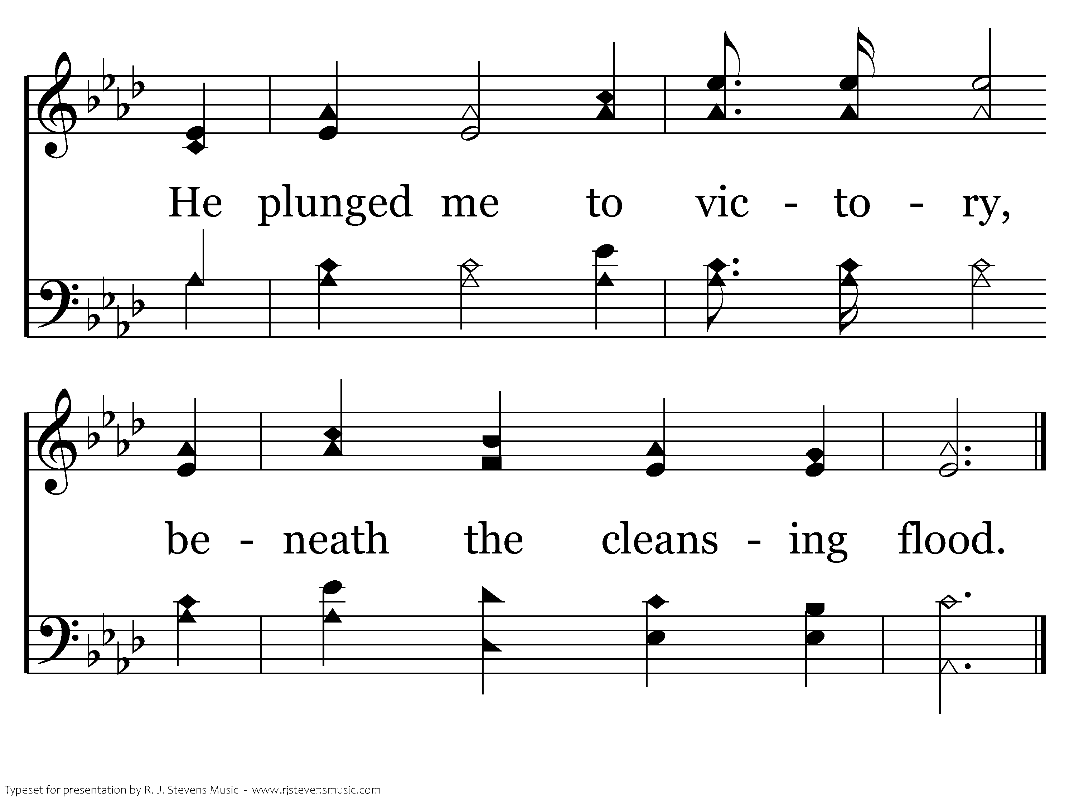
359 - Victory In Jesus - C.4
End of Verse 1

Slide 25
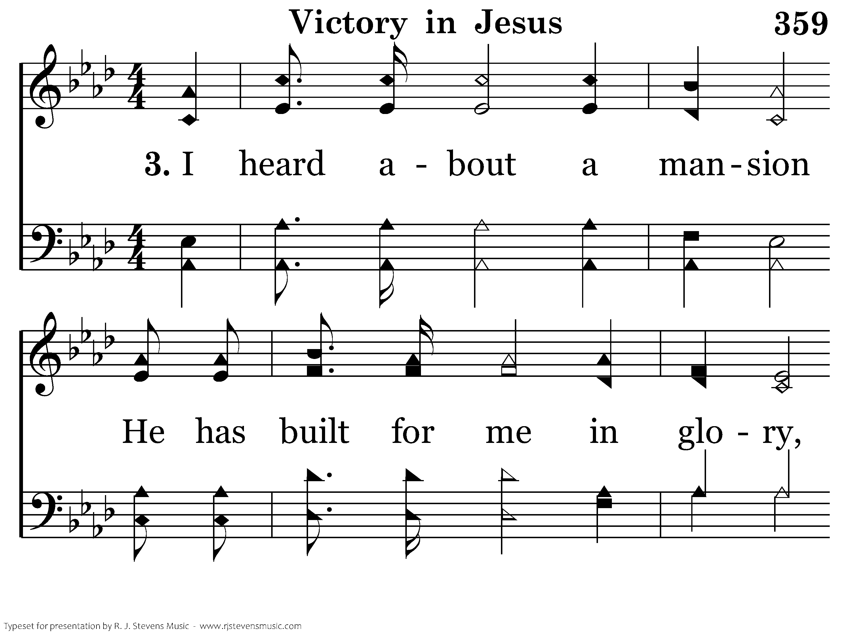
359 - Victory In Jesus - 3.1

Slide 26
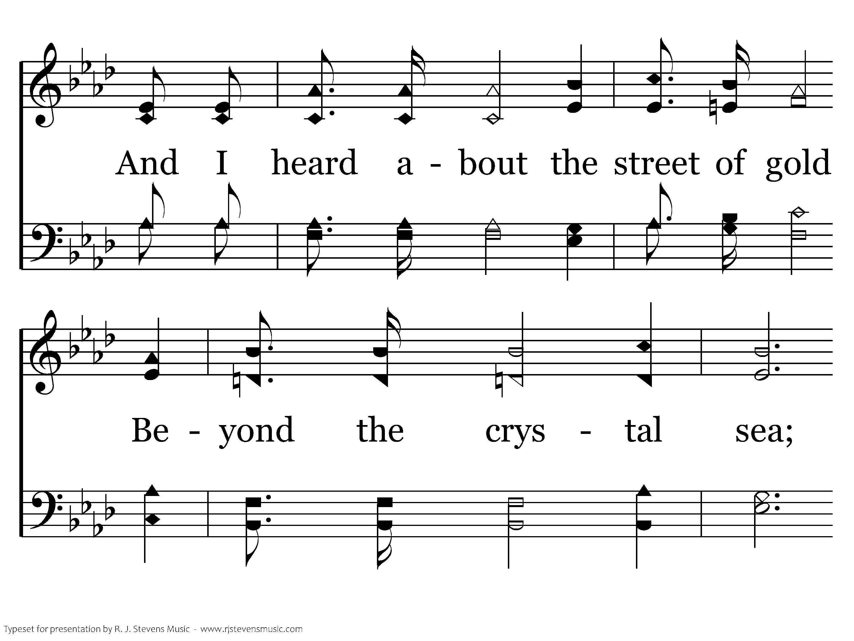
359 - Victory In Jesus - 3.2

Slide 27
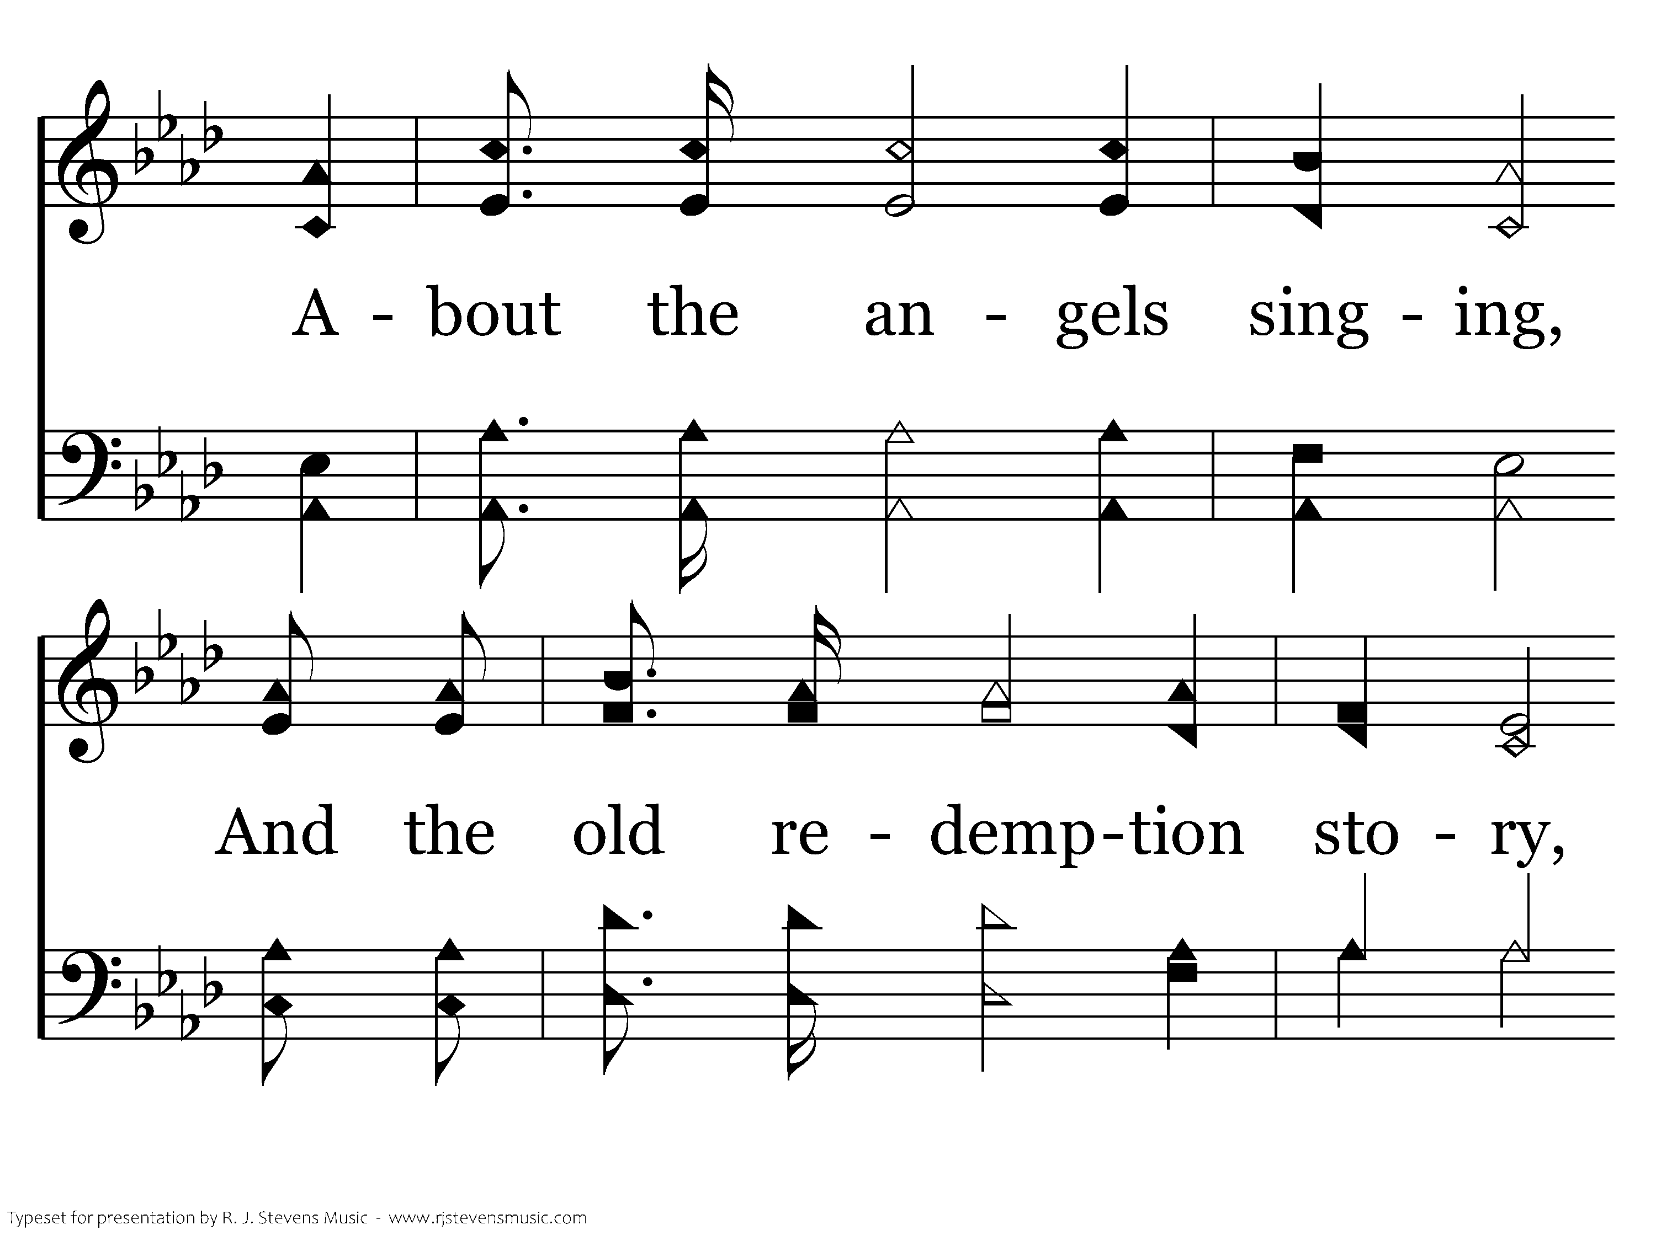
359 - Victory In Jesus - 3.3

Slide 28
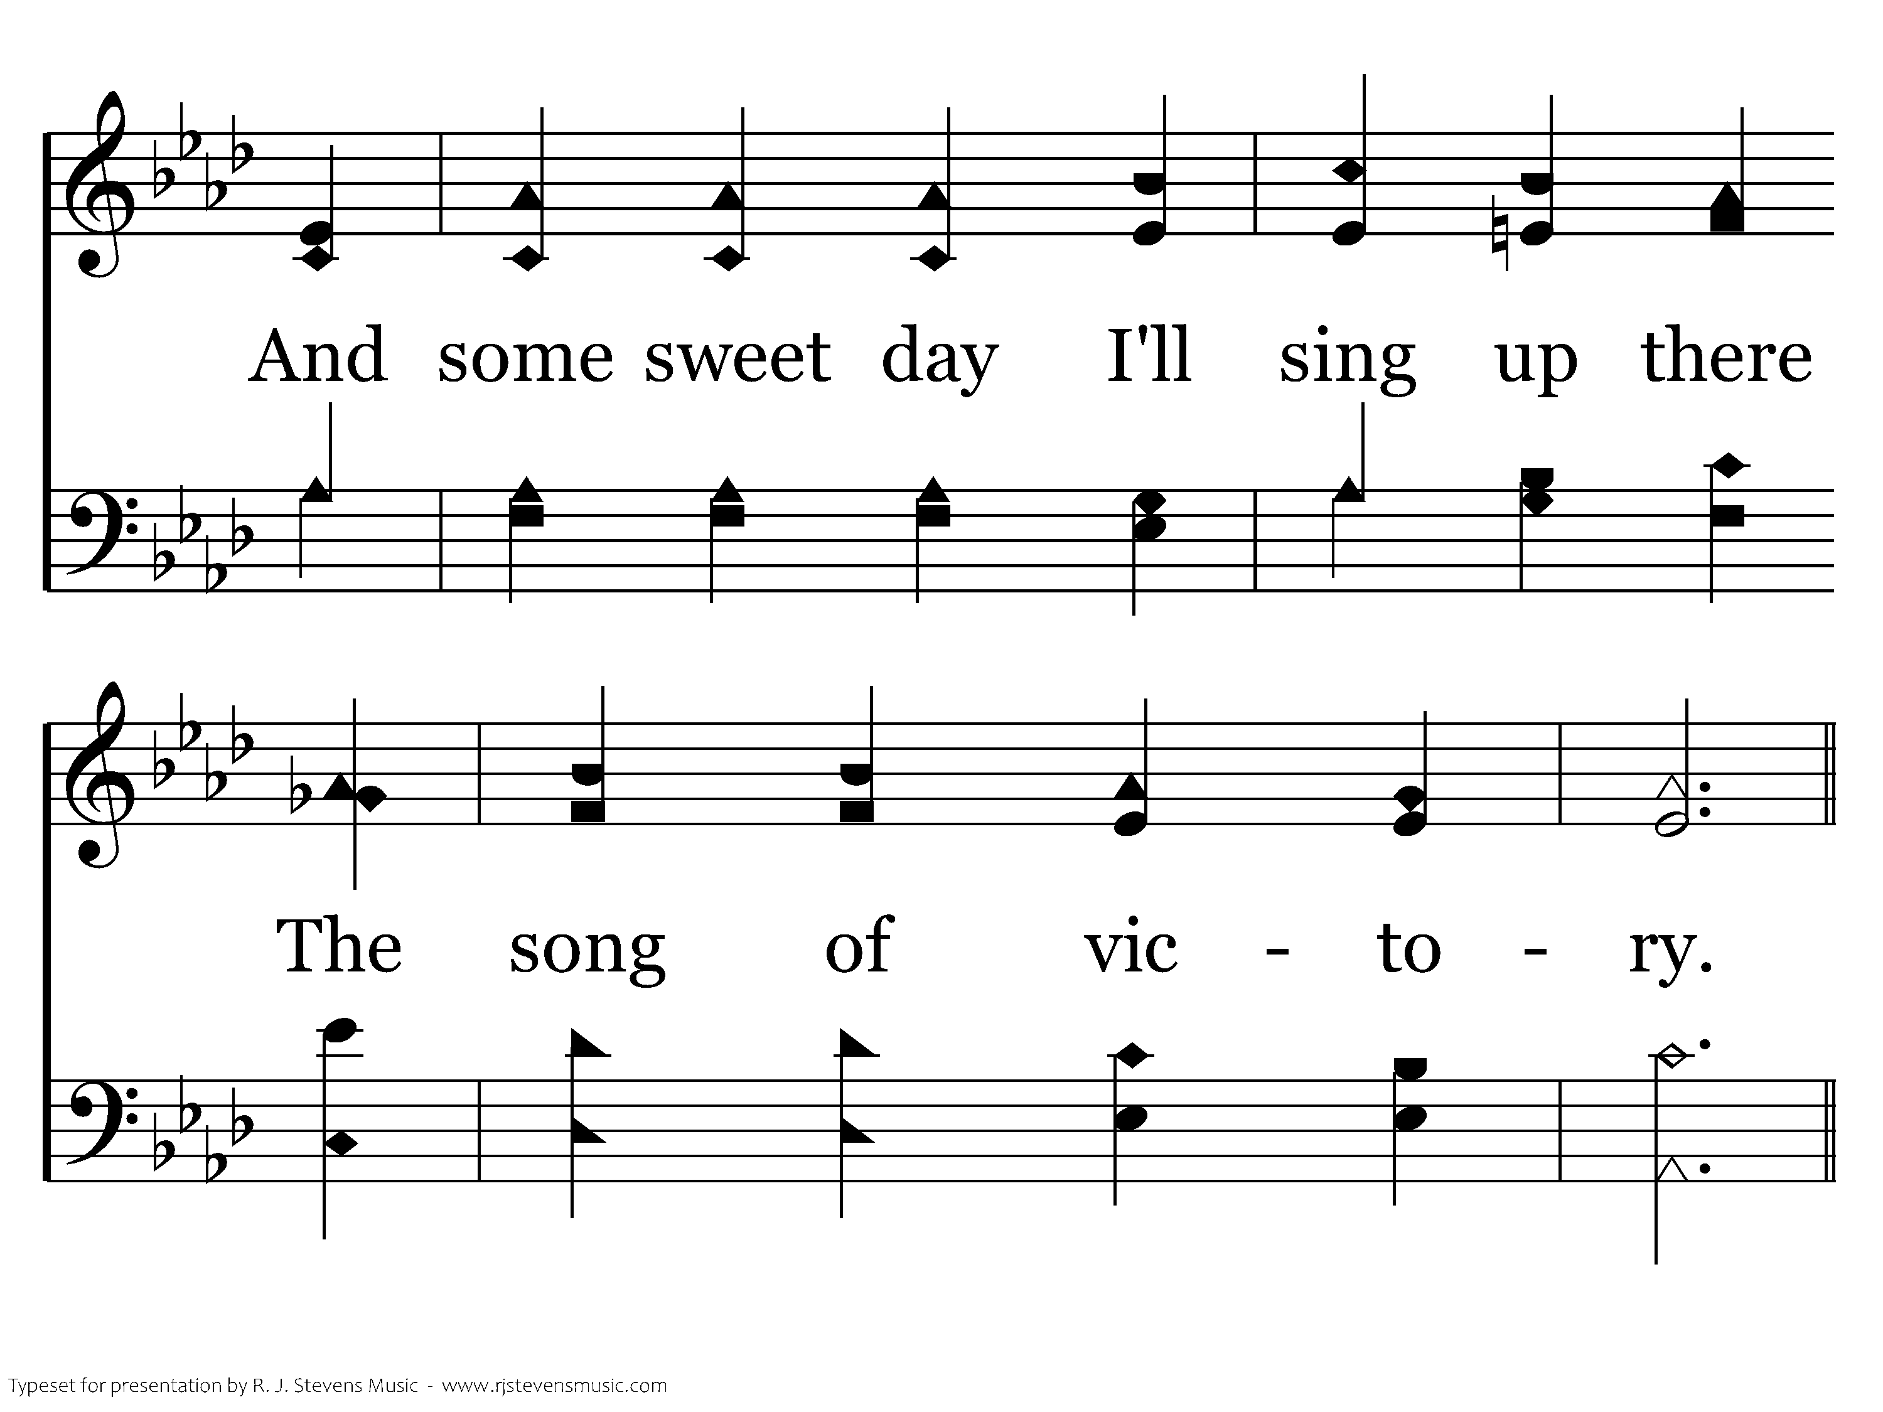
359 - Victory In Jesus - 3.4

Slide 29
359 - Victory In Jesus - C.1

Slide 30
359 - Victory In Jesus - C.2

Slide 31
359 - Victory In Jesus - C.3

Slide 32
359 - Victory In Jesus - C.4
End of Song

Slide 34
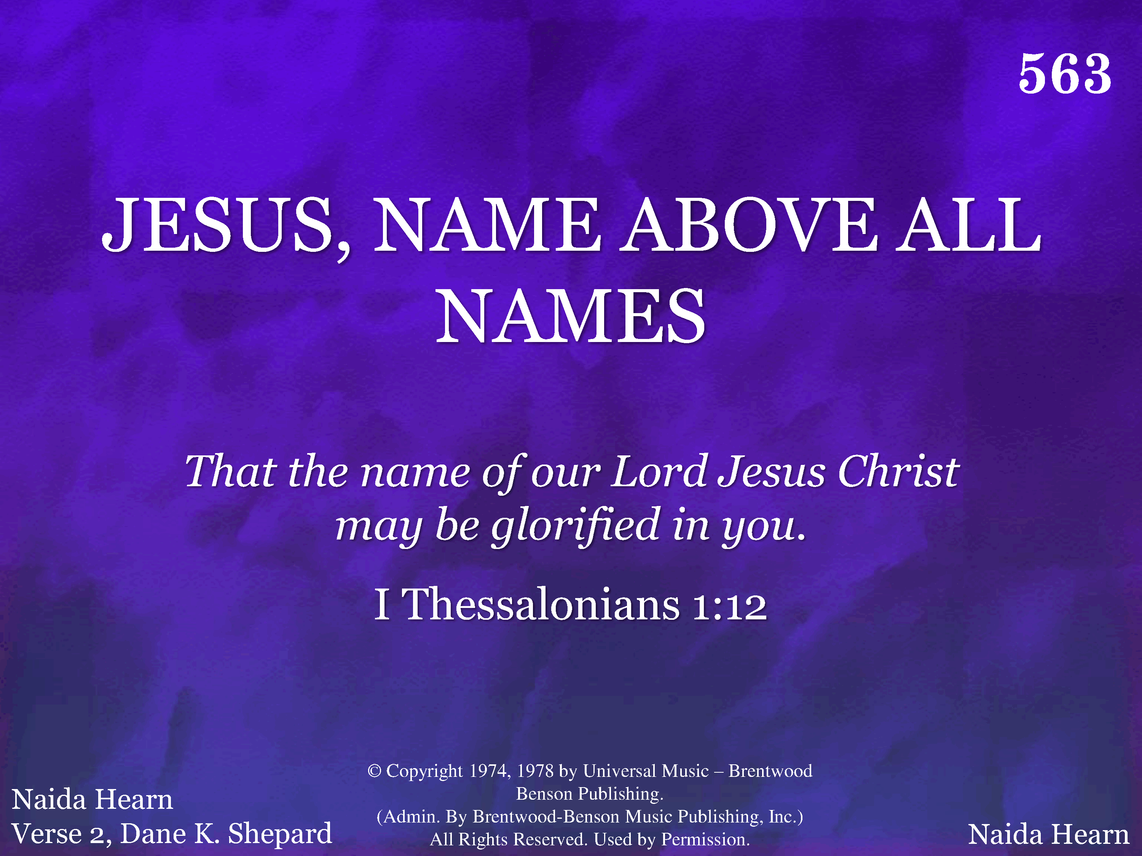
563 - Jesus, Name Above All Names - Title

Slide 35
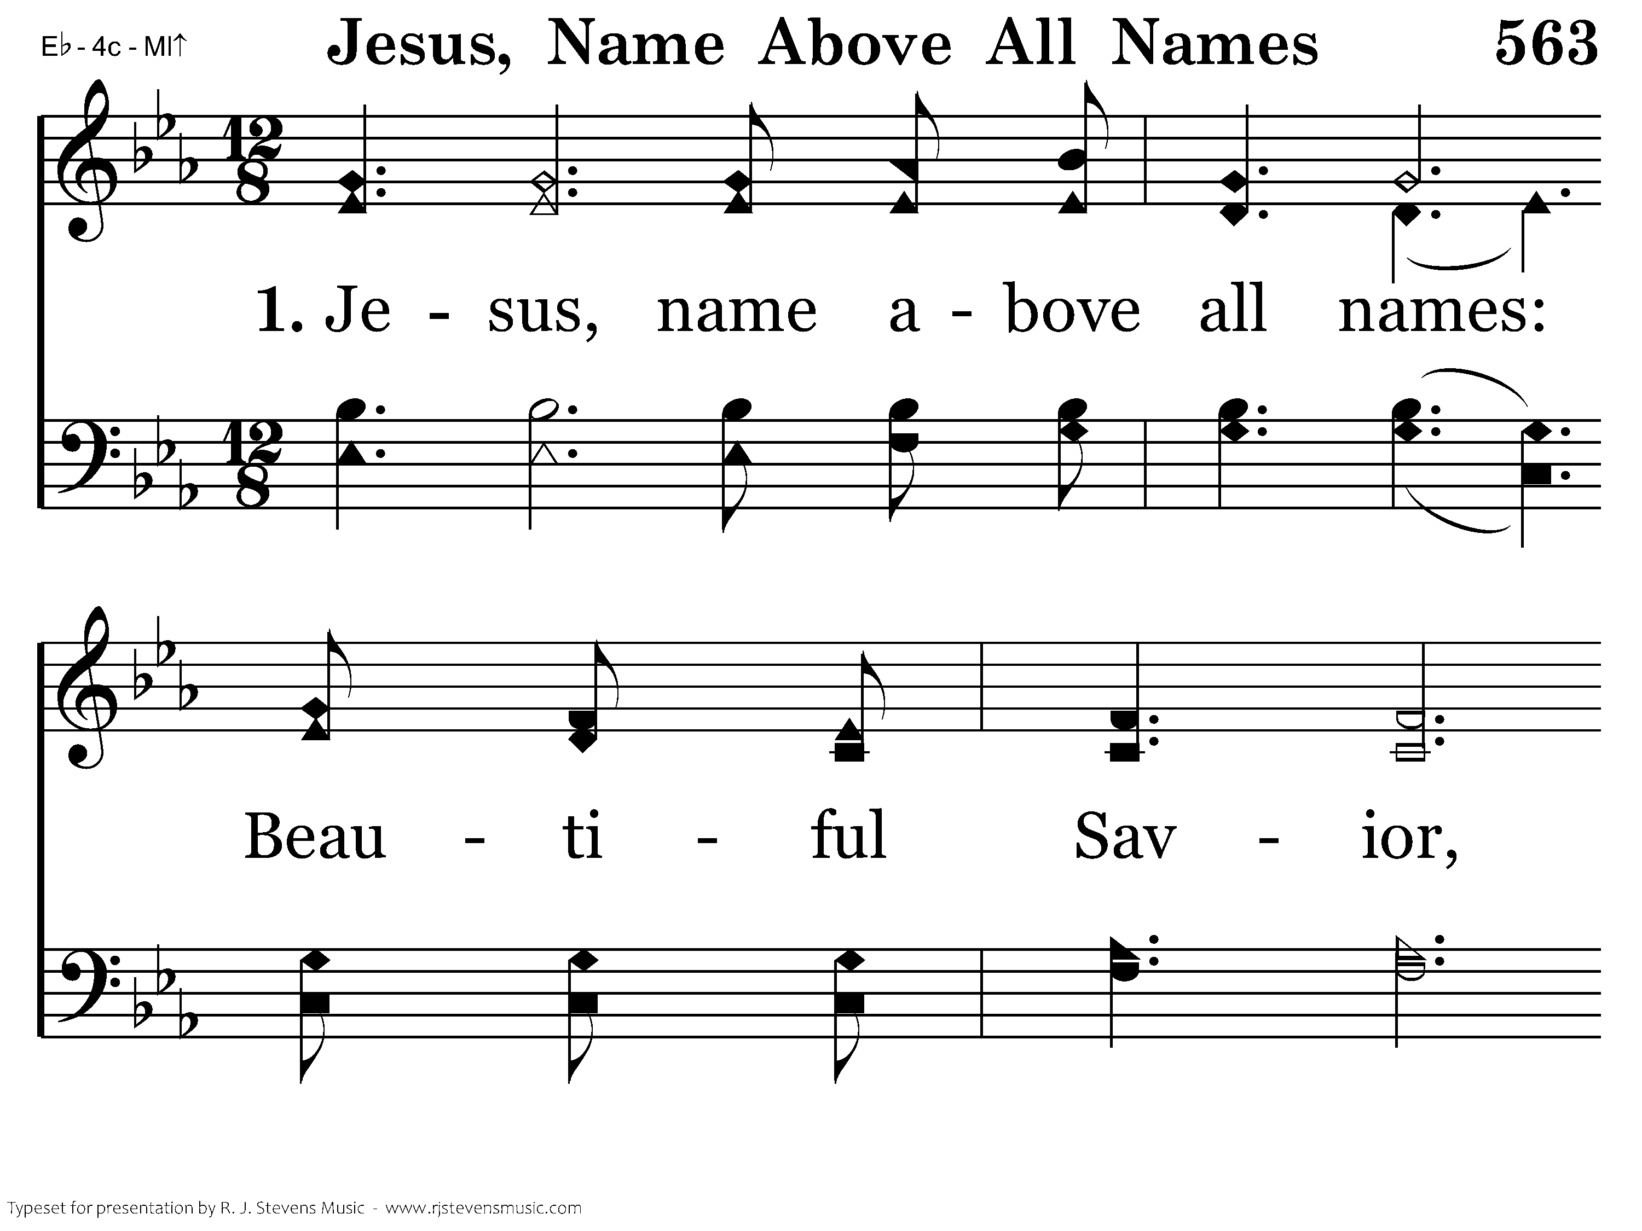
563 - Jesus, Name Above All Names - 1.1

Slide 36
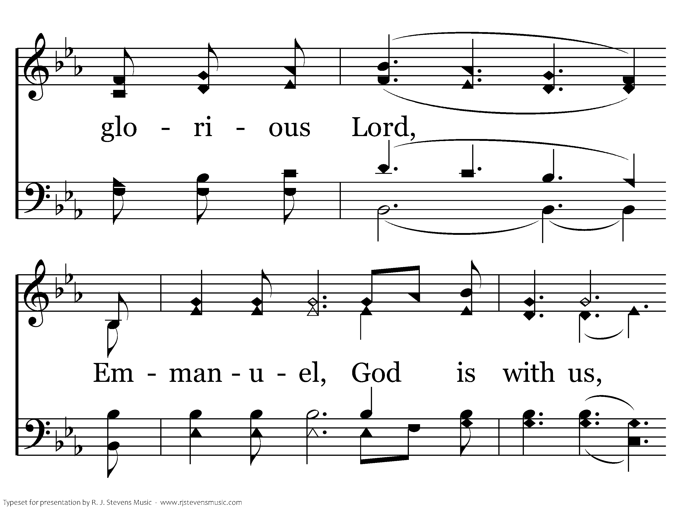
563 - Jesus, Name Above All Names - 1.2

Slide 37
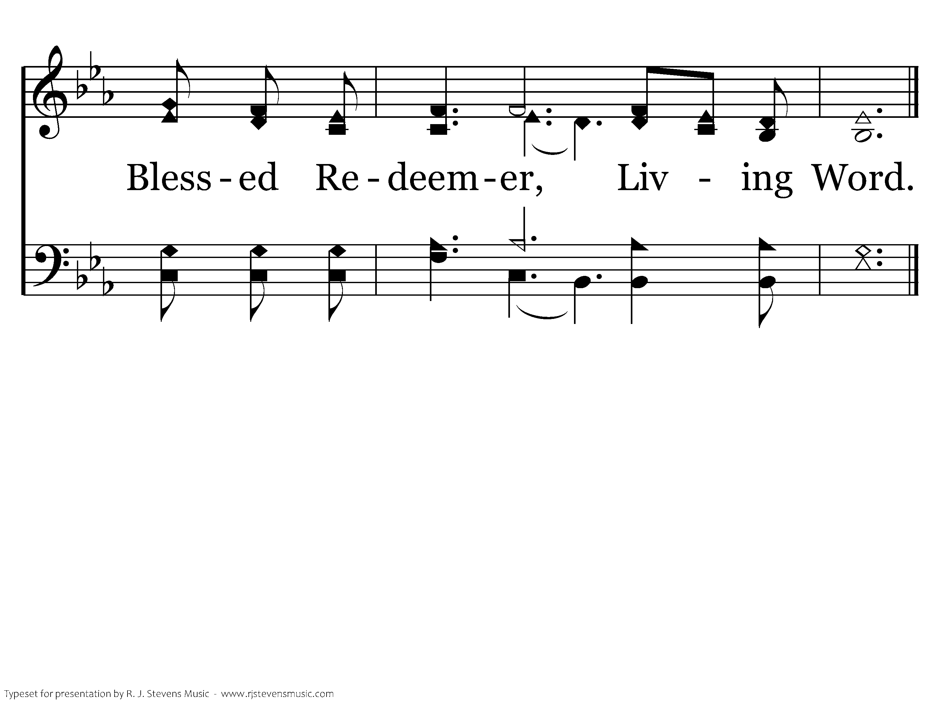
563 - Jesus, Name Above All Names - 1.3
End of Verse 1

Slide 38
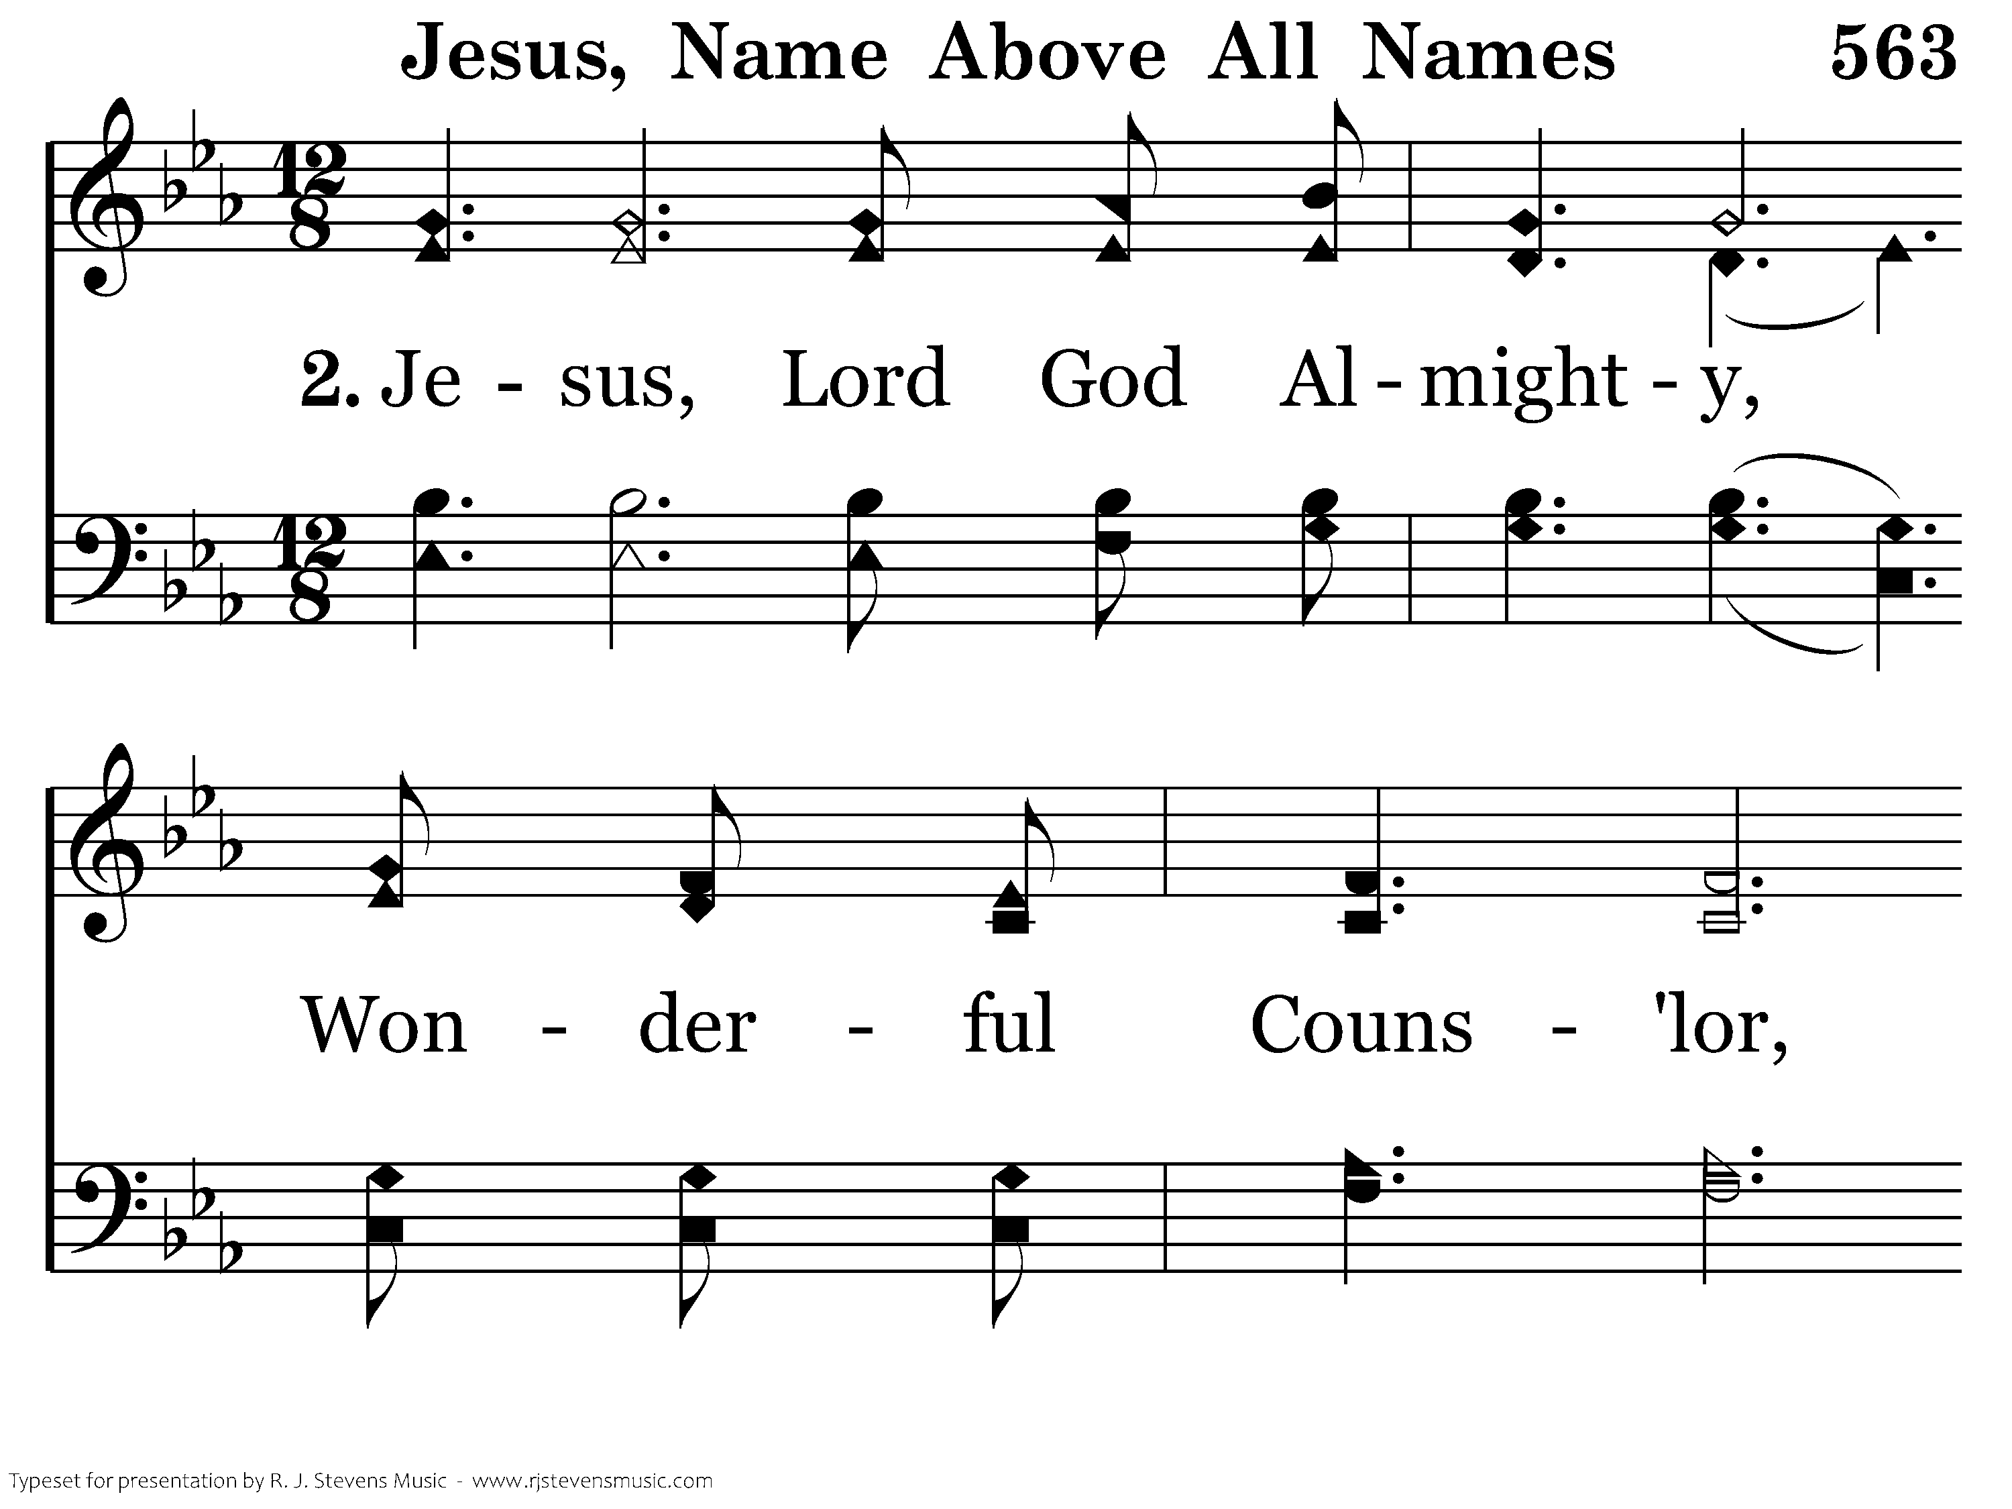
563 - Jesus, Name Above All Names - 2.1

Slide 39
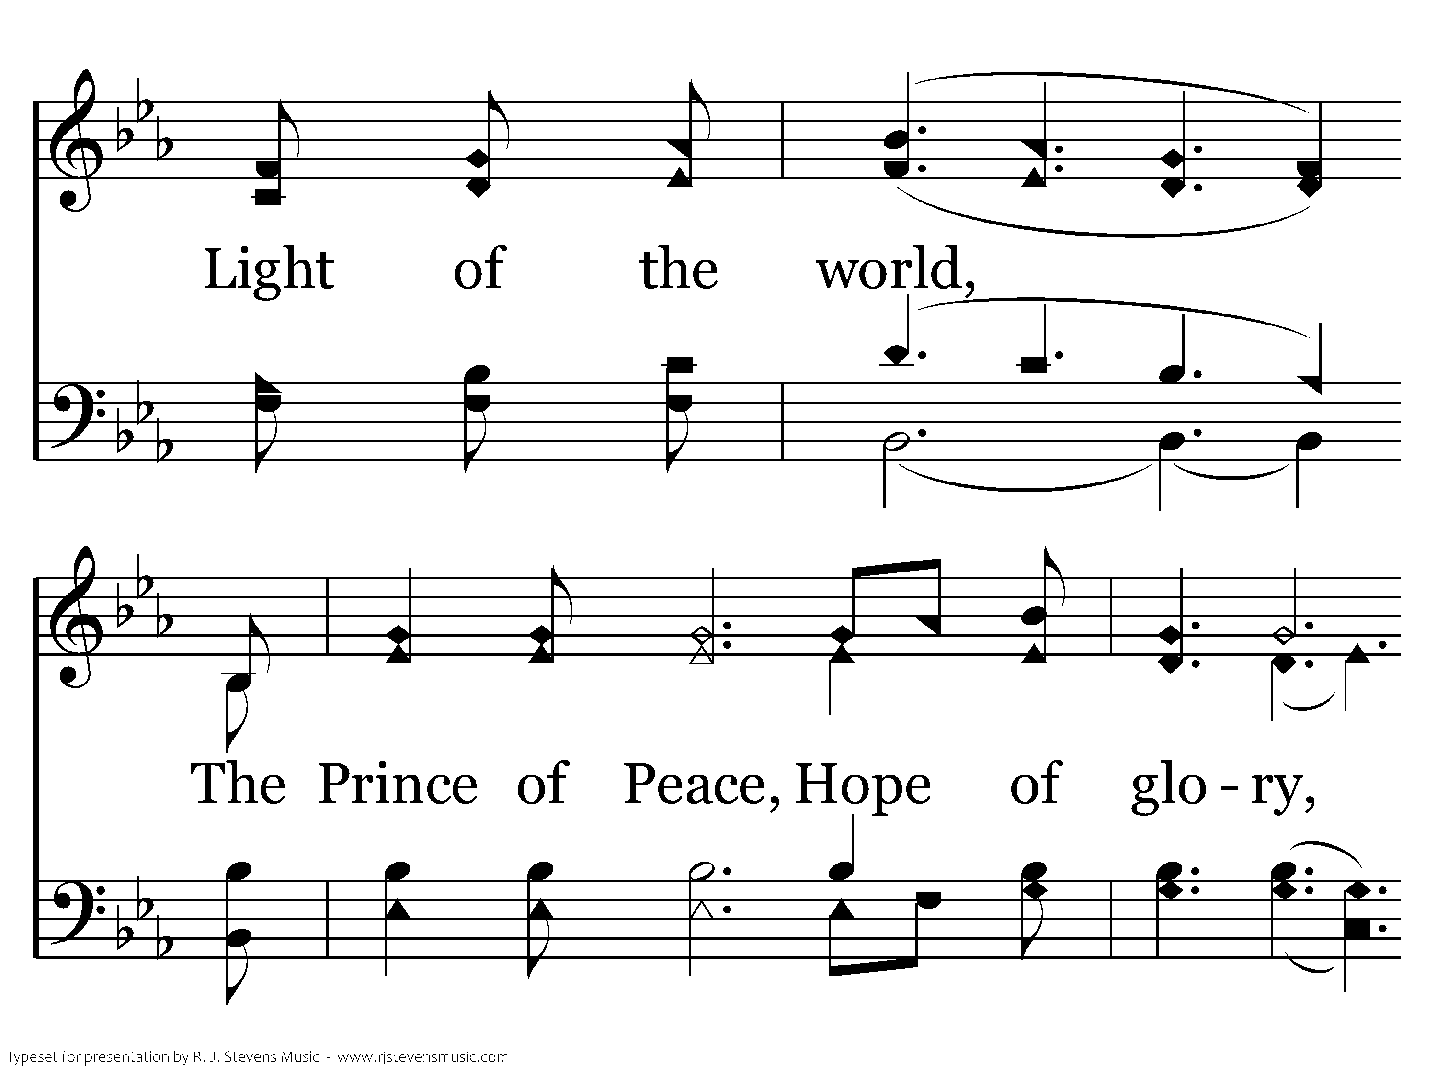
563 - Jesus, Name Above All Names - 2.2

Slide 40
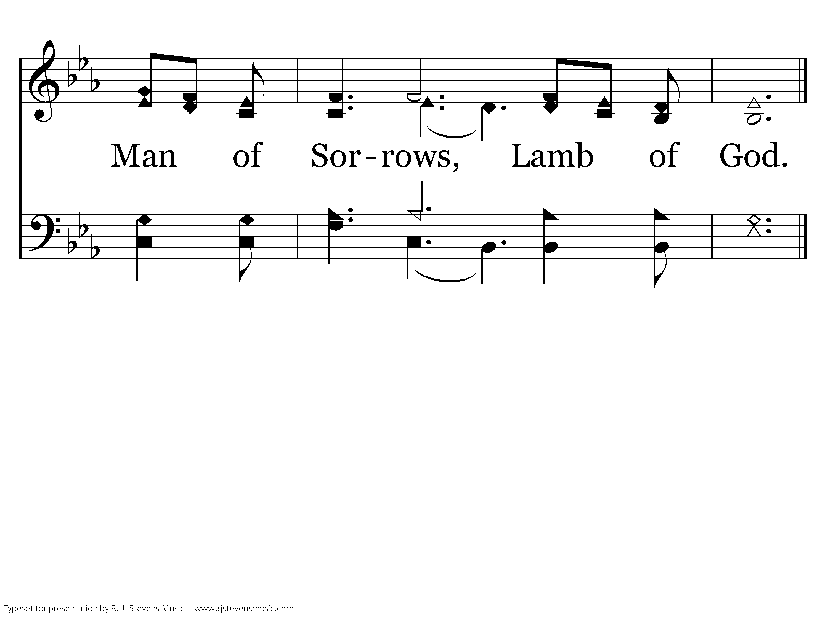
563 - Jesus, Name Above All Names - 2.3
End of Song

Slide 42

21 For to this you have been called, because Christ also suffered for you, leaving you an example, so that you might follow in his steps. 22 He committed no sin, neither was deceit found in his mouth. 23 When he was reviled, he did not revile in return; when he suffered, he did not threaten, but continued entrusting himself to him who judges justly. 24 He himself bore our sins in his body on the tree, that we might die to sin and live to righteousness. By his wounds you have been healed.
1 Peter 2.21-24

Slide 44

While they were eating, Jesus took bread, and when he had given thanks, he broke it and gave it to his disciples, saying, “Take and eat; this is my body.” Then he took a cup, and when he had given thanks, he gave it to them, saying, “Drink from it, all of you. This is my blood of the covenant, which is poured out for many for the forgiveness of sins.
Mathew 26:26-28

Slide 45
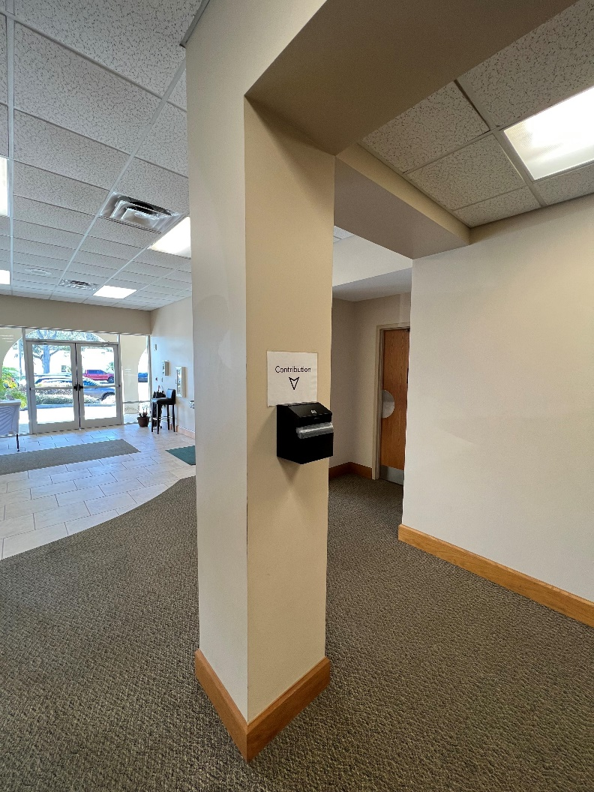
Concerning Our Giving:
For information on how to make your contribution, please visit www.universitychurchofchrist.org/contribution.
You can contribute via check, cash, your bank’s
“bill pay” feature, or through PayPal.
The instructions on how to use PayPal are all listed on the Contribution page above.

Slide 47
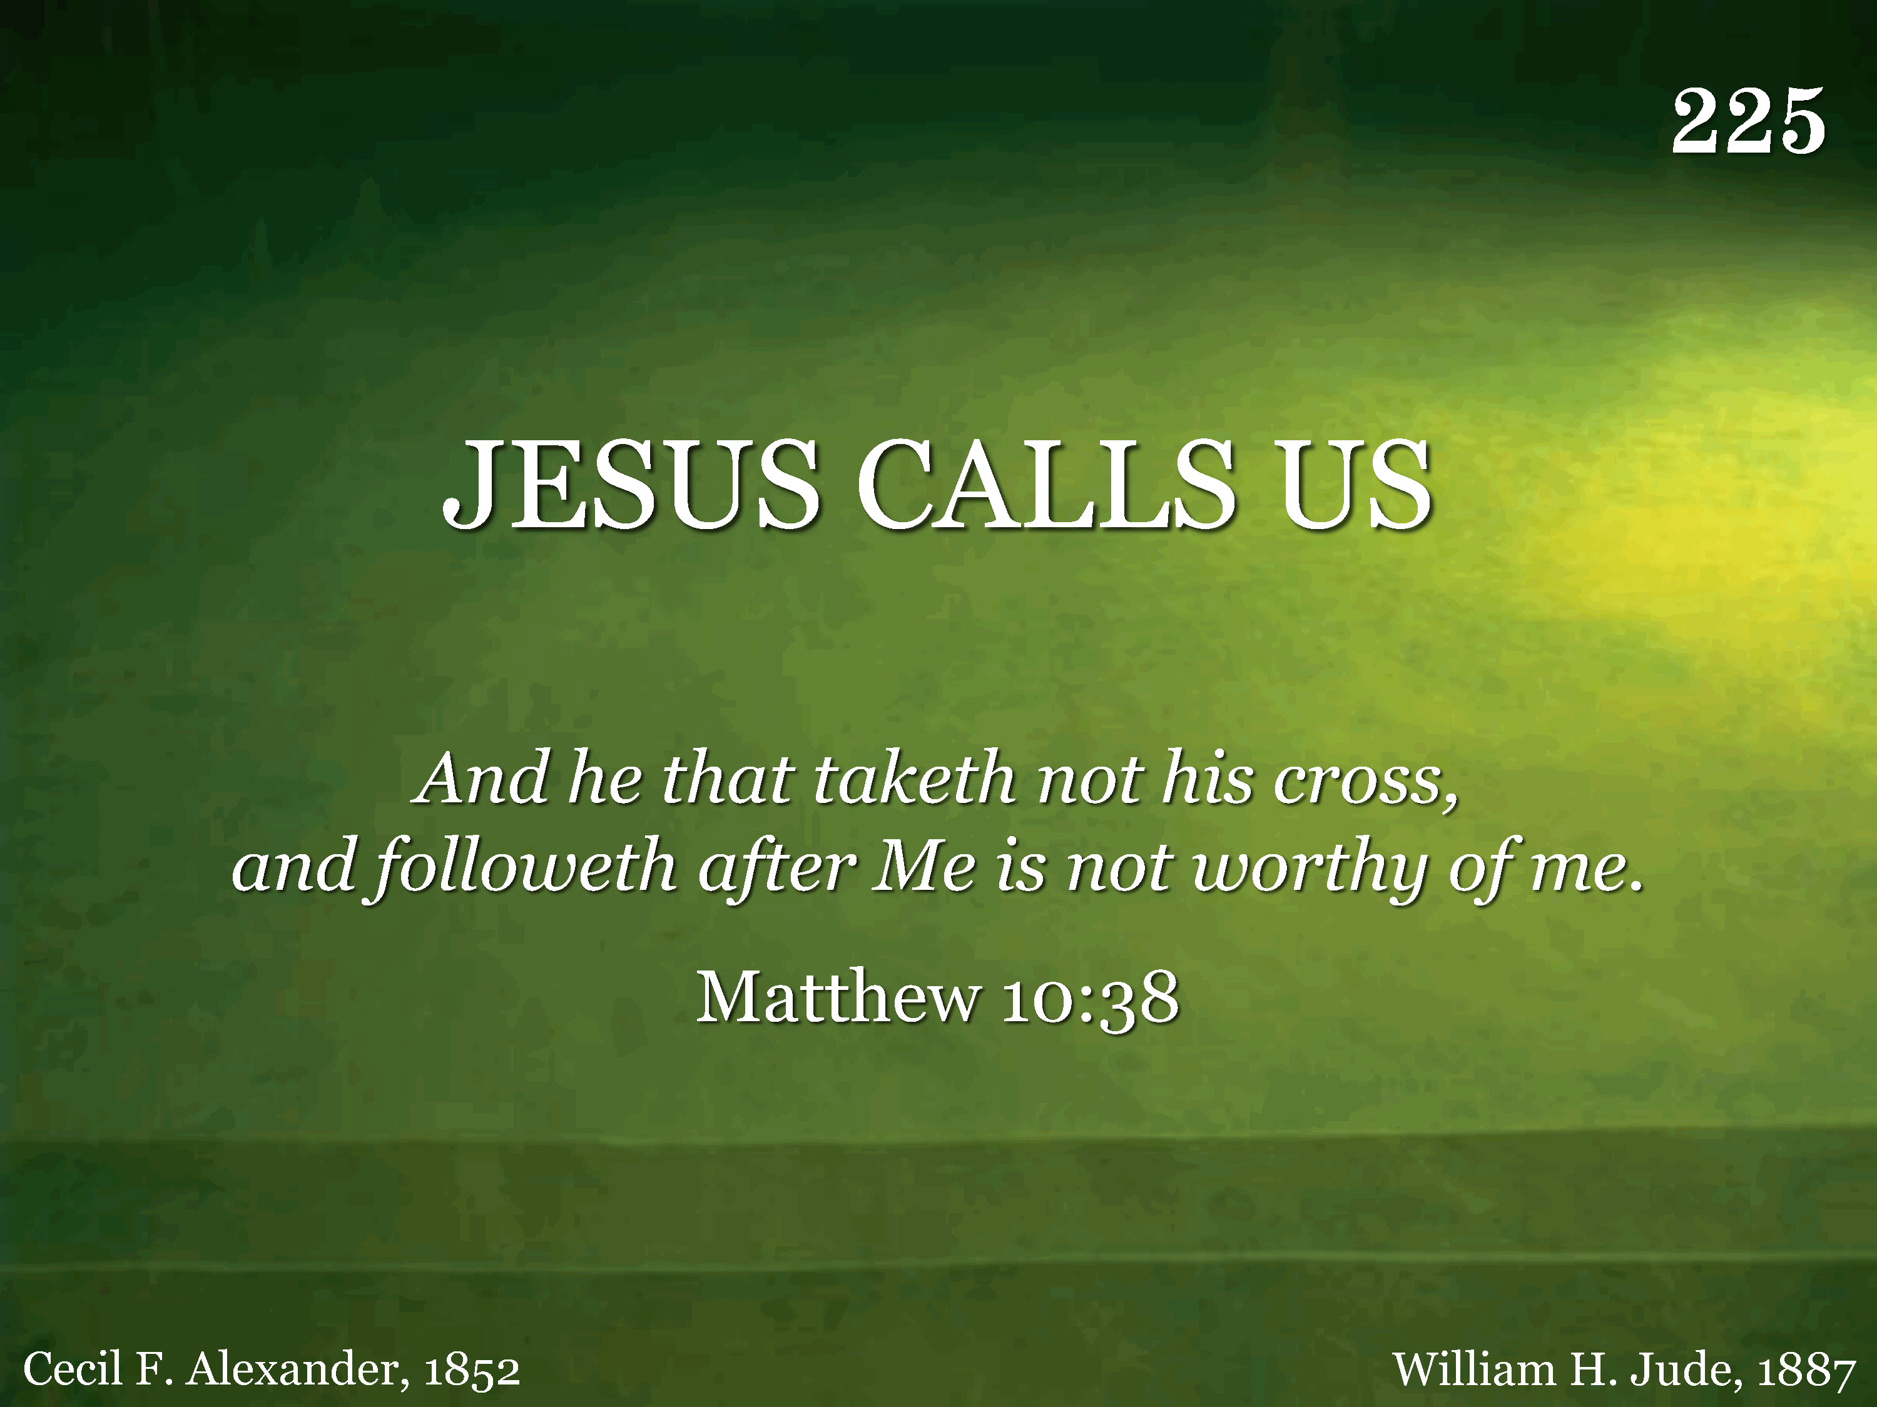
225 - Jesus Calls Us - Title

Slide 48
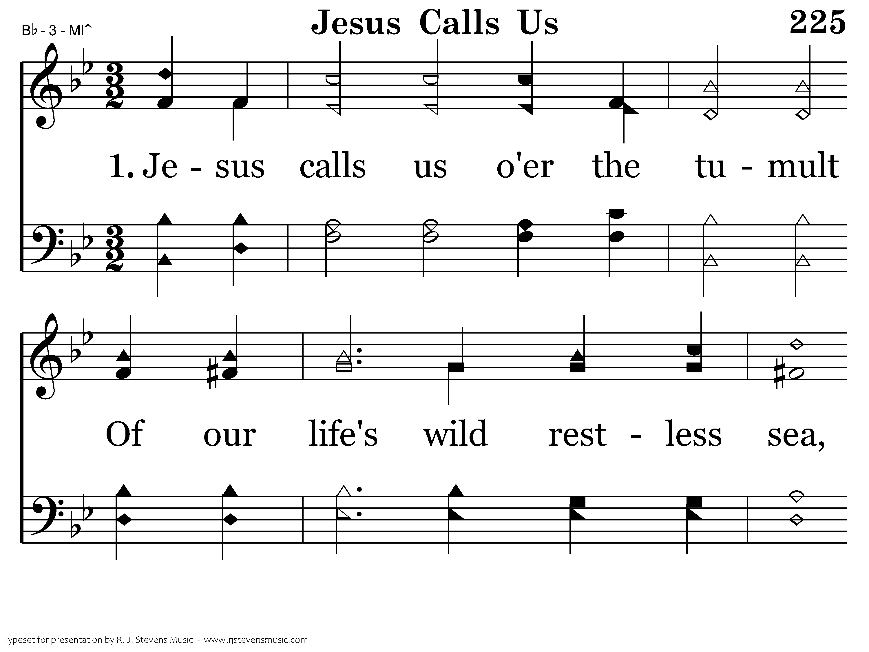
225 - Jesus Calls Us - 1.1

Slide 49
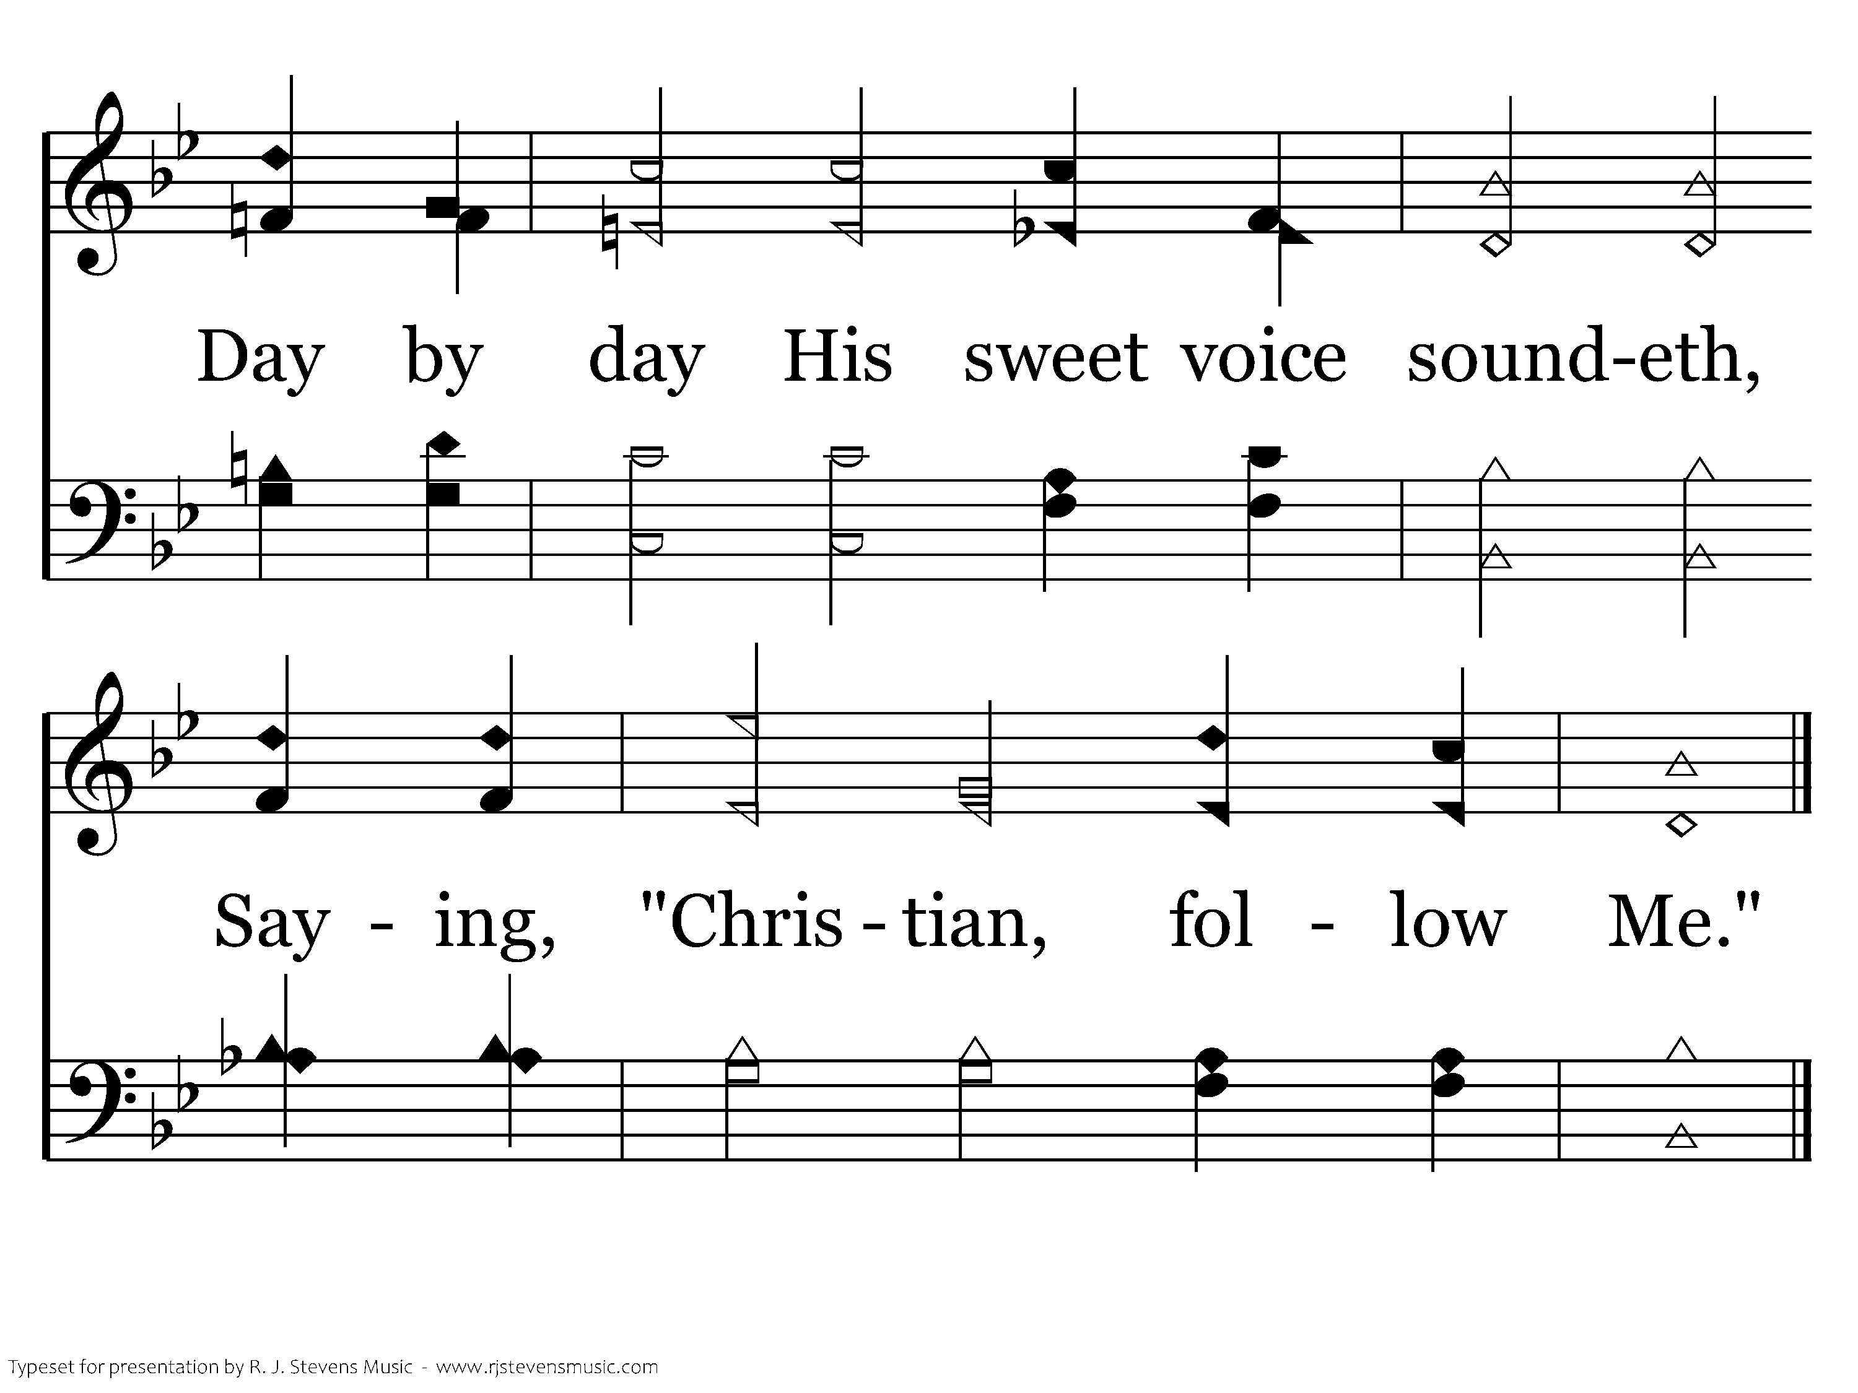
225 - Jesus Calls Us - 1.2
End of Verse 1

Slide 50
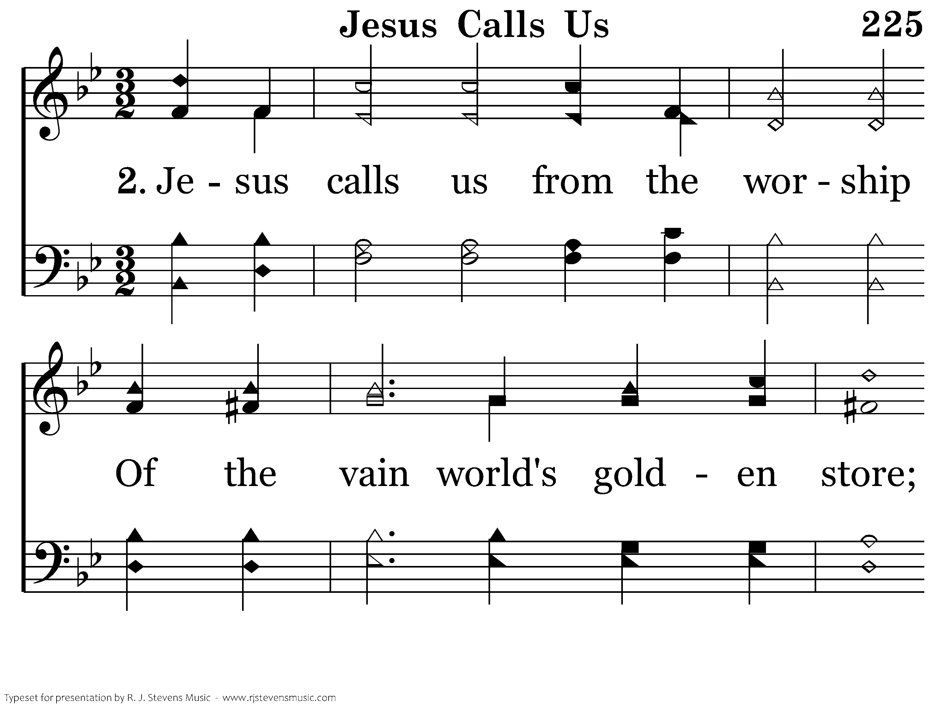
225 - Jesus Calls Us - 2.1

Slide 51
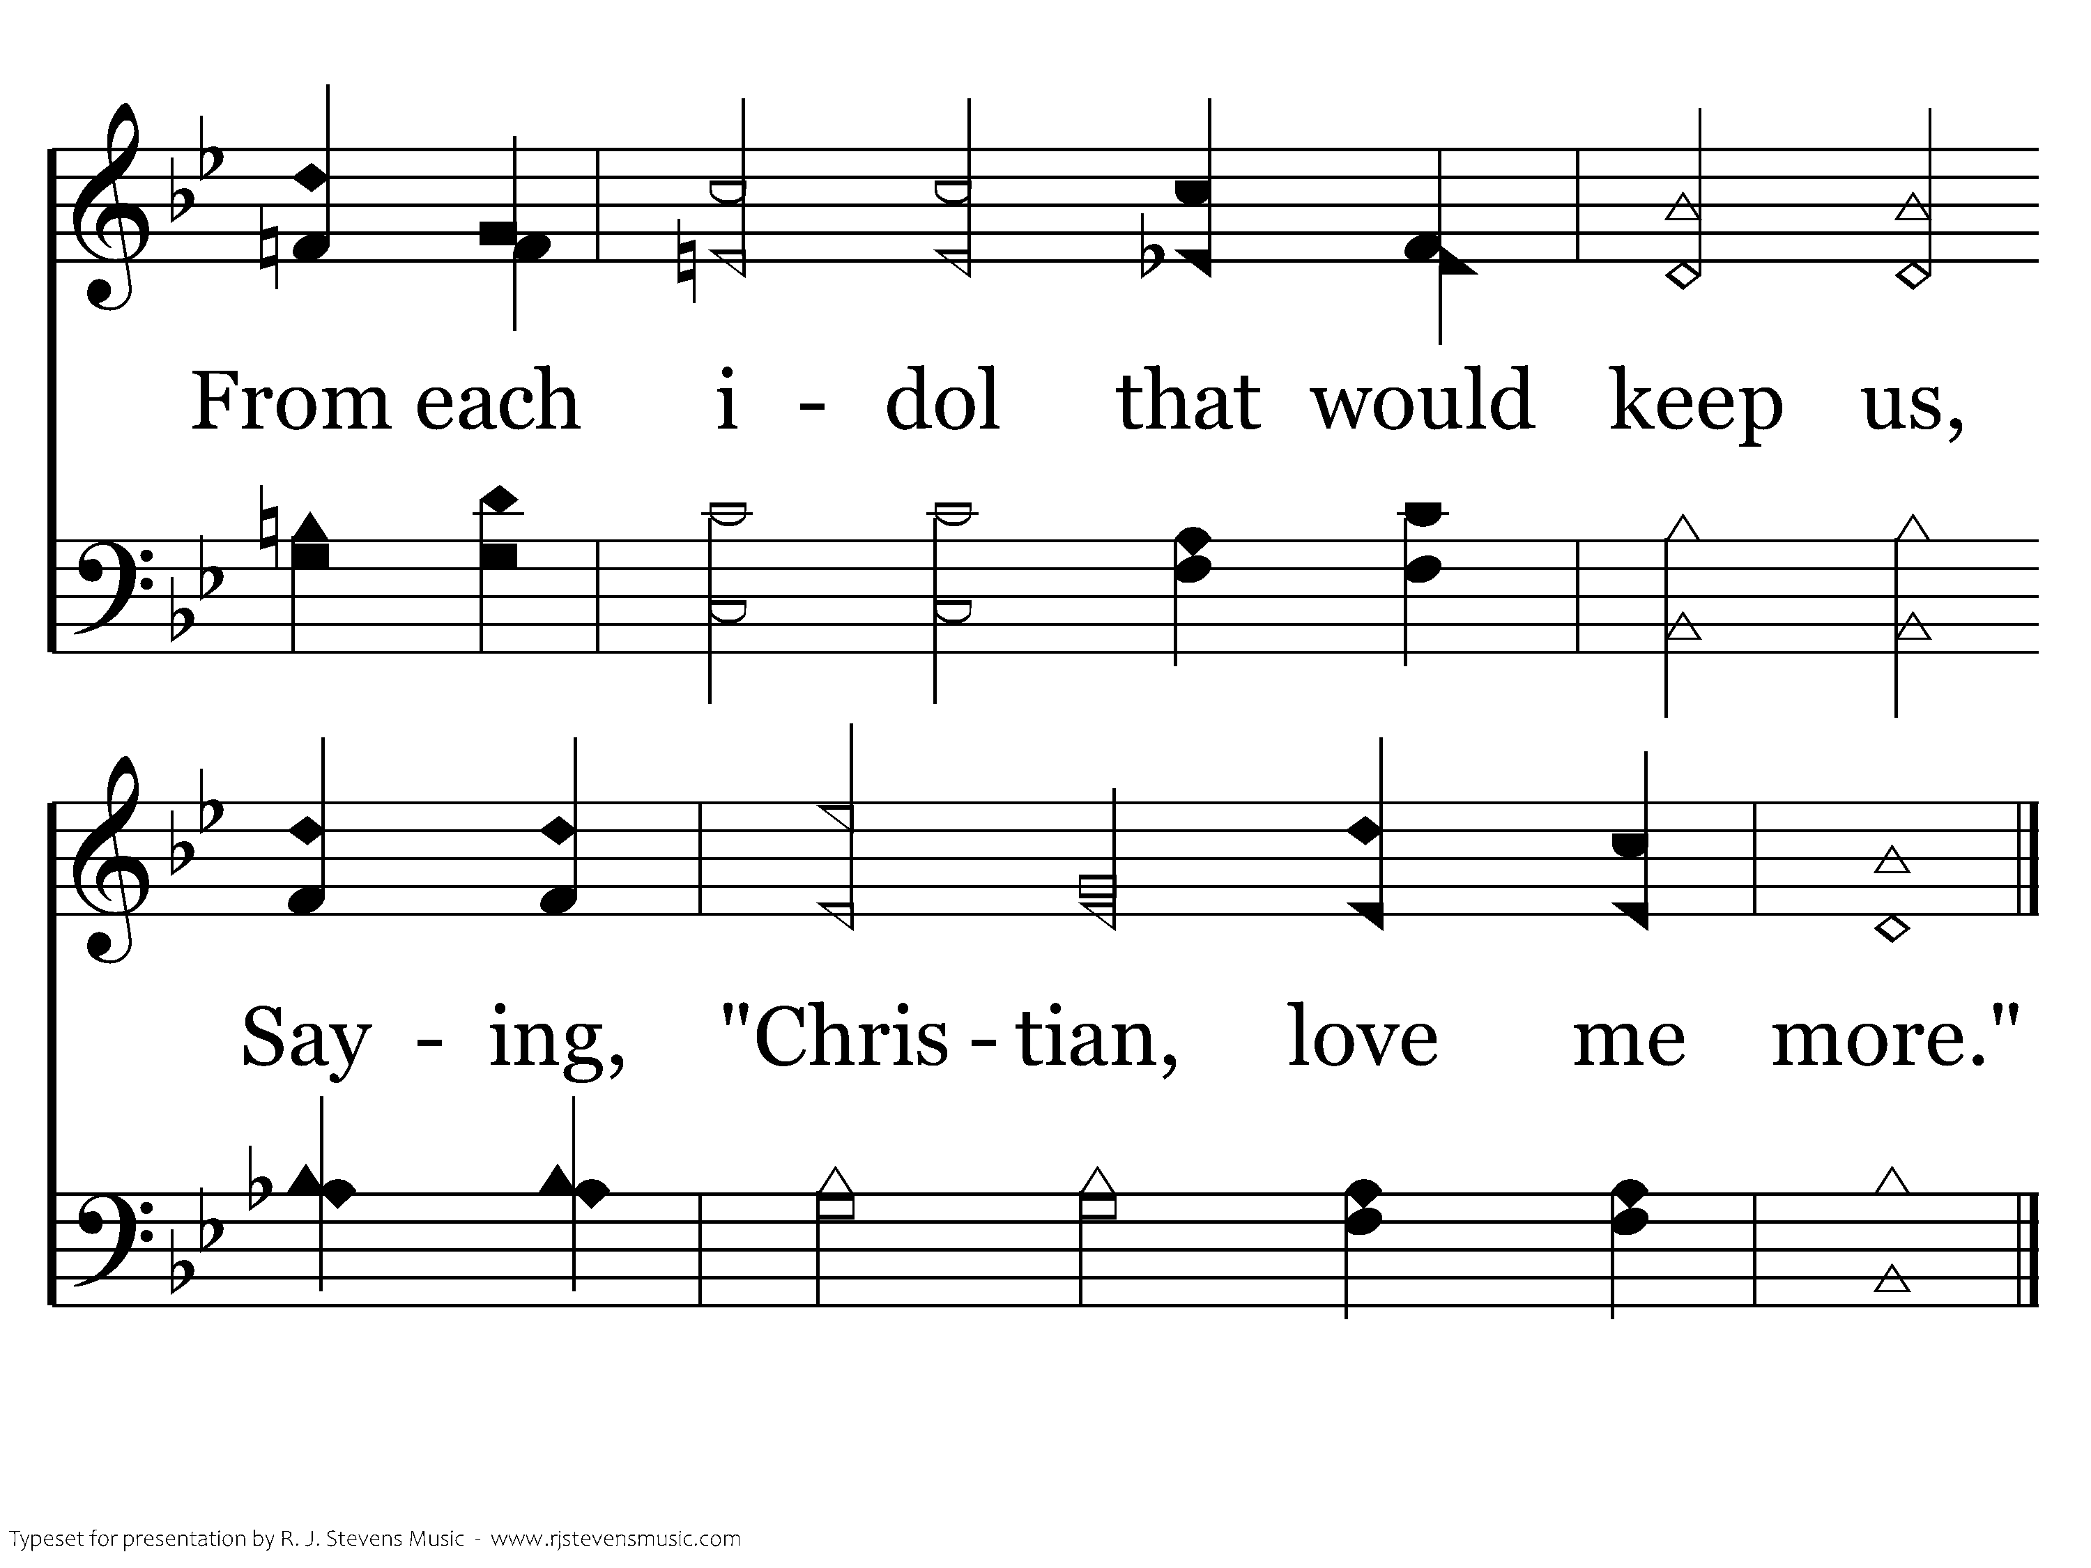
225 - Jesus Calls Us - 2.2
End of Verse 2

Slide 52
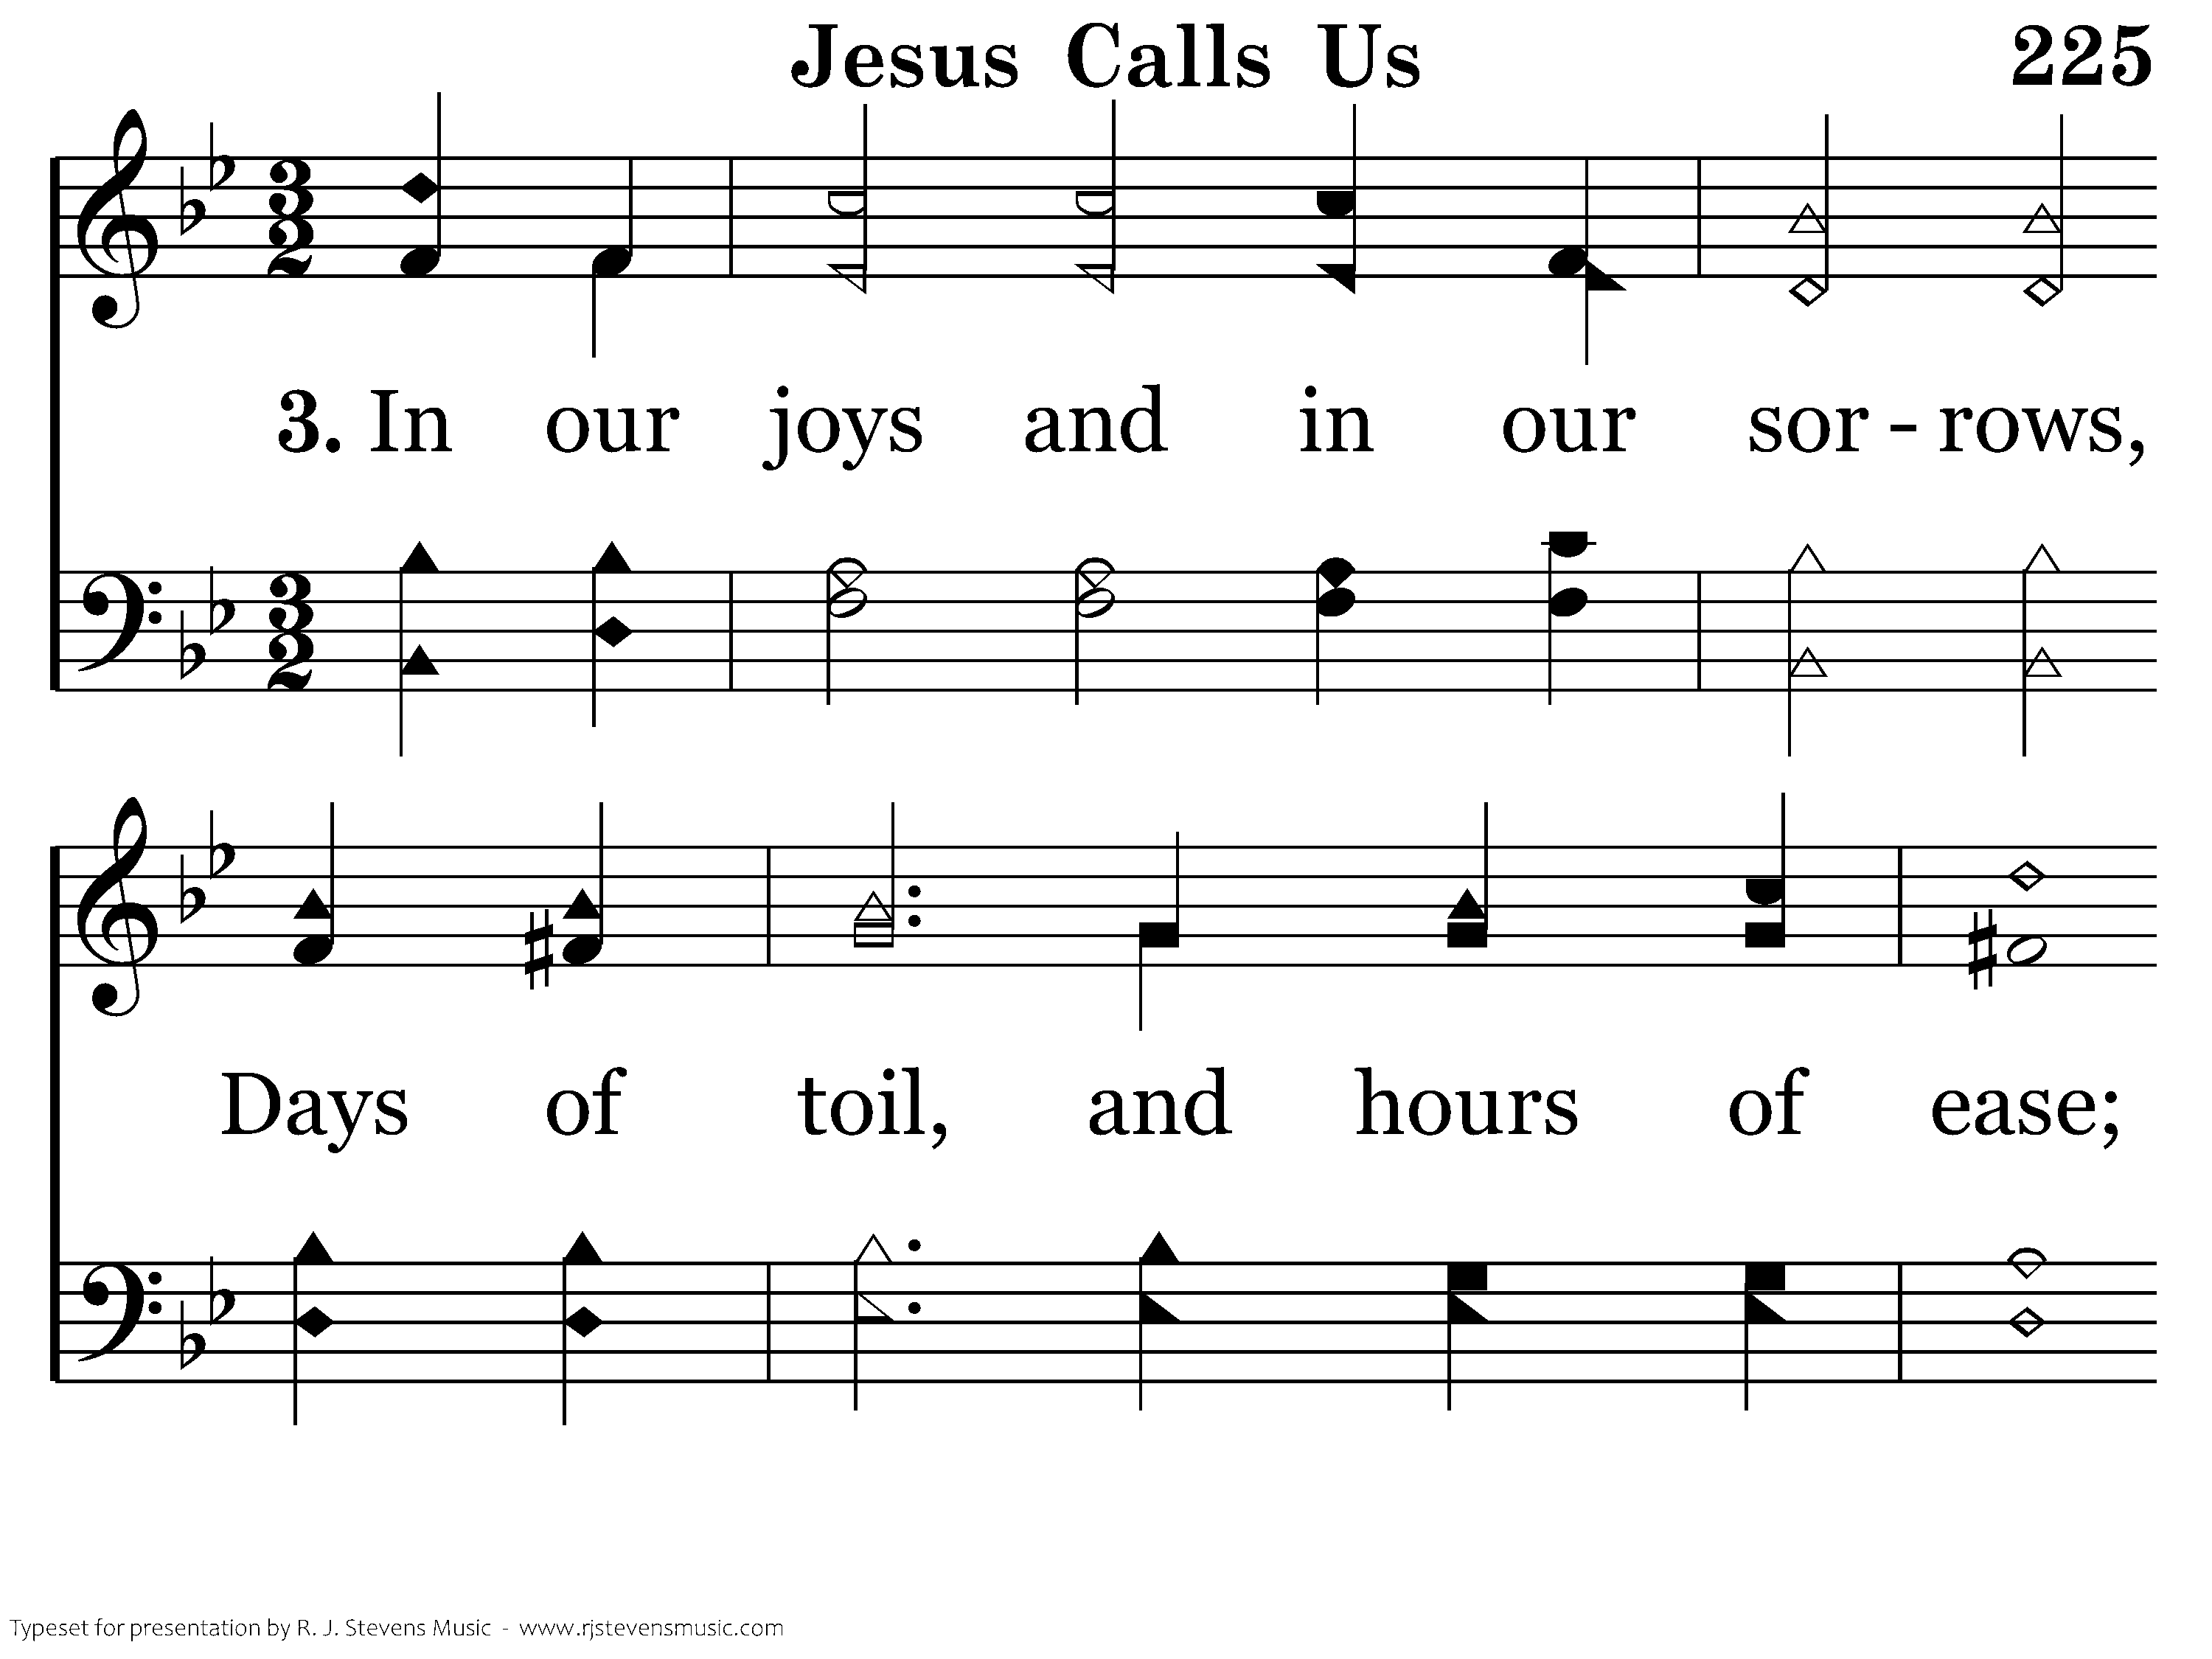
225 - Jesus Calls Us - 3.1

Slide 53
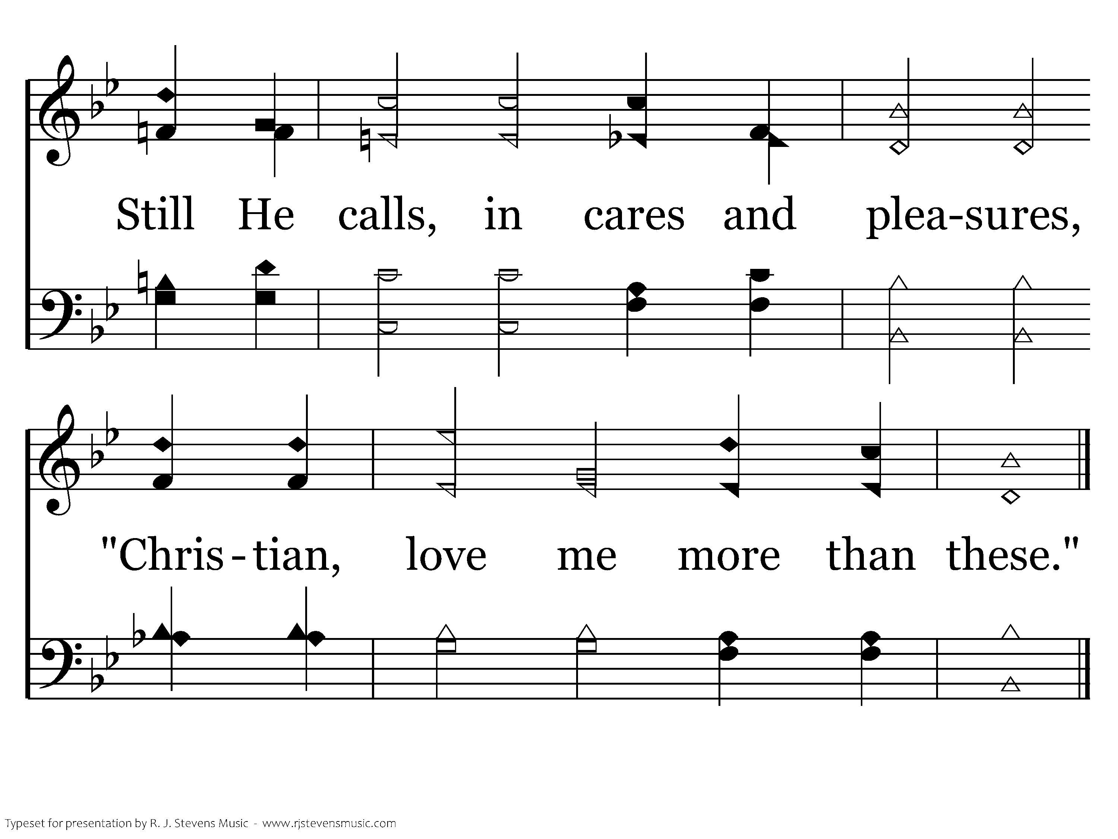
225 - Jesus Calls Us - 3.2
End of Verse 3

Slide 54
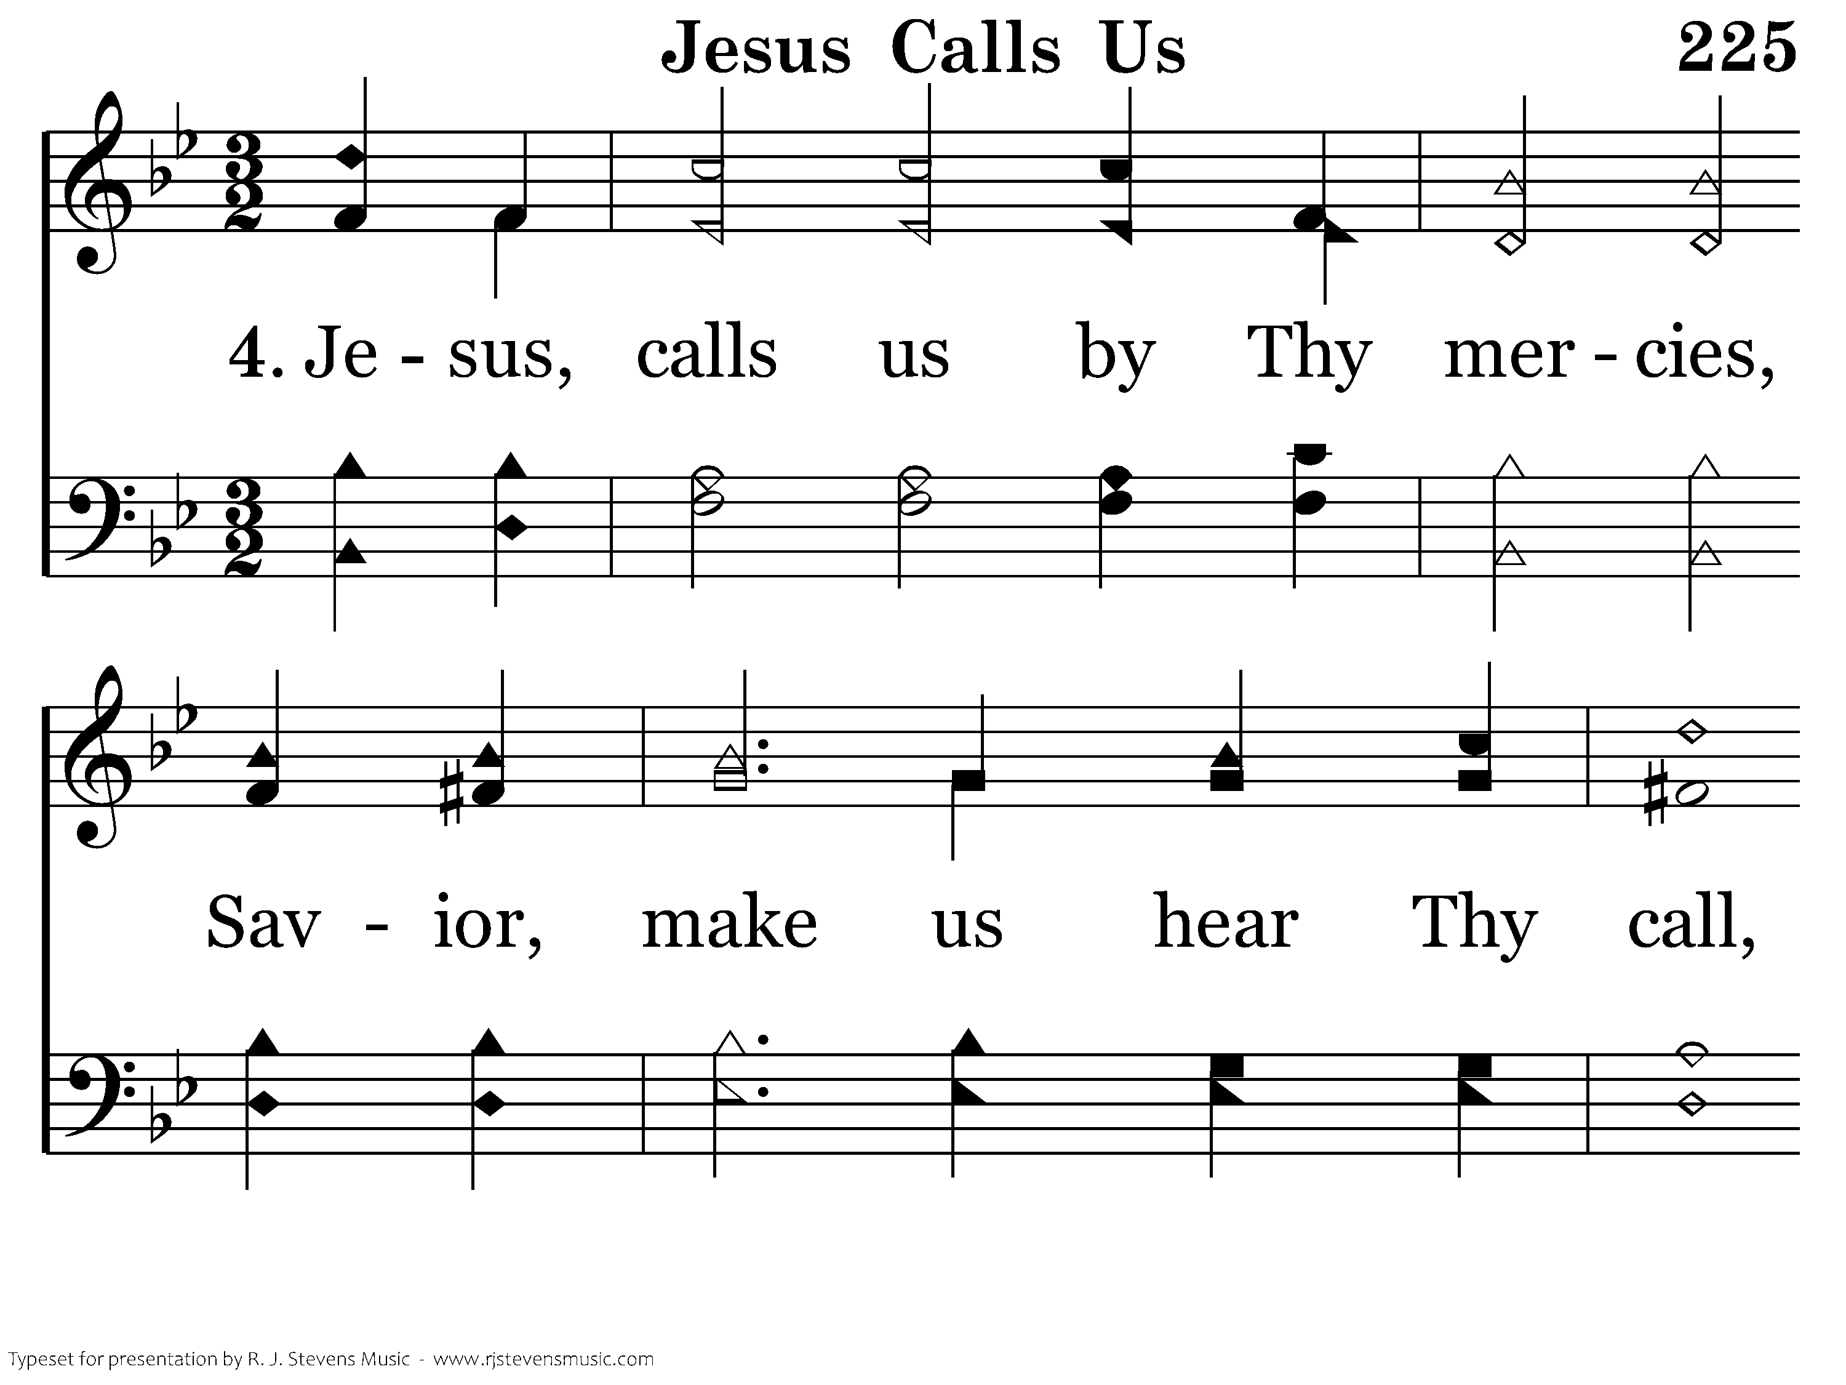
225 - Jesus Calls Us - 4.1

Slide 55
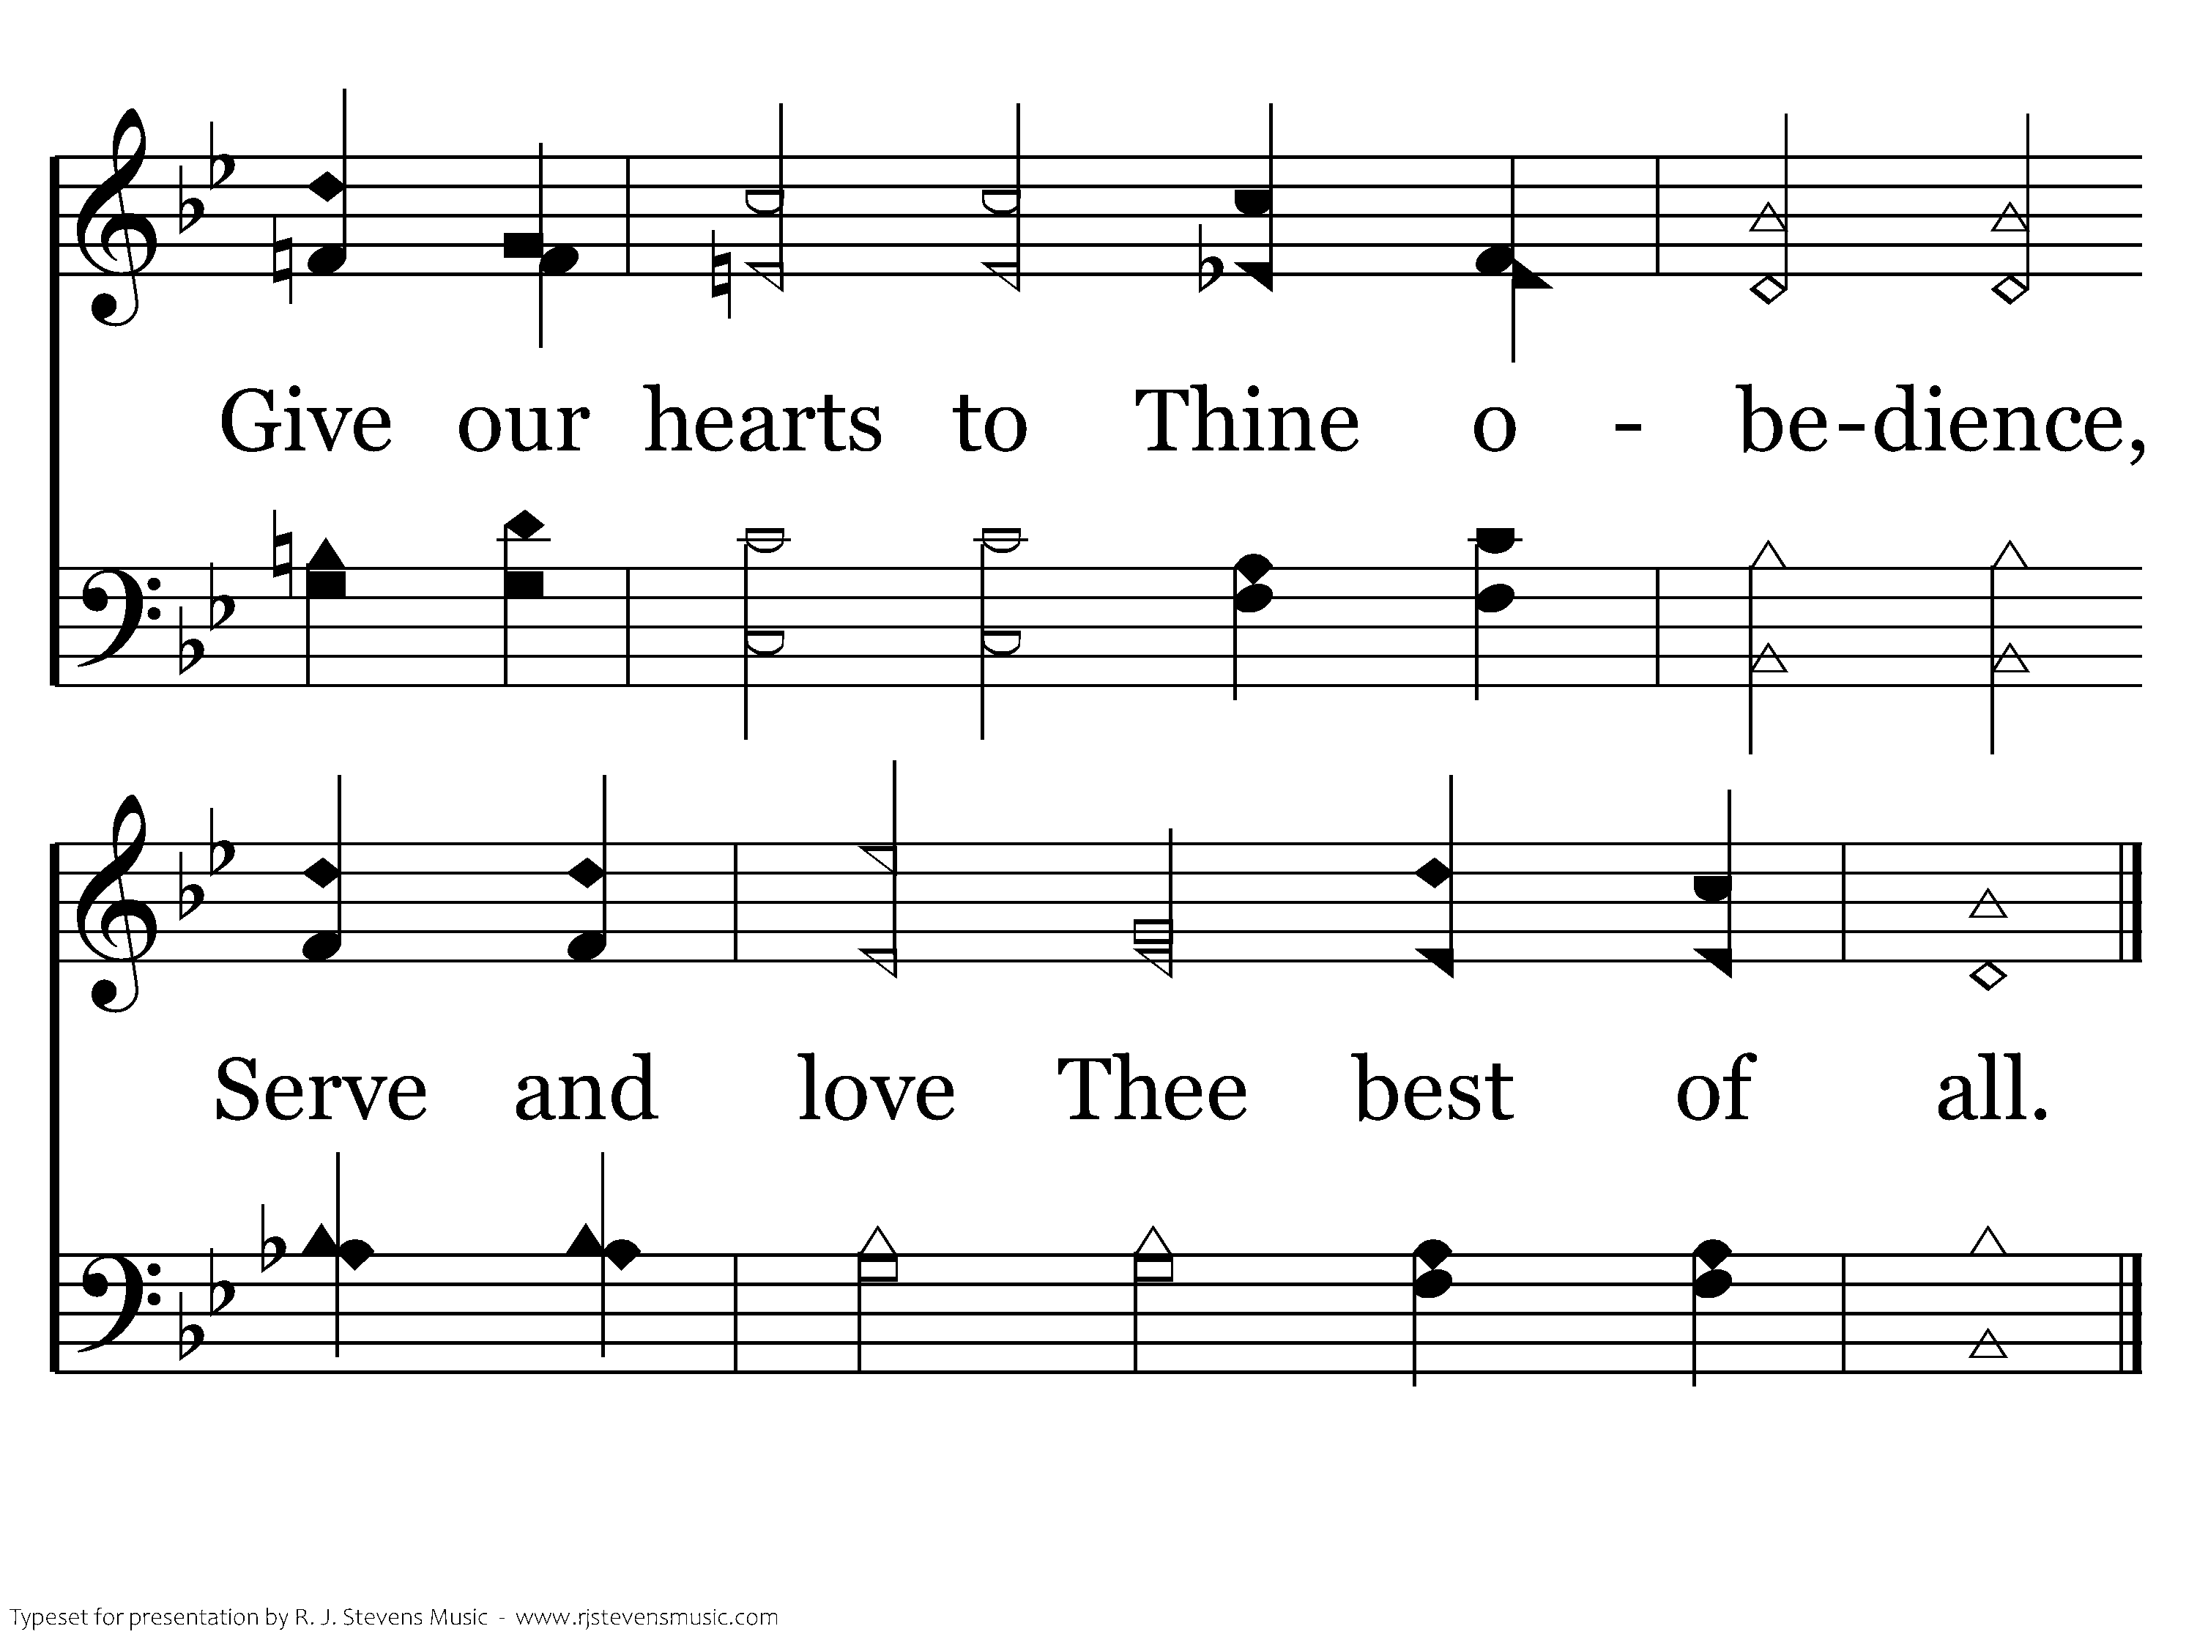
225 - Jesus Calls Us - 4.2
End of Song

Slide 57



Our Spiritual Service of Worship

Slide 58
Our Spiritual Service of Worship
Romans 12:1-8

Slide 59
Marks of True Worship
Overview of Romans
  Chapters 1-3, the problem of sin
  Chapters 6-11, the principle of salvation and obedient faith
  Chapters 12-16, the practice of faith

Slide 60
Marks of True Worship
Rom. 12:1-2— Therefore I urge you, brethren, by the mercies of God, to present your bodies a living and holy sacrifice, acceptable to God, which is your spiritual service of worship. 2 And do not be conformed to this world, but be transformed by the renewing of your mind, so that you may prove what the will of God is, that which is good and acceptable and perfect.

Slide 61
Marks of True Worship
The worship which is rendered by the reason or soul: spiritual—Thayer

Slide 62
Marks of True Worship
Self-Sacrifice
Self-Alteration
Self-Examination
Self-Involvement

Slide 64
Self-Sacrifice
Rom. 12:1— Present your bodies a living and holy sacrifice

Slide 65
Self-Sacrifice—the Christian
Living: Heb. 13:15-16— Through Him then, let us continually offer up a sacrifice of praise to God, that is, the fruit of lips that give thanks to His name. 16 And do not neglect doing good and sharing, for with such sacrifices God is pleased.

Slide 66
Self-Sacrifice—the Christian
Holy: I Pet. 1:14-15— As obedient children, do not be conformed to the former lusts which were yours in your ignorance, 15 but like the Holy One who called you, be holy yourselves also in all your behavior; 16 because it is written, “YOU SHALL BE HOLY, FOR I AM HOLY.”

Slide 67
Self-Sacrifice—the Christian
Acceptable: Heb. 13:20-21— Now the God of peace, who brought up from the dead the great Shepherd of the sheep through the blood of the eternal covenant, even Jesus our Lord, 21 equip you in every good thing to do His will, working in us that which is pleasing in His sight, through Jesus Christ, to whom be the glory forever and ever. Amen.

Slide 68
Self-Sacrifice—Surrender of Self
Macedonians: II Cor. 8:3-5— For I testify that according to their ability, and beyond their ability, they gave of their own accord, 4 begging us with much urging for the favor of participation in the support of the saints, 5 and this, not as we had expected, but they first gave themselves to the Lord and to us by the will of God.

Slide 69
Self-Sacrifice—Surrender of Self
Thessalonians: I Thess. 1:9-10— For they themselves report about us what kind of a reception we had with you, and how you turned to God from idols to serve a living and true God, 10 and to wait for His Son from heaven,

Slide 70
Self-Sacrifice—Surrender of Self
Paul: I Cor. 12:14-15— for I do not seek what is yours, but you; for children are not responsible to save up for their parents, but parents for their children. 15 I will most gladly spend and be expended for your souls.

Slide 71
Self-Sacrifice—Surrender of Self
Self is the altar upon which every acceptable sacrifice is made to God
“Grant us Thy truth to make us free, and kindling hearts that burn for Thee; till all Thy living altars claim one holy light, one heavenly flame.”—Oliver W. Holmes, “Lord of All Being, Throned Afar”

Slide 72
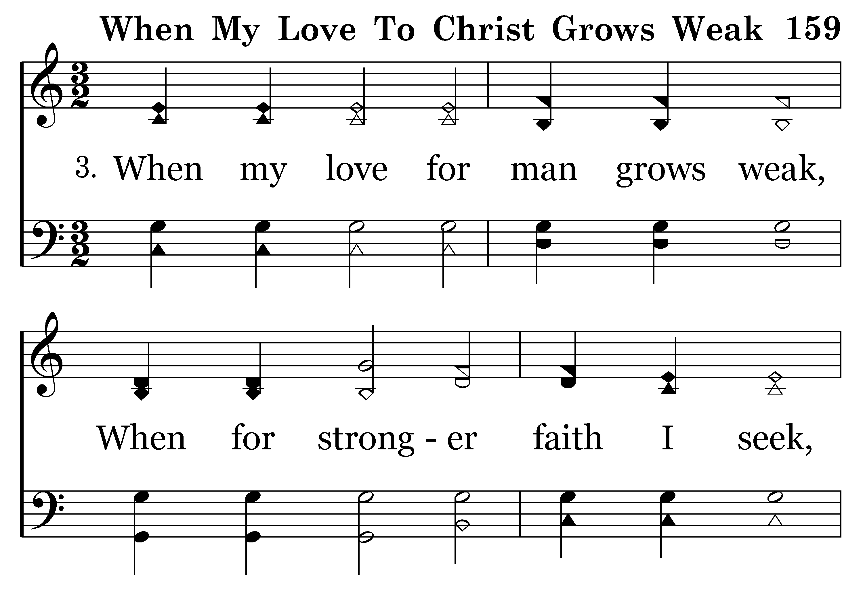
159 - When My Love To Christ Grows Weak - 3.1

Slide 73
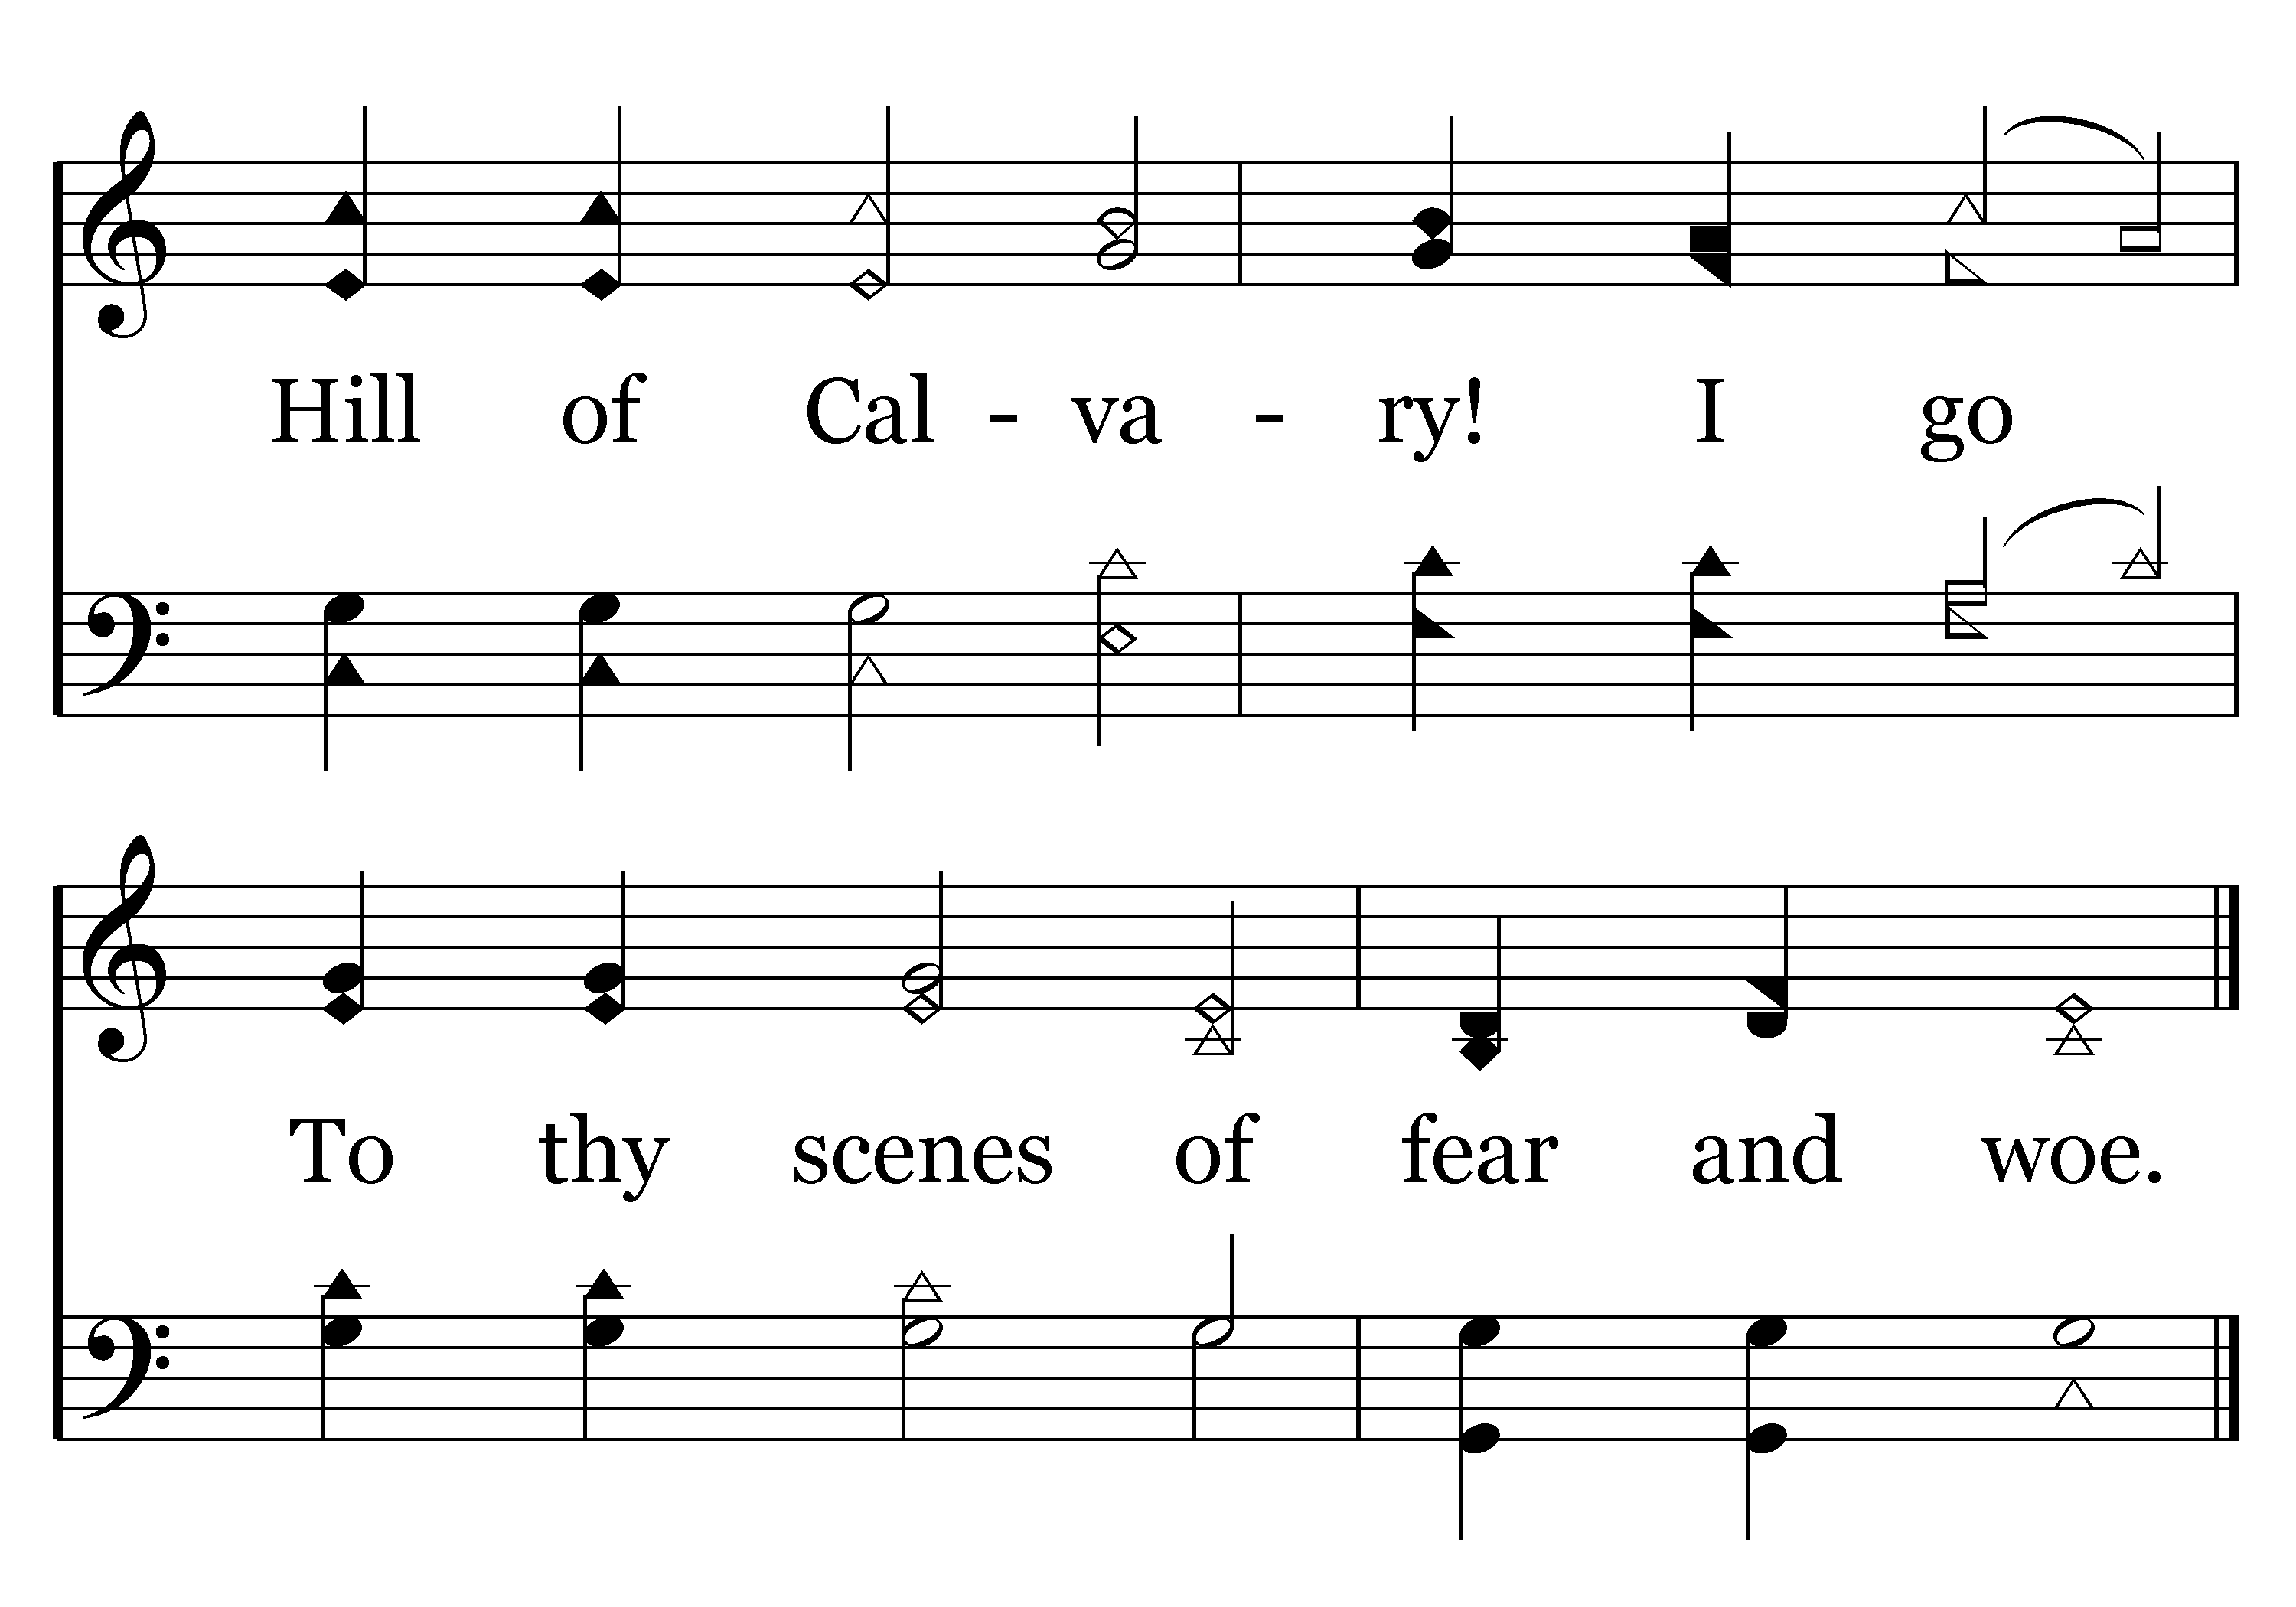
159 - When My Love To Christ Grows Weak - 3.2
End of Verse 3

Slide 74
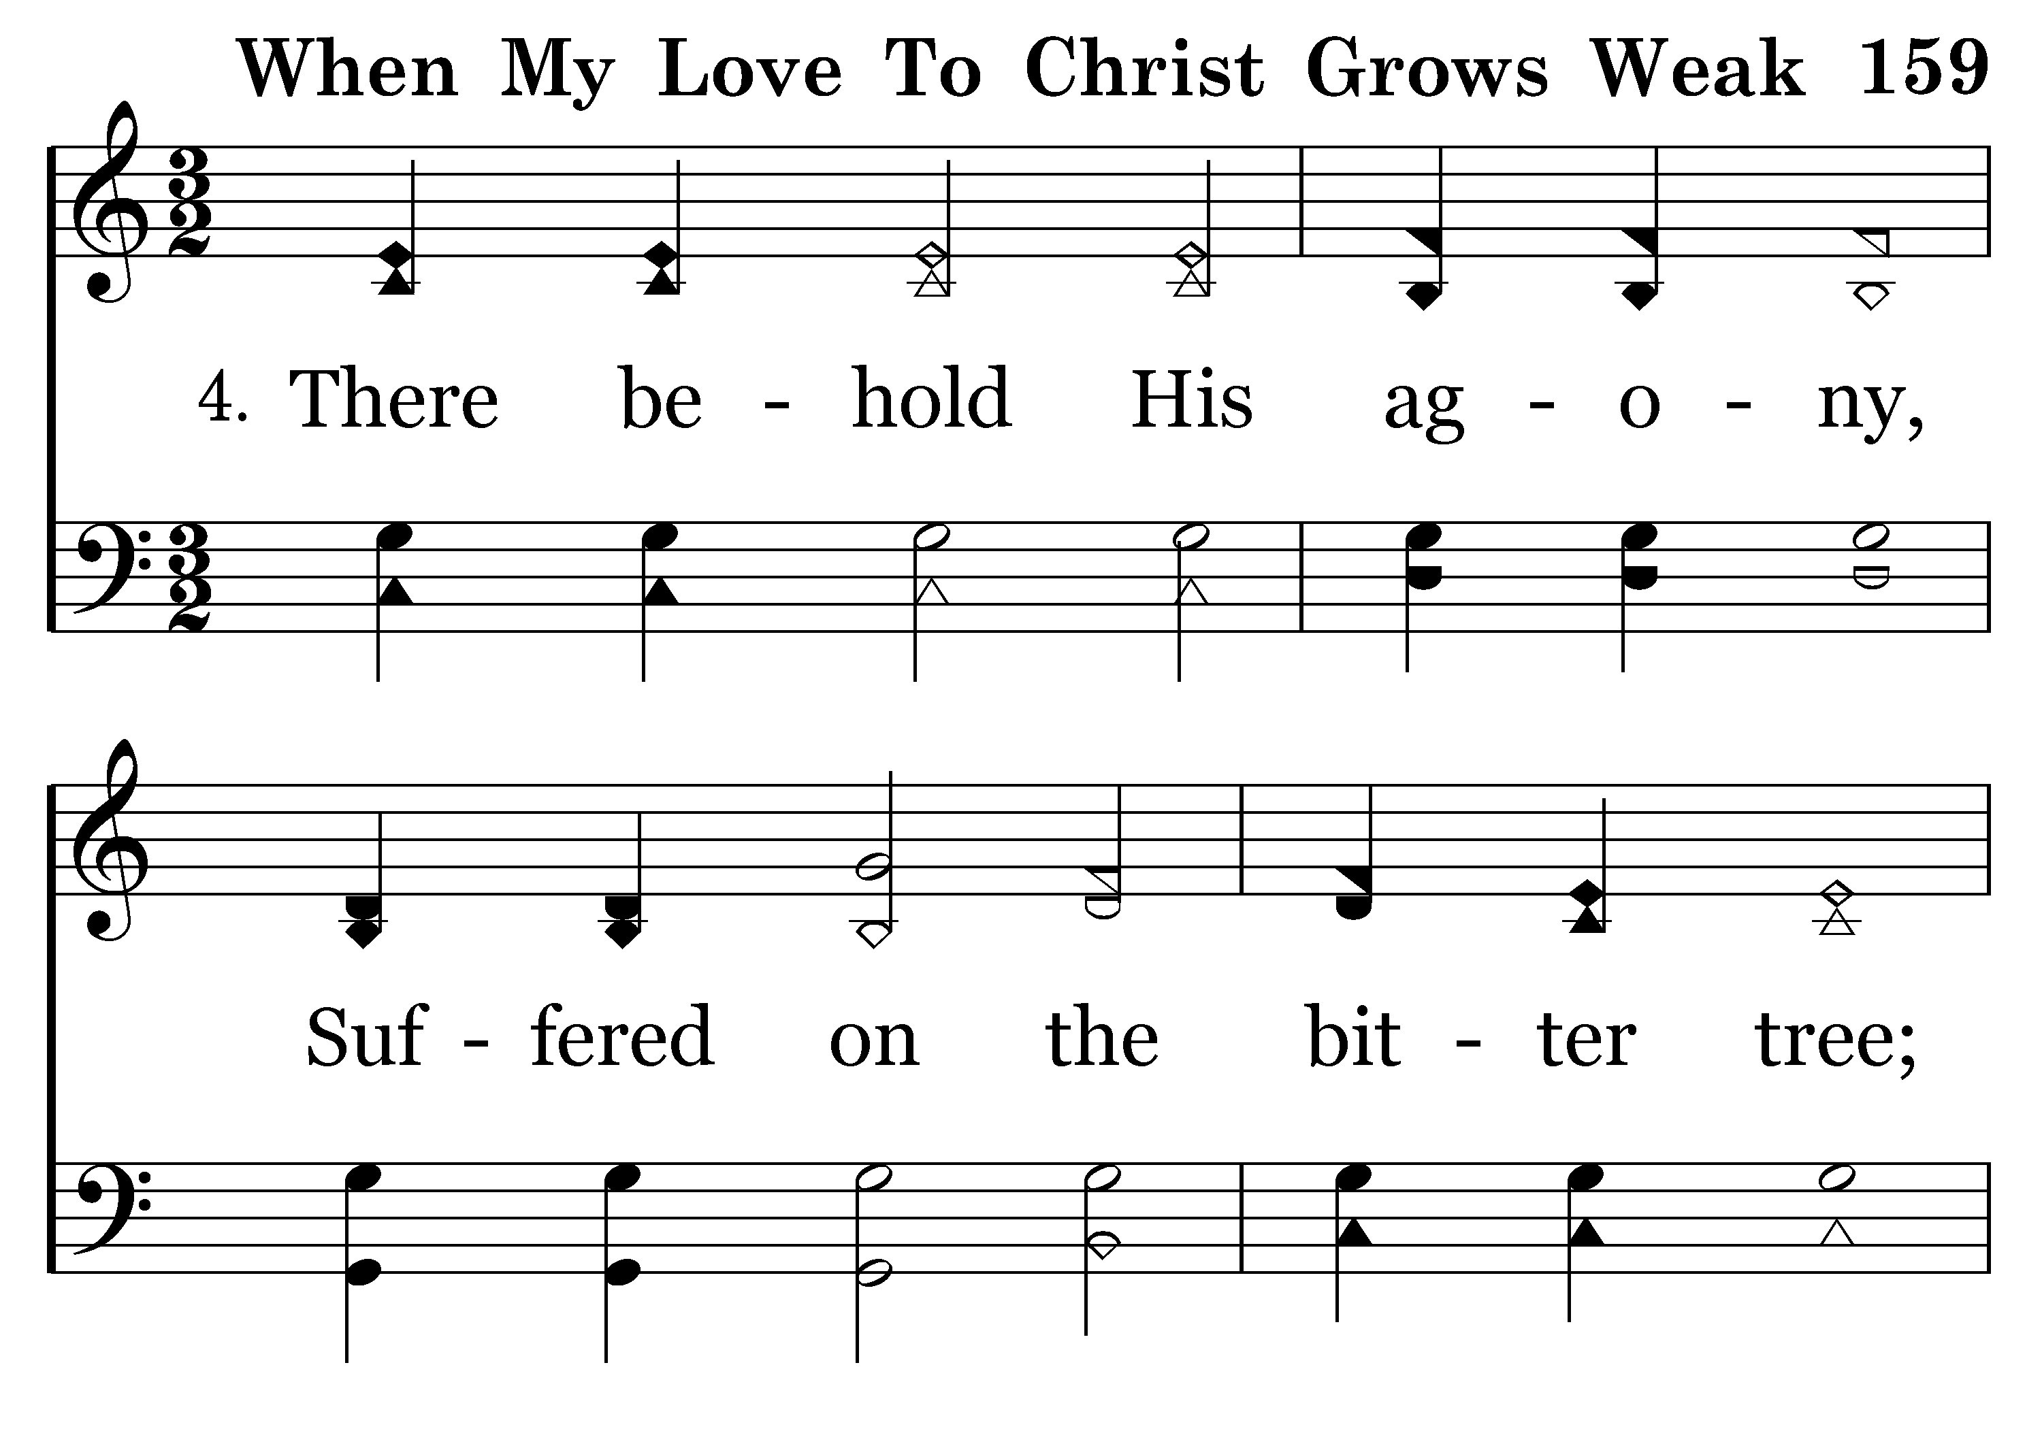
159 - When My Love To Christ Grows Weak - 4.1

Slide 75
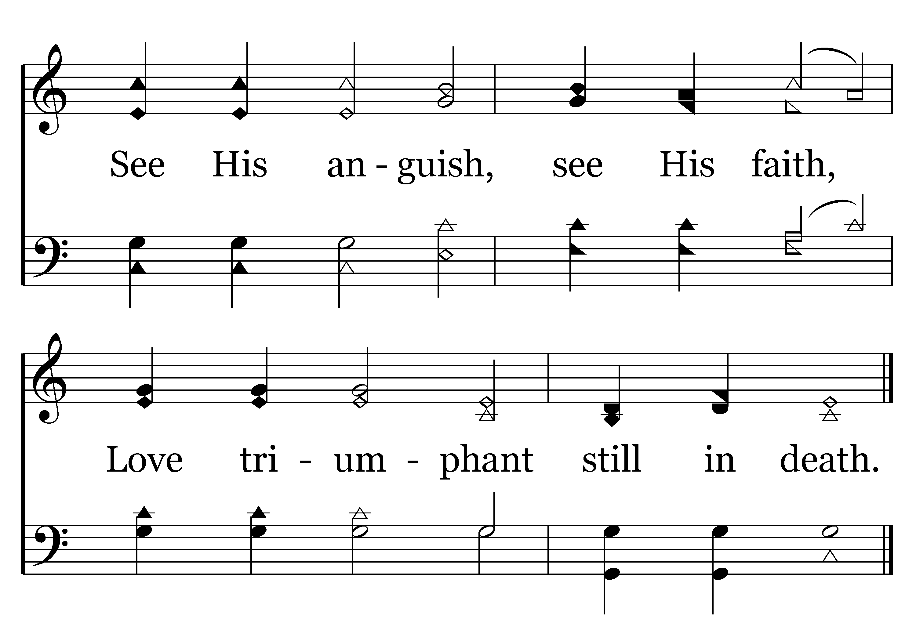
159 - When My Love To Christ Grows Weak - 4.2
End of Verse 4

Slide 76
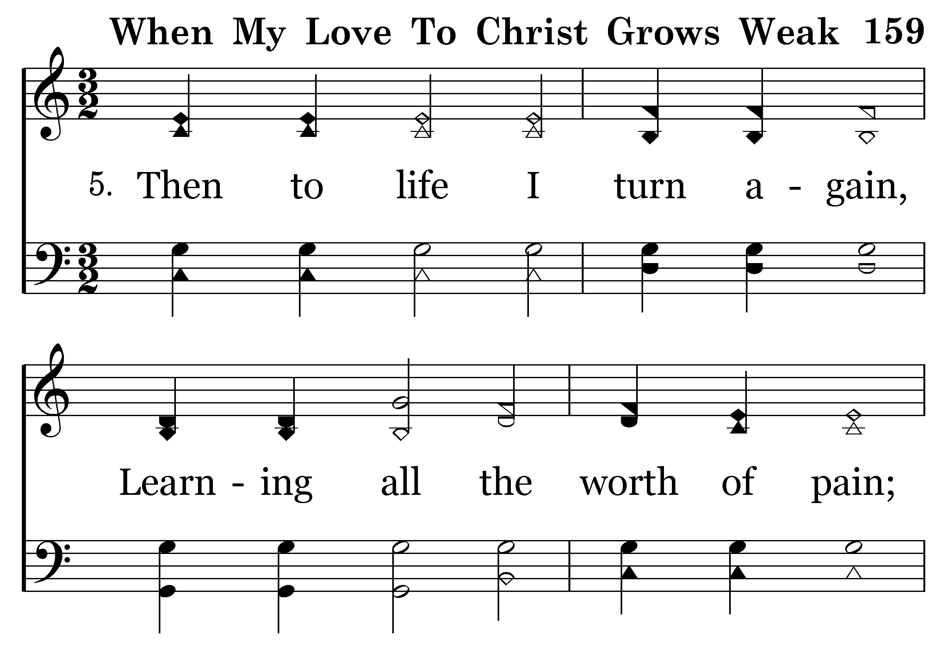
159 - When My Love To Christ Grows Weak - 5.1

Slide 77
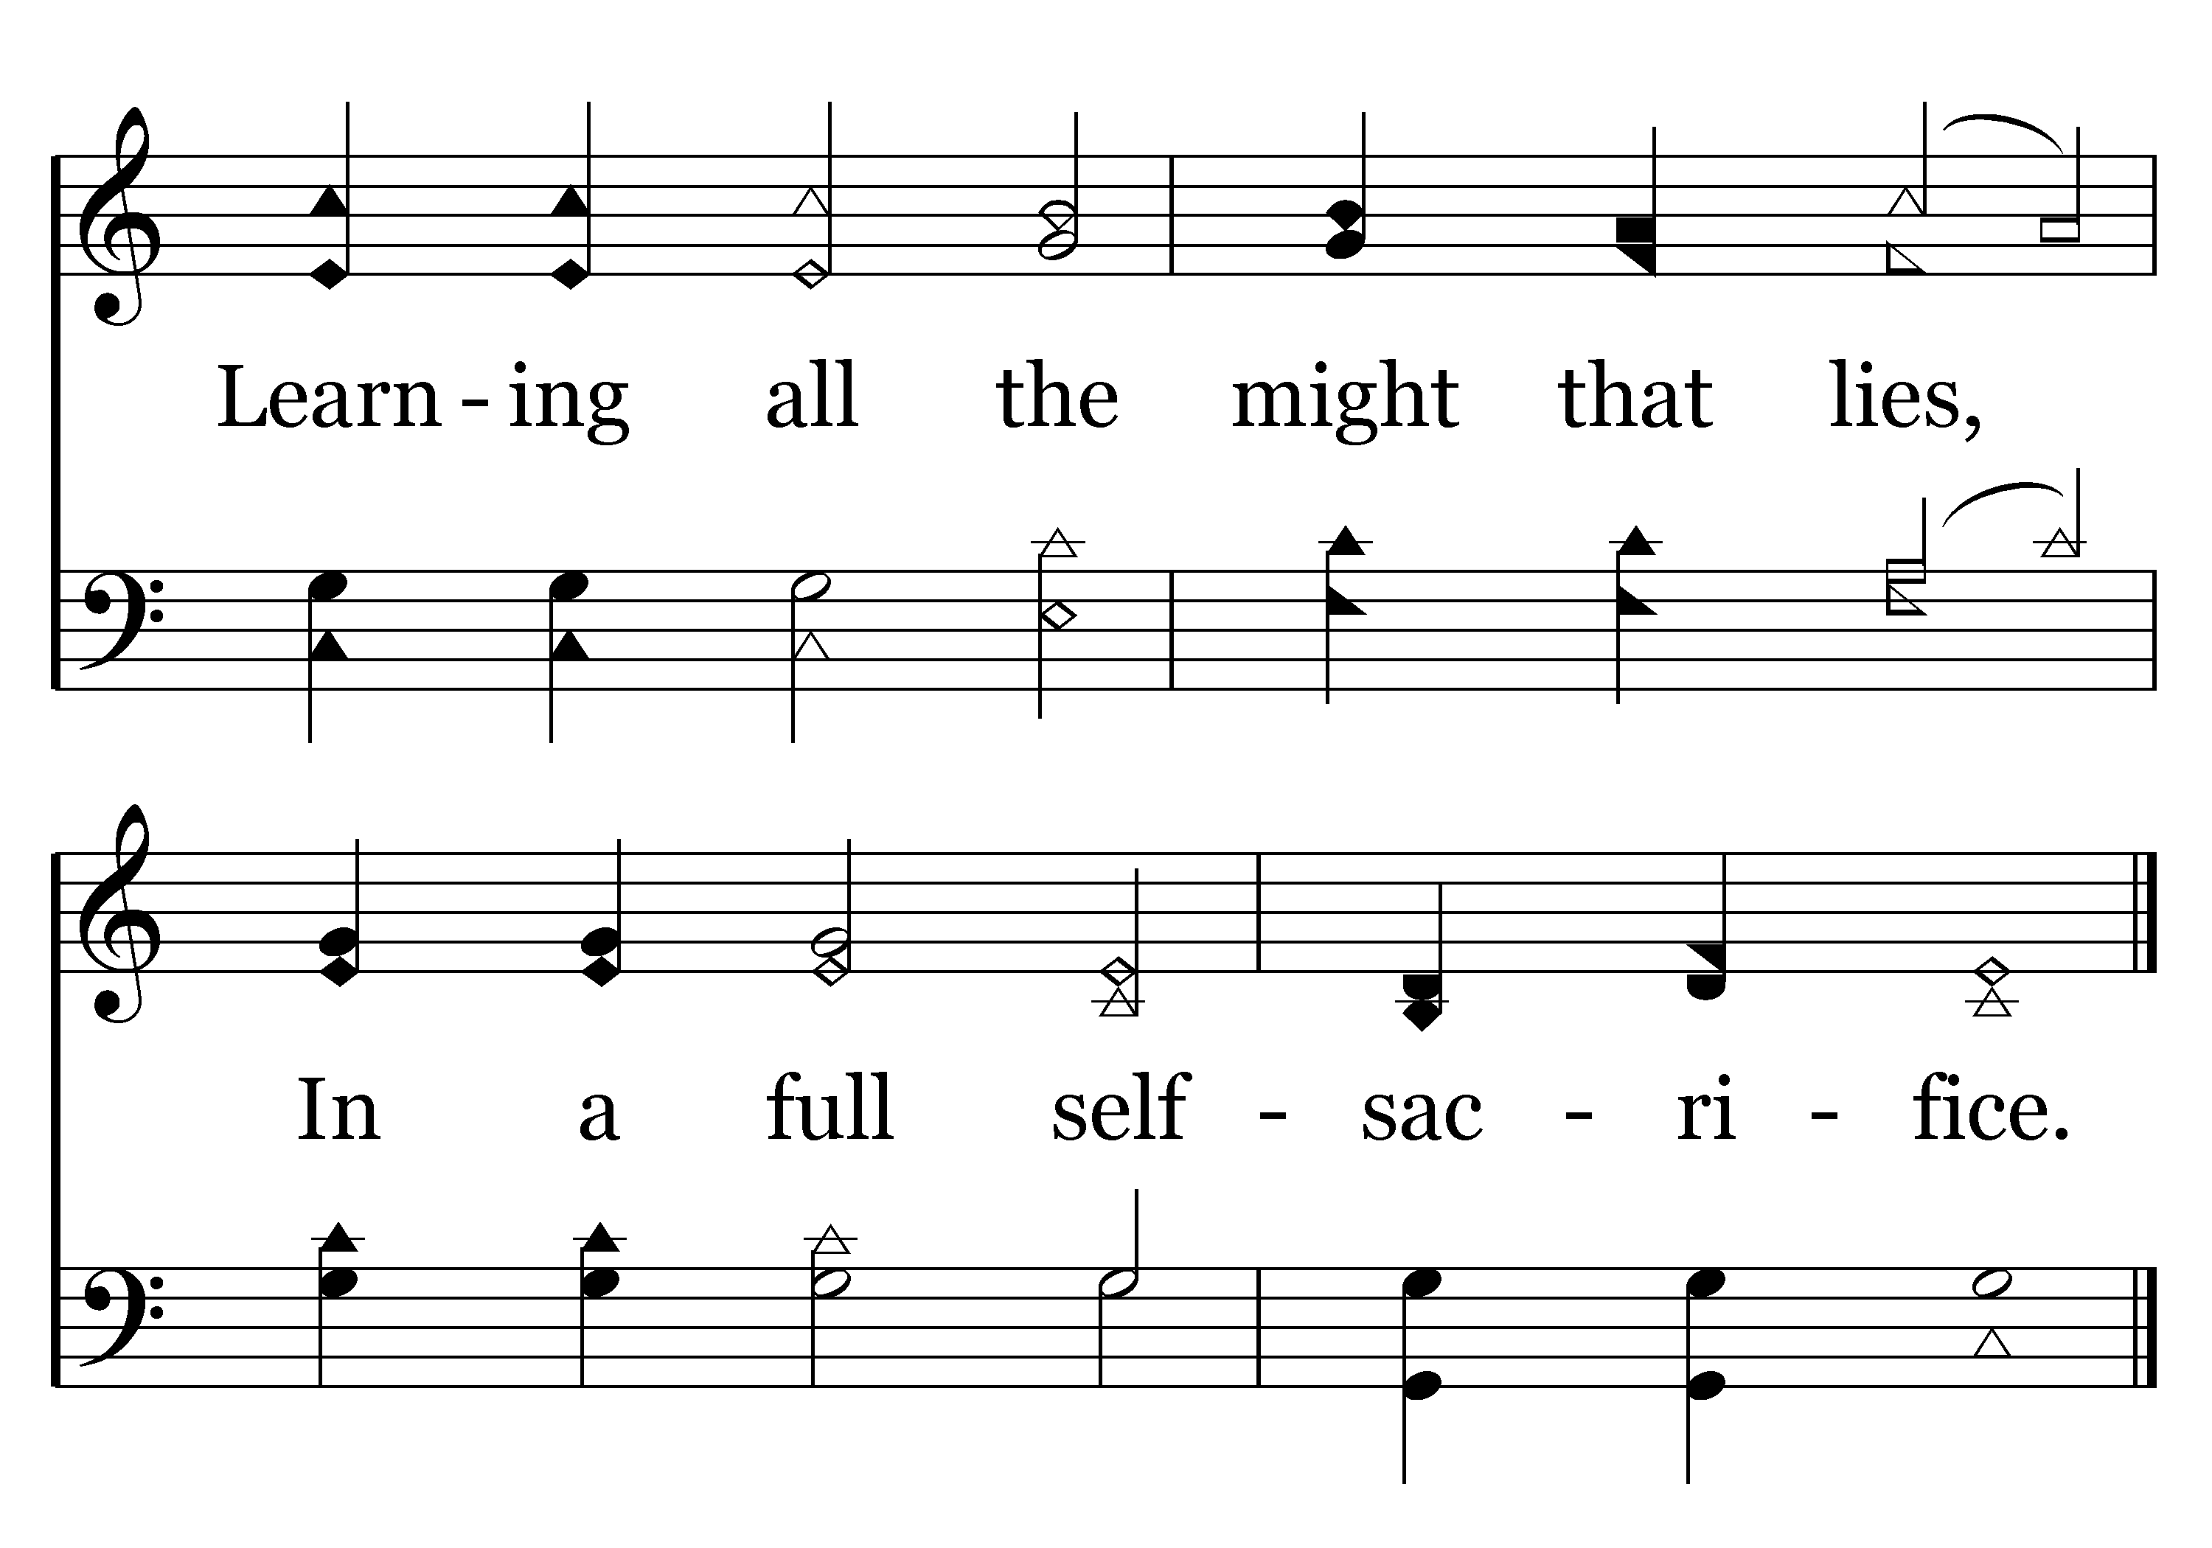
159 - When My Love To Christ Grows Weak - 5.2
End of Song

Slide 78
Self-Alteration
Rom. 12:2— but be transformed by the renewing of your mind,
Negatively, we are to not be conformed to this world,

Slide 79
Self-Alteration
I John 2:15-16— Do not love the world nor the things in the world. If anyone loves the world, the love of the Father is not in him. 16 For all that is in the world, the lust of the flesh and the lust of the eyes and the boastful pride of life, is not from the Father, but is from the world.

Slide 80
Self-Alteration
Eph. 4:22— in reference to your former manner of life, you lay aside the old self, which is being corrupted in accordance with the lusts of deceit,

Slide 81
Self-Alteration
Positively, be transformed by the renewing of your mind
Eph. 4:23-24— and that you be renewed in the spirit of your mind, 24 and put on the new self, which in the likeness of God has been created in righteousness and holiness of the truth.

Slide 82
Self-Alteration
Spiritual metamorphosis
Eph. 3:16-17, 20-21— that He would grant you, according to the riches of His glory, to be strengthened with power through His Spirit in the inner man, 17 so that Christ may dwell in your hearts through faith…

Slide 83
Self-Alteration
Spiritual metamorphosis
Eph. 3:16-17, 20-21—20 Now to Him who is able to do far more abundantly beyond all that we ask or think, according to the power that works within us, 21 to Him be the glory in the church and in Christ Jesus to all generations forever and ever. Amen.

Slide 84
Self-Alteration
Spiritual metamorphosis
Phil. 2:12-13— work out your salvation with fear and trembling; 13 for it is God who is at work in you, both to will and to work for His good pleasure.

Slide 85
Self-Alteration
Spiritual metamorphosis
The Christian is different—He is never what he aspires to be, but he is never what he used to be

Slide 86
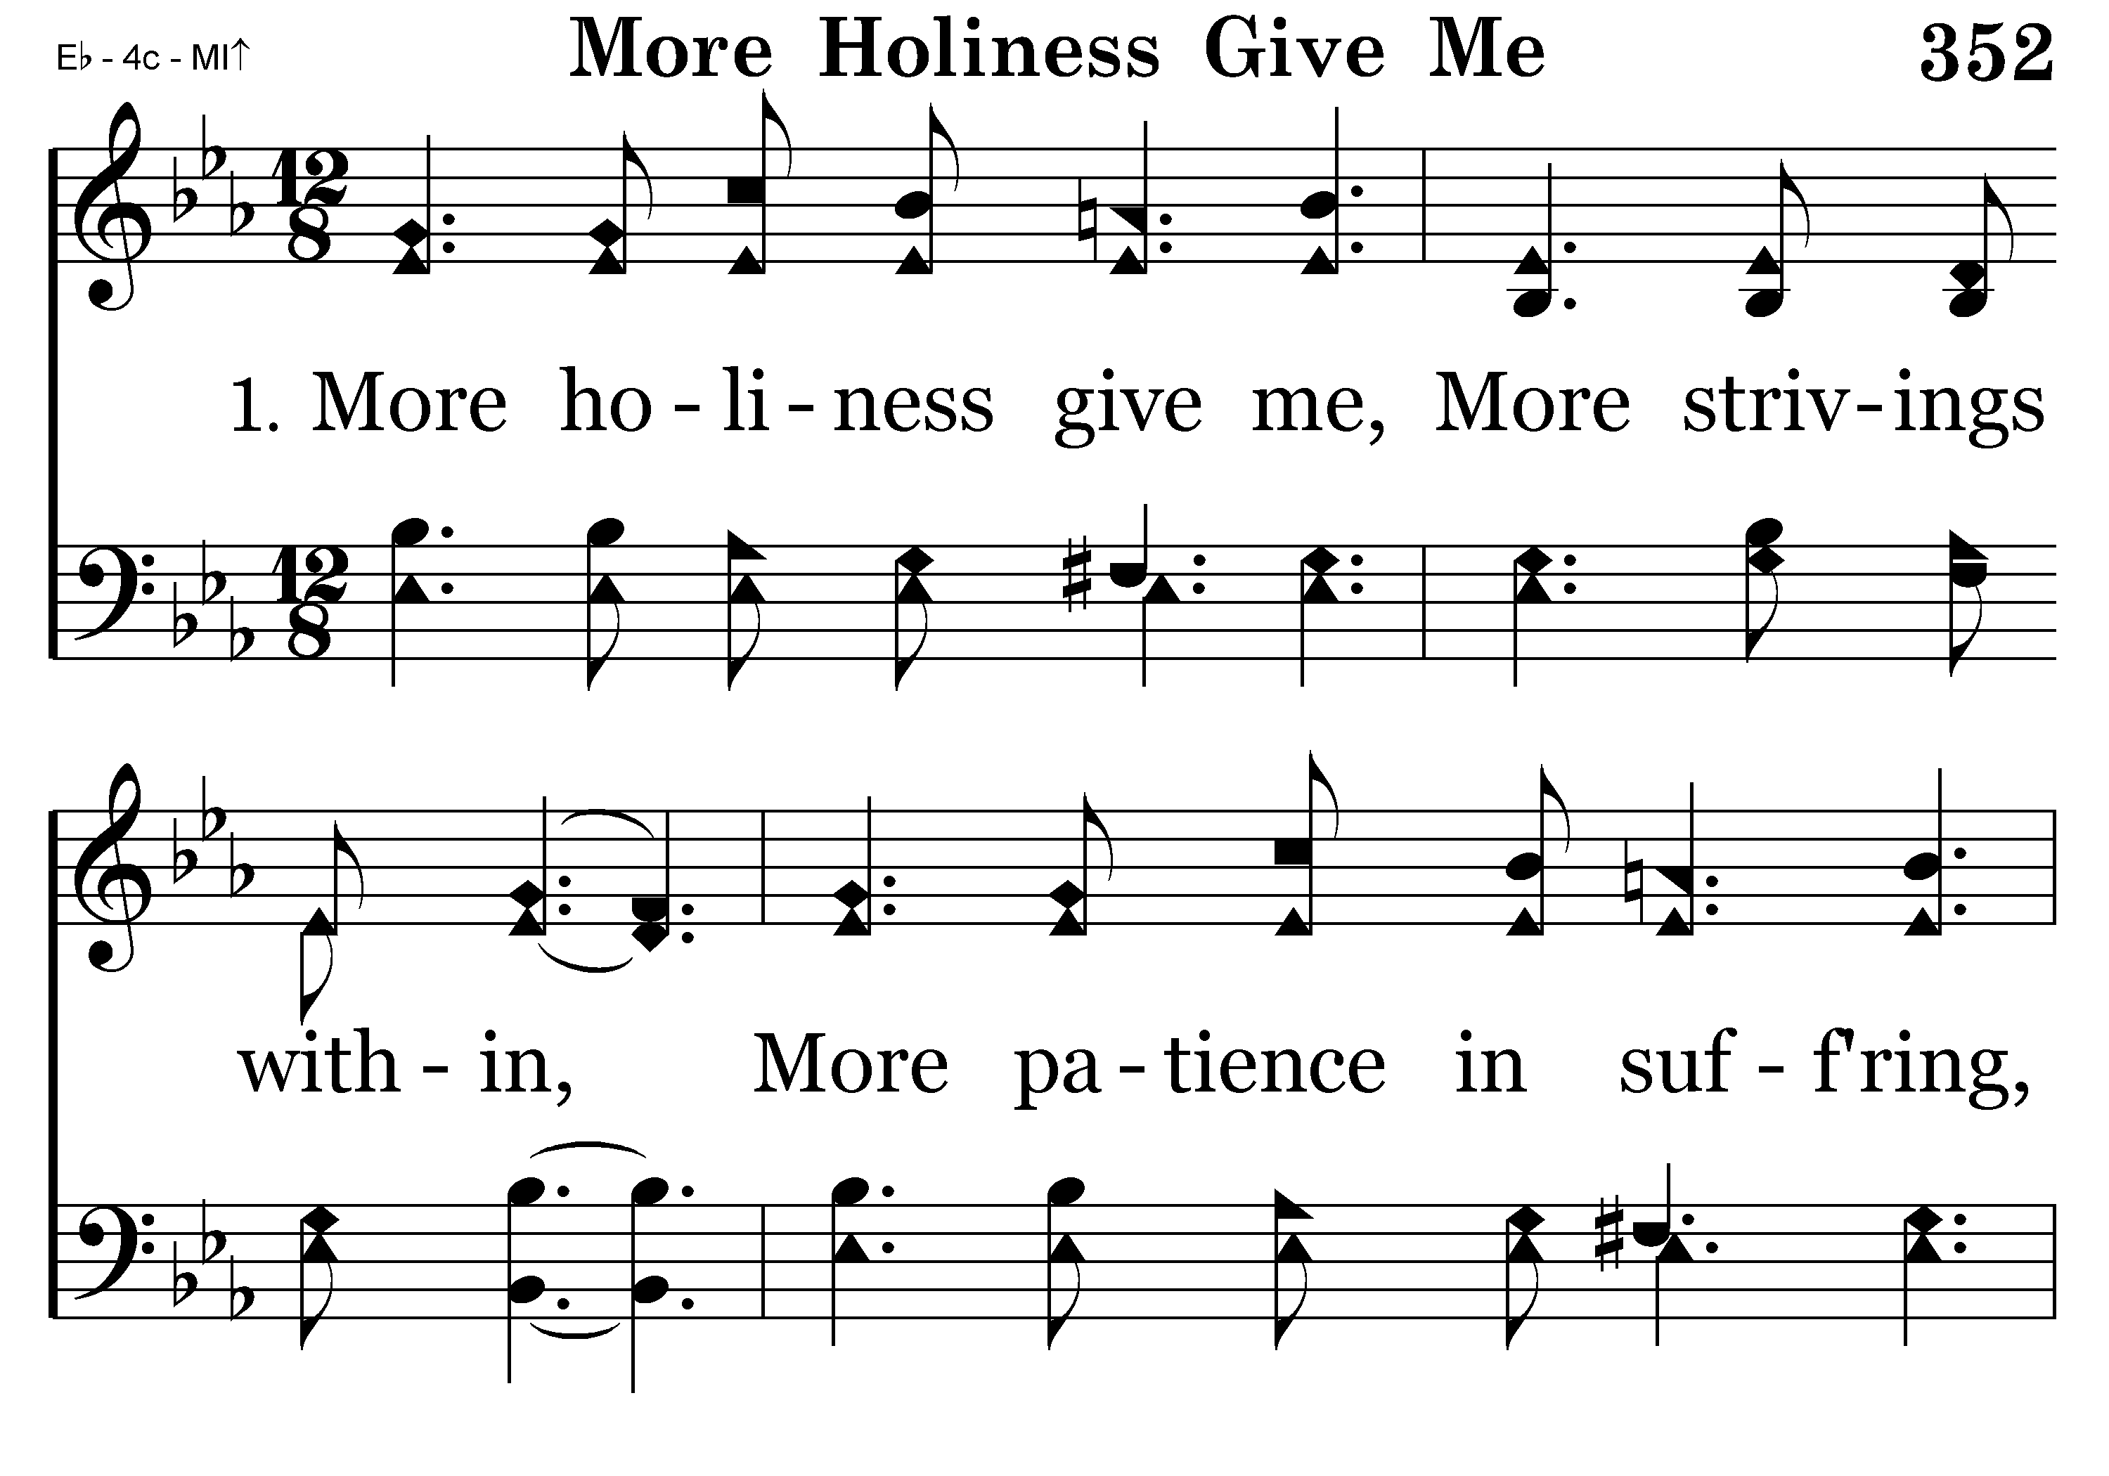
352 - More Holiness Give Me - 1.1

Slide 87
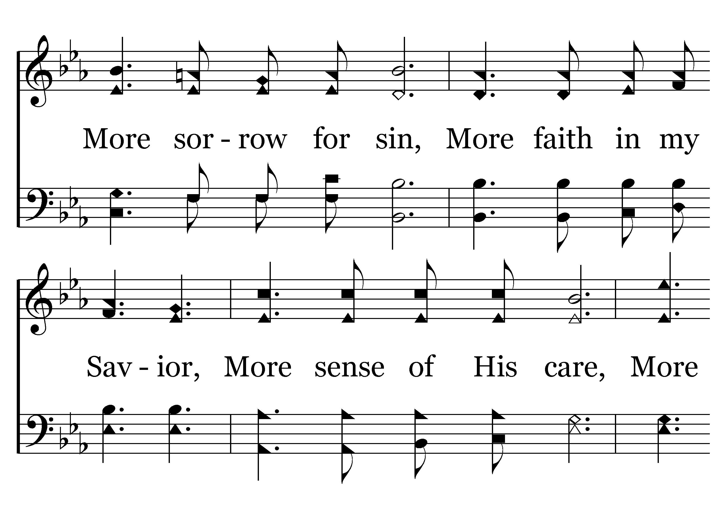
352 - More Holiness Give Me - 1.2

Slide 88
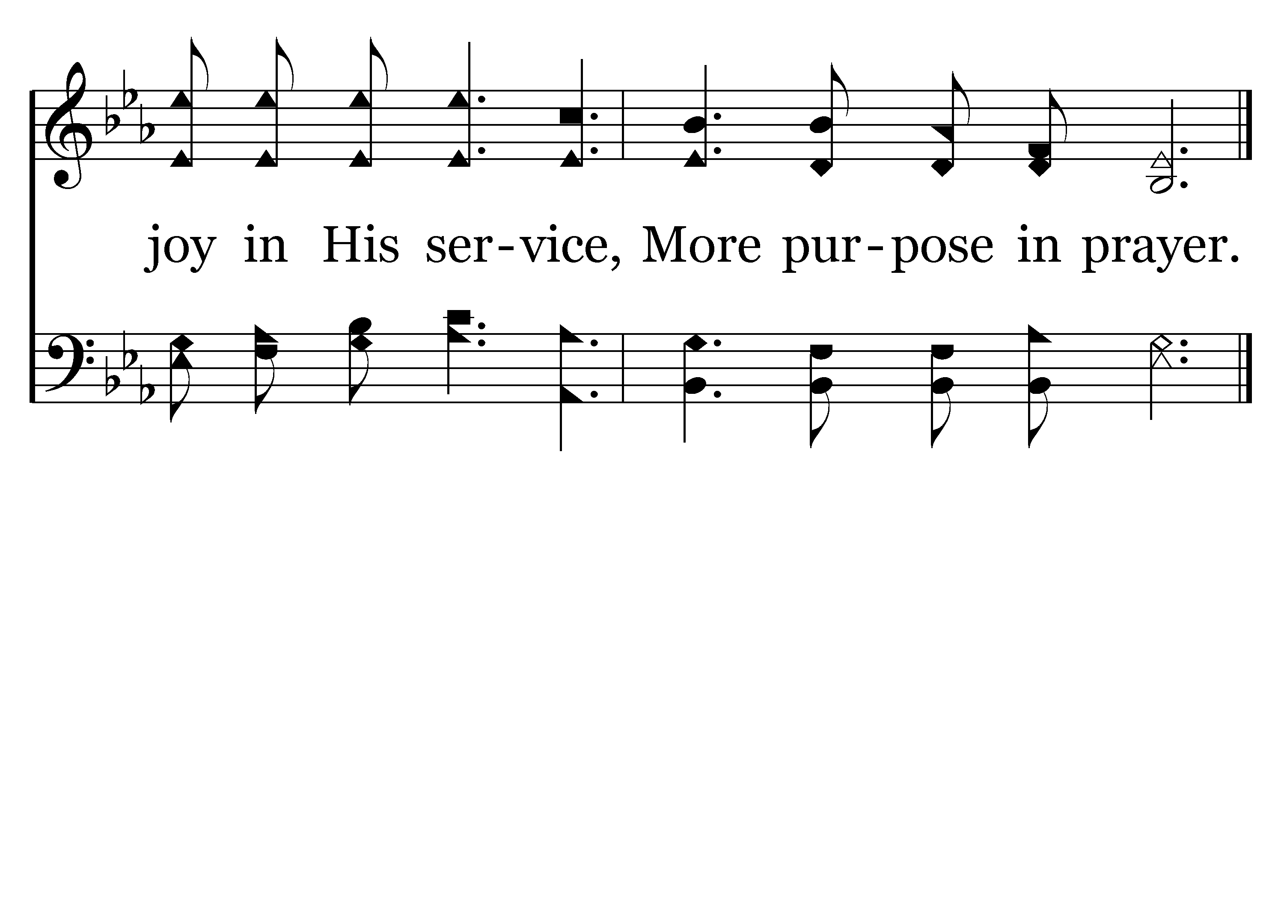
352 - More Holiness Give Me - 1.3
End of Verse 1

Slide 89
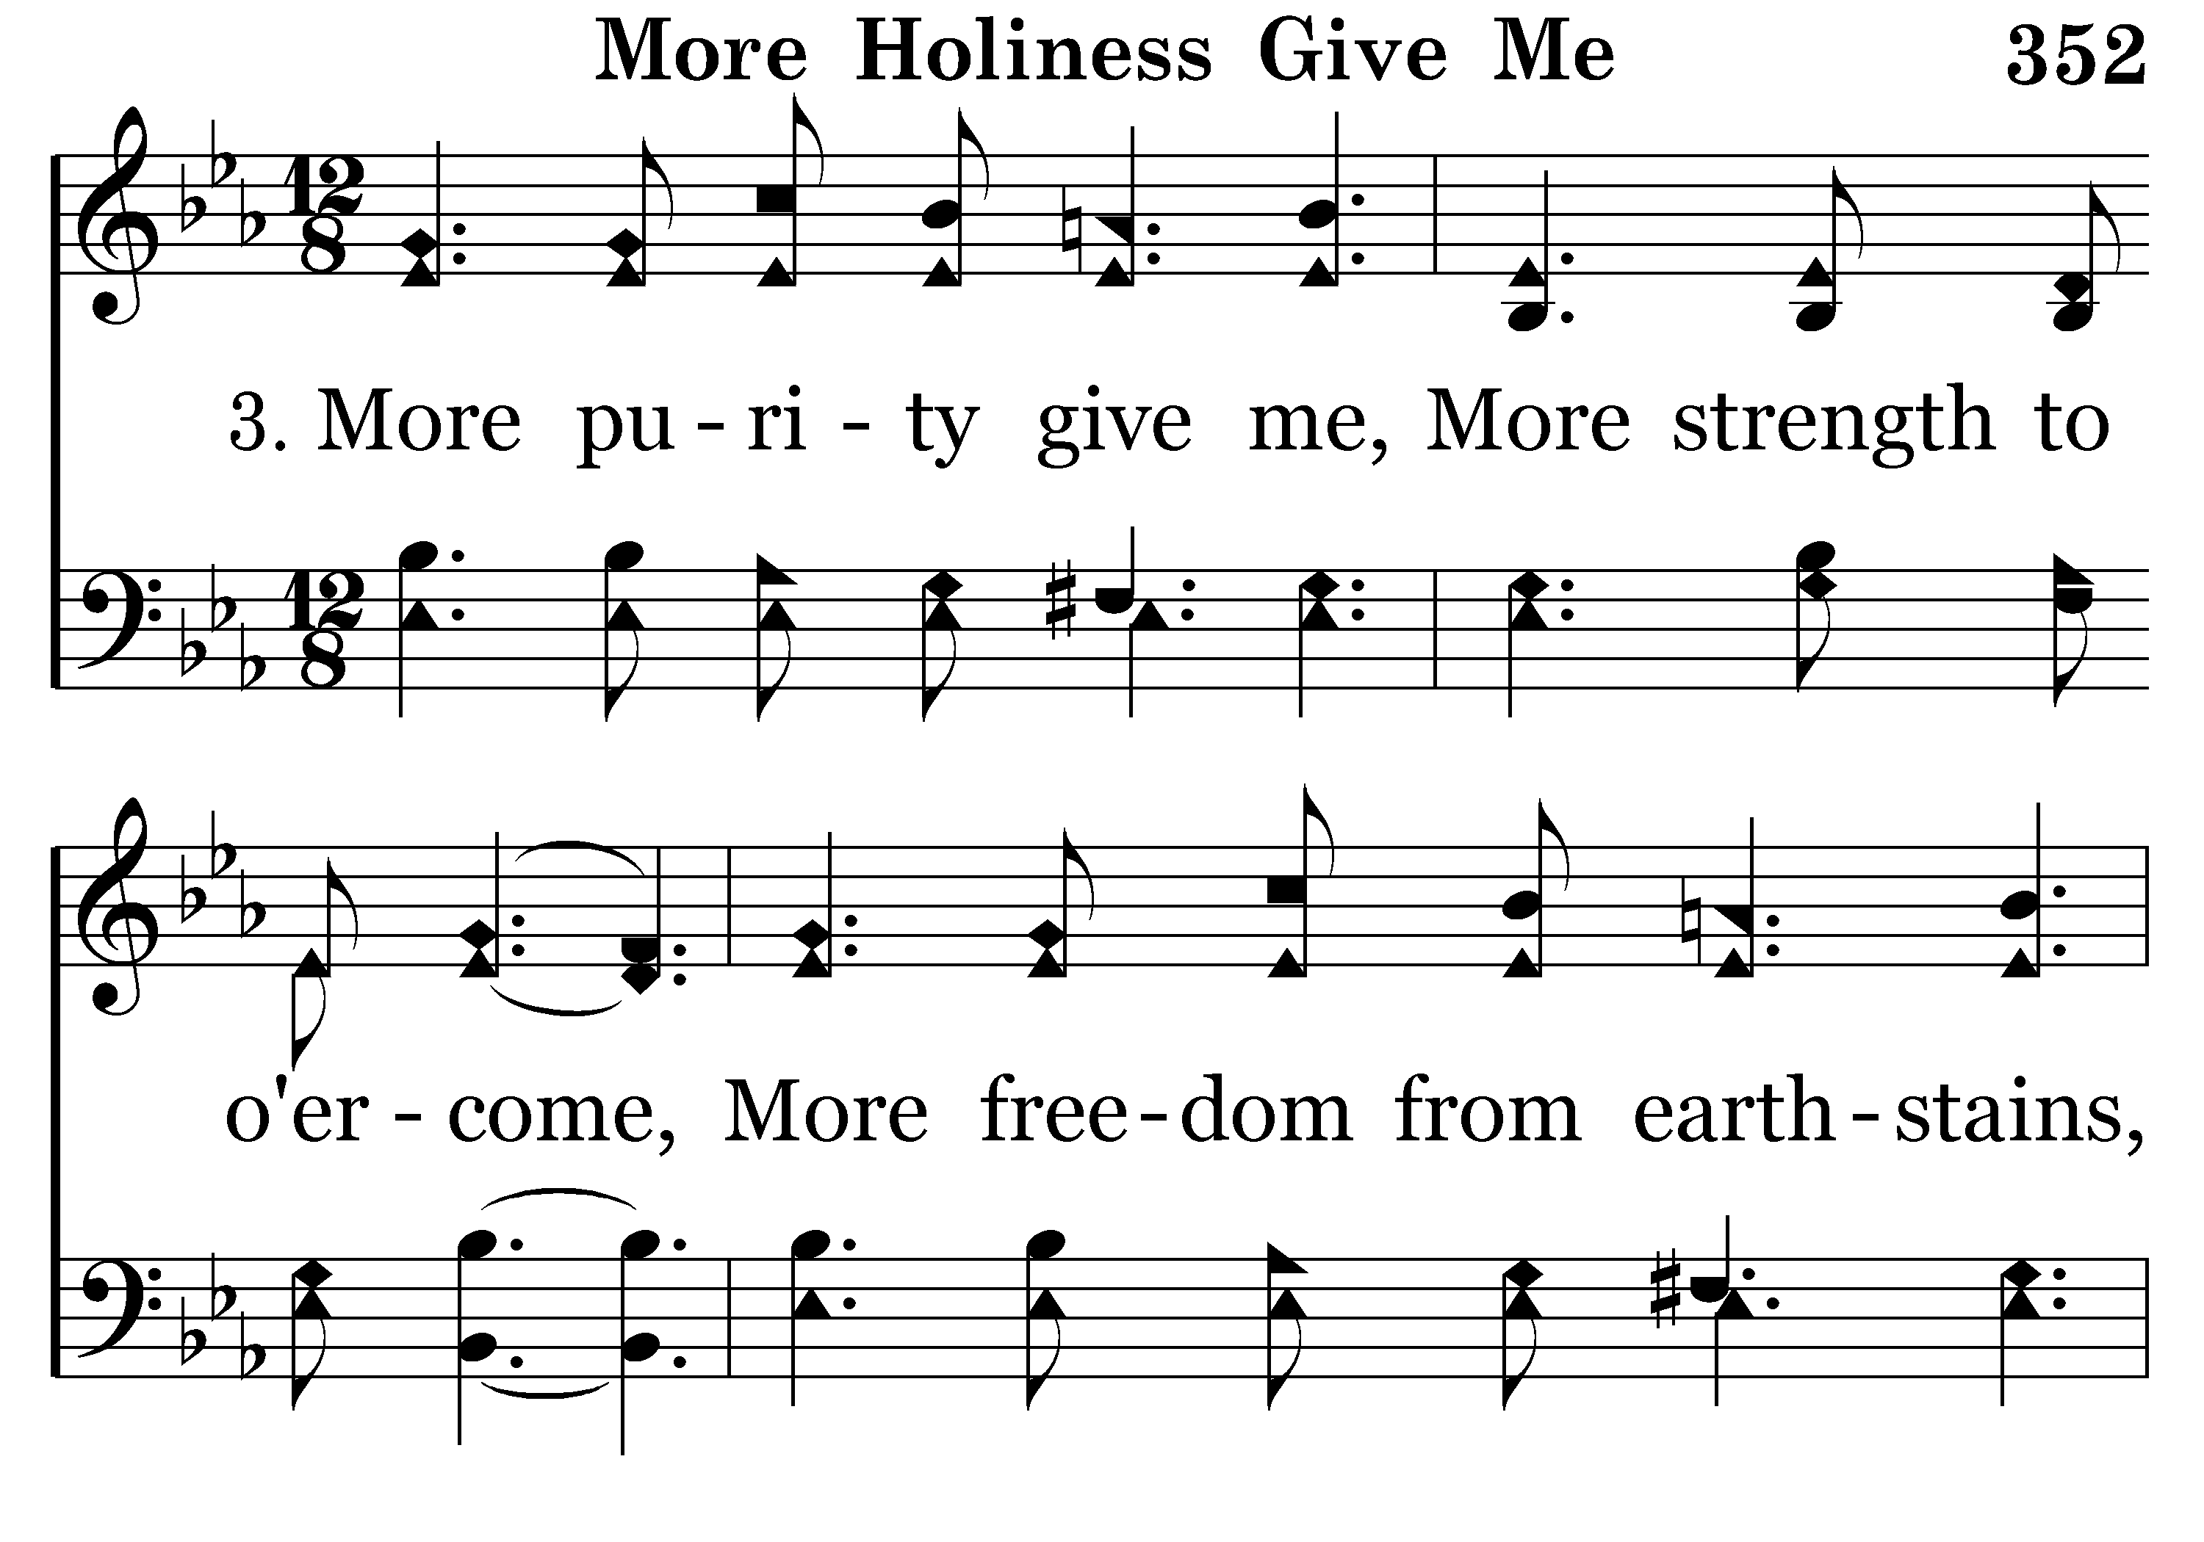
352 - More Holiness Give Me - 3.1

Slide 90
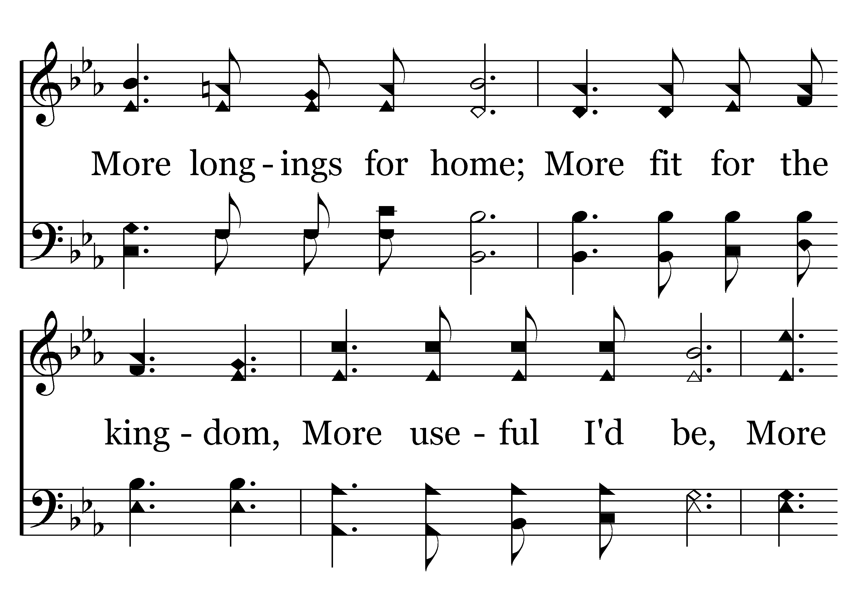
352 - More Holiness Give Me - 3.2

Slide 91
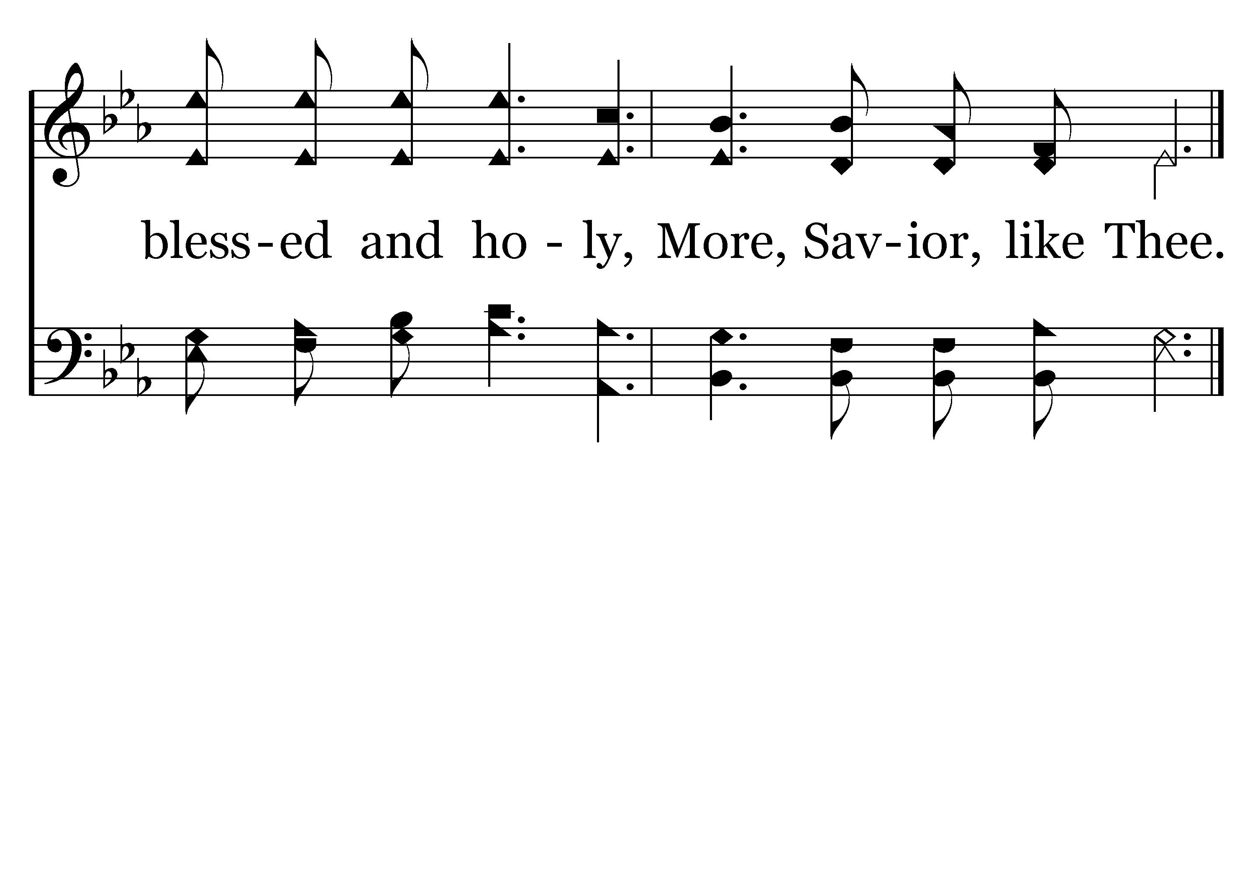
352 - More Holiness Give Me - 3.3
End of Song

Slide 92
Self-Examination
Rom. 12:3— For through the grace given to me I say to everyone among you not to think more highly of himself than he ought to think; but to think so as to have sound judgment, as God has allotted to each a measure of faith.

Slide 93
Self-Examination
Self-evaluation is essential
II Cor. 13:5-6— Test yourselves to see if you are in the faith; examine yourselves! Or do you not recognize this about yourselves, that Jesus Christ is in you—unless indeed you fail the test?

Slide 94
Self-Examination
II Cor. 10:12, 17-18— For we are not bold to class or compare ourselves with some of those who commend themselves; but when they measure themselves by themselves and compare themselves with themselves, they are without understanding…18 For it is not he who commends himself that is approved, but he whom the Lord commends.

Slide 95
Self-Examination
Over-evaluation is harmful
Rom. 12:3— For through the grace given to me I say to everyone among you not to think more highly of himself than he ought to think; but to think so as to have sound judgment, as God has allotted to each a measure of faith.

Slide 96
Self-Examination
Under-evaluation is harmful
Rom. 12:3— For through the grace given to me I say to everyone among you not to think more highly of himself than he ought to think; but to think so as to have sound judgment, as God has allotted to each a measure of faith.

Slide 97
Self-Examination
Examine by the right standard
Rom. 12:3— For through the grace given to me I say to everyone among you not to think more highly of himself than he ought to think; but to think so as to have sound judgment, as God has allotted to each a measure of faith.

Slide 98
Self-Examination
Test yourselves to see if you are in the faith.

Slide 99
Self-Examination
Look into the mirror of God’s perfect word
Jas. 1:25—But one who looks intently at the perfect law, the law of liberty, and abides by it, not having become a forgetful hearer but an effectual doer, this man will be blessed in what he does.

Slide 100
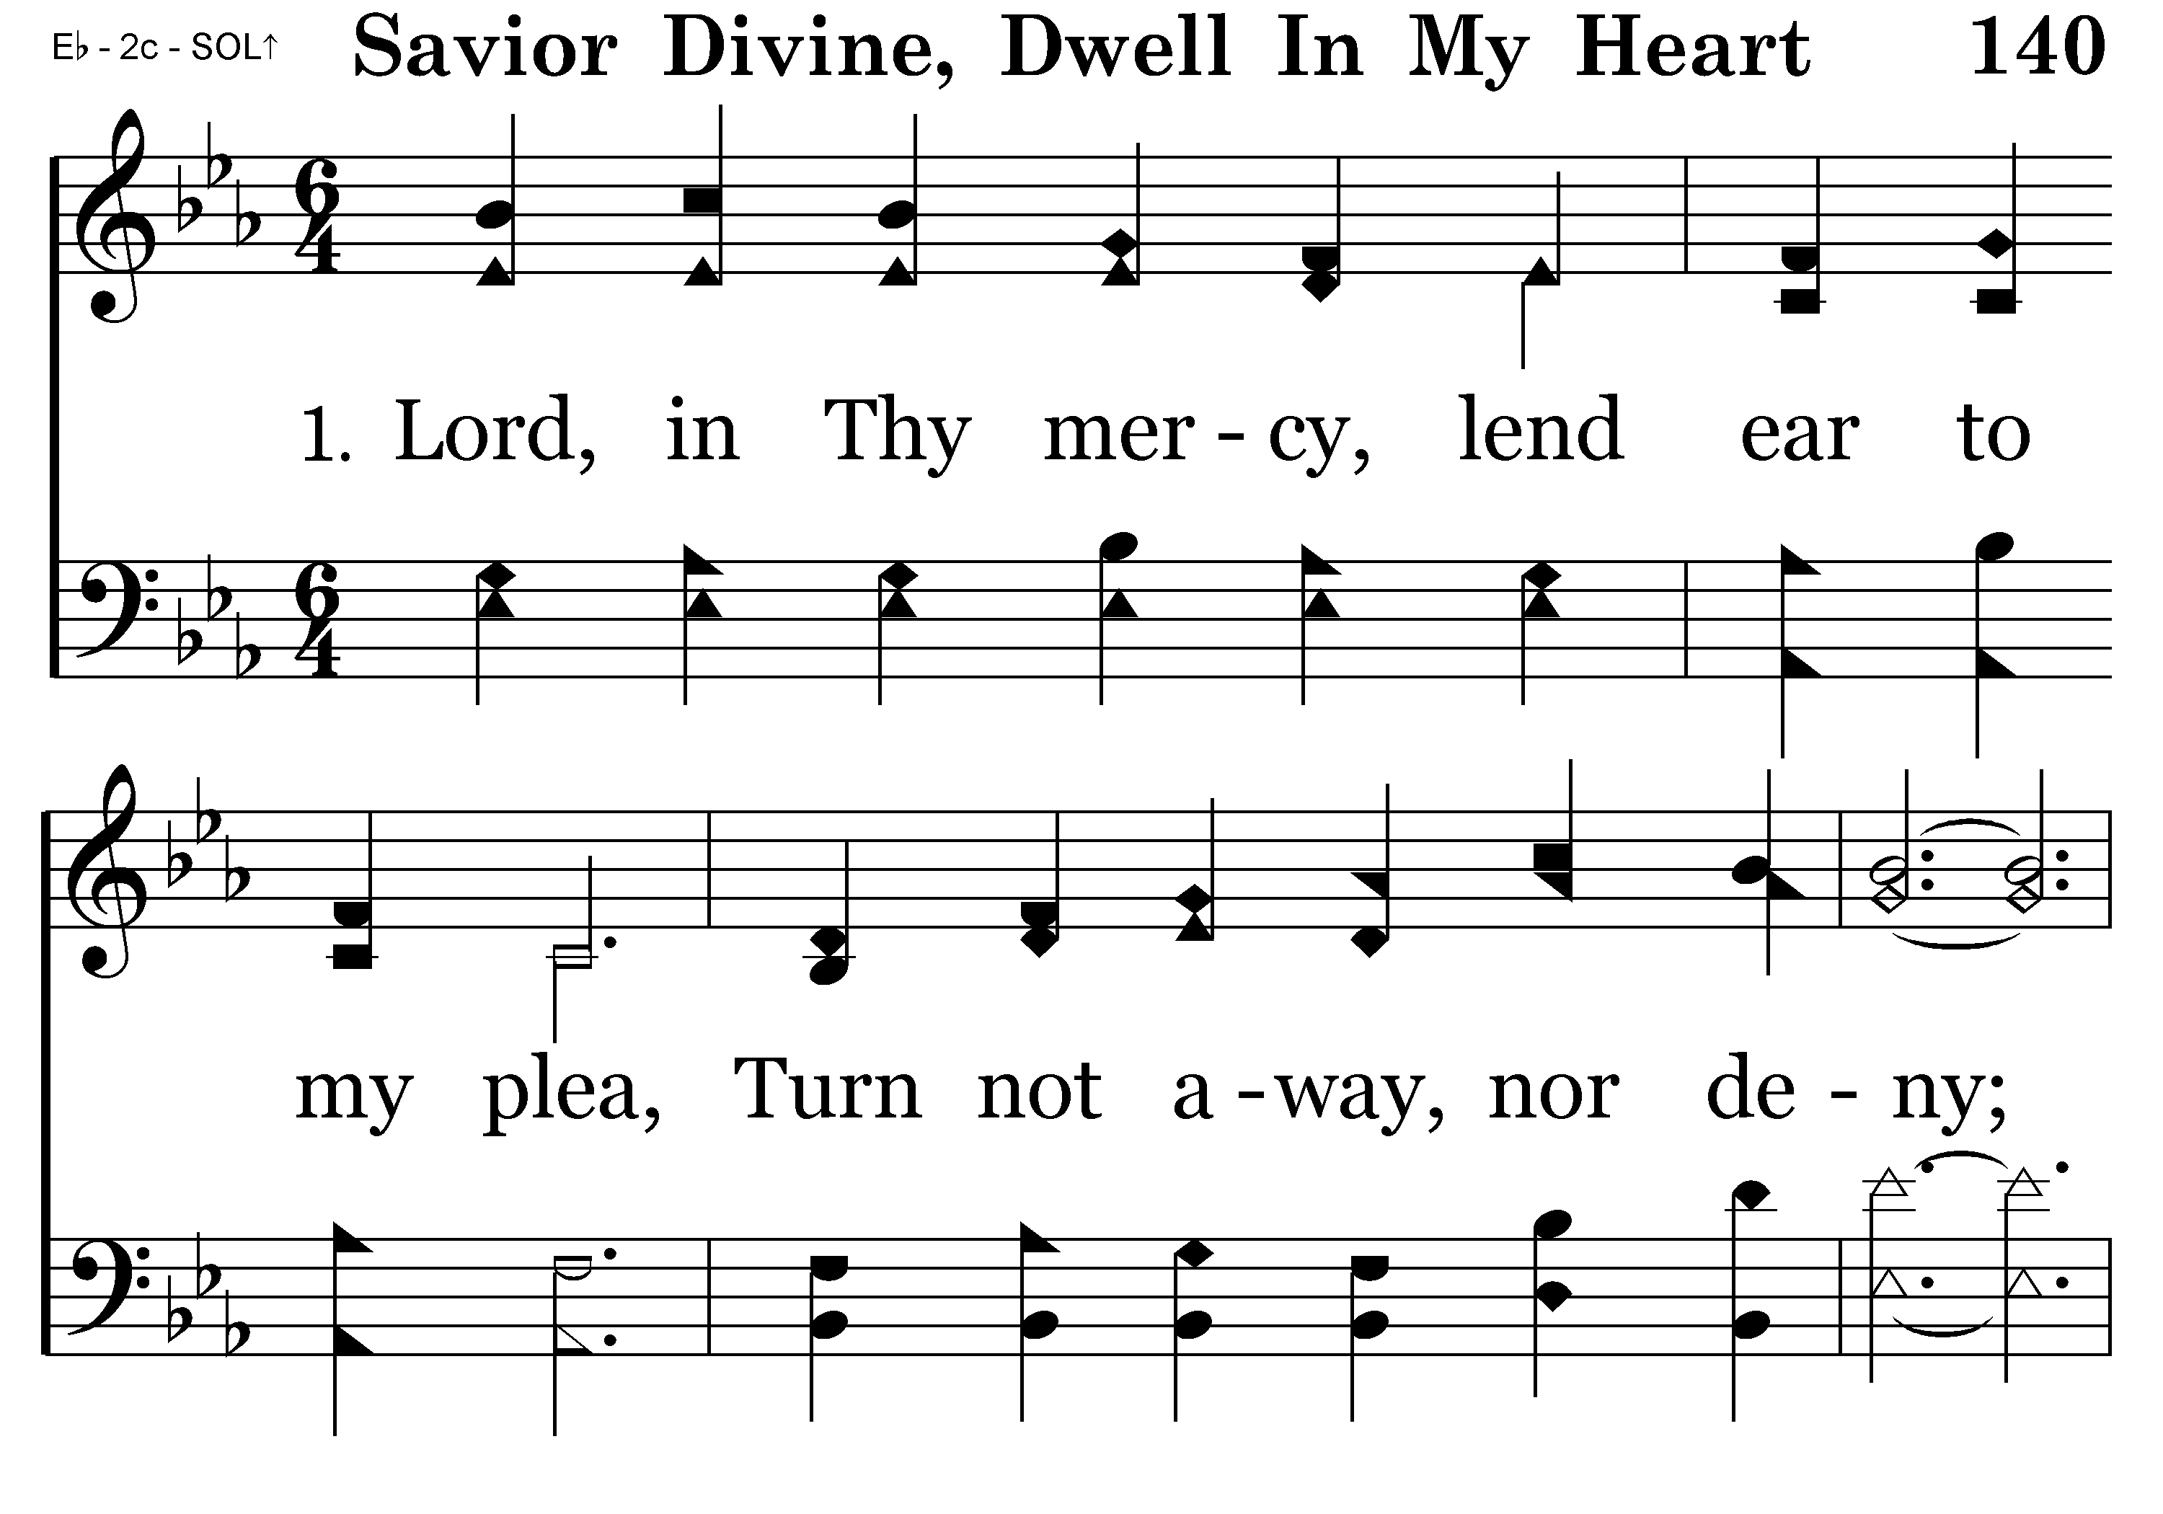
140 - Savior Divine Dwell - 1.1

Slide 101

140 - Savior Divine Dwell - 1.2

Slide 102

140 - Savior Divine Dwell - C.1

Slide 103

140 - Savior Divine Dwell - C.2
End of Verse 1

Slide 104

140 - Savior Divine Dwell - 2.1

Slide 105

140 - Savior Divine Dwell - 2.2

Slide 106
140 - Savior Divine Dwell - C.1

Slide 107
140 - Savior Divine Dwell - C.2
End of Song

Slide 108
Self-Involvement
Rom. 12:4-8— For just as we have many members in one body and all the members do not have the same function, 5 so we, who are many, are one body in Christ, and individually members one of another. 6 Since we have gifts that differ according to the grace given to us, each of us is to exercise them accordingly: if prophecy, according to the proportion of his faith;

Slide 109
Self-Involvement
Rom. 12:4-8— 7 if service, in his serving; or he who teaches, in his teaching; 8 or he who exhorts, in his exhortation; he who gives, with liberality; he who leads, with diligence; he who shows mercy, with cheerfulness.

Slide 110
Self-Involvement
Something for everyone: Eph. 4:15-16— but speaking the truth in love, we are to grow up in all aspects into Him who is the head, even Christ, 16 from whom the whole body, being fitted and held together by what every joint supplies, according to the proper working of each individual part, causes the growth of the body for the building up of itself in love.

Slide 111
Self-Involvement
Not randomness but a purposeful fitting: I Cor. 12:18-20— But now God has placed the members, each one of them, in the body, just as He desired. 19 If they were all one member, where would the body be? 20 But now there are many members, but one body.

Slide 112
Self-Involvement
Not randomness but a purposeful fitting: Since we have gifts that differ according to the grace given to us
speaking the truth in love

Slide 113
Self-Involvement
We grasp the love of Christ together: Eph. 3:14-19— For this reason I bow my knees before the Father, 15 from whom every family in heaven and on earth derives its name, 16 that He would grant you, according to the riches of His glory,

Slide 114
Self-Involvement
We grasp the love of Christ together: Eph. 3:14-19— to be strengthened with power through His Spirit in the inner man, 17 so that Christ may dwell in your hearts through faith; and that you, being rooted and grounded in love, 18 may be able to comprehend with all the saints

Slide 115
Self-Involvement
We grasp the love of Christ together: Eph. 3:14-19— what is the breadth and length and height and depth, 19 and to know the love of Christ which surpasses knowledge, that you may be filled up to all the fullness of God.

Slide 116

219 - How Sweet, How Heavenly - 1.1

Slide 117

219 - How Sweet, How Heavenly - 1.2
End of Verse 1

Slide 118

219 - How Sweet, How Heavenly - 2.1

Slide 119

219 - How Sweet, How Heavenly - 2.2
End of Verse 2

Slide 120

219 - How Sweet, How Heavenly - 4.1

Slide 121

219 - How Sweet, How Heavenly - 4.2
End of Verse 4

Slide 122

219 - How Sweet, How Heavenly - 5.1

Slide 123

219 - How Sweet, How Heavenly - 5.2
End of Song

Slide 124
Our Spiritual Service of Worship
Self-sacrifice
Self-Alteration
Self-Examination
Self-Involvement

Slide 125
Our Spiritual Service of Worship
Our reasonable and spiritual worship is a way of living
A way of life: be holy yourselves also in all your behavior
Col. 3:17— Whatever you do in word or deed, do all in the name of the Lord Jesus, giving thanks through Him to God the Father.

Slide 126
Our Spiritual Service of Worship
The altar of self-sacrifice: Gal. 2:20— I have been crucified with Christ; and it is no longer I who live, but Christ lives in me; and the life which I now live in the flesh I live by faith in the Son of God, who loved me and gave Himself up for me.

Slide 127
Our Spiritual Service of Worship
Two ways of approach
  Dieting
  Lifestyle change

Slide 128
Our Spiritual Service of Worship
Diet—Day One
I have removed all the bad food from the house.

Slide 129
Our Spiritual Service of Worship
It was delicious!

Slide 130
Our Spiritual Service of Worship
Changing a lifestyle

Slide 131
Our Spiritual Service of Worship
Actions alone will not bring about lasting change or transformation

Slide 132
Our Spiritual Service of Worship
Heart change
Continually renewing the mind: but be transformed by the renewing of your mind

Slide 133
Our Spiritual Service of Worship
Lifestyle of repentance
so that you may prove what the will of God is, that which is good and acceptable and perfect

Slide 134
Our Spiritual Service of Worship
The key to transformation and deeper spiritual renewal is the continual re-discovery of the gospel

Slide 135
Our Spiritual Service of Worship
Rom. 1:16-17— For I am not ashamed of the gospel, for it is the power of God for salvation to everyone who believes, to the Jew first and also to the Greek. 17 For in it the righteousness of God is revealed from faith to faith; as it is written, “BUT THE RIGHTEOUS man SHALL LIVE BY FAITH.”

Slide 136
Our Spiritual Service of Worship
The grace of the gospel sings a far more glorious song than the enticements of sin, if only we have the faith to hear its music!
for it is the power of God for salvation

Slide 137
Our Spiritual Service of Worship
The grace of the gospel sings a far more glorious song than the enticements of sin, if only we have the faith to hear its music!
for it is the power of God for salvation

Slide 138
Our Spiritual Service of Worship
Be transformed: Rom. 6:4— We were buried therefore with Him by baptism into death, in order that, just as Christ was raised from the dead by the glory of the Father, we too might walk in newness of life.

Slide 139

105 - I Am Thine O Lord - Title

Slide 140

105 - I Am Thine O Lord - 1.1

Slide 141

105 - I Am Thine O Lord - 1.2

Slide 142

105 - I Am Thine O Lord - C.1

Slide 143

105 - I Am Thine O Lord - C.2
End of Verse 1

Slide 144

105 - I Am Thine O Lord - 2.1

Slide 145

105 - I Am Thine O Lord - 2.2

Slide 146
105 - I Am Thine O Lord - C.1

Slide 147
105 - I Am Thine O Lord - C.2
End of Song

Slide 149

146 - Have Thine Own Way - Title

Slide 150

146 - Have Thine Own Way - 1.1

Slide 151

146 - Have Thine Own Way - 1.2

Slide 152

146 - Have Thine Own Way - 1.3
End of Verse 1

Slide 153

146 - Have Thine Own Way - 2.1

Slide 154

146 - Have Thine Own Way - 2.2

Slide 155

146 - Have Thine Own Way - 2.3
End of Verse 2

Slide 156

146 - Have Thine Own Way - 3.1

Slide 157

146 - Have Thine Own Way - 3.2

Slide 158

146 - Have Thine Own Way - 3.3
End of Song

Slide 160
Closing Prayer
Mike Quick

