Slide 2


Sing to the Lord a New Song

Slide 3

035 - O Worship The King - Title

Slide 4
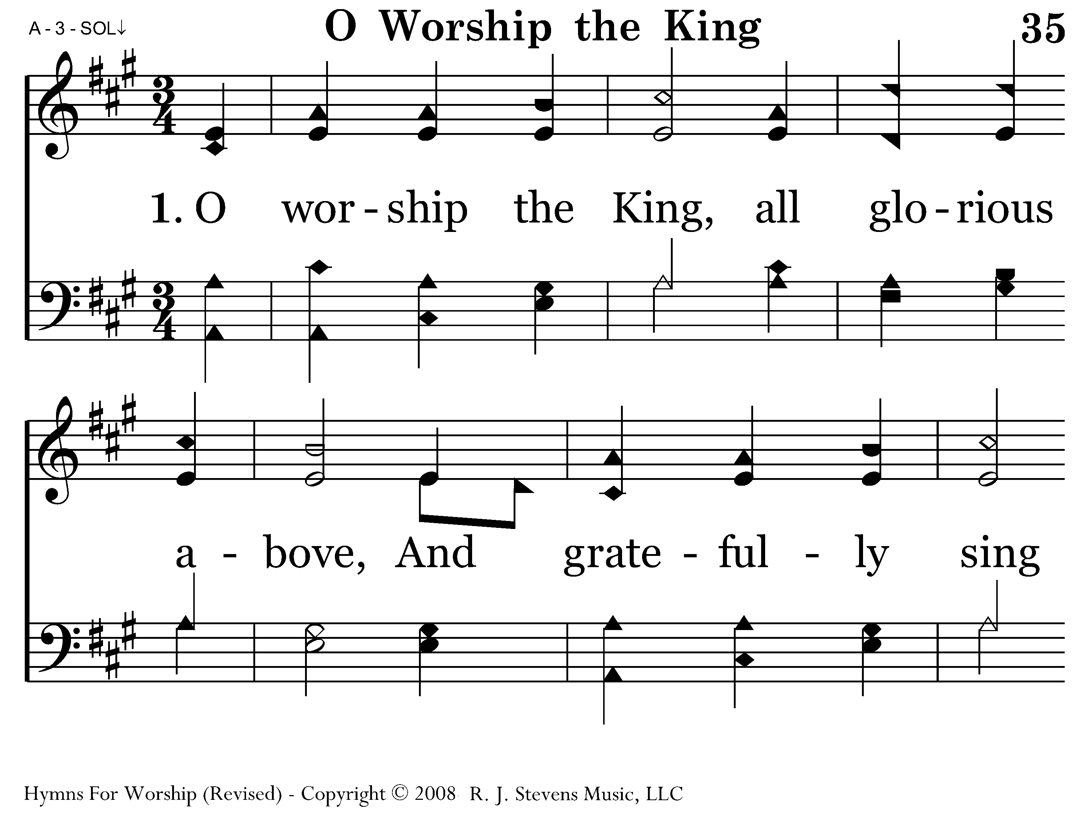
035 - O Worship The King - 1.1

Slide 5
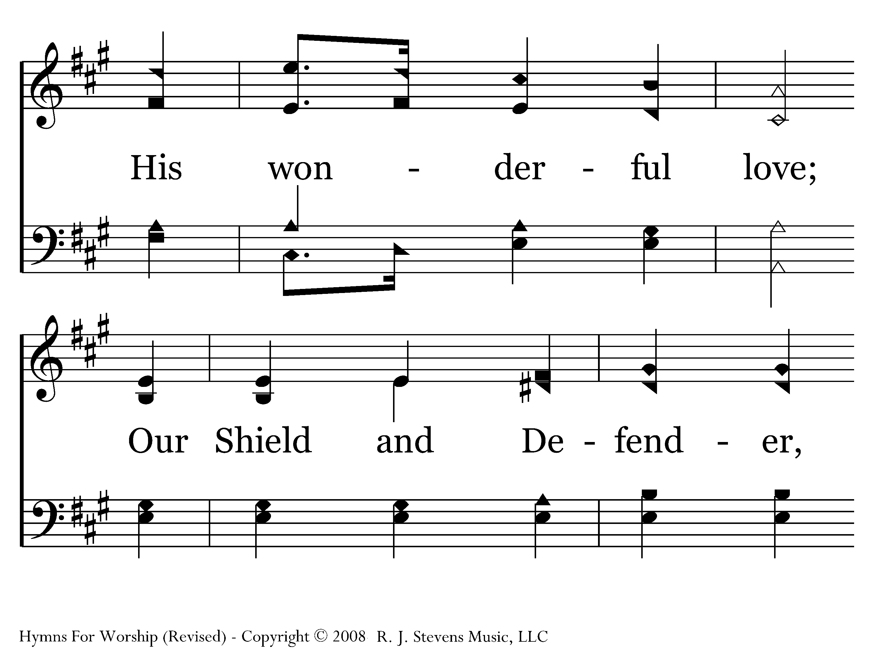
035 - O Worship The King - 1.2

Slide 6
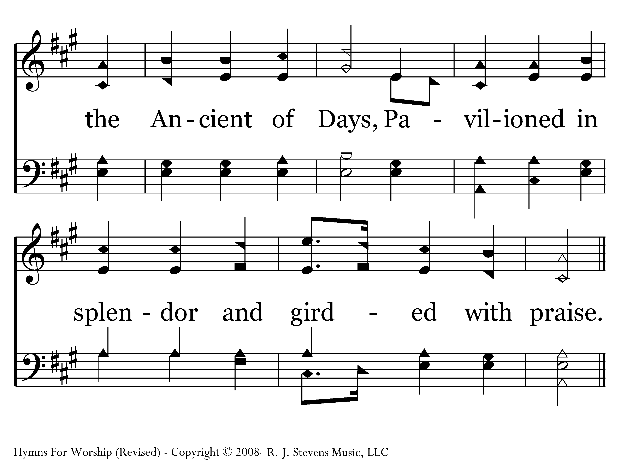
035 - O Worship The King - 1.3
End of Verse 1

Slide 7
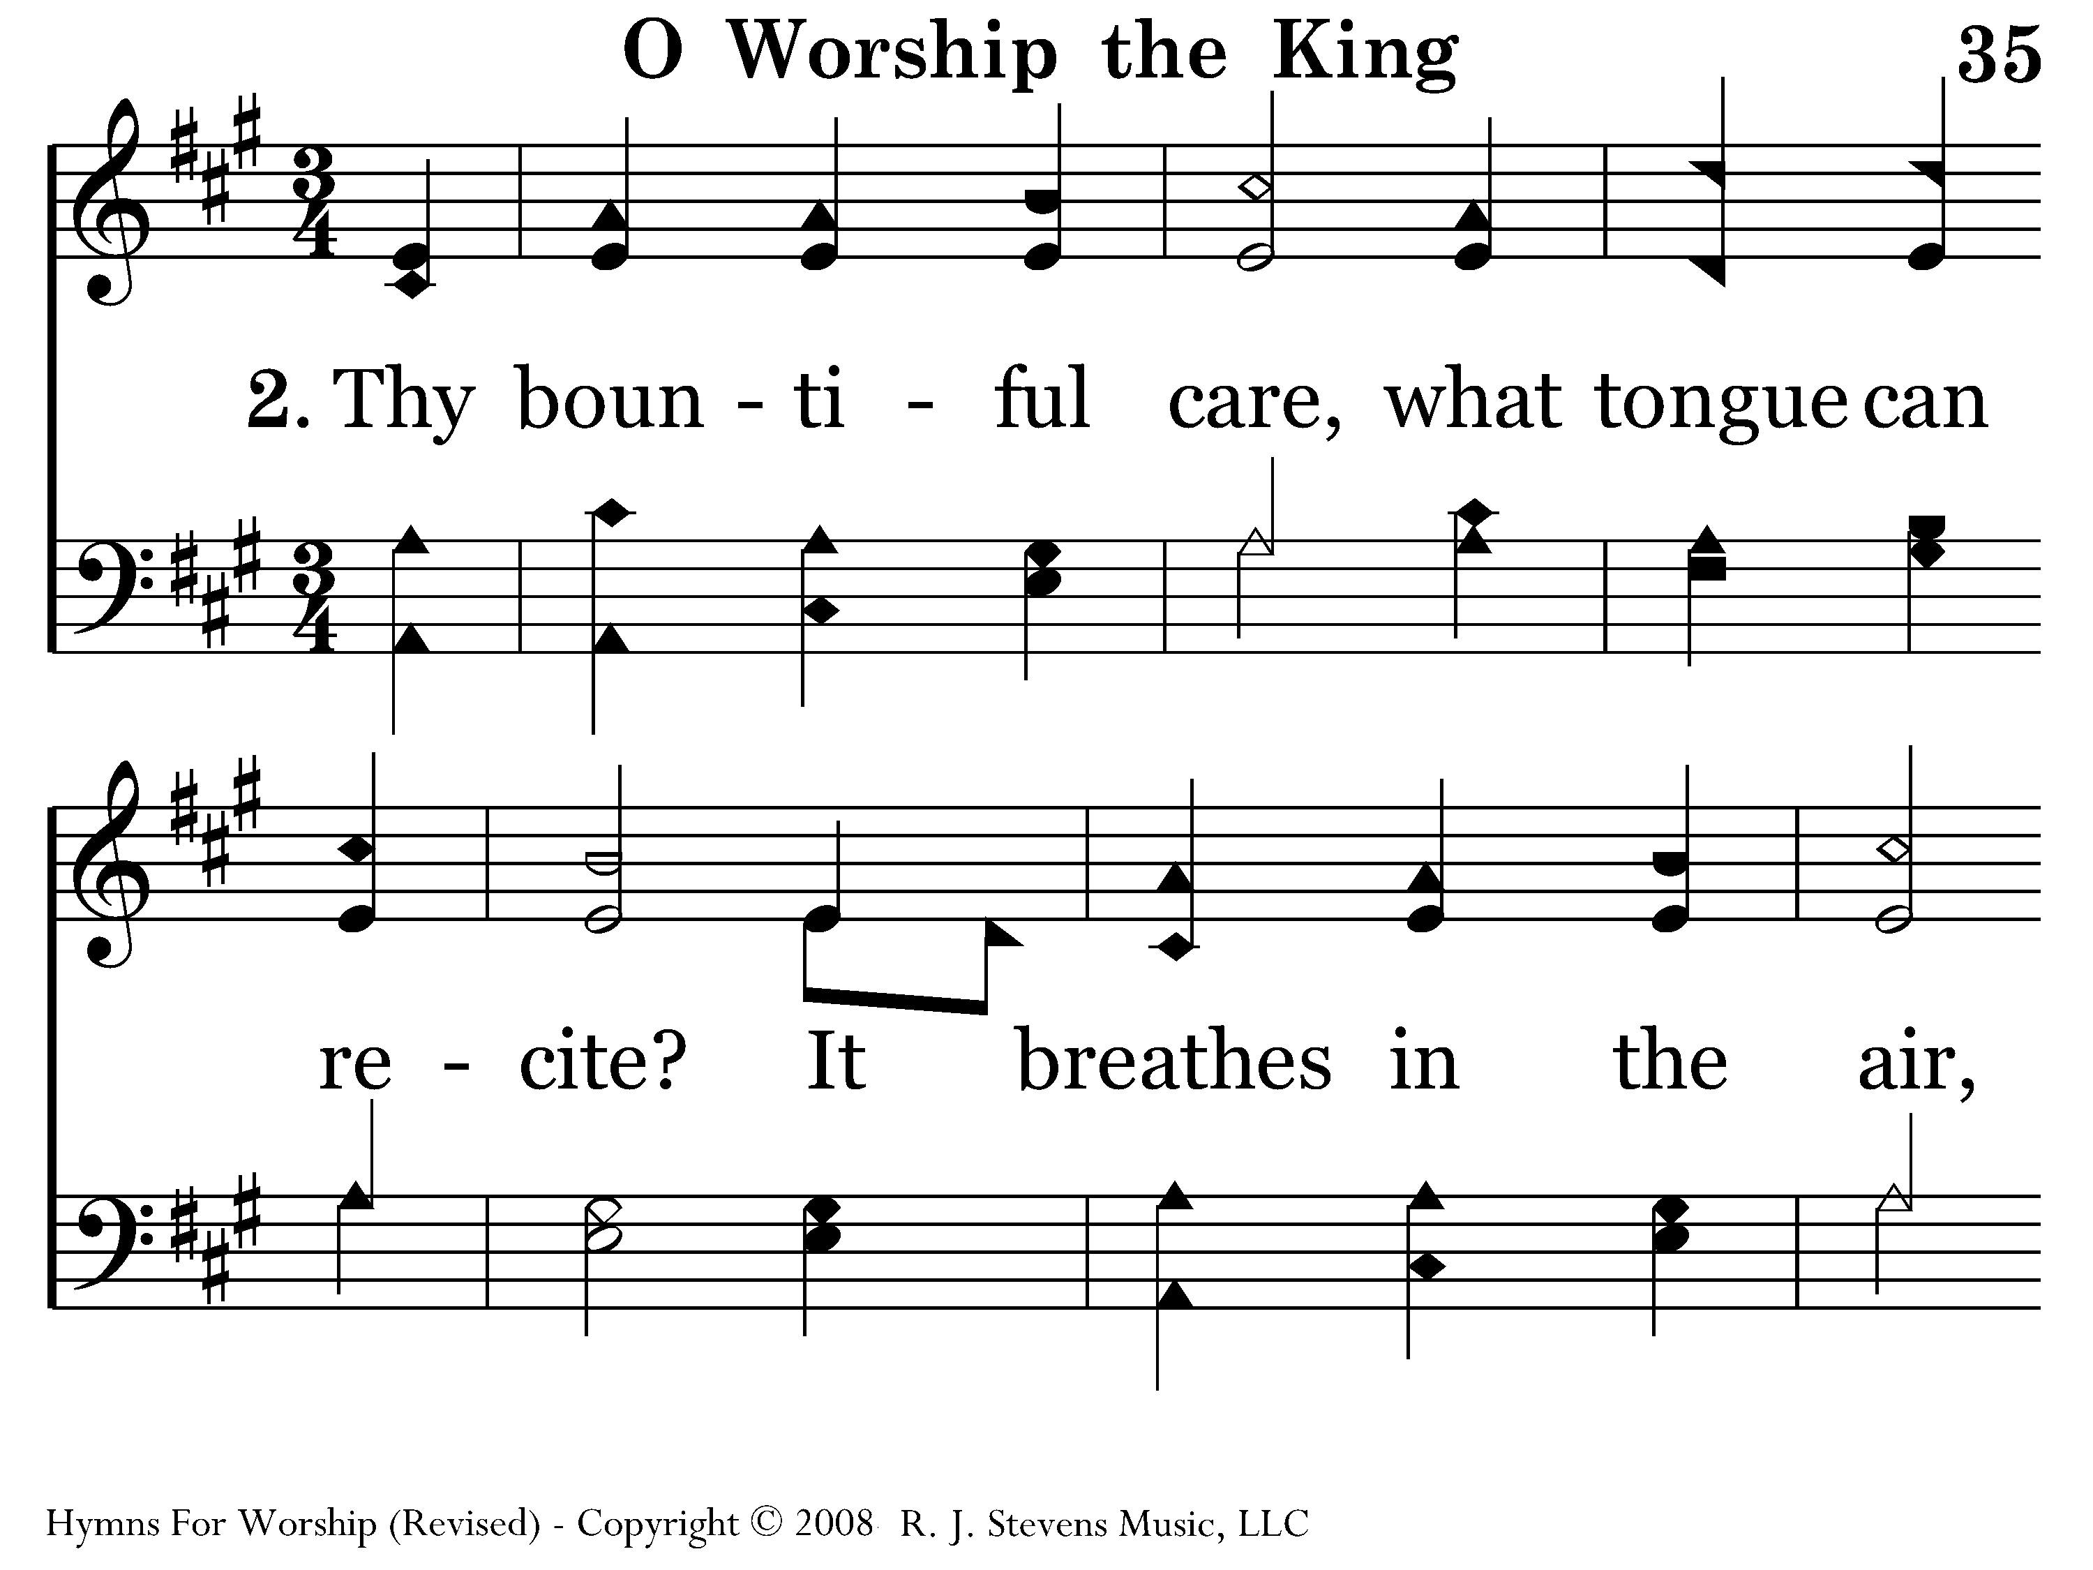
035 - O Worship The King - 2.1

Slide 8
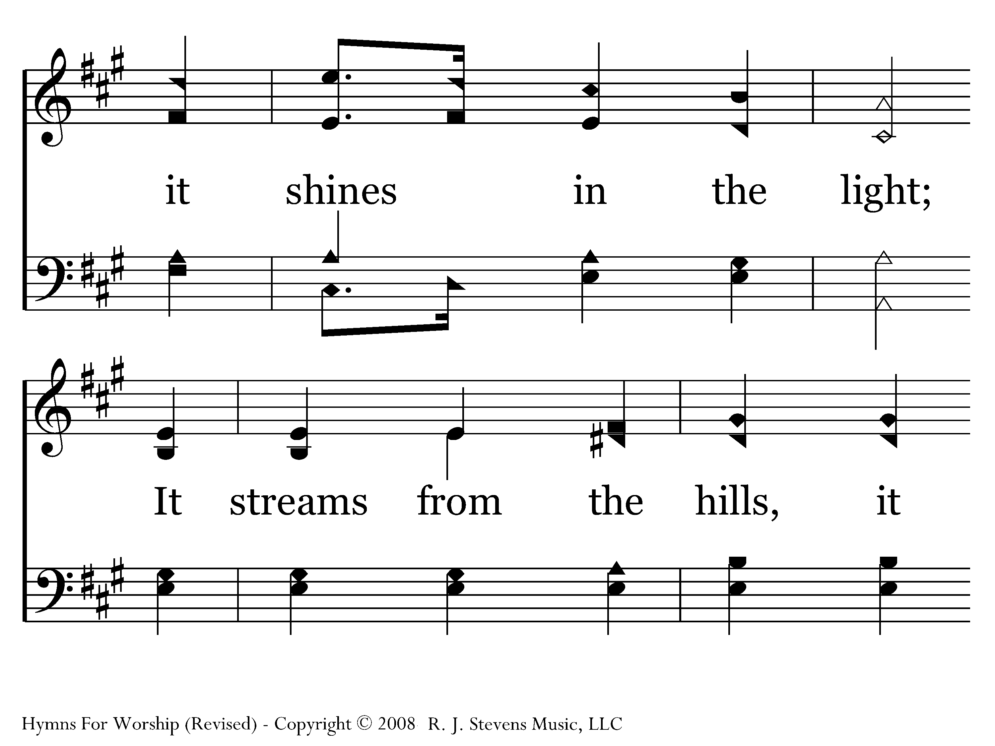
035 - O Worship The King - 2.2

Slide 9
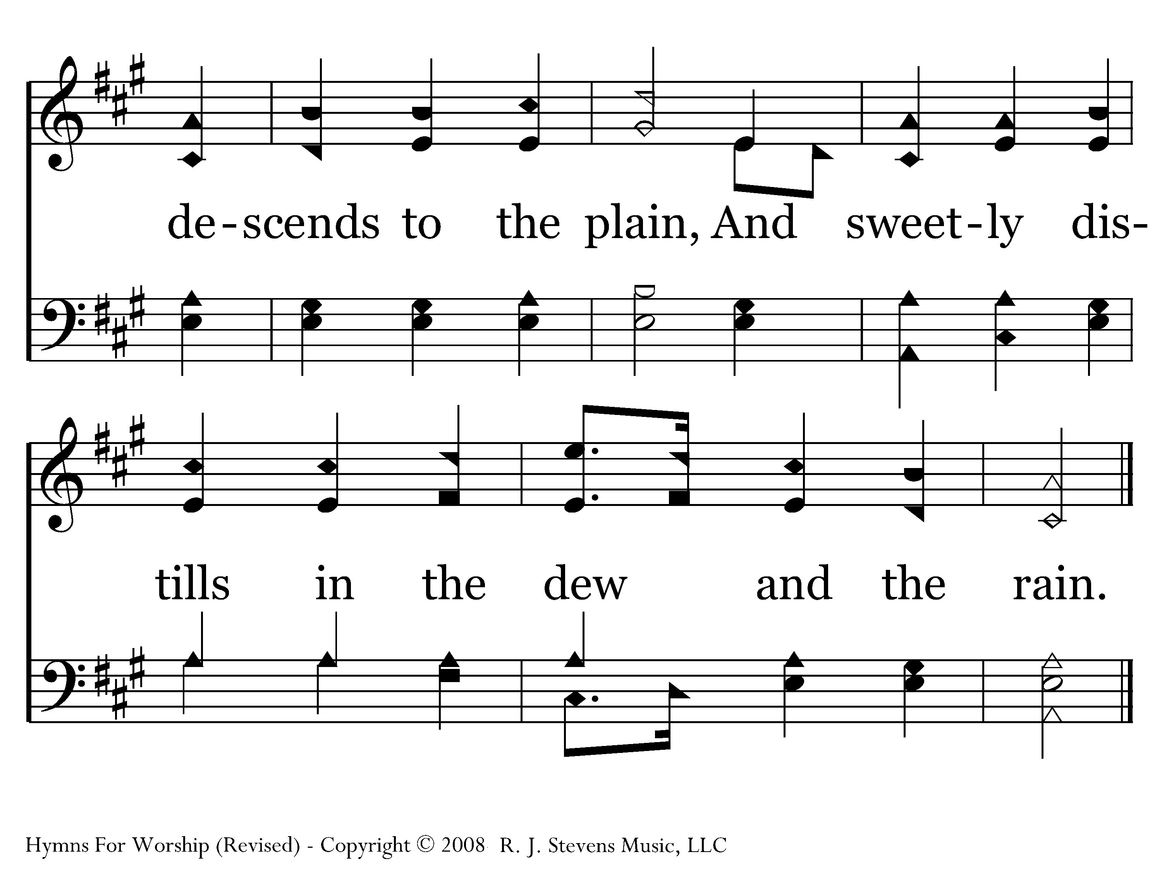
035 - O Worship The King - 2.3
End of Verse 2

Slide 10
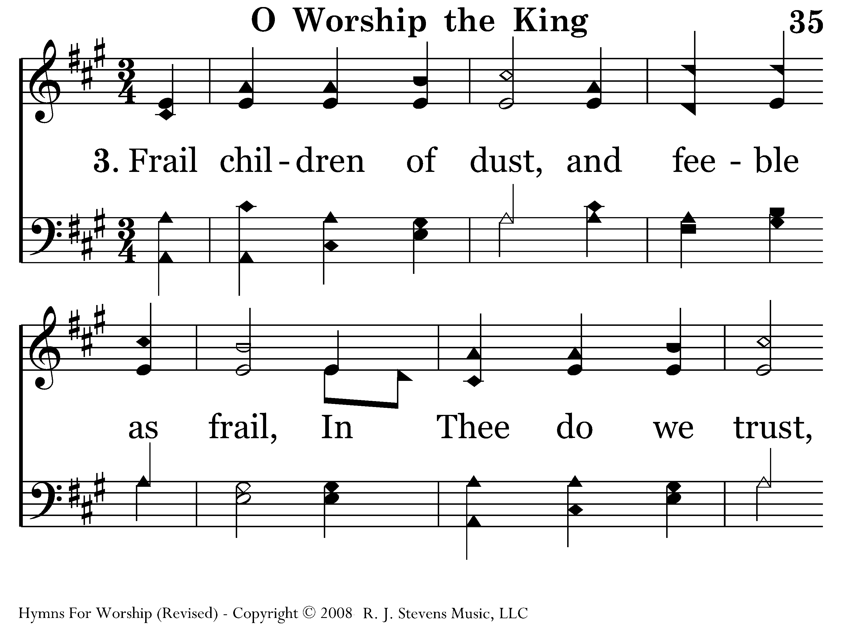
035 - O Worship The King - 3.1

Slide 11
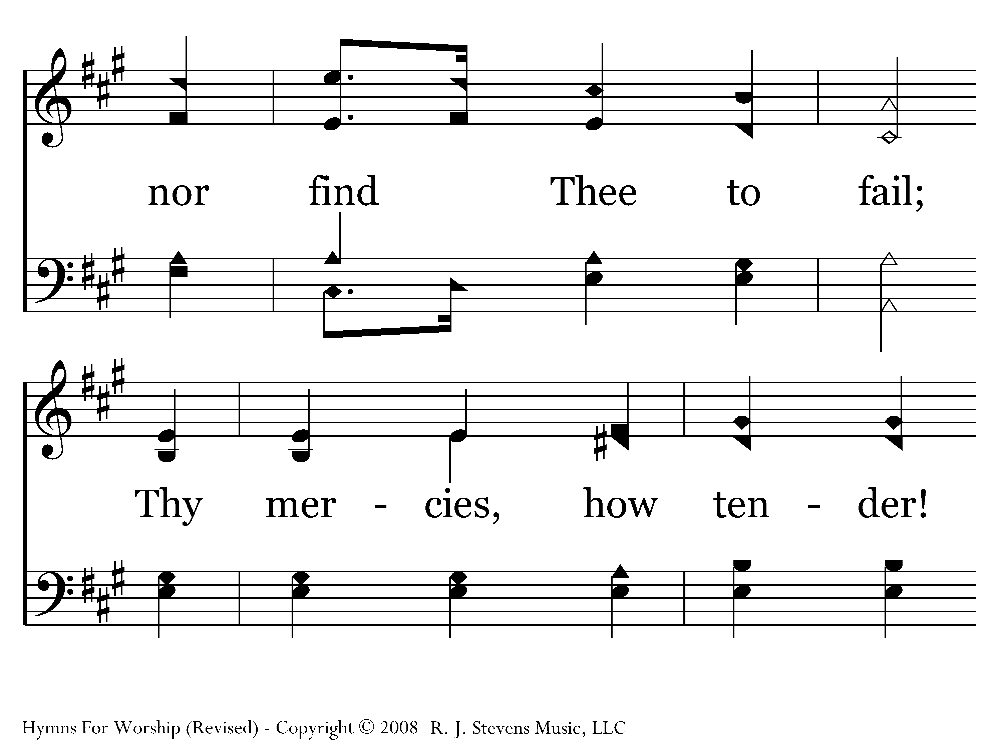
035 - O Worship The King - 3.2

Slide 12
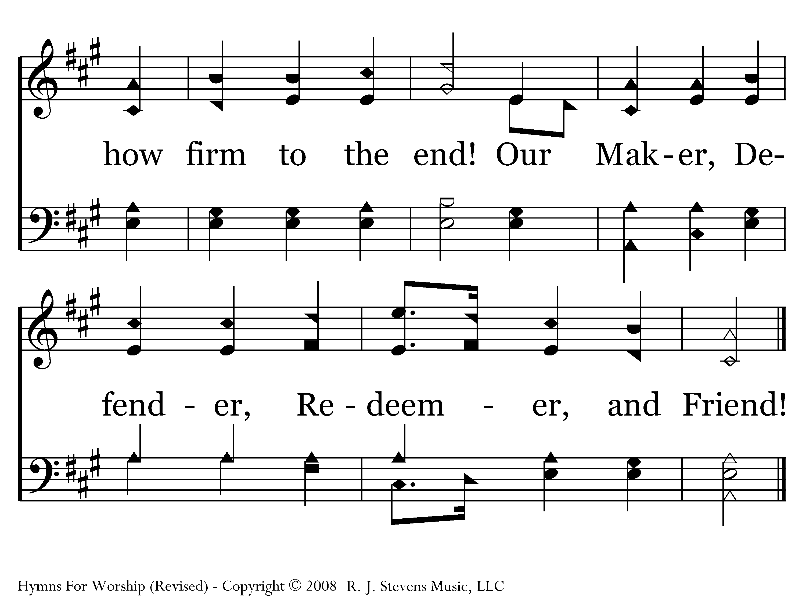
035 - O Worship The King - 3.3
End of Song

Slide 14
Sing to the Lord a New Song

Slide 15
The call to sing a new song
Psa. 98:1— Oh sing to the LORD a new song, for He has done marvelous things!
Psa. 149:1— Praise the Lord! Sing to the Lord a new song, And His praise in the congregation of the godly ones
Isa. 42:10— Sing to the Lord a new song, Sing His praise from the end of the earth!

Slide 16
The call to sing a new song
Rev. 5:9— And they sang a new song, saying, “Worthy are You to take the book and to break its seals; for You were slain, and purchased for God with Your blood men from every tribe and tongue and people and nation.”

Slide 17
New music and words
Fact: all songs were new at one time
Learning new songs requires more effort and attention
New songs give us more ways to express our faith and edify others

Slide 18
Singing a new message
Rev. 5:9 -- for You were slain, and purchased for God with Your blood men from every tribe and tongue and people and nation

Slide 19
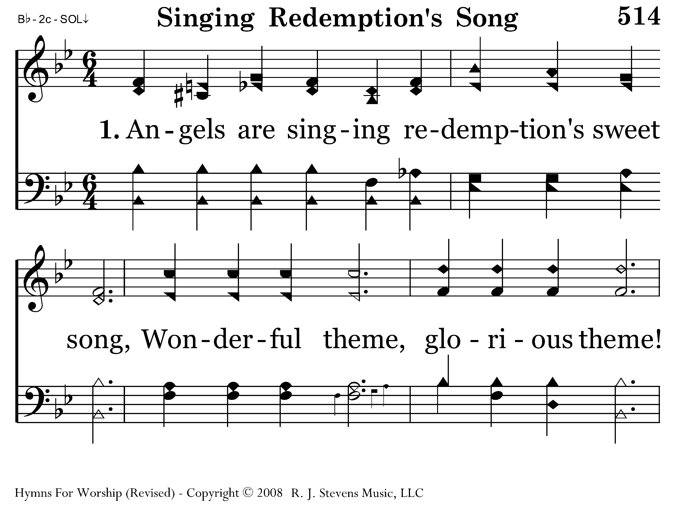
514 - Singing Redemption's Song - 1.1

Slide 20
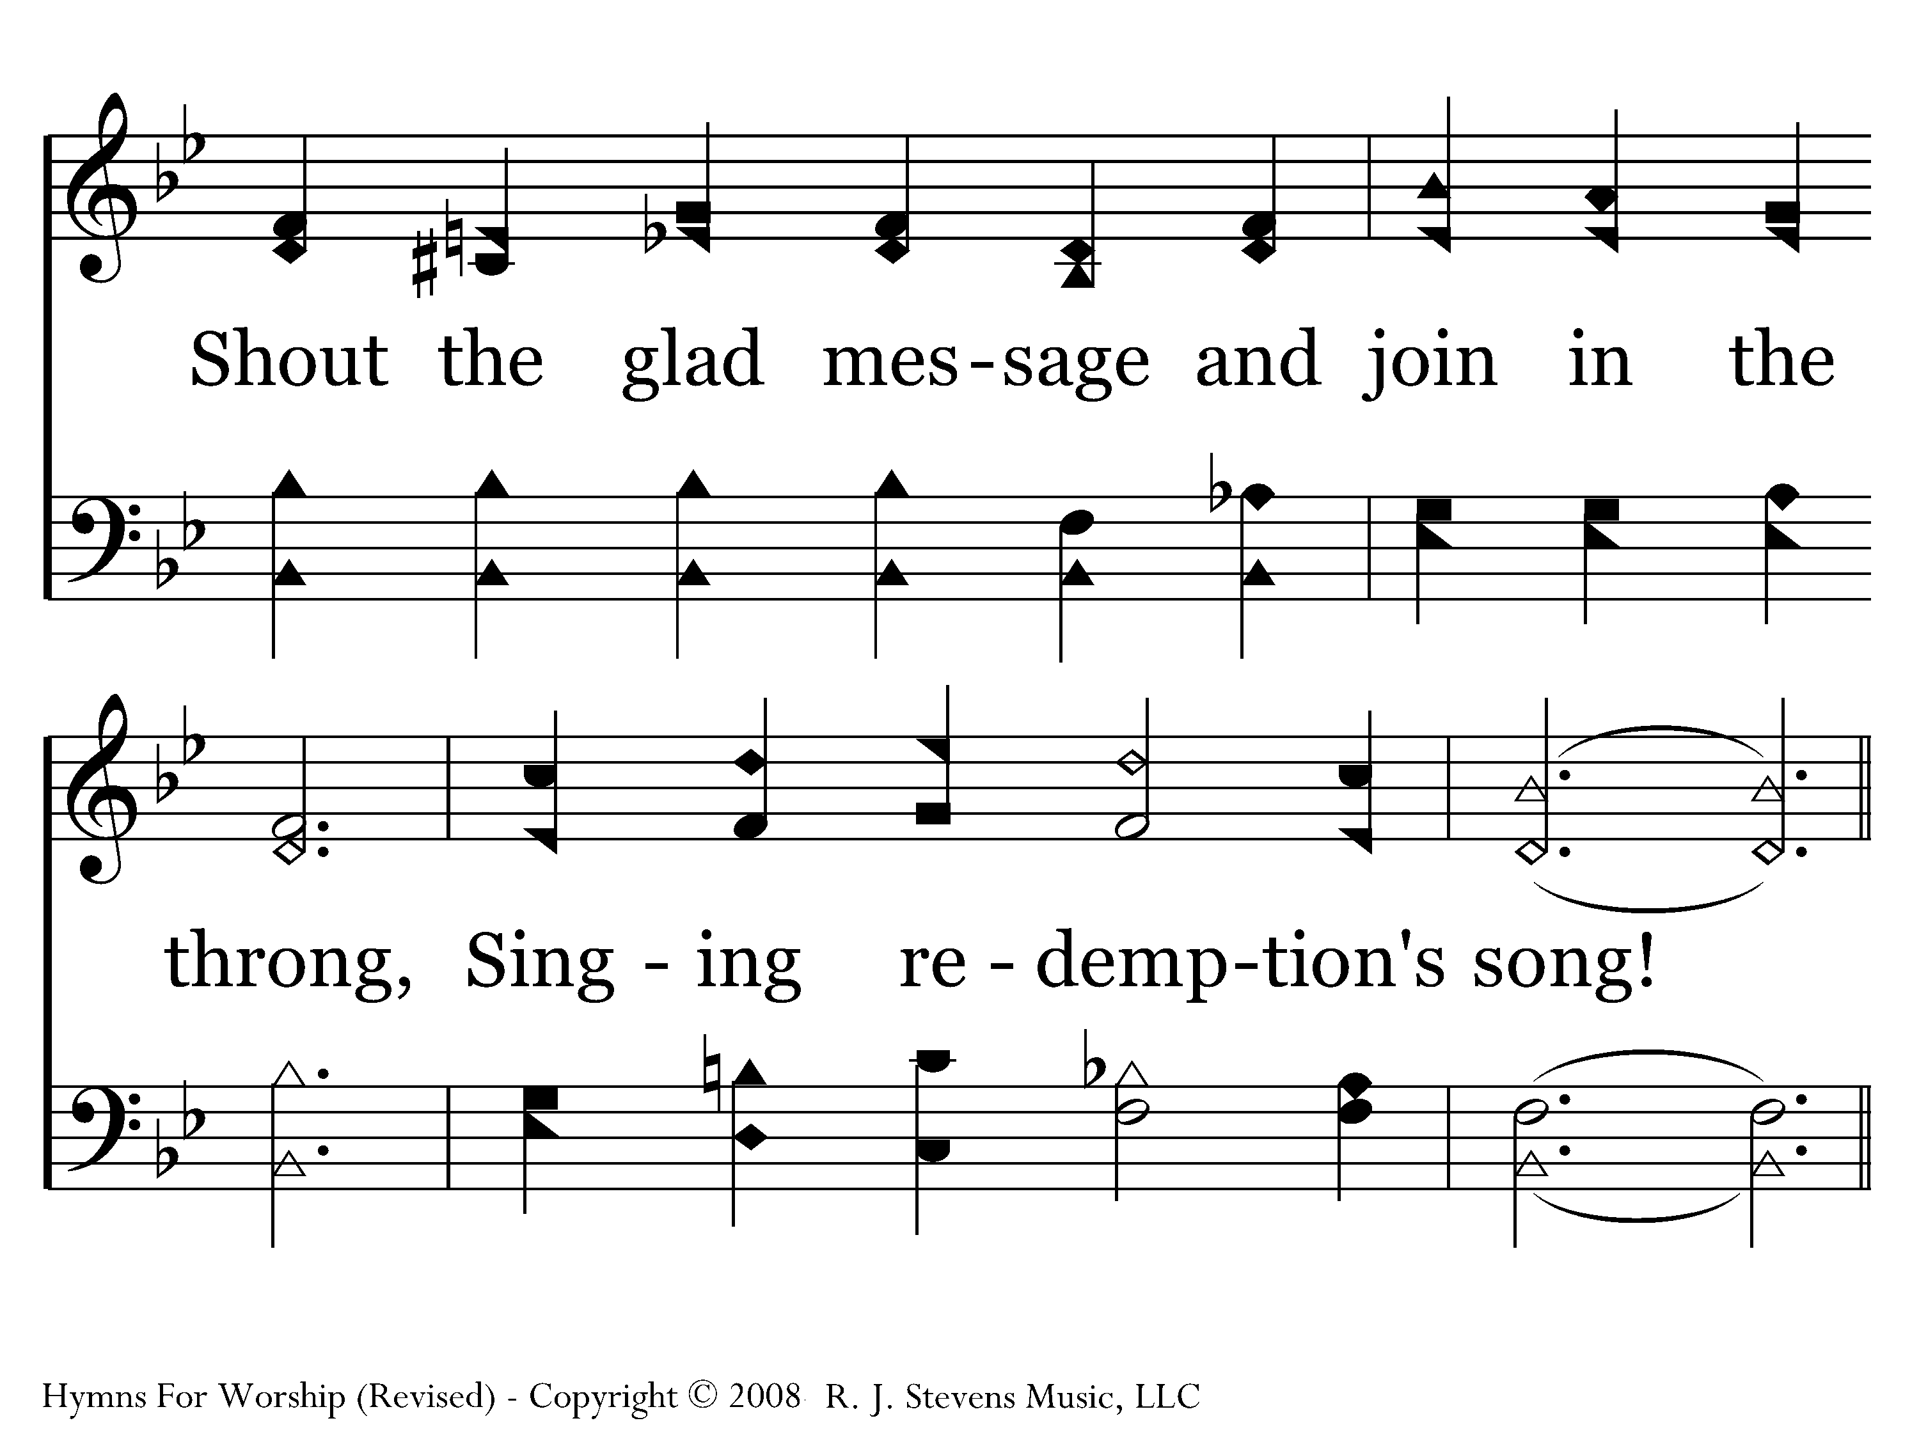
514 - Singing Redemption's Song - 1.2
Go to Verse 3

Slide 21
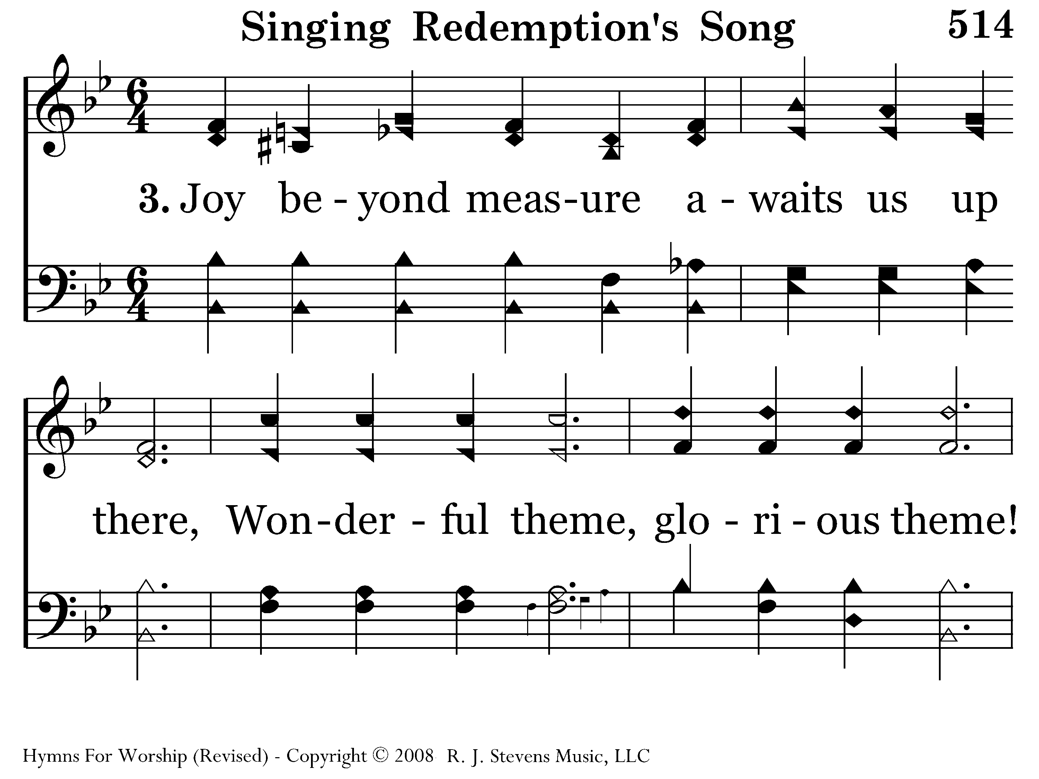
514 - Singing Redemption's Song - 3.1

Slide 22
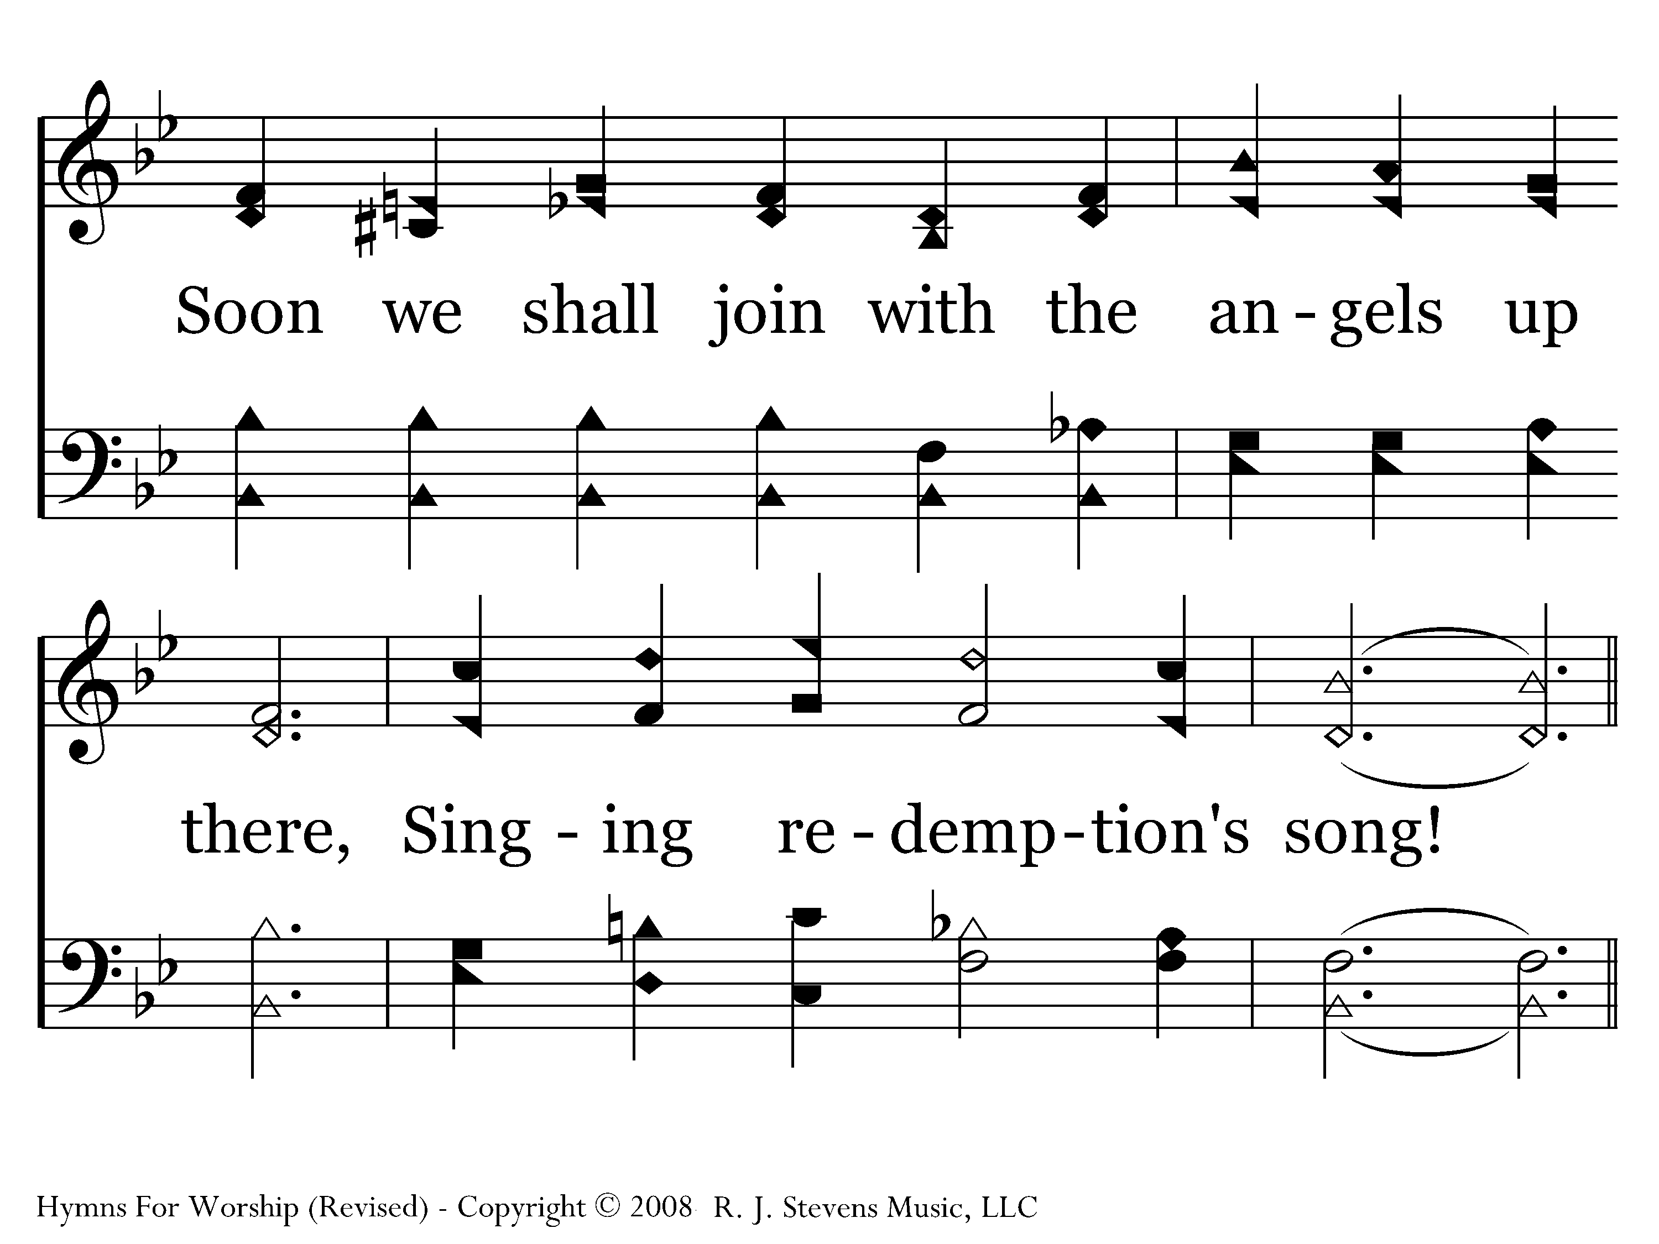
514 - Singing Redemption's Song - 3.2

Slide 23
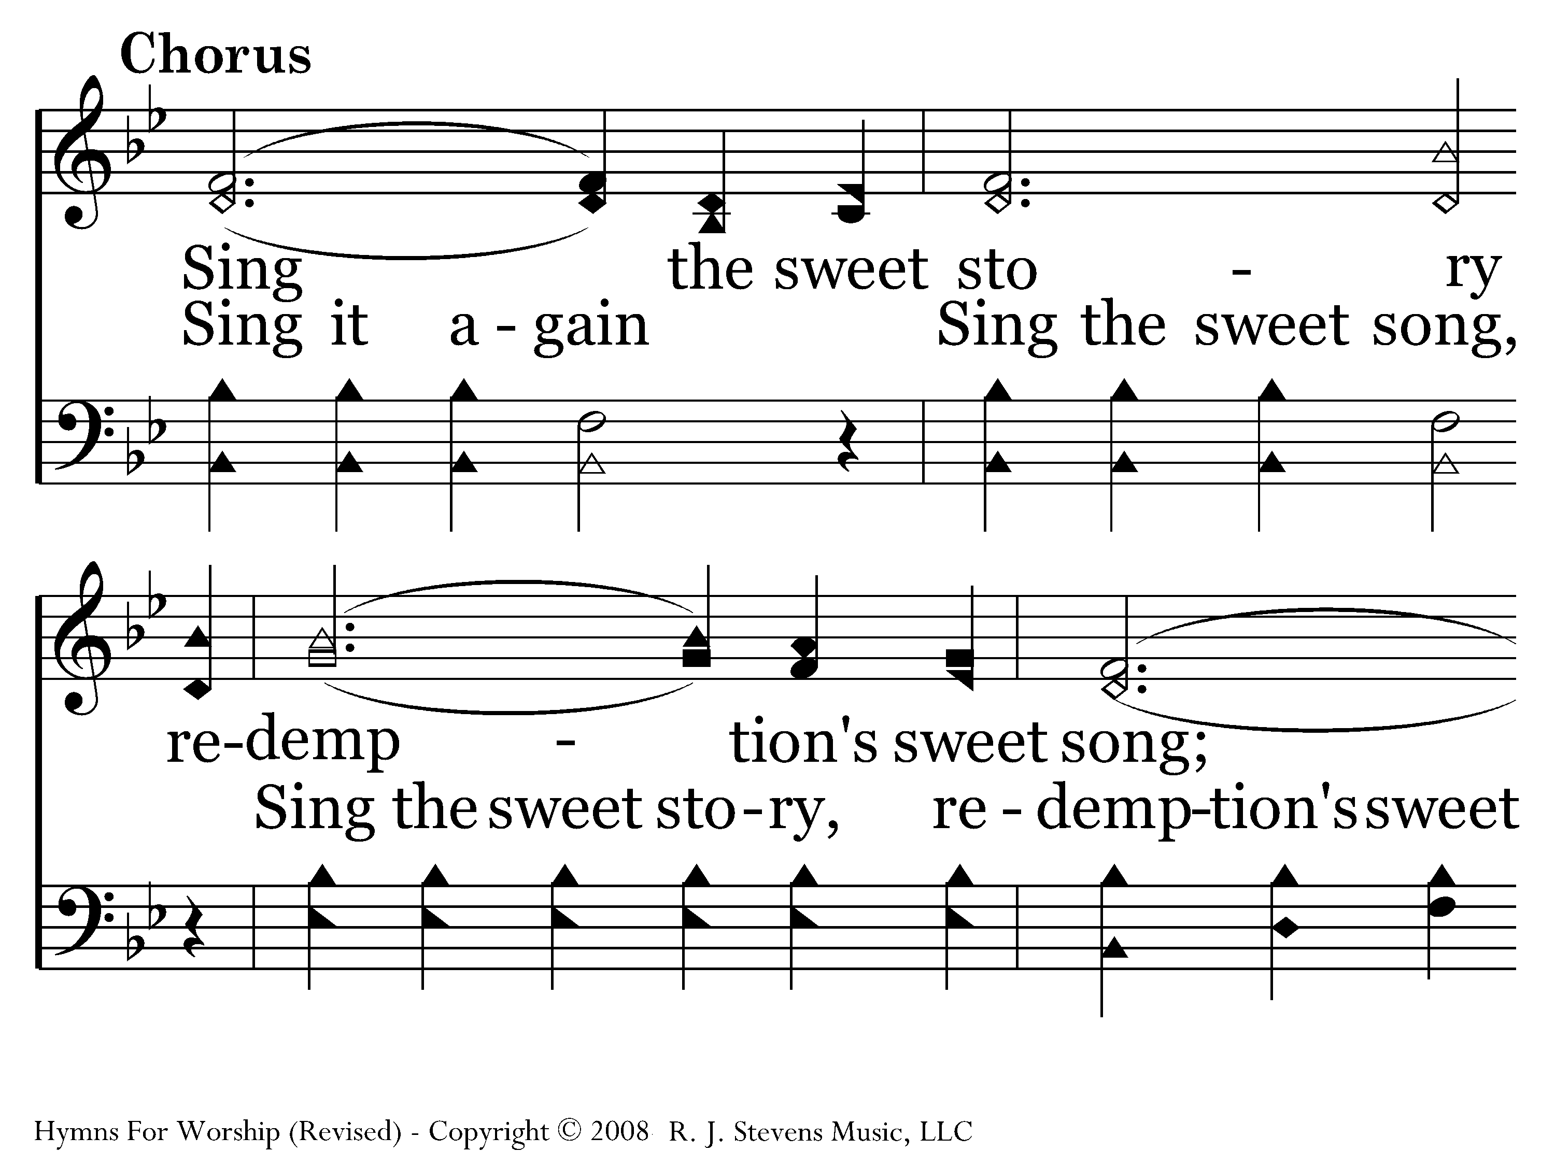
514 - Singing Redemption's Song - C.1

Slide 24
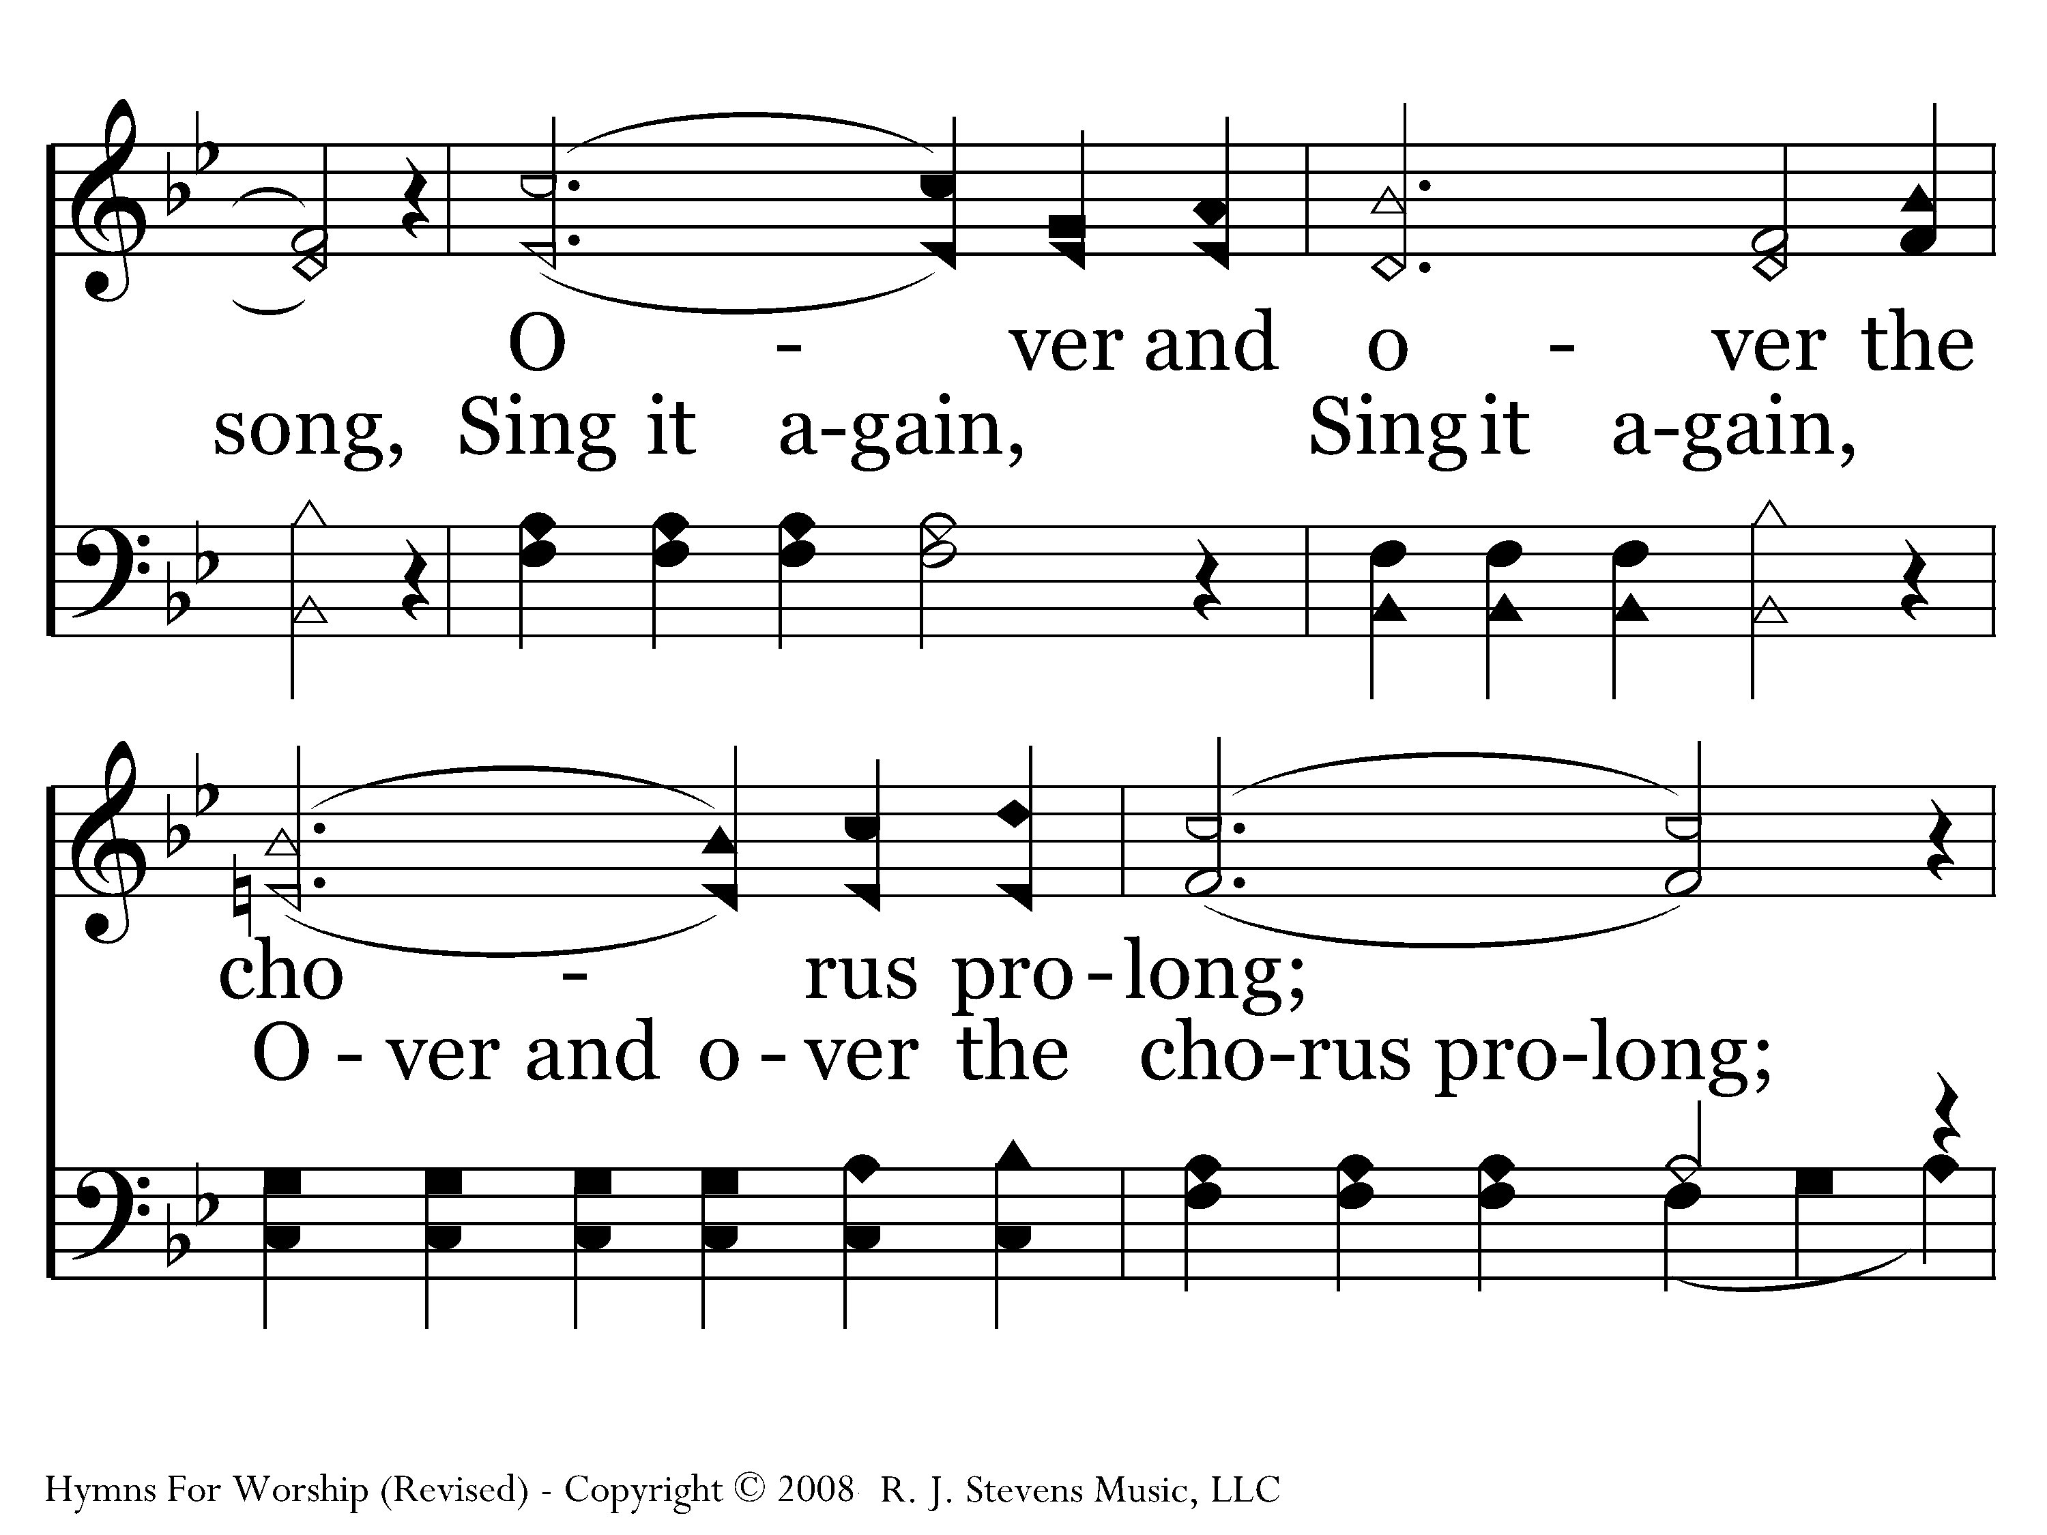
514 - Singing Redemption's Song - C.2

Slide 25
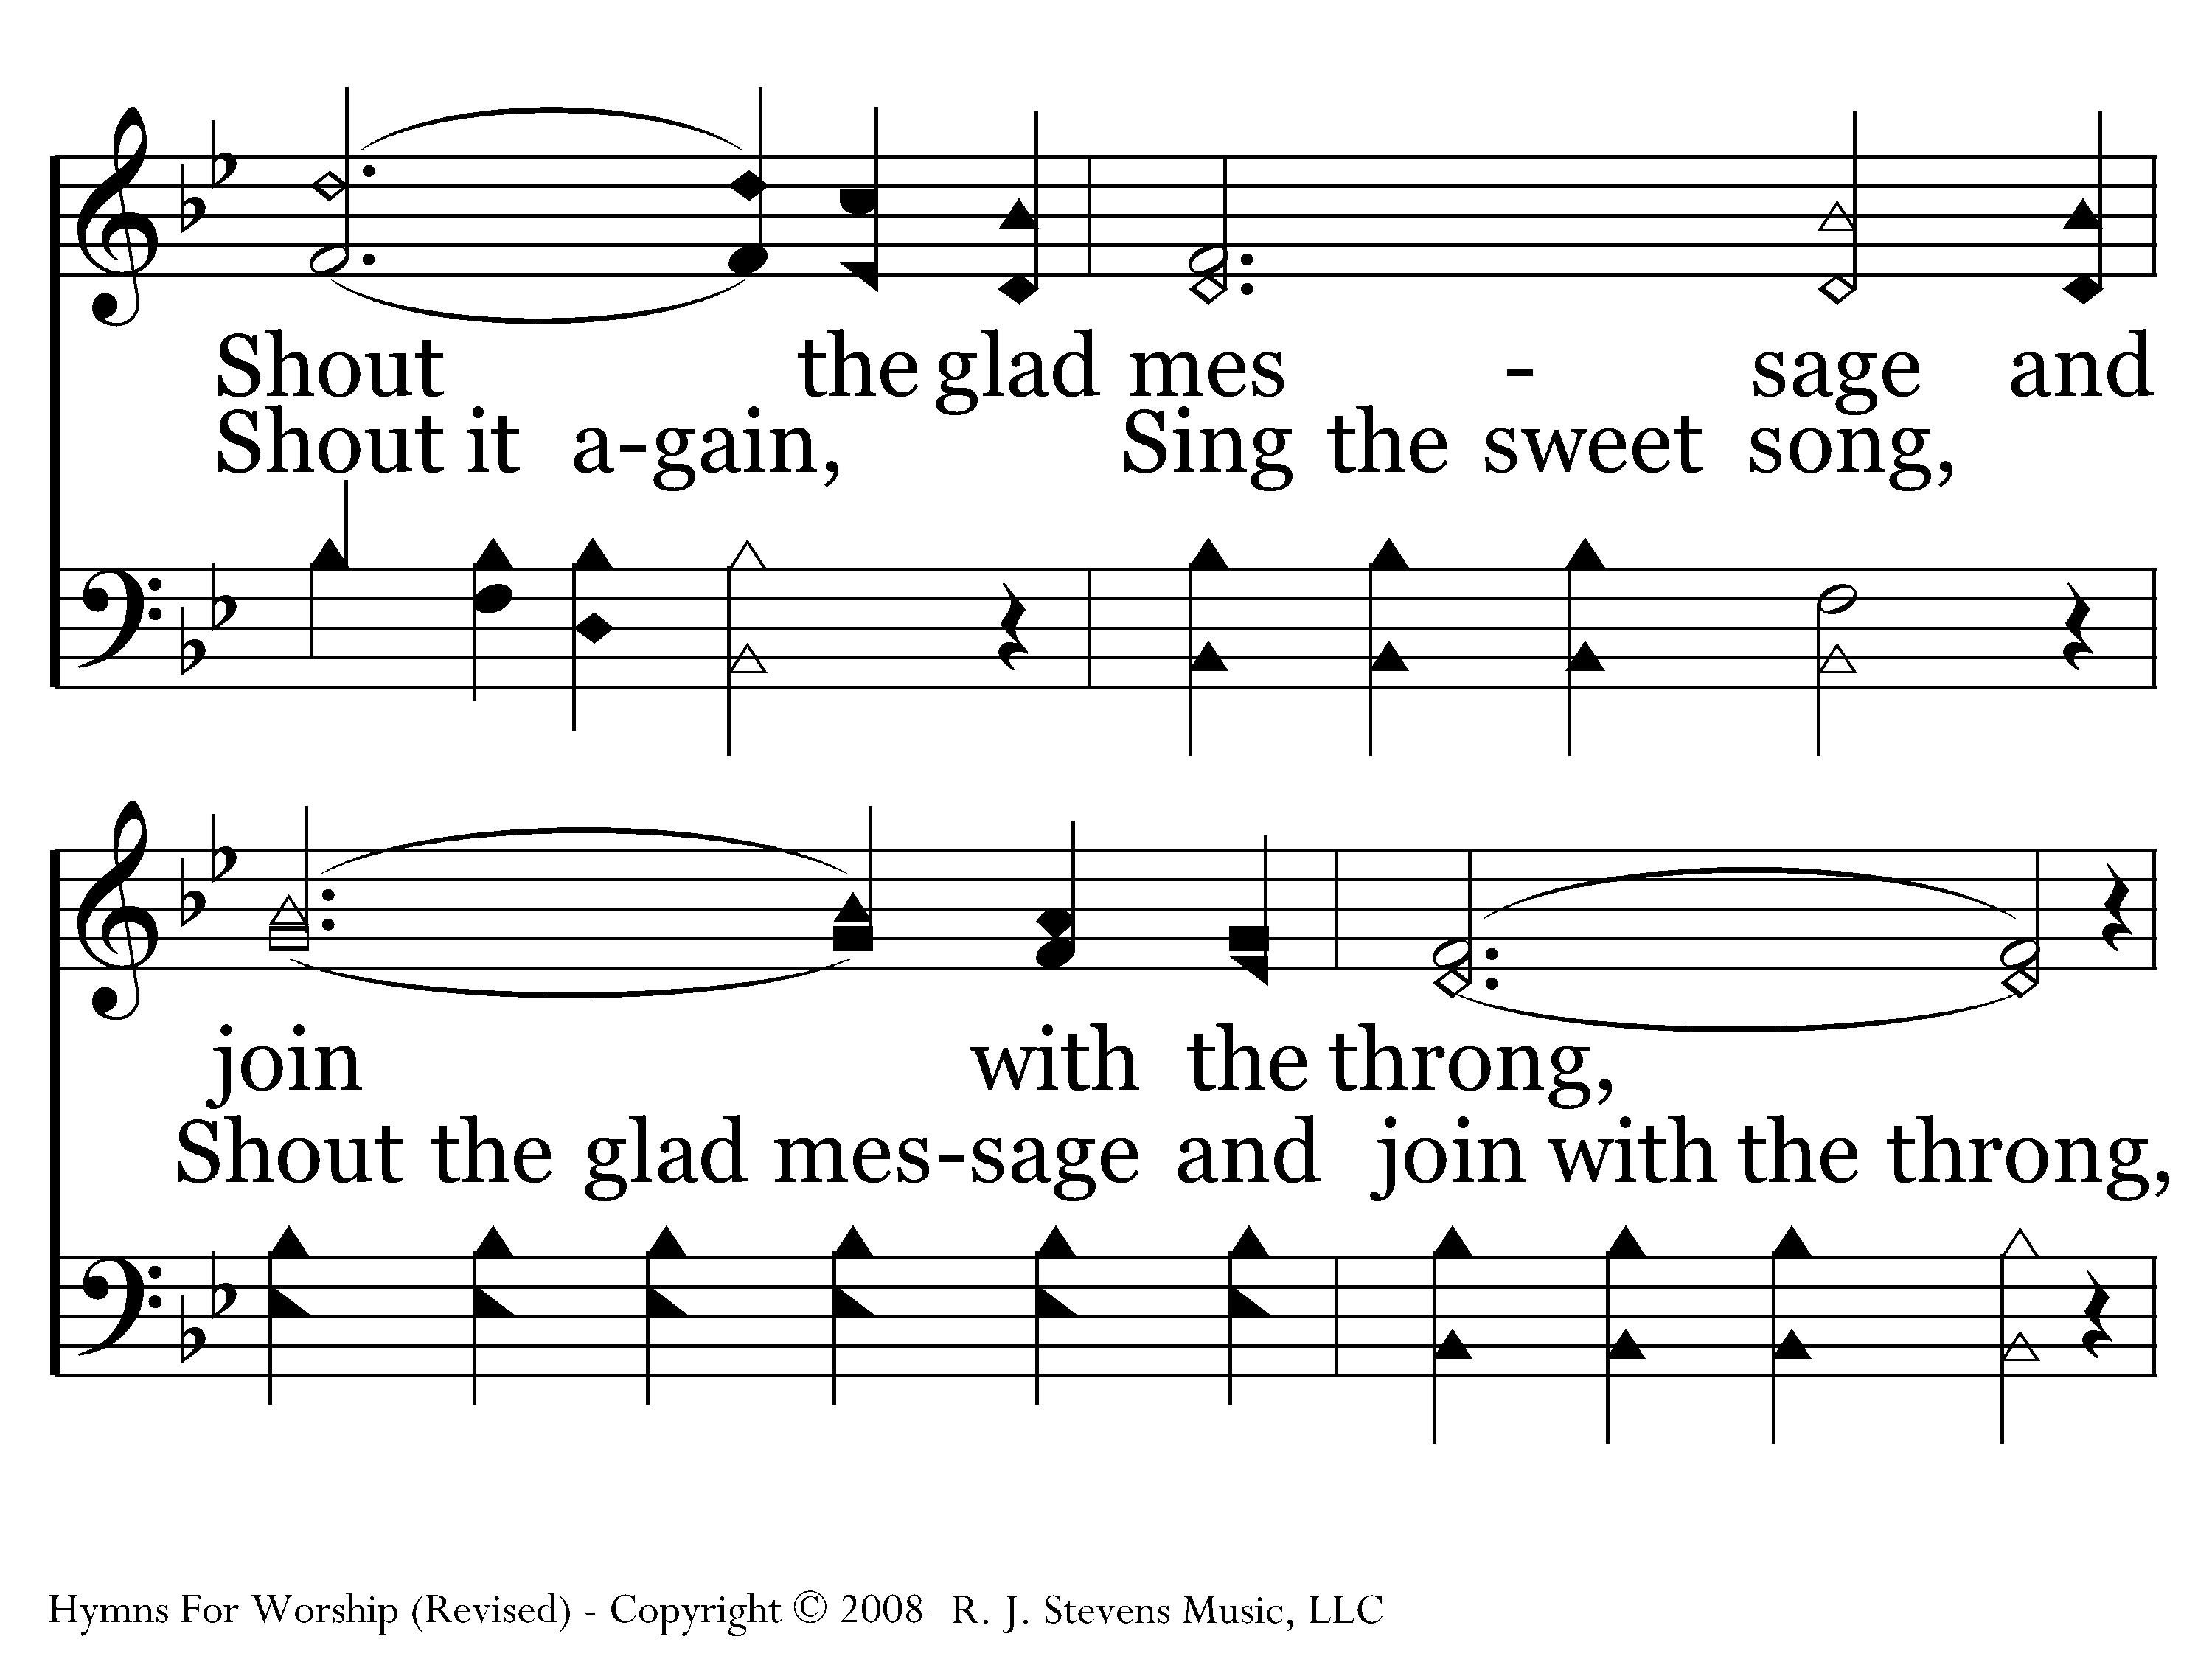
514 - Singing Redemption's Song - C.3

Slide 26
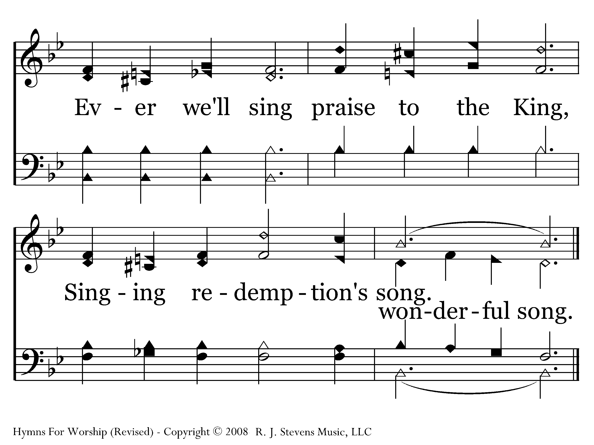
514 - Singing Redemption's Song - C.4
End of Song

Slide 27
Singing a new message
I Tim. 3:16 -- By common confession, great is the mystery of godliness: He who was revealed in the flesh, Was vindicated in the Spirit, Seen by angels, Proclaimed among the nations, Believed on in the world, Taken up in glory.

Slide 28
Singing a new message
II Tim. 2:11-13 -- It is a trustworthy statement: For if we died with Him, we will also live with Him; 12 If we endure, we will also reign with Him; If we deny Him, He also will deny us 13 If we are faithless, He remains faithful, for He cannot deny Himself

Slide 29
Singing a new message
Eph. 5:14 -- For this reason it says, “Awake, sleeper, And arise from the dead, And Christ will shine on you.”

Slide 30
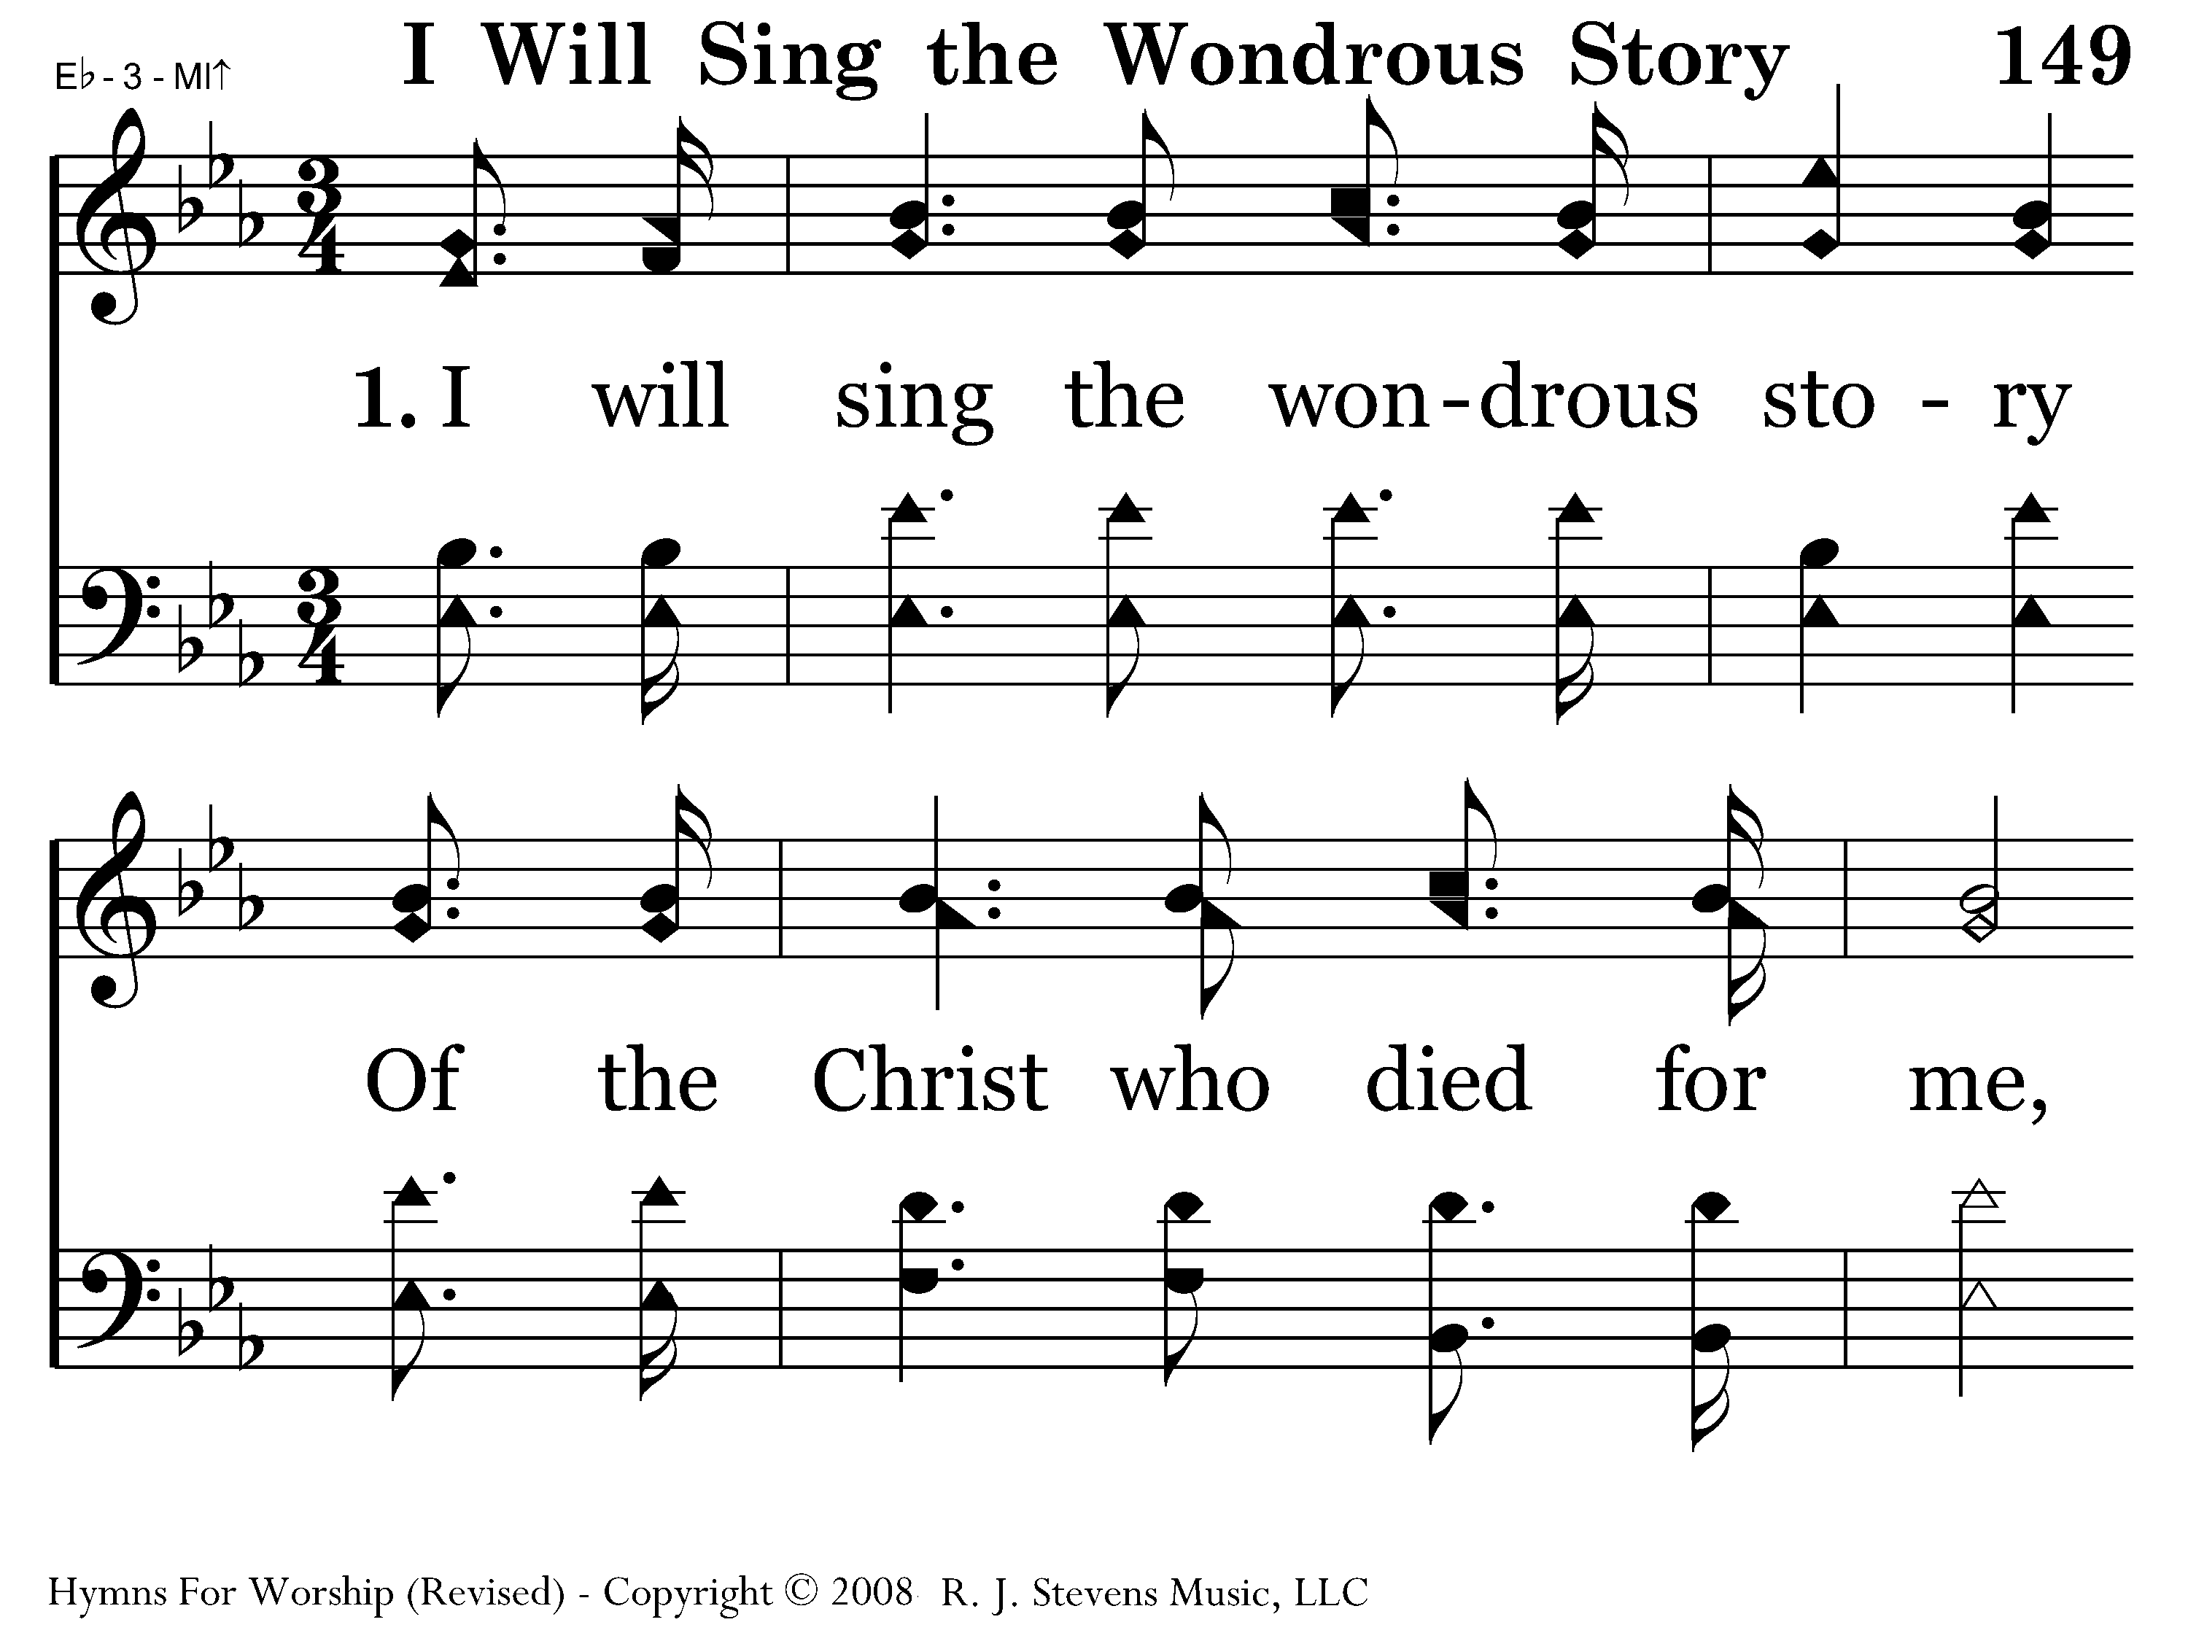
149 - I Will Sing - 1.1

Slide 31
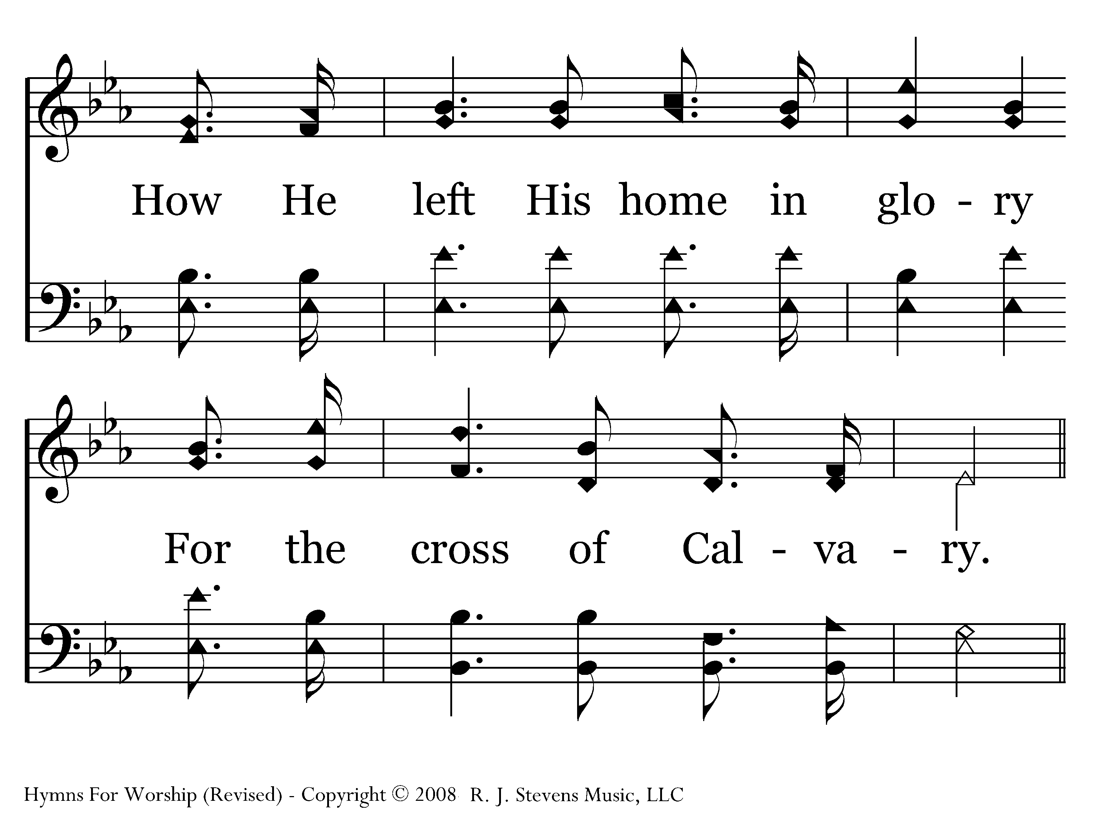
149 - I Will Sing - 1.2

Slide 32
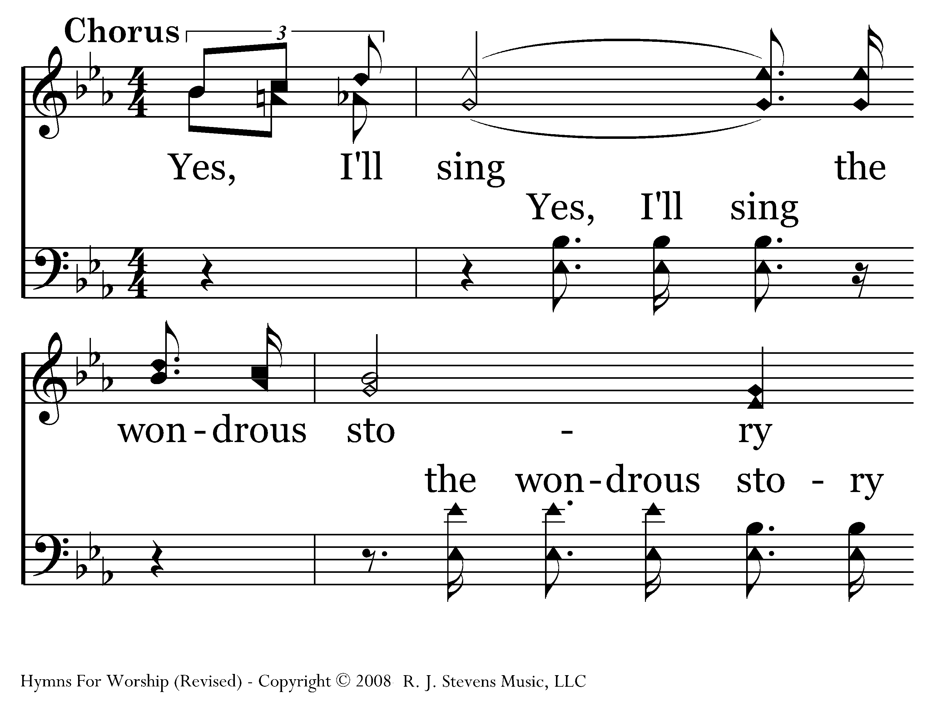
149 - I Will Sing - C.1

Slide 33
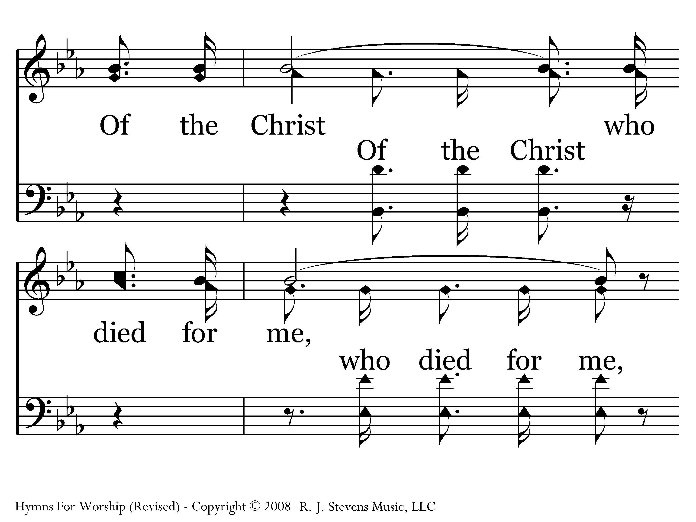
149 - I Will Sing - C.2

Slide 34
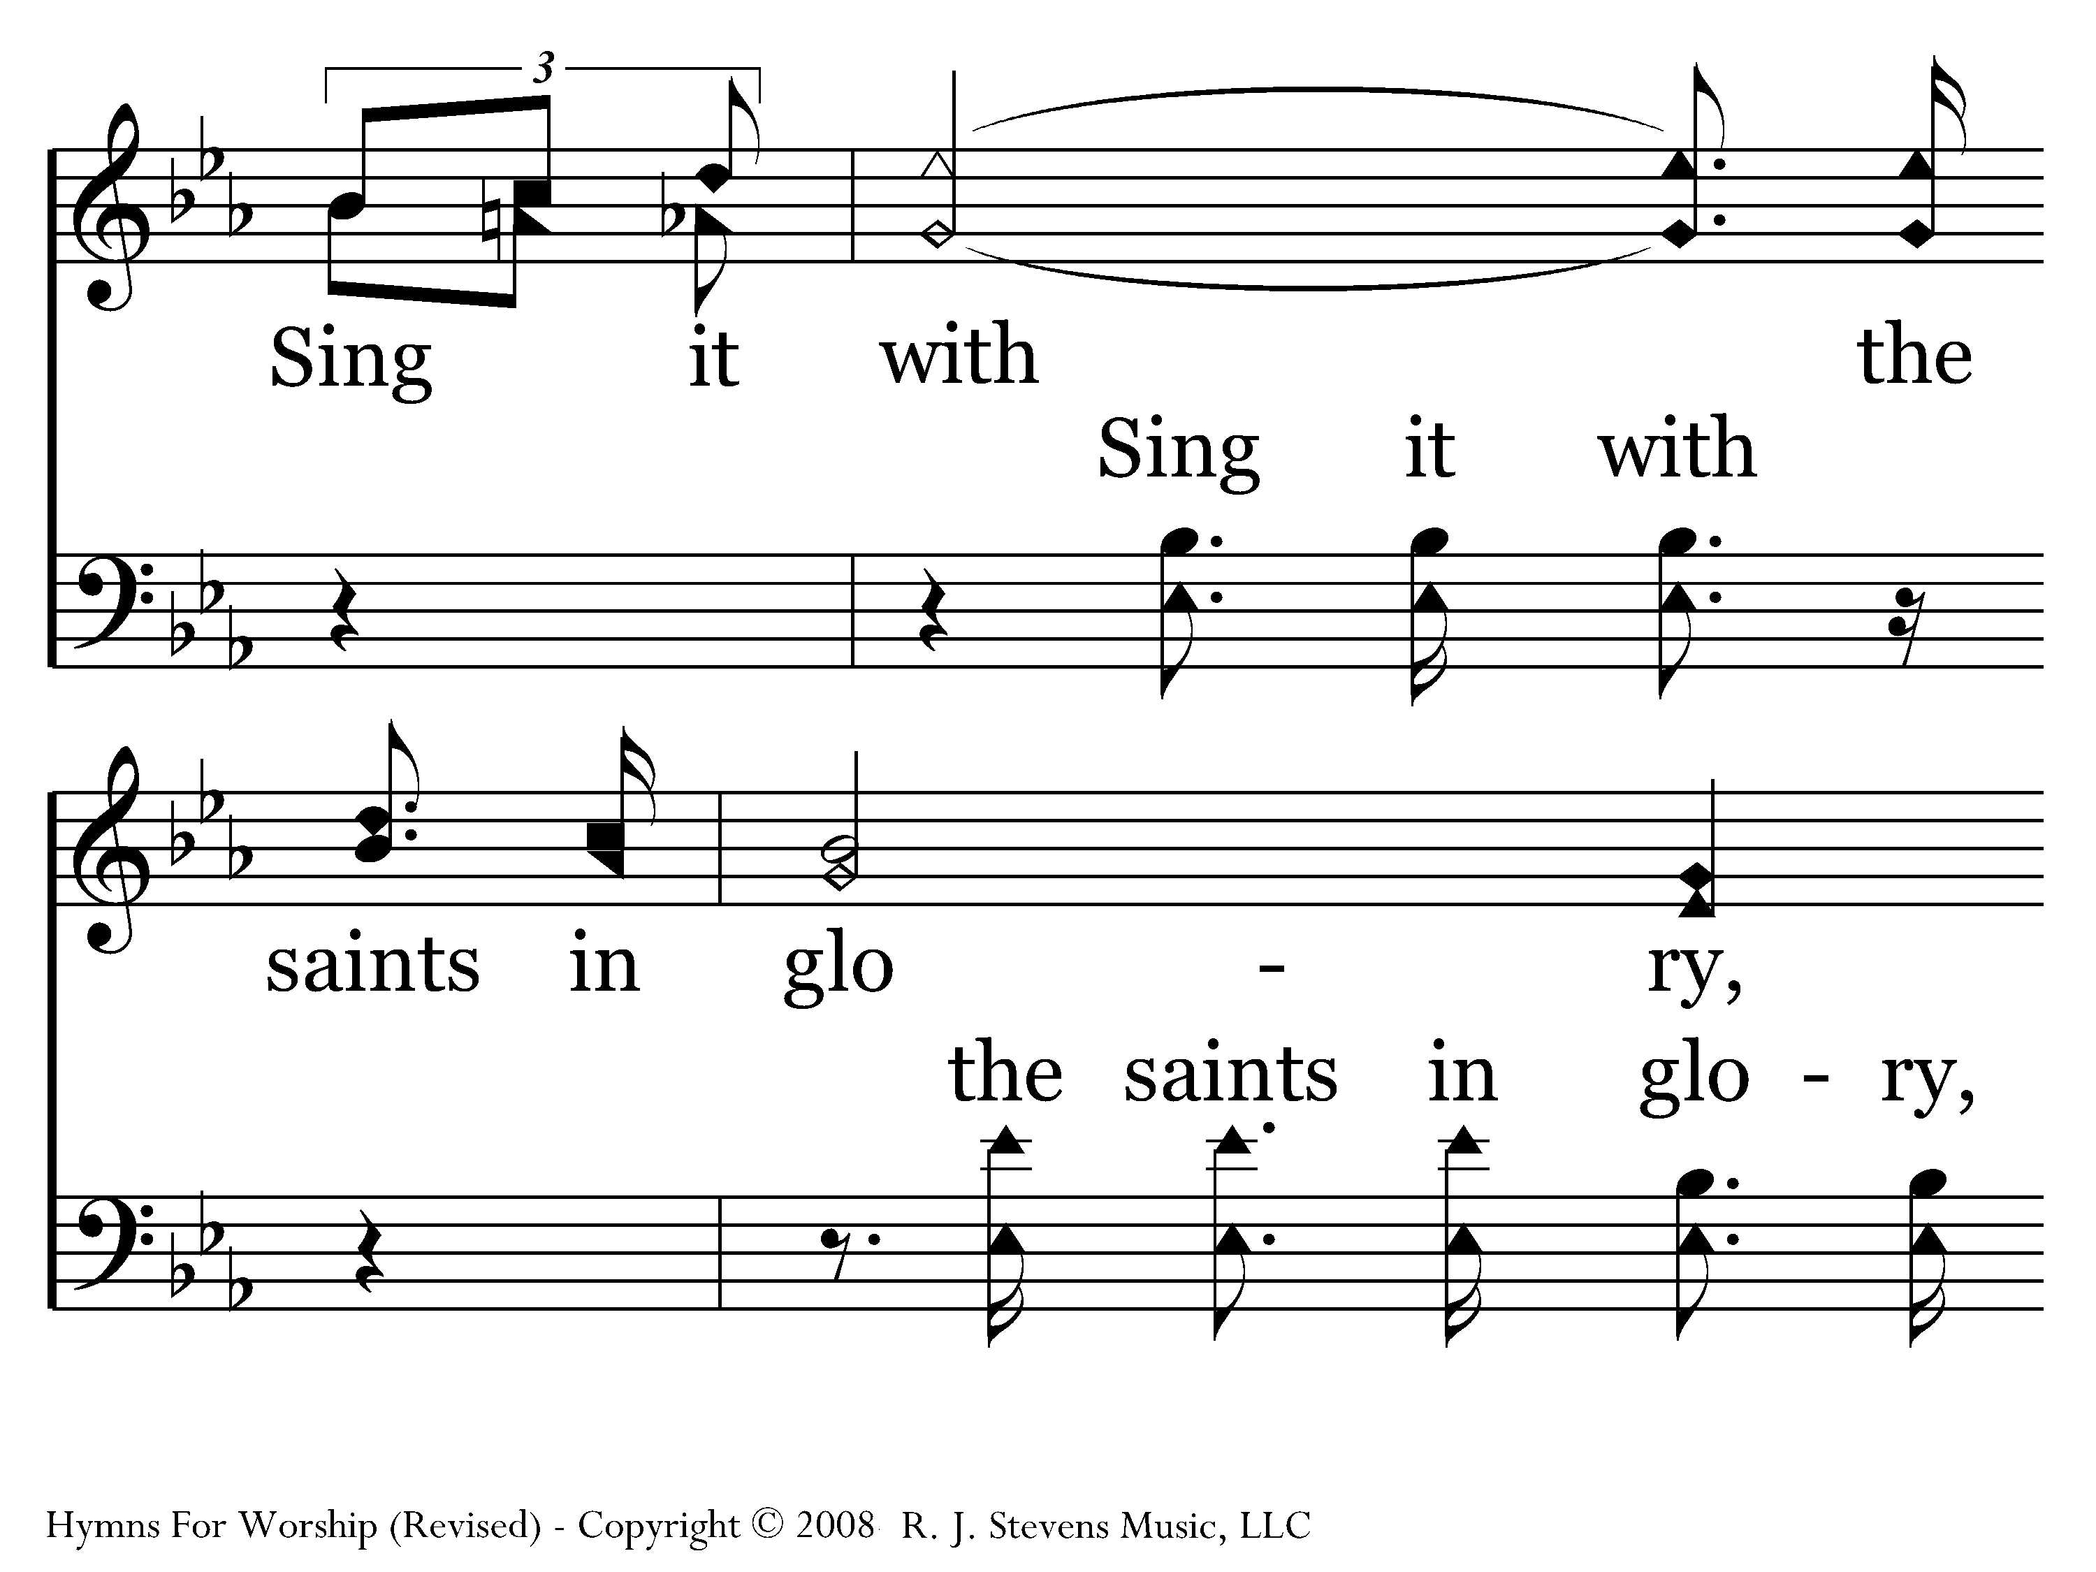
149 - I Will Sing - C.3

Slide 35
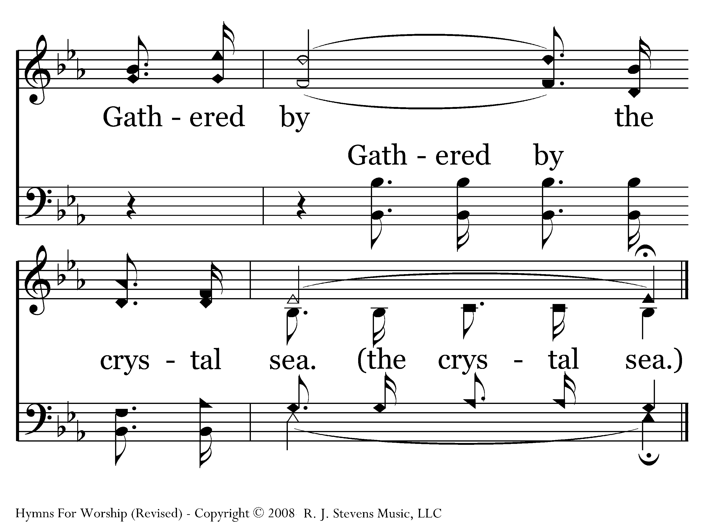
149 - I Will Sing - C.4
End of Song

Slide 36
A new perspective
Psa. 40:1-3 -- I waited patiently for the Lord; And He inclined to me and heard my cry. 2 He brought me up out of the pit of destruction, out of the miry clay, And He set my feet upon a rock making my footsteps firm. 3 He put a new song in my mouth, a song of praise to our God; Many will see and fear and will trust in the Lord

Slide 37
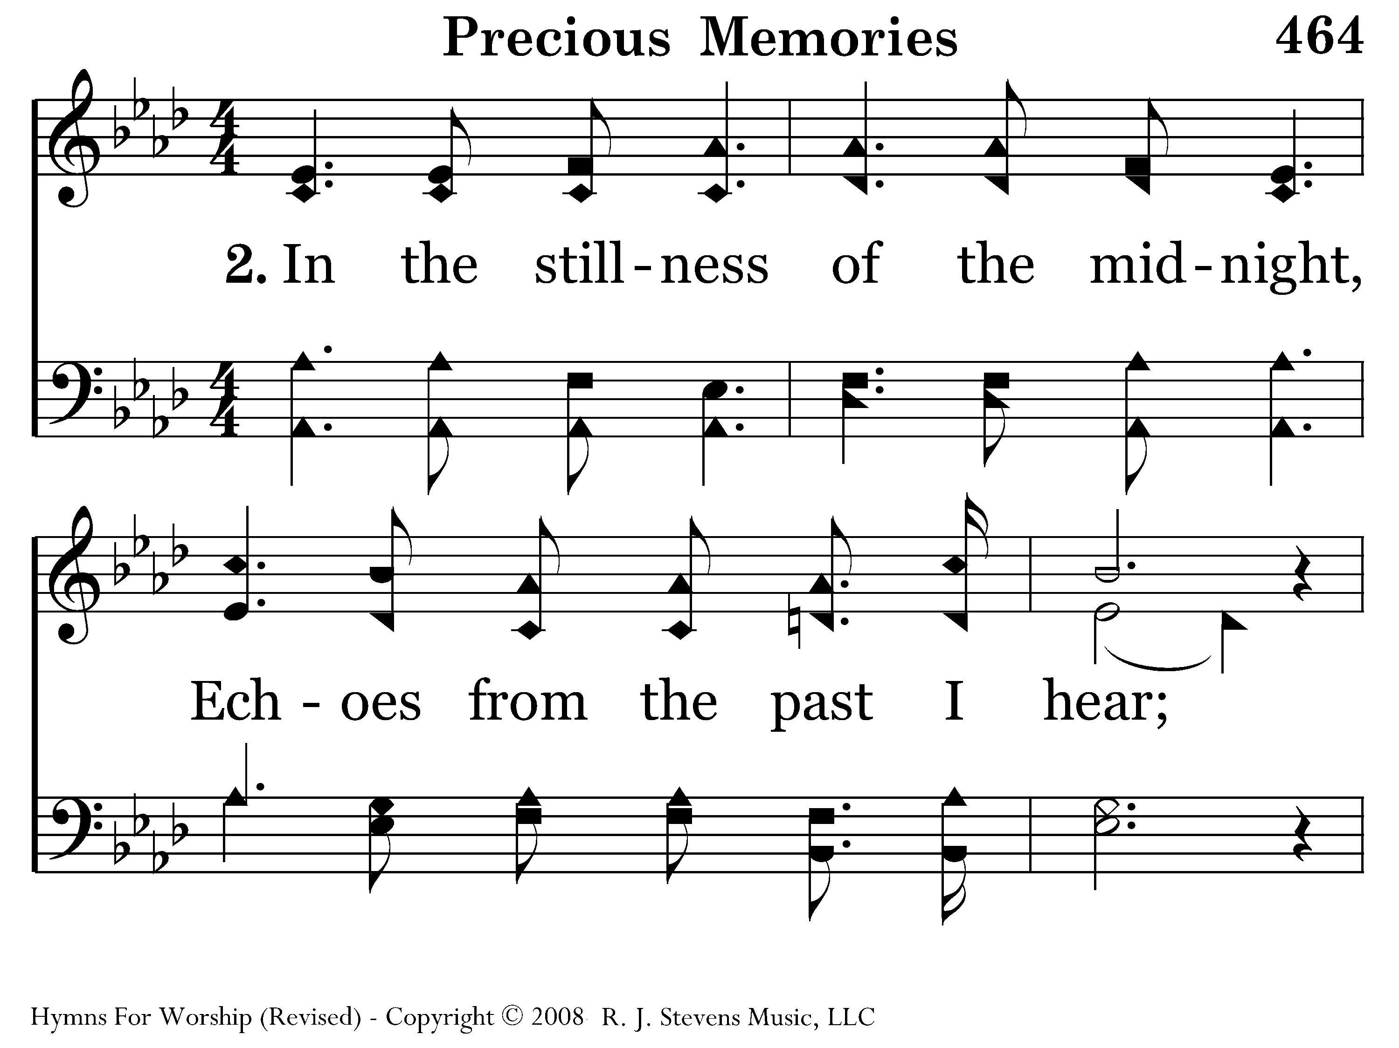
464 - Precious Memories - 2.1

Slide 38
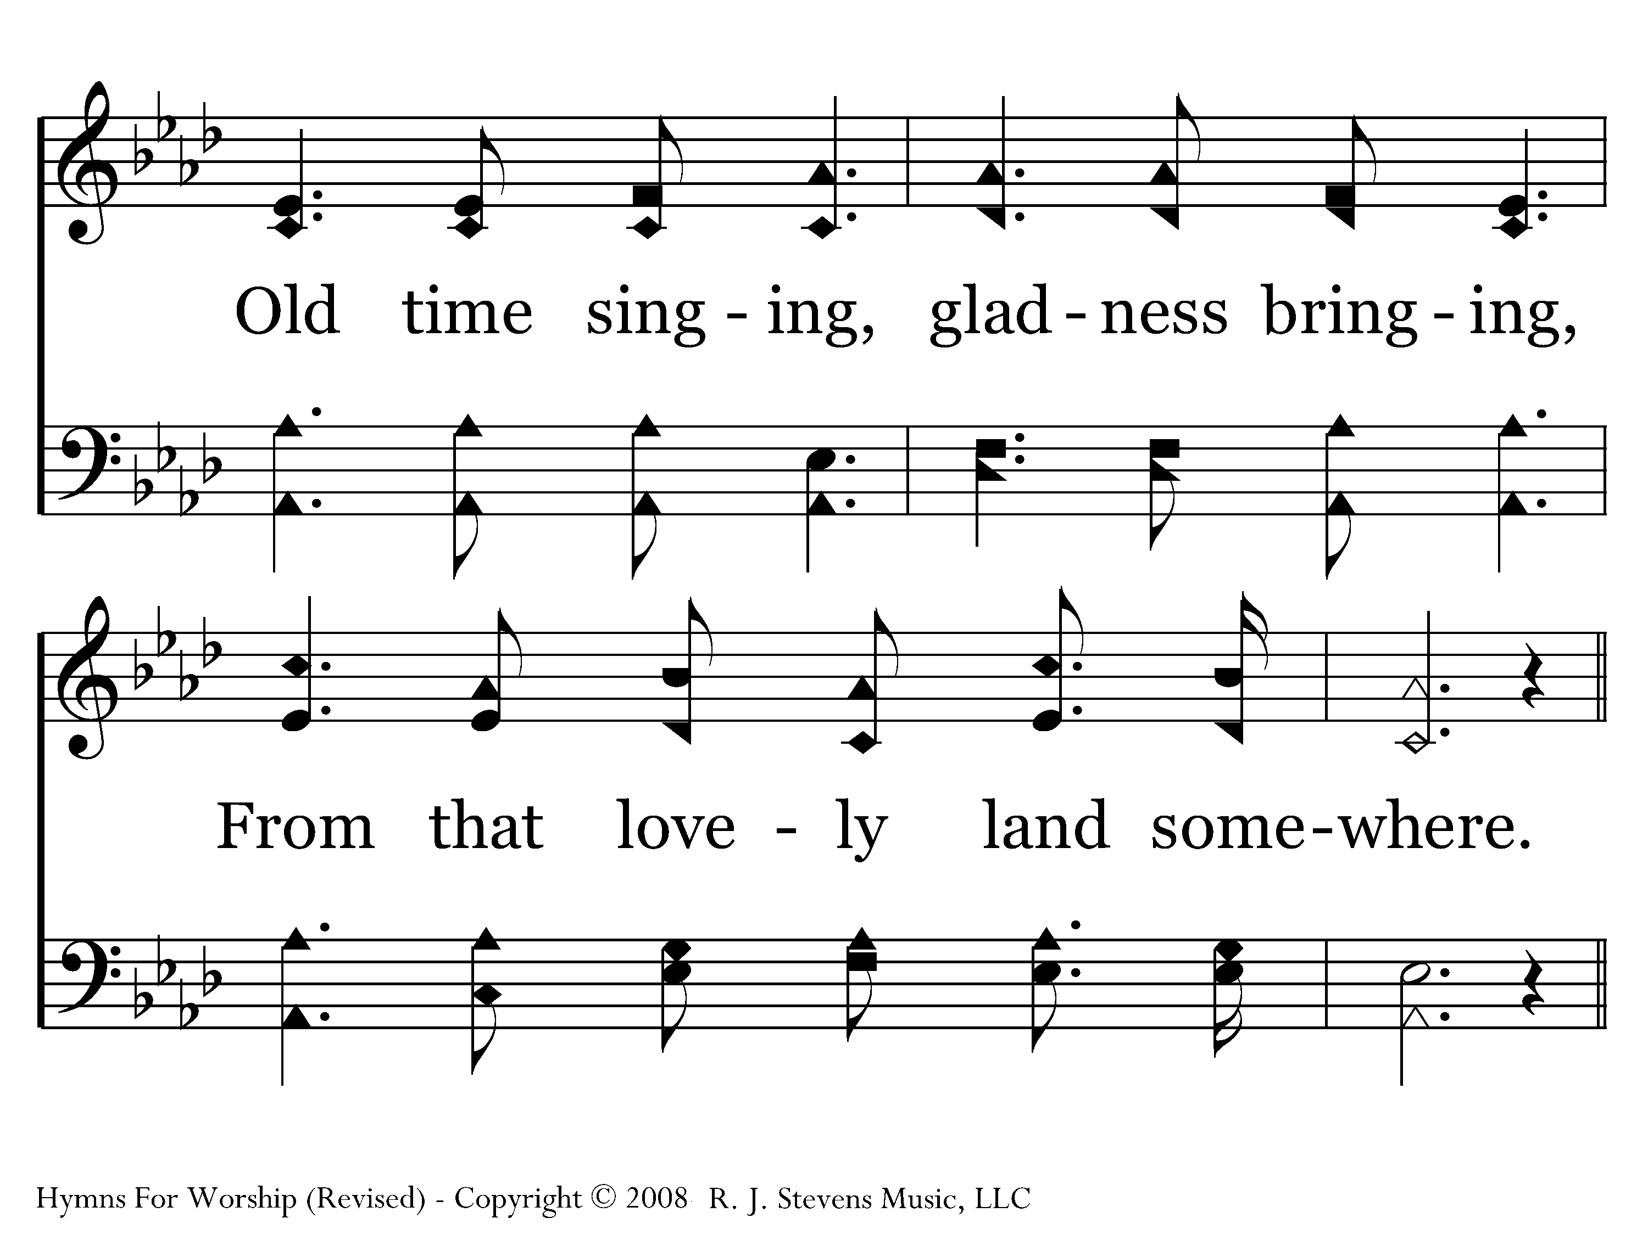
464 - Precious Memories - 2.2

Slide 39
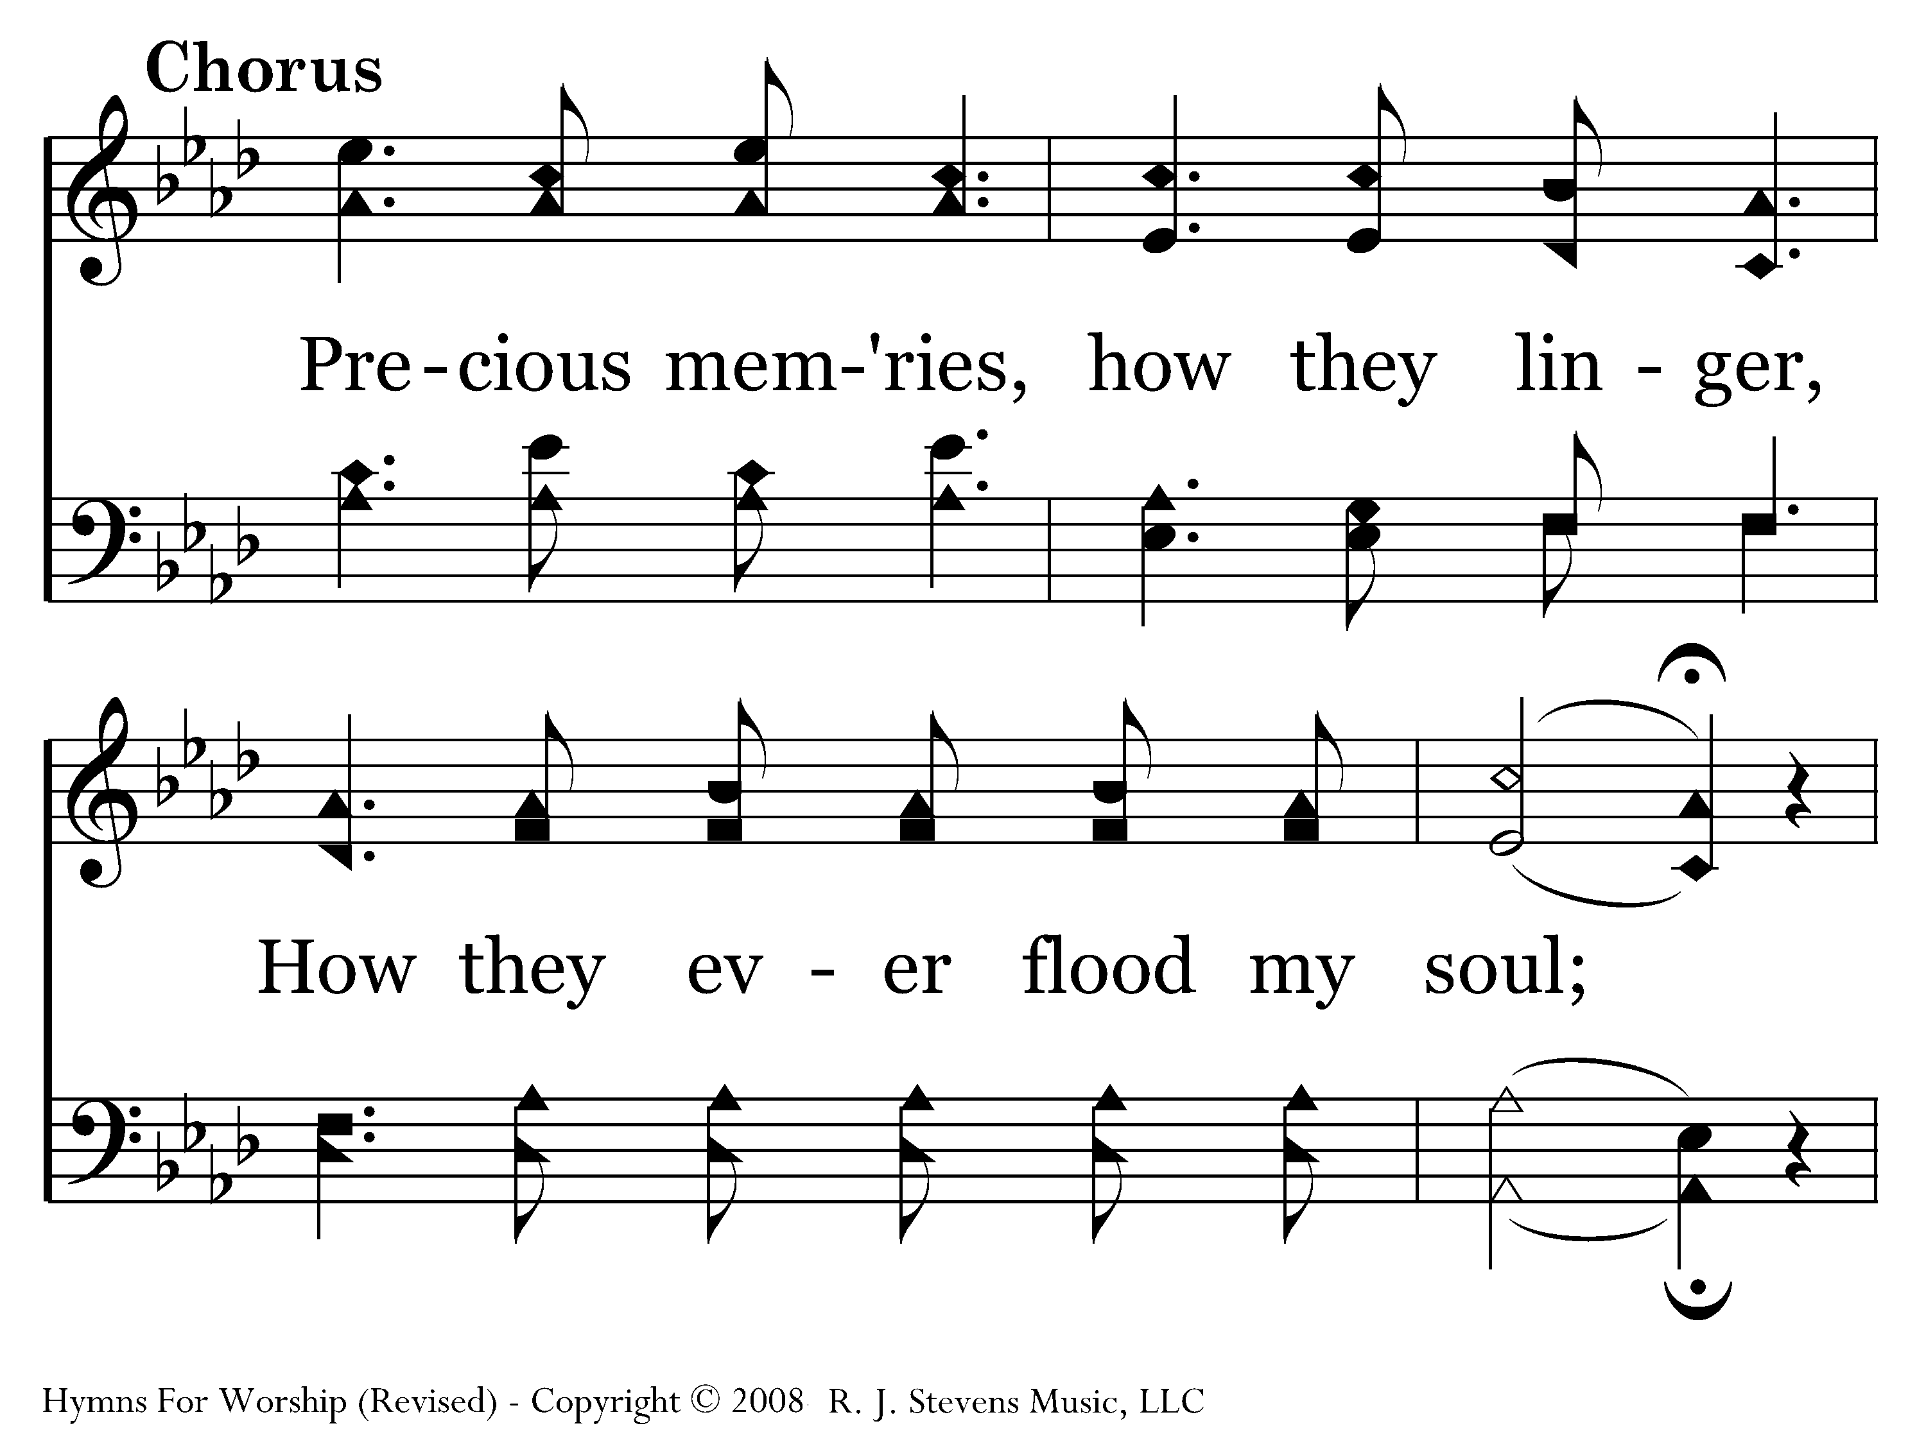
464 - Precious Memories - C.1

Slide 40
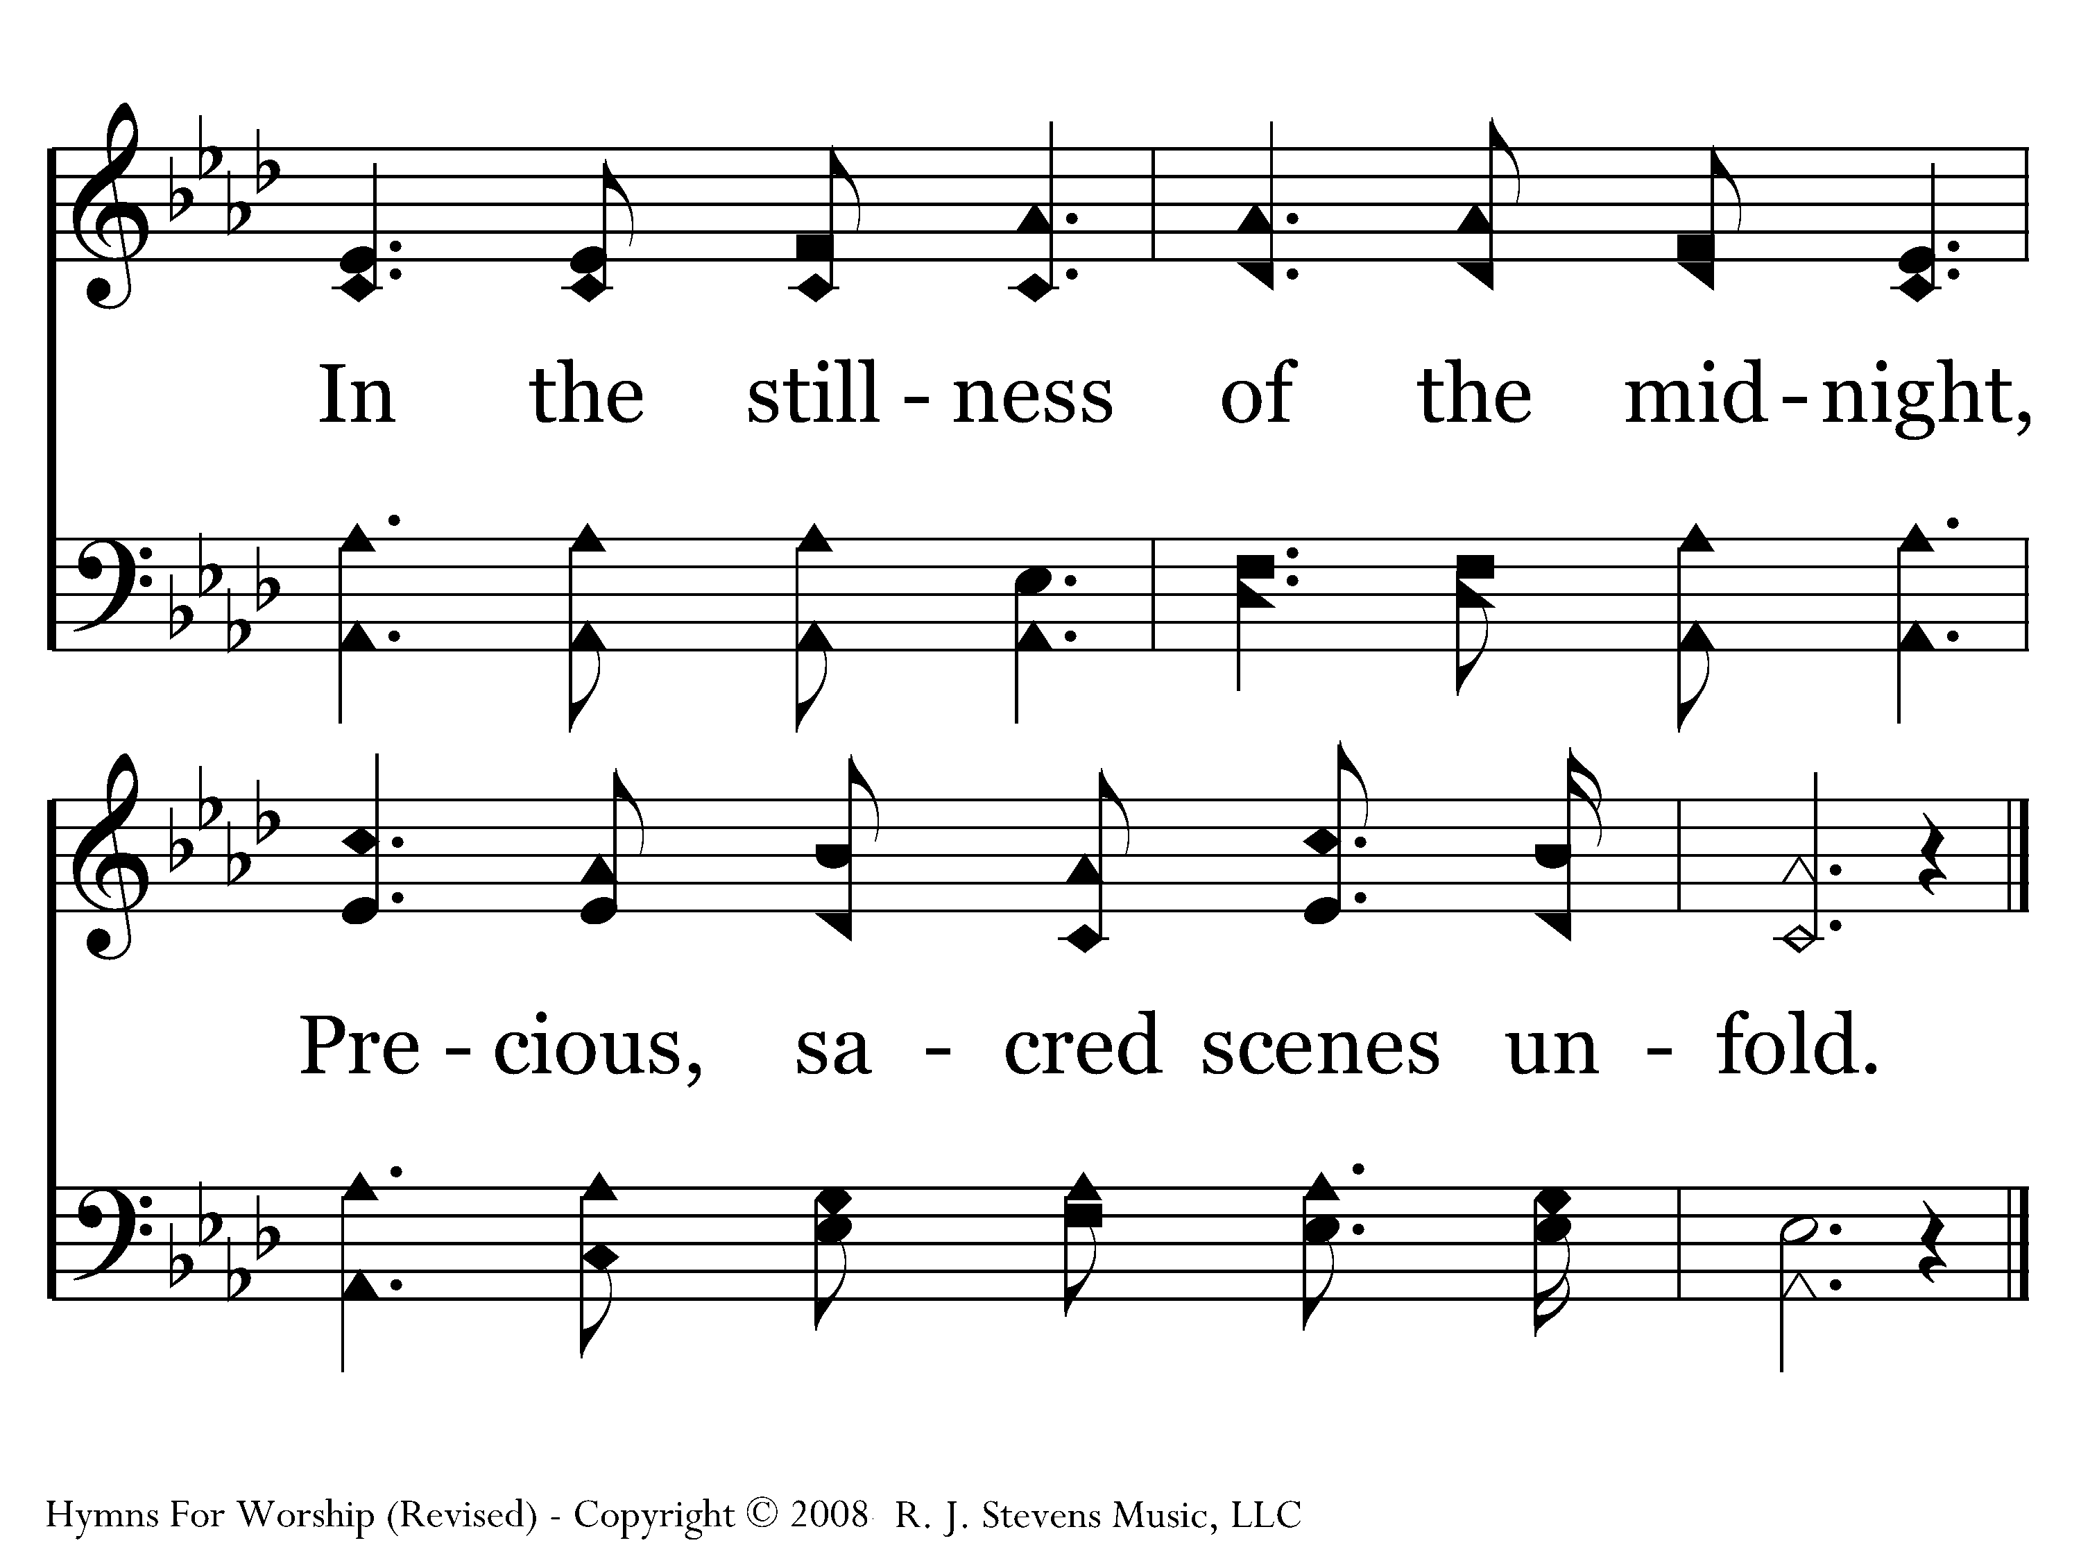
464 - Precious Memories - C.2
End of Song

Slide 41
New ways to express faith
Thoughtful exposure to new songs with appropriate training will build a congregation’s capacity for praise

Slide 42
Concept of newness
Singing new, meaningful songs gives the sense that we are not worshiping out of habit but truly offering a new song unto the Lord

Slide 43
Sing a new song to the Lord
When we sing in spirit and truth we are truly singing a new song to the Lord
Heb. 13:15 – Through Him then, let us continually offer up a sacrifice of praise to God, that is, the fruit of lips that give thanks to His name

Slide 44
Sing a new song to the Lord
Psa. 145:1-2 -- I will extol You, my God, O King, and I will bless Your name forever and ever. 2 Every day I will bless You, and I will praise Your name forever and ever

Slide 45
Sing a new song to the Lord
Psa. 40:3 -- He put a new song in my mouth, a song of praise to our God; Many will see and fear and will trust in the Lord

Slide 46
Sing a new song to the Lord
Psa. 118:14 -- The Lord is my strength and song, and He has become my salvation

Slide 47
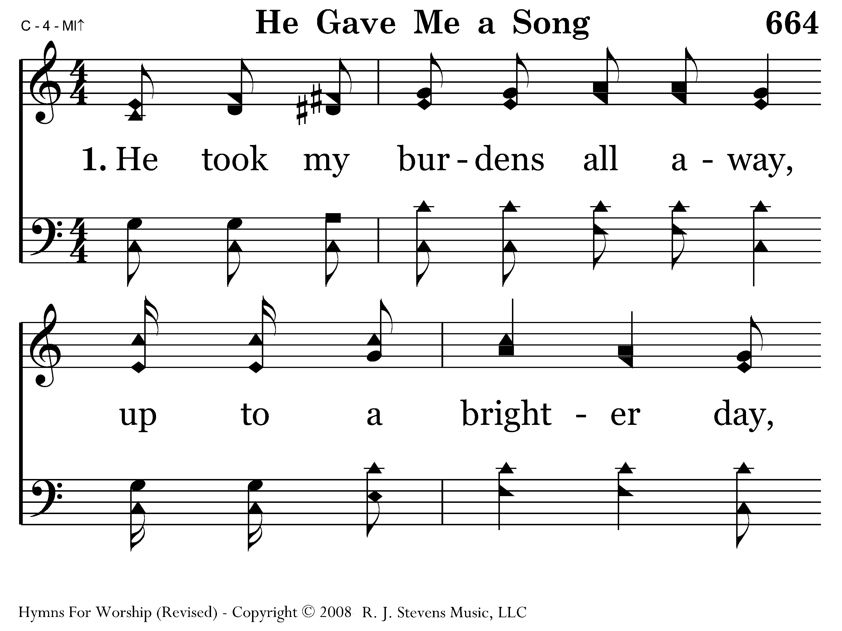
664 - He Gave Me A Song - 1.1

Slide 48
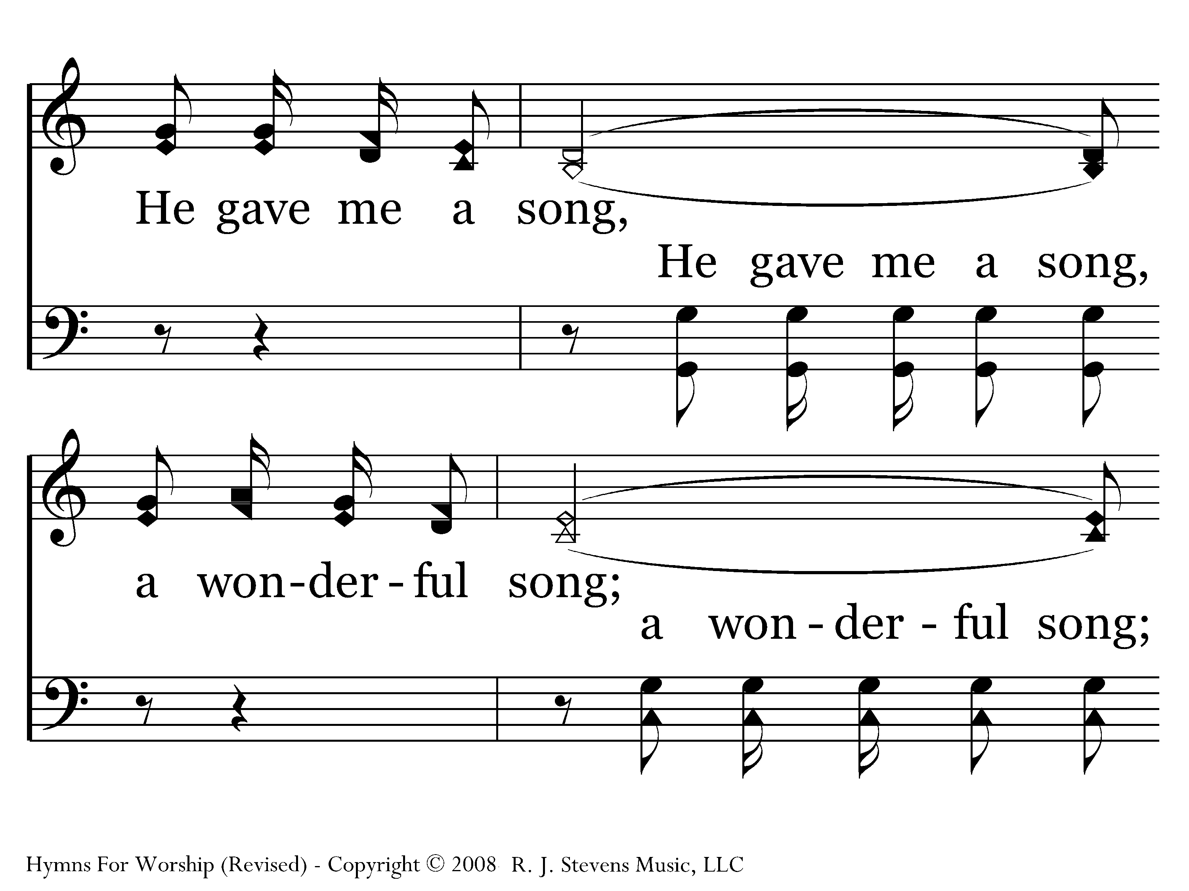
664 - He Gave Me A Song - 1.2

Slide 49
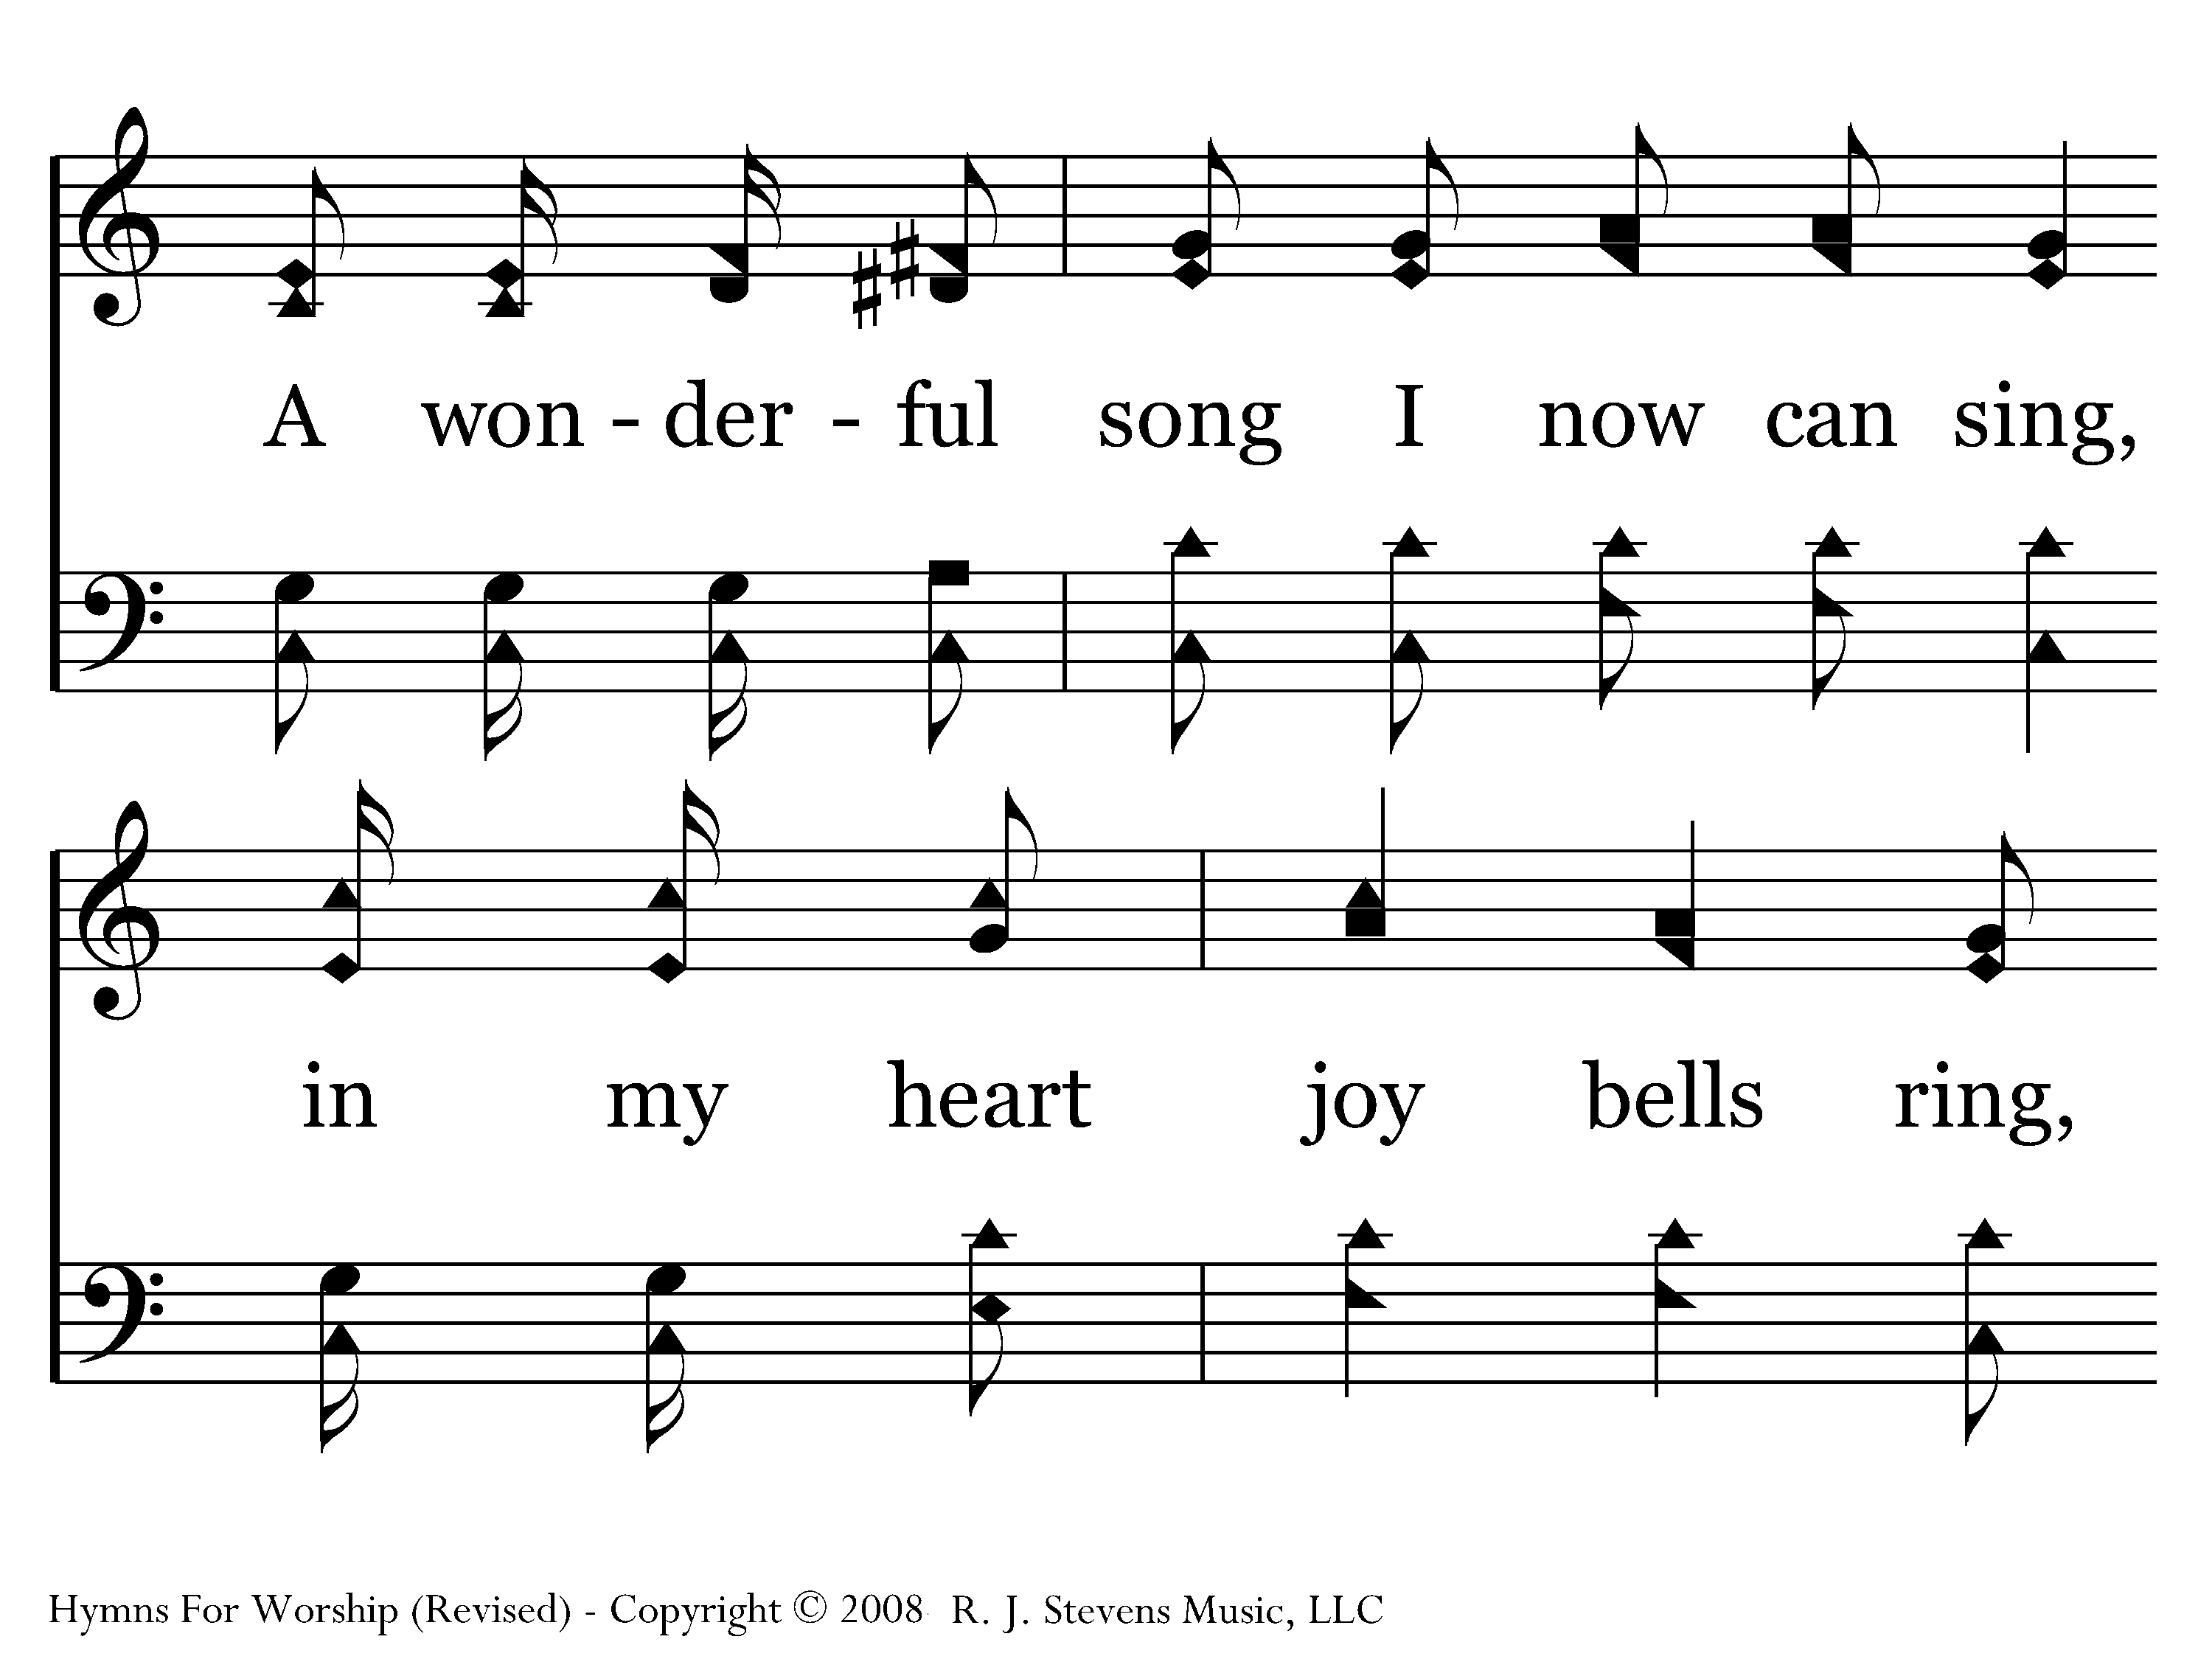
664 - He Gave Me A Song - 1.3

Slide 50
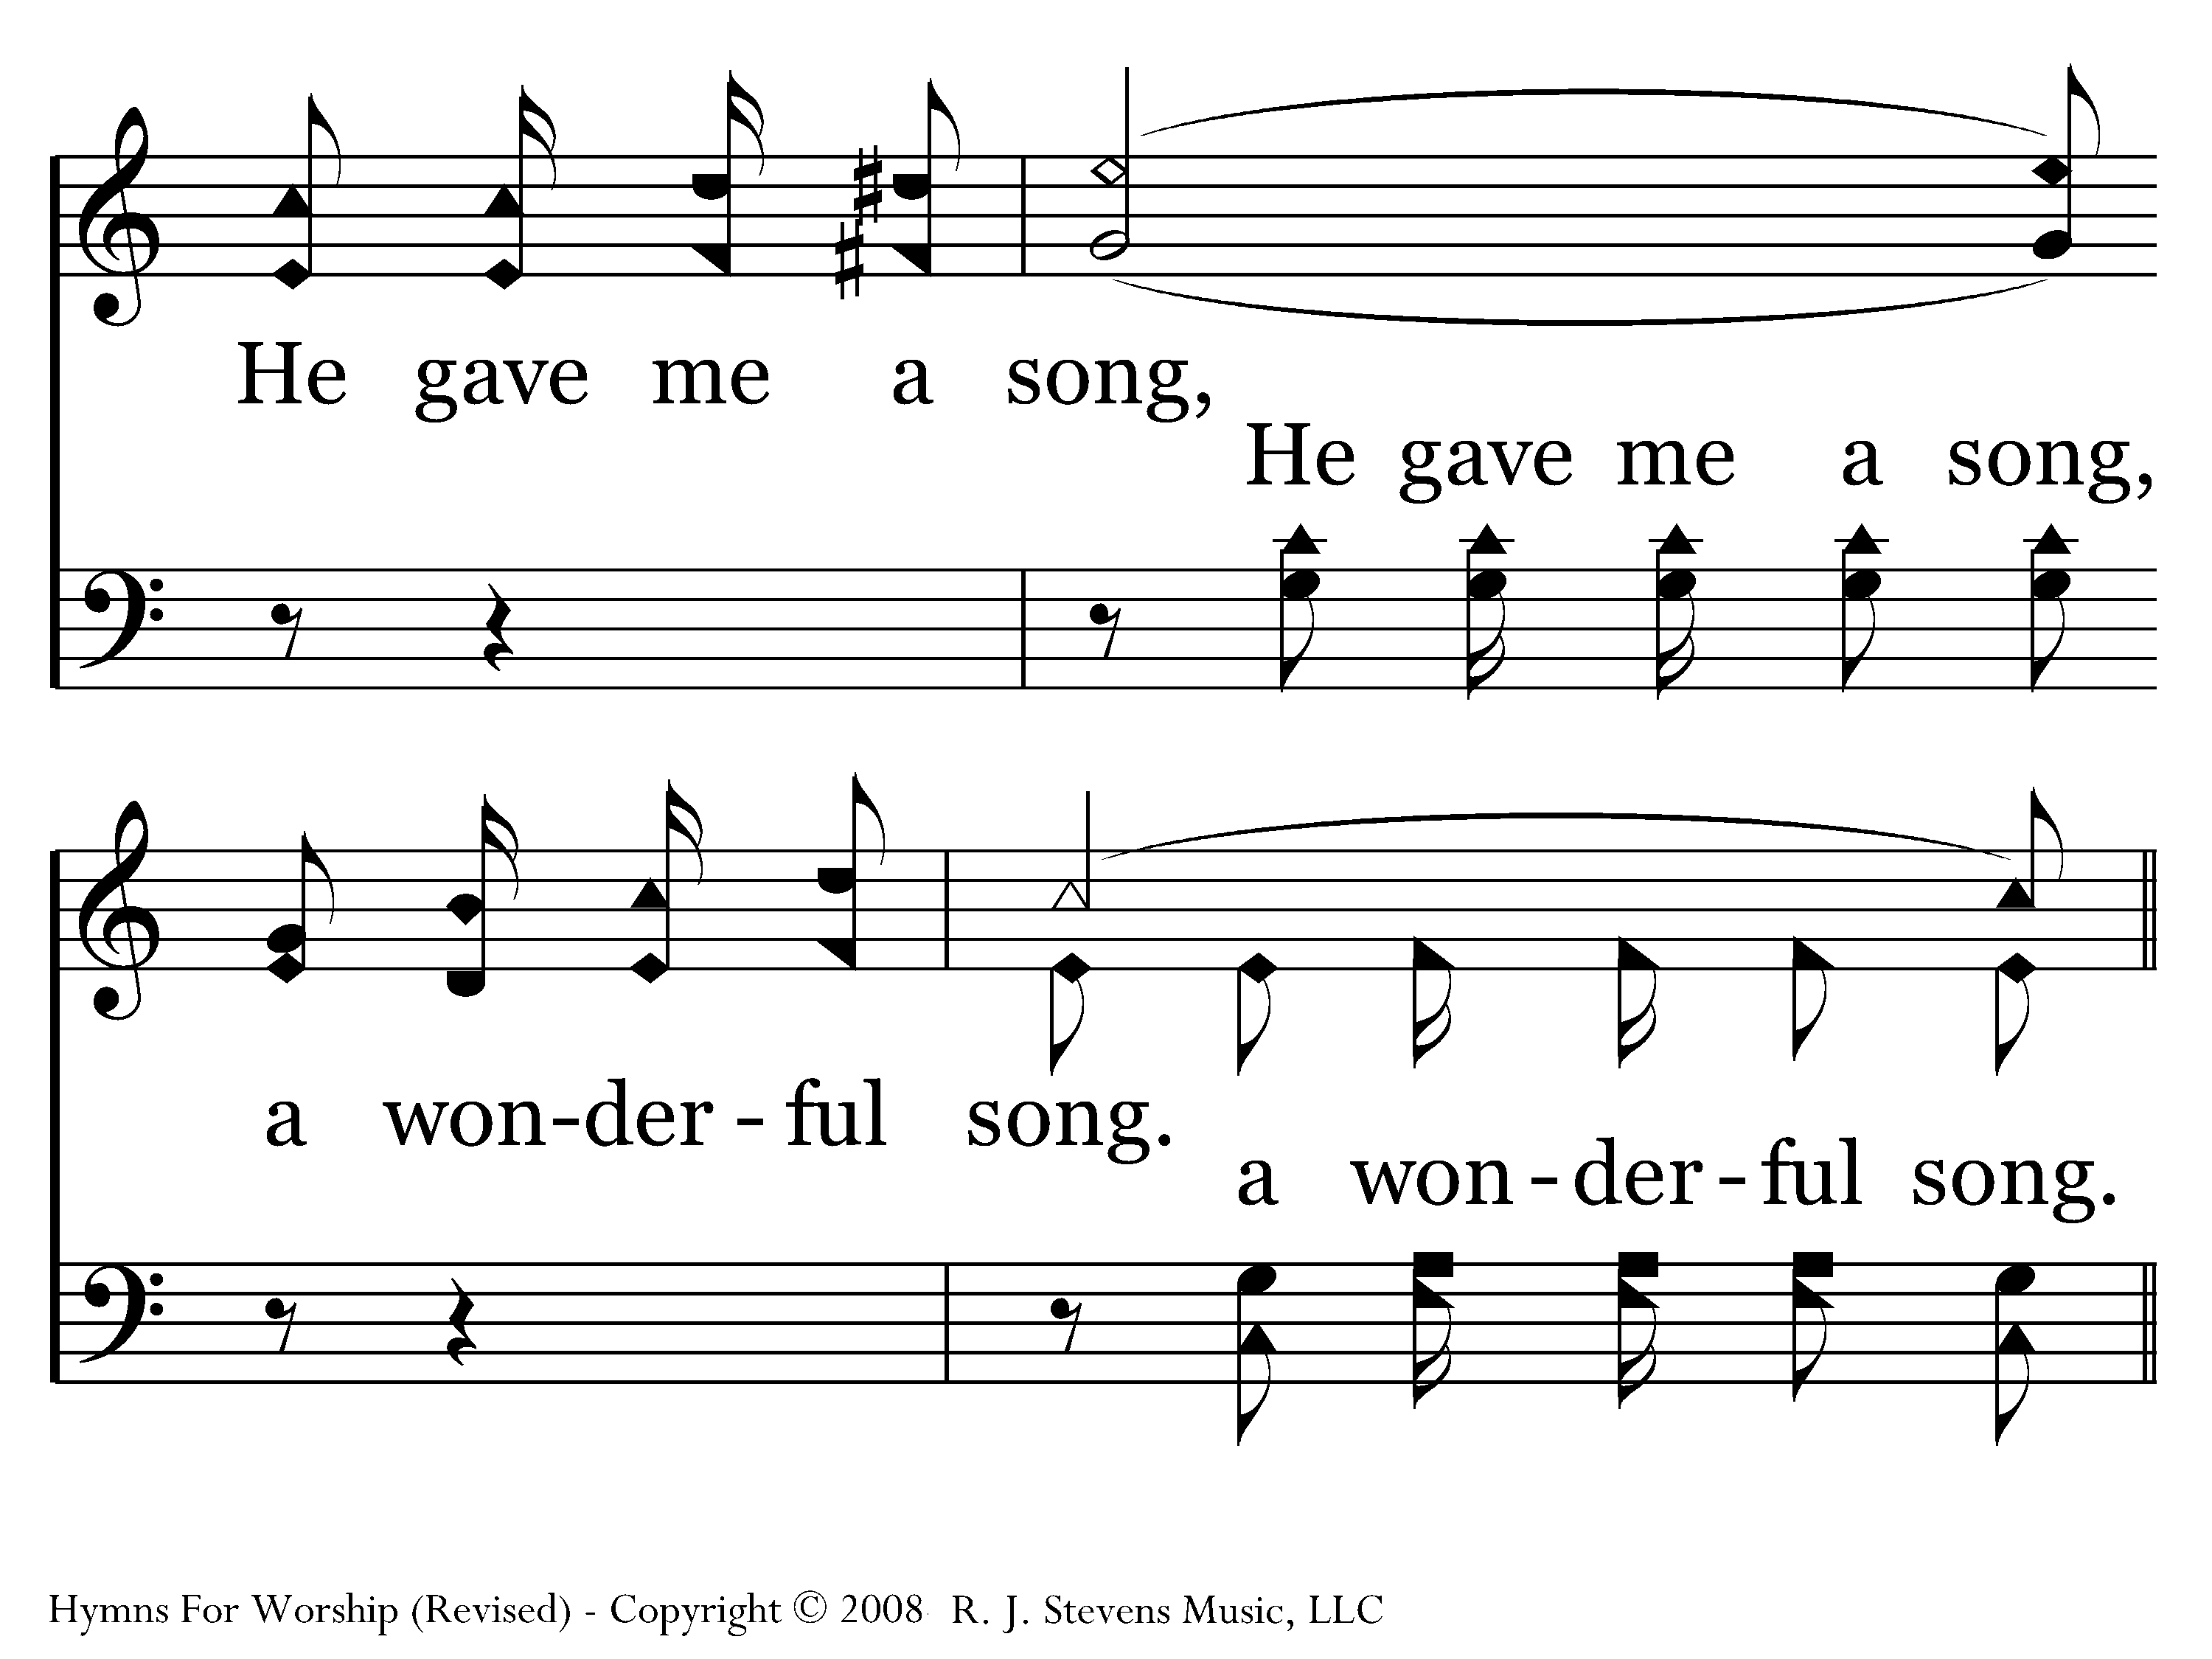
664 - He Gave Me A Song - 1.4

Slide 51
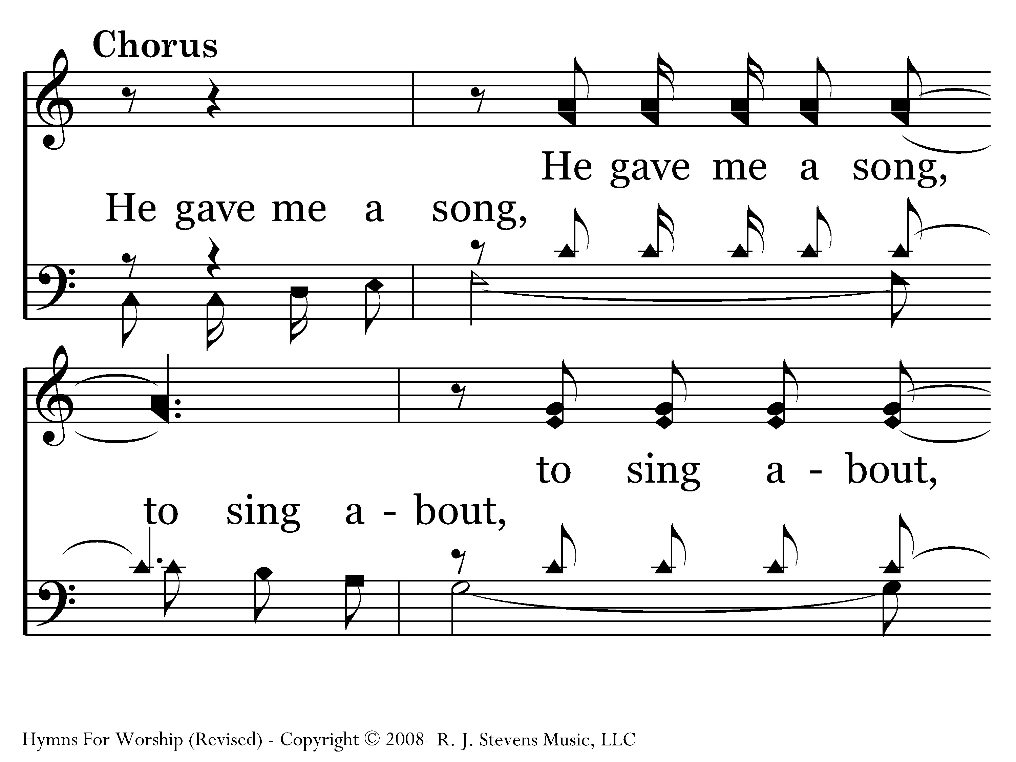
664 - He Gave Me A Song - C.1

Slide 52
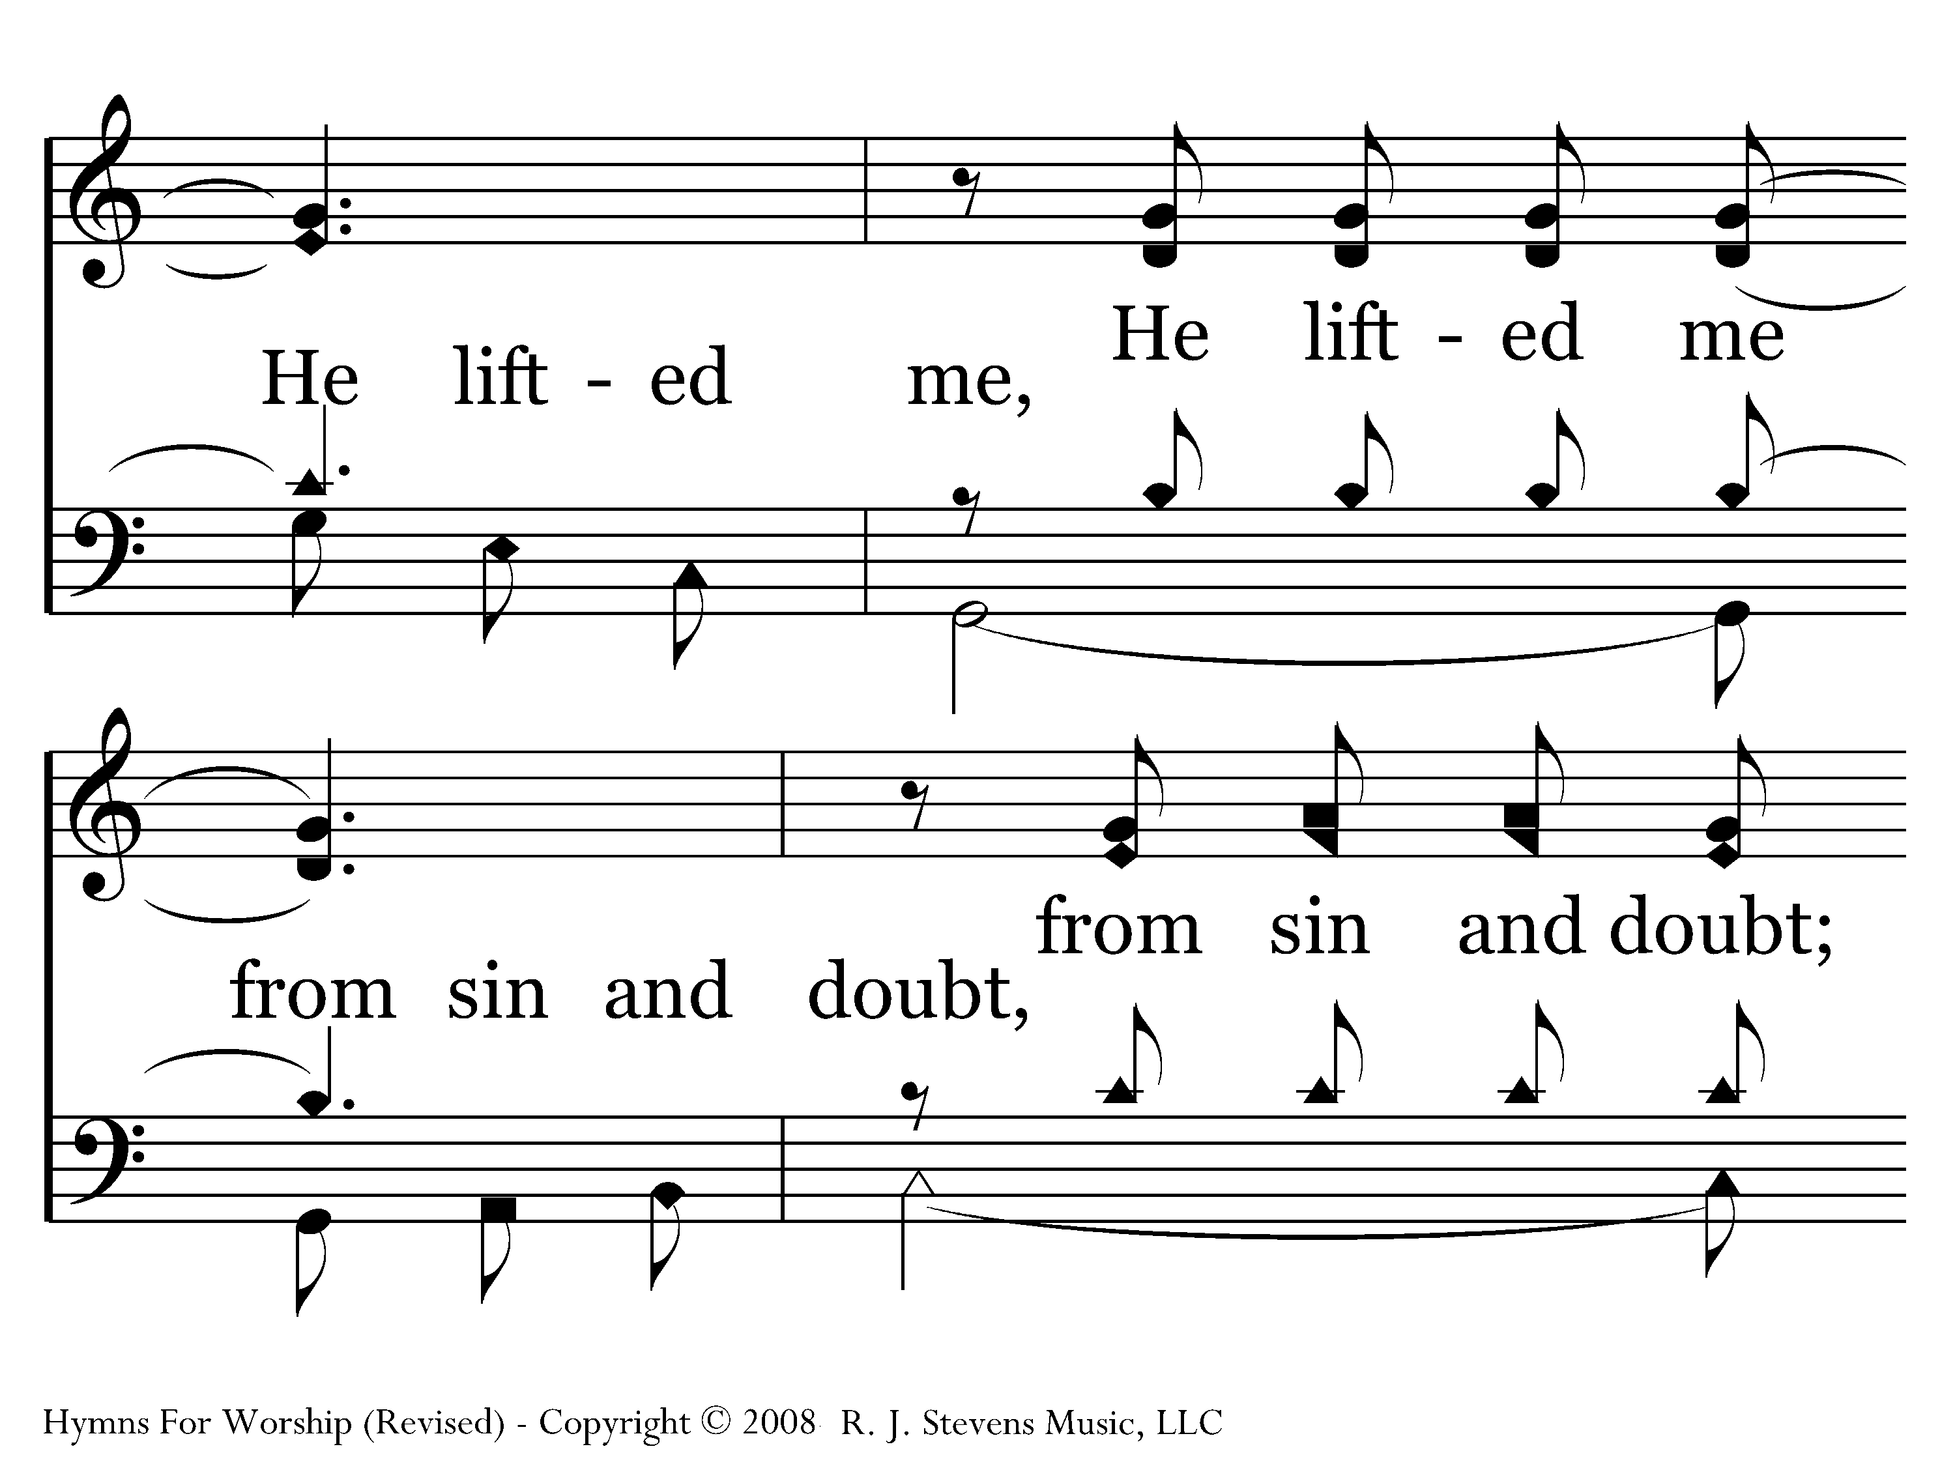
664 - He Gave Me A Song - C.2

Slide 53
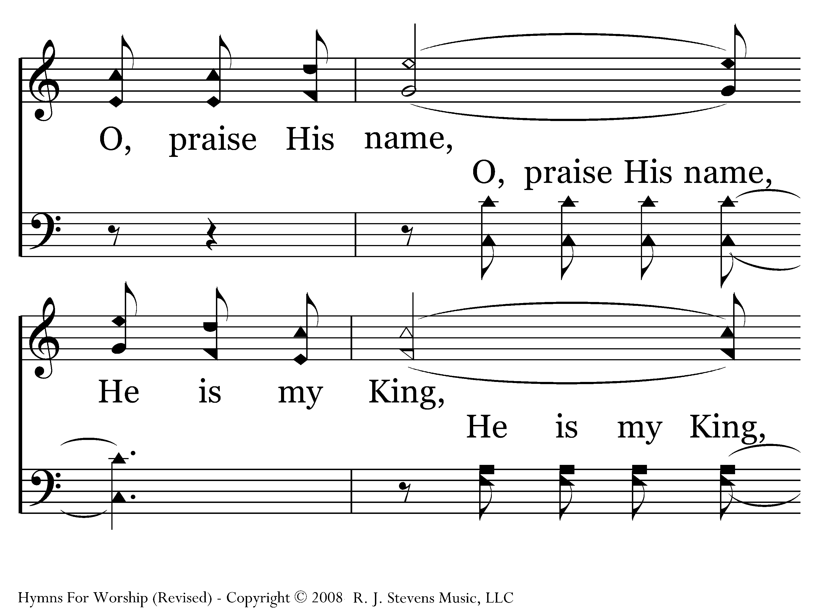
664 - He Gave Me A Song - C.3

Slide 54
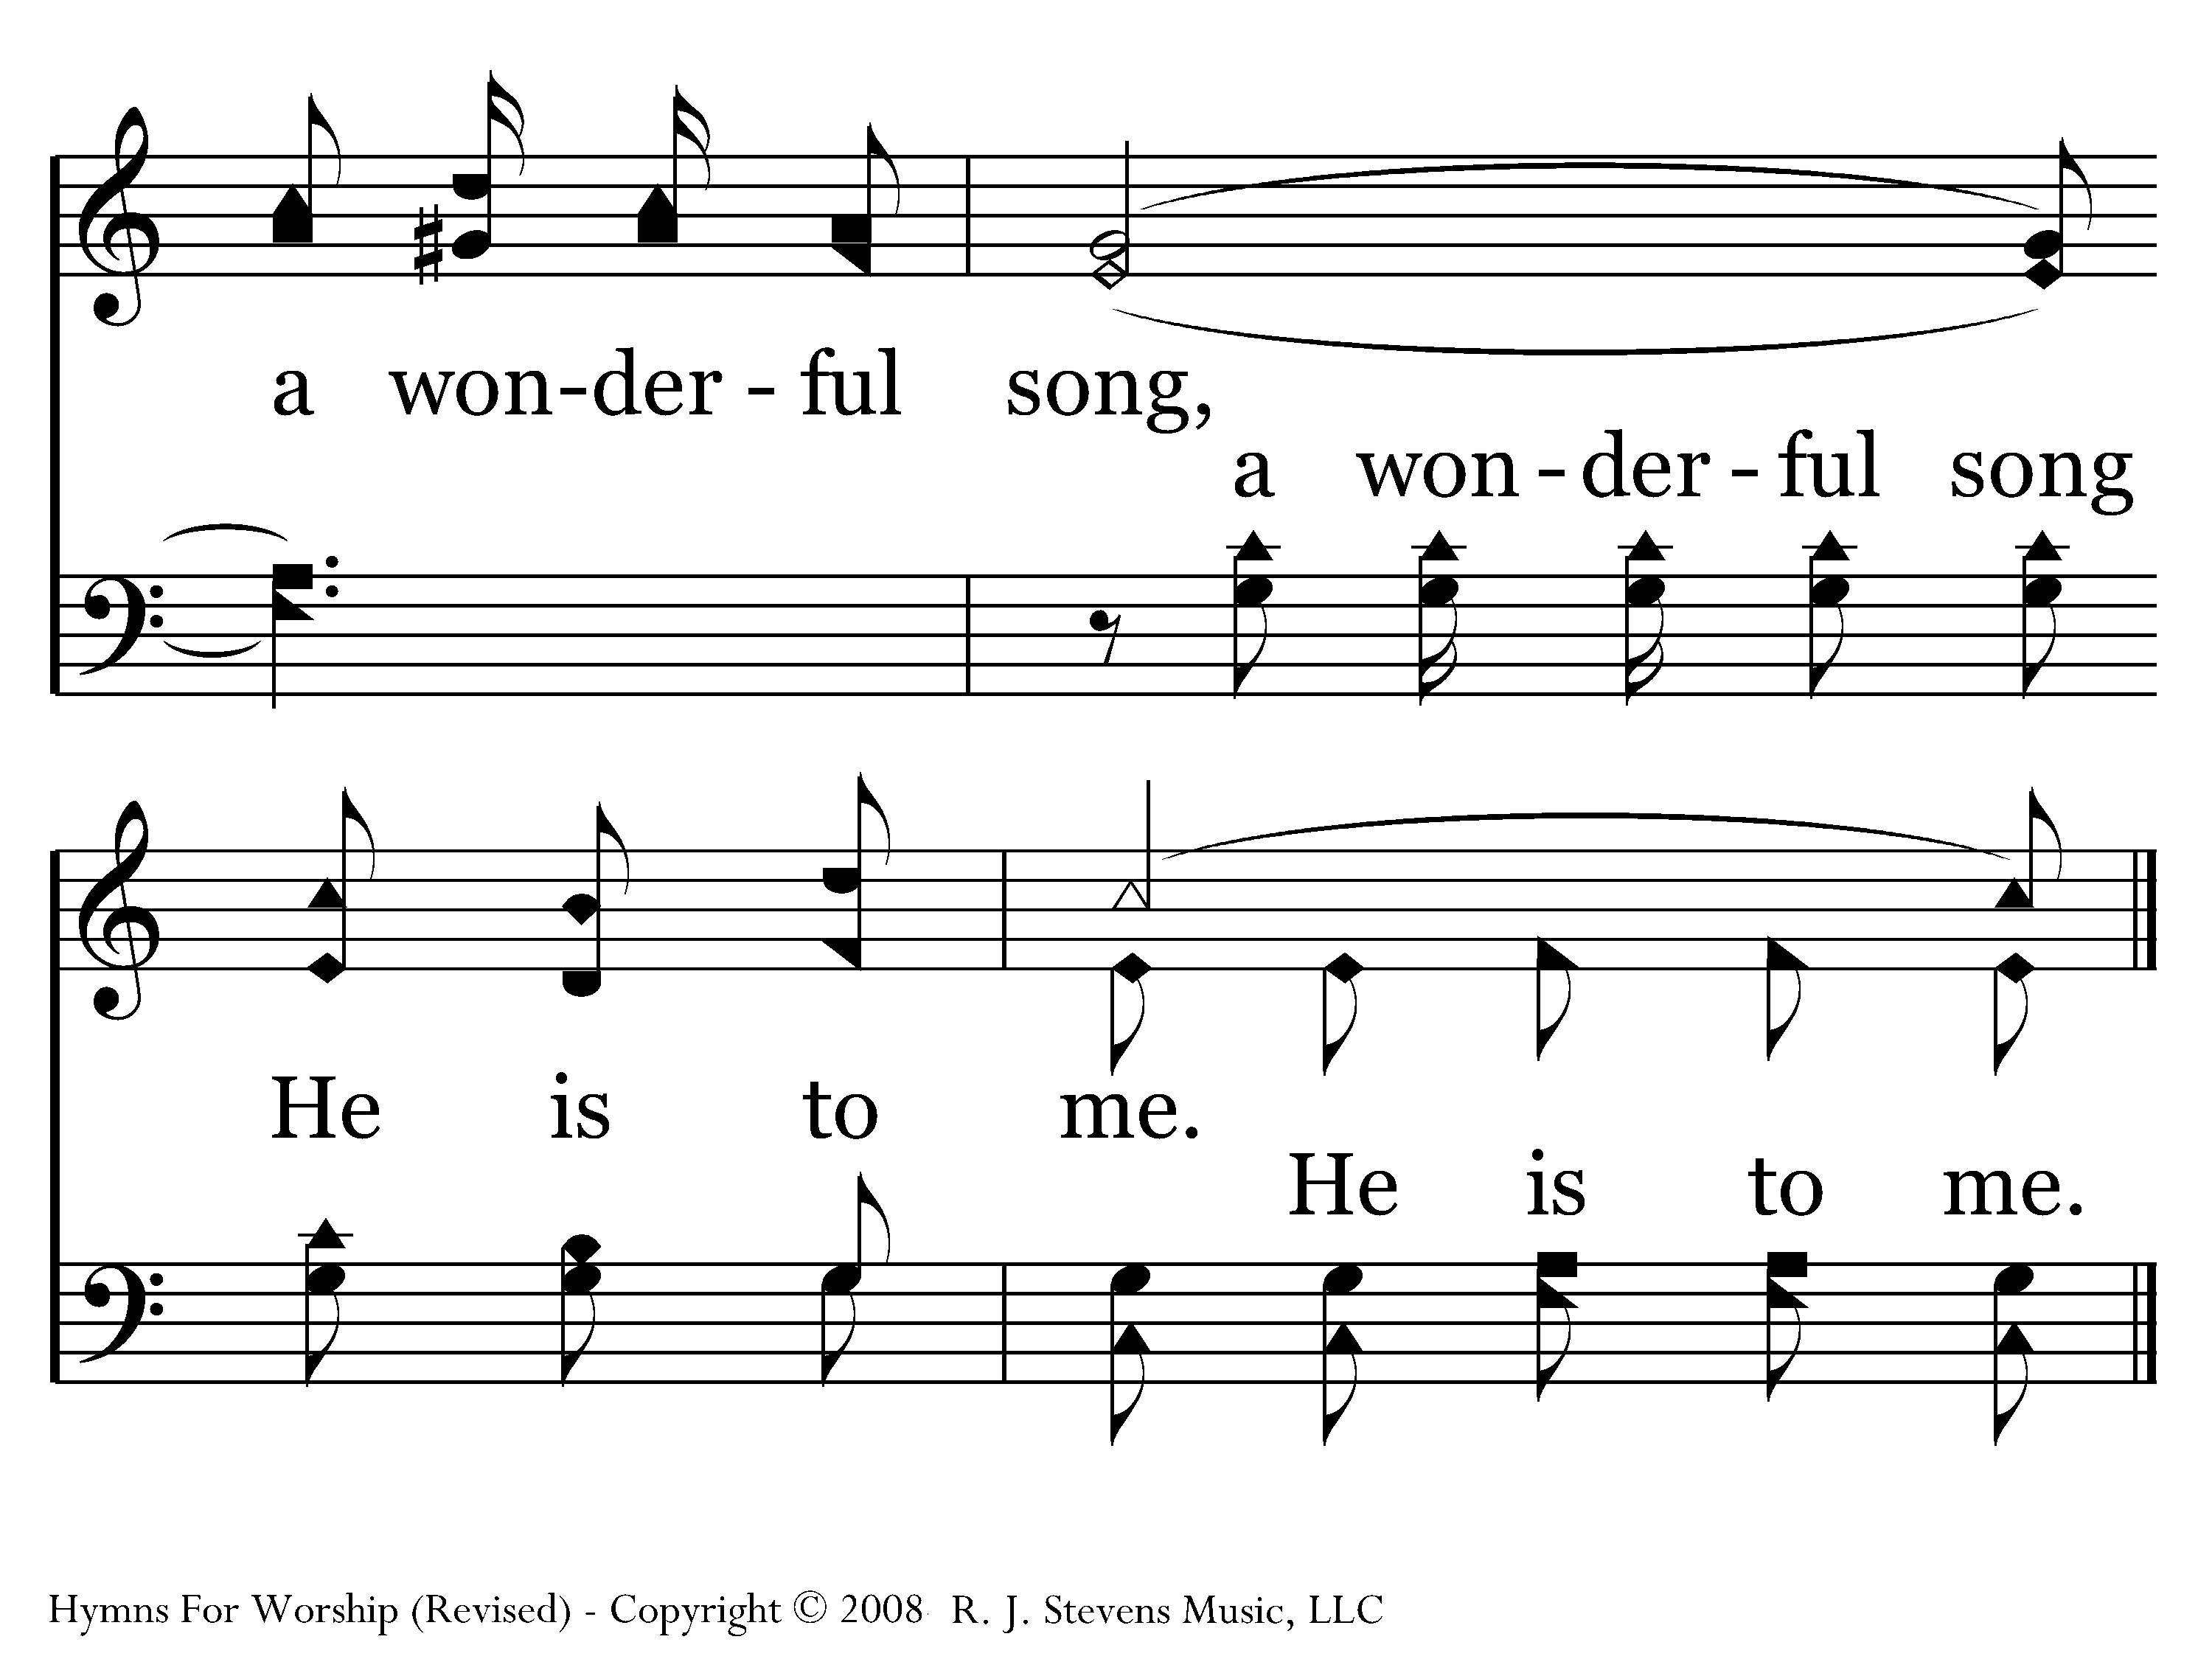
664 - He Gave Me A Song - C.4
End of Verse 1

Slide 55
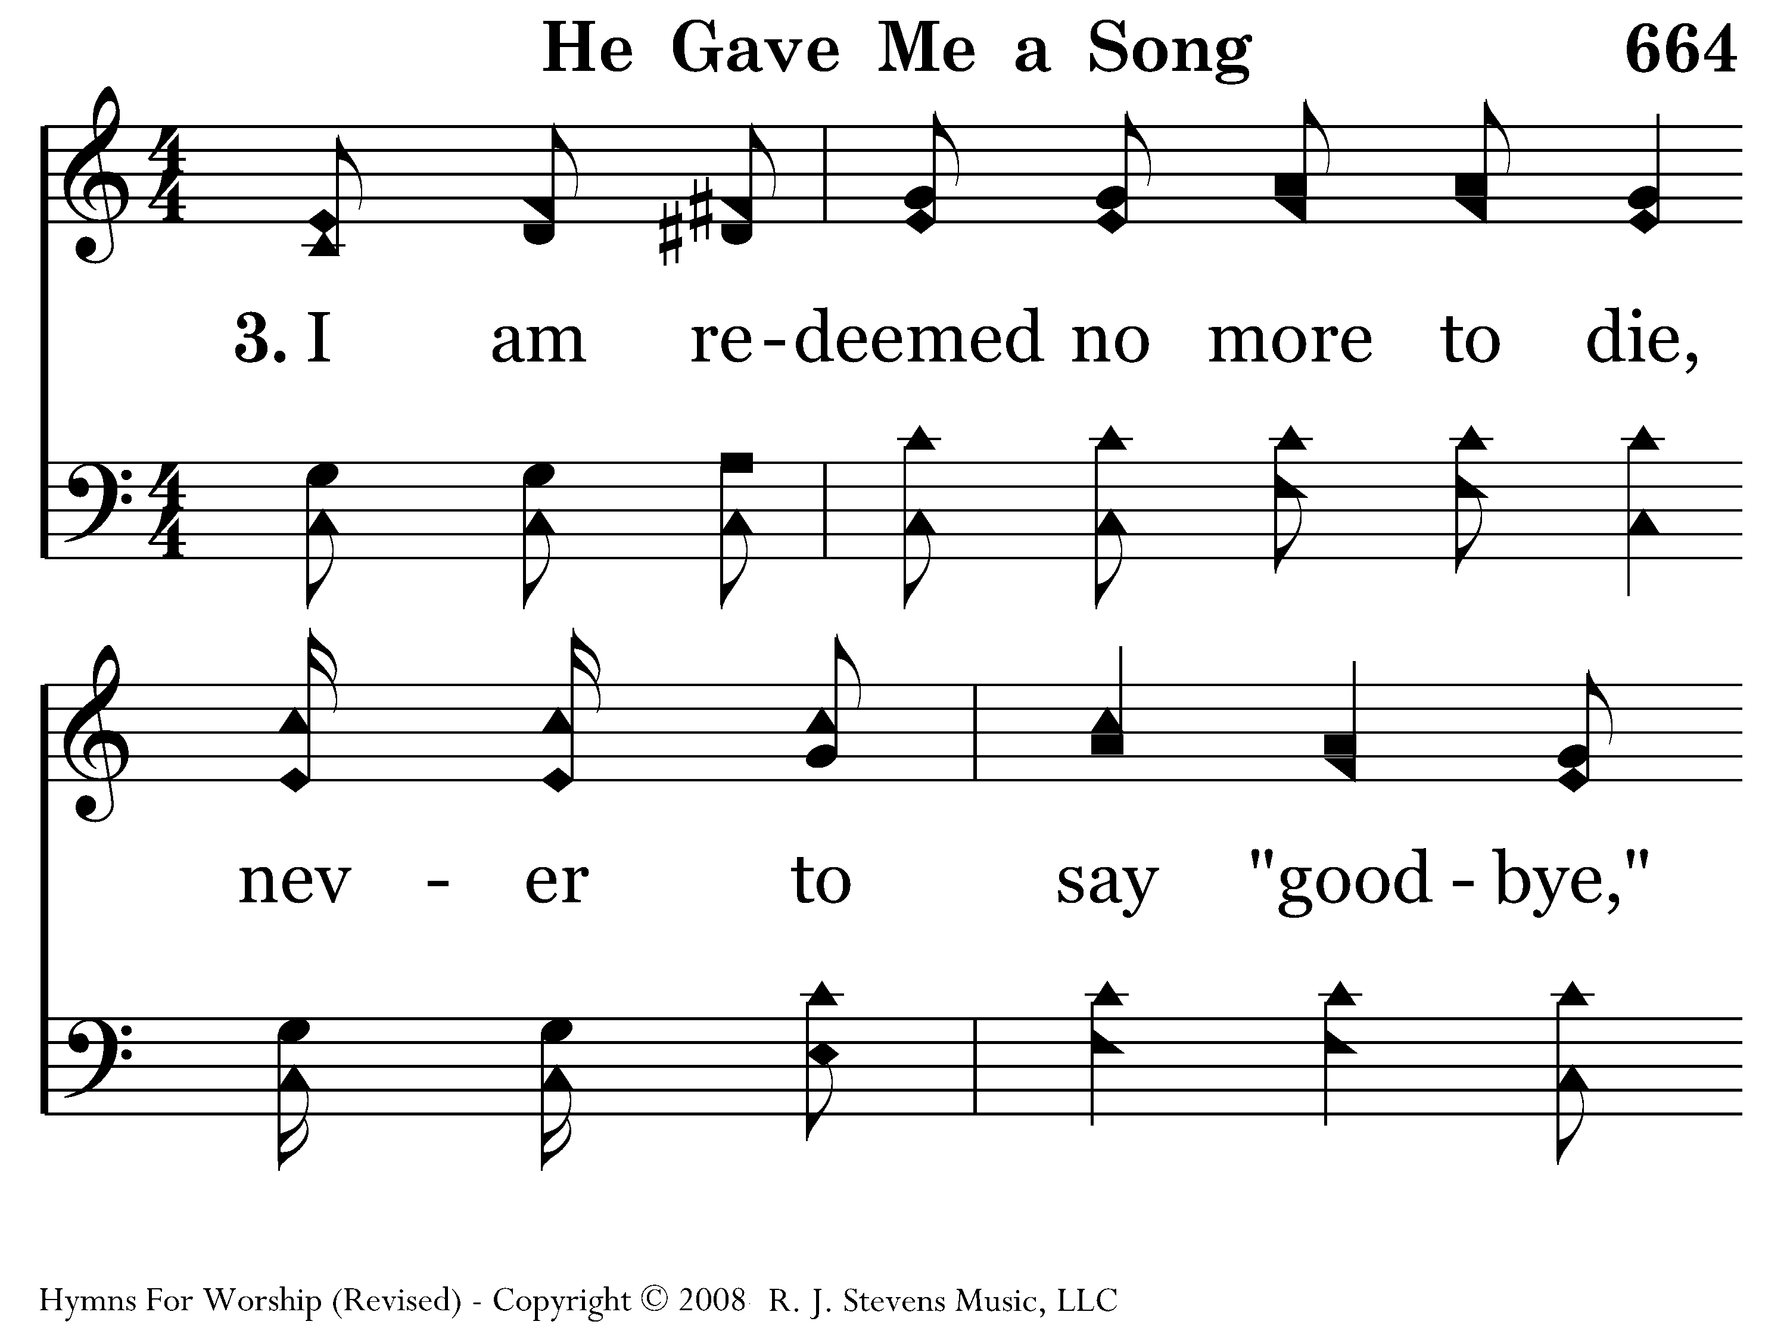
664 - He Gave Me A Song - 3.1

Slide 56
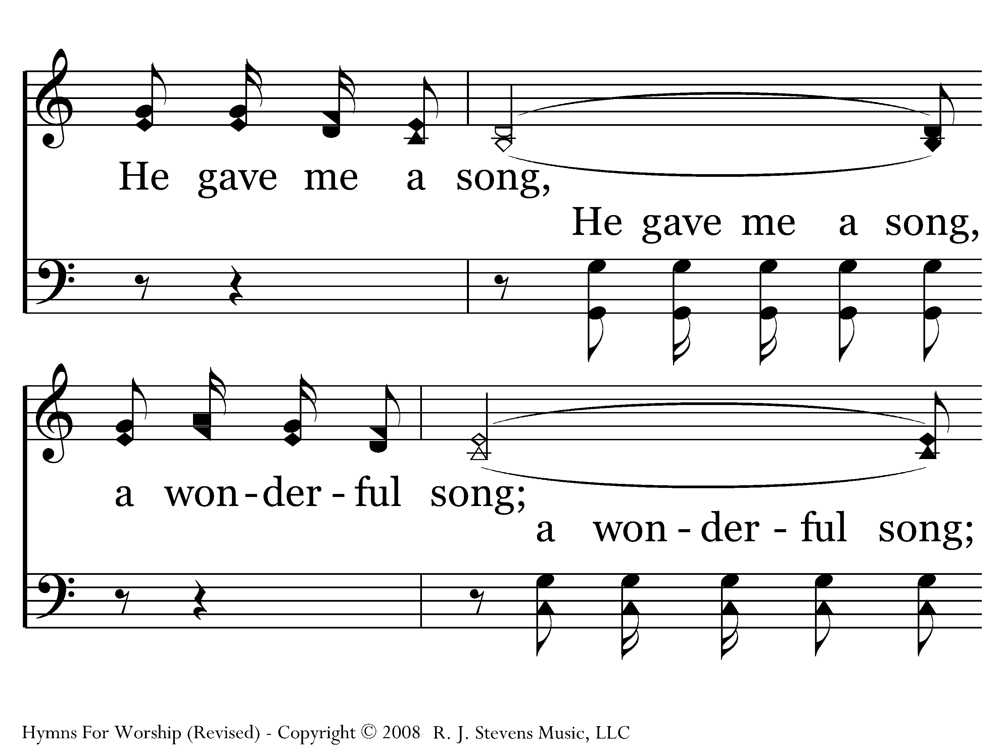
664 - He Gave Me A Song - 3.2

Slide 57
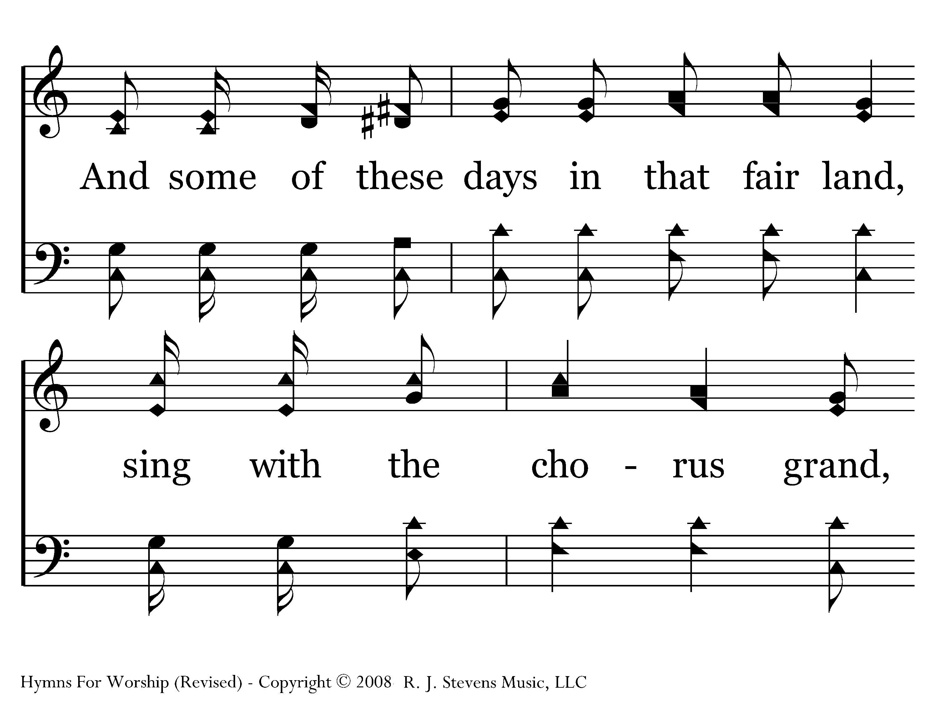
664 - He Gave Me A Song - 3.3

Slide 58
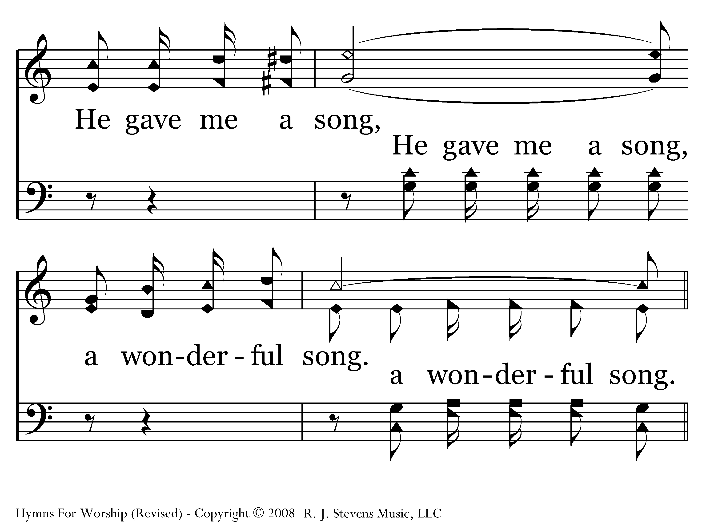
664 - He Gave Me A Song - 3.4

Slide 59
664 - He Gave Me A Song - C.1

Slide 60
664 - He Gave Me A Song - C.2

Slide 61
664 - He Gave Me A Song - C.3

Slide 62
664 - He Gave Me A Song - C.4
End of Song

Slide 63
Song Worship Leader’s Guide
Announce number, title, number, other info
Give pitch (start with DO)
Ready position/eye contact
Think starting tempo/first phrase
Wait !
Preparatory breath & beat to begin on first word
Continue conducting/eye contact/expression
Hold final note and give cut-off

Slide 64

498 - Where He Leads I'll Follow - Title

Slide 65
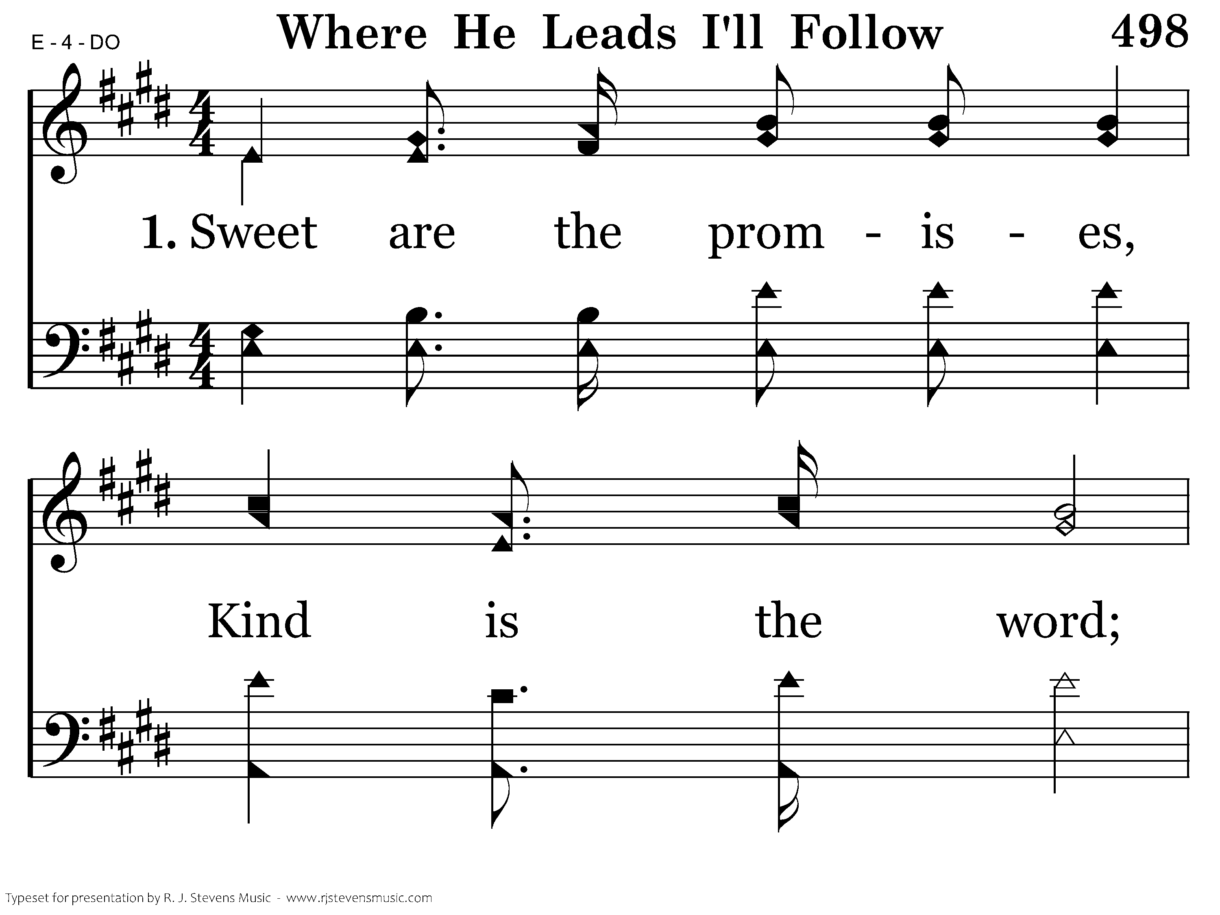
498 - Where He Leads I'll Follow - 1.1

Slide 66
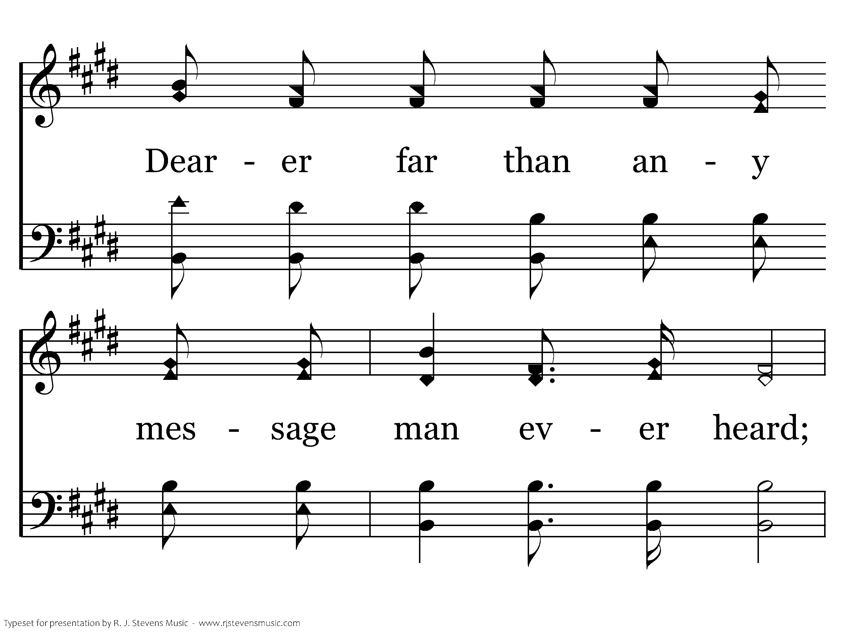
498 - Where He Leads I'll Follow - 1.2

Slide 67
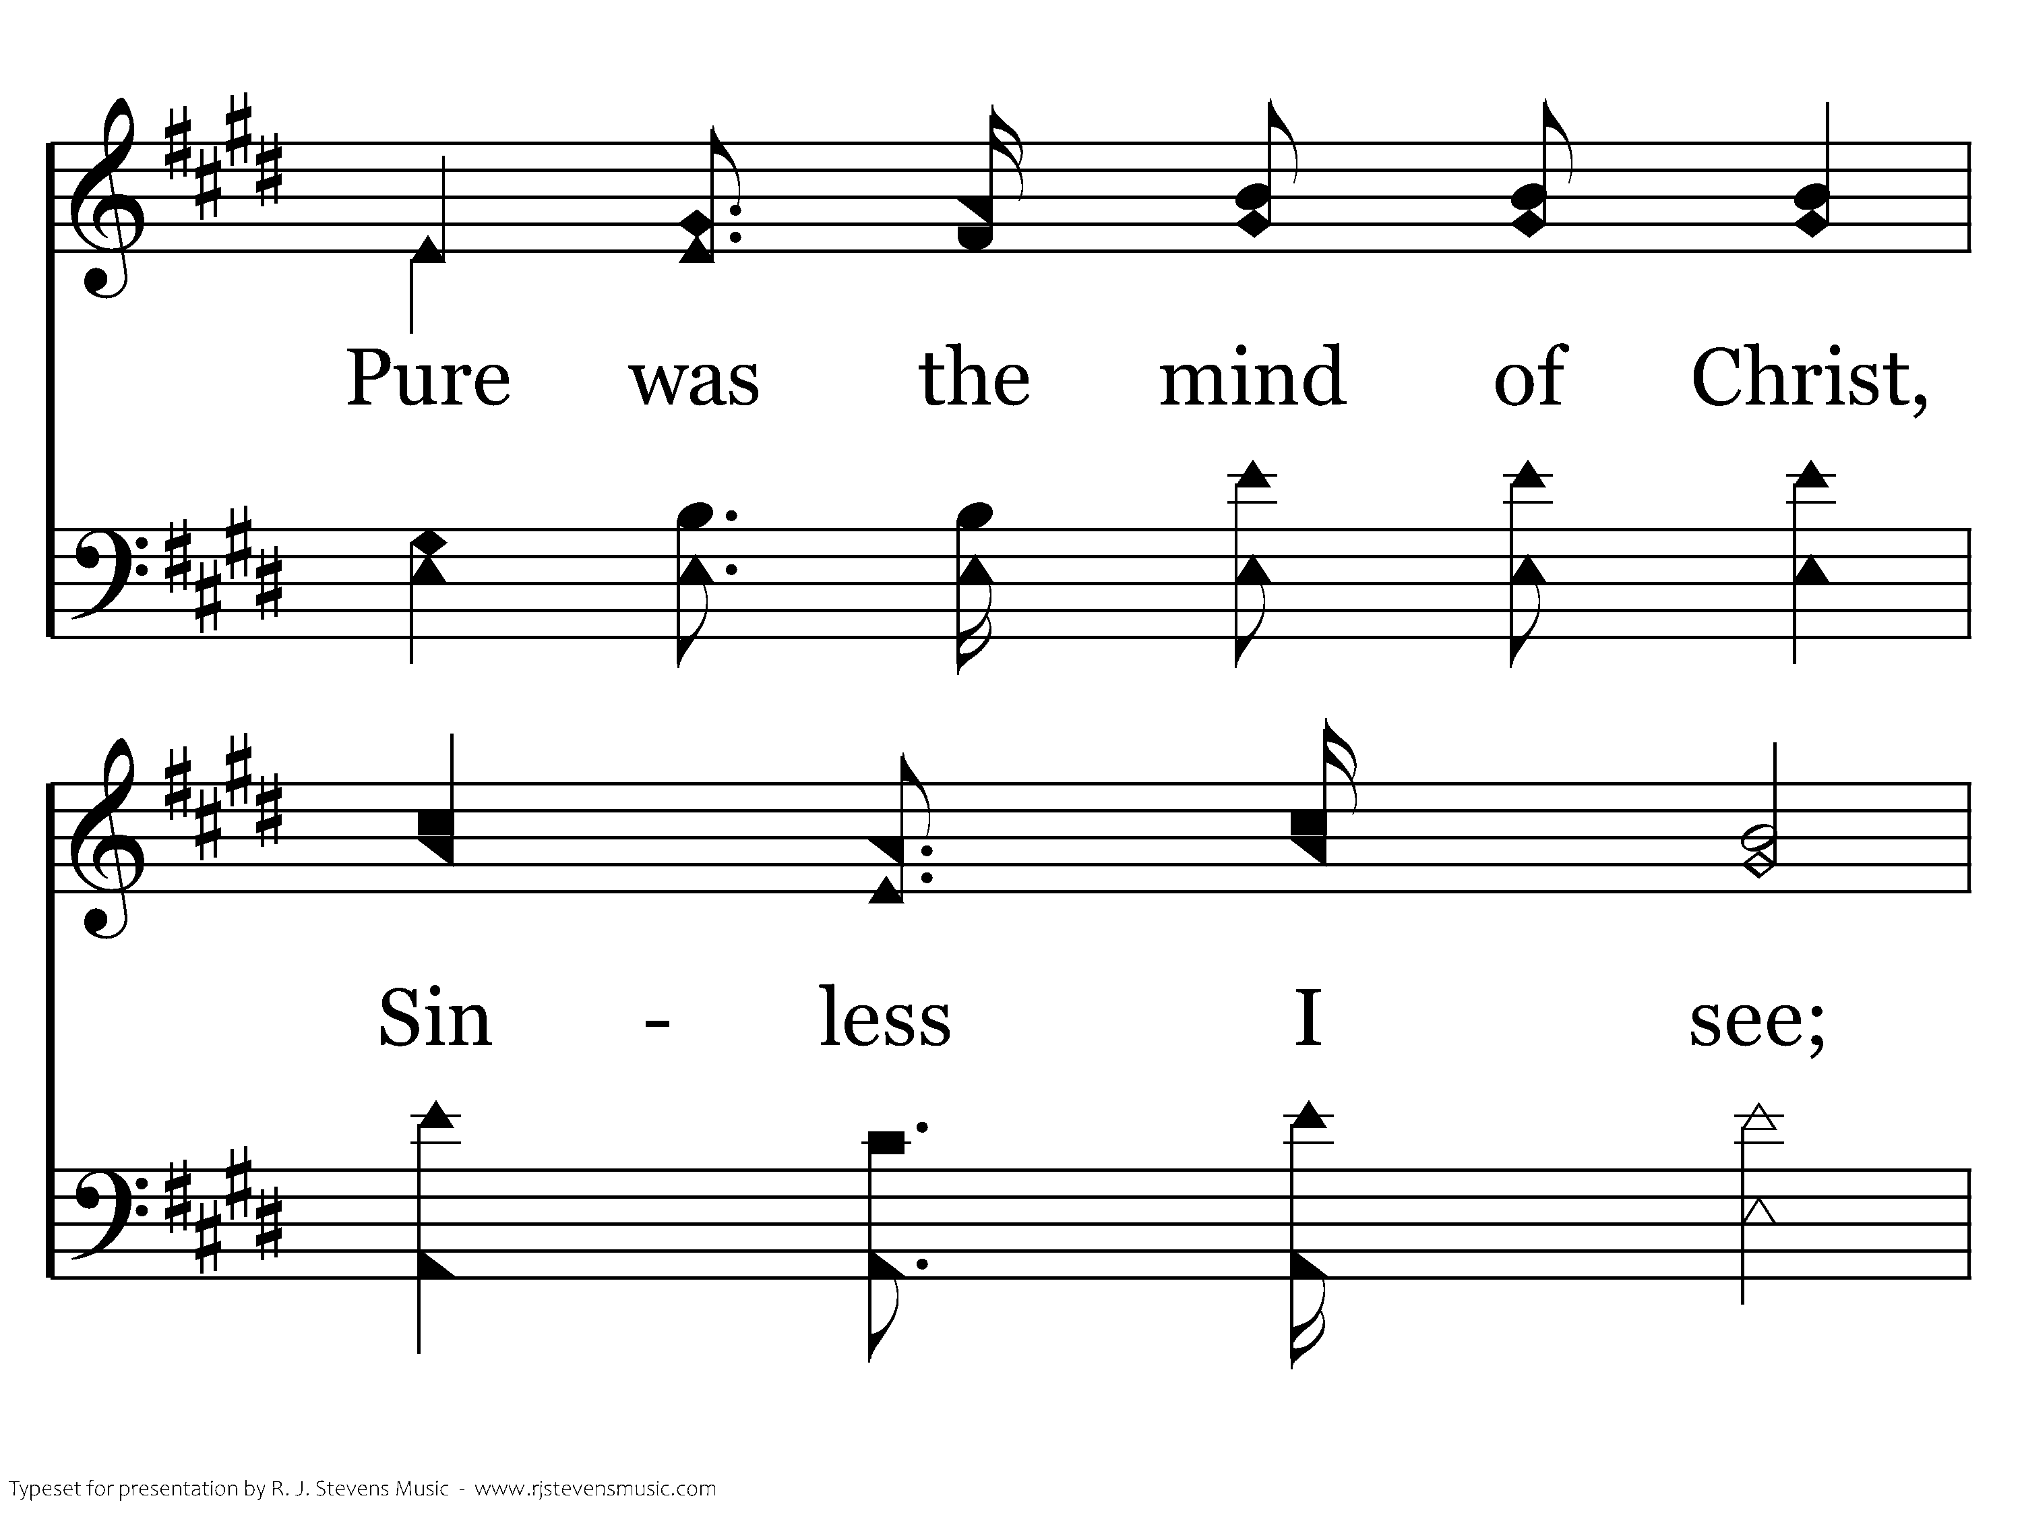
498 - Where He Leads I'll Follow - 1.3

Slide 68
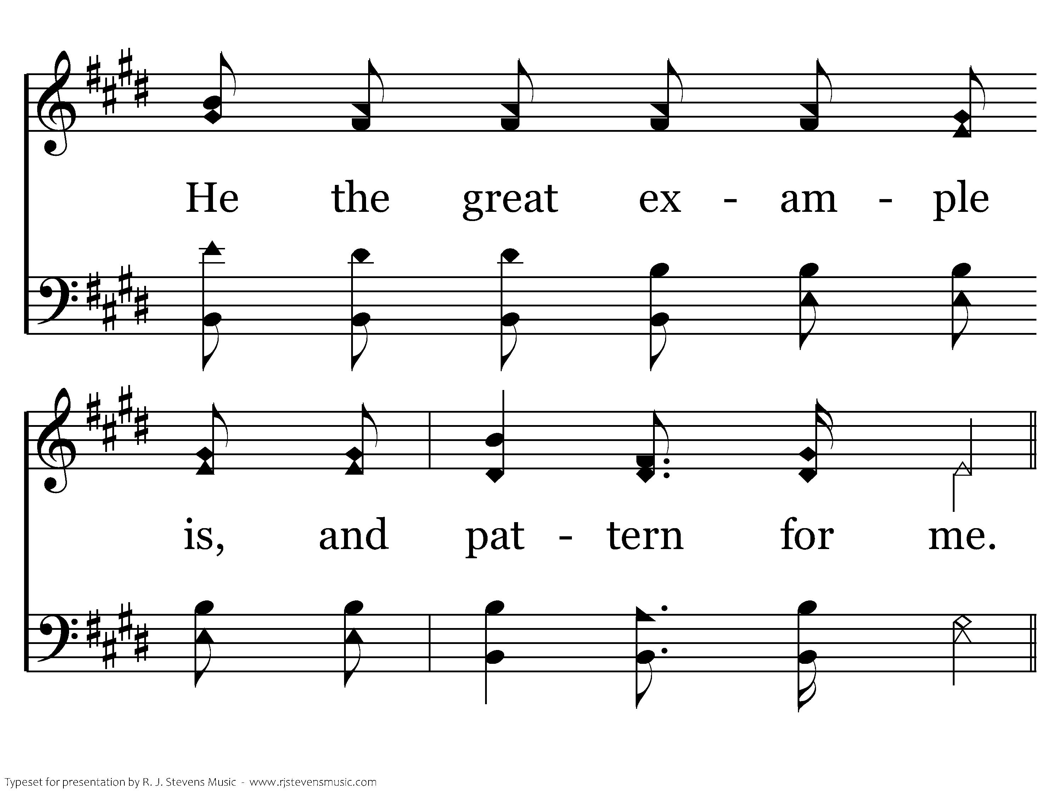
498 - Where He Leads I'll Follow - 1.4

Slide 69
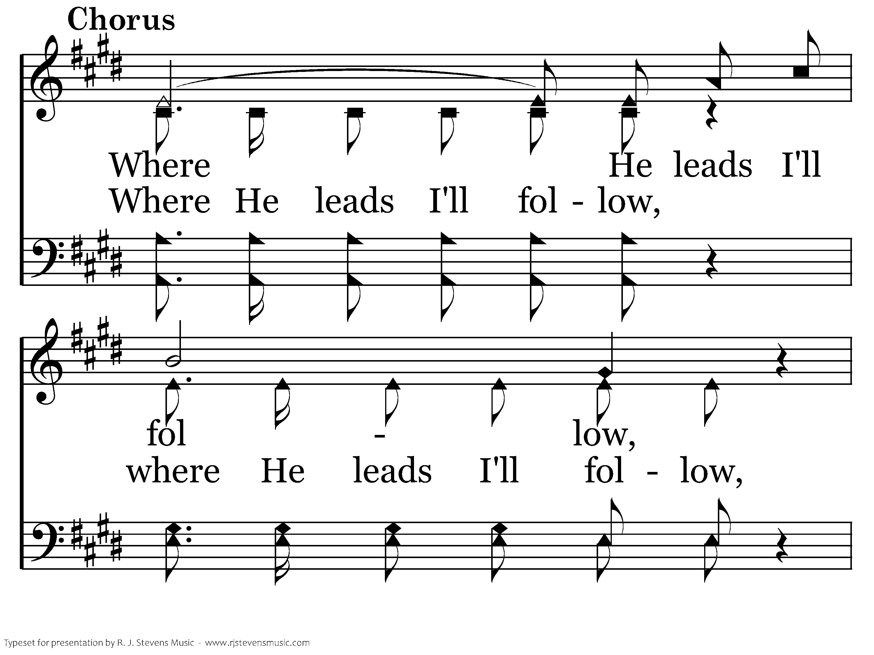
498 - Where He Leads I'll Follow - C.1

Slide 70
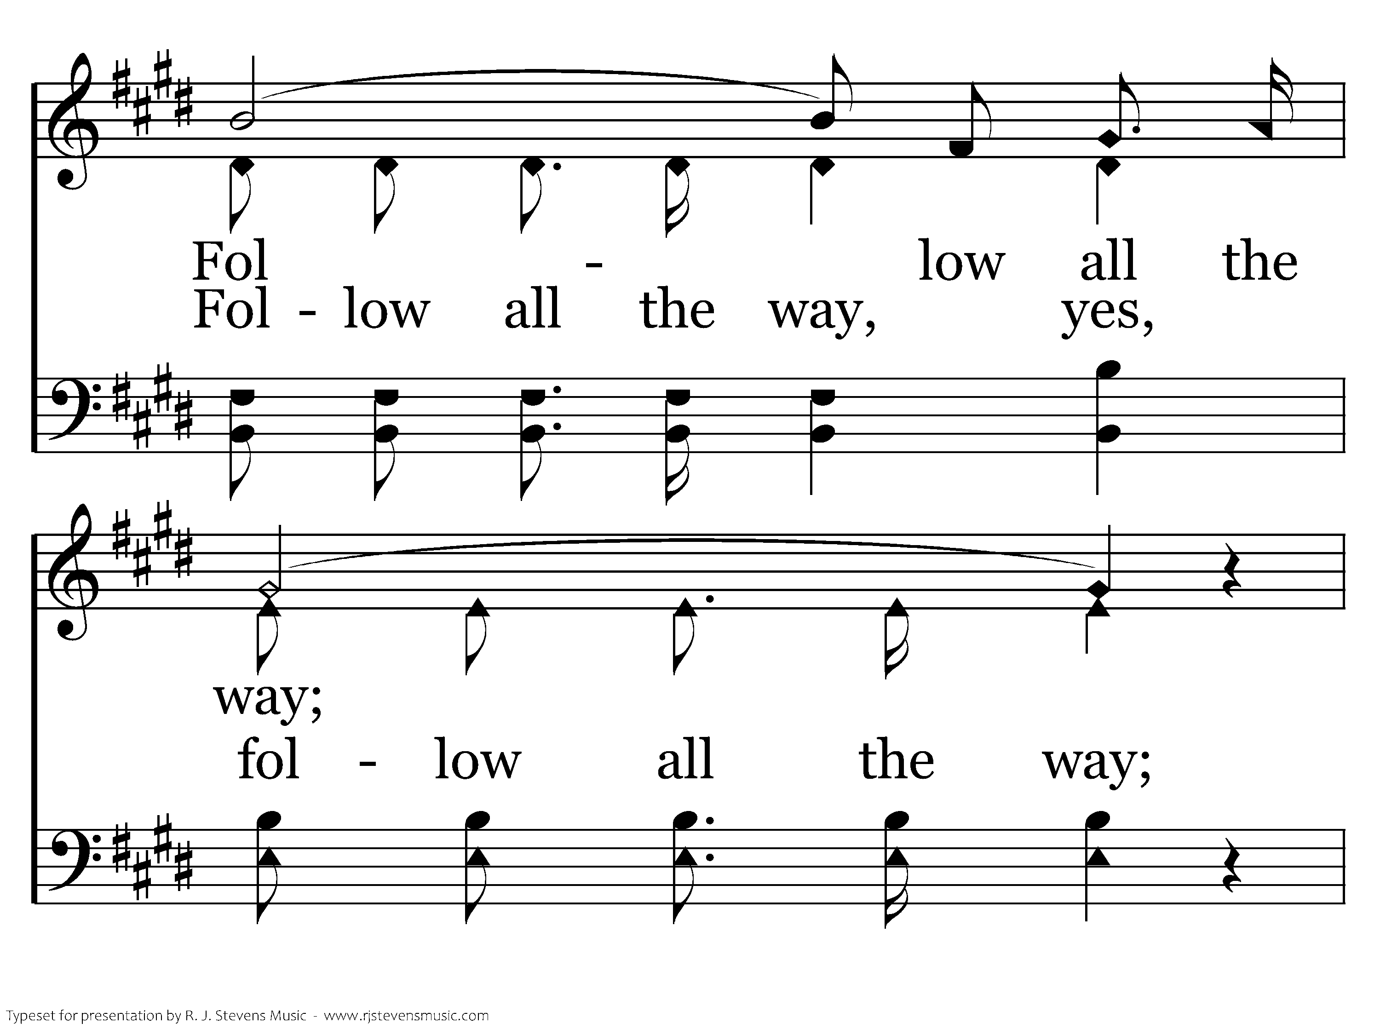
498 - Where He Leads I'll Follow - C.2

Slide 71
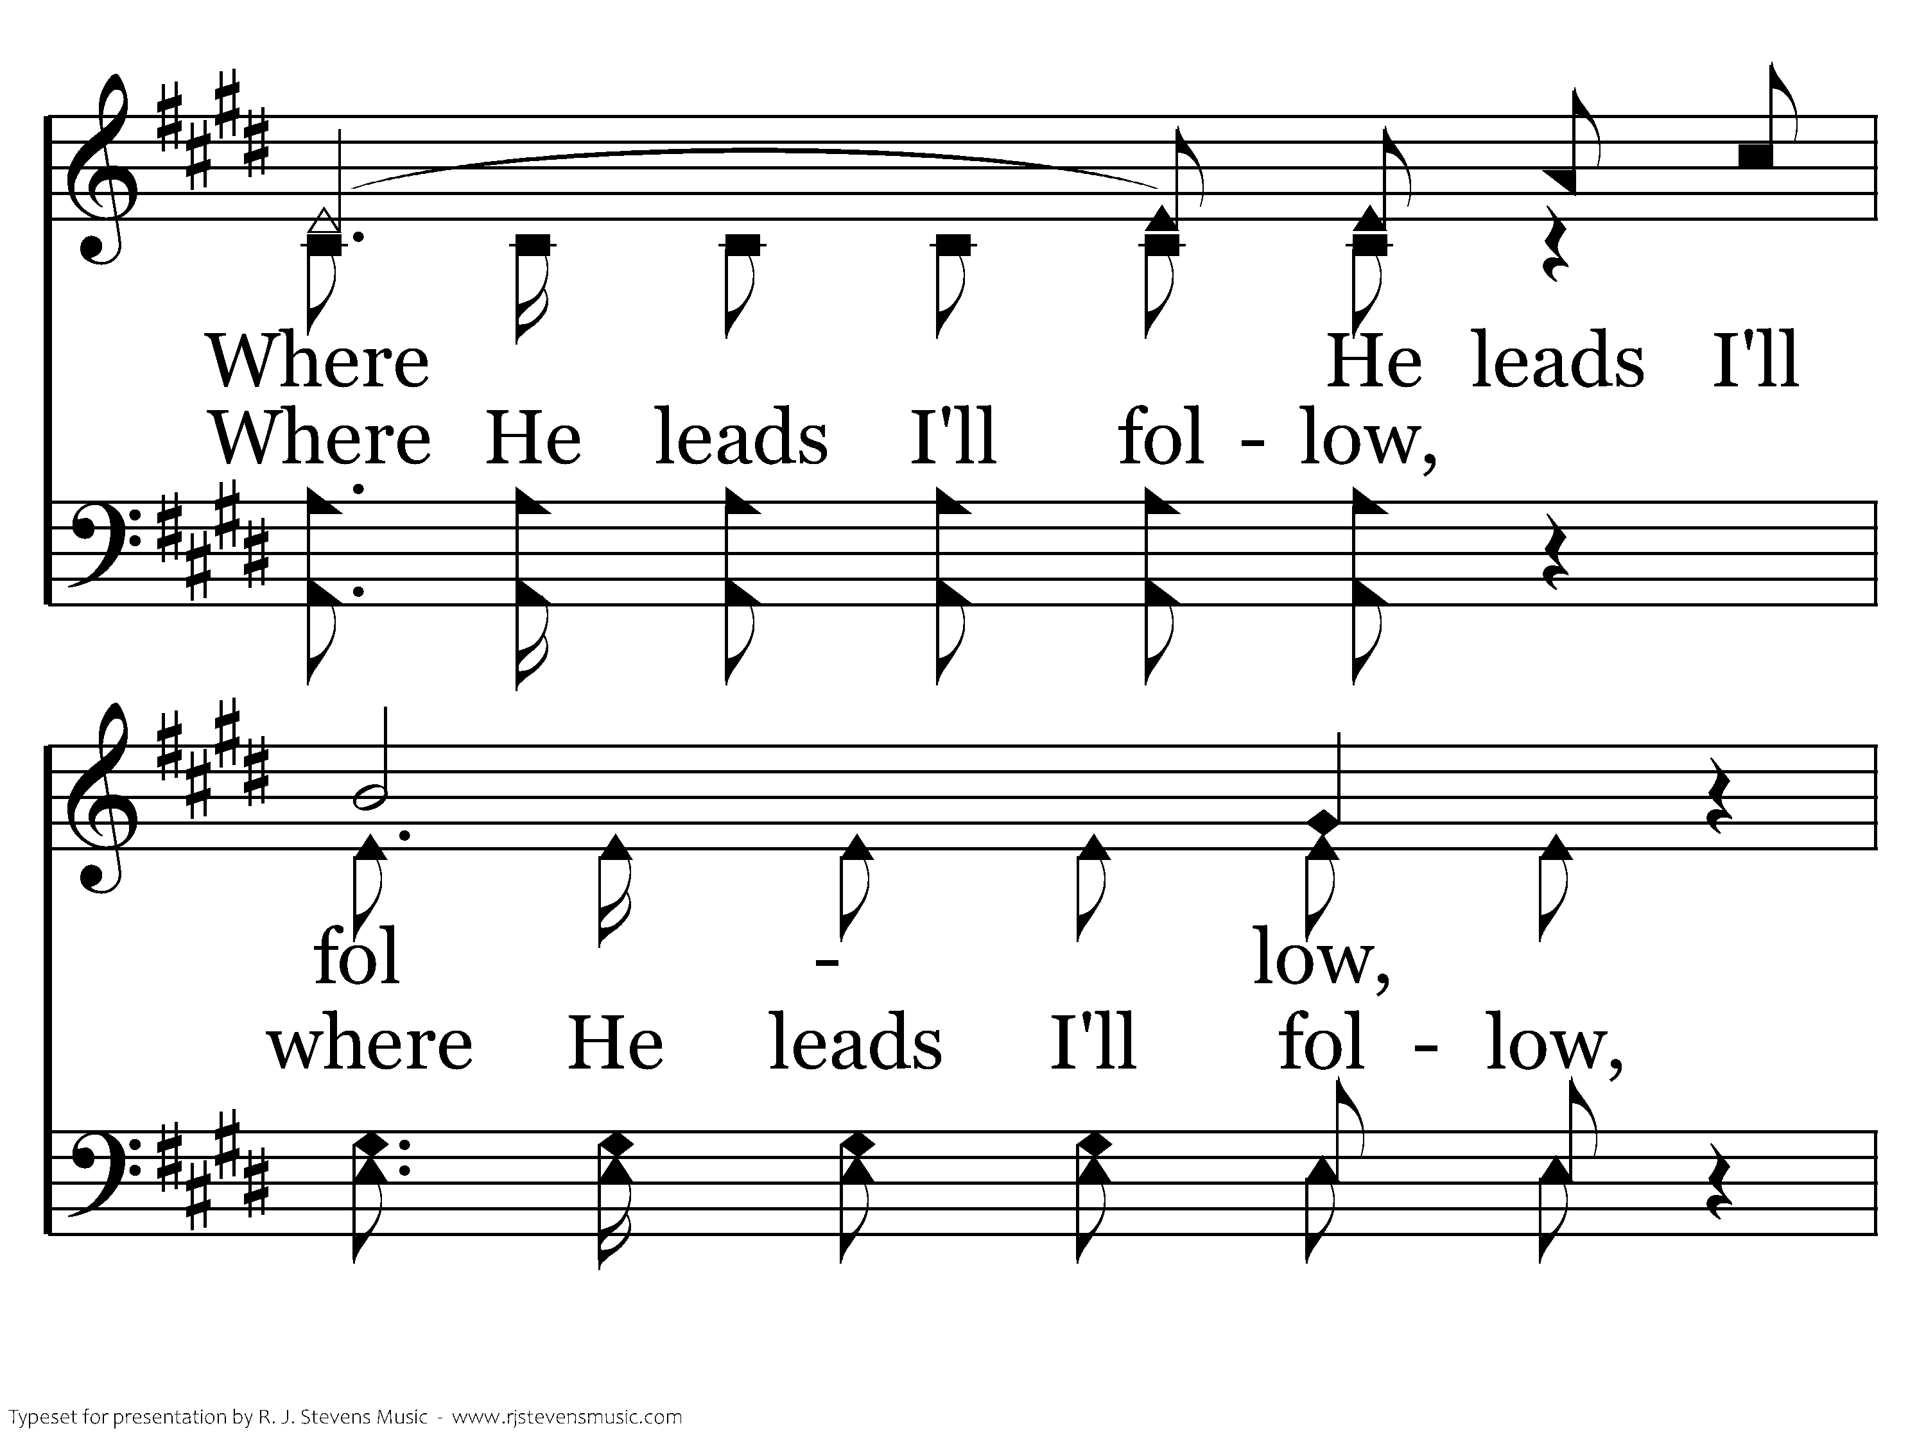
498 - Where He Leads I'll Follow - C.3

Slide 72
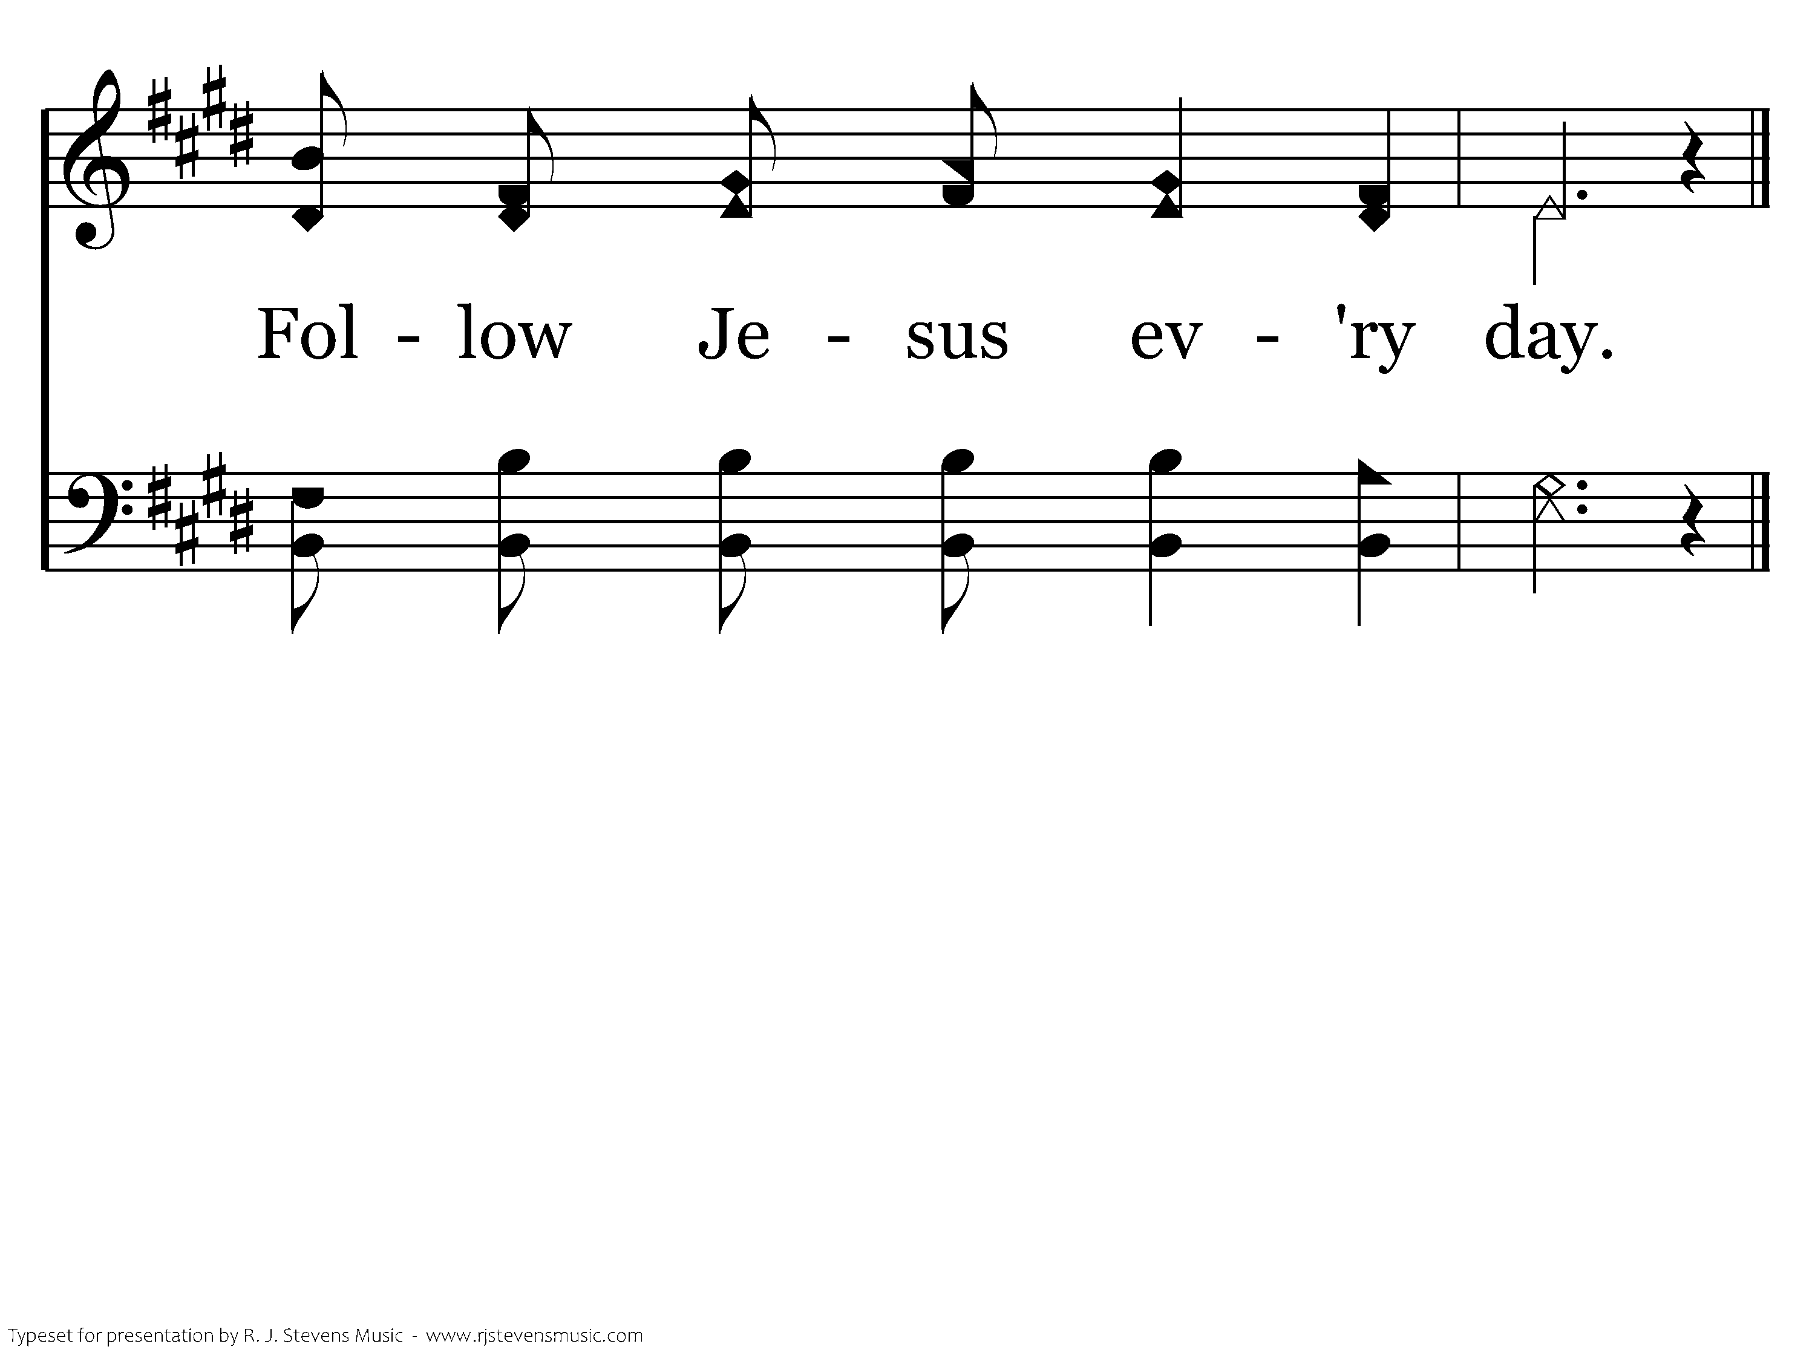
498 - Where He Leads I'll Follow - C.4
End of Verse 1

Slide 73
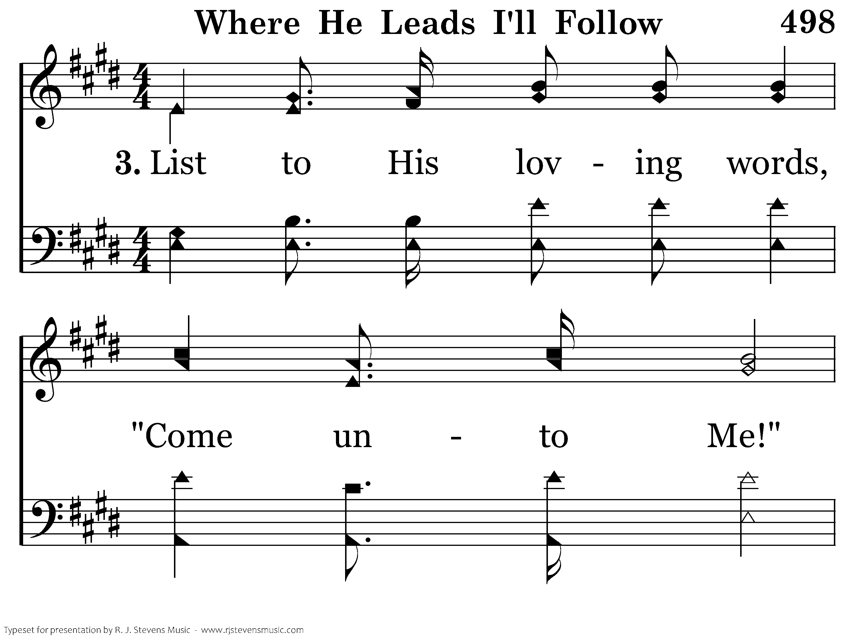
498 - Where He Leads I'll Follow - 3.1

Slide 74
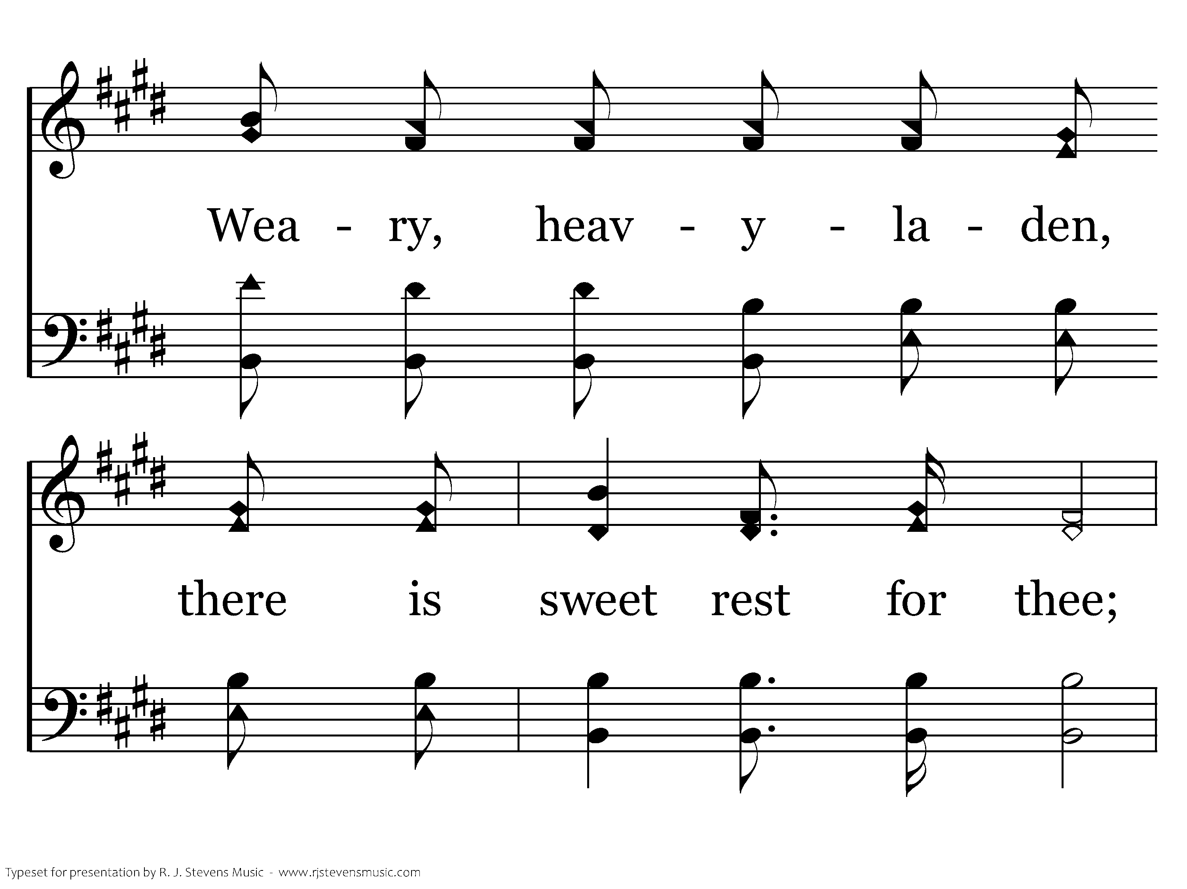
498 - Where He Leads I'll Follow - 3.2

Slide 75
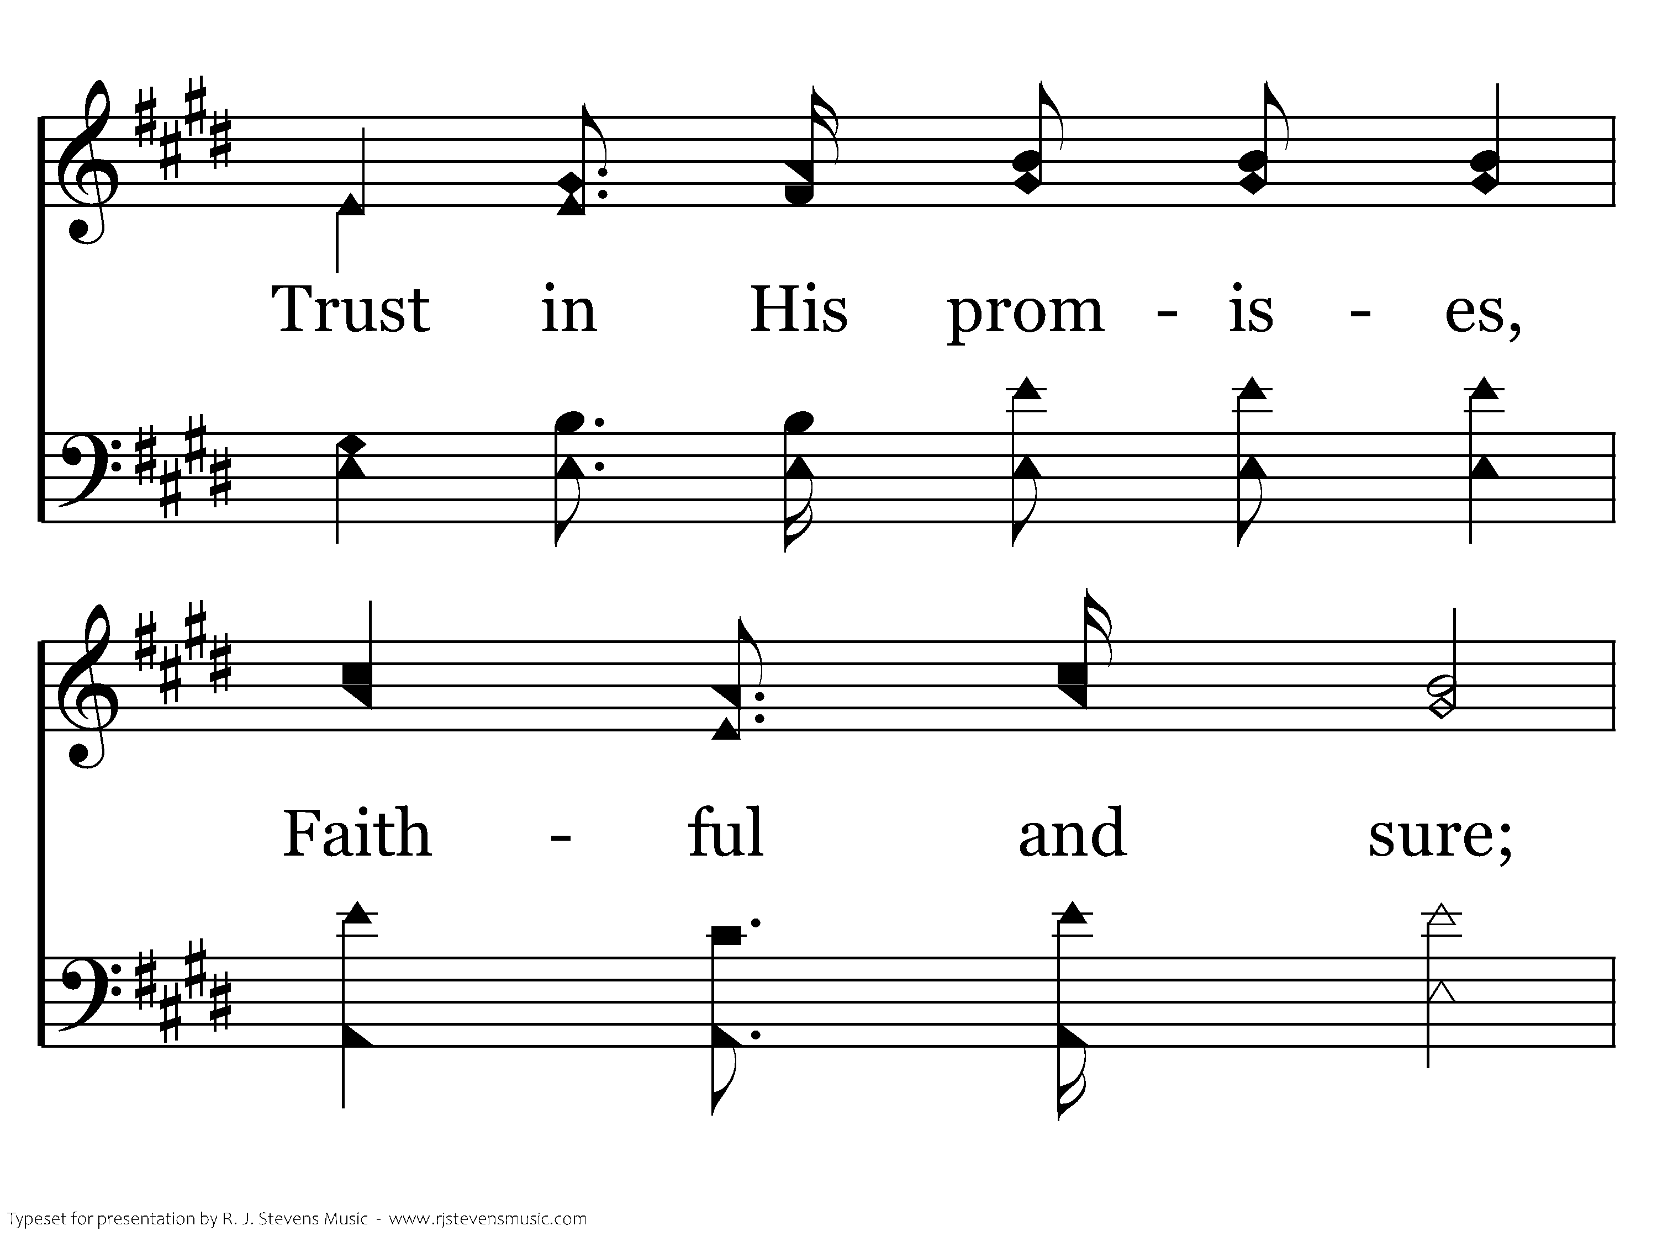
498 - Where He Leads I'll Follow - 3.3

Slide 76

498 - Where He Leads I'll Follow - 3.4

Slide 77
498 - Where He Leads I'll Follow - C.1

Slide 78
498 - Where He Leads I'll Follow - C.2

Slide 79
498 - Where He Leads I'll Follow - C.3

Slide 80
498 - Where He Leads I'll Follow - C.4
End of Song

Slide 81

679 - Jesus, Hold My Hand - Title

Slide 82

679 - Jesus, Hold My Hand - 1.1

Slide 83

679 - Jesus, Hold My Hand - 1.2

Slide 84

679 - Jesus, Hold My Hand - 1.3

Slide 85

679 - Jesus, Hold My Hand - 1.4

Slide 86

679 - Jesus, Hold My Hand - C.1

Slide 87

679 - Jesus, Hold My Hand - C.2

Slide 88

679 - Jesus, Hold My Hand - C.3

Slide 89

679 - Jesus, Hold My Hand - C.4

Slide 90

679 - Jesus, Hold My Hand - C.5
End of Verse 1

Slide 91

679 - Jesus, Hold My Hand - 3.1

Slide 92

679 - Jesus, Hold My Hand - 3.2

Slide 93

679 - Jesus, Hold My Hand - 3.3

Slide 94

679 - Jesus, Hold My Hand - 3.4

Slide 95
679 - Jesus, Hold My Hand - C.1

Slide 96
679 - Jesus, Hold My Hand - C.2

Slide 97
679 - Jesus, Hold My Hand - C.3

Slide 98
679 - Jesus, Hold My Hand - C.4

Slide 99
679 - Jesus, Hold My Hand - C.5
End of Song

Slide 100

608 - The Love Of God - Title

Slide 101

608 - The Love Of God - 1.1

Slide 102

608 - The Love Of God - 1.2

Slide 103

608 - The Love Of God - 1.3

Slide 104

608 - The Love Of God - 1.4

Slide 105

608 - The Love Of God - C.1

Slide 106

608 - The Love Of God - C.2
End of Verse 1

Slide 107

608 - The Love Of God - 3.1

Slide 108

608 - The Love Of God - 3.2

Slide 109

608 - The Love Of God - 3.3

Slide 110

608 - The Love Of God - 3.4

Slide 111
608 - The Love Of God - C.1

Slide 112
608 - The Love Of God - C.2
End of Song

Slide 113

1100 - Lamb Of God - Title

Slide 114

1100 - Lamb Of God - 1.1

Slide 115

1100 - Lamb Of God - 1.2

Slide 116

1100 - Lamb Of God - C.1

Slide 117

1100 - Lamb Of God - C.2
End of Verse 1

Slide 118

1100 - Lamb Of God - 2.1

Slide 119

1100 - Lamb Of God - 2.2

Slide 120
1100 - Lamb Of God - C.1

Slide 121
1100 - Lamb Of God - C.2
End of Verse 2

Slide 122

1100 - Lamb Of God - 3.1

Slide 123

1100 - Lamb Of God - 3.2

Slide 124
1100 - Lamb Of God - C.1

Slide 125
1100 - Lamb Of God - C.2
End of Song

Slide 126

1141 - We Will Glorify The King Of Kings - Title

Slide 127

1141 - We Will Glorify The King Of Kings - 1.1

Slide 128

1141 - We Will Glorify The King Of Kings - 1.2
End of Verse 1

Slide 129

1141 - We Will Glorify The King Of Kings - 2.1

Slide 130

1141 - We Will Glorify The King Of Kings - 2.2
End of Verse 2

Slide 131

1141 - We Will Glorify The King Of Kings - 3.1

Slide 132

1141 - We Will Glorify The King Of Kings - 3.2
End of Verse 3

Slide 133

1141 - We Will Glorify The King Of Kings - 4.1

Slide 134

1141 - We Will Glorify The King Of Kings - 4.2
End of Song

Slide 135

072 - Be With Me, Lord - Title

Slide 136

072 - Be With Me, Lord - 1.1

Slide 137

072 - Be With Me, Lord - 1.2
End of Verse 1

Slide 138

072 - Be With Me, Lord - 2.1

Slide 139

072 - Be With Me, Lord - 2.2
End of Verse 2

Slide 140

072 - Be With Me, Lord - 3.1

Slide 141

072 - Be With Me, Lord - 3.2
End of Verse 3

Slide 142

072 - Be With Me, Lord - 4.1

Slide 143

072 - Be With Me, Lord - 4.2
End of Song

Slide 144

013.15 - Alleluia - Title

Slide 145

013.15 - Alleluia - 1.1

Slide 146

013.15 - Alleluia - 1.2
End of Verse 1

Slide 147

013.15 - Alleluia - 2.1

Slide 148

013.15 - Alleluia - 2.2

Slide 149

013.15 - Alleluia - 2.3

Slide 150

013.15 - Alleluia - 2.4
End of Verse 2

Slide 151

013.15 - Alleluia - 3.1

Slide 152

013.15 - Alleluia - 3.2

Slide 153

013.15 - Alleluia - 3.3

Slide 154

013.15 - Alleluia - 3.4
End of Verse 3

Slide 155

013.15 - Alleluia - 4.1

Slide 156

013.15 - Alleluia - 4.2

Slide 157

013.15 - Alleluia - 4.3

Slide 158

013.15 - Alleluia - 4.4
End of Verse 4

Slide 159

013.15 - Alleluia - 5.1

Slide 160

013.15 - Alleluia - 5.2

Slide 161

013.15 - Alleluia - 5.3

Slide 162

013.15 - Alleluia - 5.4
End of Song

Slide 163

420 - O Thou Fount Of Every Blessing - Title

Slide 164

420 - O Thou Fount Of Every Blessing - 1.1

Slide 165

420 - O Thou Fount Of Every Blessing - 1.2

Slide 166

420 - O Thou Fount Of Every Blessing - 1.3

Slide 167

420 - O Thou Fount Of Every Blessing - 1.4
End of Verse 1

Slide 168

420 - O Thou Fount Of Every Blessing - 3.1

Slide 169

420 - O Thou Fount Of Every Blessing - 3.2

Slide 170

420 - O Thou Fount Of Every Blessing - 3.3

Slide 171

420 - O Thou Fount Of Every Blessing - 3.4
End of Song

Slide 172

085 - Sowing The Seed Of The Kingdom - Title

Slide 173

085 - Sowing The Seed Of The Kingdom - 1.1

Slide 174

085 - Sowing The Seed Of The Kingdom - 1.2

Slide 175

085 - Sowing The Seed Of The Kingdom - 1.3

Slide 176

085 - Sowing The Seed Of The Kingdom - C.1

Slide 177

085 - Sowing The Seed Of The Kingdom - C.2

Slide 178

085 - Sowing The Seed Of The Kingdom - C.3
End of Verse 1

Slide 179

085 - Sowing The Seed Of The Kingdom - 2.1

Slide 180

085 - Sowing The Seed Of The Kingdom - 2.2

Slide 181

085 - Sowing The Seed Of The Kingdom - 2.3

Slide 182
085 - Sowing The Seed Of The Kingdom - C.1

Slide 183
085 - Sowing The Seed Of The Kingdom - C.2

Slide 184
085 - Sowing The Seed Of The Kingdom - C.3
End of Verse 2

Slide 185

085 - Sowing The Seed Of The Kingdom - 3.1

Slide 186

085 - Sowing The Seed Of The Kingdom - 3.2

Slide 187

085 - Sowing The Seed Of The Kingdom - 3.3

Slide 188
085 - Sowing The Seed Of The Kingdom - C.1

Slide 189
085 - Sowing The Seed Of The Kingdom - C.2

Slide 190
085 - Sowing The Seed Of The Kingdom - C.3
End of Song

Slide 191

493 - Heaven Came Down - Title

Slide 192

493 - Heaven Came Down - 1.1

Slide 193

493 - Heaven Came Down - 1.2

Slide 194

493 - Heaven Came Down - 1.3

Slide 195

493 - Heaven Came Down - 1.4

Slide 196

493 - Heaven Came Down - C.1

Slide 197

493 - Heaven Came Down - C.2

Slide 198

493 - Heaven Came Down - C.3

Slide 199

493 - Heaven Came Down - C.4
End of Verse 1

Slide 200

493 - Heaven Came Down - 2.1

Slide 201

493 - Heaven Came Down - 2.2

Slide 202

493 - Heaven Came Down - 2.3

Slide 203

493 - Heaven Came Down - 2.4

Slide 204
493 - Heaven Came Down - C.1

Slide 205
493 - Heaven Came Down - C.2

Slide 206
493 - Heaven Came Down - C.3

Slide 207
493 - Heaven Came Down - C.4
End of Song

Slide 208

1025 - I Close My Eyes - Title

Slide 209

1025 - I Close My Eyes - 1.1

Slide 210

1025 - I Close My Eyes - 1.2

Slide 211

1025 - I Close My Eyes - 1.3

Slide 212

1025 - I Close My Eyes - 1.4

Slide 213

1025 - I Close My Eyes - C.1

Slide 214

1025 - I Close My Eyes - C.2
End of Verse 1

Slide 215

1025 - I Close My Eyes - 2.1

Slide 216

1025 - I Close My Eyes - 2.2

Slide 217

1025 - I Close My Eyes - 2.3

Slide 218

1025 - I Close My Eyes - 2.4

Slide 219
1025 - I Close My Eyes - C.1

Slide 220
1025 - I Close My Eyes - C.2
End of Song

Slide 221

647 - The Way That He Loves - Title

Slide 222

647 - The Way That He Loves - 1.1

Slide 223

647 - The Way That He Loves - 1.2

Slide 224

647 - The Way That He Loves - 1.3

Slide 225

647 - The Way That He Loves - 1.4
End of Verse 1

Slide 226

647 - The Way That He Loves - 2.1

Slide 227

647 - The Way That He Loves - 2.2

Slide 228

647 - The Way That He Loves - 2.3

Slide 229

647 - The Way That He Loves - 2.4
End of Song

Slide 230

473 - When He Comes In Glory By And By - Title

Slide 231

473 - When He Comes In Glory By And By - 1.1

Slide 232

473 - When He Comes In Glory By And By - 1.2

Slide 233

473 - When He Comes In Glory By And By - C.1

Slide 234

473 - When He Comes In Glory By And By - C.2
End of Verse 1

Slide 235

473 - When He Comes In Glory By And By - 3.1

Slide 236

473 - When He Comes In Glory By And By - 3.2

Slide 237
473 - When He Comes In Glory By And By - C.1

Slide 238
473 - When He Comes In Glory By And By - C.2
End of Song

Slide 240

232 - When All Of God's Singers Get Home - Title

Slide 241

232 - When All Of God's Singers Get Home - 1.1

Slide 242

232 - When All Of God's Singers Get Home - 1.2

Slide 243

232 - When All Of God's Singers Get Home - 1.3

Slide 244

232 - When All Of God's Singers Get Home - C.1

Slide 245

232 - When All Of God's Singers Get Home - C.2
End of Verse 1

Slide 246

232 - When All Of God's Singers Get Home - 3.1

Slide 247

232 - When All Of God's Singers Get Home - 3.2

Slide 248

232 - When All Of God's Singers Get Home - 3.3

Slide 249
232 - When All Of God's Singers Get Home - C.1

Slide 250
232 - When All Of God's Singers Get Home - C.2
End of Song

Slide 252

230 - This World Is Not My Home - Title

Slide 253

230 - This World Is Not My Home - 1.1

Slide 254

230 - This World Is Not My Home - 1.2

Slide 255

230 - This World Is Not My Home - 1.3

Slide 256

230 - This World Is Not My Home - 1.4

Slide 257

230 - This World Is Not My Home - C.1

Slide 258

230 - This World Is Not My Home - C.2

Slide 259

230 - This World Is Not My Home - C.3

Slide 260

230 - This World Is Not My Home - C.4
End of Verse 1

Slide 261

230 - This World Is Not My Home - 3.1

Slide 262

230 - This World Is Not My Home - 3.2

Slide 263

230 - This World Is Not My Home - 3.3

Slide 264

230 - This World Is Not My Home - 3.4

Slide 265
230 - This World Is Not My Home - C.1

Slide 266
230 - This World Is Not My Home - C.2

Slide 267
230 - This World Is Not My Home - C.3

Slide 268
230 - This World Is Not My Home - C.4
End of Song

