Slide 1
A Report Preaching the Gospel in Spanish
University CHURCH OF CHRIST Tampa, Florida
March 27, 2022

Slide 2
Started Preaching October 3, 1965 Port Arthur, Texas Tex-Mex Spanish English

Slide 3
1930’s – USA & MEXICO * S.A. Argentina – Chile – Brazil – Colombia Ecuador – Peru – Uruguay – Venezuela * C.A. Costa Rica – El Salvador – Guatemala Nicaragua – Honduras * Caribbean Cuba – Dominican Republic – Cayman Islands – Saint Croix * Canada Calgary – Montreal * Europe Spain – England – Switzerland

Slide 4
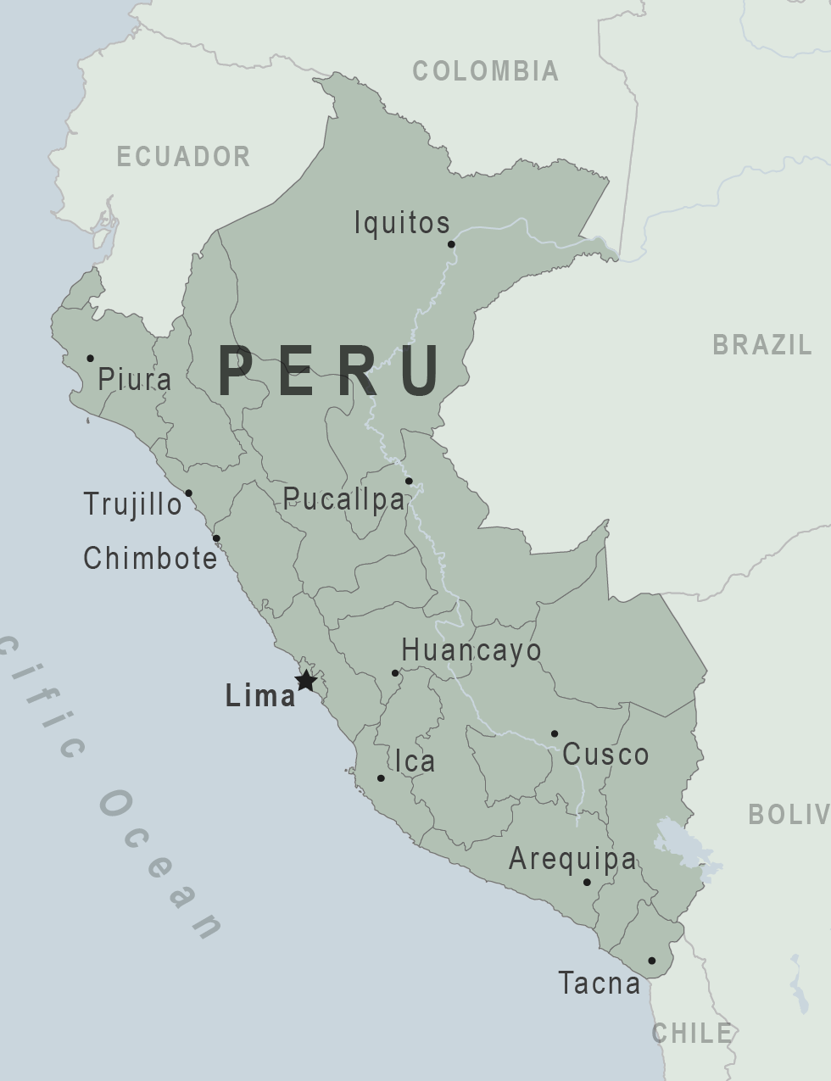
2021; 2022 ○Lima ○Piura ○Catacaos

Slide 5
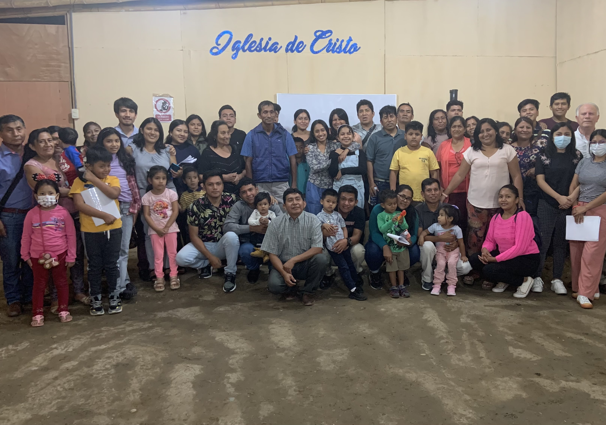
Catacaos

Slide 6
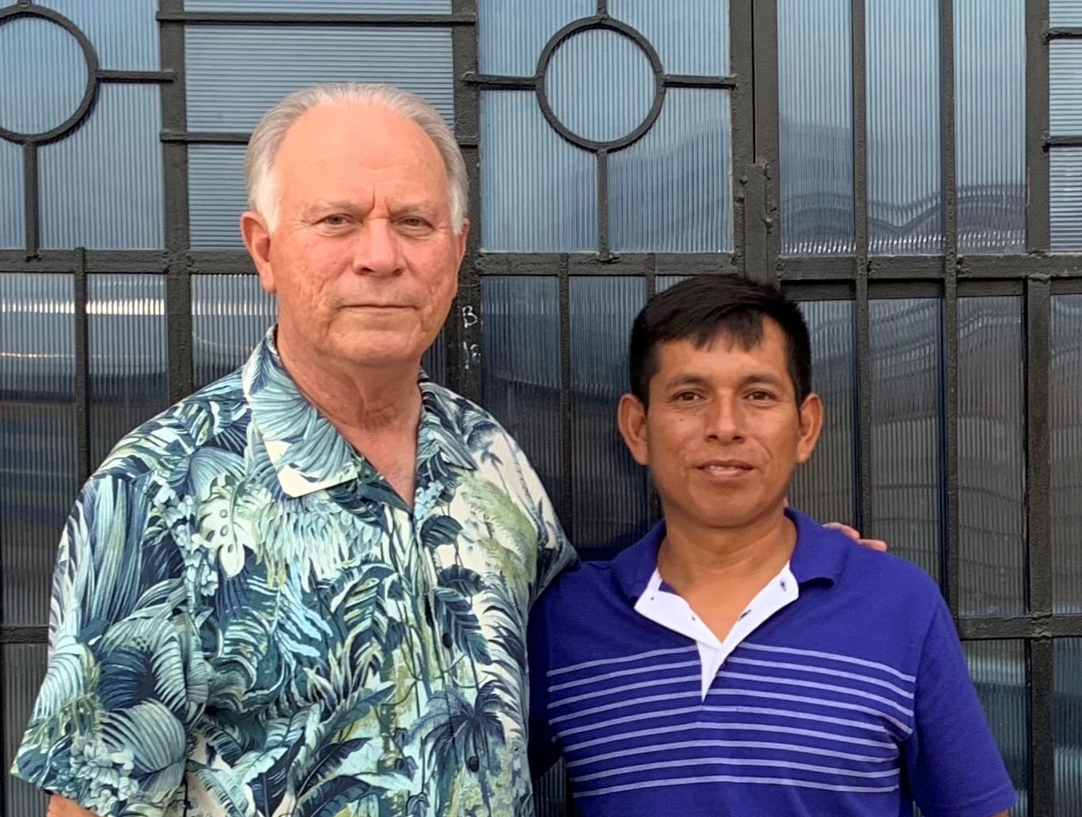
Henrry Nelson Cruz

Slide 7
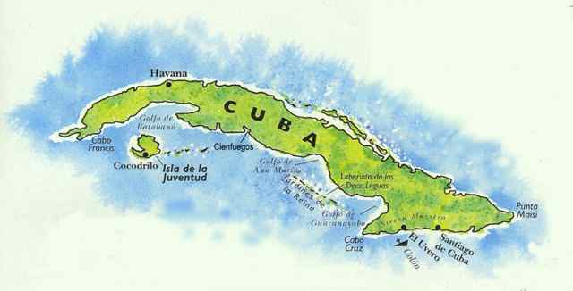
Havana, Cuba March 2022

Slide 8
Tampa, Florida 1930’s – 1940’s
José Ricardo Jiménez – Cuban/USA Ernesto Estévez – Cuban/USA
Pedro Puig – Cuban/USA

