Slide 1


The why and how of song worship

Slide 2
I John 3:2— Beloved, we are God’s children now, and what we will be has not yet appeared; but we know that when He appears we shall be like Him, because we shall see Him as He is.

Slide 3
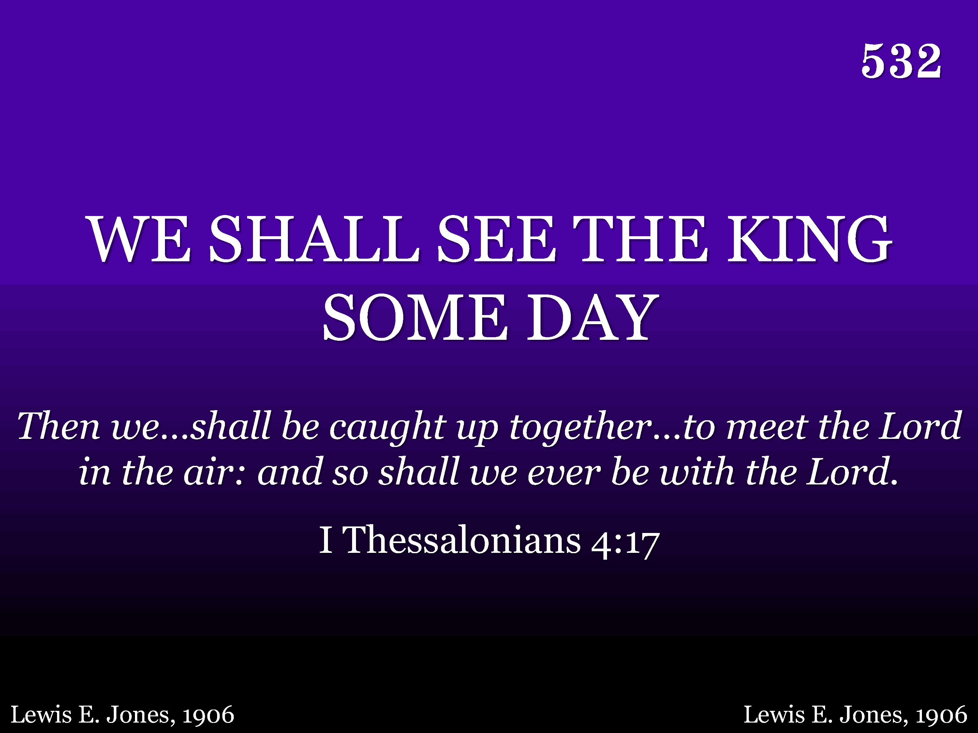
532 - We Shall See The King Some Day - Title

Slide 4
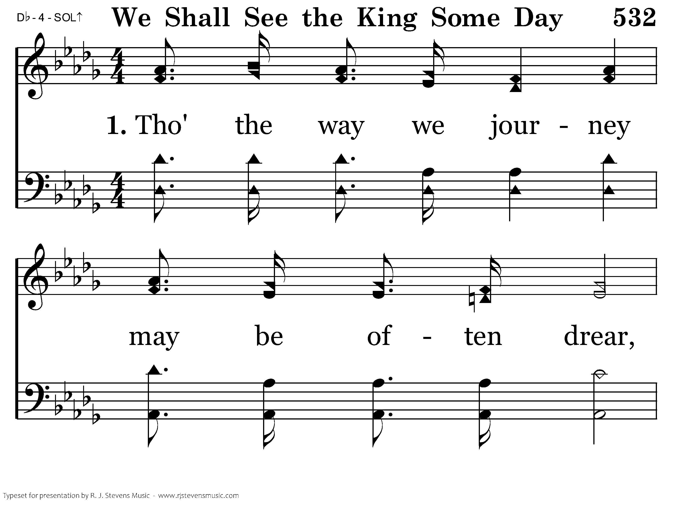
532 - We Shall See The King Some Day - 1.1

Slide 5
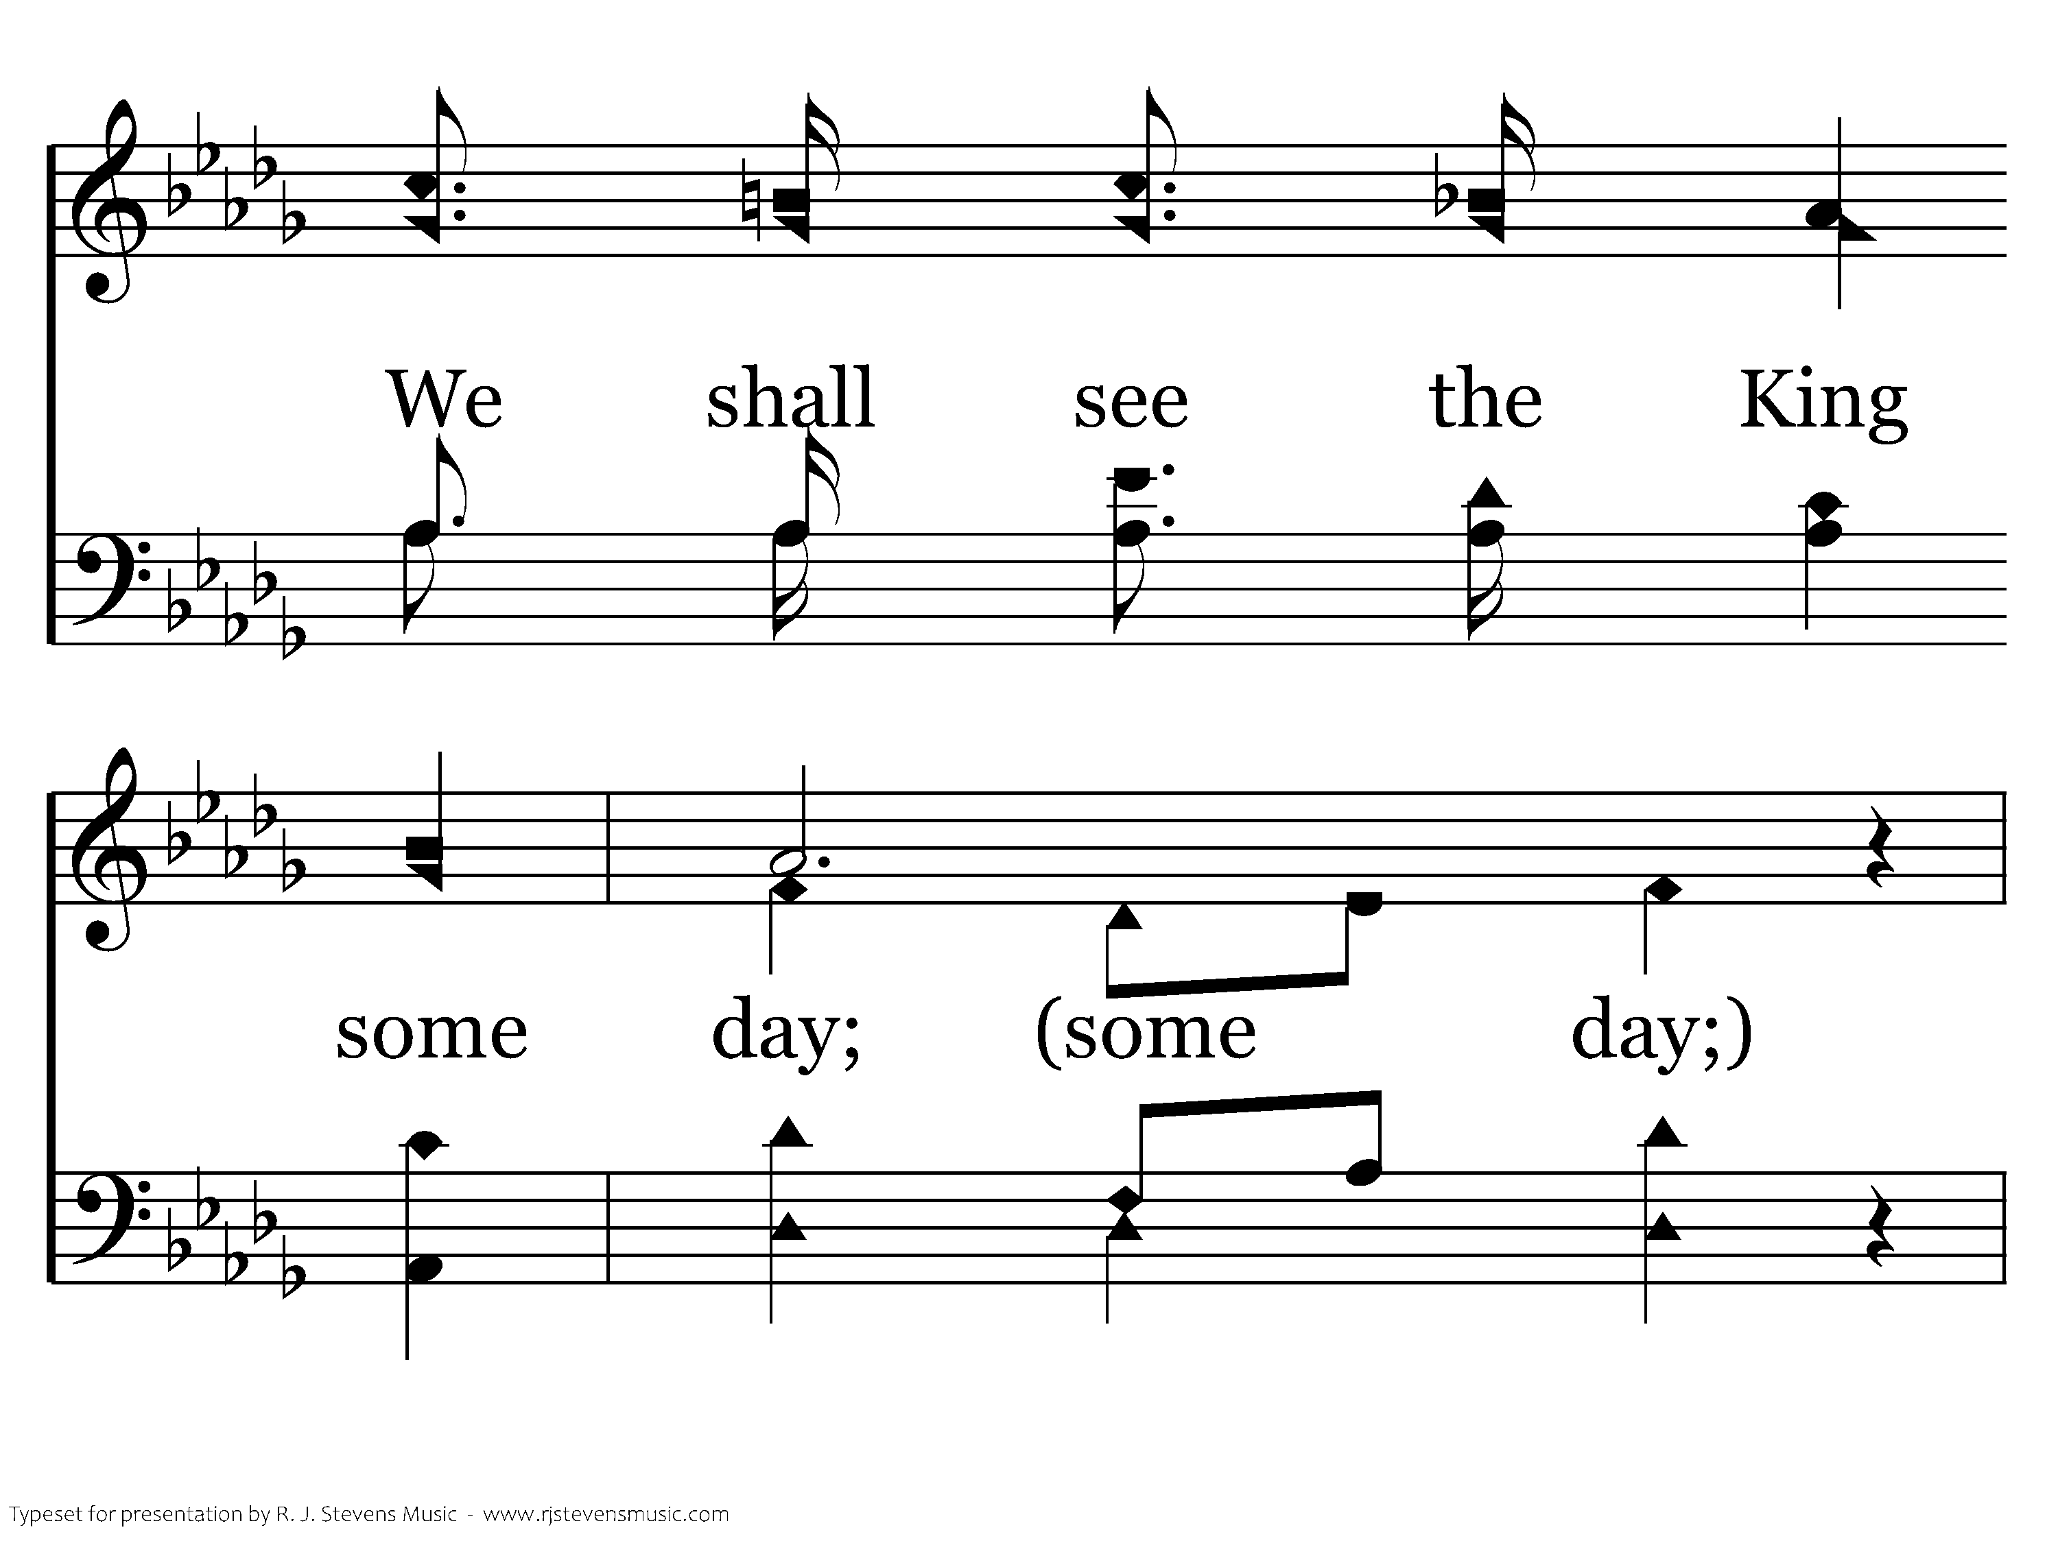
532 - We Shall See The King Some Day - 1.2

Slide 6
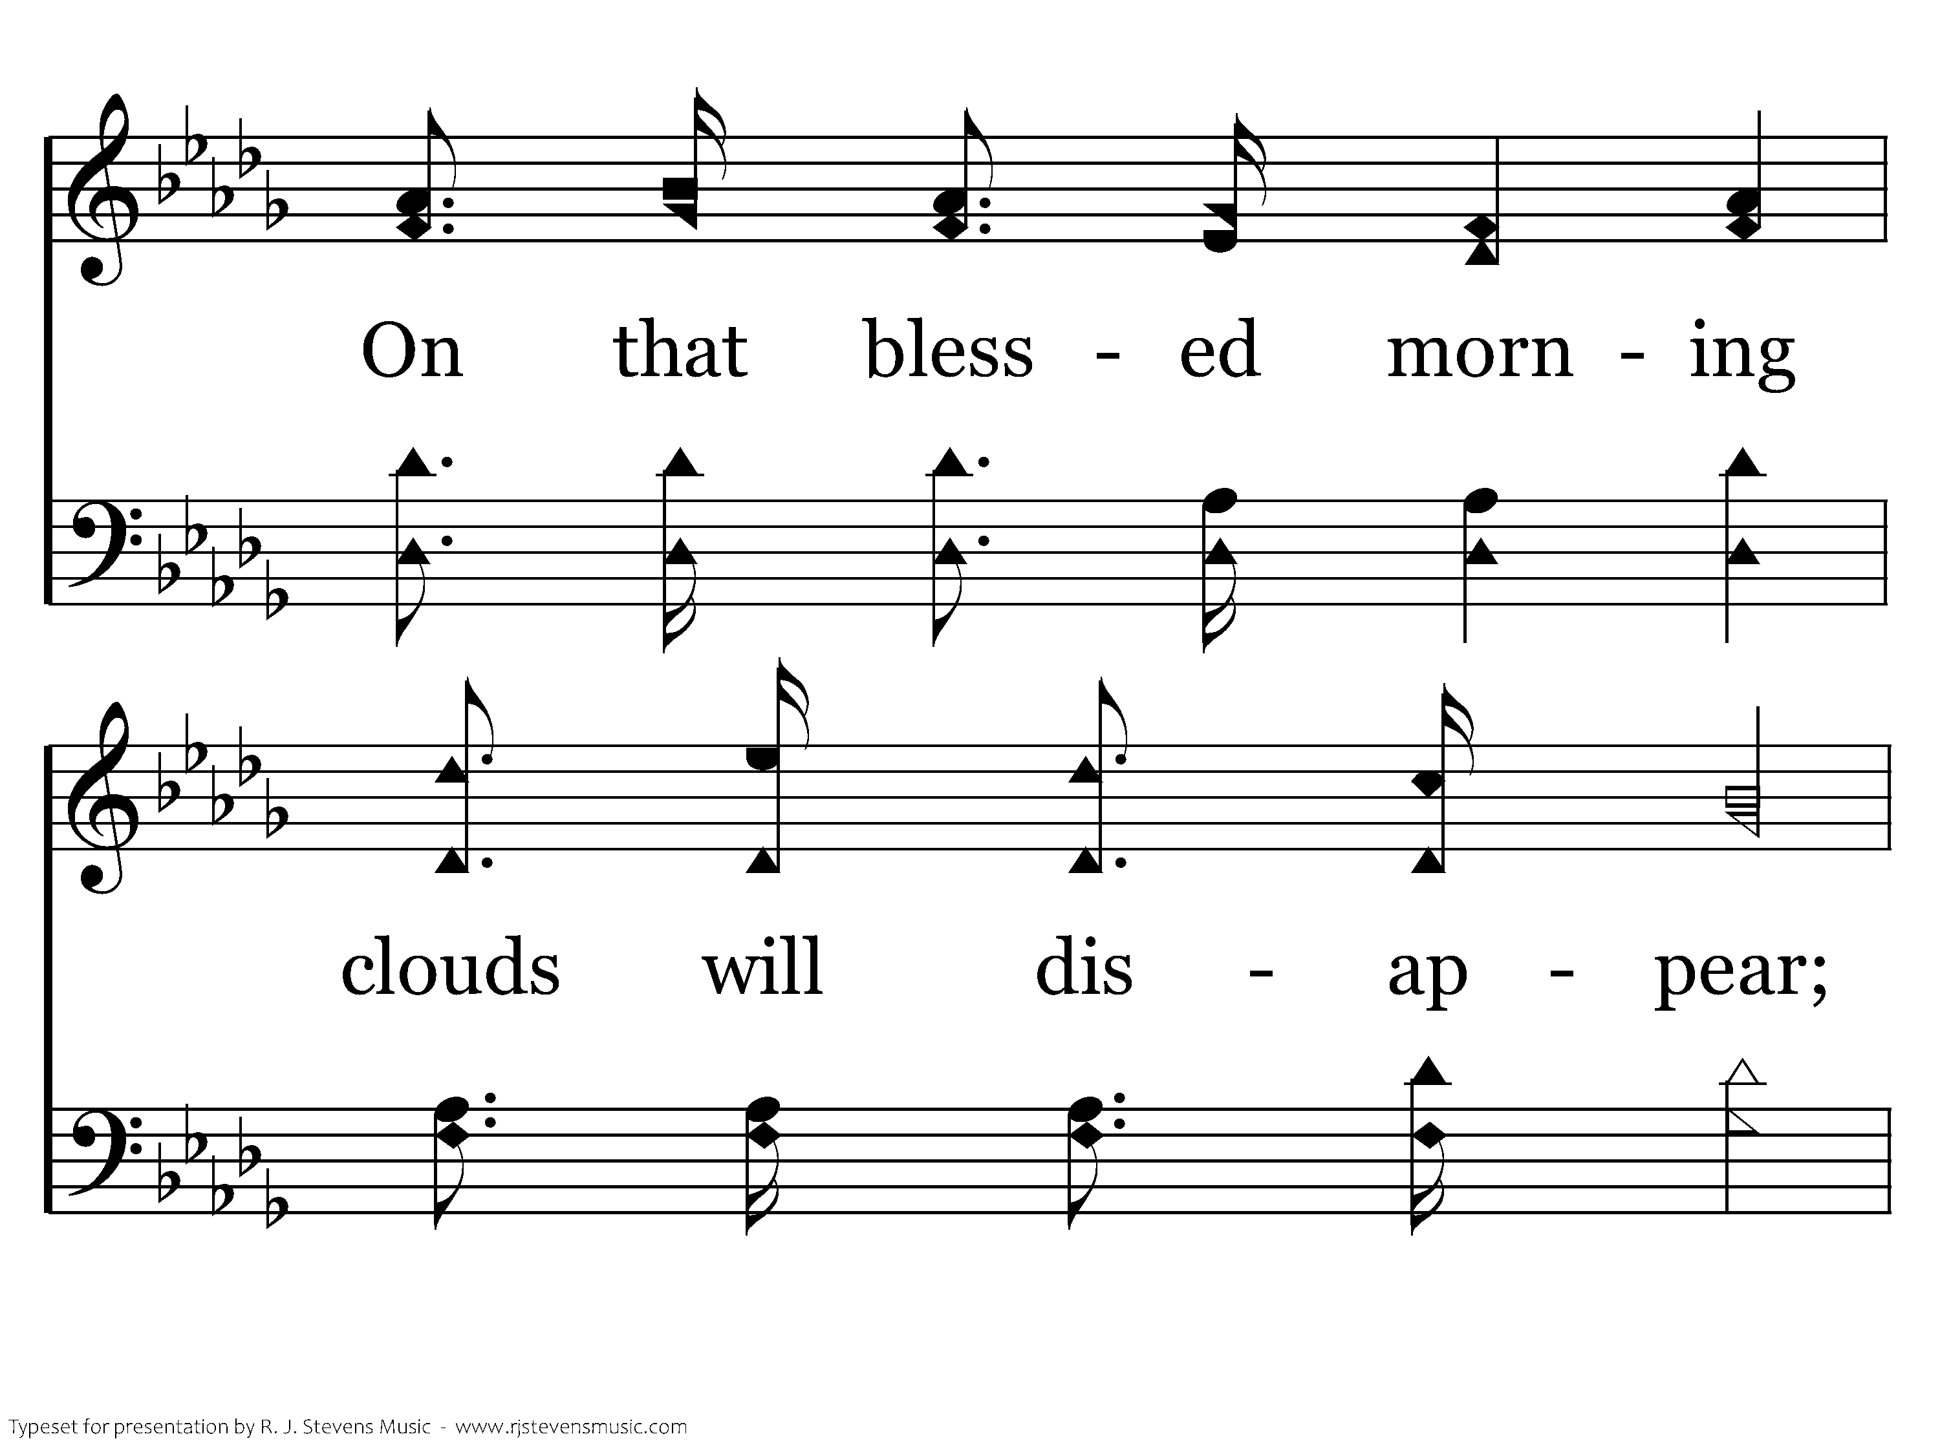
532 - We Shall See The King Some Day - 1.3

Slide 7
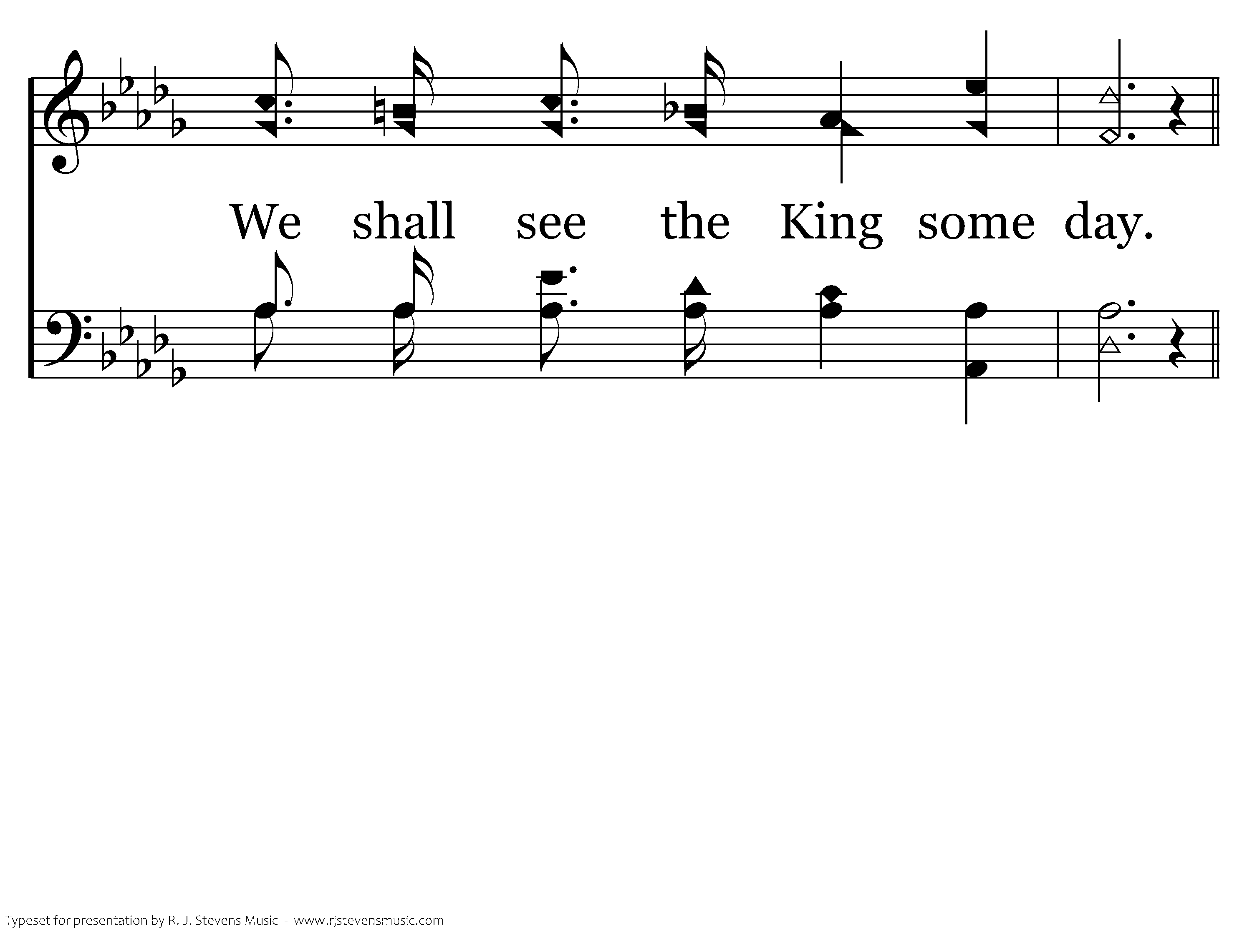
532 - We Shall See The King Some Day - 1.4

Slide 8
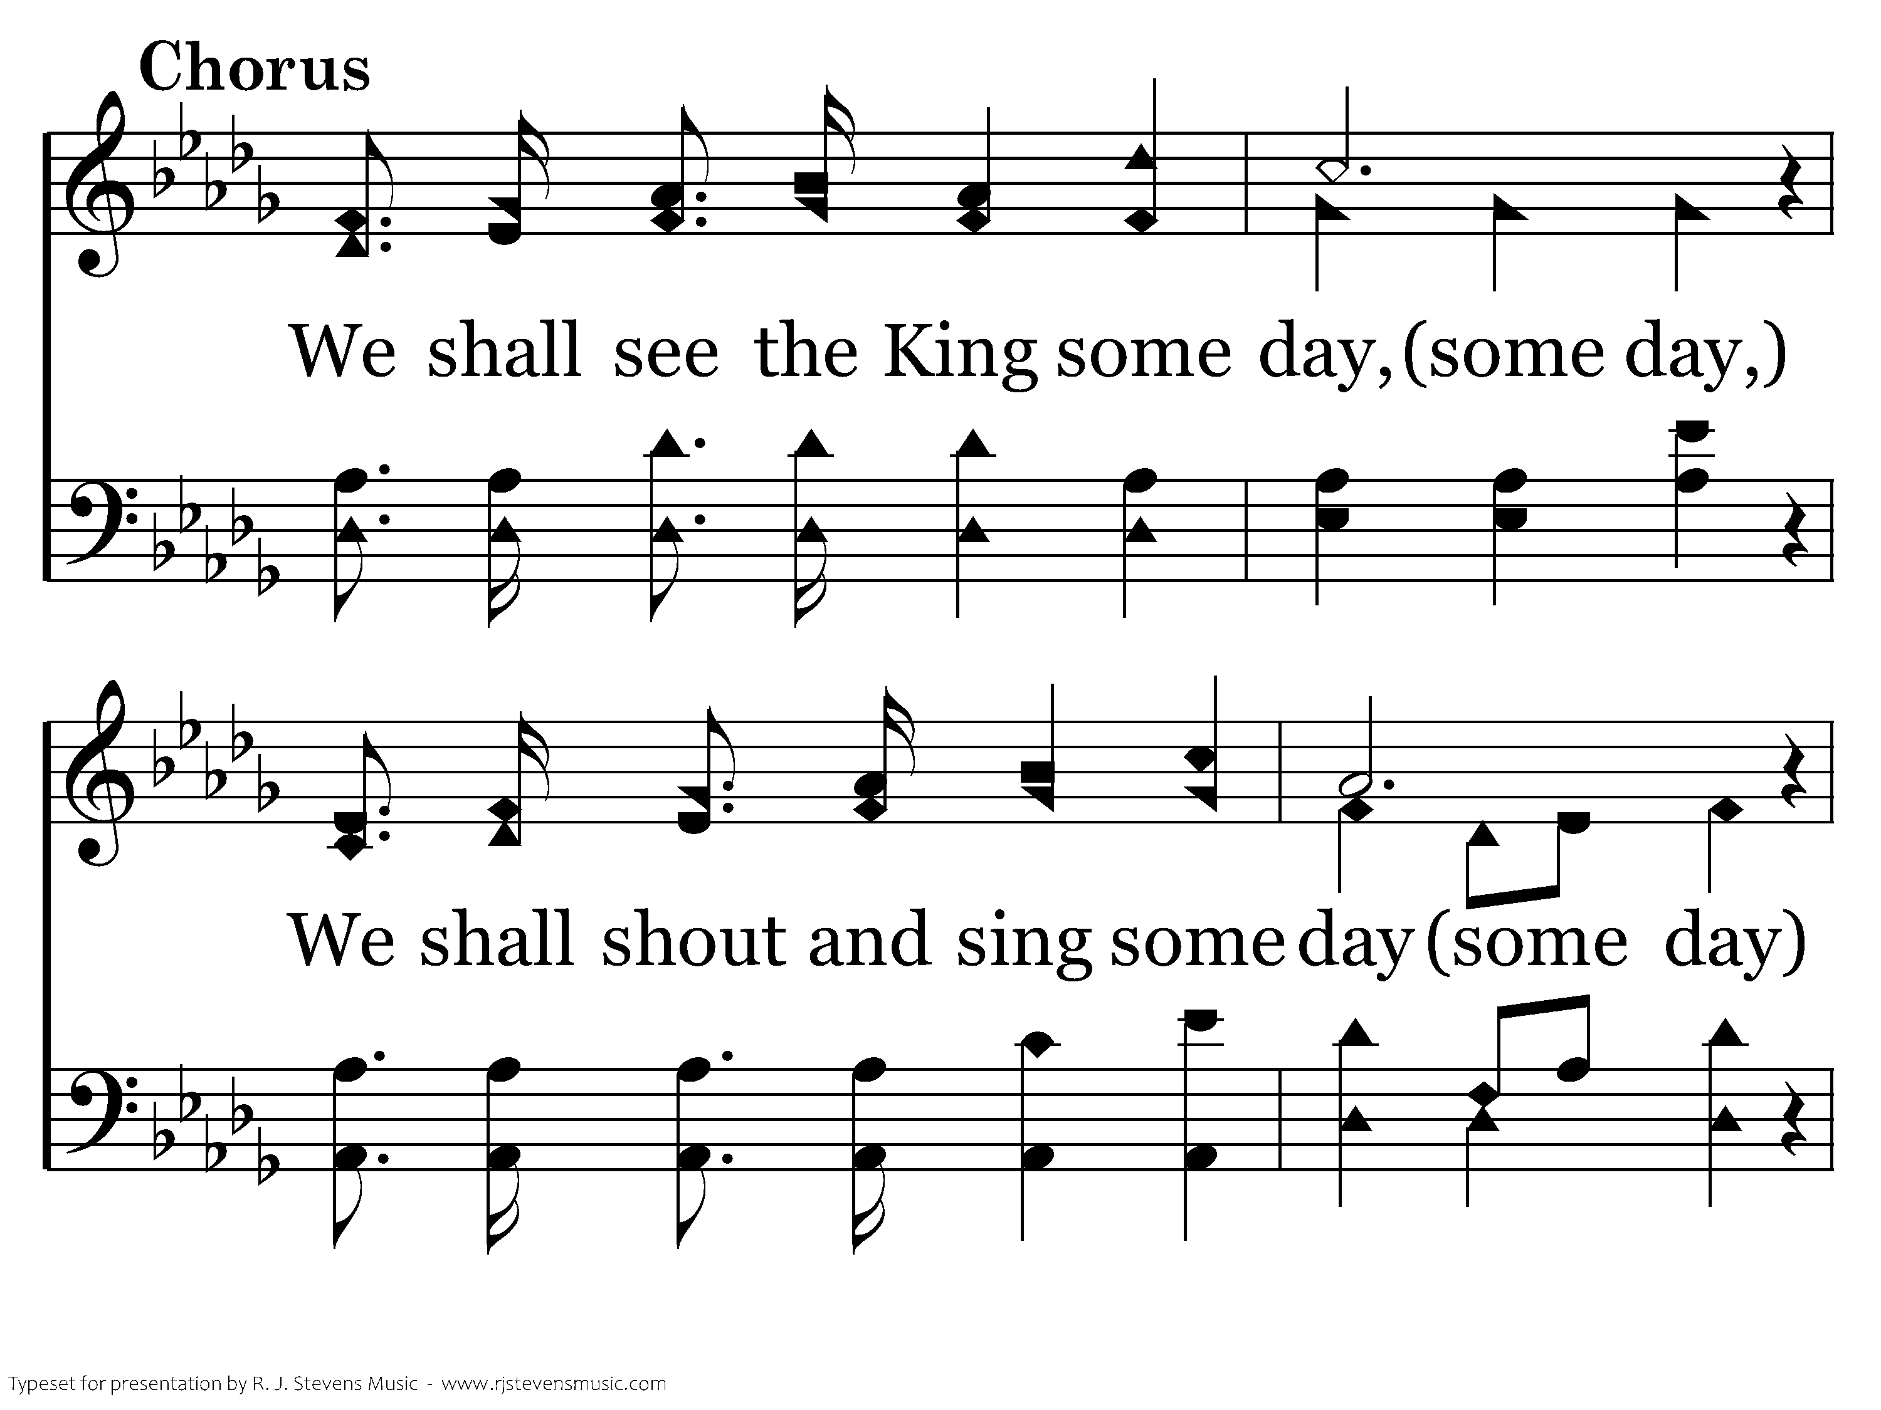
532 - We Shall See The King Some Day - C.1

Slide 9
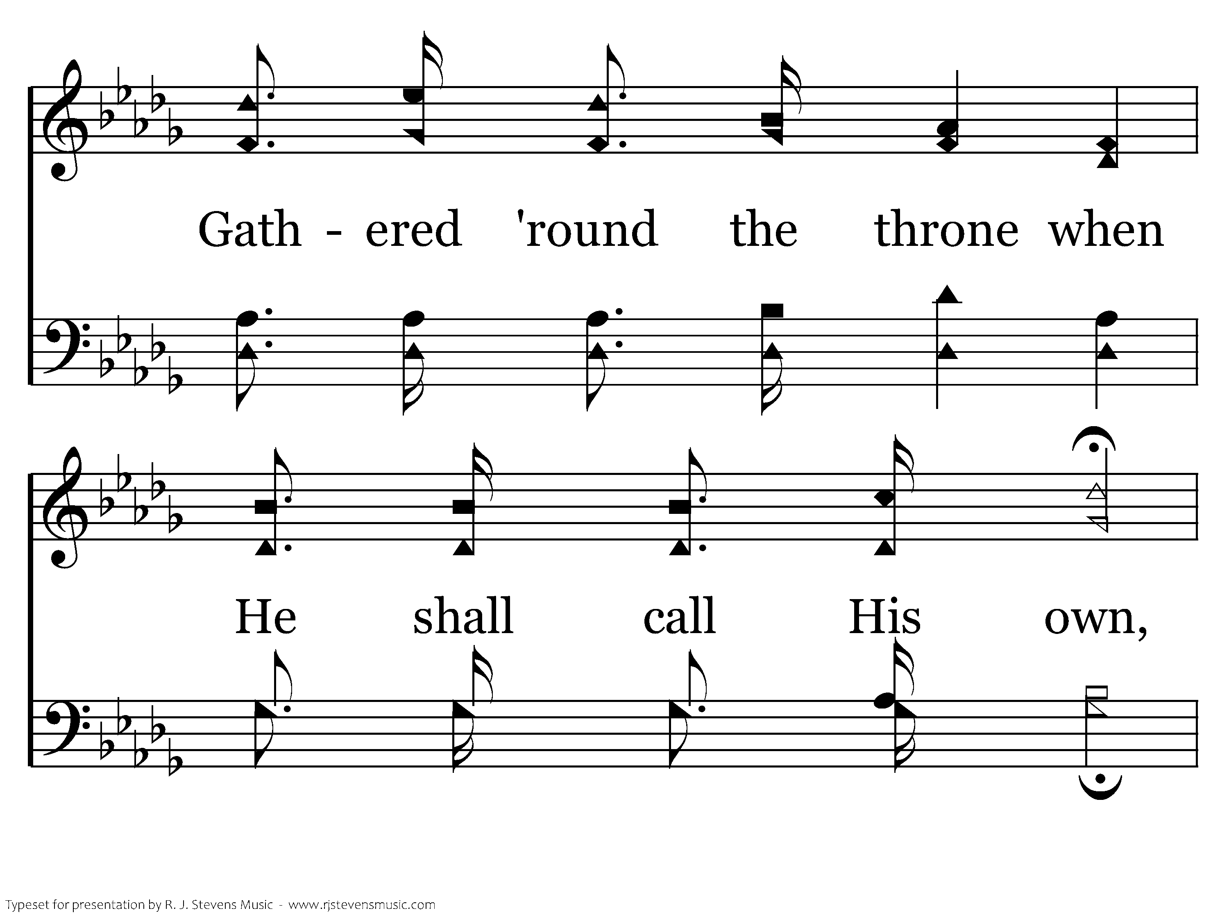
532 - We Shall See The King Some Day - C.2

Slide 10
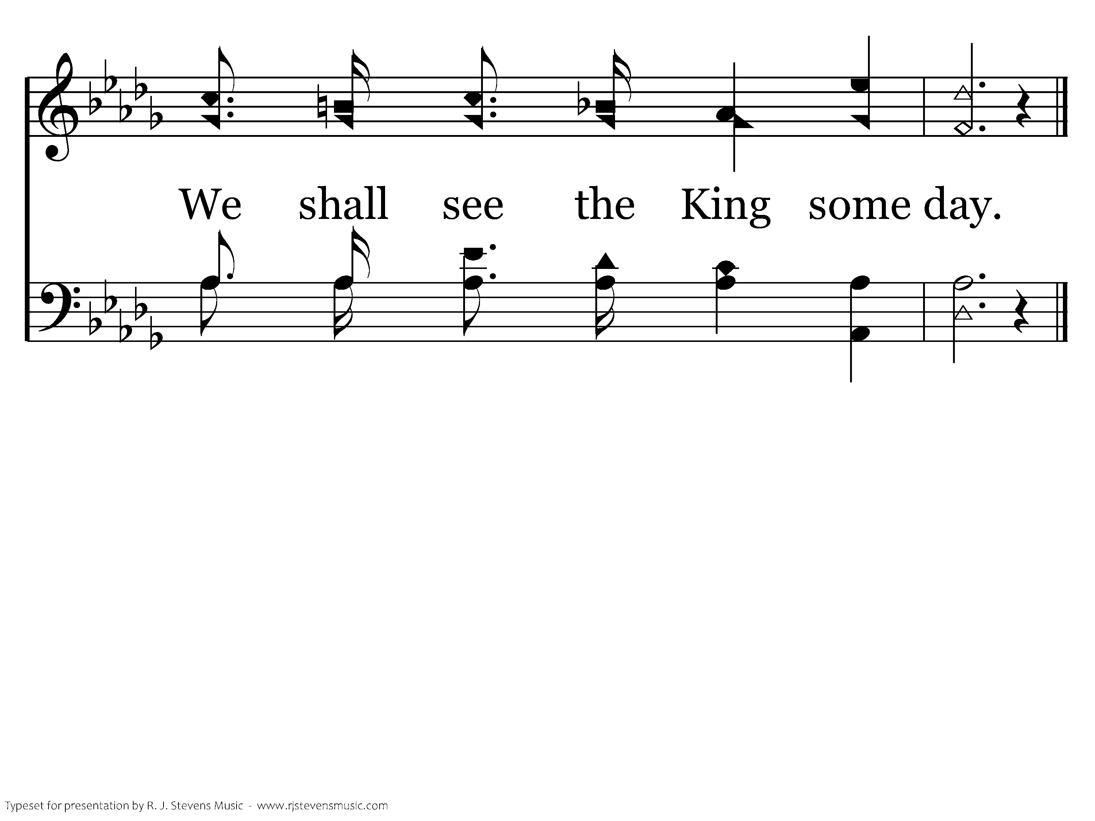
532 - We Shall See The King Some Day - C.3
End of Verse 1

Slide 11
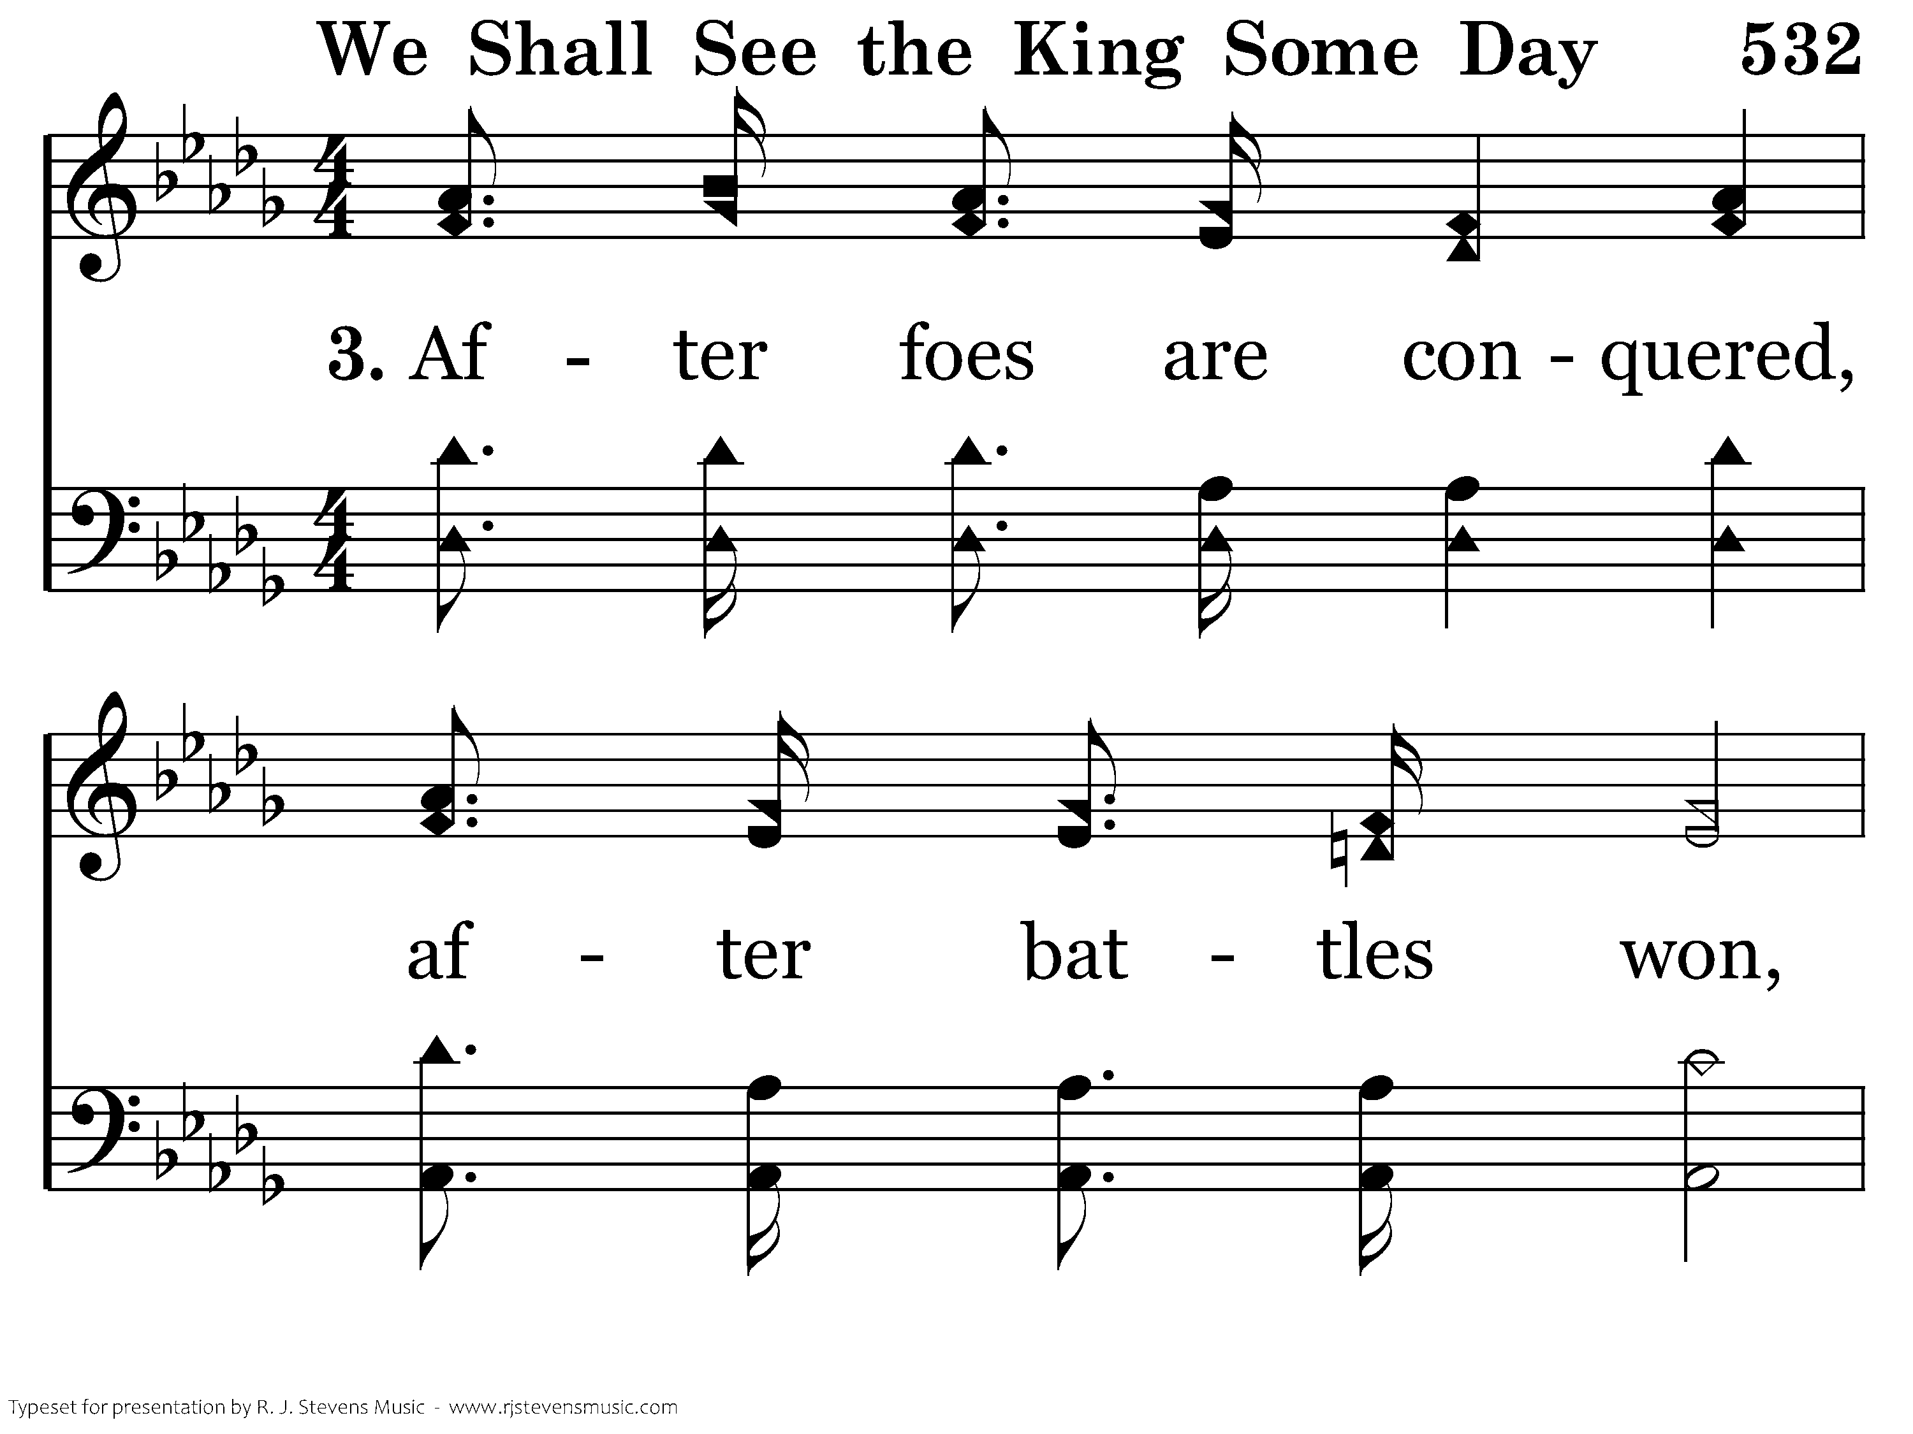
532 - We Shall See The King Some Day - 3.1

Slide 12
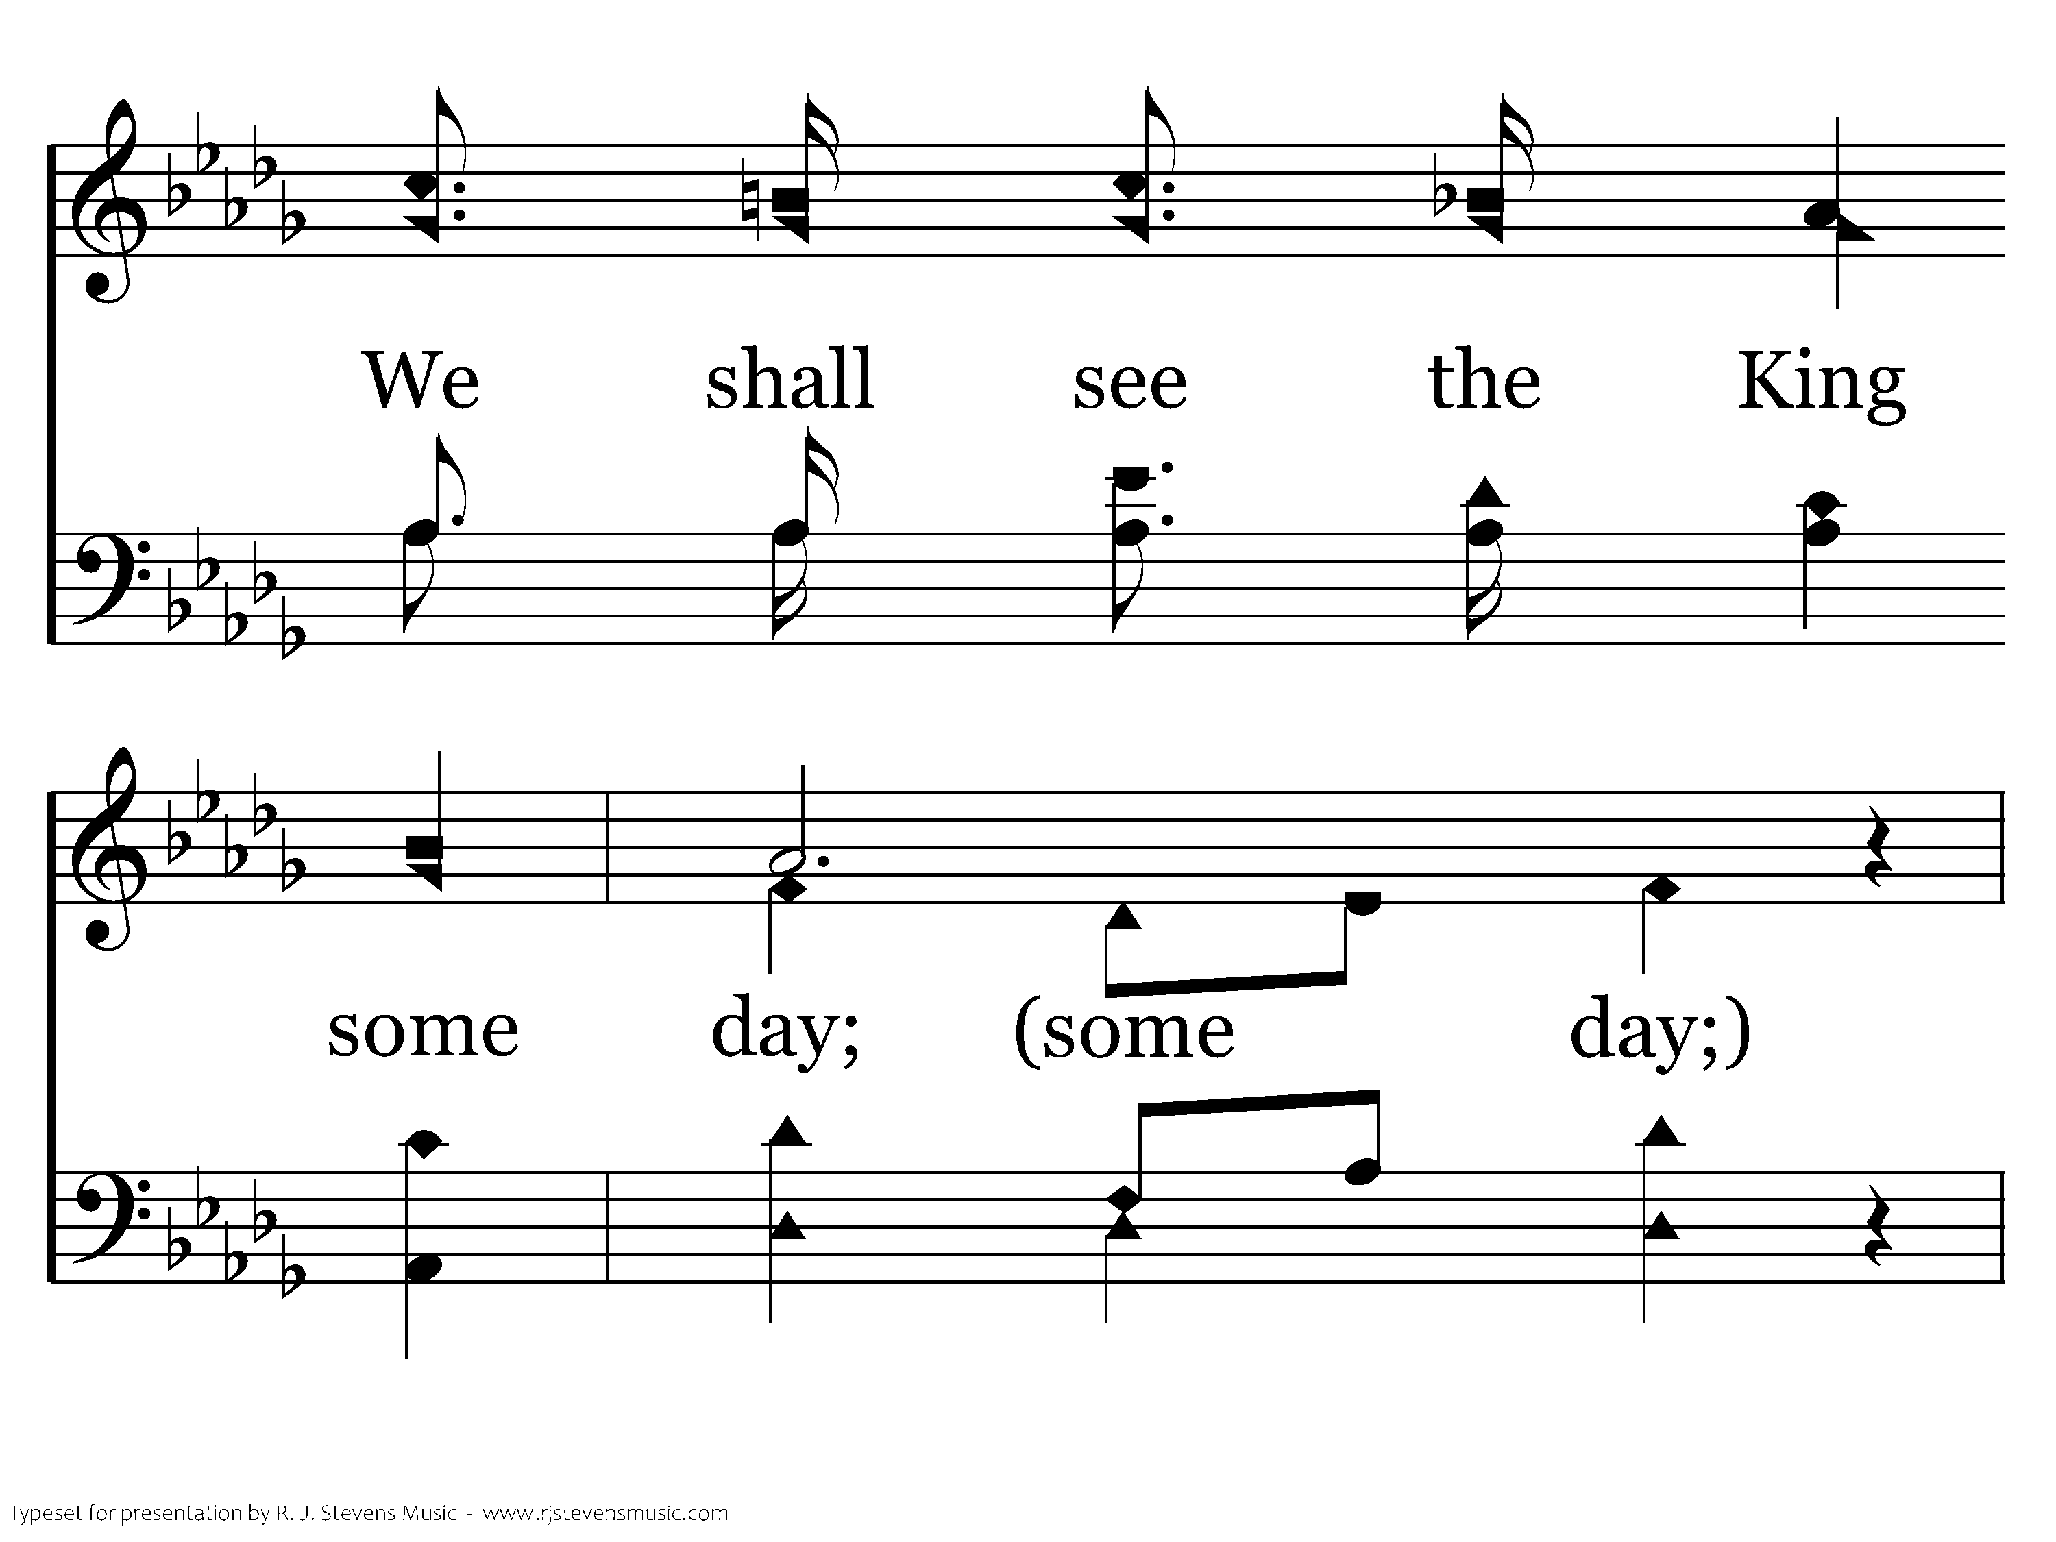
532 - We Shall See The King Some Day - 3.2

Slide 13
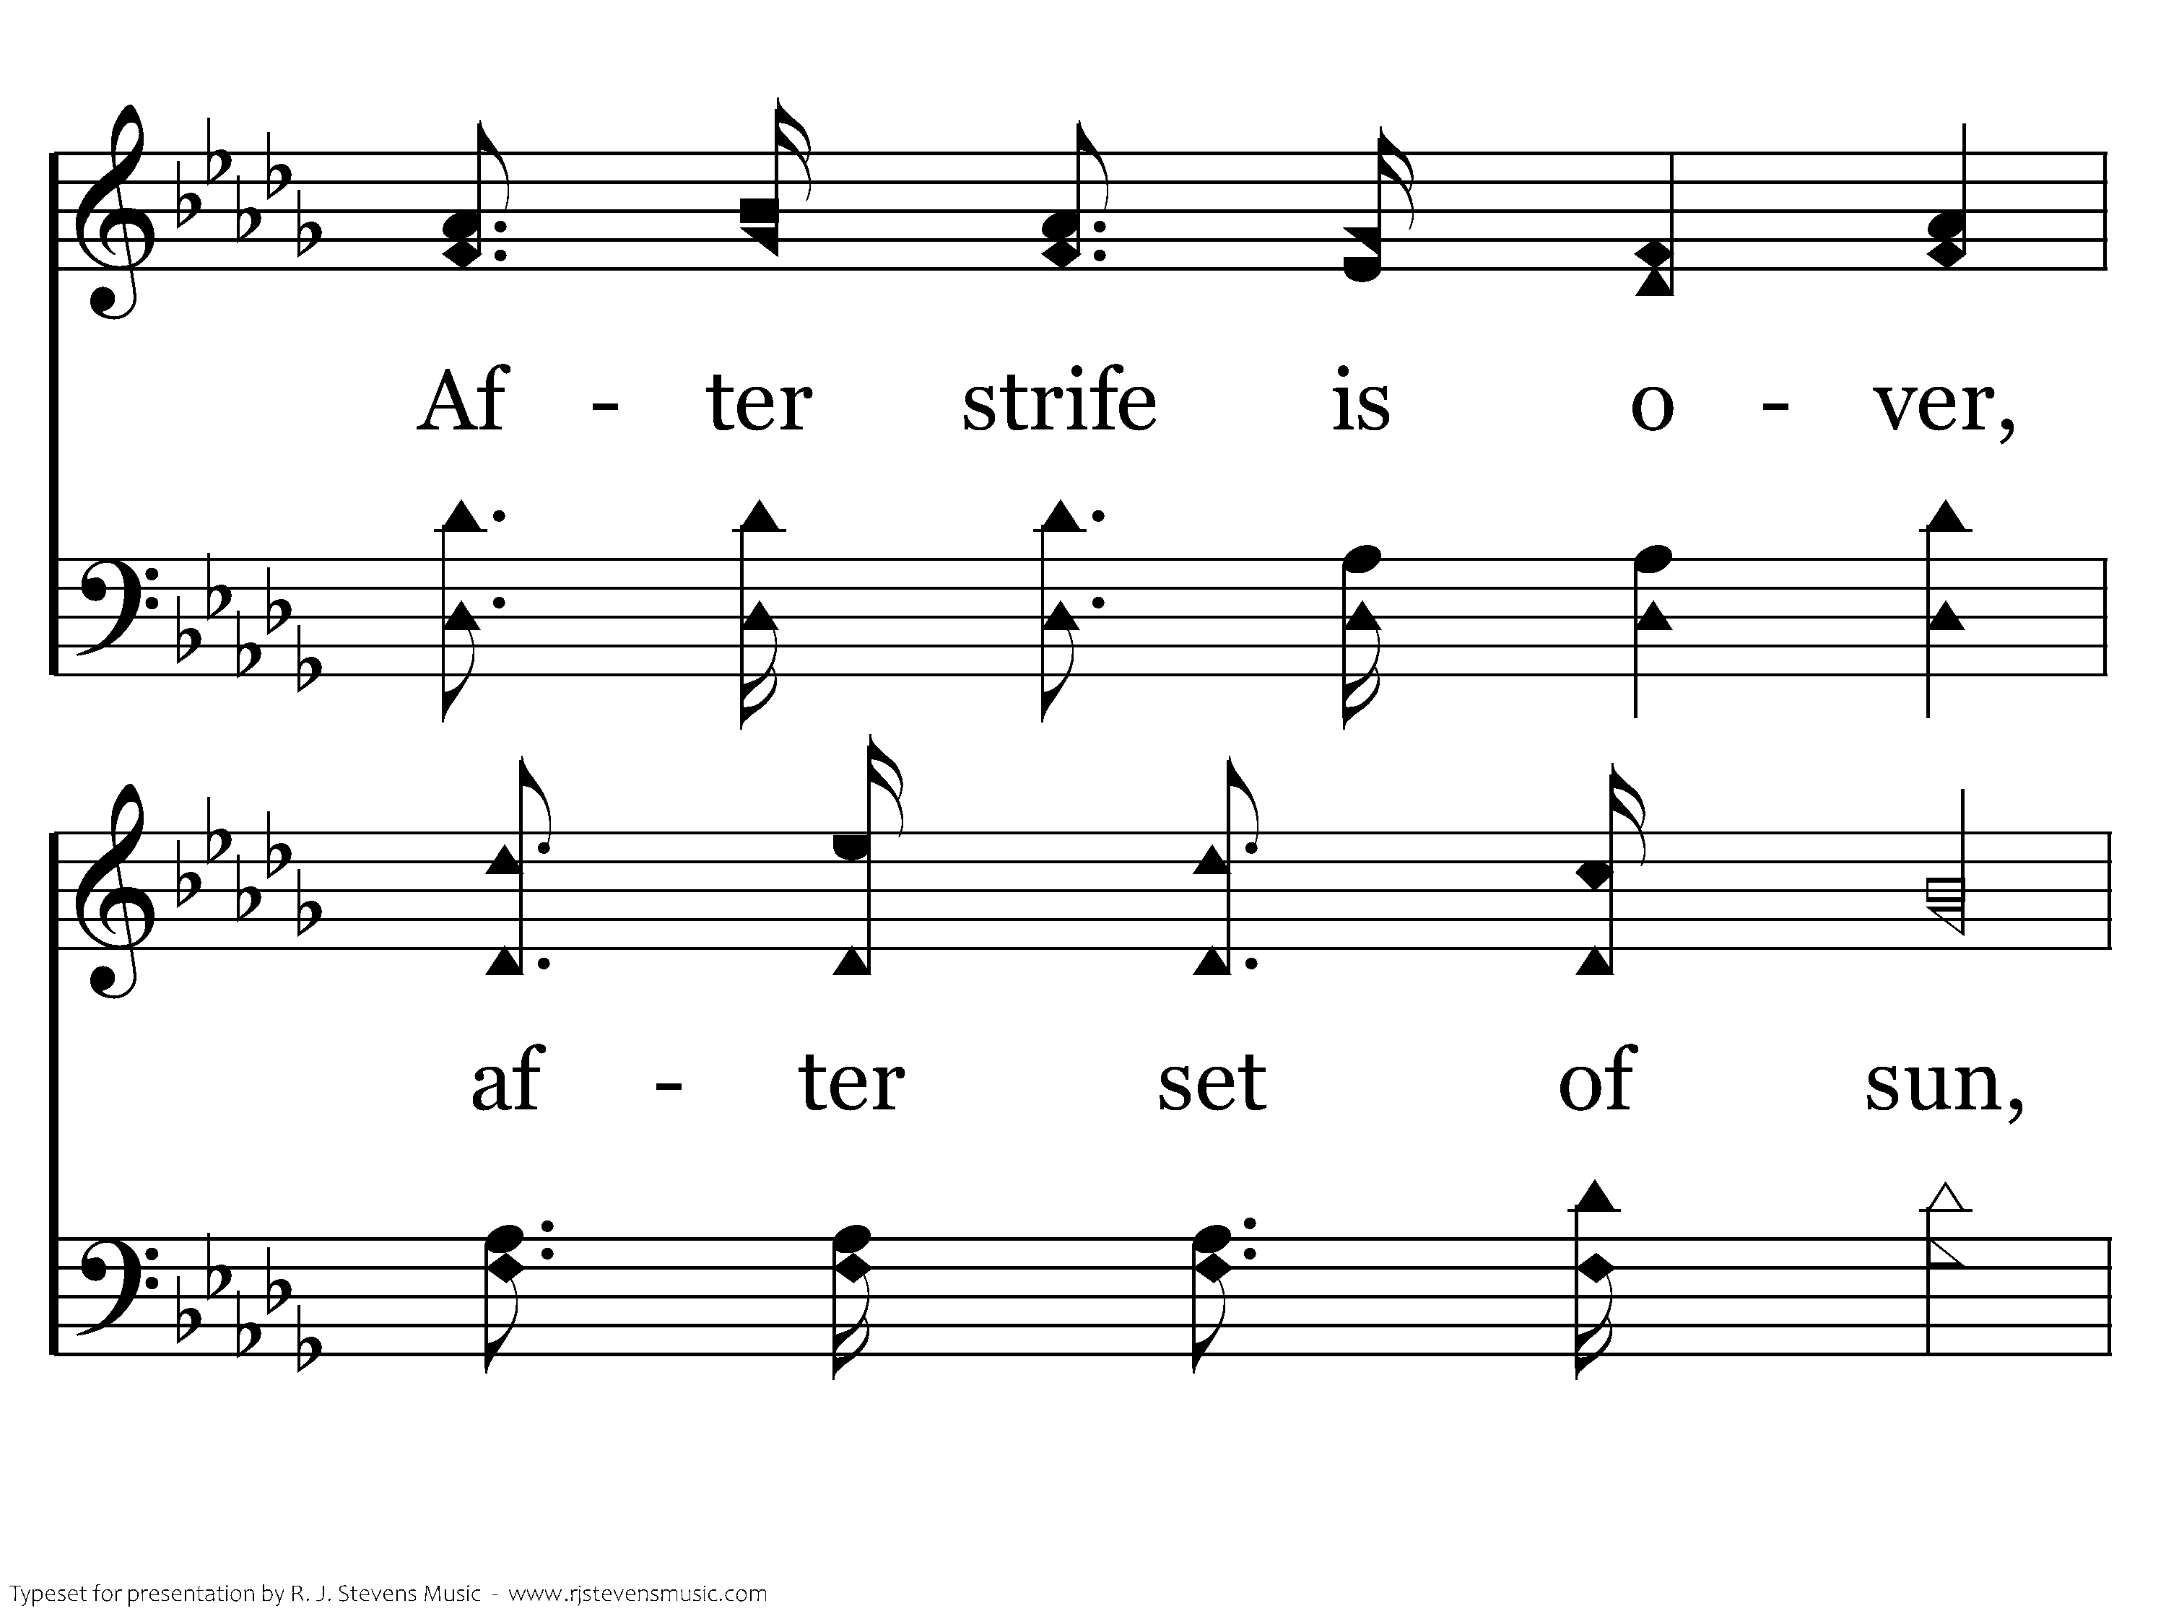
532 - We Shall See The King Some Day - 3.3

Slide 14

532 - We Shall See The King Some Day - 3.4

Slide 15
532 - We Shall See The King Some Day - C.1

Slide 16
532 - We Shall See The King Some Day - C.2

Slide 17
532 - We Shall See The King Some Day - C.3
End of Song

Slide 18
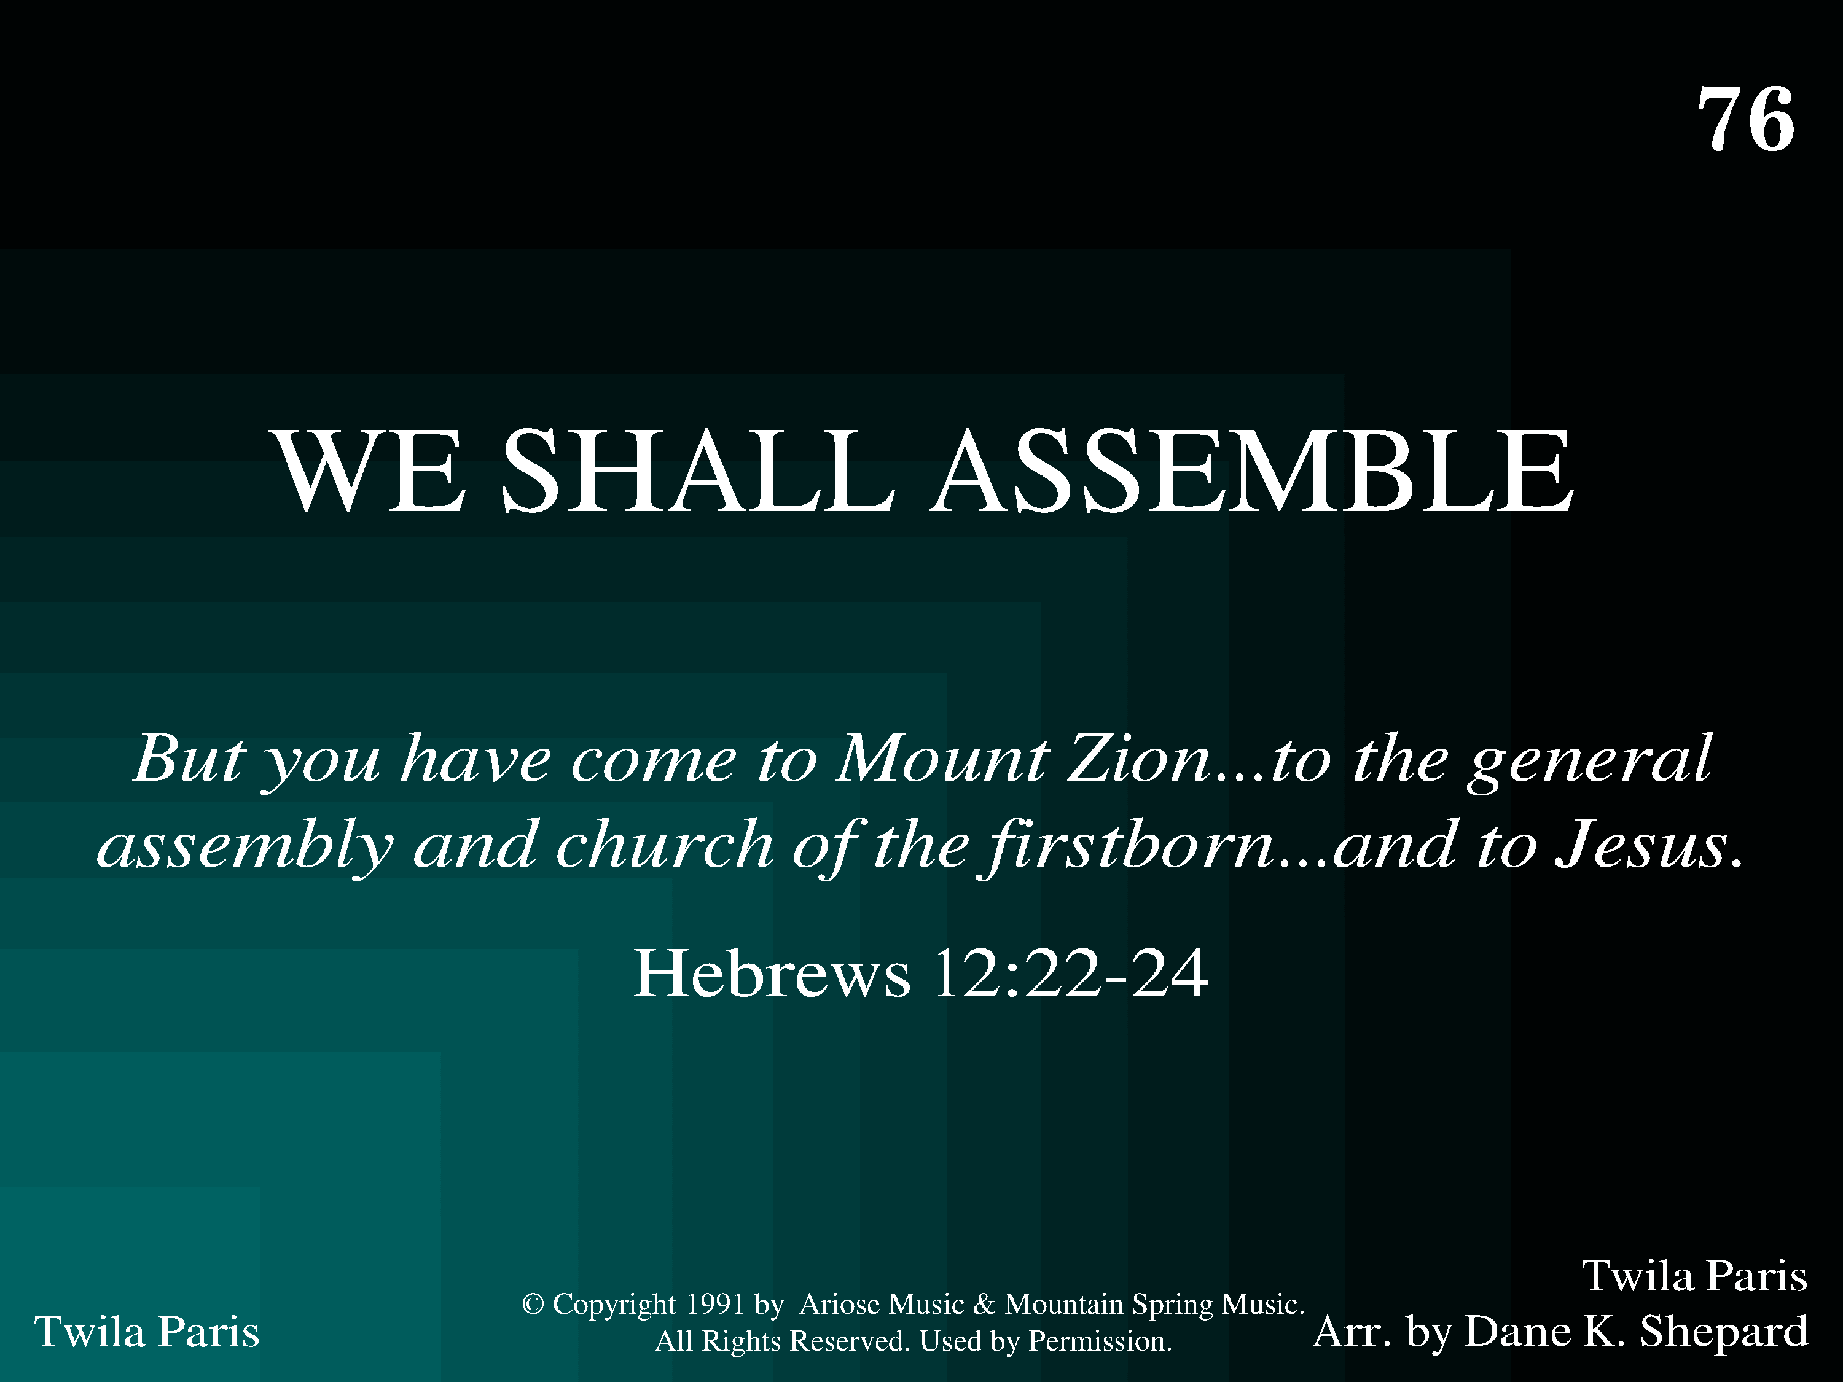
1076 - We Shall Assemble - Title

Slide 19
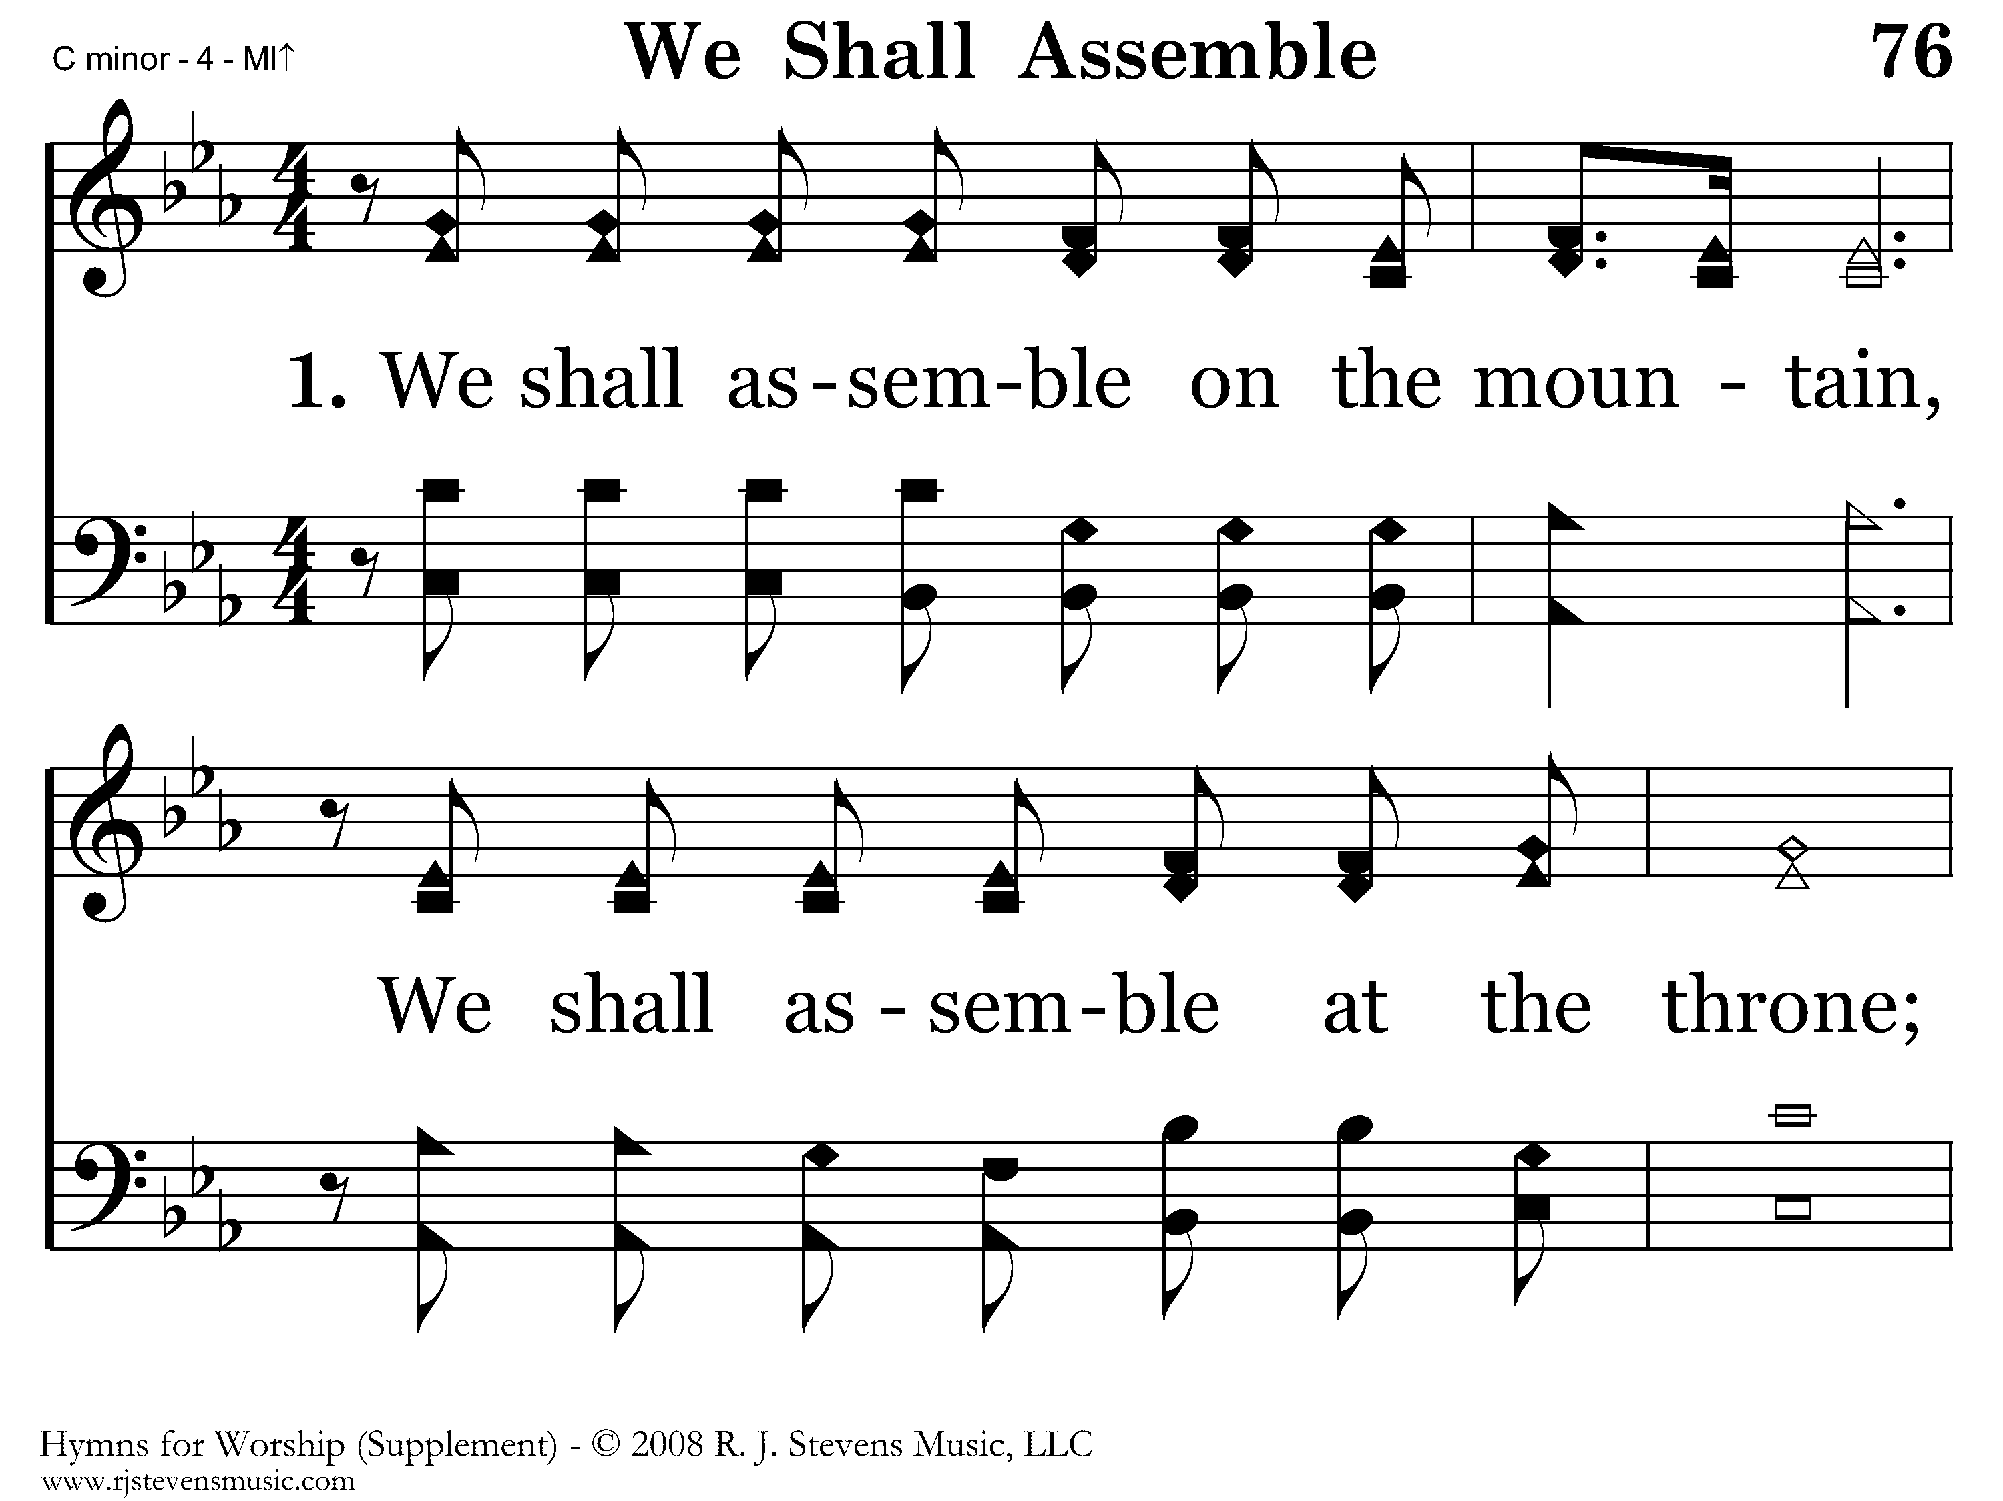
1076 - We Shall Assemble - 1.1

Slide 20
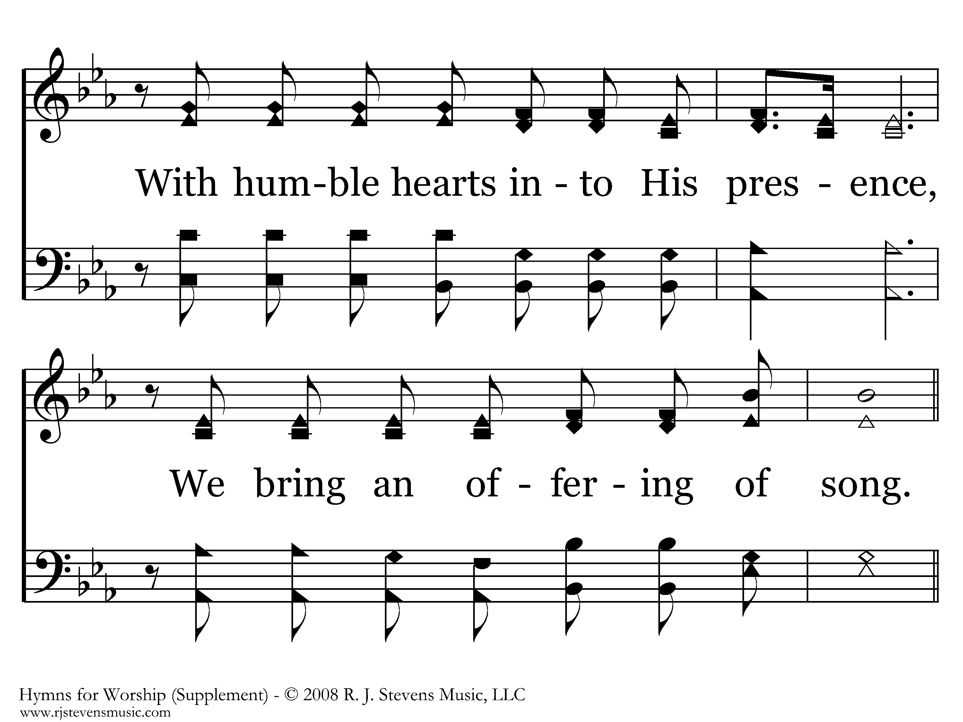
1076 - We Shall Assemble - 1.2

Slide 21
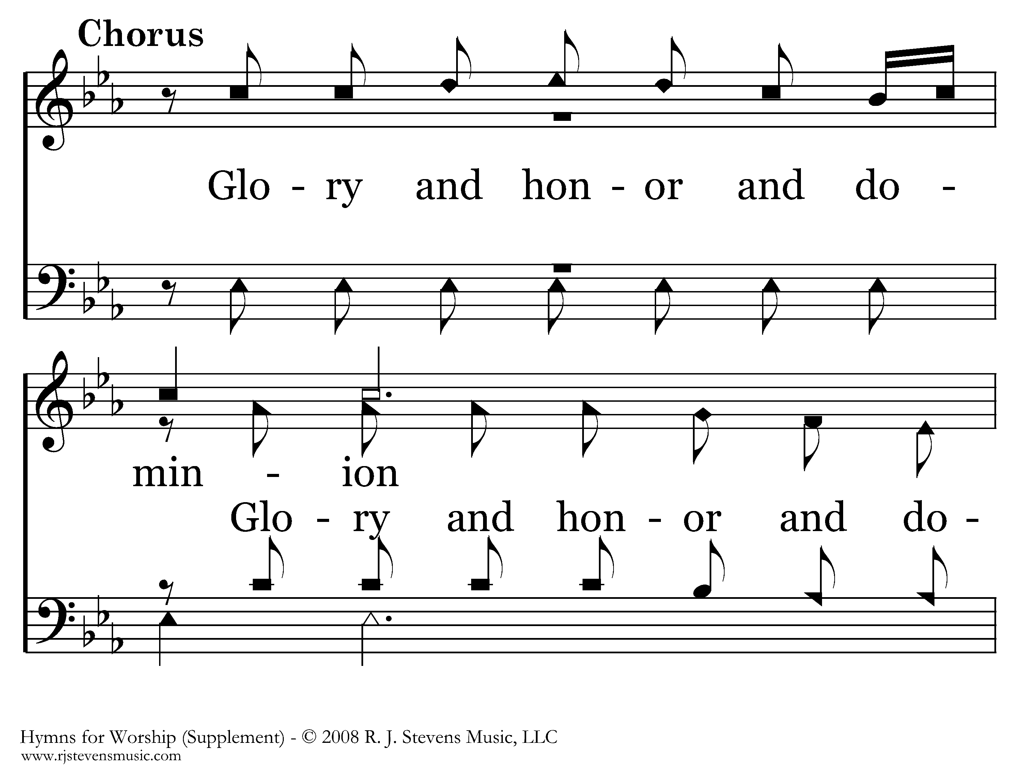
1076 - We Shall Assemble - C.1

Slide 22
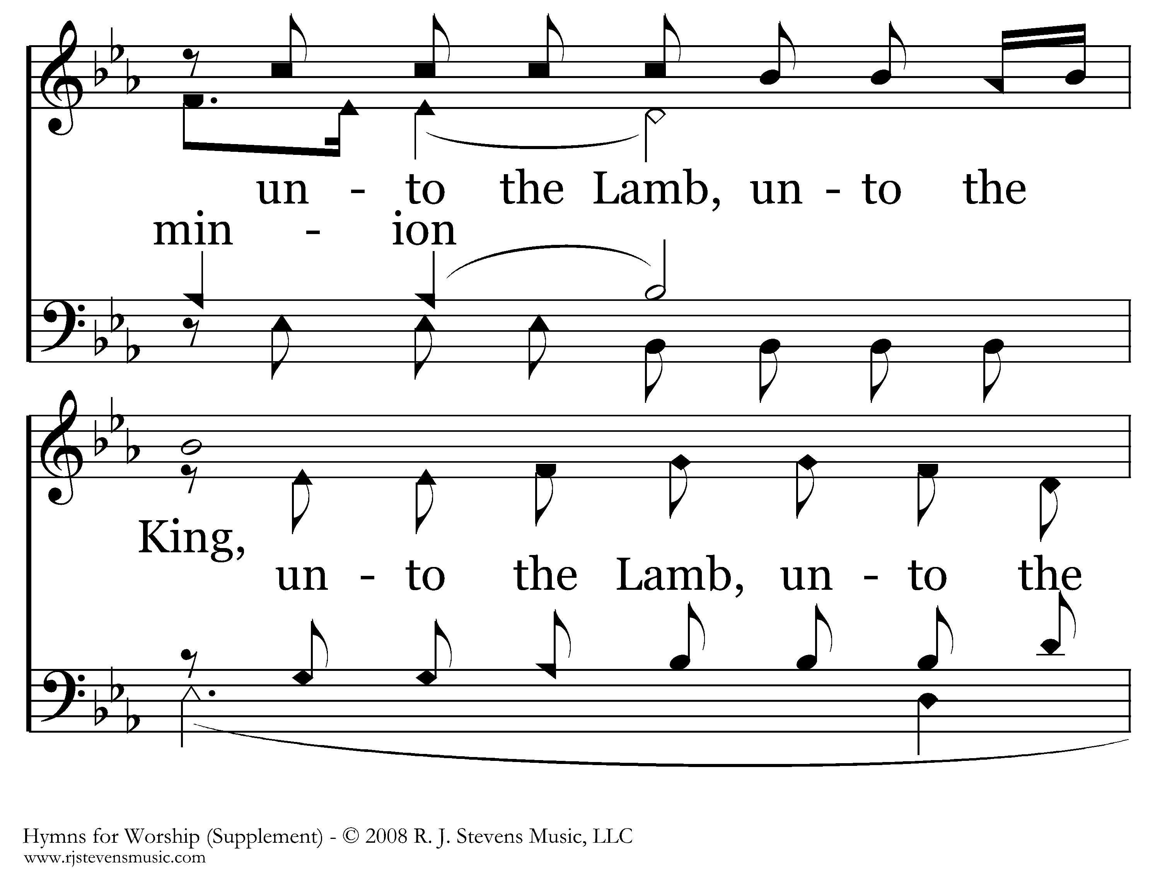
1076 - We Shall Assemble - C.2

Slide 23
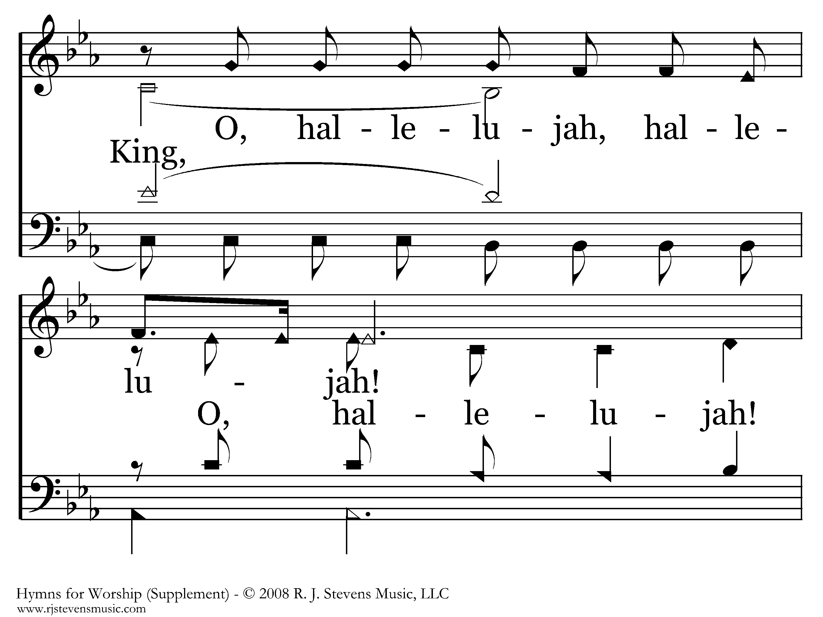
1076 - We Shall Assemble - C.3

Slide 24
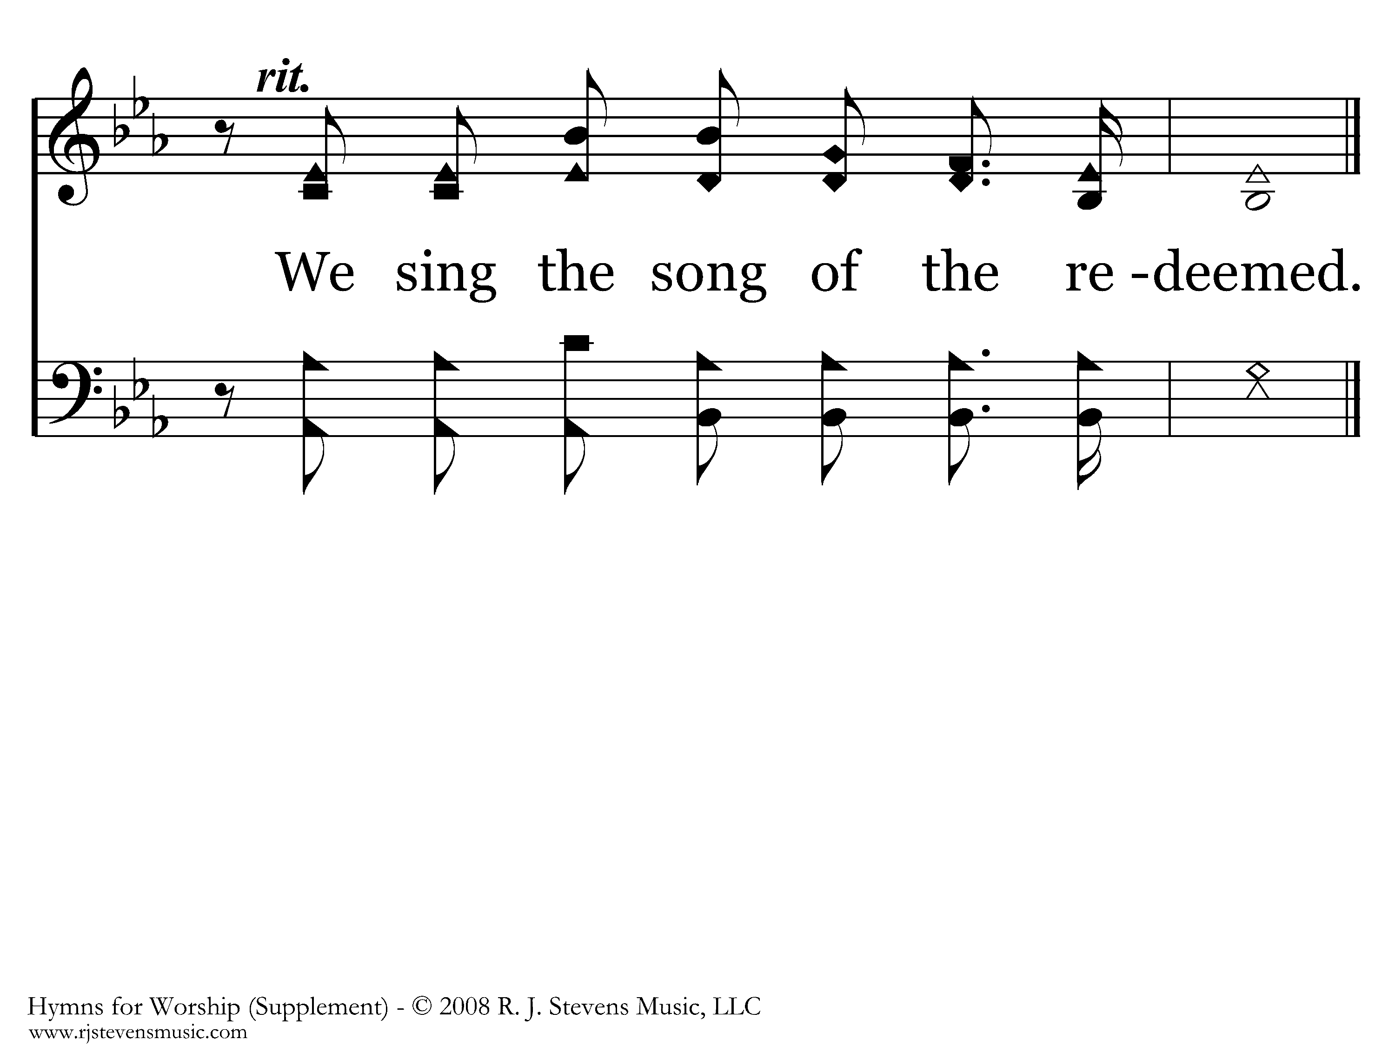
1076 - We Shall Assemble - C.4
End of Verse 1

Slide 25
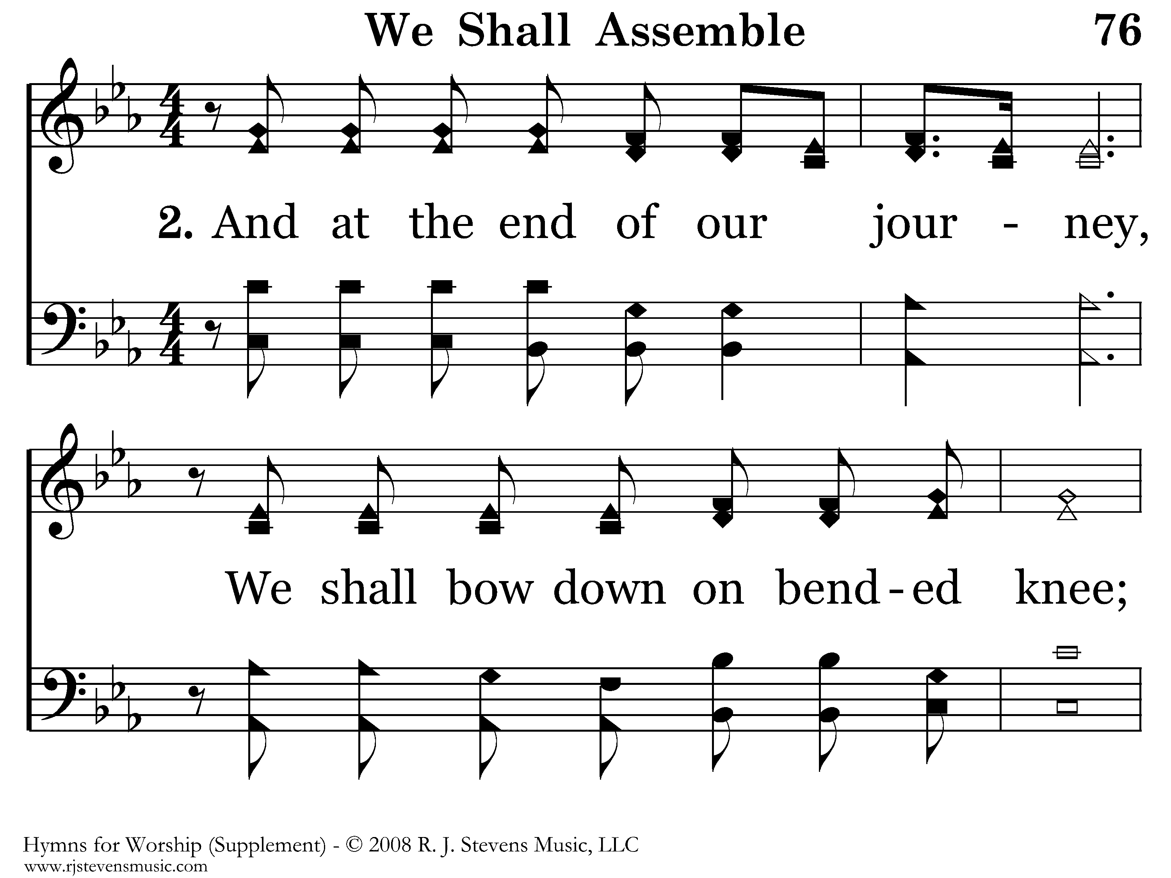
1076 - We Shall Assemble - 2.1

Slide 26
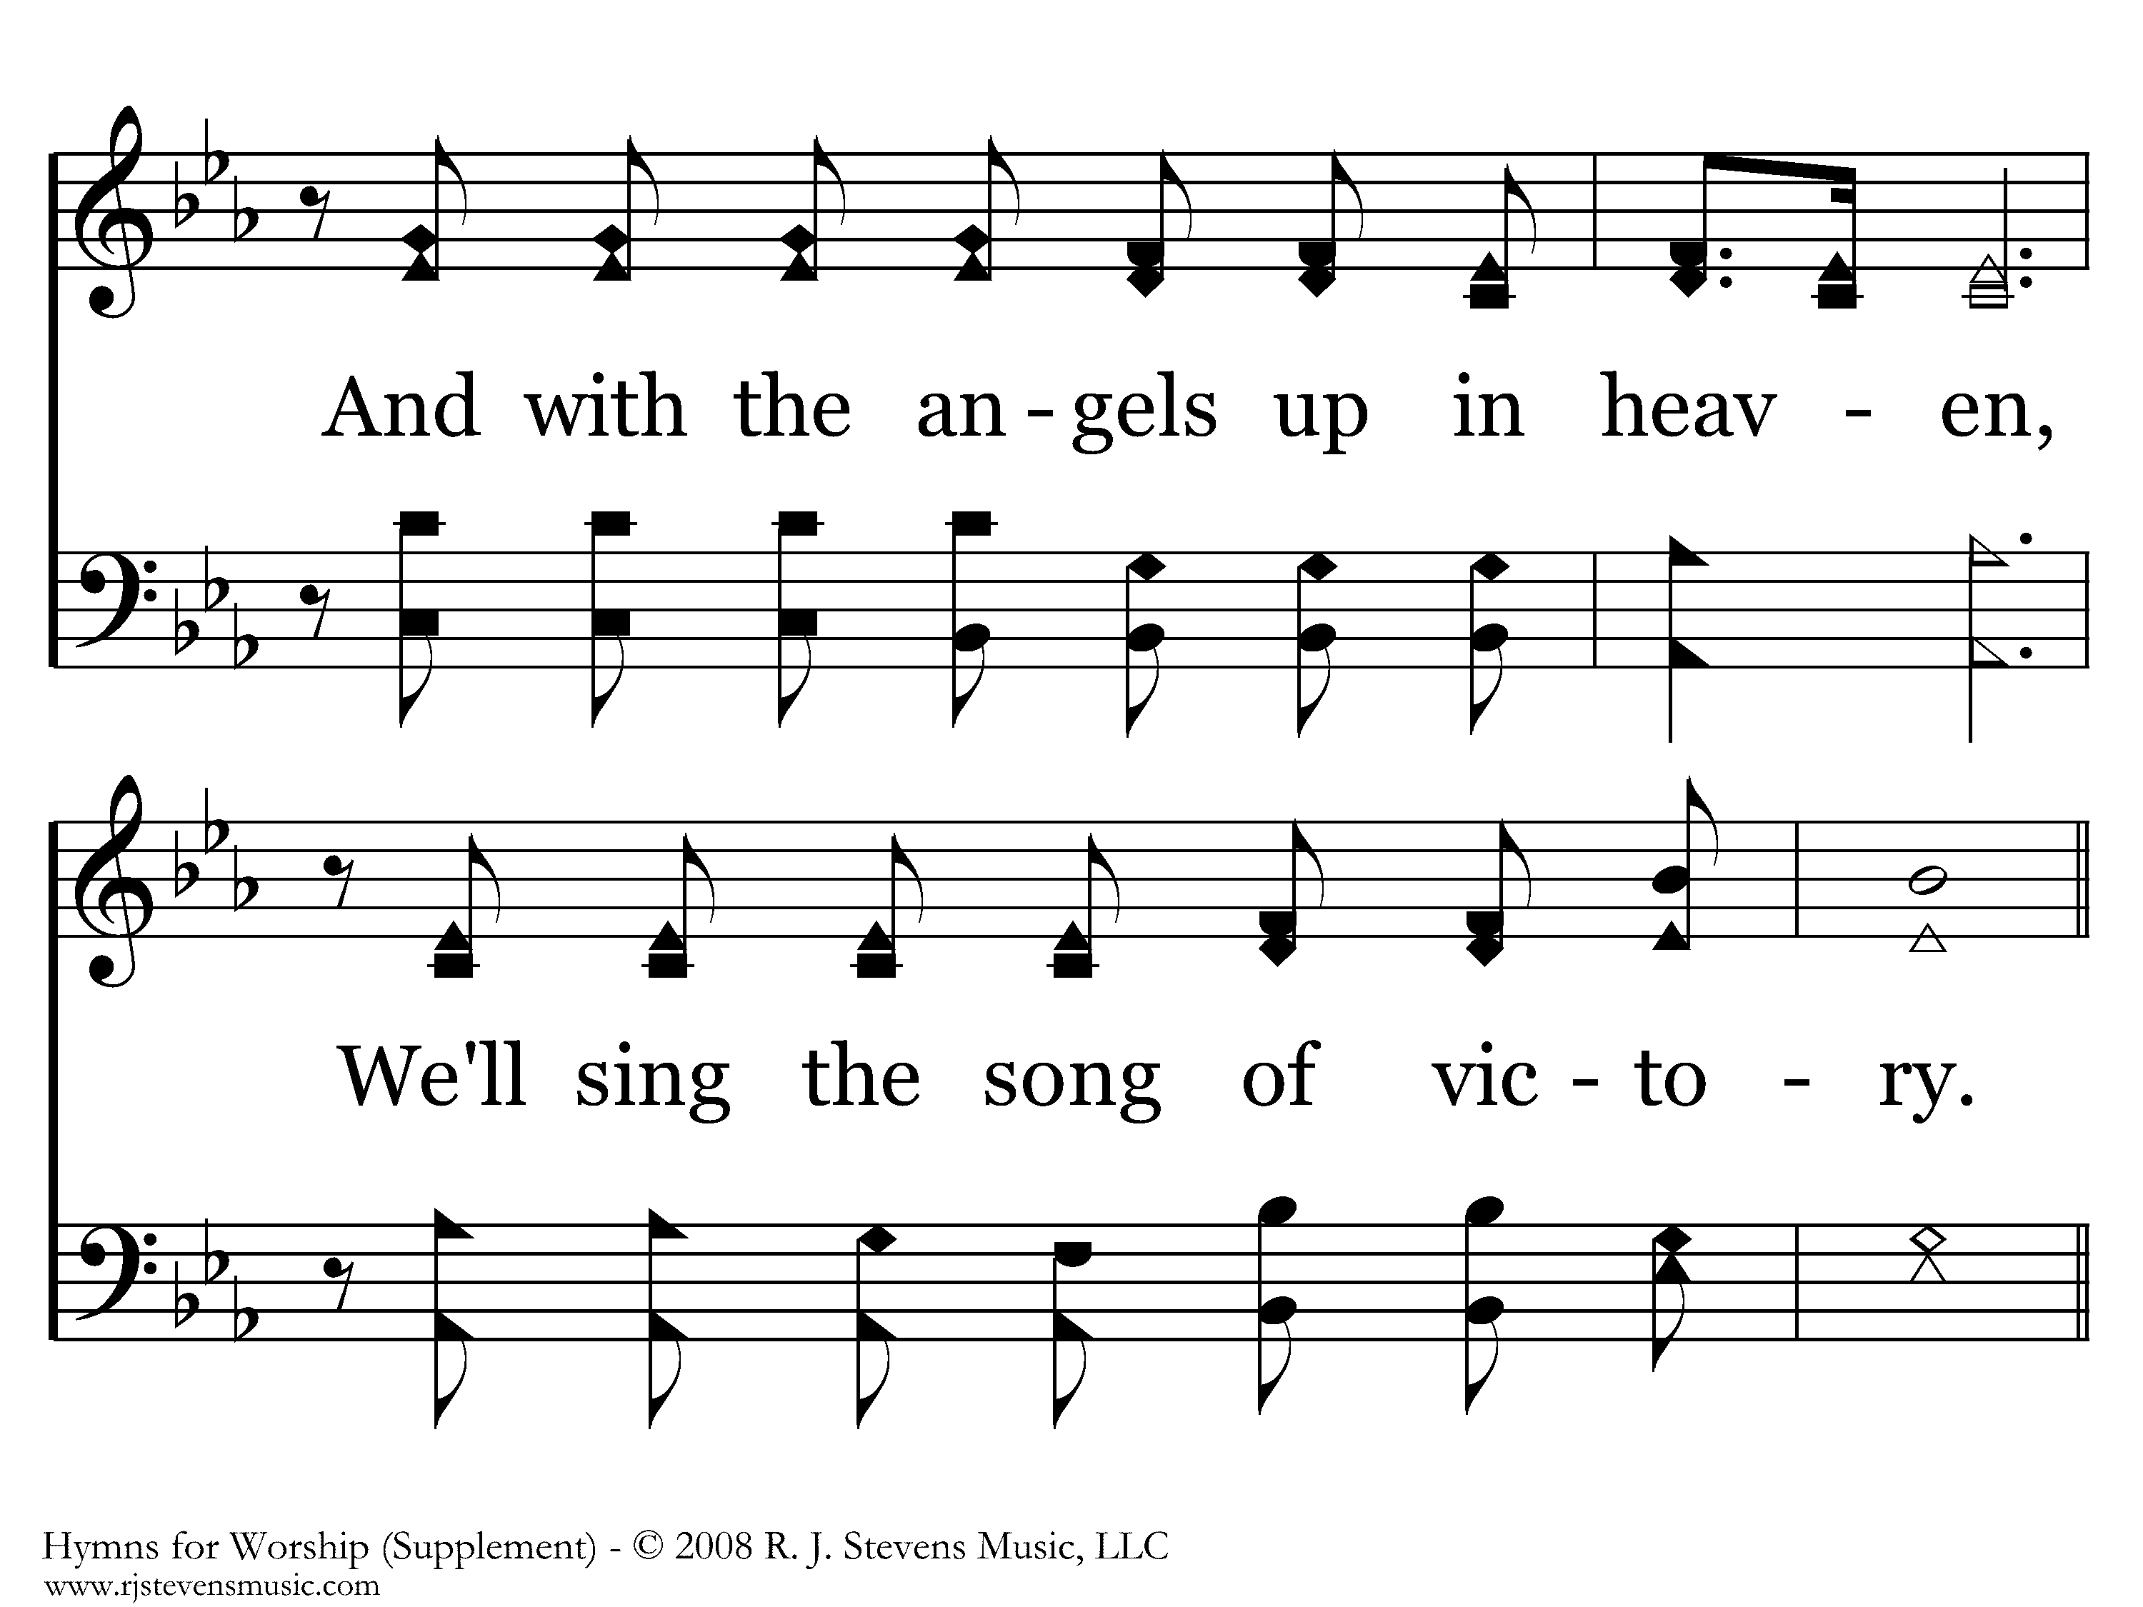
1076 - We Shall Assemble - 2.2

Slide 27
1076 - We Shall Assemble - C.1

Slide 28
1076 - We Shall Assemble - C.2

Slide 29
1076 - We Shall Assemble - C.3

Slide 30
1076 - We Shall Assemble - C.4
End of Song

Slide 32
Our Goal
Increase edification
Eliminate distraction and confusion
Sing a complete thought with the spirit and understanding in an orderly manner
How? Start, stay, and stop together
Necessary to follow a song worship leader

Slide 33
Song Worship Leader’s Guide
Announce number, title, number, other info
Give pitch (start with DO)
Ready position/eye contact
Think starting tempo/first phrase
Wait !
Preparatory breath & beat to begin on first word
Continue conducting/eye contact/expression
Hold final note and give cut-off

Slide 34
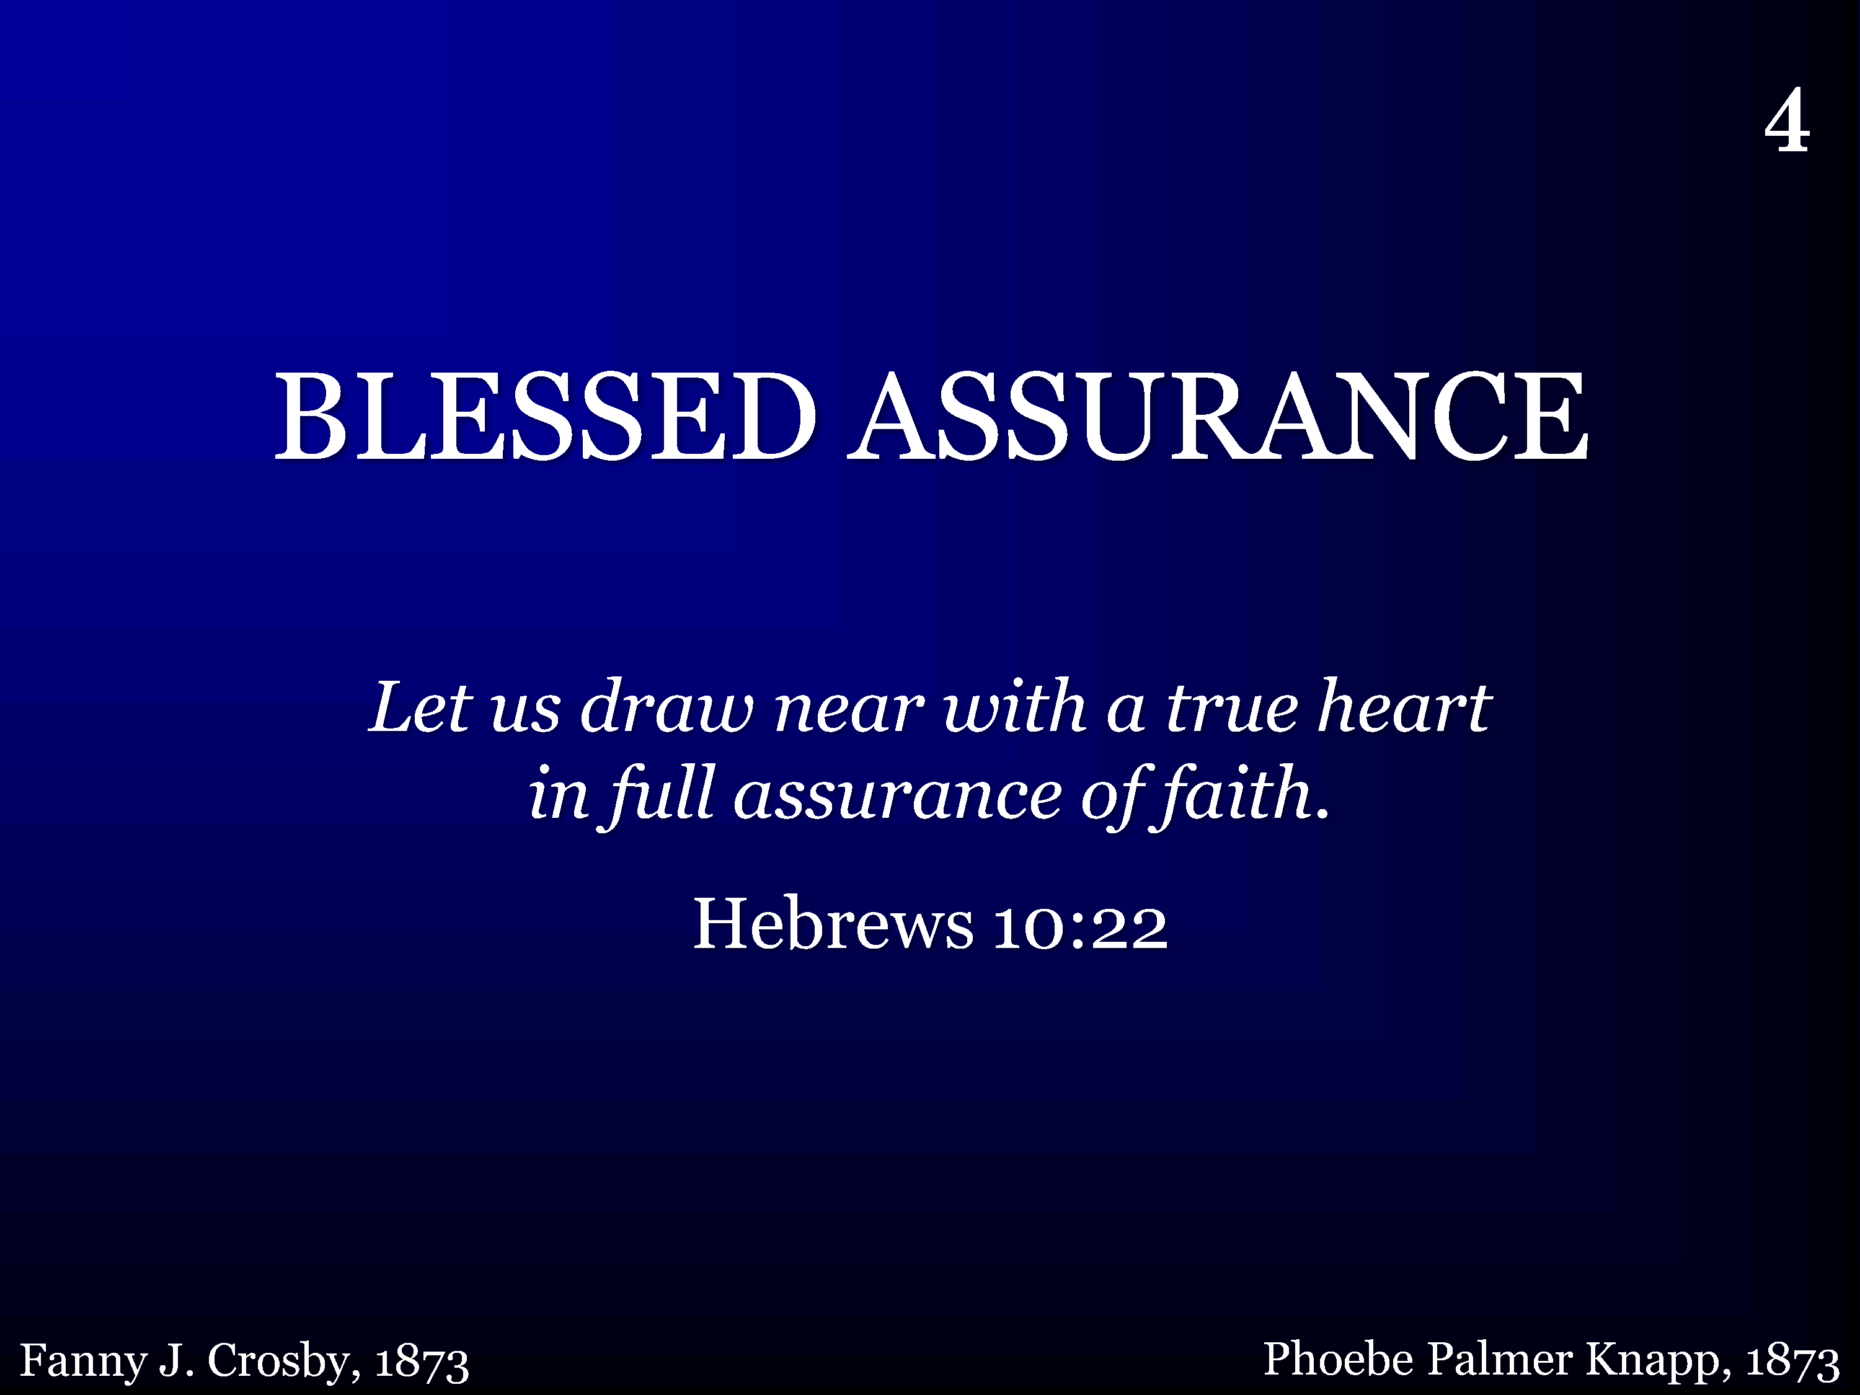
004 - Blessed Assurance - Title

Slide 35
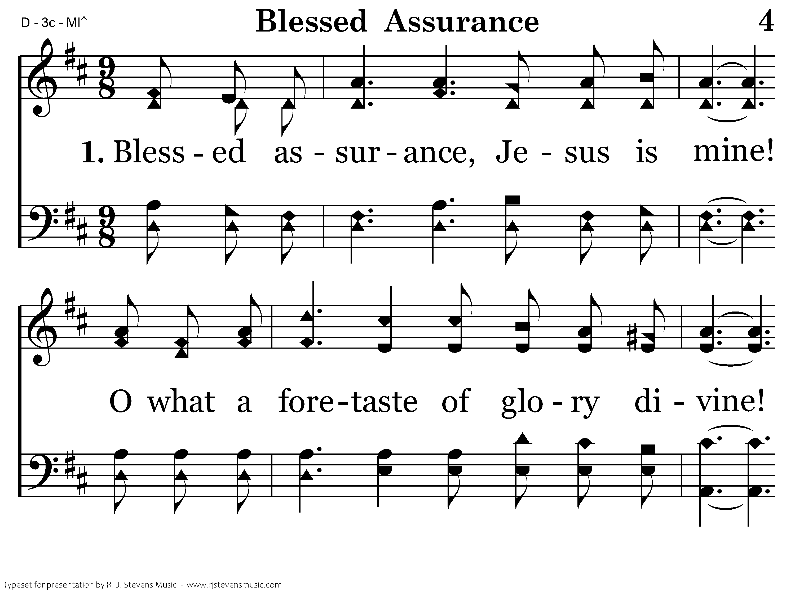
004 - Blessed Assurance - 1.1

Slide 36
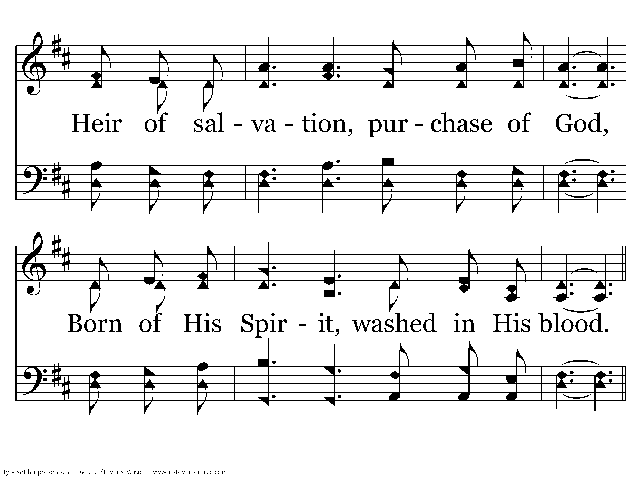
004 - Blessed Assurance - 1.2

Slide 37
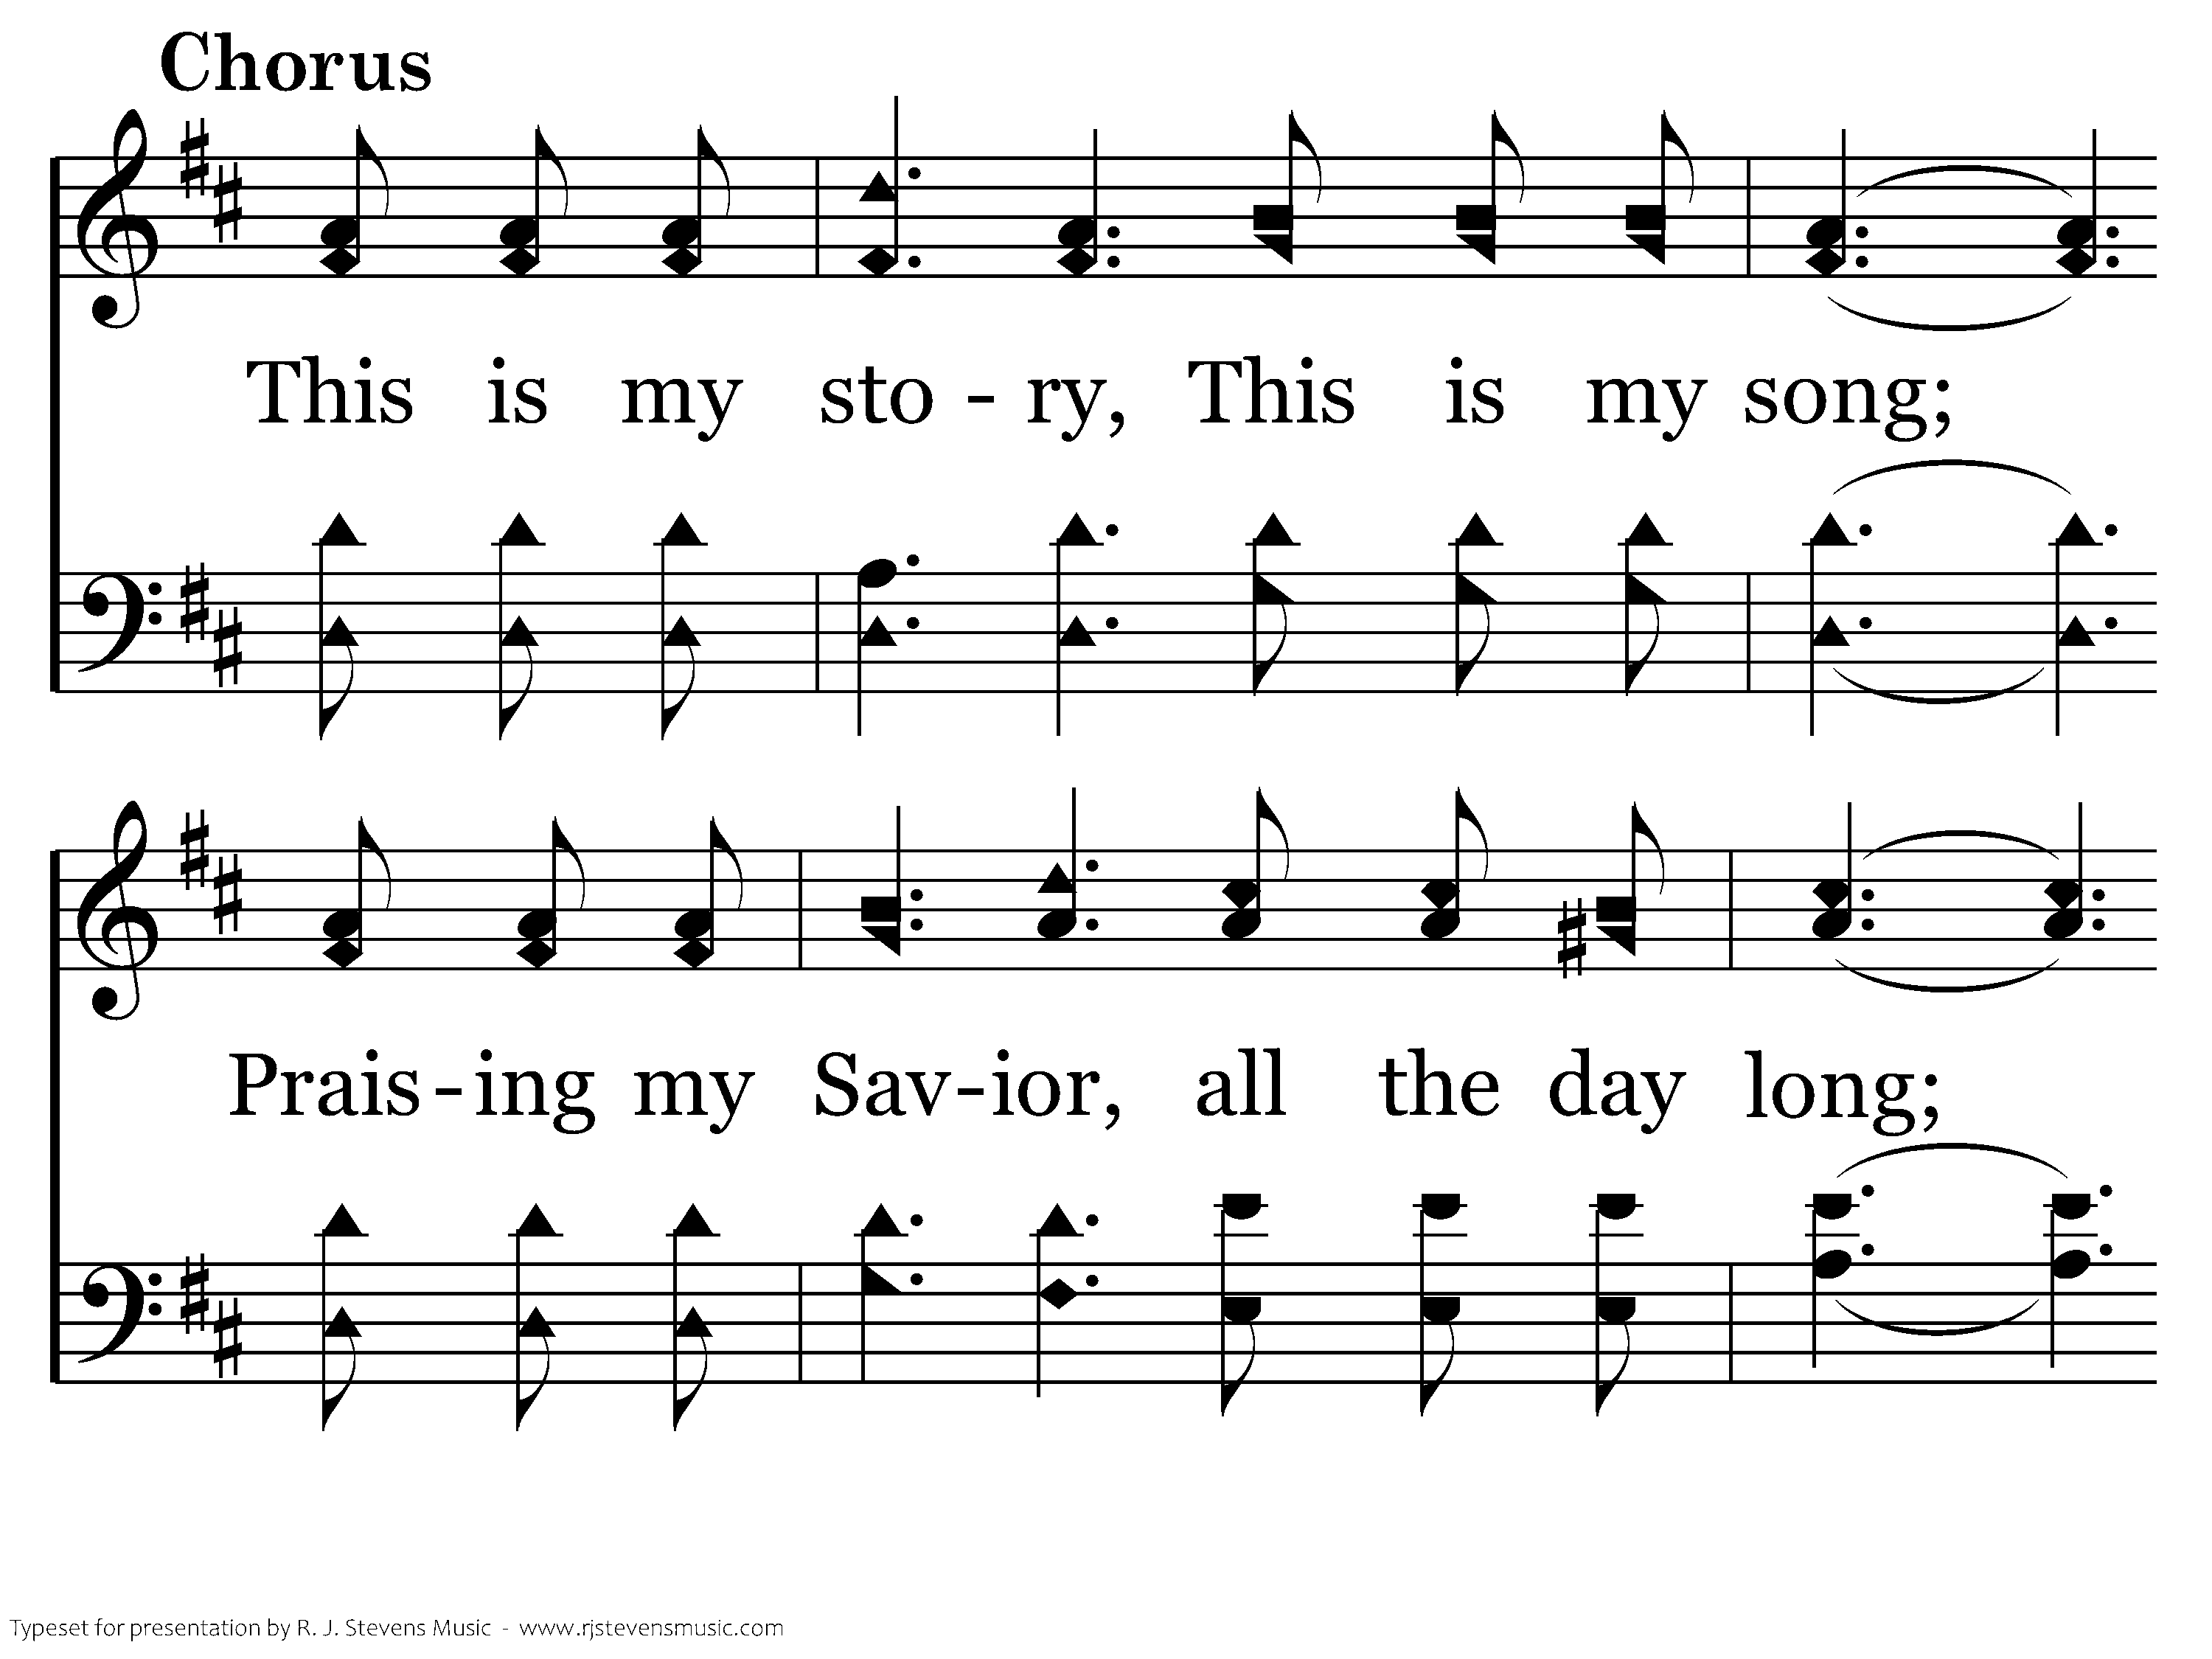
004 - Blessed Assurance - C.1

Slide 38
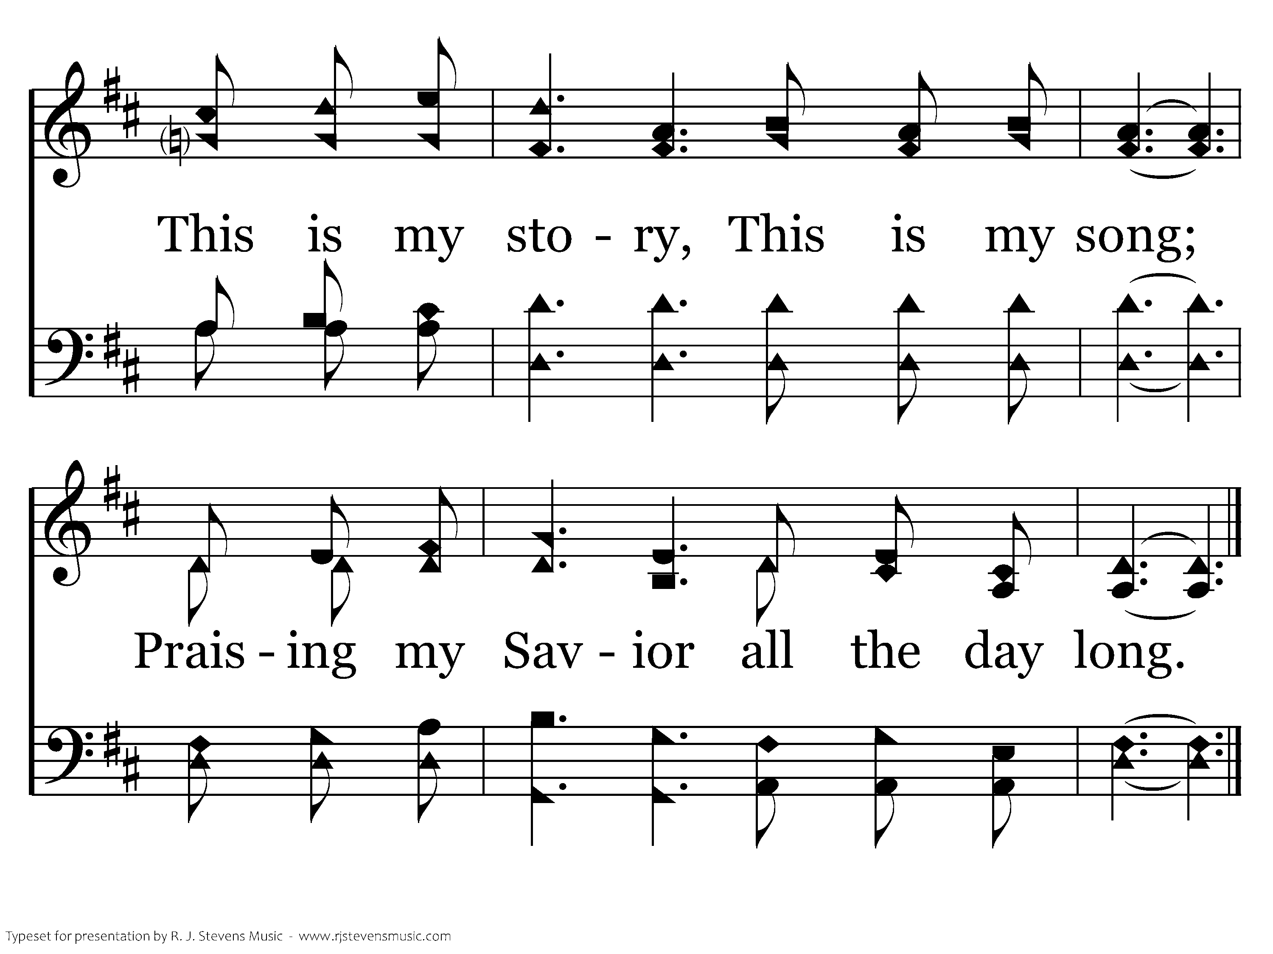
004 - Blessed Assurance - C.2
End of Verse 1

Slide 39
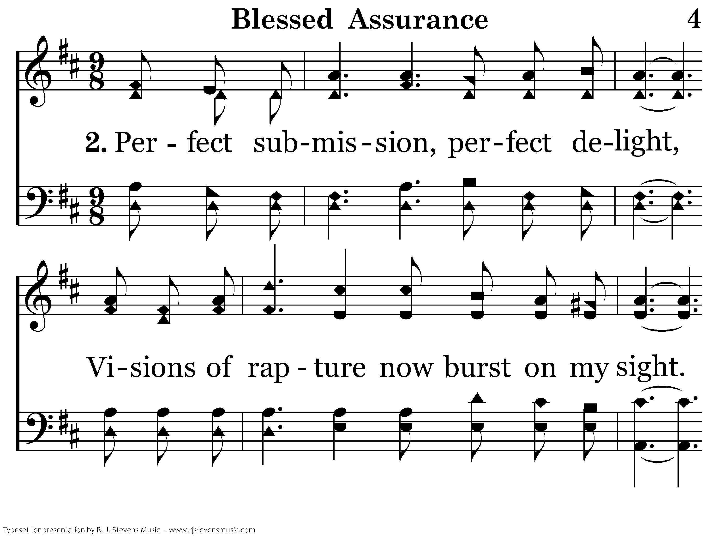
004 - Blessed Assurance - 2.1

Slide 40
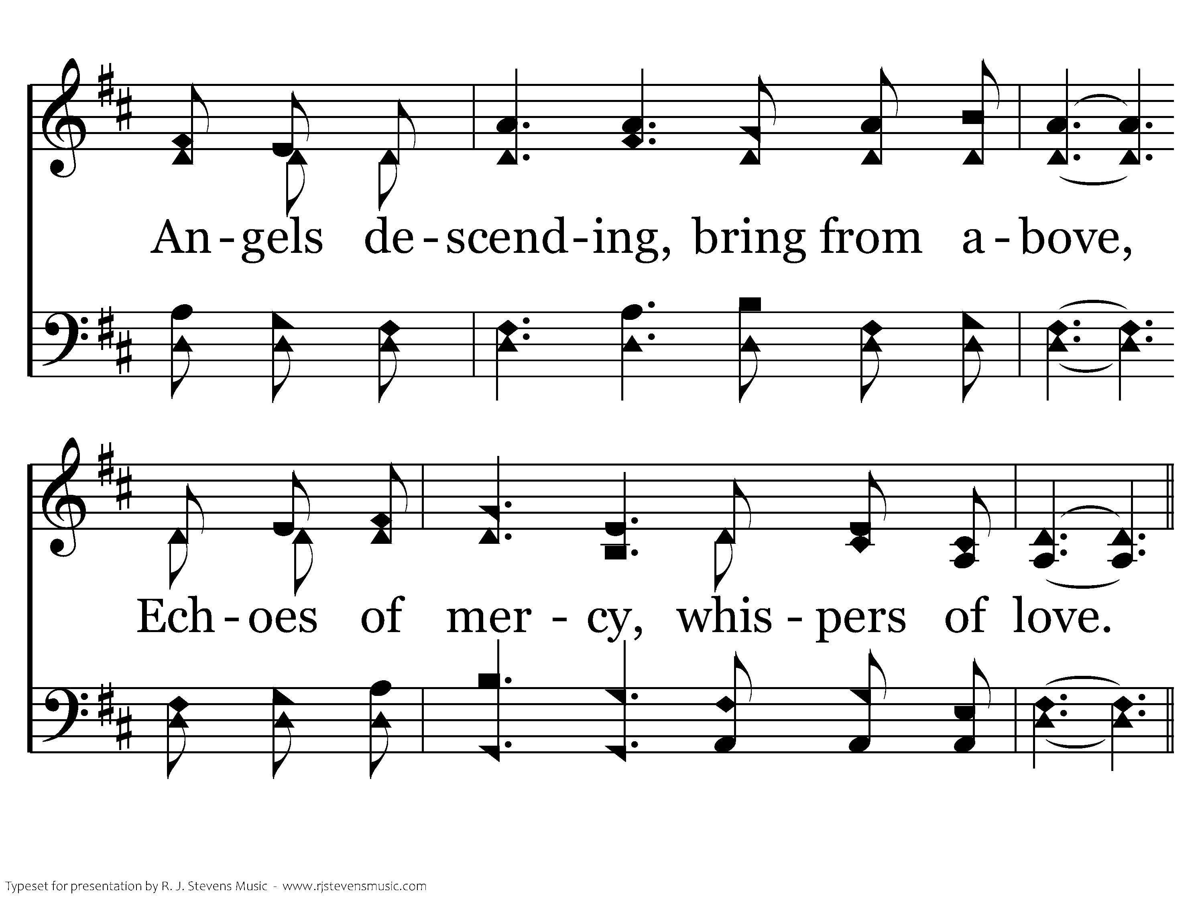
004 - Blessed Assurance - 2.2

Slide 41
004 - Blessed Assurance - C.1

Slide 42
004 - Blessed Assurance - C.2
End of Verse 2

Slide 43
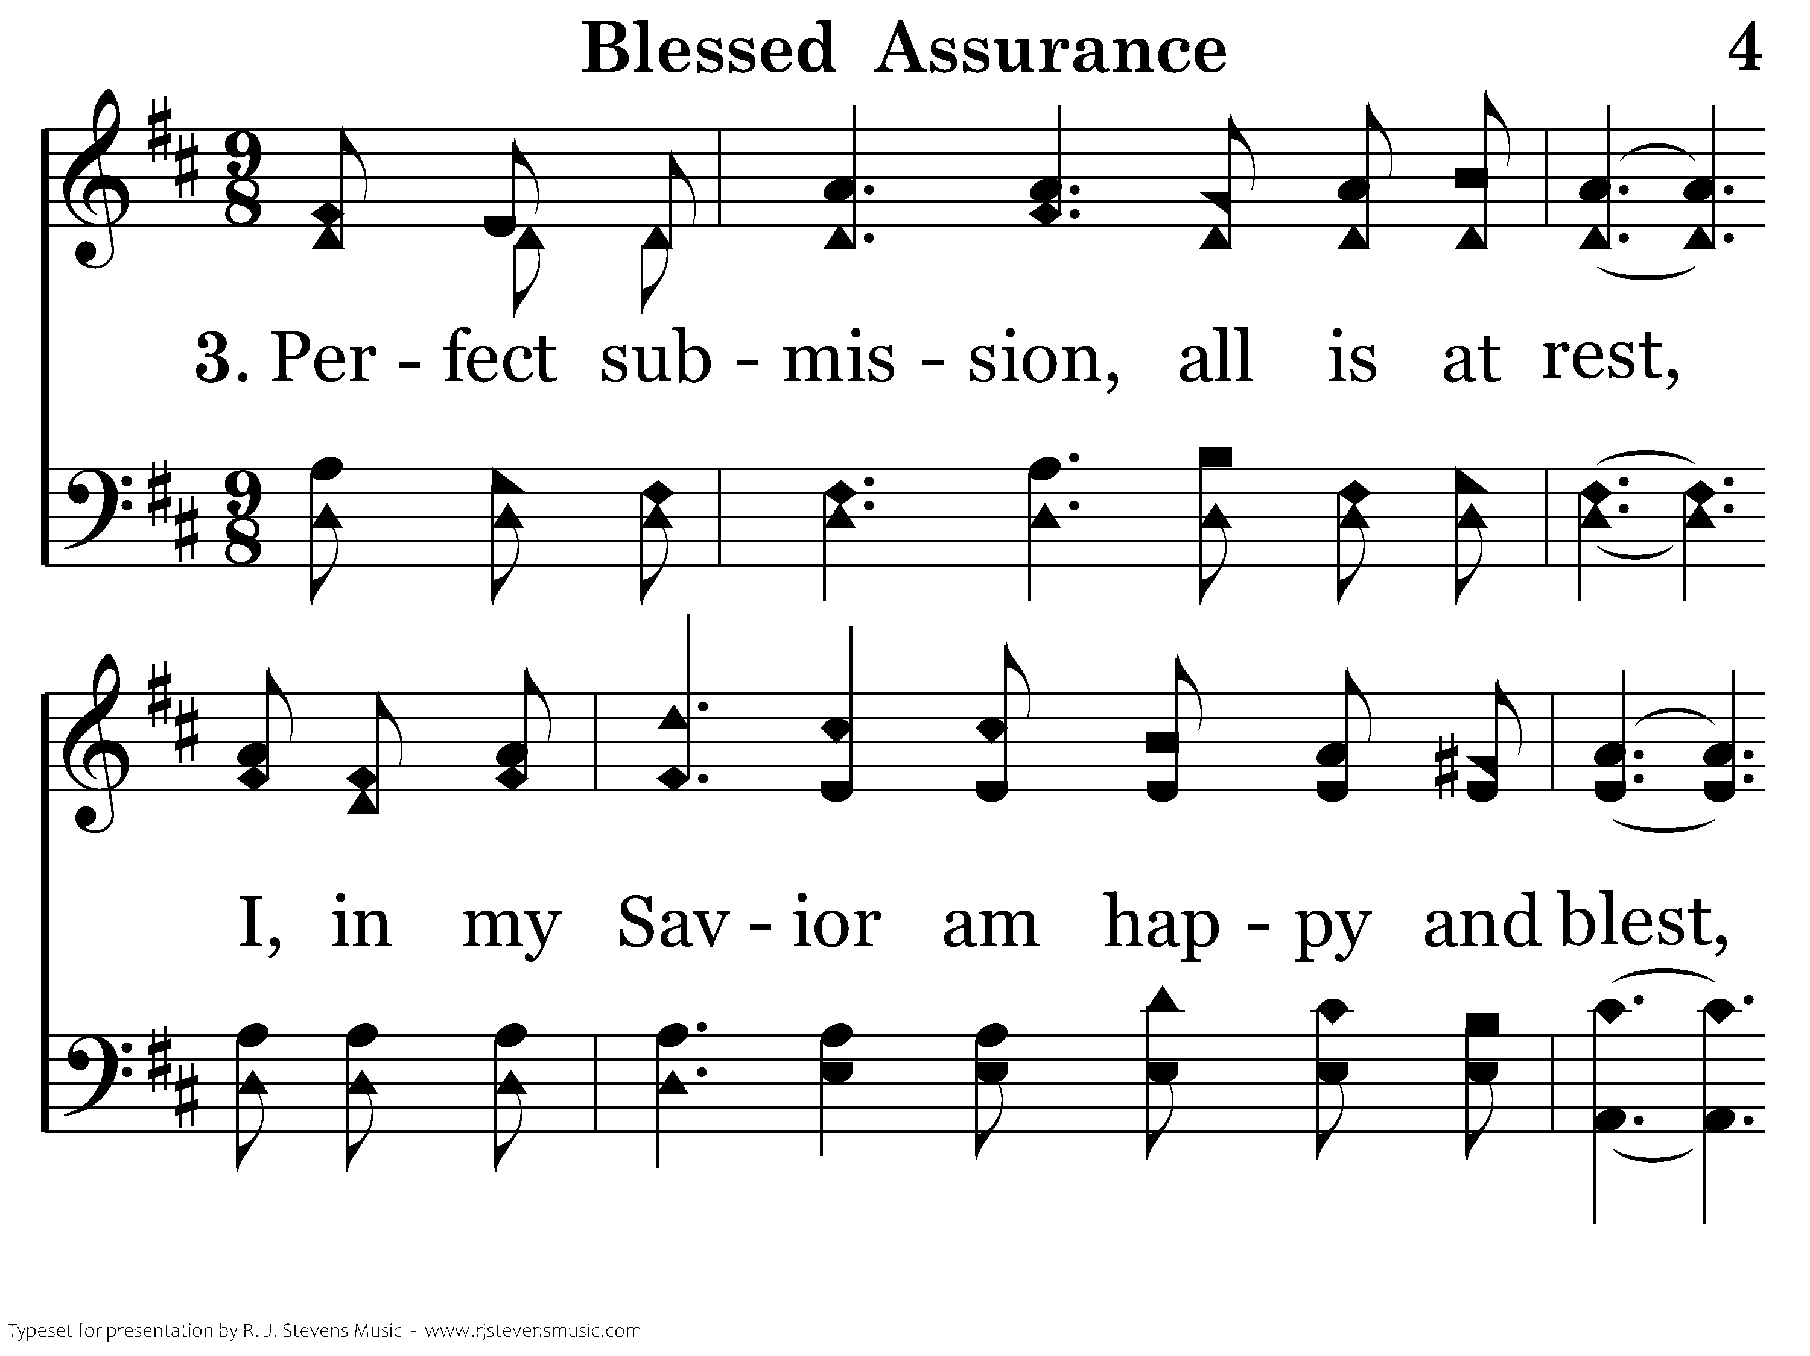
004 - Blessed Assurance - 3.1

Slide 44
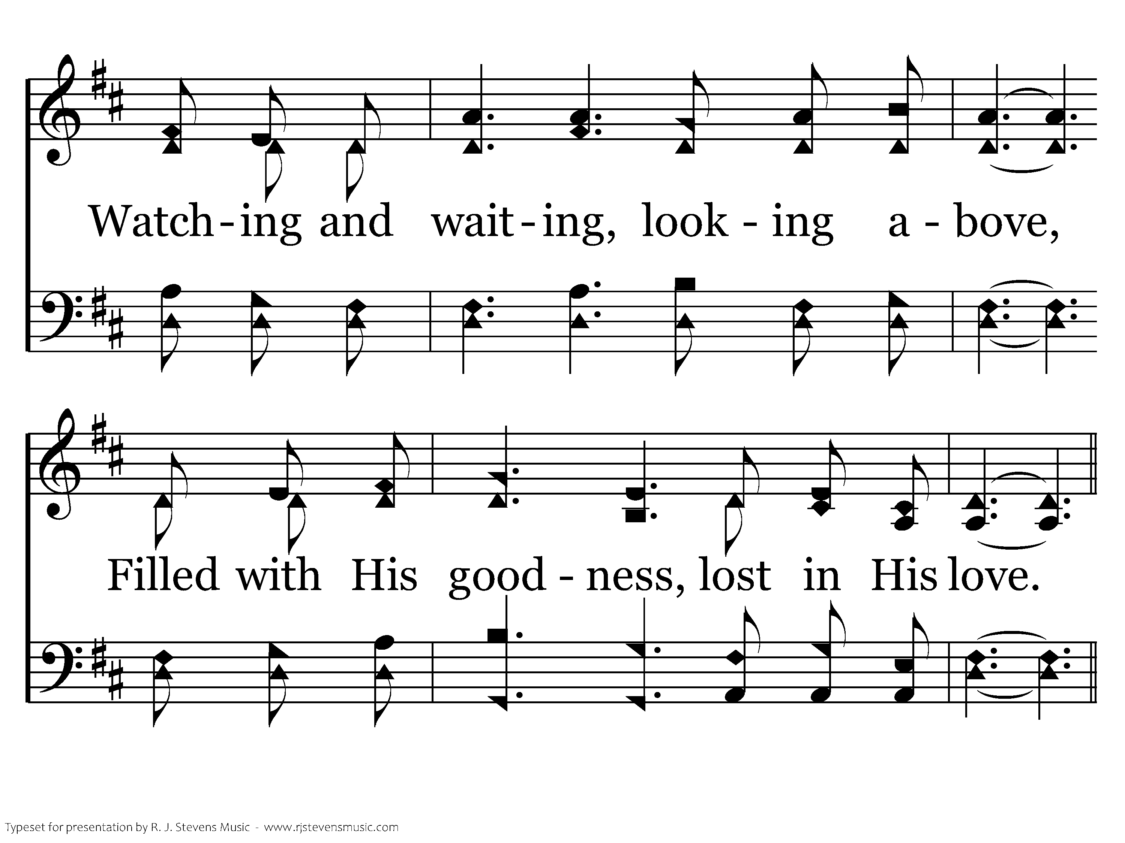
004 - Blessed Assurance - 3.2

Slide 45
004 - Blessed Assurance - C.1

Slide 46
004 - Blessed Assurance - C.2
End of Song

Slide 47
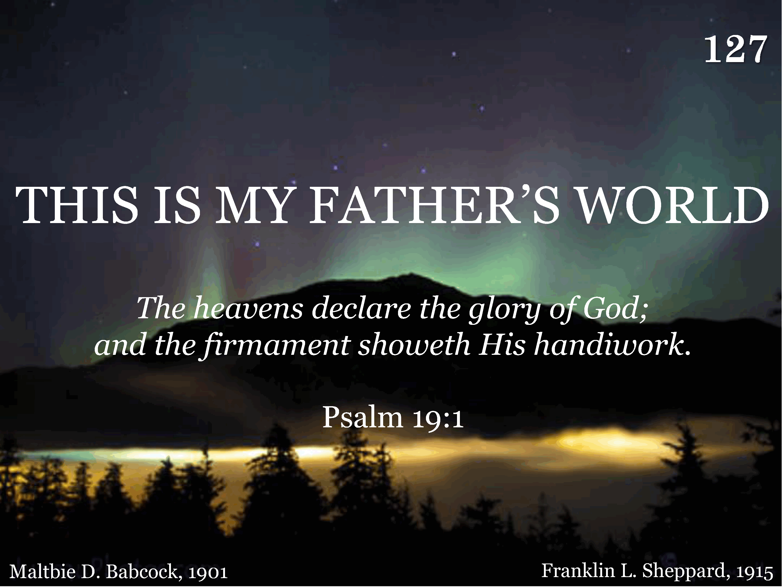
127 - This Is My Father's World - Title

Slide 48
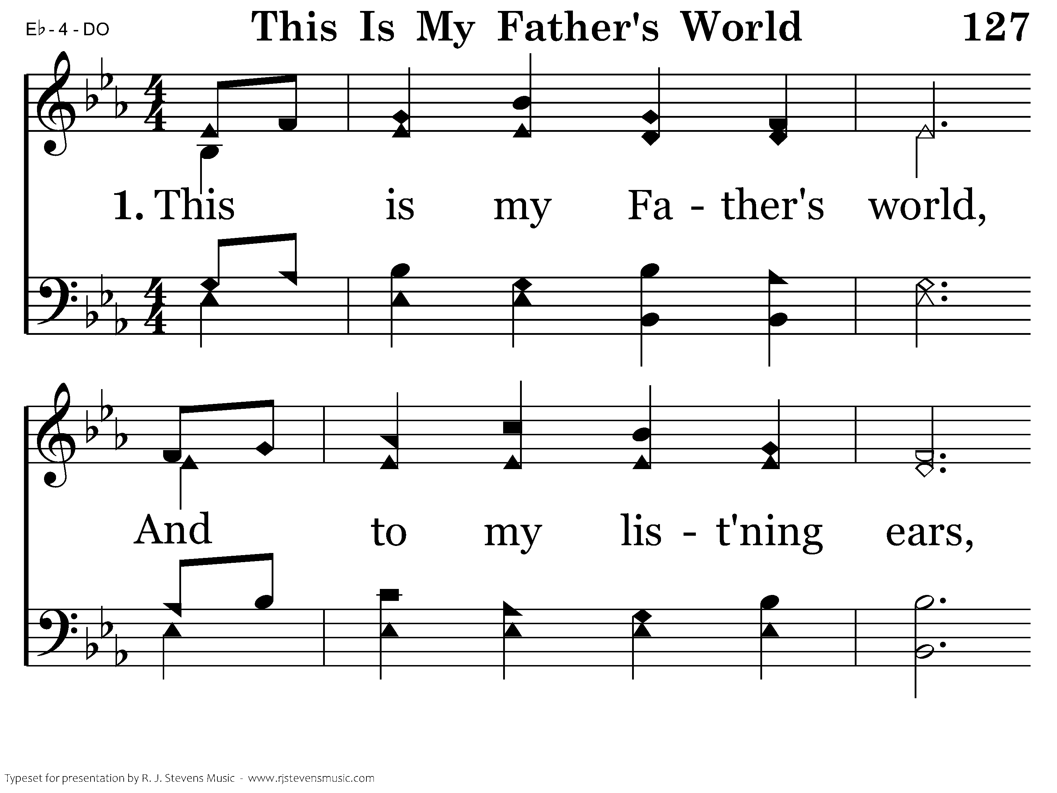
127 - This Is My Father's World - 1.1

Slide 49
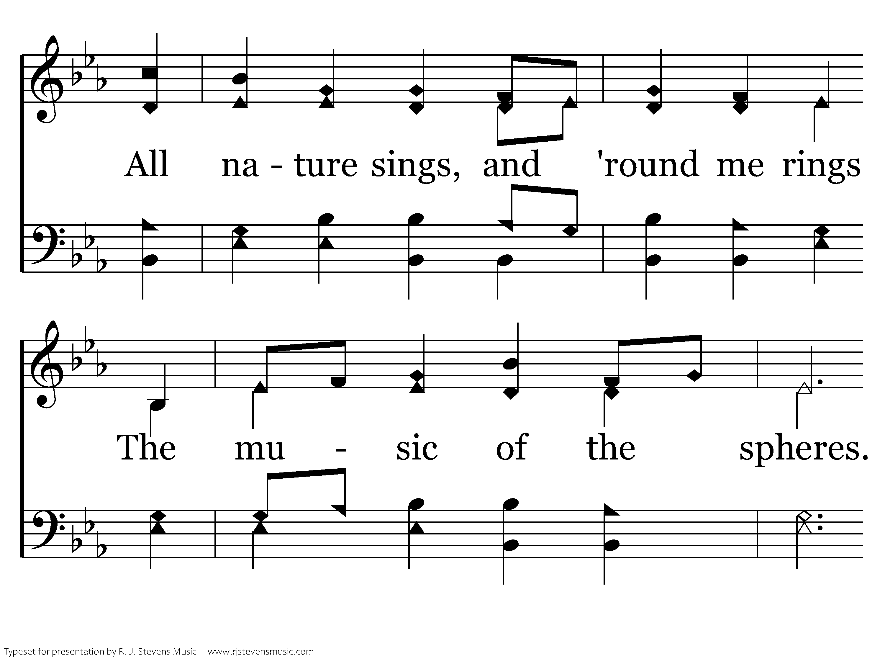
127 - This Is My Father's World - 1.2

Slide 50
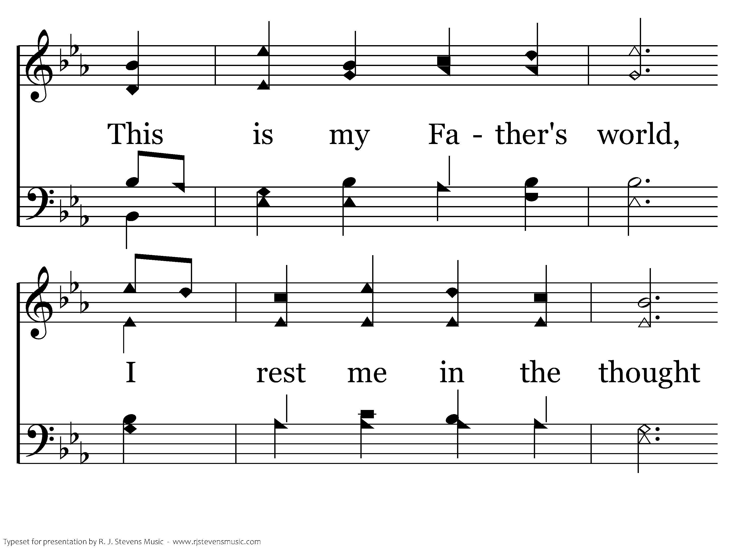
127 - This Is My Father's World - 1.3

Slide 51
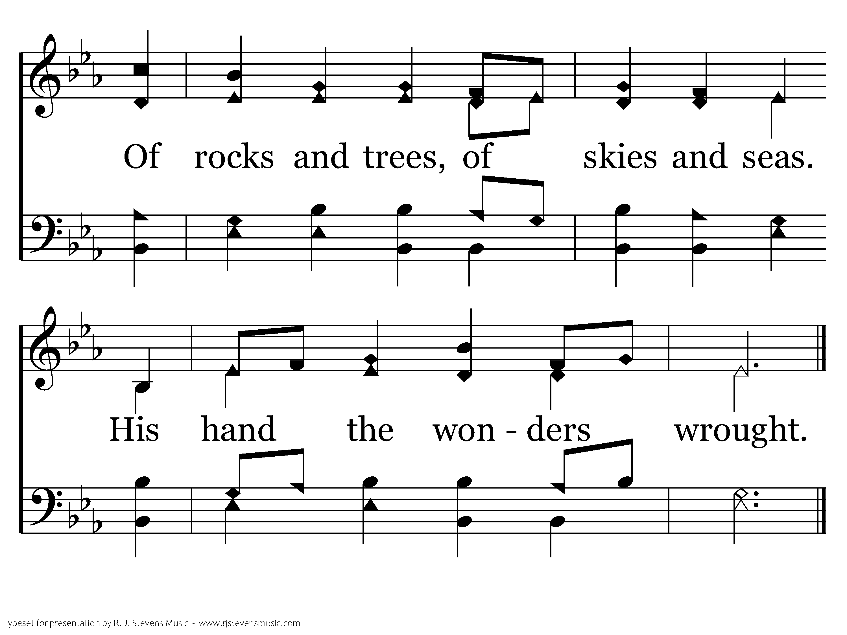
127 - This Is My Father's World - 1.4
End of Verse 1

Slide 52
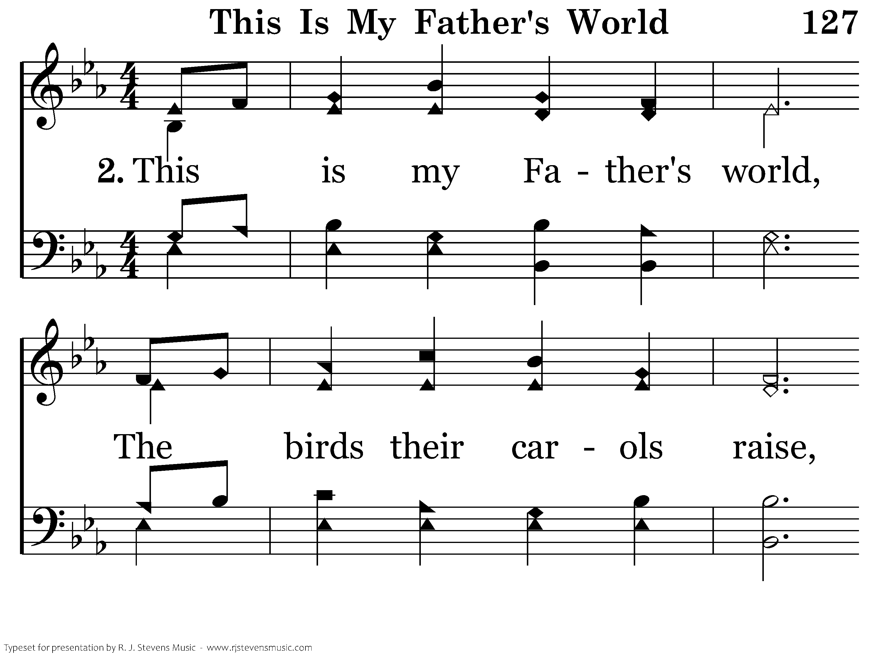
127 - This Is My Father's World - 2.1

Slide 53
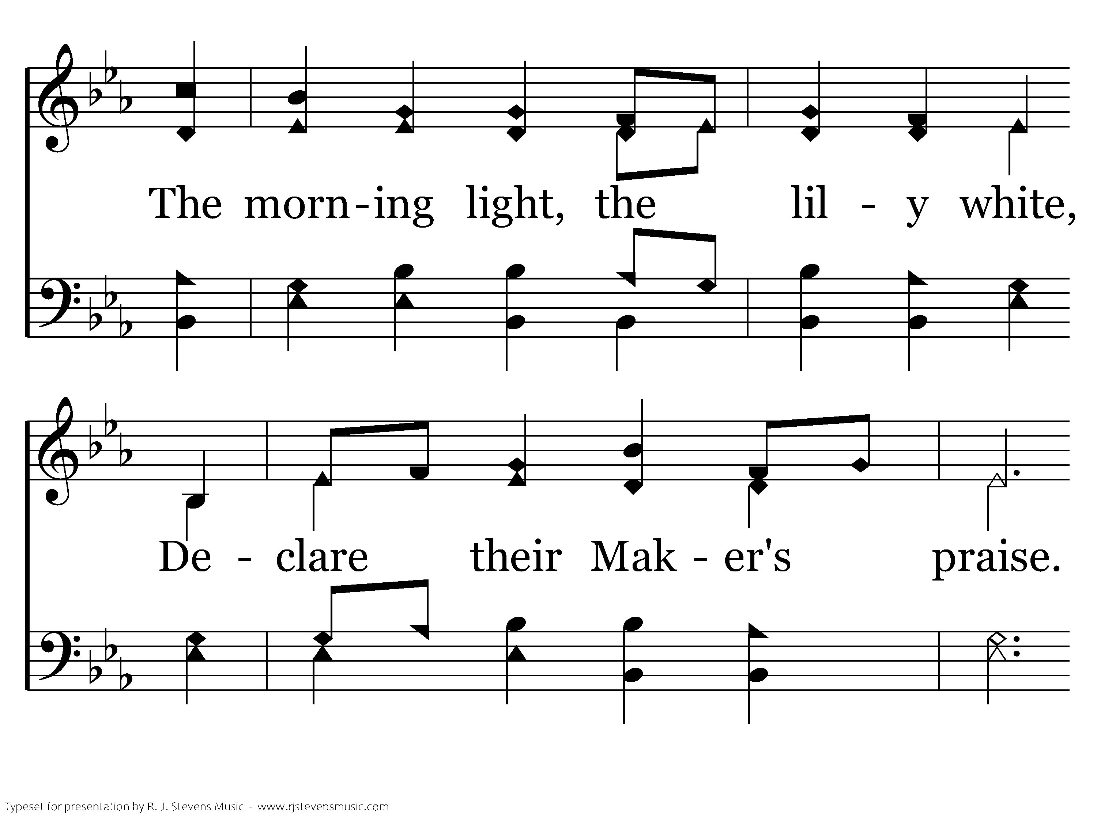
127 - This Is My Father's World - 2.2

Slide 54
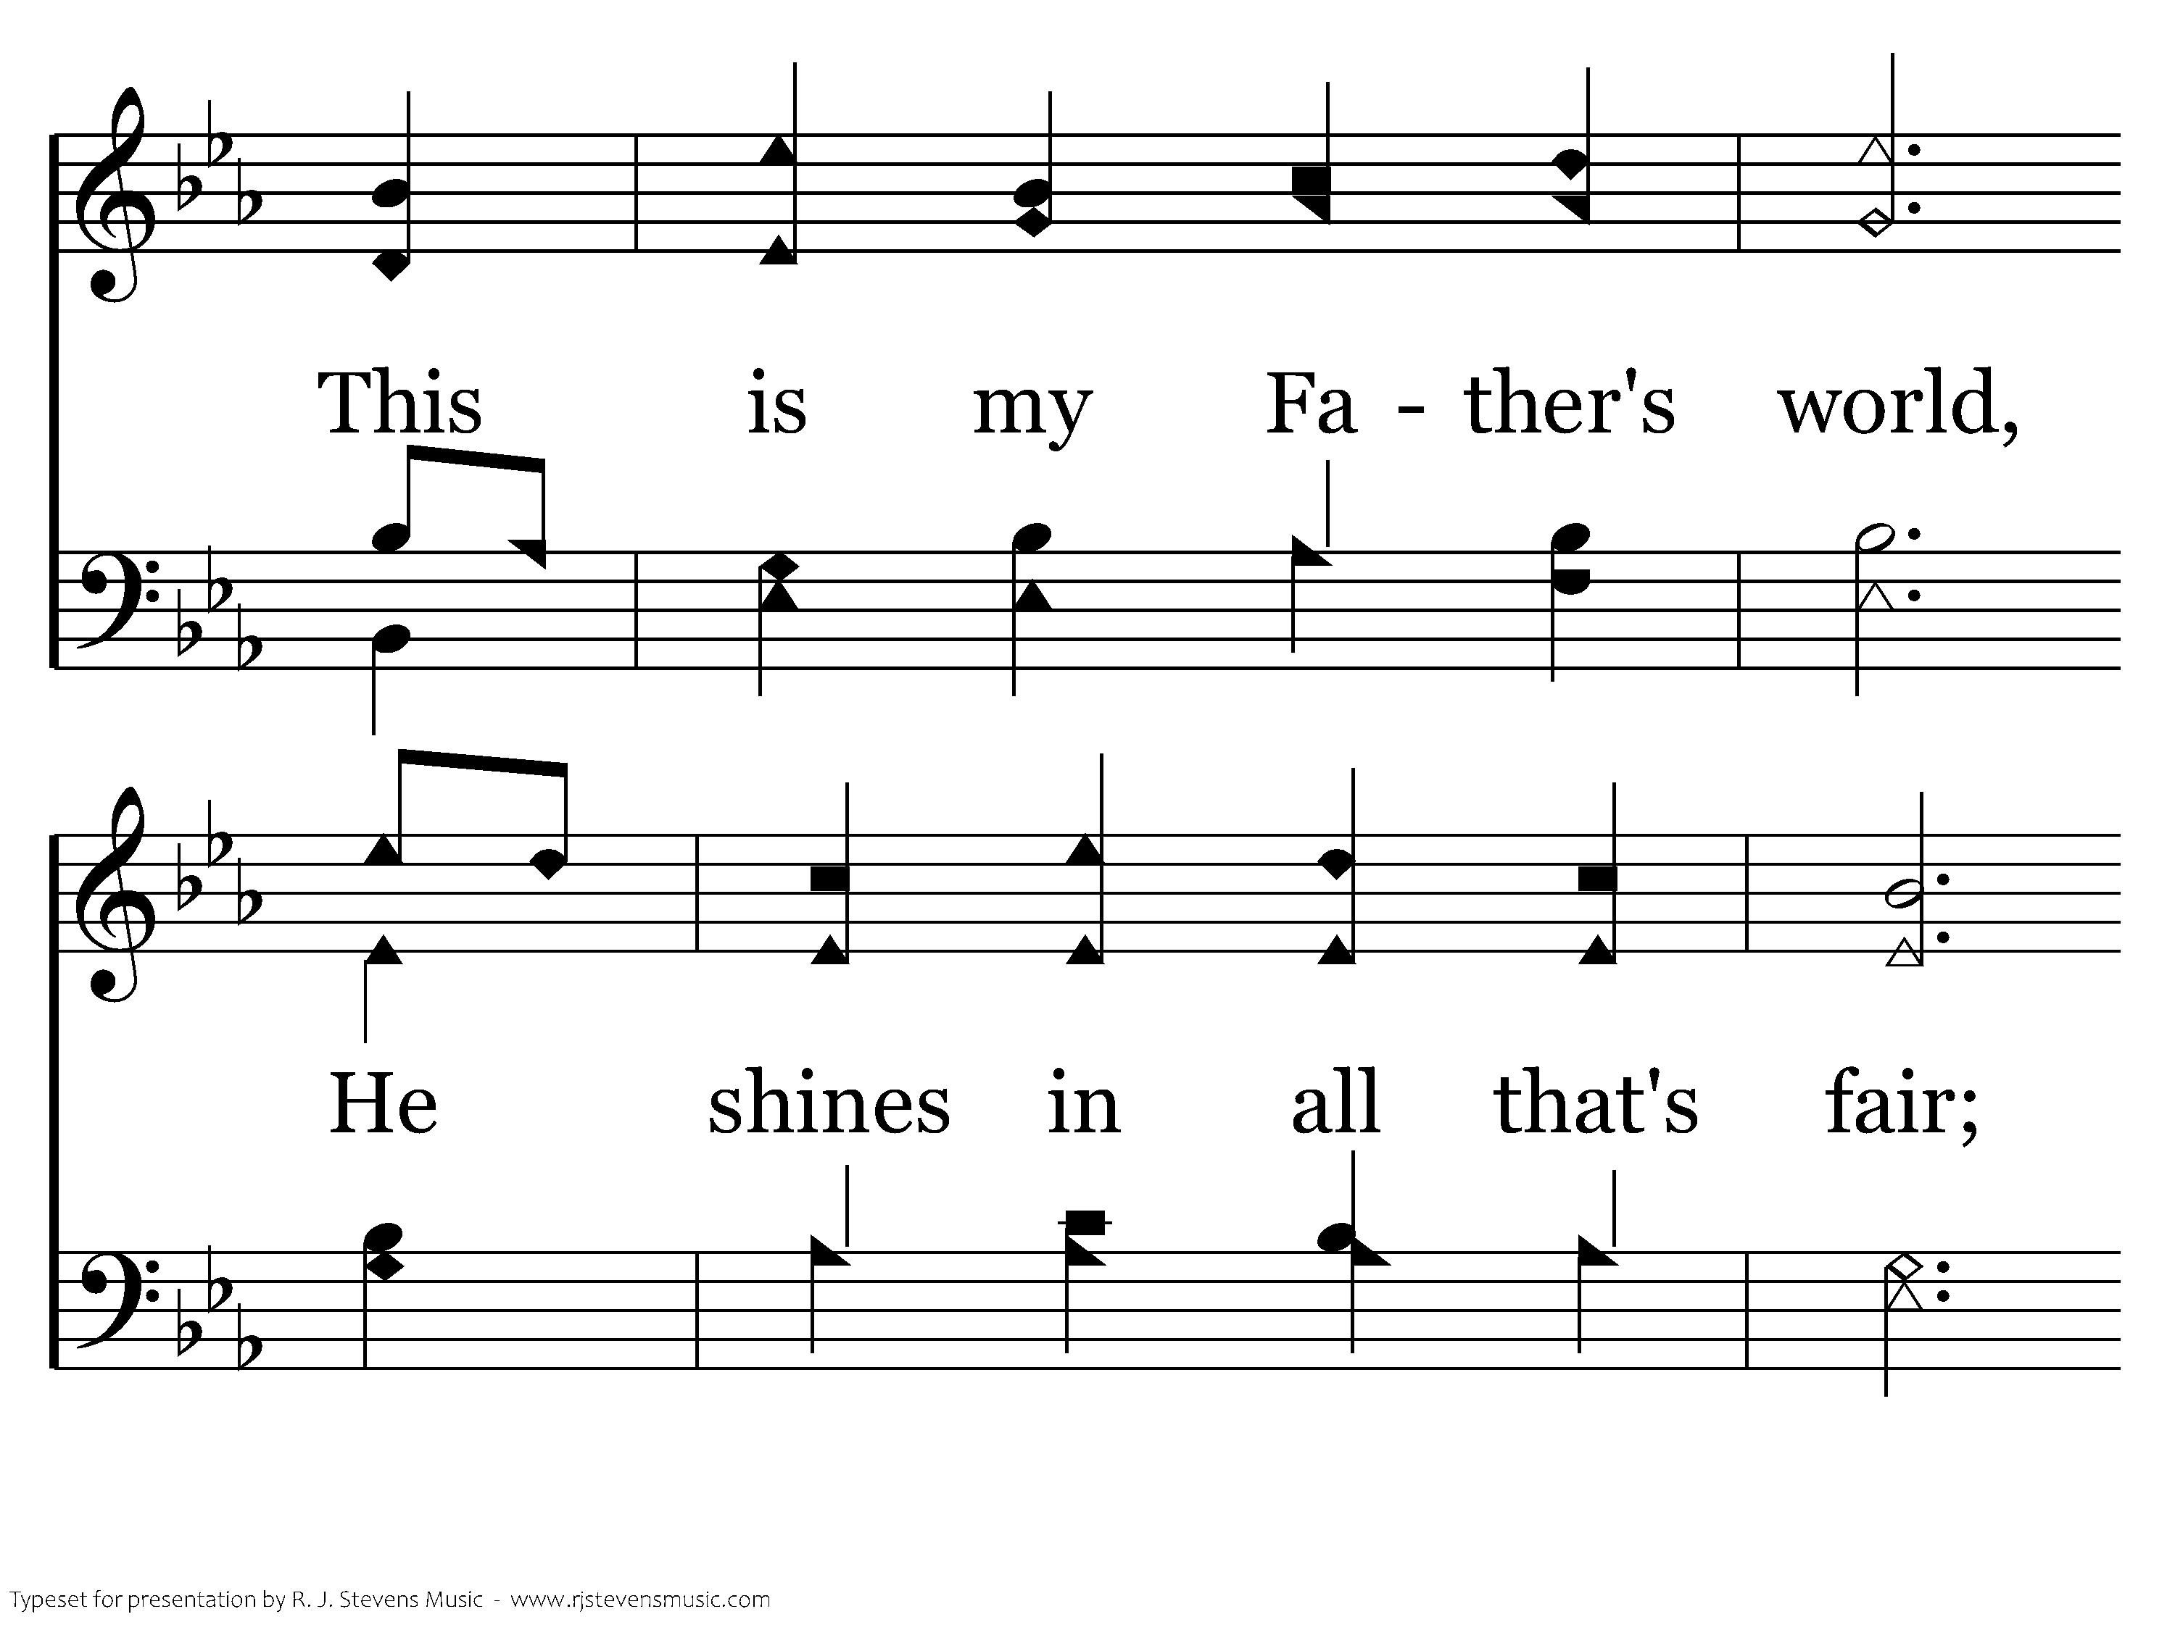
127 - This Is My Father's World - 2.3

Slide 55
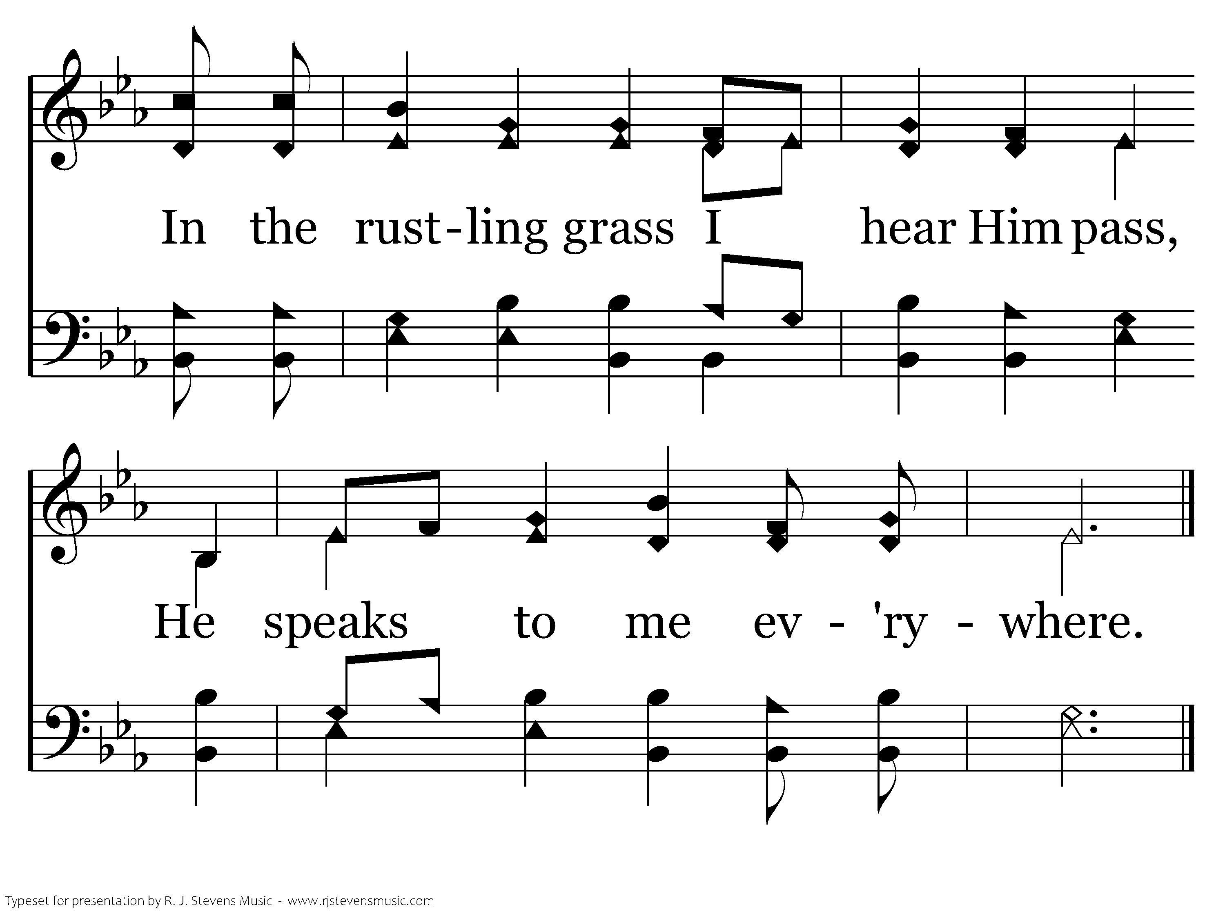
127 - This Is My Father's World - 2.4
End of Verse 2

Slide 56
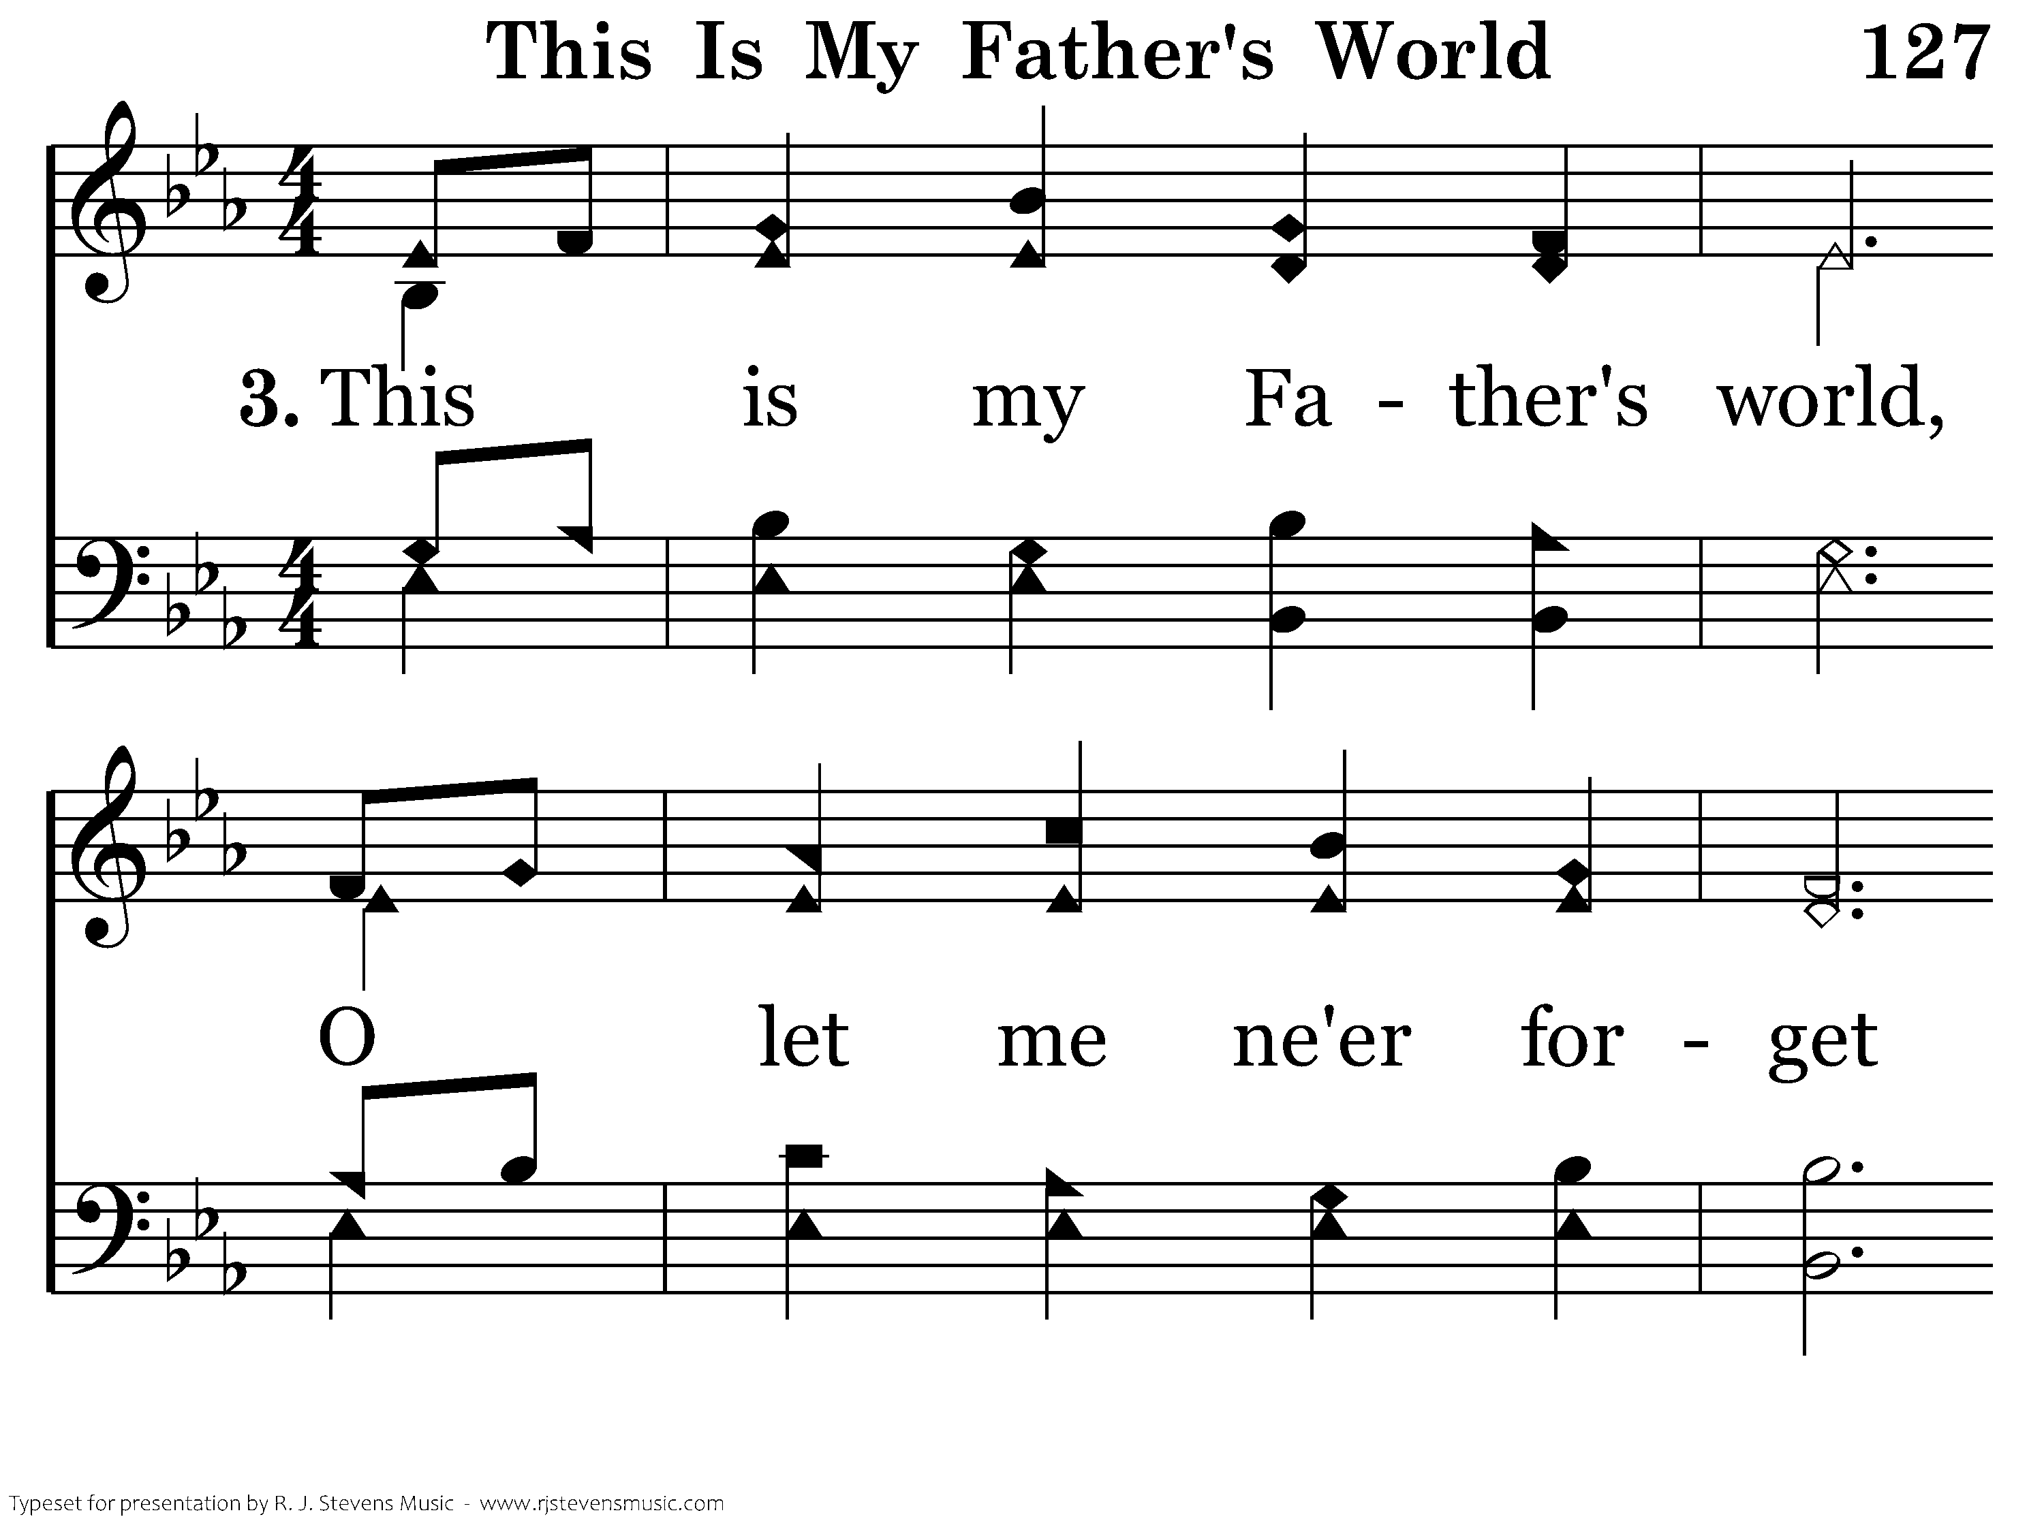
127 - This Is My Father's World - 3.1

Slide 57
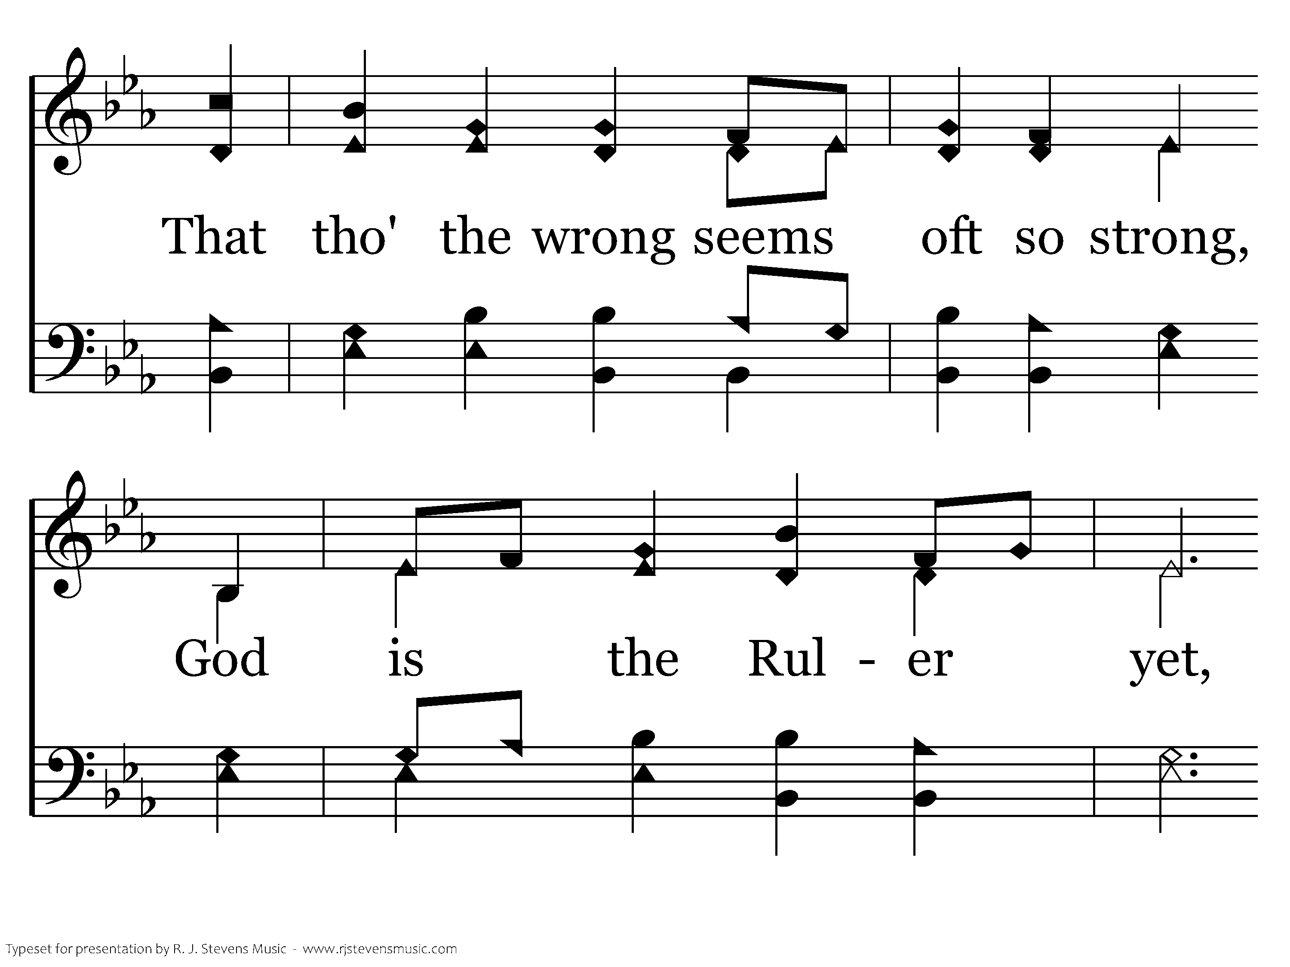
127 - This Is My Father's World - 3.2

Slide 58
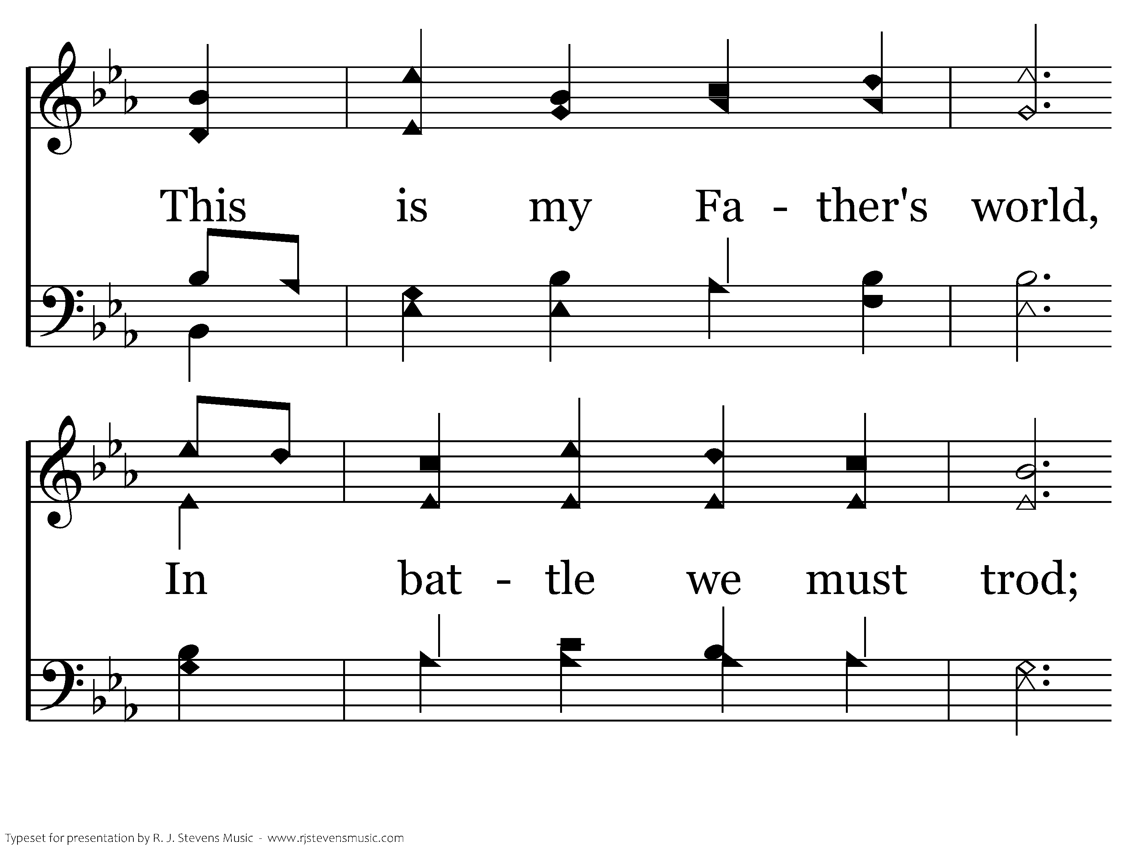
127 - This Is My Father's World - 3.3

Slide 59
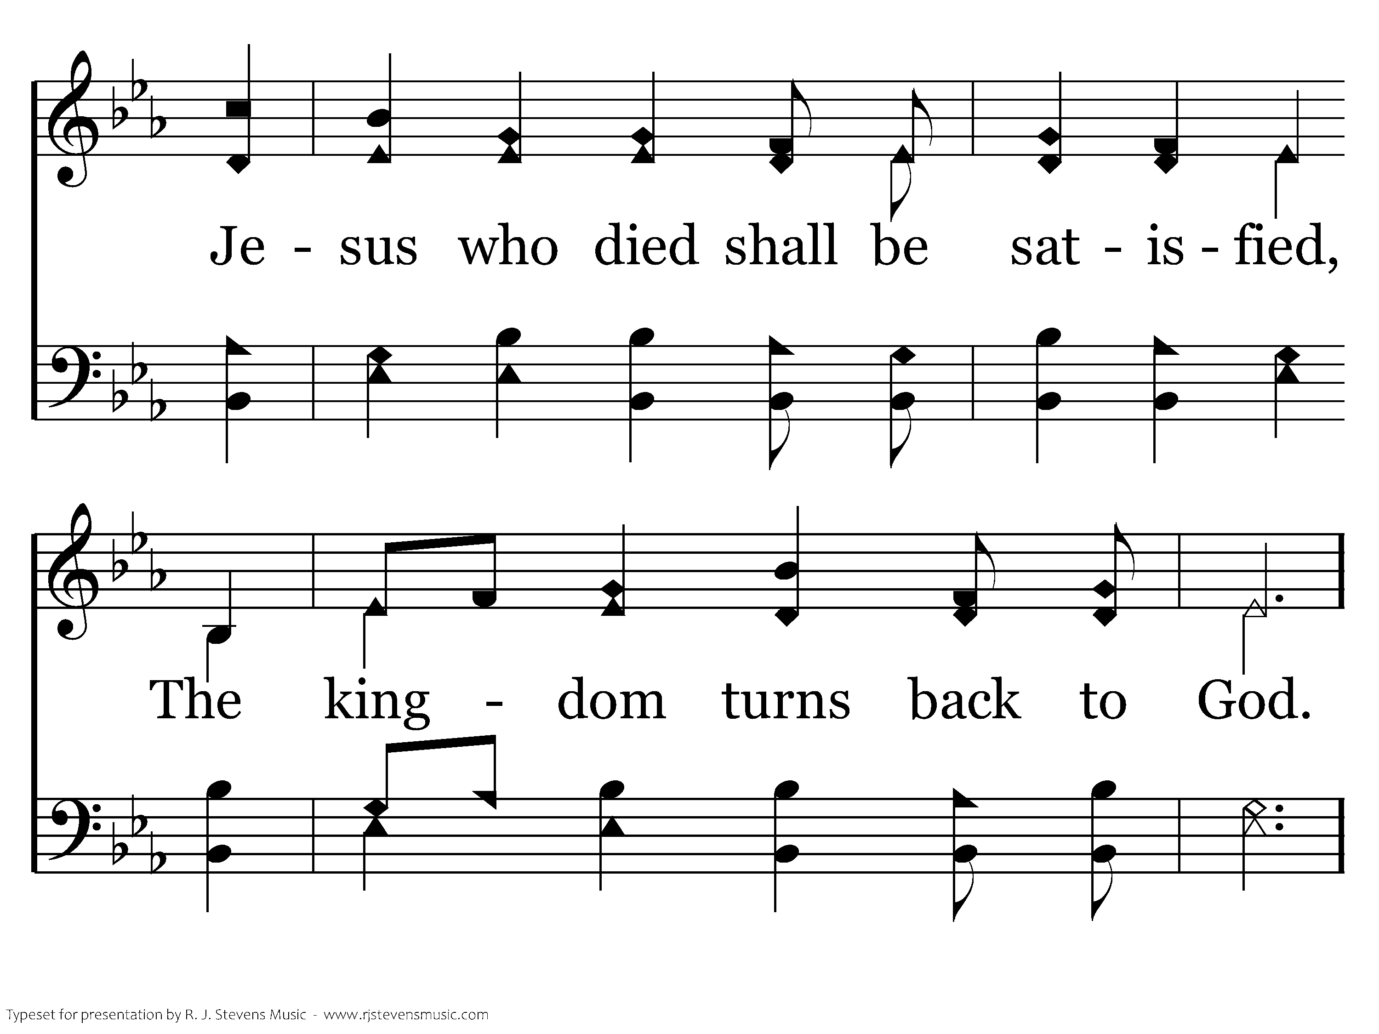
127 - This Is My Father's World - 3.4

Slide 60
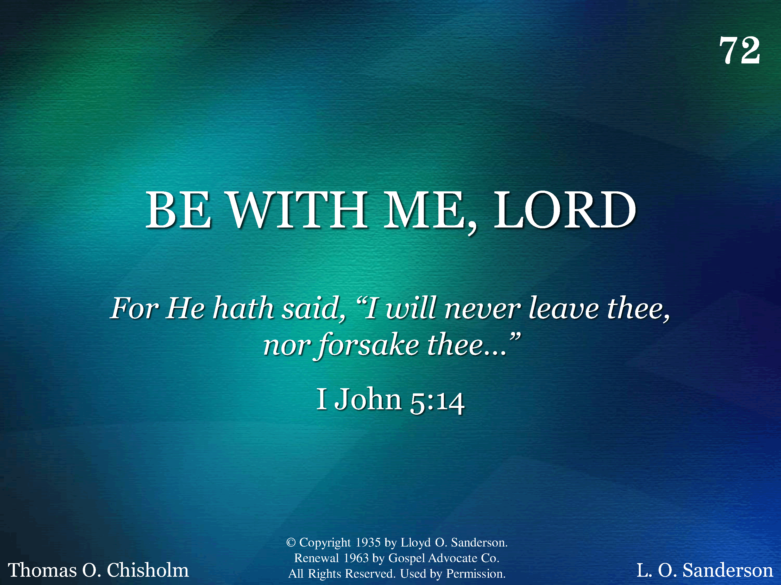
072 - Be With Me, Lord - Title

Slide 61
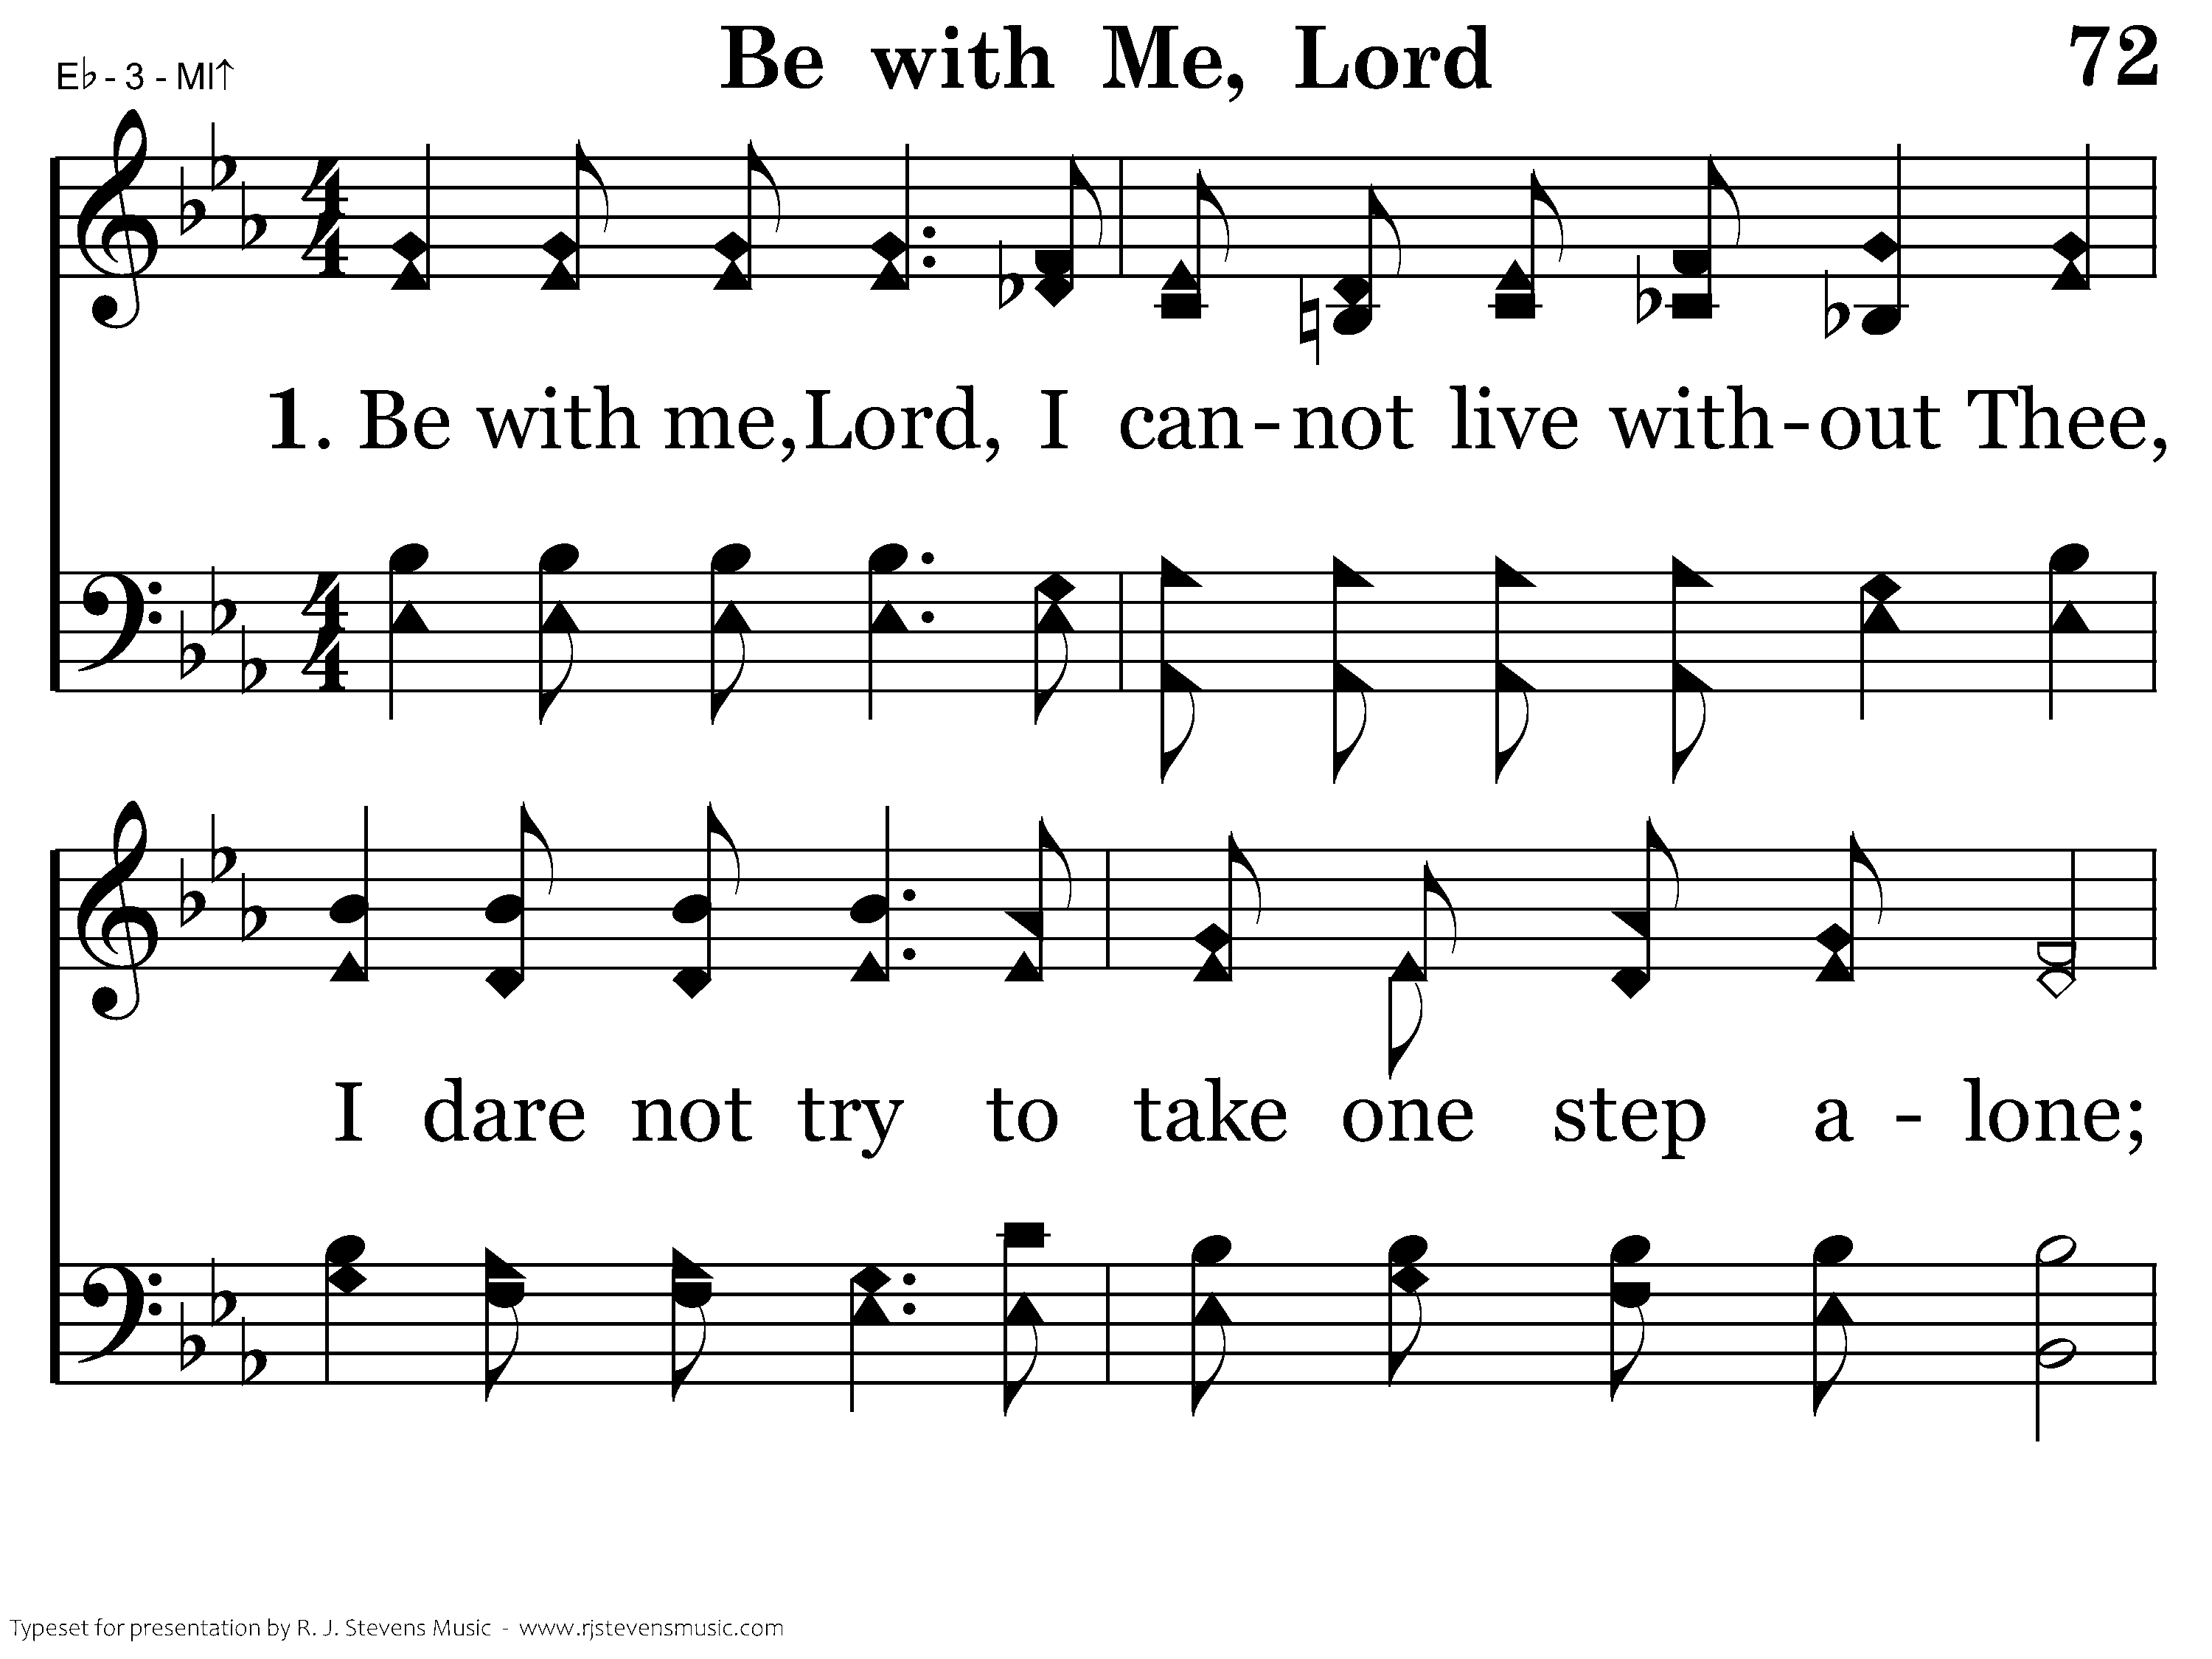
072 - Be With Me, Lord - 1.1

Slide 62
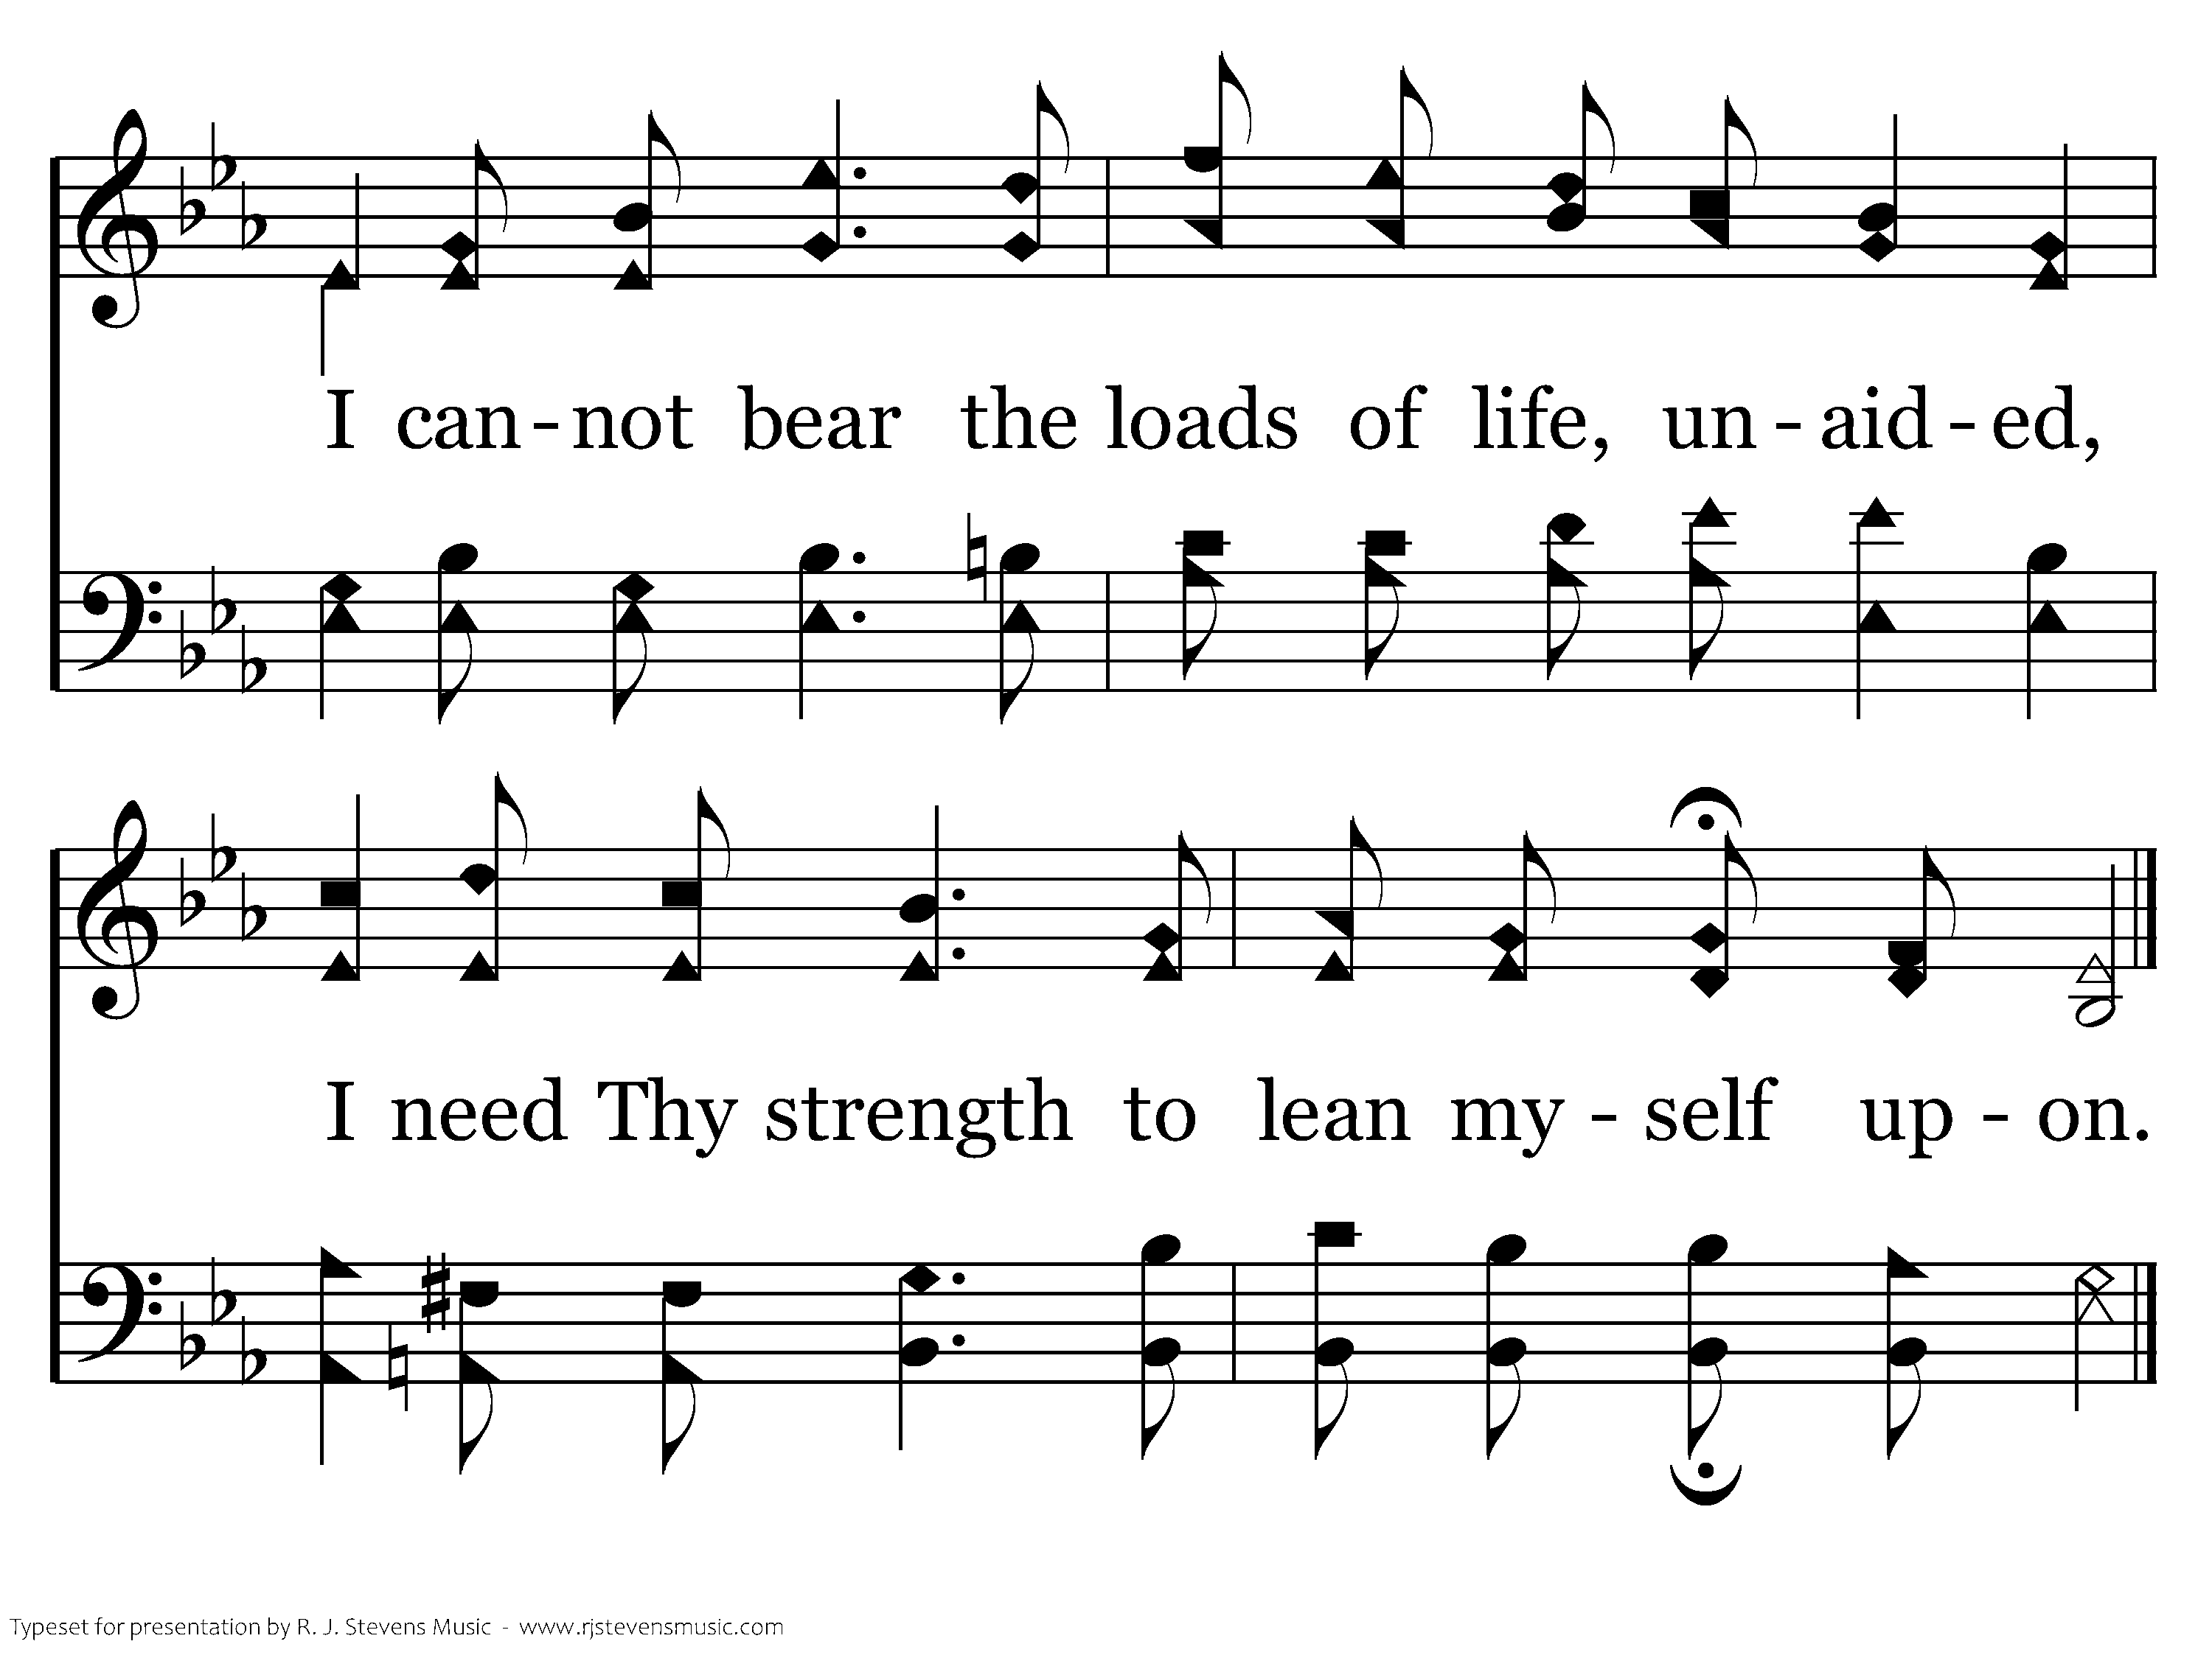
072 - Be With Me, Lord - 1.2
End of Verse 1

Slide 63
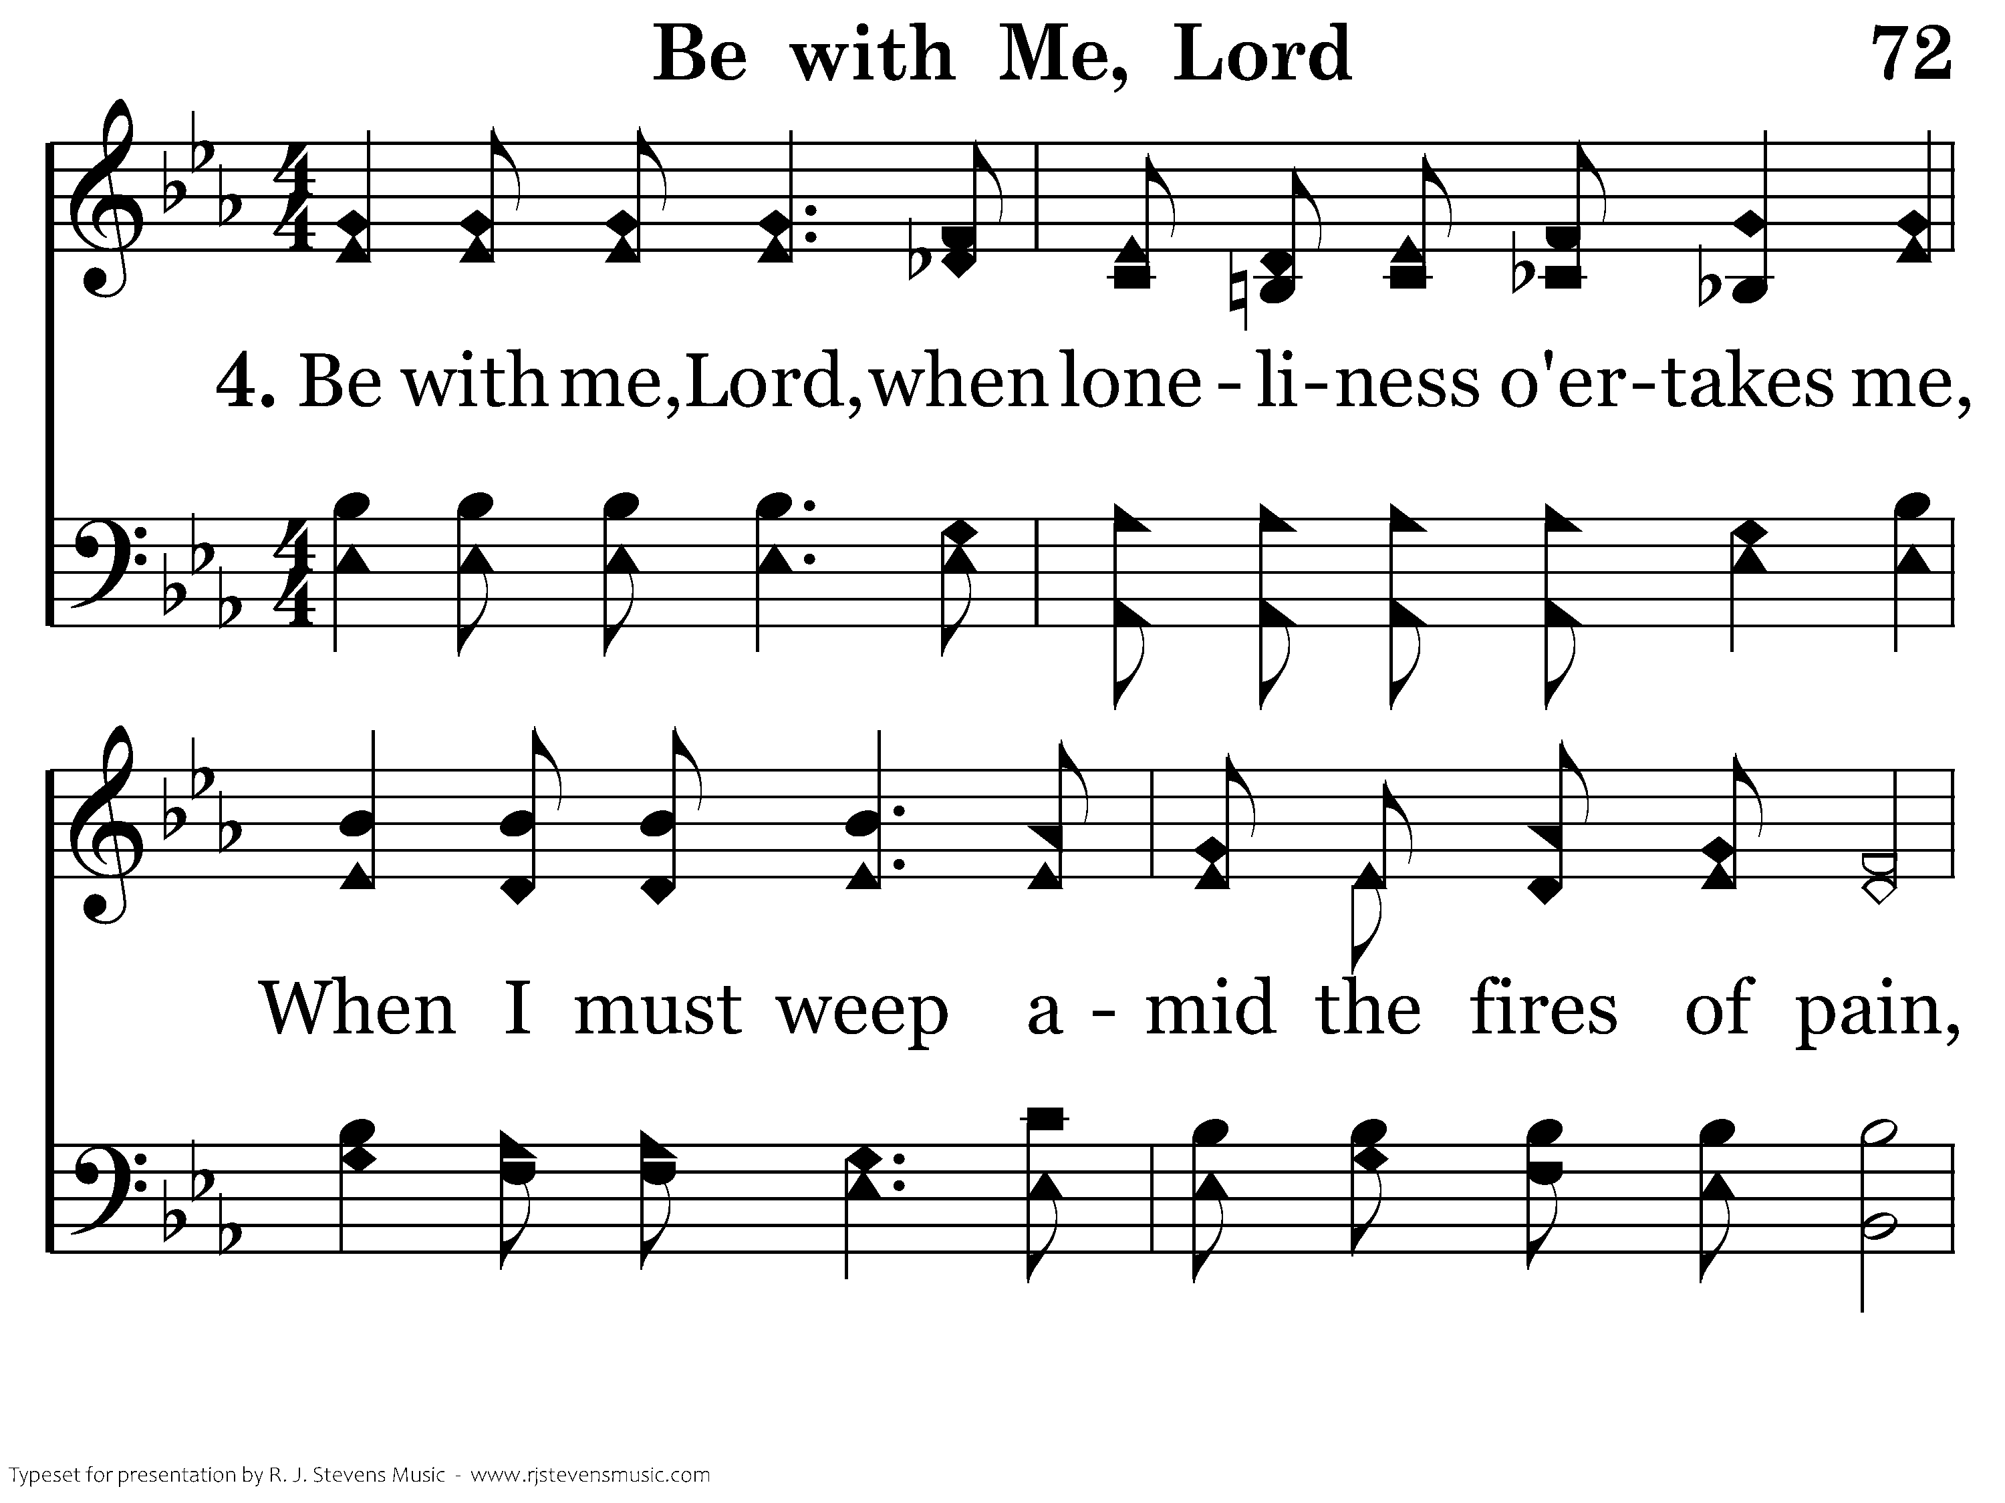
072 - Be With Me, Lord - 4.1

Slide 64
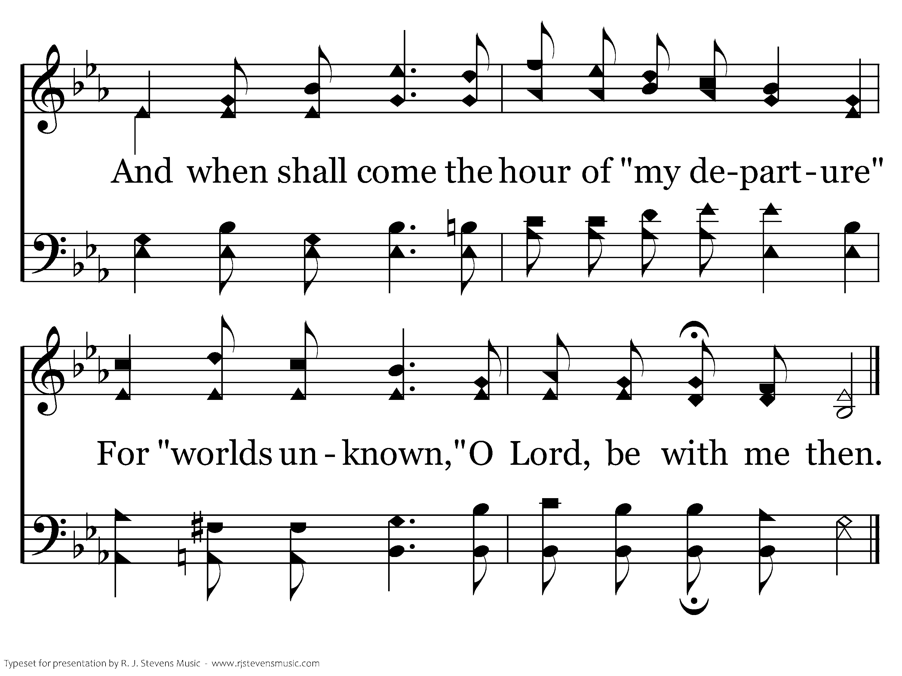
072 - Be With Me, Lord - 4.2
End of Song

Slide 65

047 - God Is So Good - Title

Slide 66
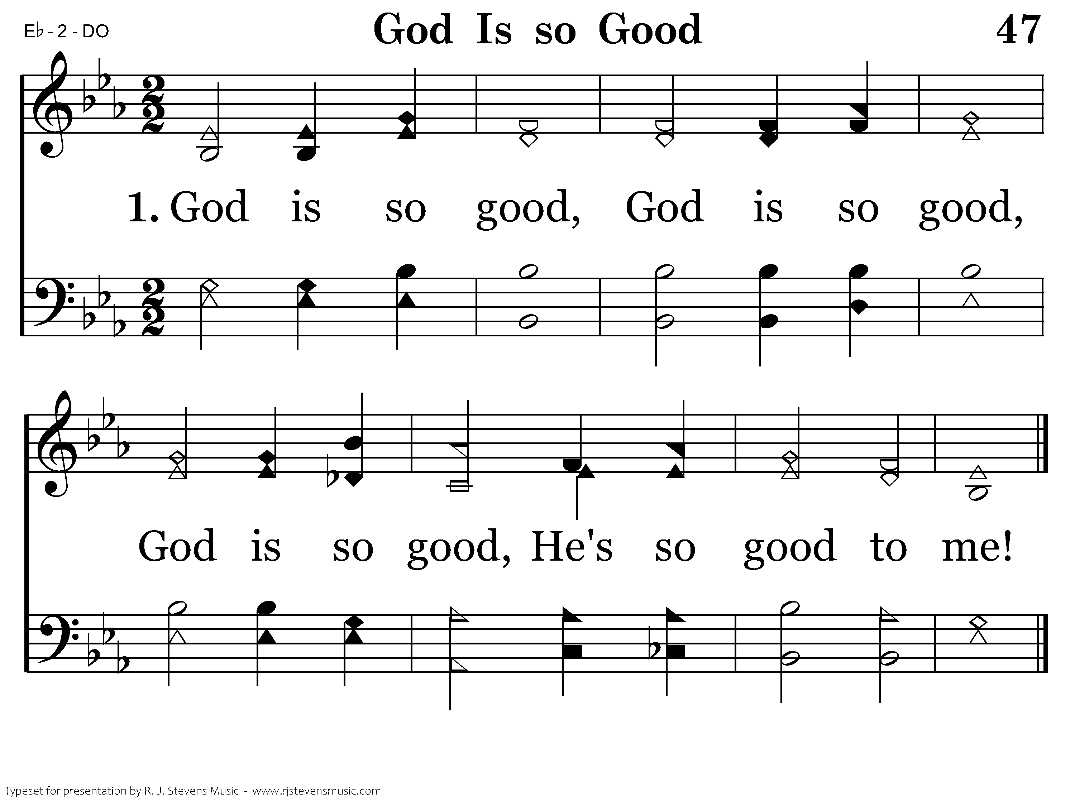
047 - God Is So Good - 1.1
End of Verse 1

Slide 67
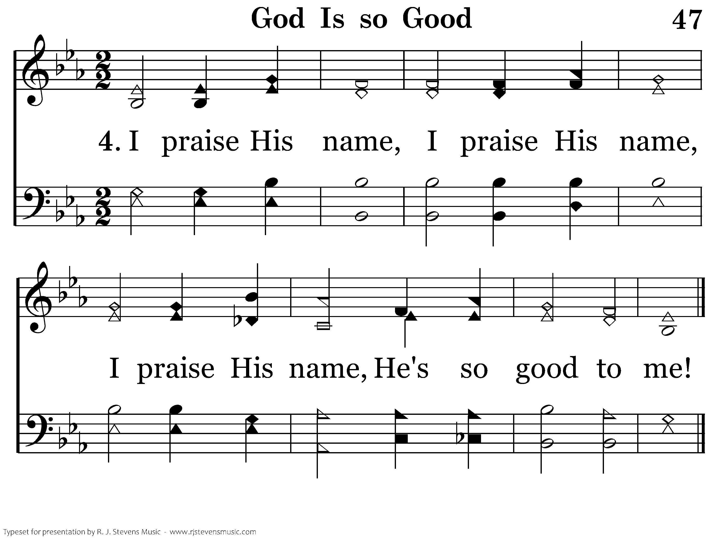
047 - God Is So Good - 4.1
End of Song

Slide 68
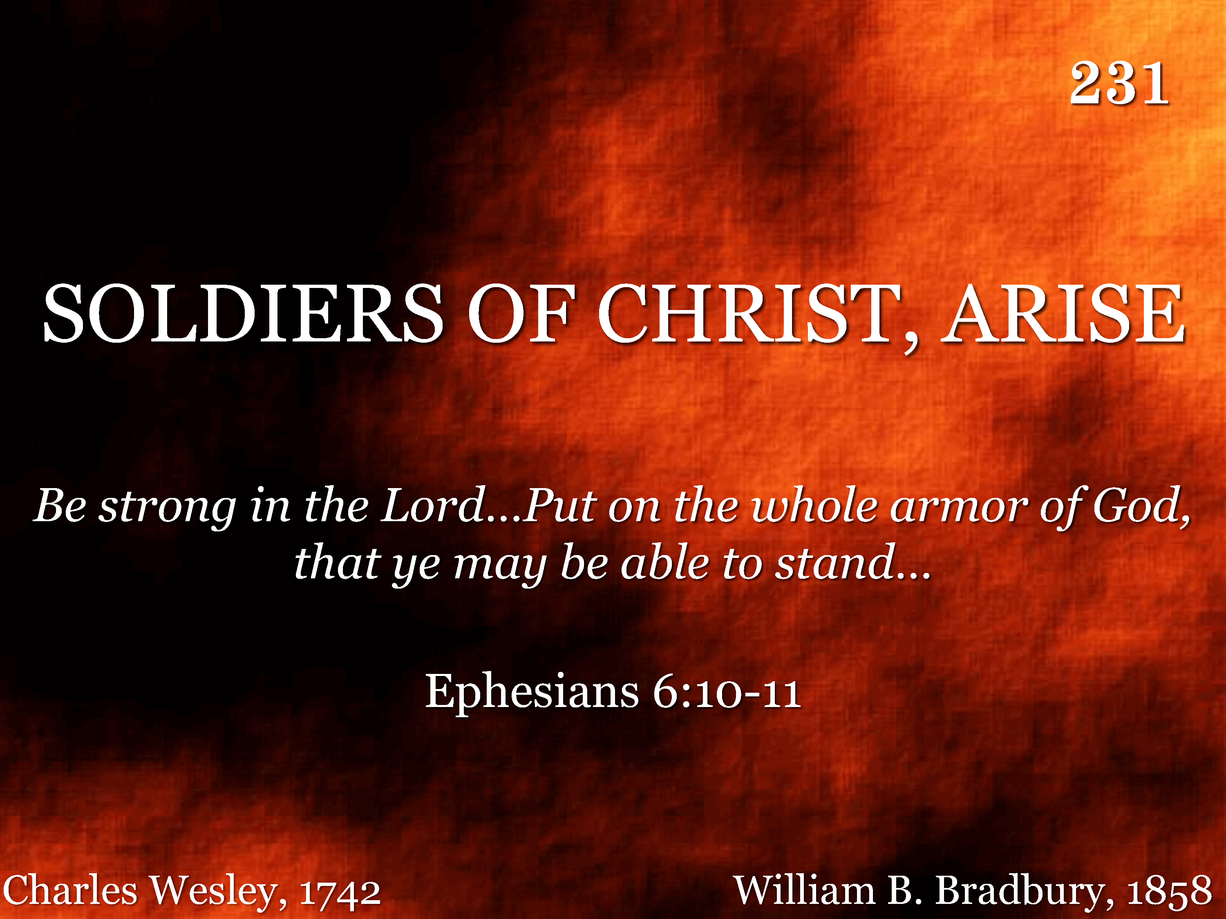
231 - Soldiers Of Christ, Arise - Title

Slide 69

231 - Soldiers Of Christ, Arise - 1.1

Slide 70

231 - Soldiers Of Christ, Arise - 1.2

Slide 71

231 - Soldiers Of Christ, Arise - 1.3
End of Verse 1

Slide 72

231 - Soldiers Of Christ, Arise - 2.1

Slide 73

231 - Soldiers Of Christ, Arise - 2.2

Slide 74

231 - Soldiers Of Christ, Arise - 2.3
End of Verse 2

Slide 75

231 - Soldiers Of Christ, Arise - 3.1

Slide 76

231 - Soldiers Of Christ, Arise - 3.2

Slide 77

231 - Soldiers Of Christ, Arise - 3.3
End of Song

Slide 78

085 - Sowing The Seed Of The Kingdom - Title

Slide 79

085 - Sowing The Seed Of The Kingdom - 1.1

Slide 80

085 - Sowing The Seed Of The Kingdom - 1.2

Slide 81

085 - Sowing The Seed Of The Kingdom - 1.3

Slide 82

085 - Sowing The Seed Of The Kingdom - C.1

Slide 83

085 - Sowing The Seed Of The Kingdom - C.2

Slide 84

085 - Sowing The Seed Of The Kingdom - C.3
End of Verse 1

Slide 85

085 - Sowing The Seed Of The Kingdom - 2.1

Slide 86

085 - Sowing The Seed Of The Kingdom - 2.2

Slide 87

085 - Sowing The Seed Of The Kingdom - 2.3

Slide 88
085 - Sowing The Seed Of The Kingdom - C.1

Slide 89
085 - Sowing The Seed Of The Kingdom - C.2

Slide 90
085 - Sowing The Seed Of The Kingdom - C.3
End of Verse 2

Slide 91

085 - Sowing The Seed Of The Kingdom - 3.1

Slide 92

085 - Sowing The Seed Of The Kingdom - 3.2

Slide 93

085 - Sowing The Seed Of The Kingdom - 3.3

Slide 94
085 - Sowing The Seed Of The Kingdom - C.1

Slide 95
085 - Sowing The Seed Of The Kingdom - C.2

Slide 96
085 - Sowing The Seed Of The Kingdom - C.3
End of Song

Slide 97

360.16 - Standing On The Promises - Title

Slide 98

360.16 - Standing On The Promises - 1.1

Slide 99

360.16 - Standing On The Promises - 1.2

Slide 100

360.16 - Standing On The Promises - 1.3

Slide 101

360.16 - Standing On The Promises - C.1

Slide 102

360.16 - Standing On The Promises - C.2

Slide 103

360.16 - Standing On The Promises - C.3
End of Song

Slide 104

267 - Jesus Loves Me - Title

Slide 105

267 - Jesus Loves Me - 1.1

Slide 106

267 - Jesus Loves Me - 1.2

Slide 107

267 - Jesus Loves Me - C.1

Slide 108

267 - Jesus Loves Me - C.2
End of Song

Slide 109

407 - He Leadeth Me - Title

Slide 110

407 - He Leadeth Me - 1.1

Slide 111

407 - He Leadeth Me - 1.2

Slide 112

407 - He Leadeth Me - C.1

Slide 113

407 - He Leadeth Me - C.2
End of Verse 1

Slide 114

407 - He Leadeth Me - 2.1

Slide 115

407 - He Leadeth Me - 2.2

Slide 116
407 - He Leadeth Me - C.1

Slide 117
407 - He Leadeth Me - C.2
End of Verse 2

Slide 118

407 - He Leadeth Me - 3.1

Slide 119

407 - He Leadeth Me - 3.2

Slide 120
407 - He Leadeth Me - C.1

Slide 121
407 - He Leadeth Me - C.2
End of Song

Slide 122

1010 - My Eyes Have Seen Your Glory - Title

Slide 123

1010 - My Eyes Have Seen Your Glory - 1.1

Slide 124

1010 - My Eyes Have Seen Your Glory - 1.2

Slide 125

1010 - My Eyes Have Seen Your Glory - 1.3

Slide 126

1010 - My Eyes Have Seen Your Glory - 1.4

Slide 127

1010 - My Eyes Have Seen Your Glory - C.1

Slide 128

1010 - My Eyes Have Seen Your Glory - C.2

Slide 129

1010 - My Eyes Have Seen Your Glory - C.3

Slide 130

1010 - My Eyes Have Seen Your Glory - C.4

Slide 131

1010 - My Eyes Have Seen Your Glory - C.5
End of Verse 1

Slide 132

1010 - My Eyes Have Seen Your Glory - 2.1

Slide 133

1010 - My Eyes Have Seen Your Glory - 2.2

Slide 134

1010 - My Eyes Have Seen Your Glory - 2.3

Slide 135

1010 - My Eyes Have Seen Your Glory - 2.4

Slide 136
1010 - My Eyes Have Seen Your Glory - C.1

Slide 137
1010 - My Eyes Have Seen Your Glory - C.2

Slide 138
1010 - My Eyes Have Seen Your Glory - C.3

Slide 139
1010 - My Eyes Have Seen Your Glory - C.4

Slide 140
1010 - My Eyes Have Seen Your Glory - C.5
End of Song

Slide 141

1143 - More Precious Than Silver - Title

Slide 142

1143 - More Precious Than Silver - 1.1

Slide 143

1143 - More Precious Than Silver - 1.2

Slide 144

1143 - More Precious Than Silver - 1.3
End of Song

Slide 145

194 - When We All Get To Heaven - Title

Slide 146

194 - When We All Get To Heaven - 1.1

Slide 147

194 - When We All Get To Heaven - 1.2

Slide 148

194 - When We All Get To Heaven - C.1

Slide 149

194 - When We All Get To Heaven - C.2

Slide 150

194 - When We All Get To Heaven - C.3
End of Verse 1

Slide 151

194 - When We All Get To Heaven - 3.1

Slide 152

194 - When We All Get To Heaven - 3.2

Slide 153
194 - When We All Get To Heaven - C.1

Slide 154
194 - When We All Get To Heaven - C.2

Slide 155
194 - When We All Get To Heaven - C.3
End of Song

Slide 156

1054 - Savior And Friend - Title

Slide 157

1054 - Savior And Friend - 1.1

Slide 158

1054 - Savior And Friend - 1.2
End of Verse 1

Slide 159

1054 - Savior And Friend - 3.1

Slide 160

1054 - Savior And Friend - 3.2
End of Song

Slide 161

174 - Christ Arose - Title

Slide 162

174 - Christ Arose - 1.1

Slide 163

174 - Christ Arose - 1.2

Slide 164

174 - Christ Arose - C.1

Slide 165

174 - Christ Arose - C.2

Slide 166

174 - Christ Arose - C.3
End of Verse 1

Slide 167

174 - Christ Arose - 3.1

Slide 168

174 - Christ Arose - 3.2

Slide 169
174 - Christ Arose - C.1

Slide 170
174 - Christ Arose - C.2

Slide 171
174 - Christ Arose - C.3
End of Song

Slide 172

420 - O Thou Fount Of Every Blessing - Title

Slide 173

420 - O Thou Fount Of Every Blessing - 1.1

Slide 174

420 - O Thou Fount Of Every Blessing - 1.2

Slide 175

420 - O Thou Fount Of Every Blessing - 1.3

Slide 176

420 - O Thou Fount Of Every Blessing - 1.4
End of Verse 1

Slide 177

420 - O Thou Fount Of Every Blessing - 3.1

Slide 178

420 - O Thou Fount Of Every Blessing - 3.2

Slide 179

420 - O Thou Fount Of Every Blessing - 3.3

Slide 180

420 - O Thou Fount Of Every Blessing - 3.4
End of Song

Slide 182

022 - He Is In Our Midst - Title
Medley

Slide 183

1006 - Magnify, O Magnify! - Title

Slide 184

022 - He Is In Our Midst - 1.1

Slide 185

022 - He Is In Our Midst - 1.2

Slide 186

022 - He Is In Our Midst - C.1

Slide 187

022 - He Is In Our Midst - C.2

Slide 188

022 - He Is In Our Midst - C.3
Go to Next Song

Slide 189

1006 - Magnify, O Magnify! - 1.1

Slide 190

1006 - Magnify, O Magnify! - 1.2

Slide 191

1006 - Magnify, O Magnify! - 1.3

Slide 192

1006 - Magnify, O Magnify! - 1.4

Slide 193

1006 - Magnify, O Magnify! - 1.5

Slide 194

1006 - Magnify, O Magnify! - 1.6
End of Verse 1

Slide 195

1006 - Magnify, O Magnify! - 3.1

Slide 196

1006 - Magnify, O Magnify! - 3.2

Slide 197

1006 - Magnify, O Magnify! - 3.3

Slide 198

1006 - Magnify, O Magnify! - 3.4

Slide 199

1006 - Magnify, O Magnify! - 3.5

Slide 200

1006 - Magnify, O Magnify! - 3.6
End of Song

