Slide 1
download lessons at
www.builtbyhim.com

Slide 3
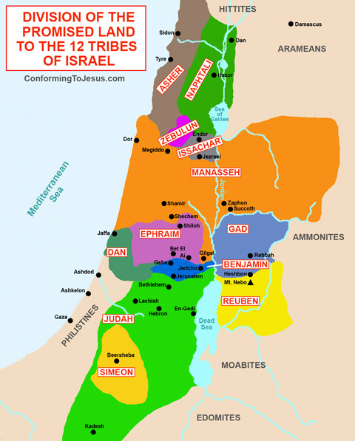

Slide 4
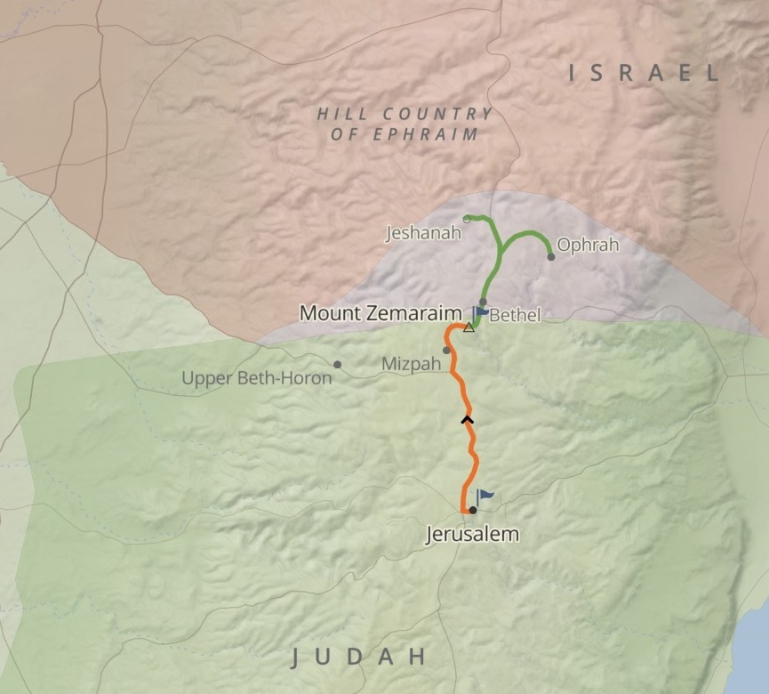

Slide 5
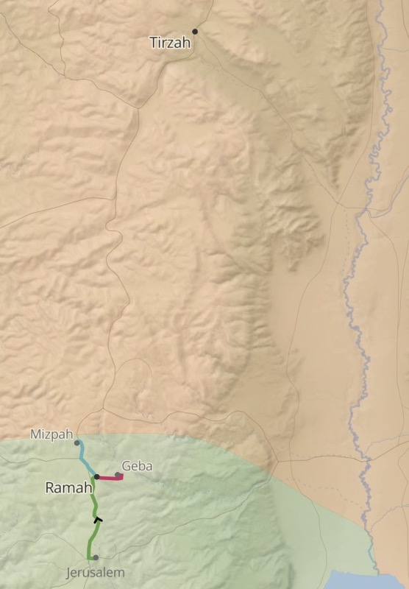

Slide 6
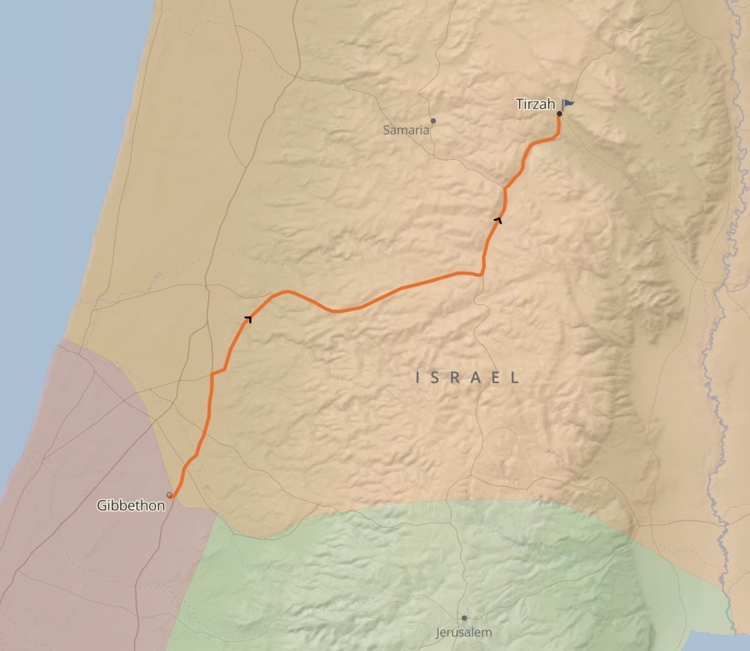

Slide 7
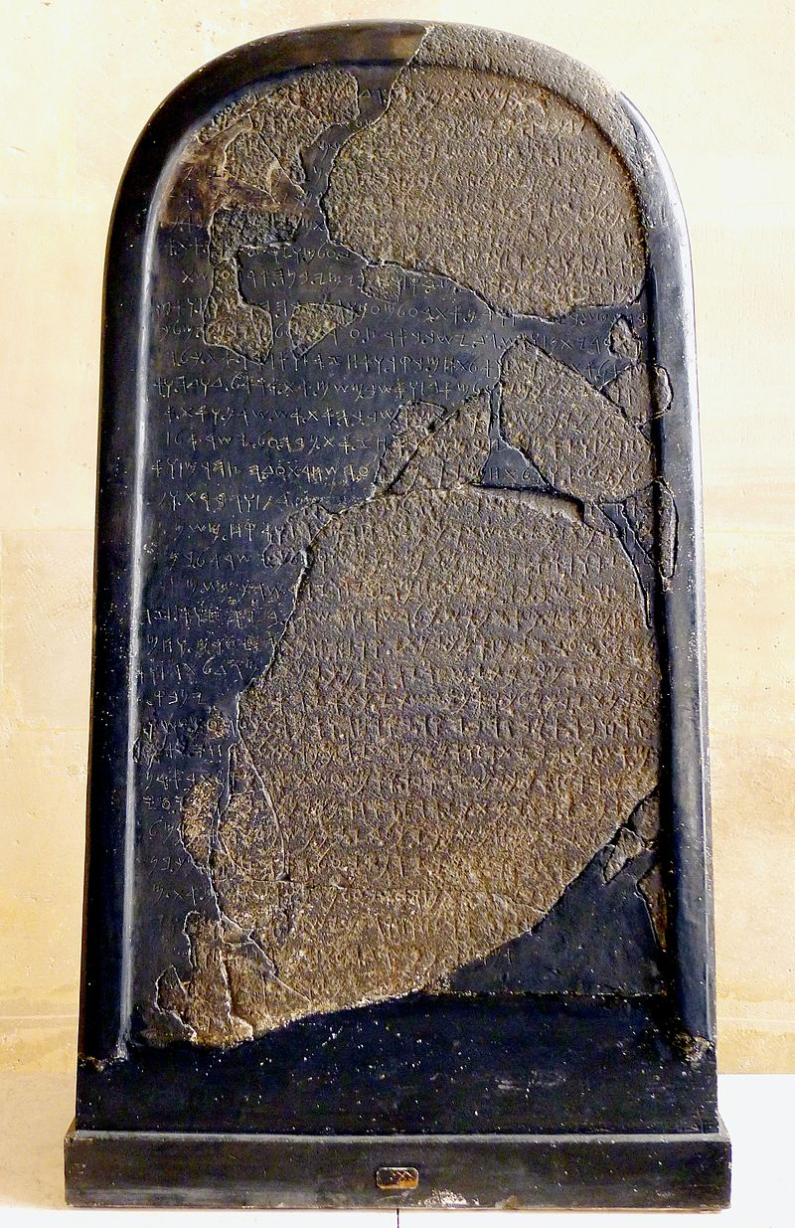
Moabite Stone
840 BC

Slide 8
Sample Header

