Slide 1
download lessons at
www.builtbyhim.com

Slide 2
“So the Lord said to Solomon, ‘Because you have done this, and you have not kept My covenant and My statutes, which I have commanded you, I will surely tear the kingdom from you, and will give it to your servant. Nevertheless I will not do it in your days for the sake of your father David, but I will tear it out of the hand of your son. However, I will not tear away all the kingdom, but I will give one tribe to your son for the sake of My servant David and for the sake of Jerusalem which I have chosen.’”
(1 Kings 11:11–13, NASB95)

Slide 3
“‘I will take you, and you shall reign over whatever you desire, and you shall be king over Israel. ‘Then it will be, that if you listen to all that I command you and walk in My ways, and do what is right in My sight by observing My statutes and My commandments, as My servant David did, then I will be with you and build you an enduring house as I built for David, and I will give Israel to you.”
(1 Kings 11:37–38, NASB95)

Slide 4
Capitals at sites associated with Jacob
Jeroboam’s Failure
1Kings 12.25-33

Slide 5
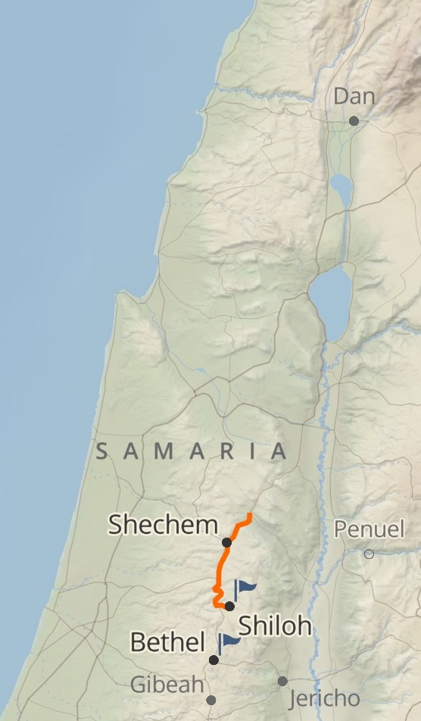

Slide 6
Capitals at sites associated with Jacob
Copied Aaron’s golden calf
Placed calves at sites with religious history
Jeroboam’s Failure
1Kings 12.25-33

Slide 7
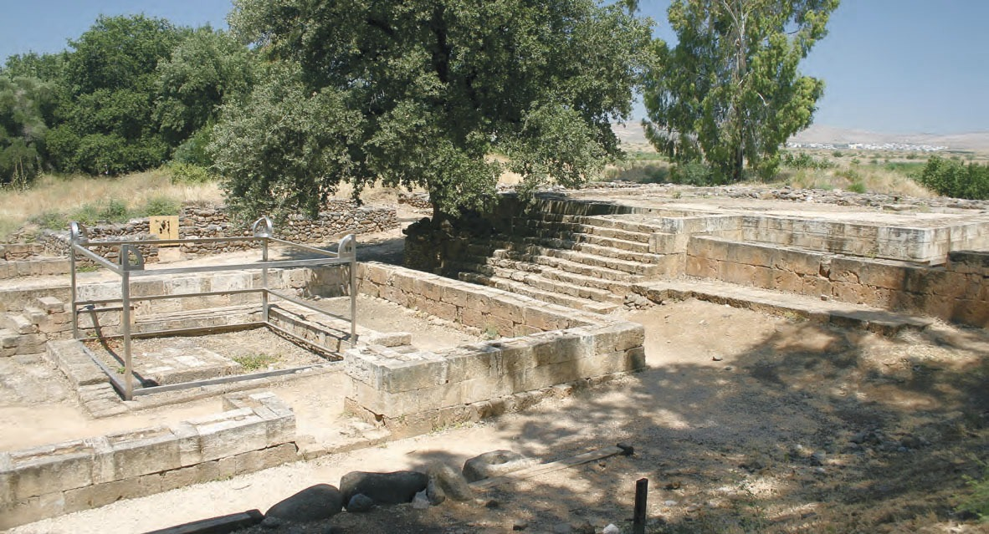

Slide 8
Capitals at sites associated with Jacob
Copied Aaron’s golden calf
Placed calves at sites with religious history
Rejected Levites (who opposed Aaron)
Made himself the new “Aaron”
High priest
Same names for sons
Instituted new feast
Jeroboam’s Failure
1Kings 12.25-33

Slide 9
“After this event Jeroboam did not return from his evil way, but again he made priests of the high places from among all the people; any who would, he ordained, to be priests of the high places. This event became sin to the house of Jeroboam, even to blot it out and destroy it from off the face of the earth.”
(1 Kings 13:33–34, NASB95)
Judgment Against False Worship (1Kings 13.1-10)

Slide 10
Judgment Against the Lord’s Prophet (1Kings 13.11-32)

Slide 11
Judgment Against Jeroboam’s House (1Kings 14.1-20; 15.25-31)

