Slide 1
download lessons at
www.builtbyhim.com

Slide 2
“Ahab the son of Omri did evil in the sight of the Lord more than all who were before him.”
(1 Kings 16:30, NASB95)

Slide 3
“He walked in the way of his father Asa and did not depart from it, doing right in the sight of the Lord.”
(2 Chronicles 20:32, NASB95)

Slide 5
Followed the example of David (2Chron. 17.3)
Did not seek the Baals, but the God of his father (2Chron. 17.3-4)
Instructed the people in the Law of God (2Chron. 17.7-9; 19.4)
Promoted justice among the people (2Chron. 19.5-11)
Jehoshaphat “took pride” in the ways of the Lord

Slide 6
“The high places, however, were not removed; the people had not yet directed their hearts to the God of their fathers.”
(2 Chronicles 20:33, NASB95)

Slide 7
“So the Lord established the kingdom in his control, and all Judah brought tribute to Jehoshaphat, and he had great riches and honor.”
(2 Chronicles 17:5, NASB95)
Jehoshaphat “took pride” in the ways of the Lord

Slide 8
Marriage alliance (2Chron. 18.1)
Military alliance with Ahab against Aram (2Chron. 18)
Jehoshaphat’s blindspot

Slide 9
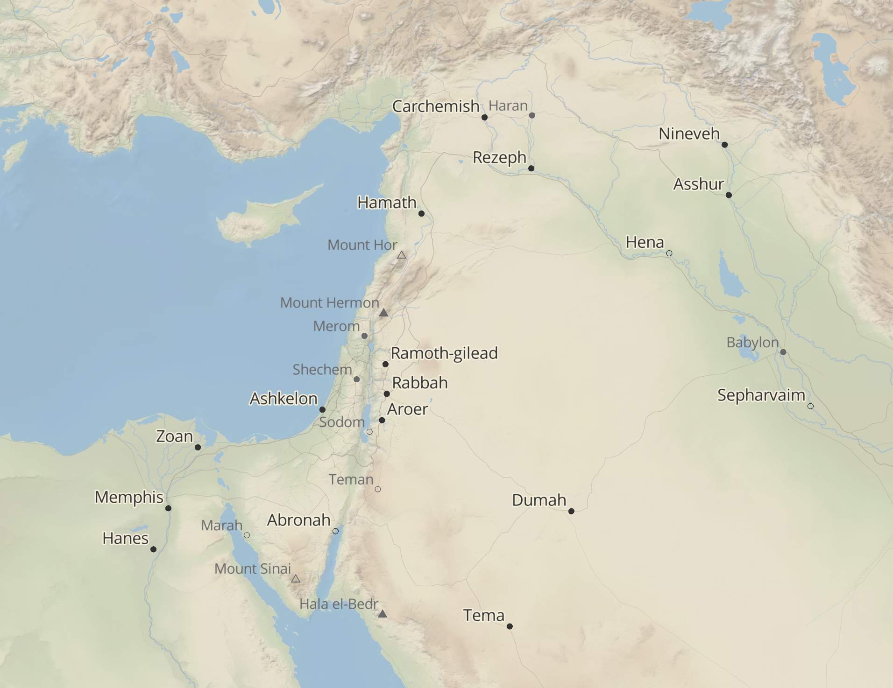

Slide 10
Marriage alliance (2Chron. 18.1)
Military alliance with Ahab against Aram (2Chron. 18)
Trade alliance with Ahaziah (2Chron. 20.35-37)
Jehoshaphat’s blindspot

Slide 11
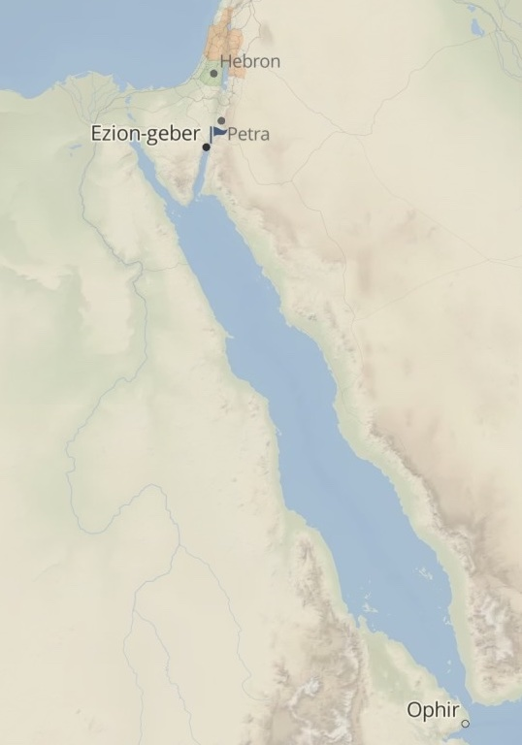

Slide 12
Marriage alliance (2Chron. 18.1)
Military alliance with Ahab against Aram (2Chron. 18)
Trade alliance with Ahaziah (2Chron. 20.35-37)
Military alliance with Jehoram against Moab (2Kings 3.4-27)
Jehoshaphat’s blindspot

Slide 13
Rebuked by the Lord (2Chron. 19.1-3; 20.37)
Invaded by Moab and Ammon (2Chron 20)
Lasting consequences…
Jehoshaphat’s blindspot

Slide 14
Jehoshaphat’s blindspot

