Slide 1
download lessons at
www.builtbyhim.com

Slide 2
“He did evil in the sight of the Lord and walked in the way of his father and in the way of his mother and in the way of Jeroboam the son of Nebat, who caused Israel to sin.”
(1 Kings 22:52, NASB95)

Slide 3
“He walked in the way of the kings of Israel, just as the house of Ahab did (for Ahab’s daughter was his wife), and he did evil in the sight of the Lord.”
(2 Chronicles 21:6, NASB95)

Slide 4
Ahab’s legacy

Slide 5
Ahab’s legacy in Israel

Slide 6
Ahab’s legacy in Israel

Slide 7
Ahab’s legacy in Judah

Slide 8
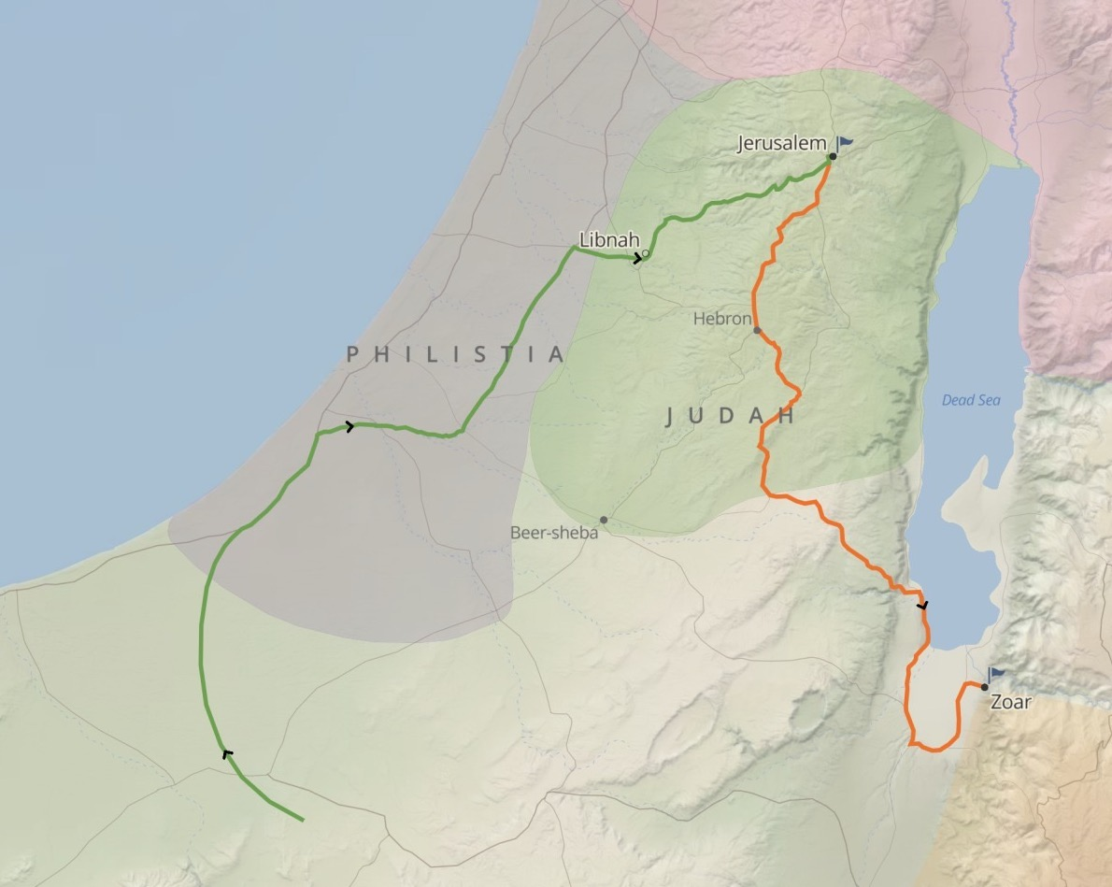
Ahab’s legacy in Judah

Slide 9
Ahab’s legacy in Judah

Slide 10
Ahab’s legacy in Judah

Slide 11
Ahab’s legacy in Judah

Slide 12
Seen in conflict with Moab (2Kings 3)
Seen in conflict with Aram (2Kings 5,6-7, 8)
God Still Reigns!

Slide 13
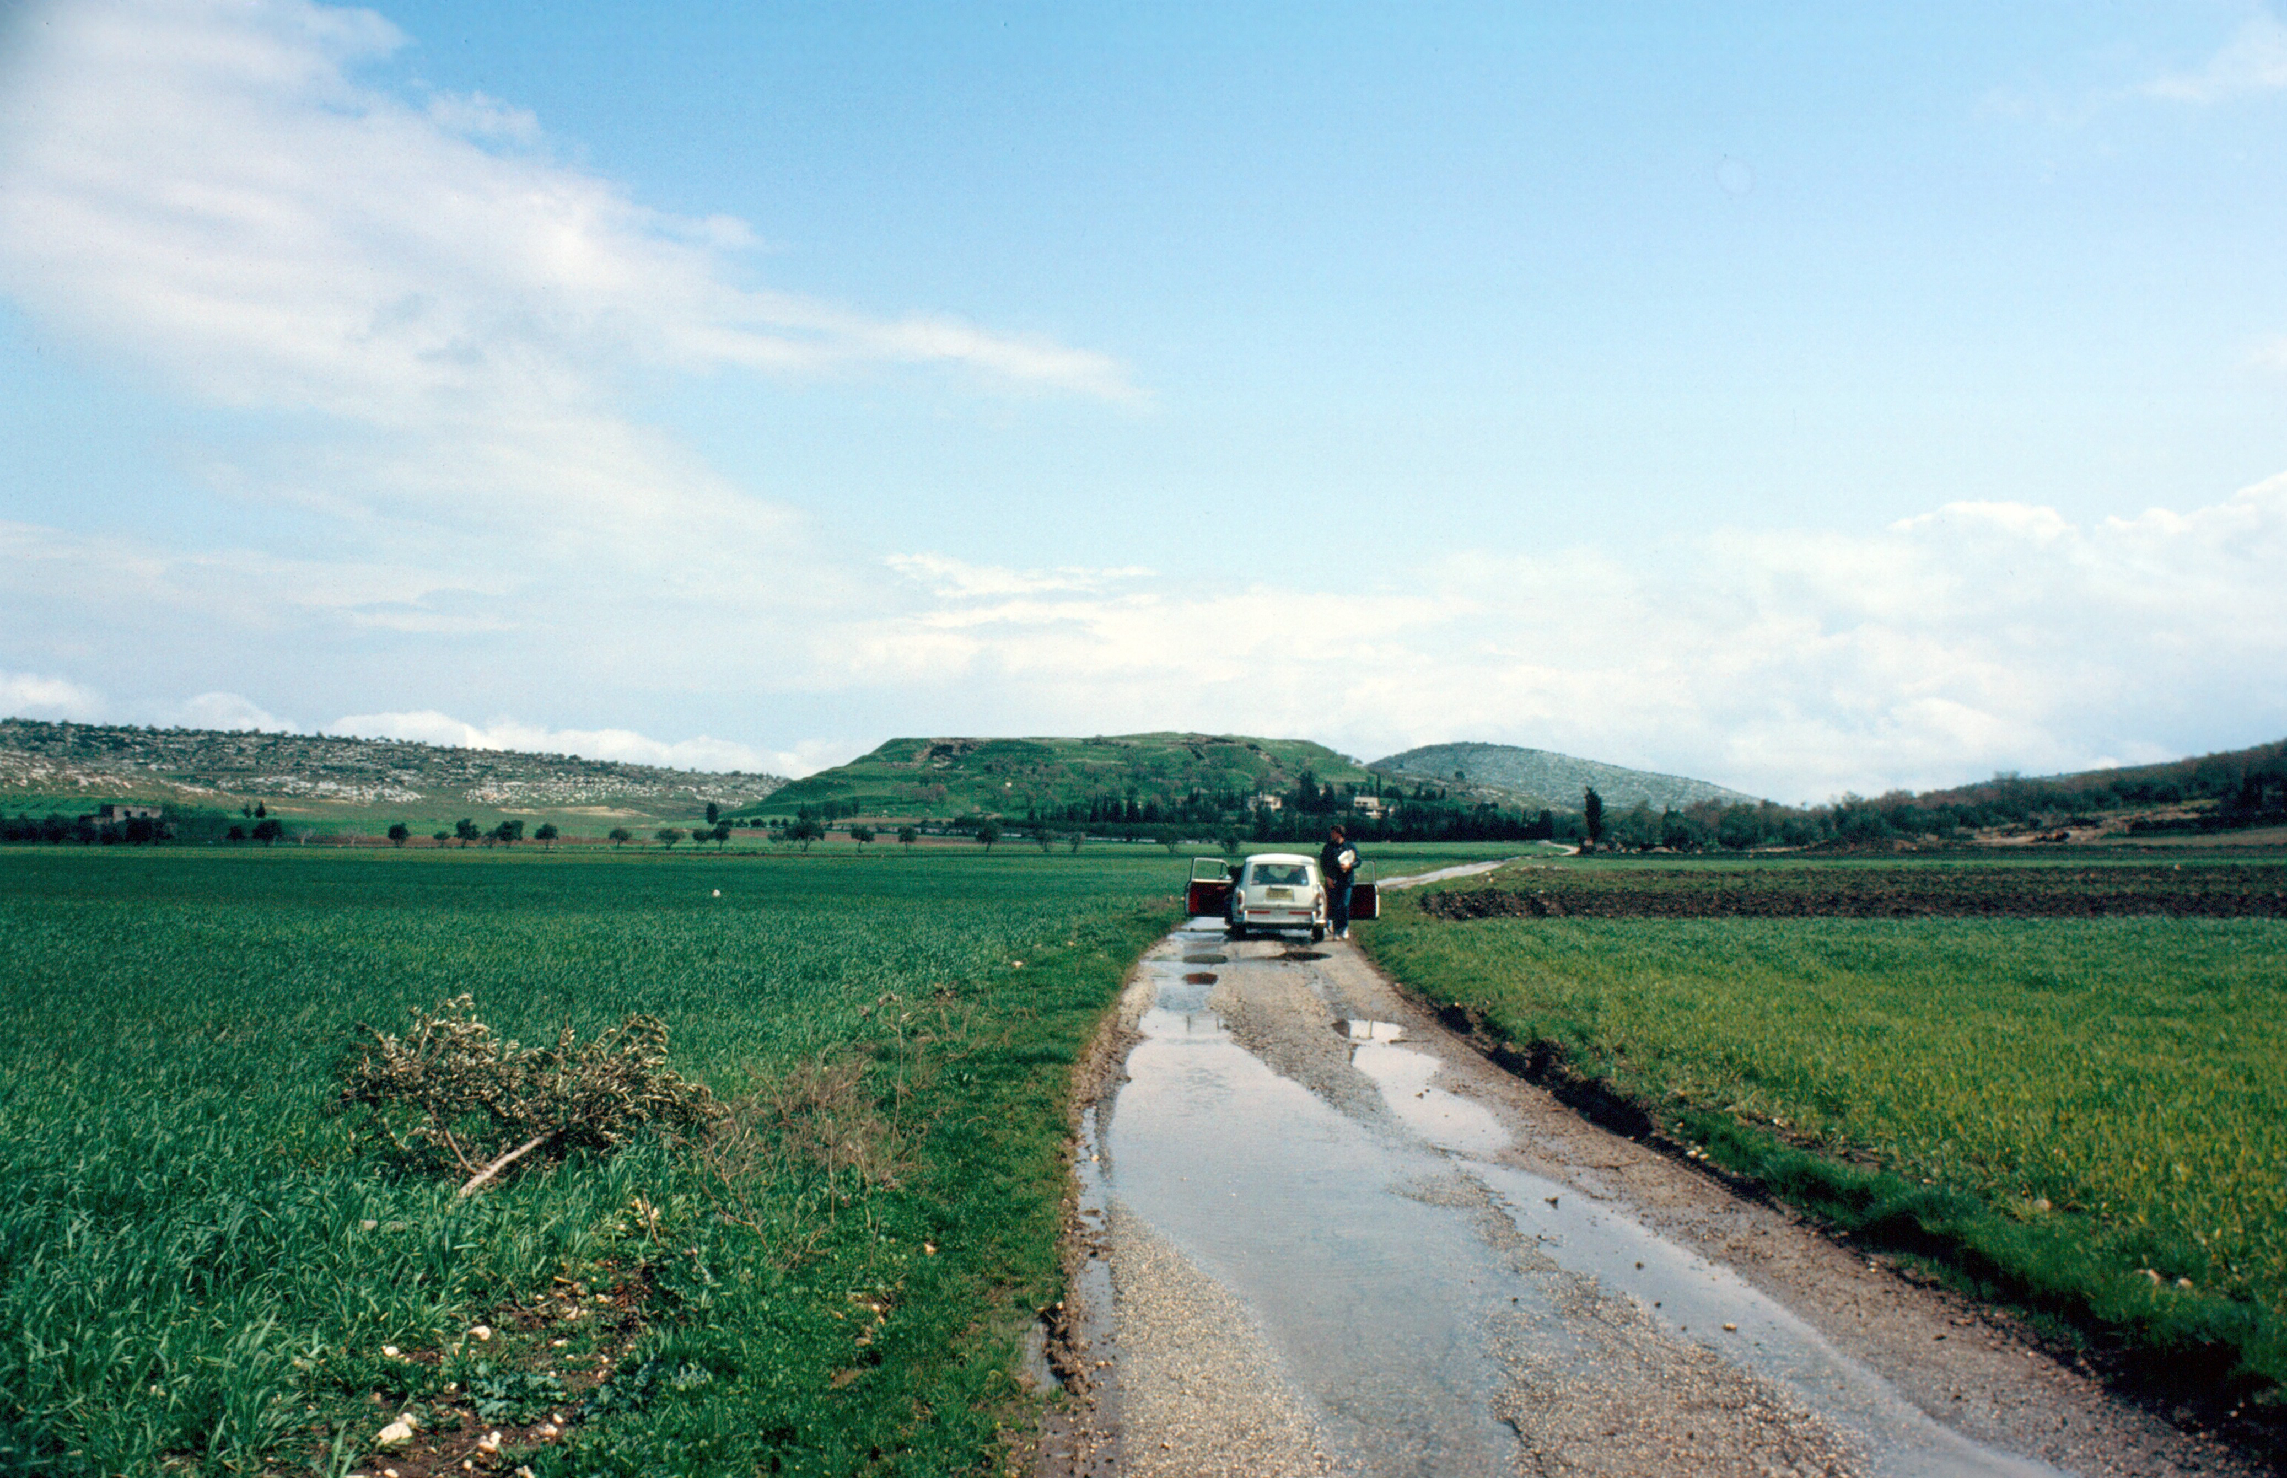
God Still Reigns!

Slide 14
Seen in conflict with Moab (2Kings 3)
Seen in conflict with Aram (2Kings 5,6-7, 8)
Seen in conflict with Edom (Obadiah)
God Still Reigns!

Slide 15
Obadiah 21 (NASB95)
²¹ The deliverers will ascend Mount Zion
To judge the mountain of Esau,
And the kingdom will be the Lord’s.
God Still Reigns!

