Slide 2
DANGEROUS
DOCTRINES
SEARCHING FOR REVELATION
Deuteronomy 18.9-22

Slide 3
“There shall not be found among you anyone who makes his son or his daughter pass through the fire, one who uses divination, one who practices witchcraft, or one who interprets omens, or a sorcerer, or one who casts a spell, or a medium, or a spiritist, or one who calls up the dead.”
(Deuteronomy 18:10–11, NASB95)
SEEKING REVELATION IS “DETESTABLE”

Slide 4
“But the prophet who speaks a word presumptuously in My name which I have not commanded him to speak, or which he speaks in the name of other gods, that prophet shall die.”
(Deuteronomy 18:20, NASB95)
SEEKING REVELATION IS “DETESTABLE”

Slide 5
SEEKING REVELATION IS “DETESTABLE”

Slide 6
SEEKING REVELATION IS STILL “DETESTABLE”

Slide 7
New Age beliefs
Holy Spirit “leading”
Biblical prophecy
SEEKING REVELATION IS STILL “DETESTABLE”

Slide 8
Makes the Bible as reliable as a fortune cookie
SEEKING REVELATION IS STILL “DETESTABLE”

Slide 9
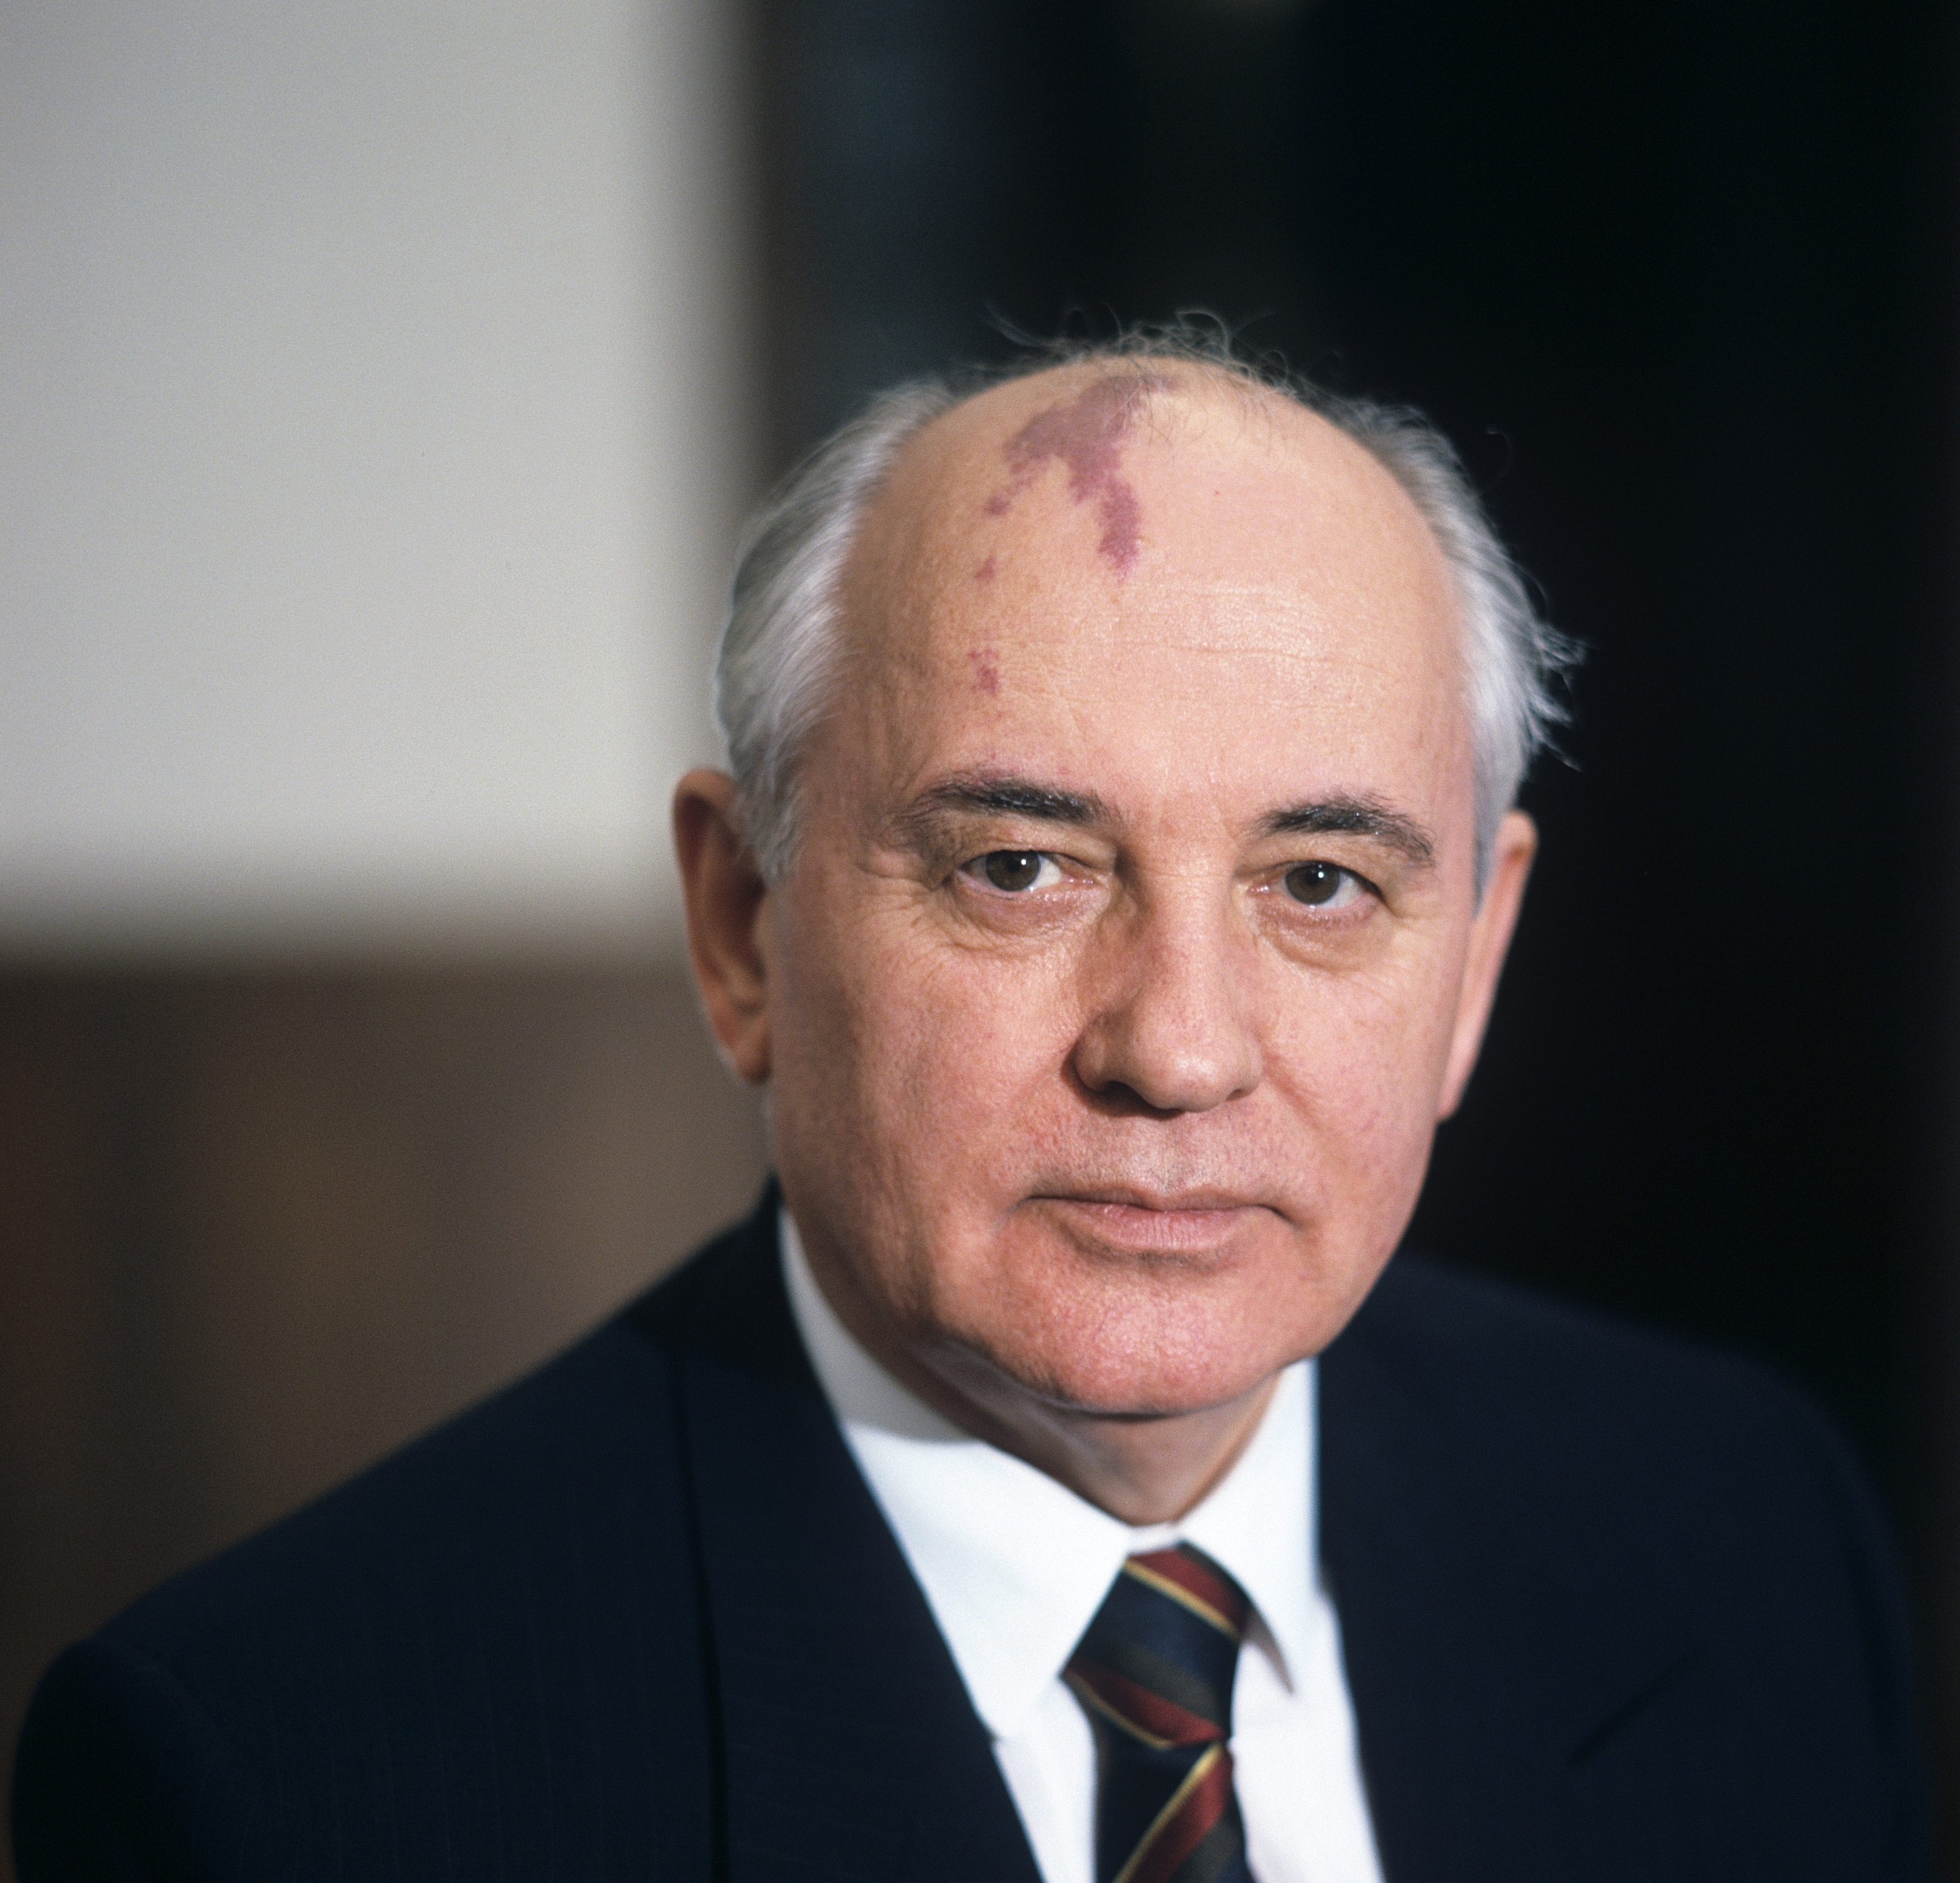
SEEKING REVELATION IS STILL “DETESTABLE”

Slide 10
Makes the Bible as reliable as a fortune cookie
We’re presuming to speak for God
We’re not putting enough faith in God
SEEKING REVELATION IS STILL “DETESTABLE”

Slide 11
“The Lord your God will raise up for you a prophet like me from among you, from your countrymen, you shall listen to him… I will raise up a prophet from among their countrymen like you, and I will put My words in his mouth, and he shall speak to them all that I command him.”
(Deuteronomy 18:15,18, NASB95)
Solution: God Raises Up His Prophet

Slide 12
“God, after He spoke long ago to the fathers in the prophets in many portions and in many ways, in these last days has spoken to us in His Son, whom He appointed heir of all things, through whom also He made the world.”
(Hebrews 1:1–2, NASB95)
Solution: God Raises Up His Prophet

Slide 13
“But when He, the Spirit of truth, comes, He will guide you into all the truth; for He will not speak on His own initiative, but whatever He hears, He will speak; and He will disclose to you what is to come.”
(John 16:13, NASB95)
Solution: God Raises Up His Prophet

Slide 14
“All Scripture is breathed out by God and profitable for teaching, for reproof, for correction, and for training in righteousness, that the man of God may be complete, equipped for every good work.”
(2 Timothy 3:16–17, ESV)
Solution: God Raises Up His Prophet

Slide 15
“You shall be blameless before the Lord your God.”
(Deuteronomy 18:13, NASB95)
Result: Focus On Righteousness

