Slide 1
download lessons at
www.builtbyhim.com

Slide 2
“Judah has gone into exile under affliction And under harsh servitude; She dwells among the nations, But she has found no rest; All her pursuers have overtaken her In the midst of distress.”
(Lamentations 1:3, NASB95)

Slide 3
“The Lord has rejected His altar, He has abandoned His sanctuary…”
(Lamentations 2:7, NASB95)

Slide 4
“Her adversaries have become her masters, Her enemies prosper; For the Lord has caused her grief Because of the multitude of her transgressions…”
(Lamentations 1:5, NASB95)

Slide 6
Tribal Divisions
Why did the Kingdom Divide?

Slide 7
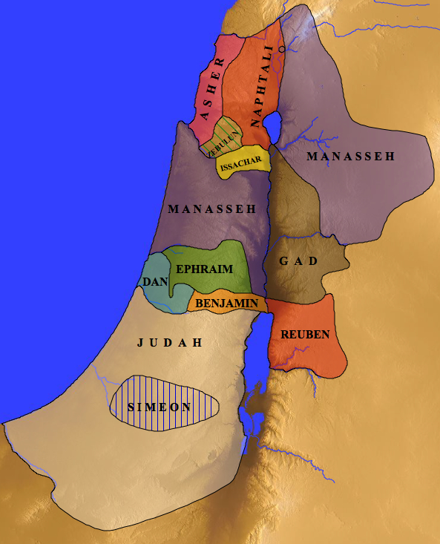
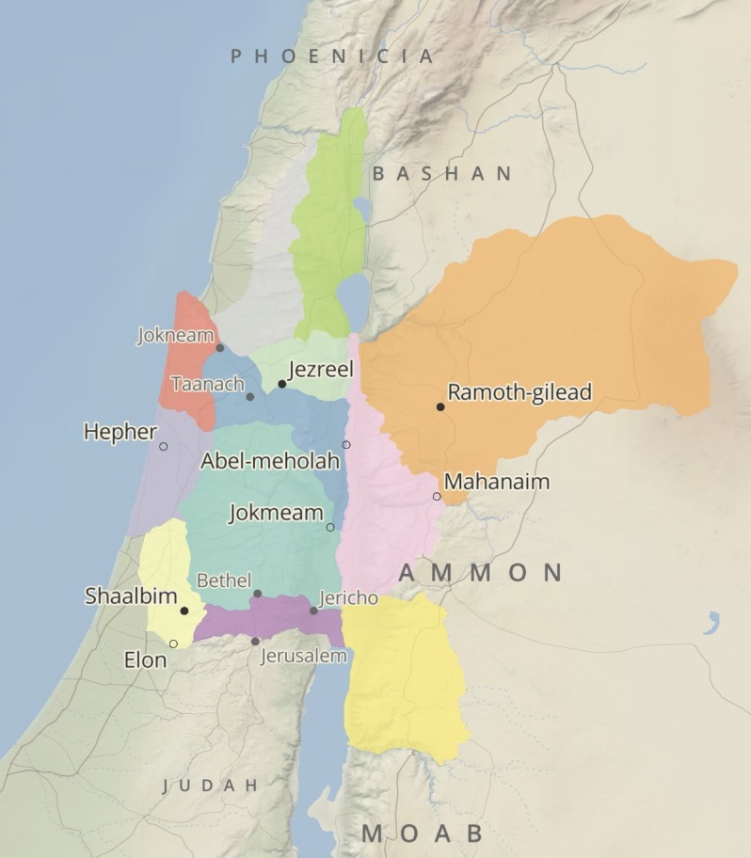

Slide 8
Tribal Divisions
Leadership Failures
Why did the Kingdom Divide?

Slide 9
Must not rely on military (horses)
Must not rely on alliances (wives)
Must not rely on wealth (silver & gold)
God’s Will For The King
Deuteronomy 17.14-20

Slide 10
Tribal Divisions
Leadership Failures
Covenant Unfaithfulness
Geopolitics
Why did the Kingdom Divide?

Slide 11
To remain united, we must find our identity in Christ
Godly leaders are sacrificial leaders
Security belongs to those who are faithful to the covenant
Takeaways

