Slide 1
download lessons at
www.builtbyhim.com

Slide 2
“When your days are complete and you lie down with your fathers, I will raise up your descendant after you, who will come forth from you, and I will establish his kingdom. He shall build a house for My name, and I will establish the throne of his kingdom forever.”
(2Samuel 7.12-13, NASB95)

Slide 3
“So the Lord said to Solomon, ‘Because you have done this, and you have not kept My covenant and My statutes, which I have commanded you, I will surely tear the kingdom from you, and will give it to your servant.’”
(1 Kings 11:11, NASB95)

Slide 4
The Kingdom Divides
1Kings 12.1-24; 2Chron. 10.1-11.4

Slide 5
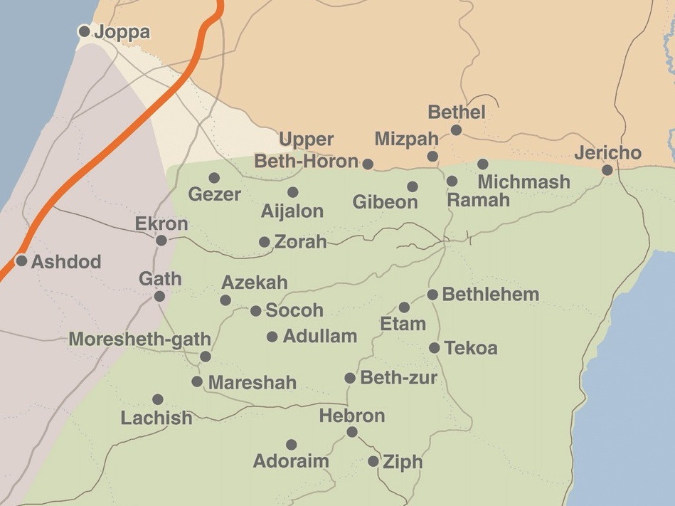
Rehoboam Strengthens His Kingdom (2Chron. 11.5-23)

Slide 6
“Those from all the tribes of Israel who set their hearts on seeking the Lord God of Israel followed them to Jerusalem, to sacrifice to the Lord God of their fathers. They strengthened the kingdom of Judah and supported Rehoboam the son of Solomon for three years, for they walked in the way of David and Solomon for three years.” (2 Chronicles 11:16–17, NASB95)
Rehoboam Strengthens His Kingdom (2Chron. 11.5-23)

Slide 7
Rehoboam’s Unfaithfulness
(1Kings 14.21-24; 2Chron. 12.1)

Slide 8
“And it came about in King Rehoboam’s fifth year, because they had been unfaithful to the Lord, that Shishak king of Egypt came up against Jerusalem with 1,200 chariots and 60,000 horsemen. And the people who came with him from Egypt were without number: the Lubim, the Sukkiim and the Ethiopians. He captured the fortified cities of Judah and came as far as Jerusalem. Then Shemaiah the prophet came to Rehoboam and the princes of Judah who had gathered at Jerusalem because of Shishak, and he said to them, “Thus says the Lord, ‘You have forsaken Me, so I also have forsaken you to Shishak.’ ”” (2 Chronicles 12:2–5, NASB95)
Egypt Invades
(1Kings 14.25-28; 2Chron. 12.2-14)

Slide 9
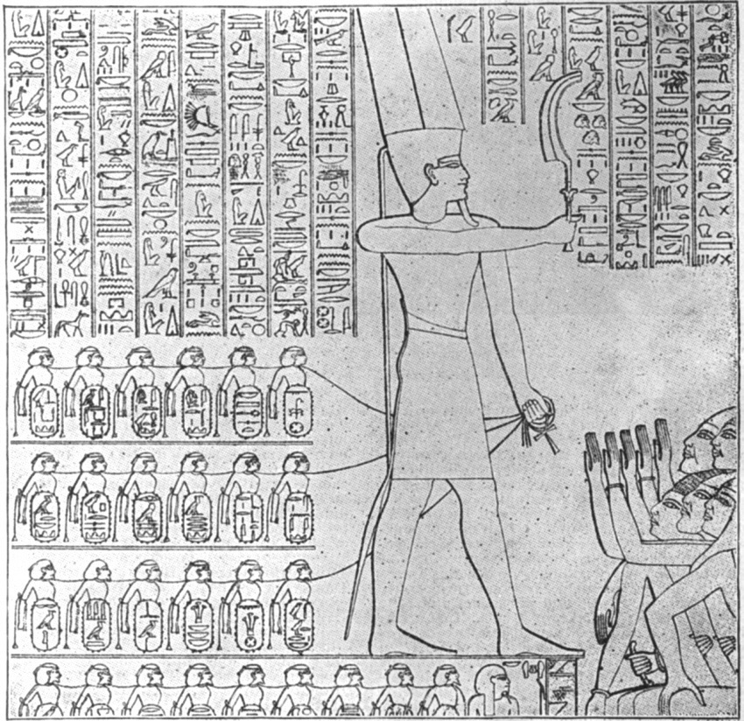
Egypt Invades
(1Kings 14.25-28; 2Chron. 12.2-14)

Slide 10
Death of Rehoboam
(1Kings 14.29-31; 2Chron. 12.15-16)

