Slide 1


The why and how of song worship

Slide 2
Psa. 89:1-2— I will sing of the steadfast love of the Lord, forever; with my mouth I will make known your faithfulness to all generations. 2 For I said, “Steadfast love will be built up forever; in the heavens You will establish Your faithfulness.”

Slide 3
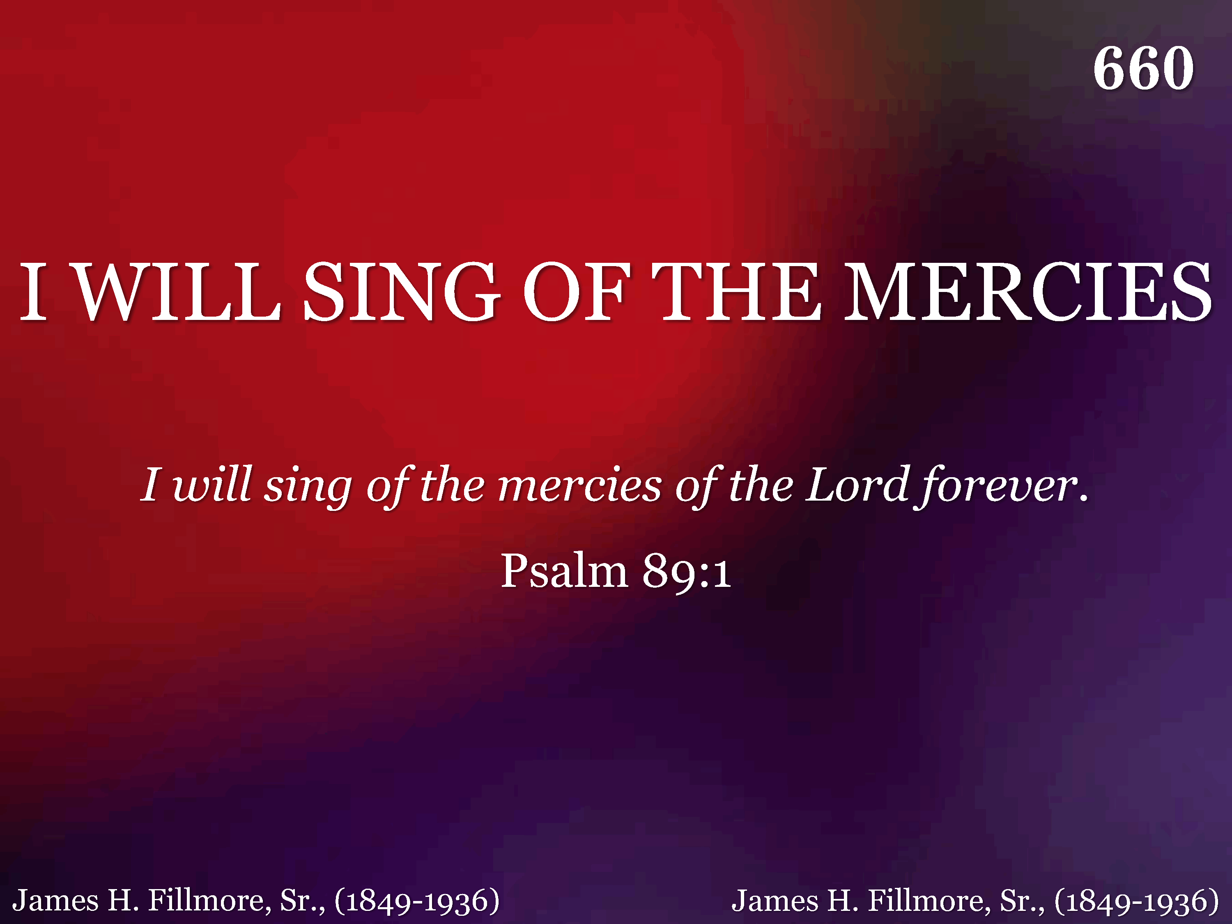
660 - I Will Sing Of The Mercies - Title

Slide 4
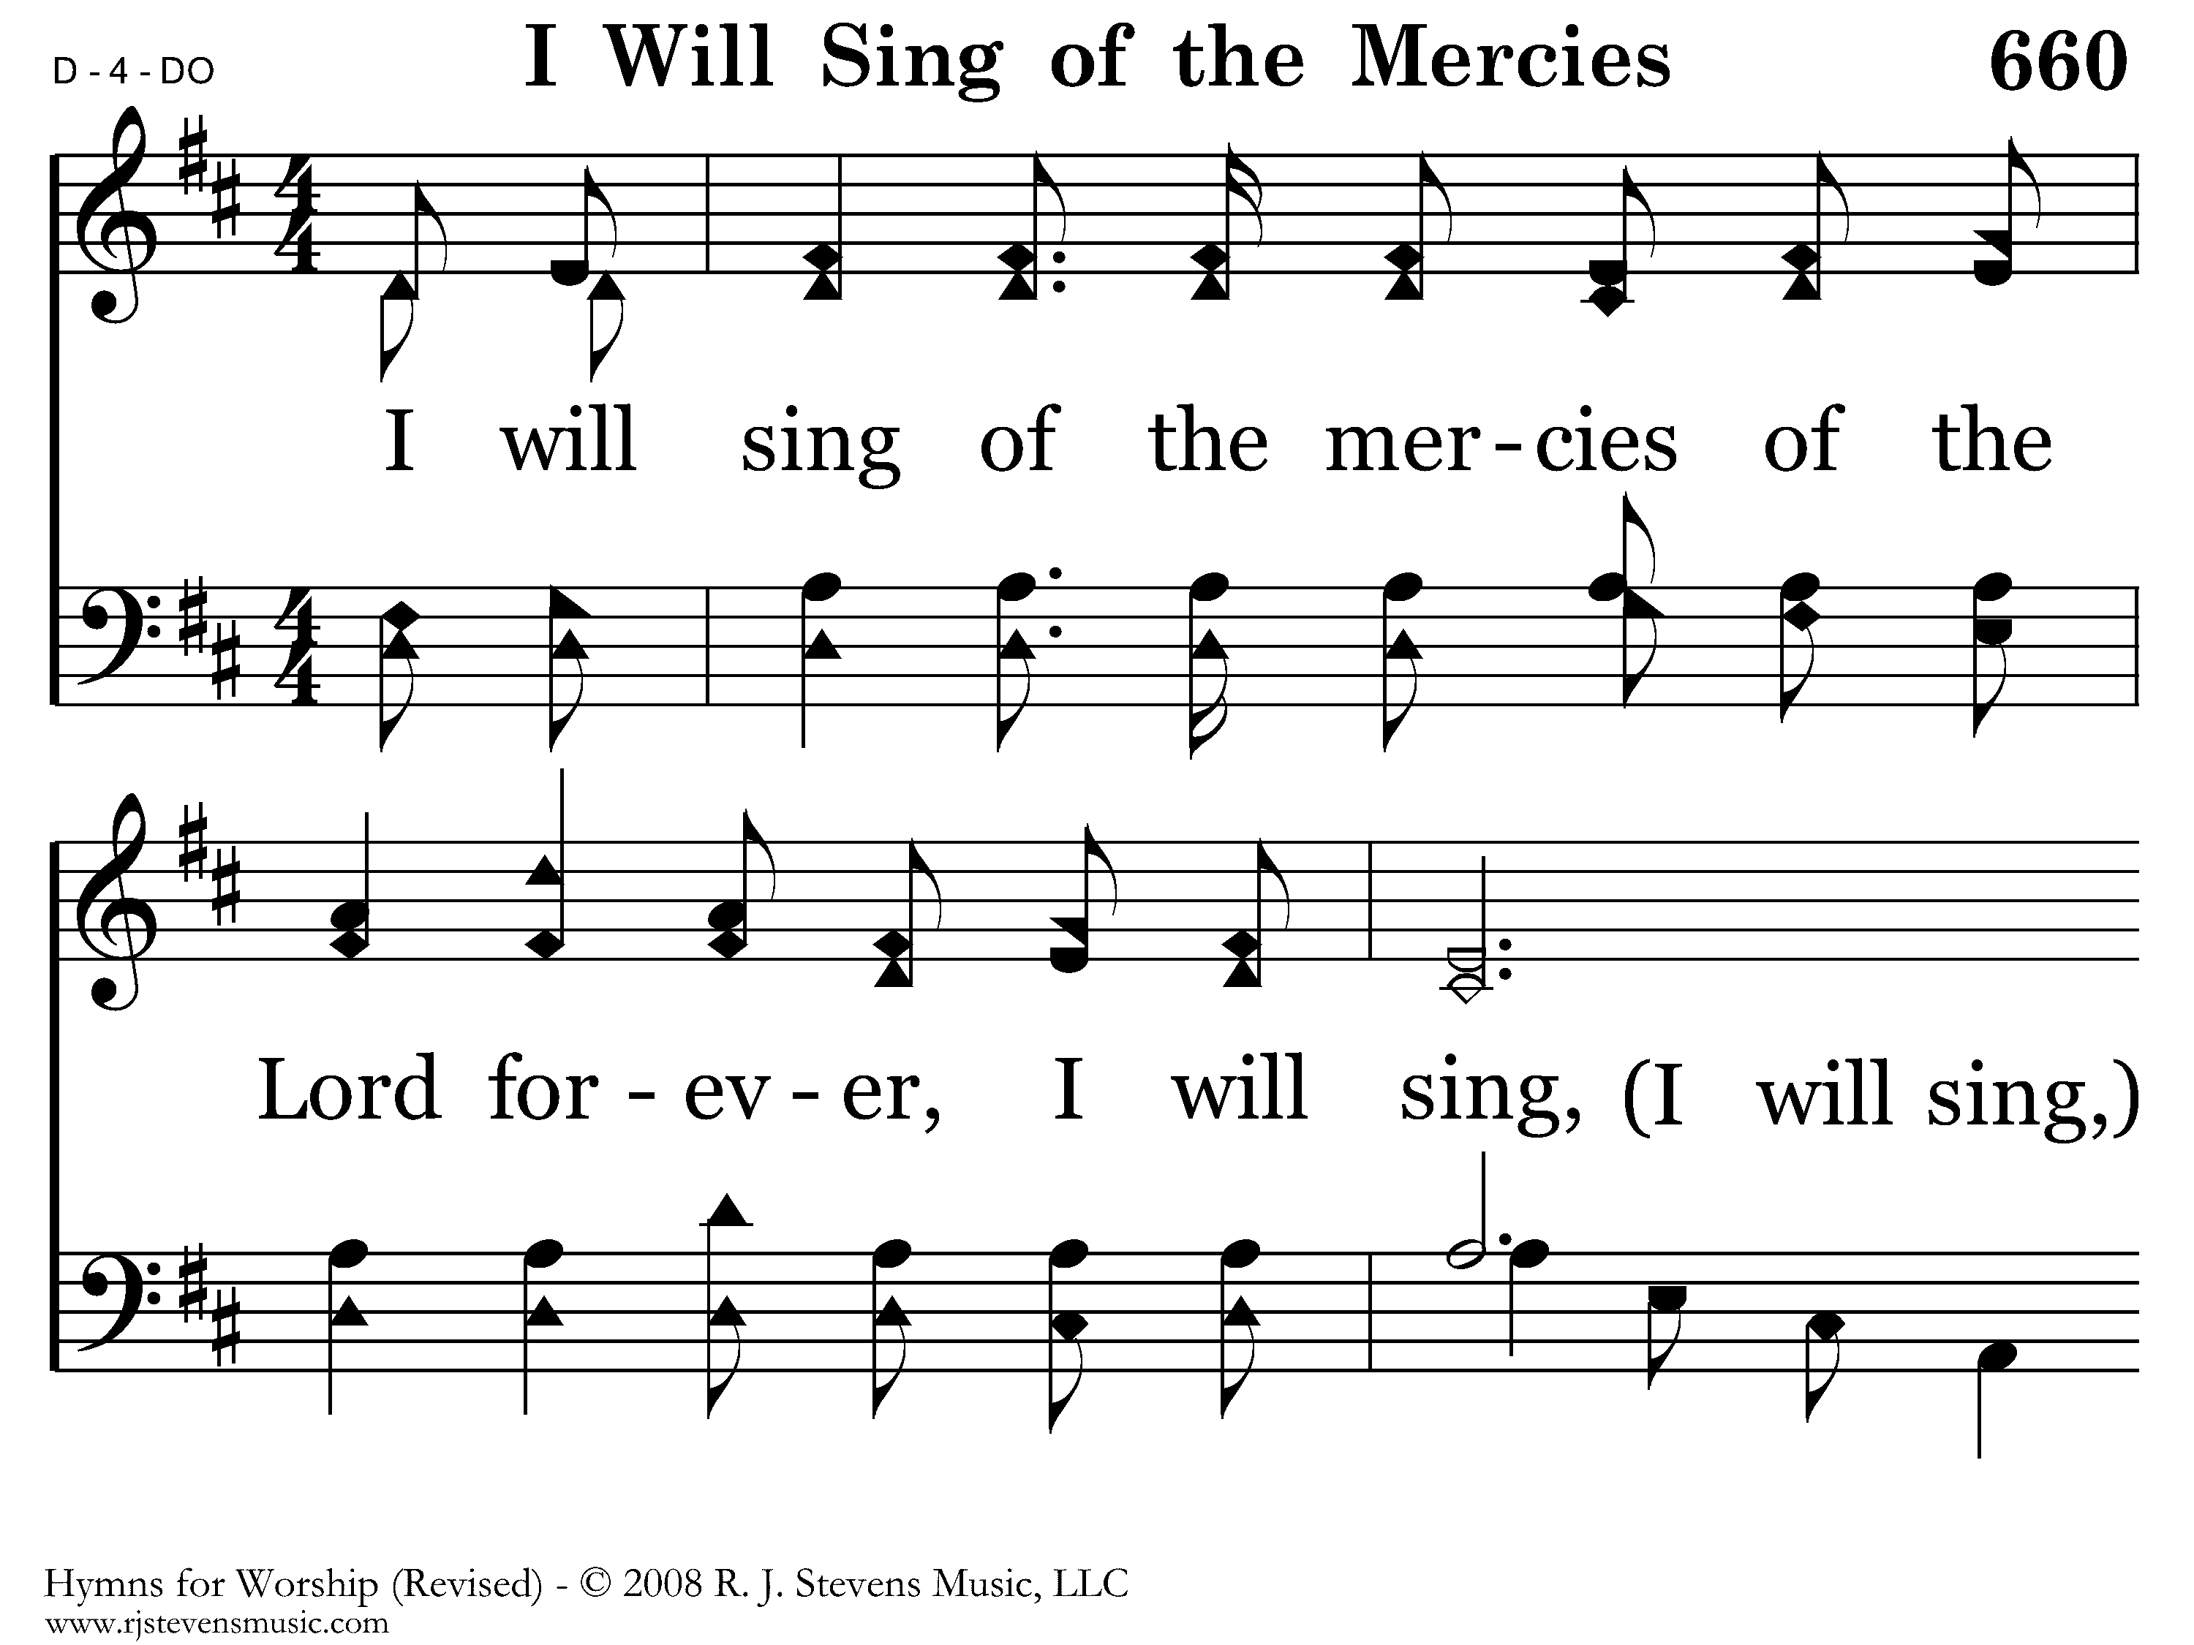
660 - I Will Sing Of The Mercies - 1.1

Slide 5
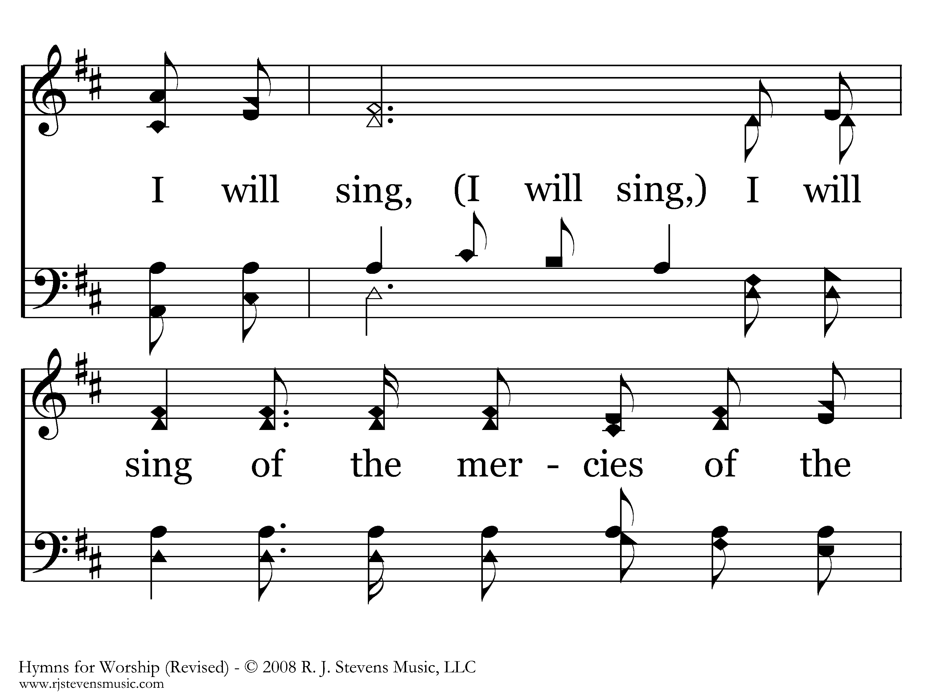
660 - I Will Sing Of The Mercies - 1.2

Slide 6
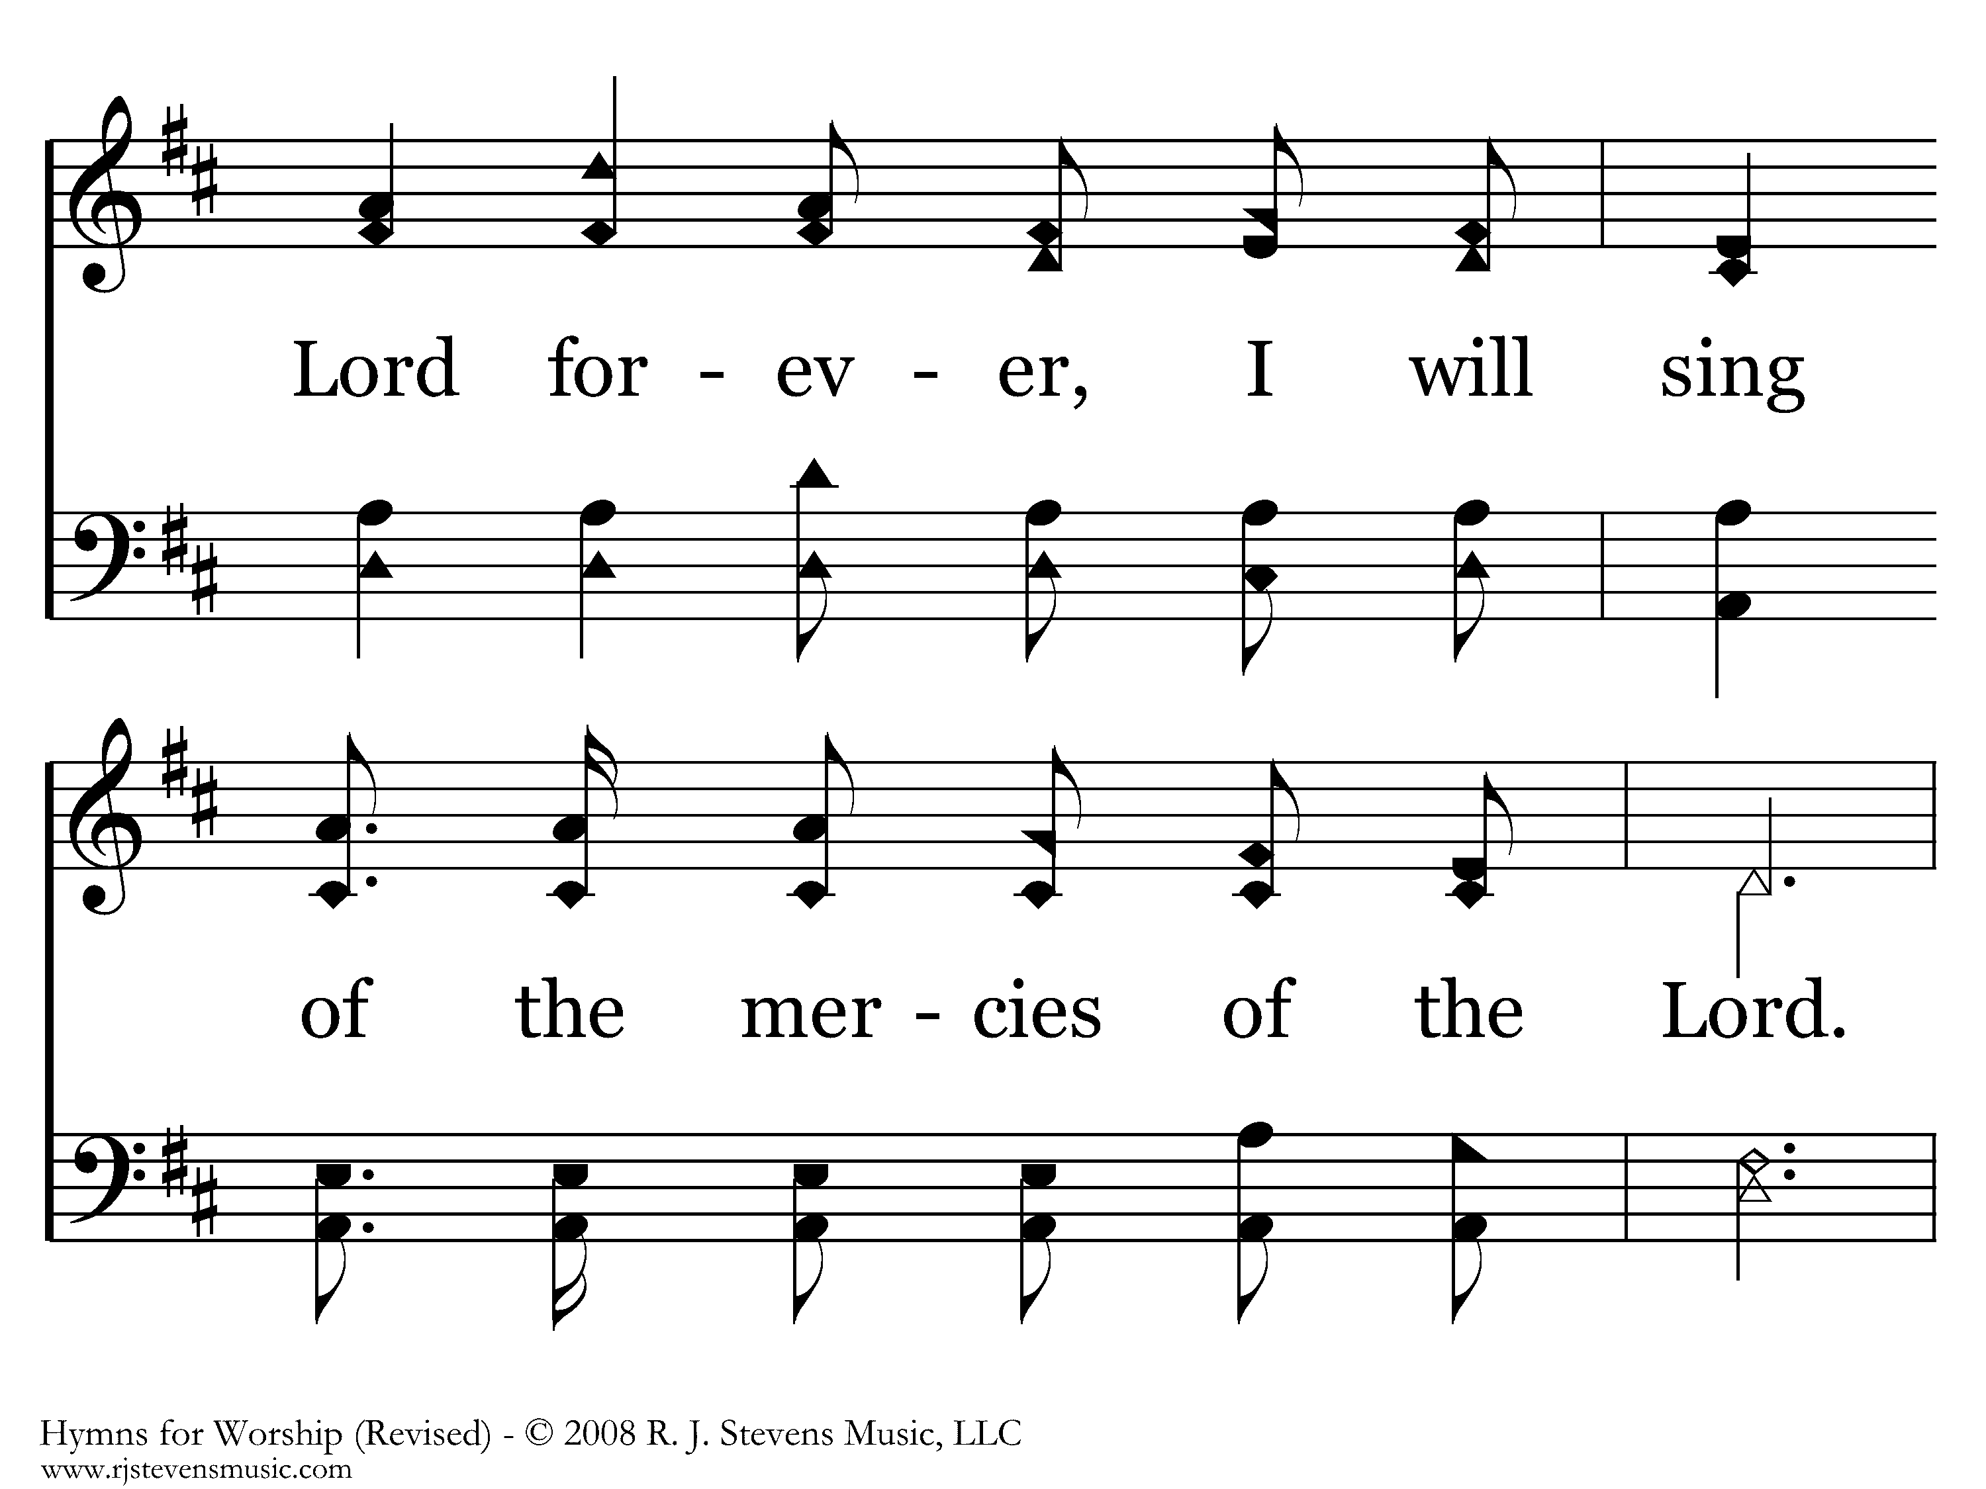
660 - I Will Sing Of The Mercies - 1.3

Slide 7
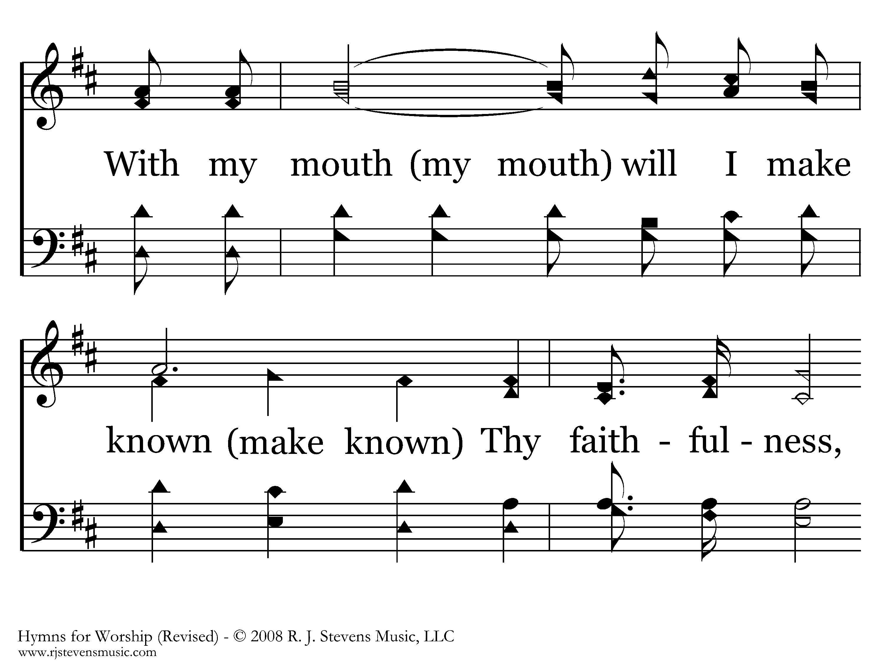
660 - I Will Sing Of The Mercies - 1.4

Slide 8
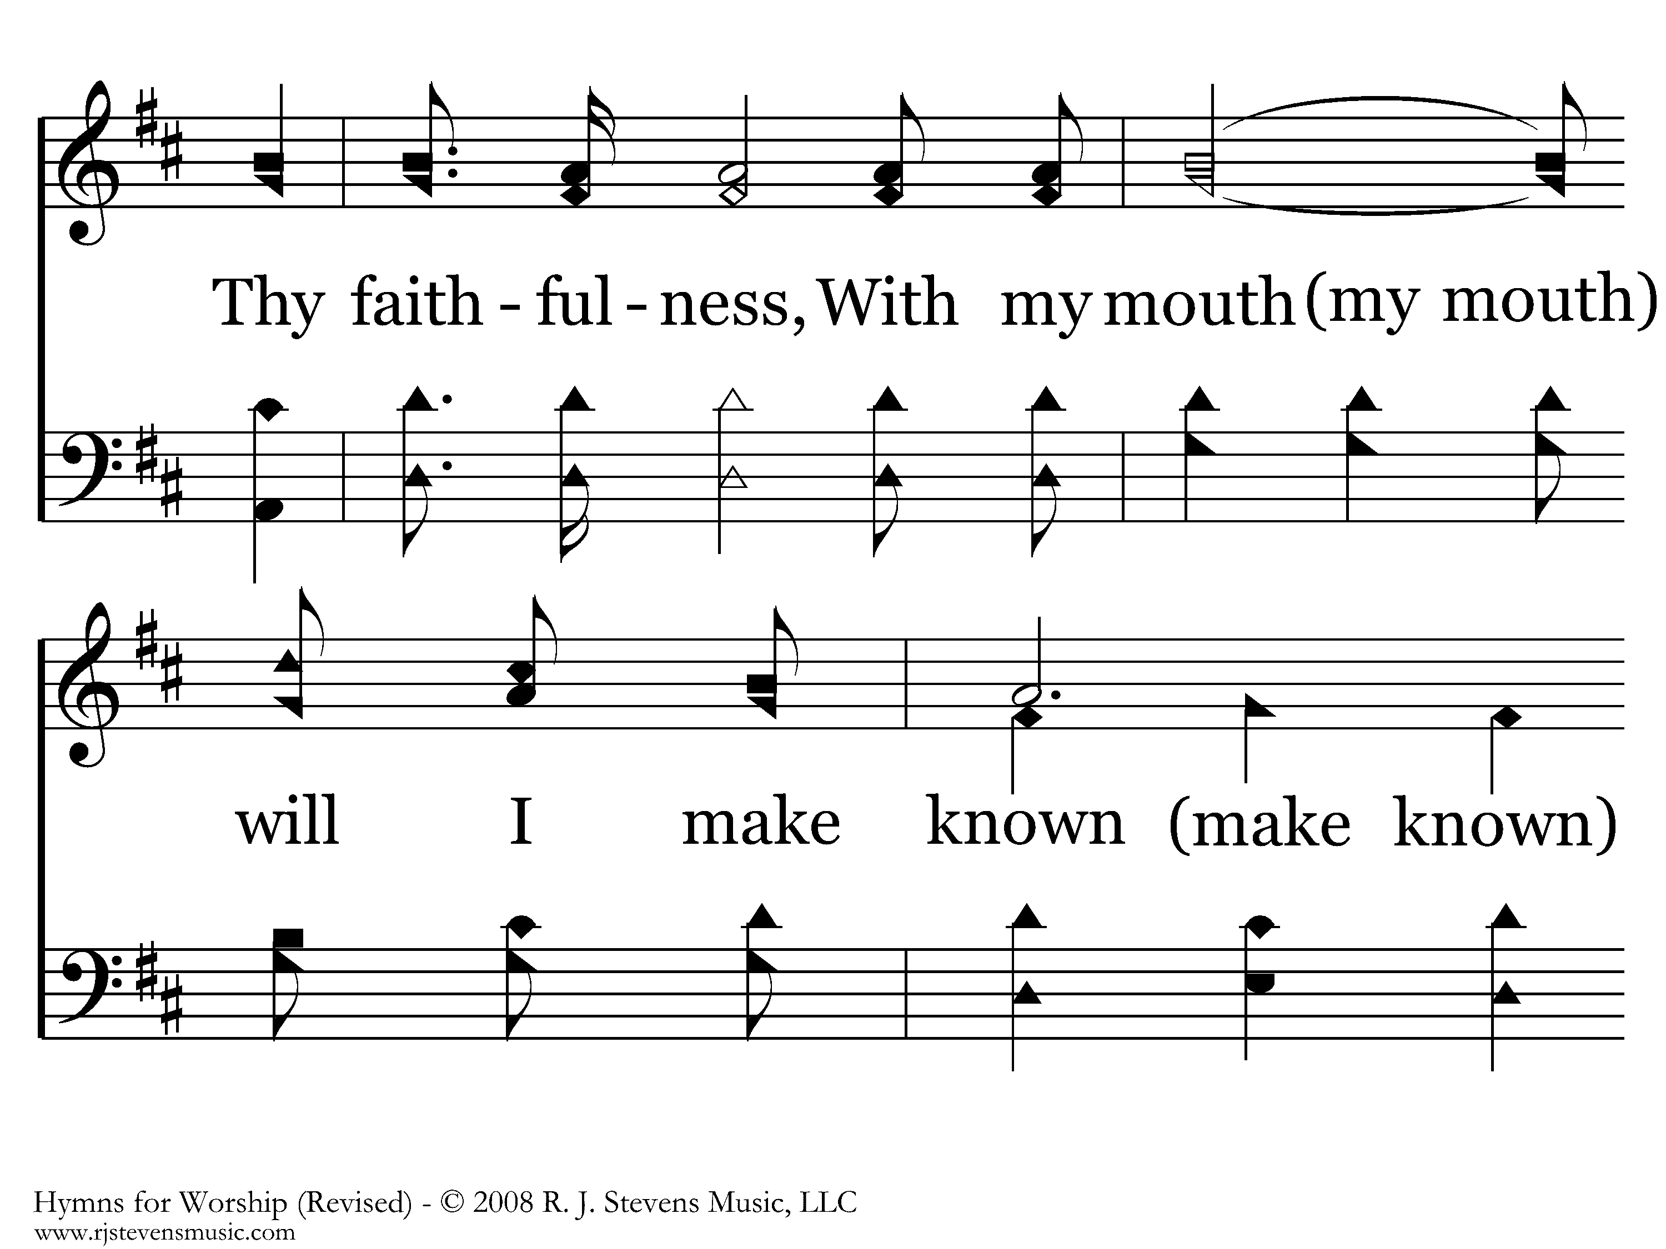
660 - I Will Sing Of The Mercies - 1.5

Slide 9
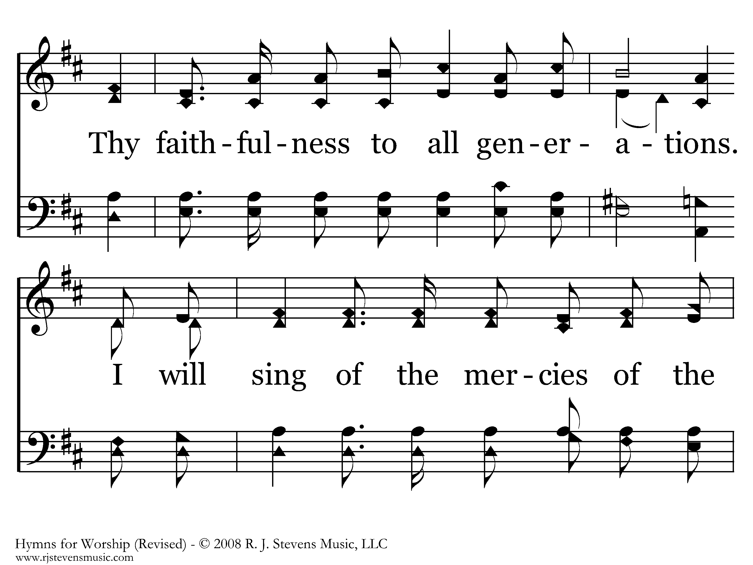
660 - I Will Sing Of The Mercies - 1.6

Slide 10
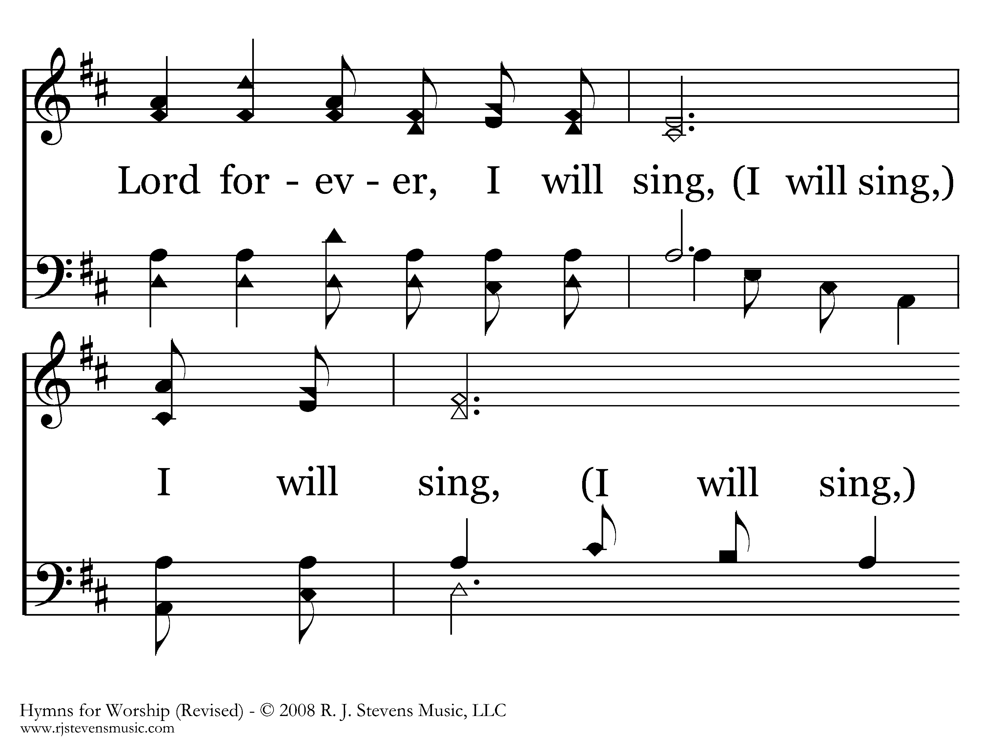
660 - I Will Sing Of The Mercies - 1.7

Slide 11
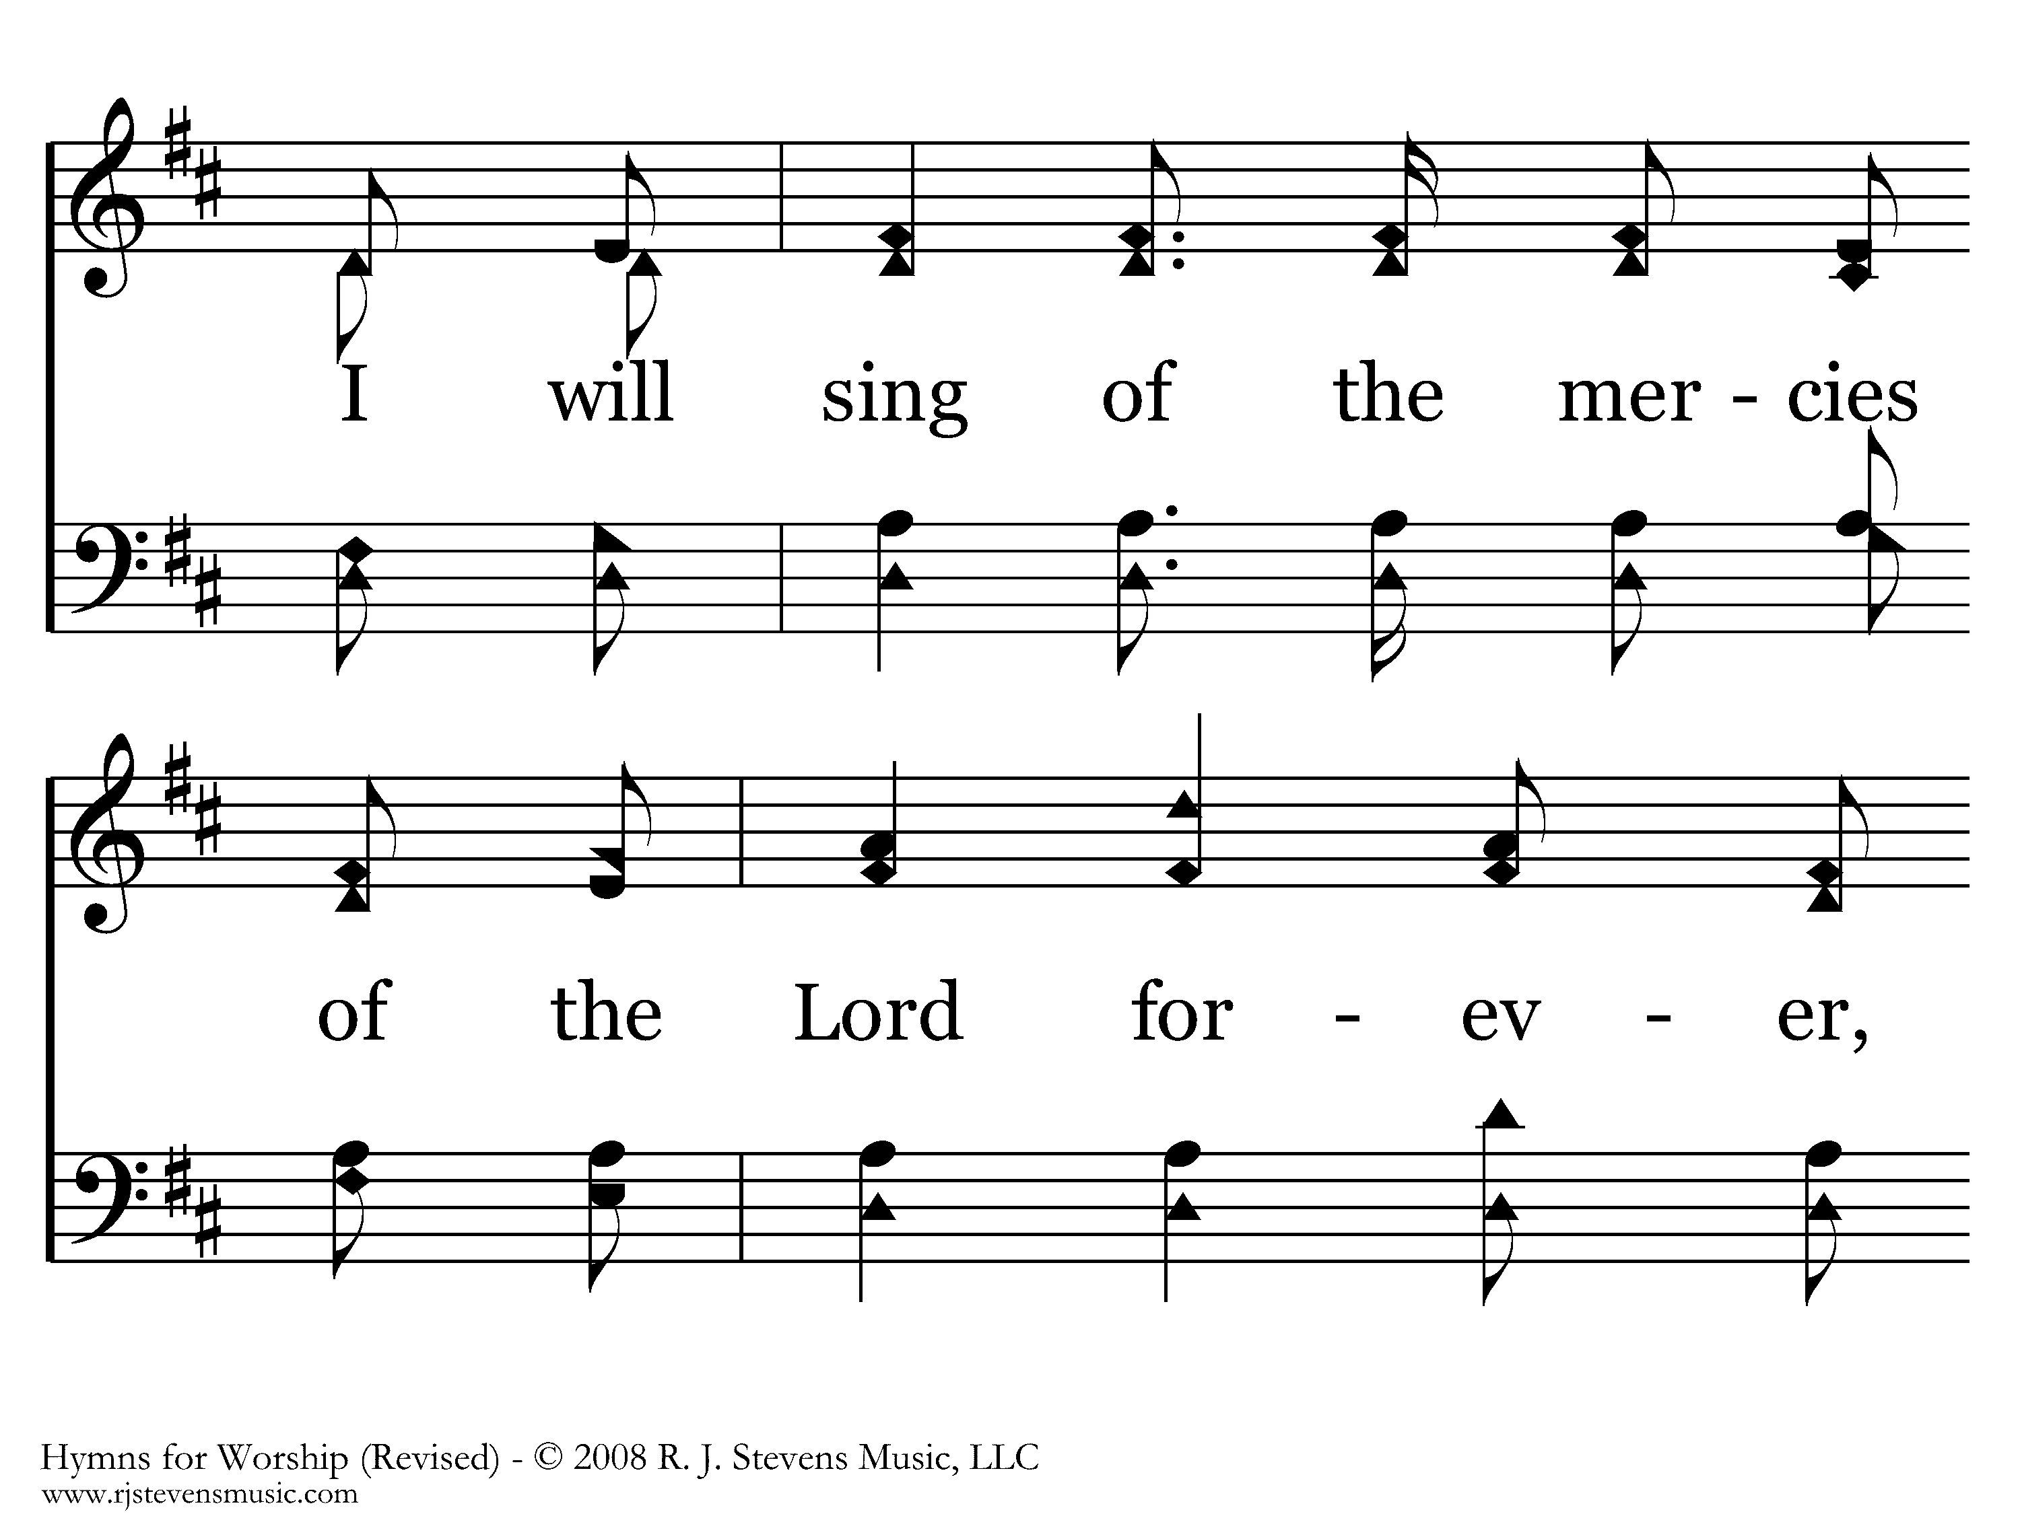
660 - I Will Sing Of The Mercies - 1.8

Slide 12
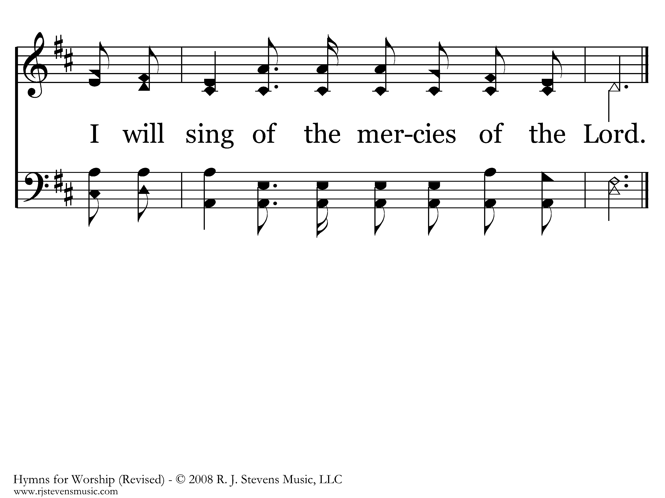
660 - I Will Sing Of The Mercies - 1.9
End of Song

Slide 13
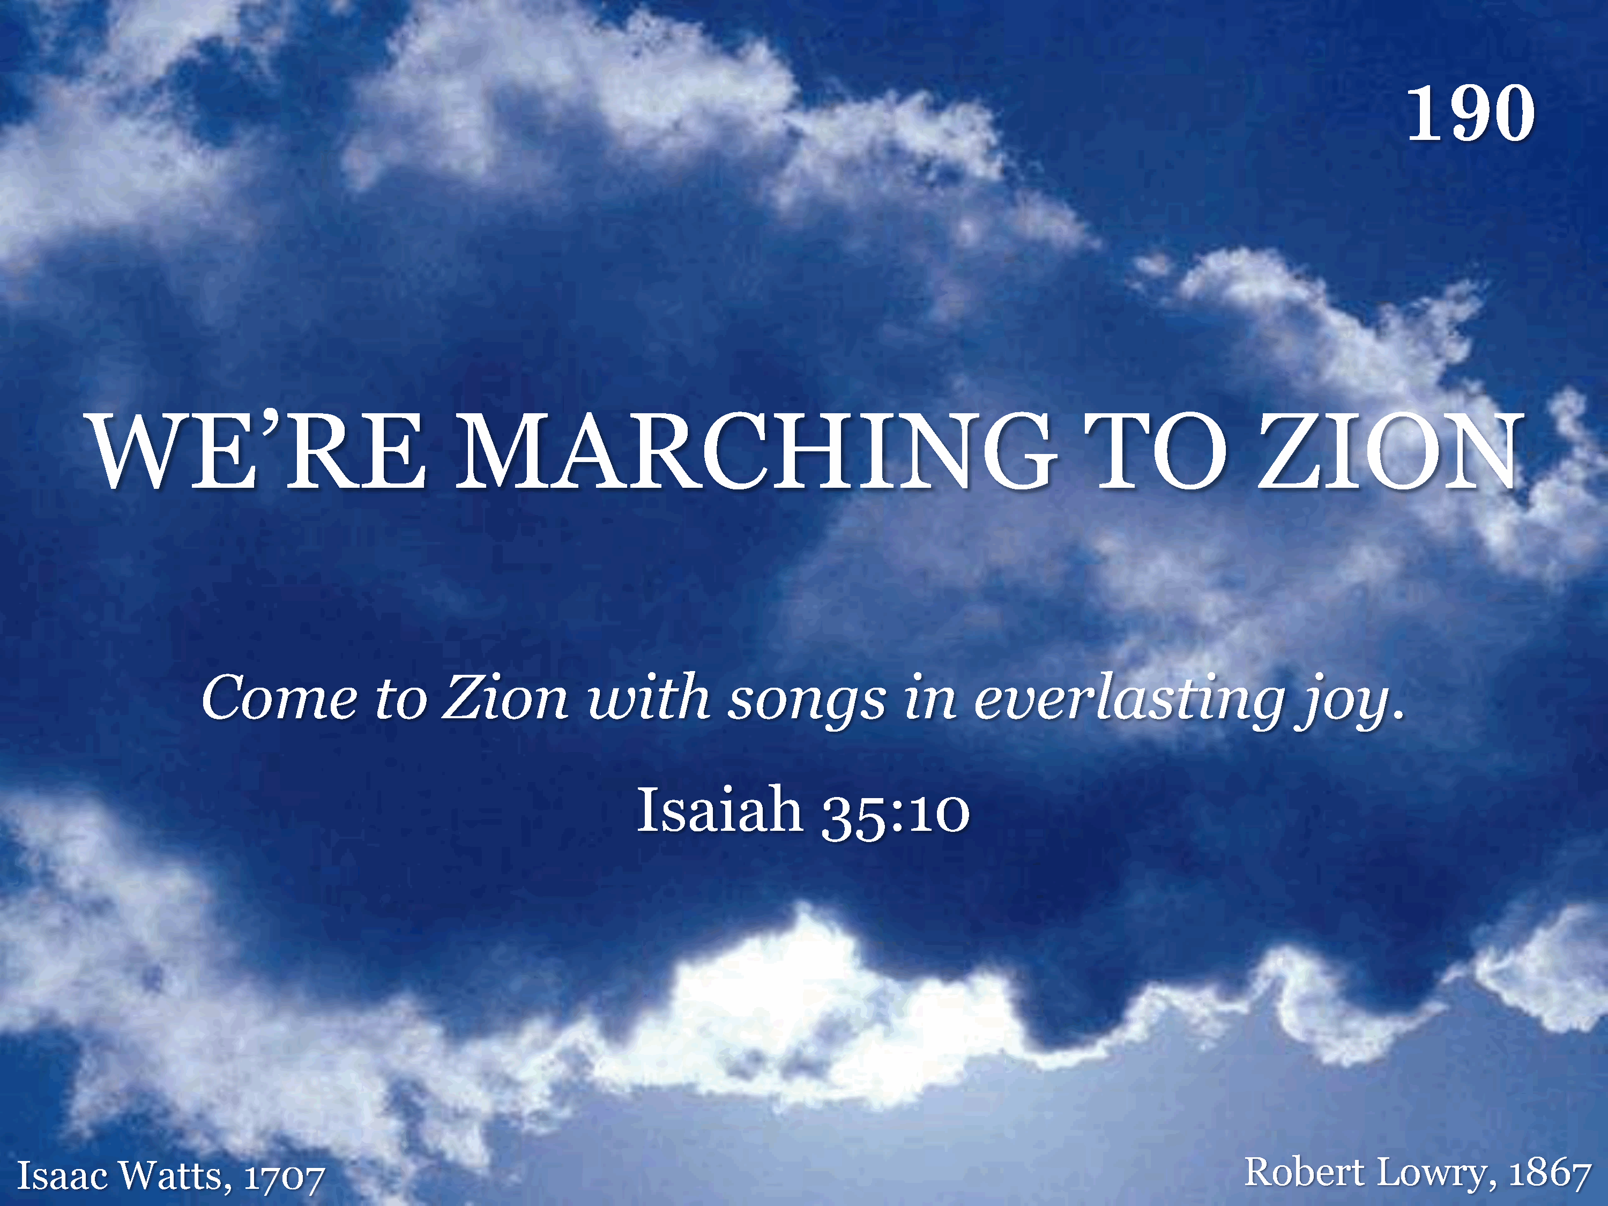
190 - We're Marching To Zion - Title

Slide 14
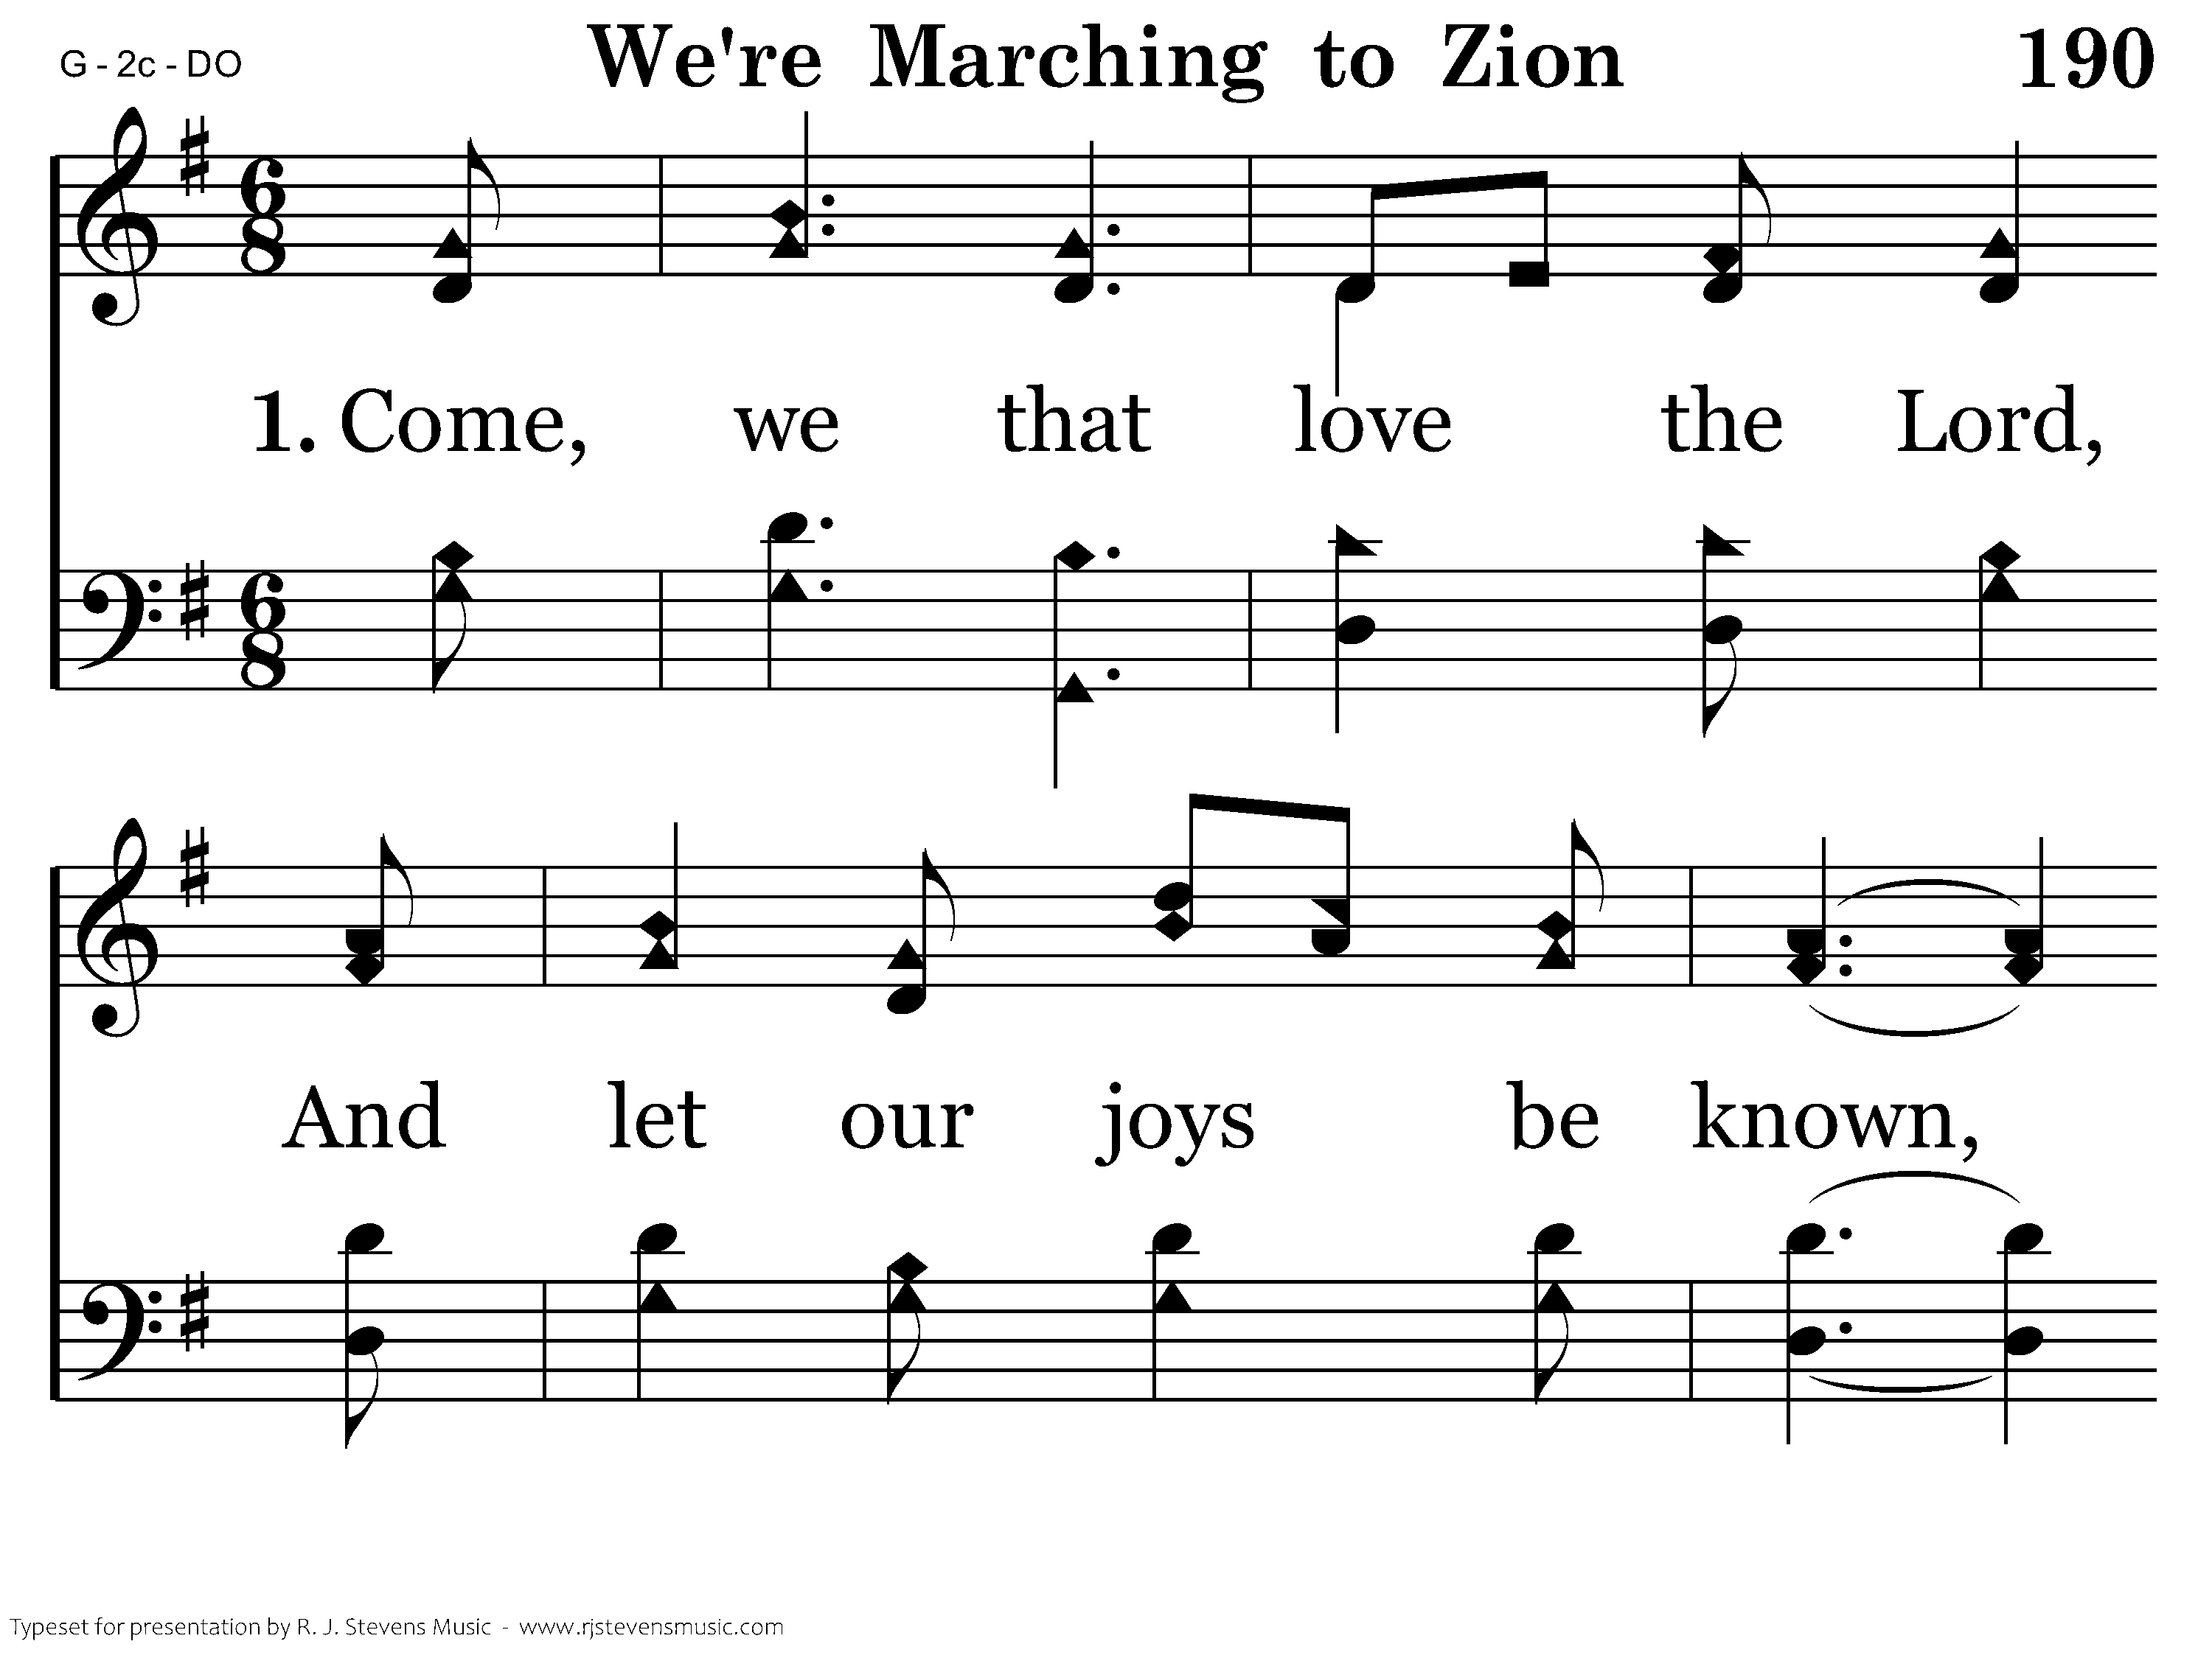
190 - We're Marching To Zion - 1.1

Slide 15
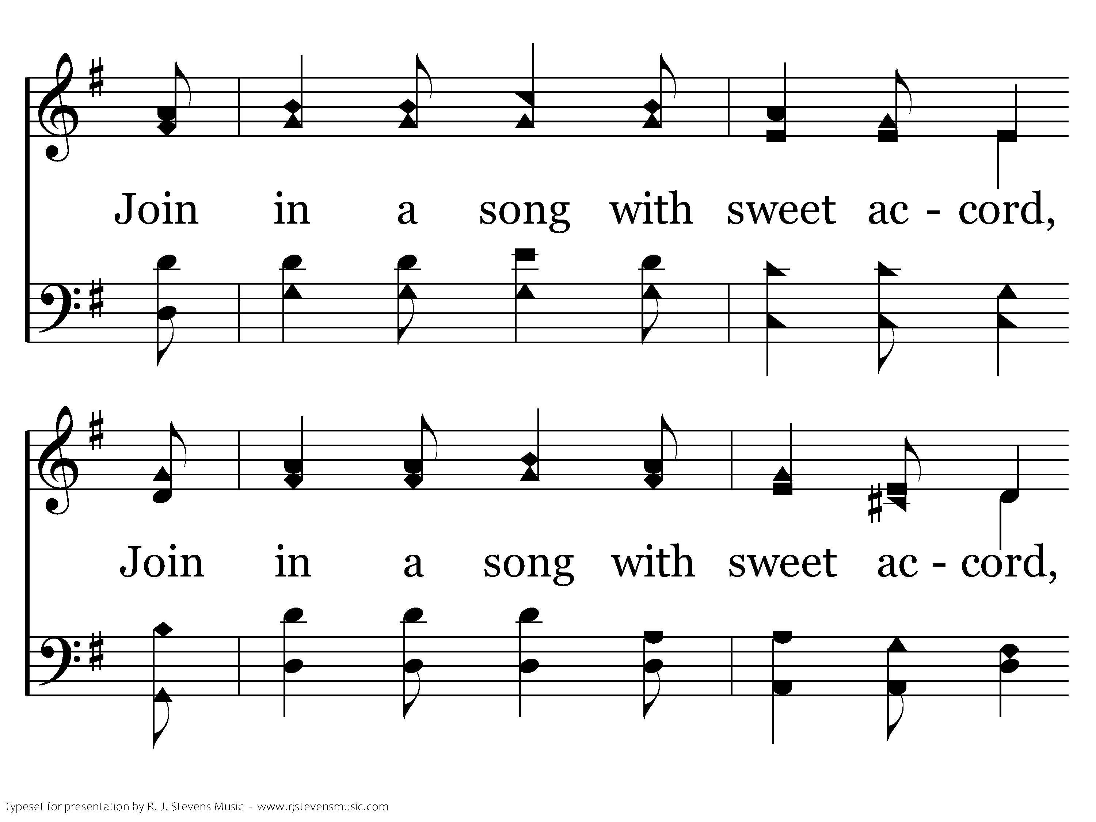
190 - We're Marching To Zion - 1.2

Slide 16
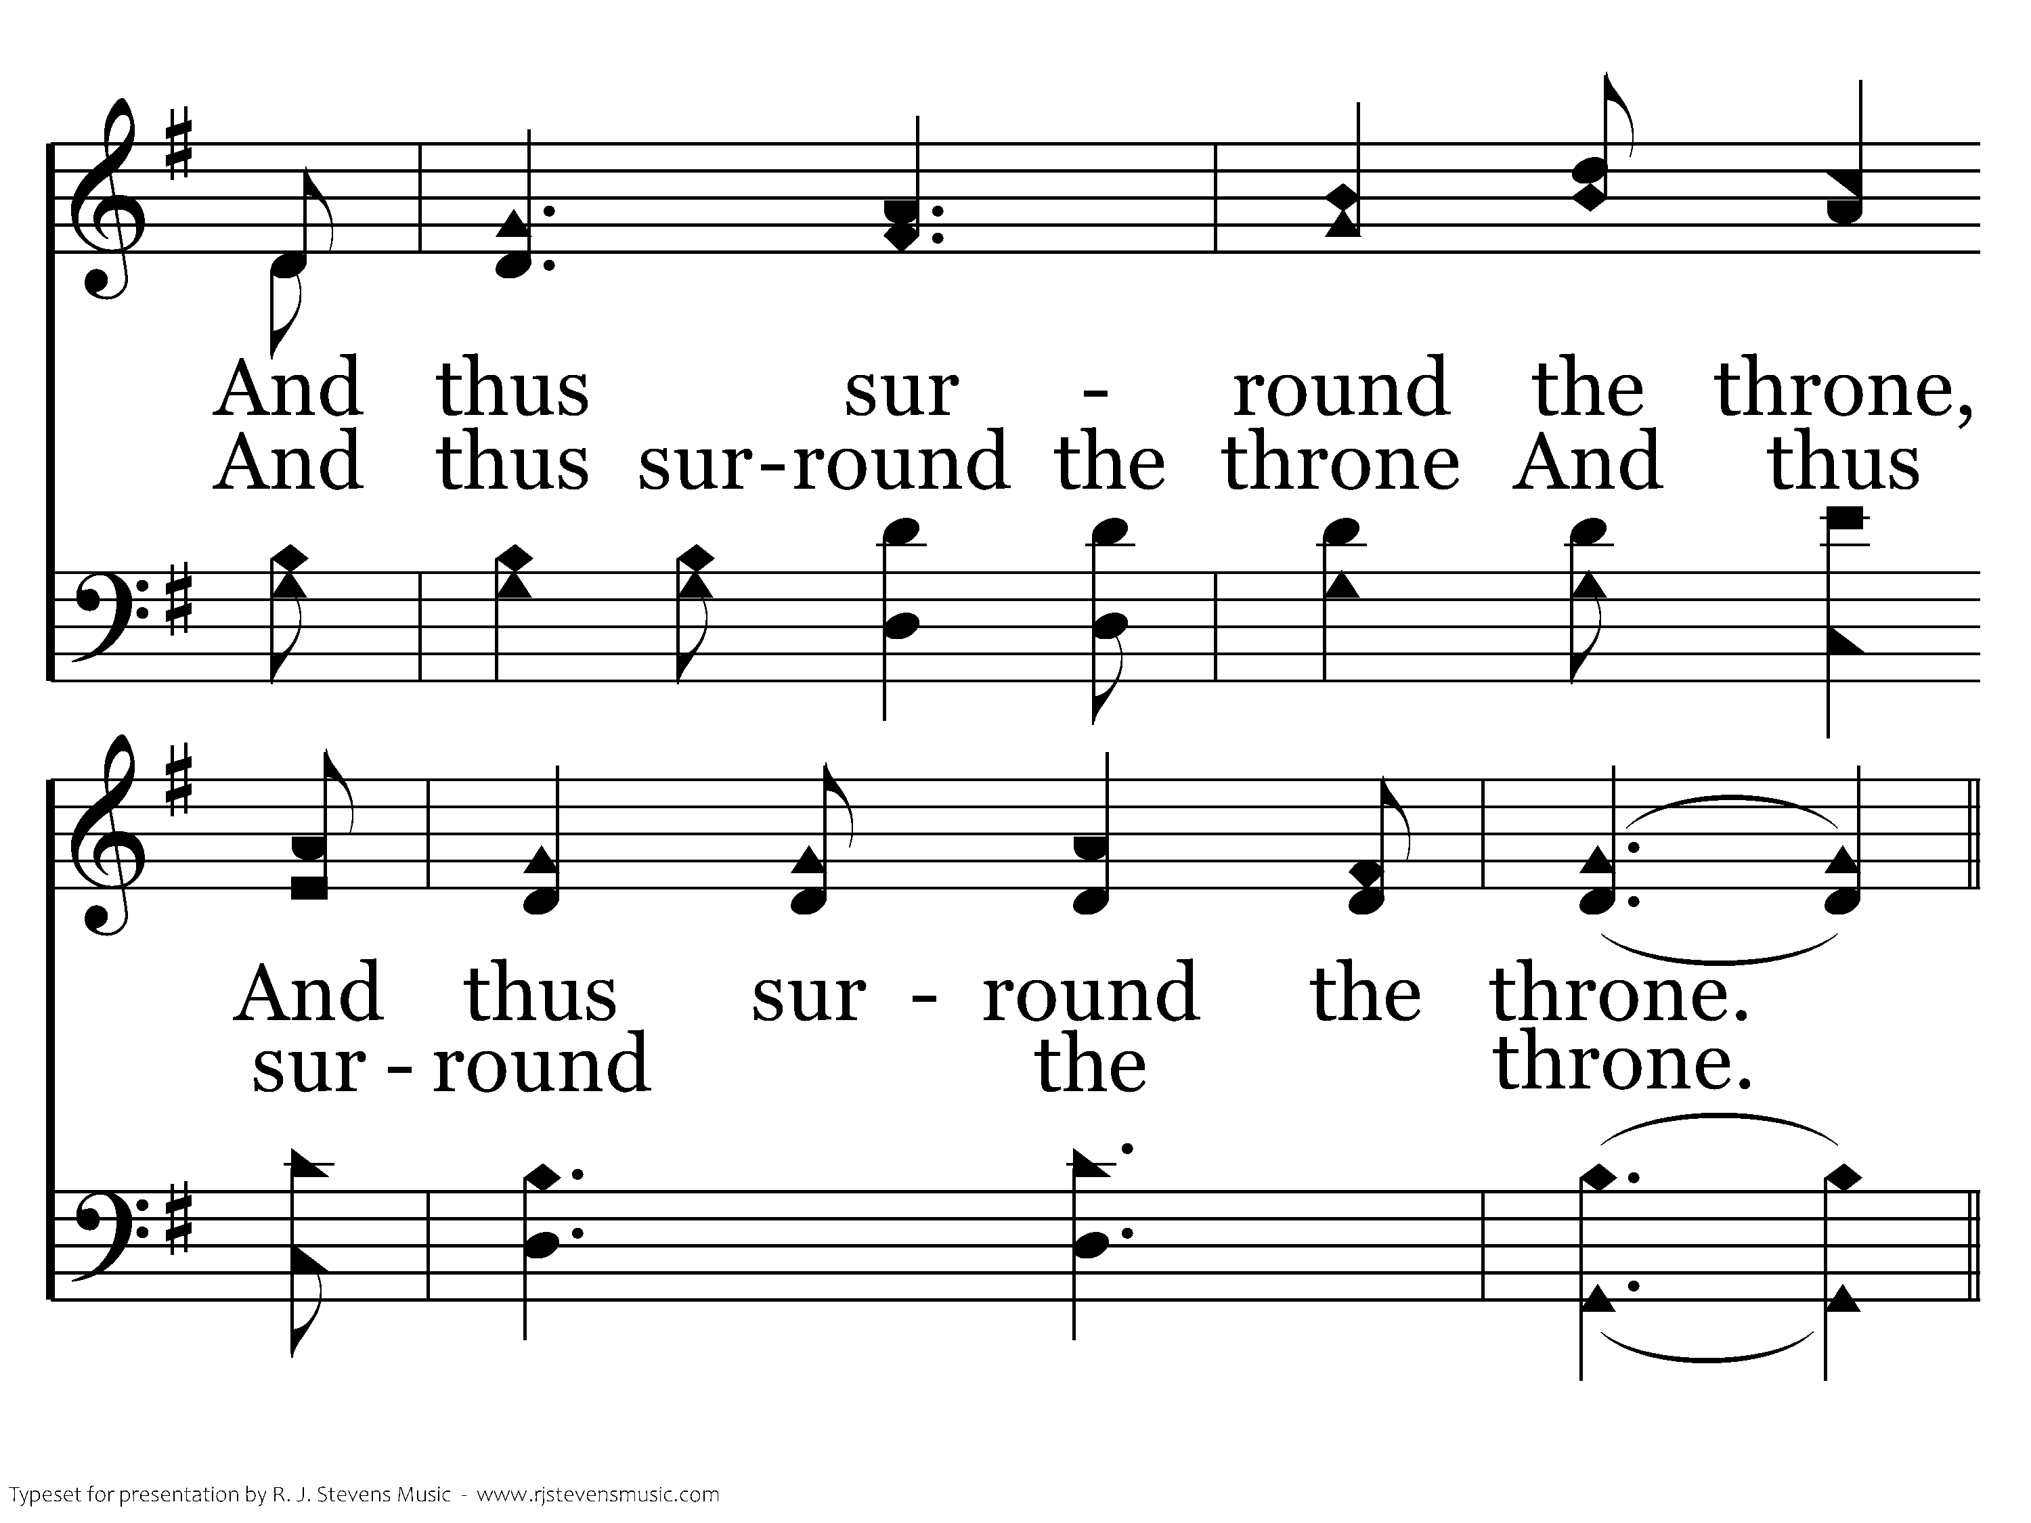
190 - We're Marching To Zion - 1.3

Slide 17
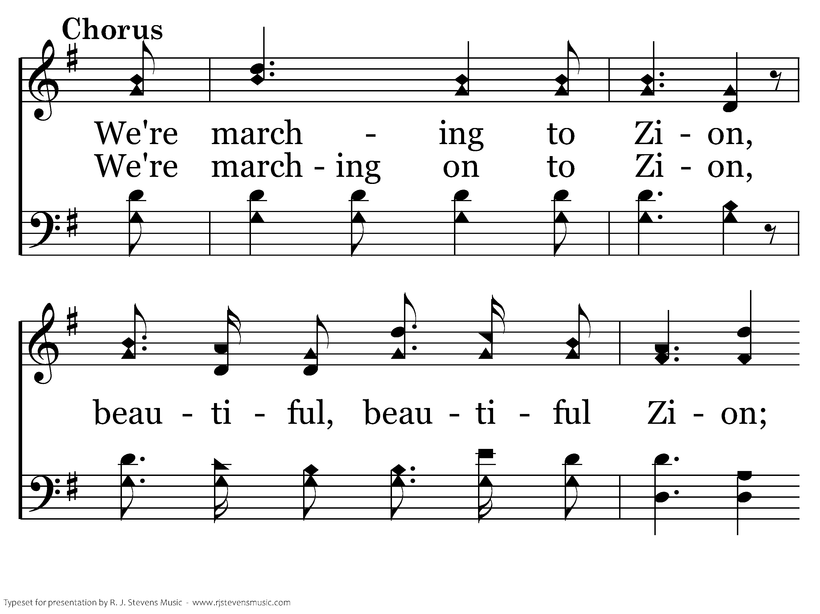
190 - We're Marching To Zion - C.1

Slide 18
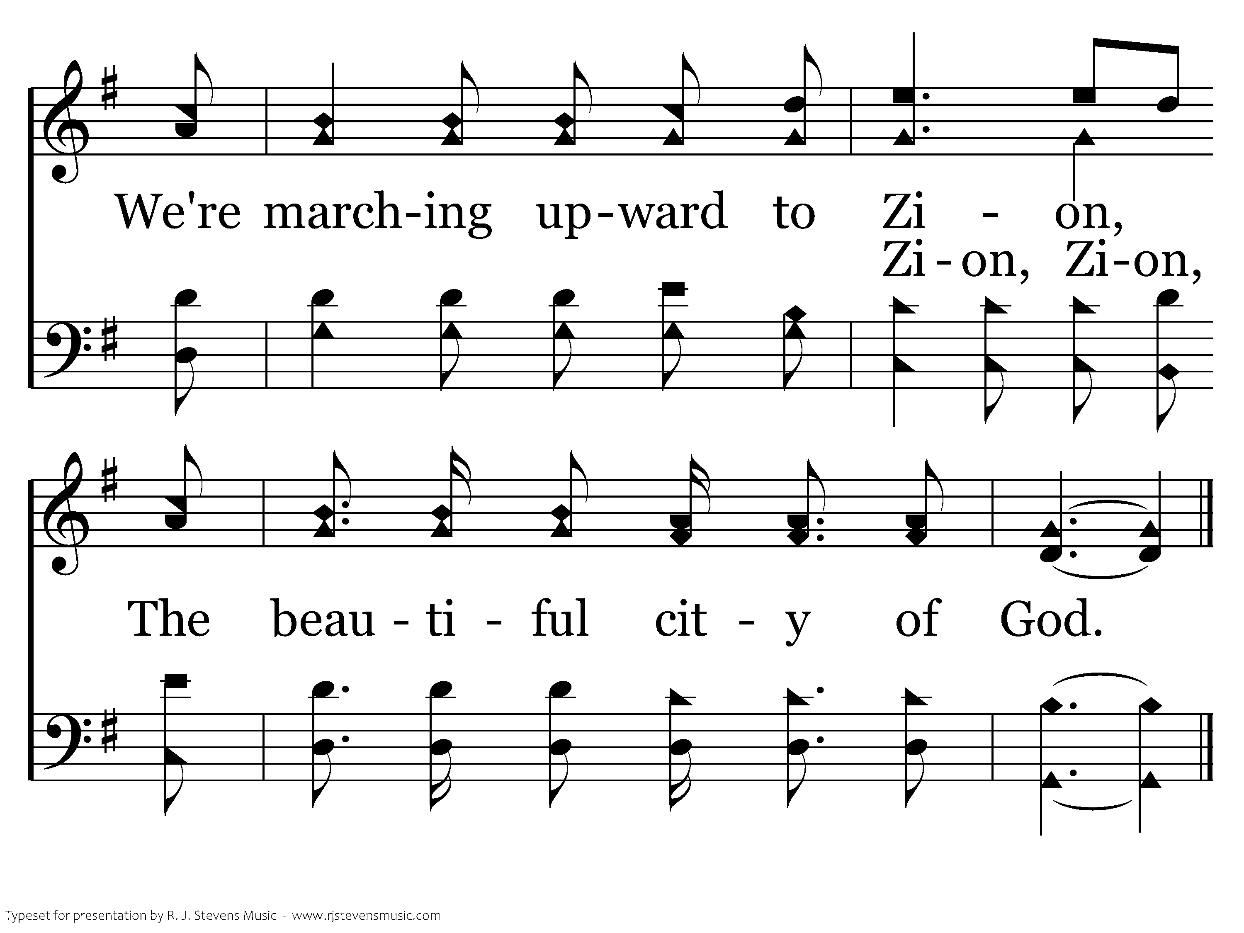
190 - We're Marching To Zion - C.2
End of Verse 1

Slide 19
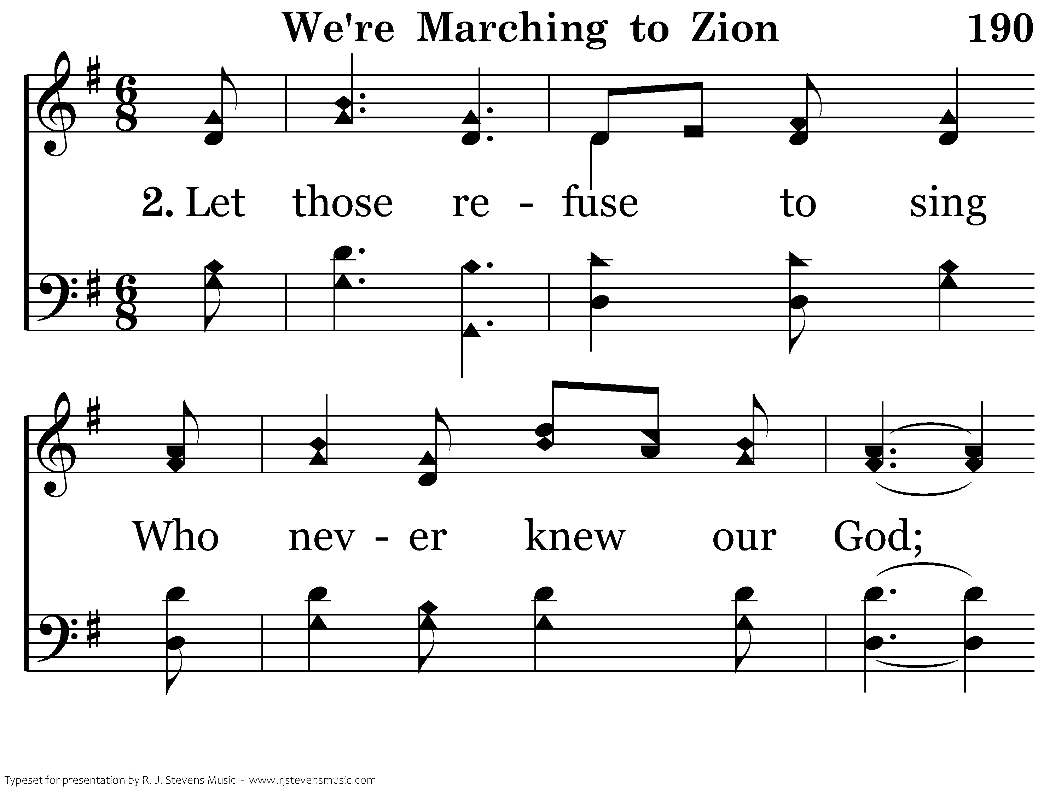
190 - We're Marching To Zion - 2.1

Slide 20
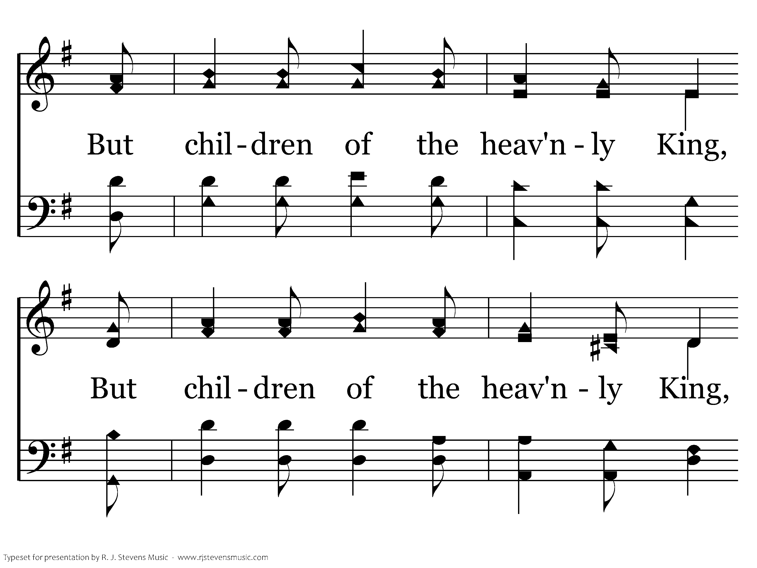
190 - We're Marching To Zion - 2.2

Slide 21
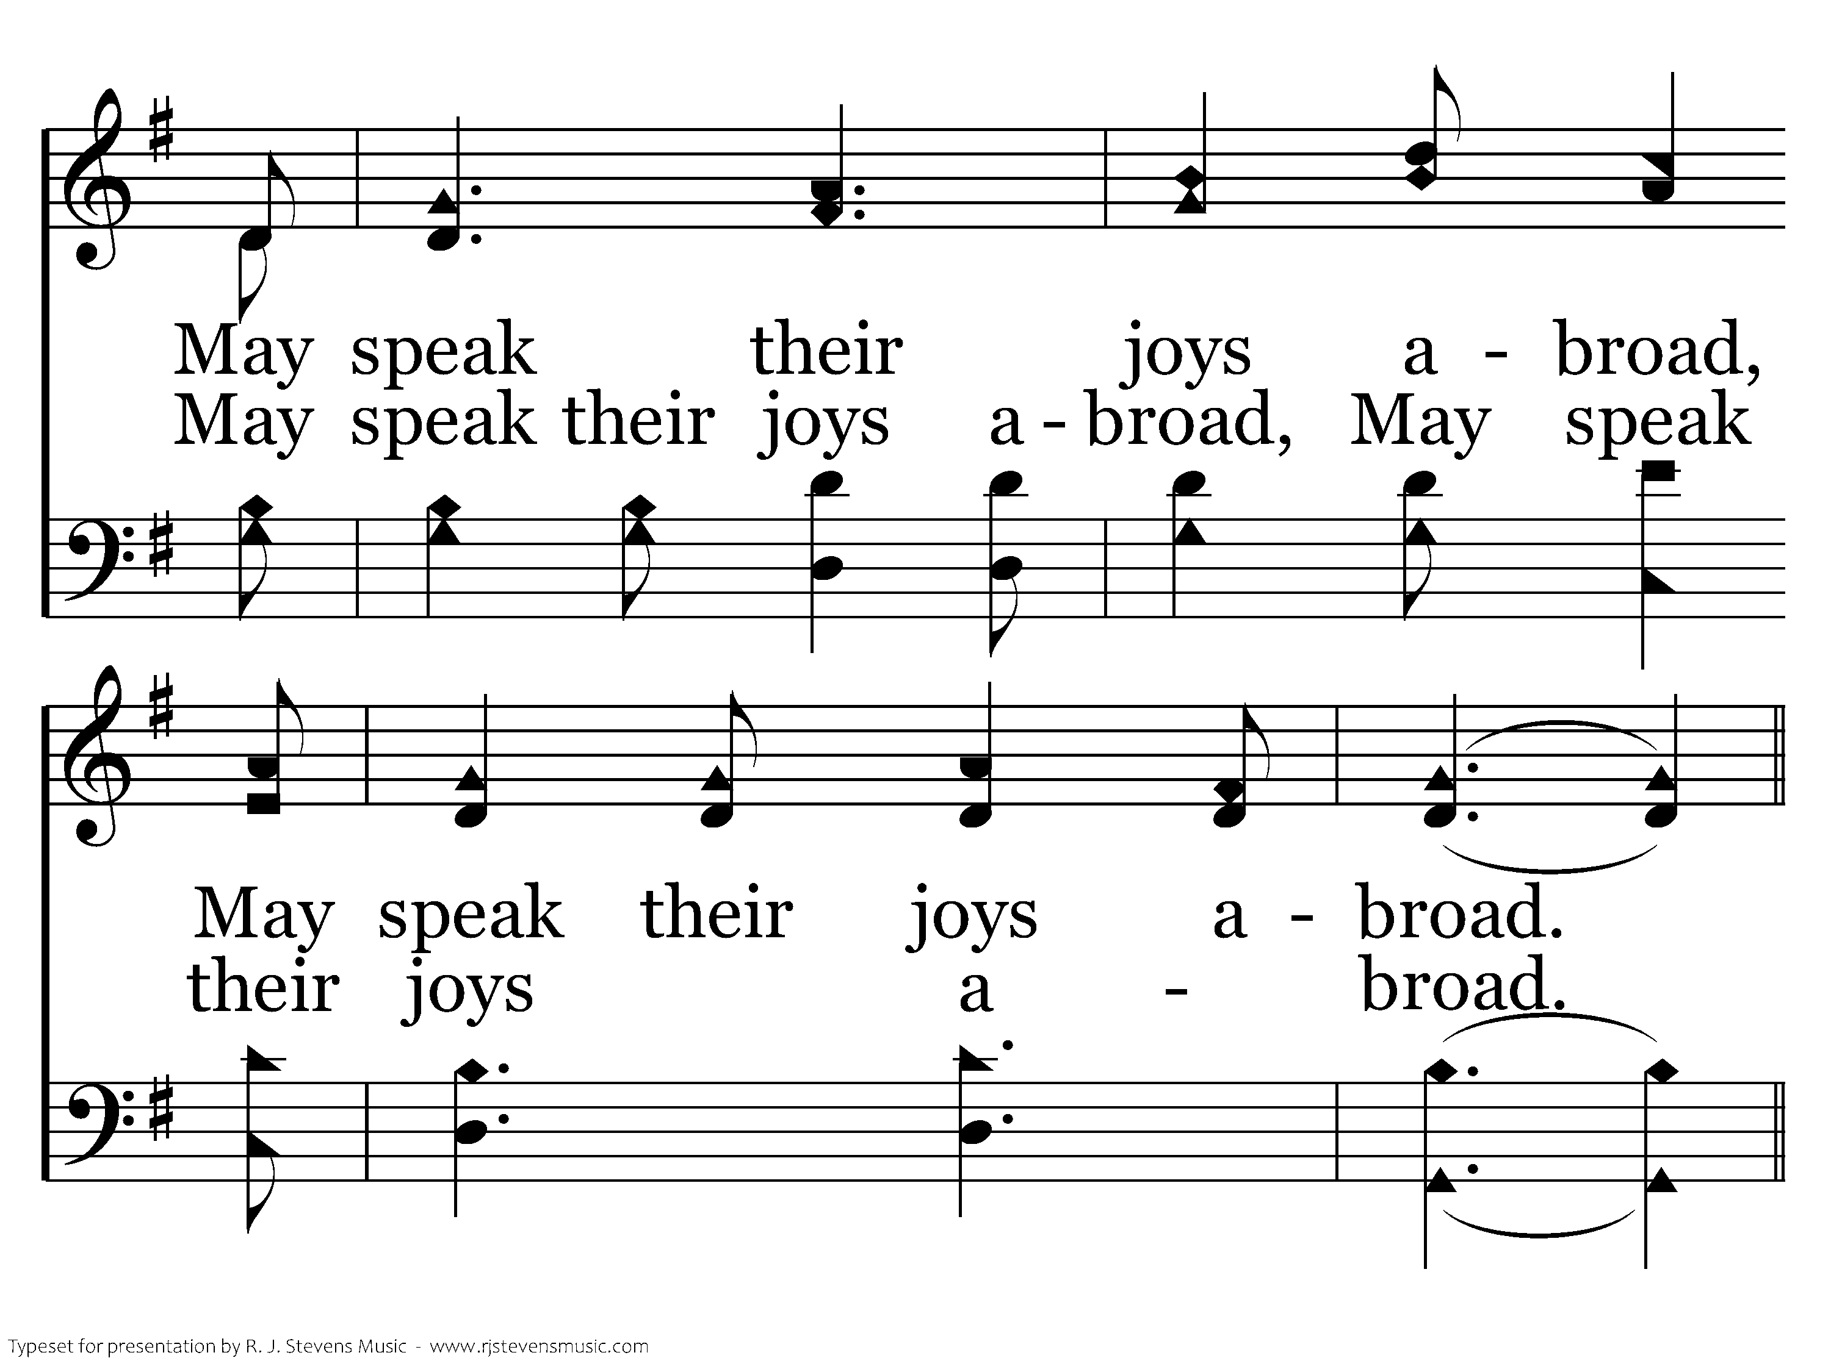
190 - We're Marching To Zion - 2.3

Slide 22
190 - We're Marching To Zion - C.1

Slide 23
190 - We're Marching To Zion - C.2
End of Verse 2

Slide 24
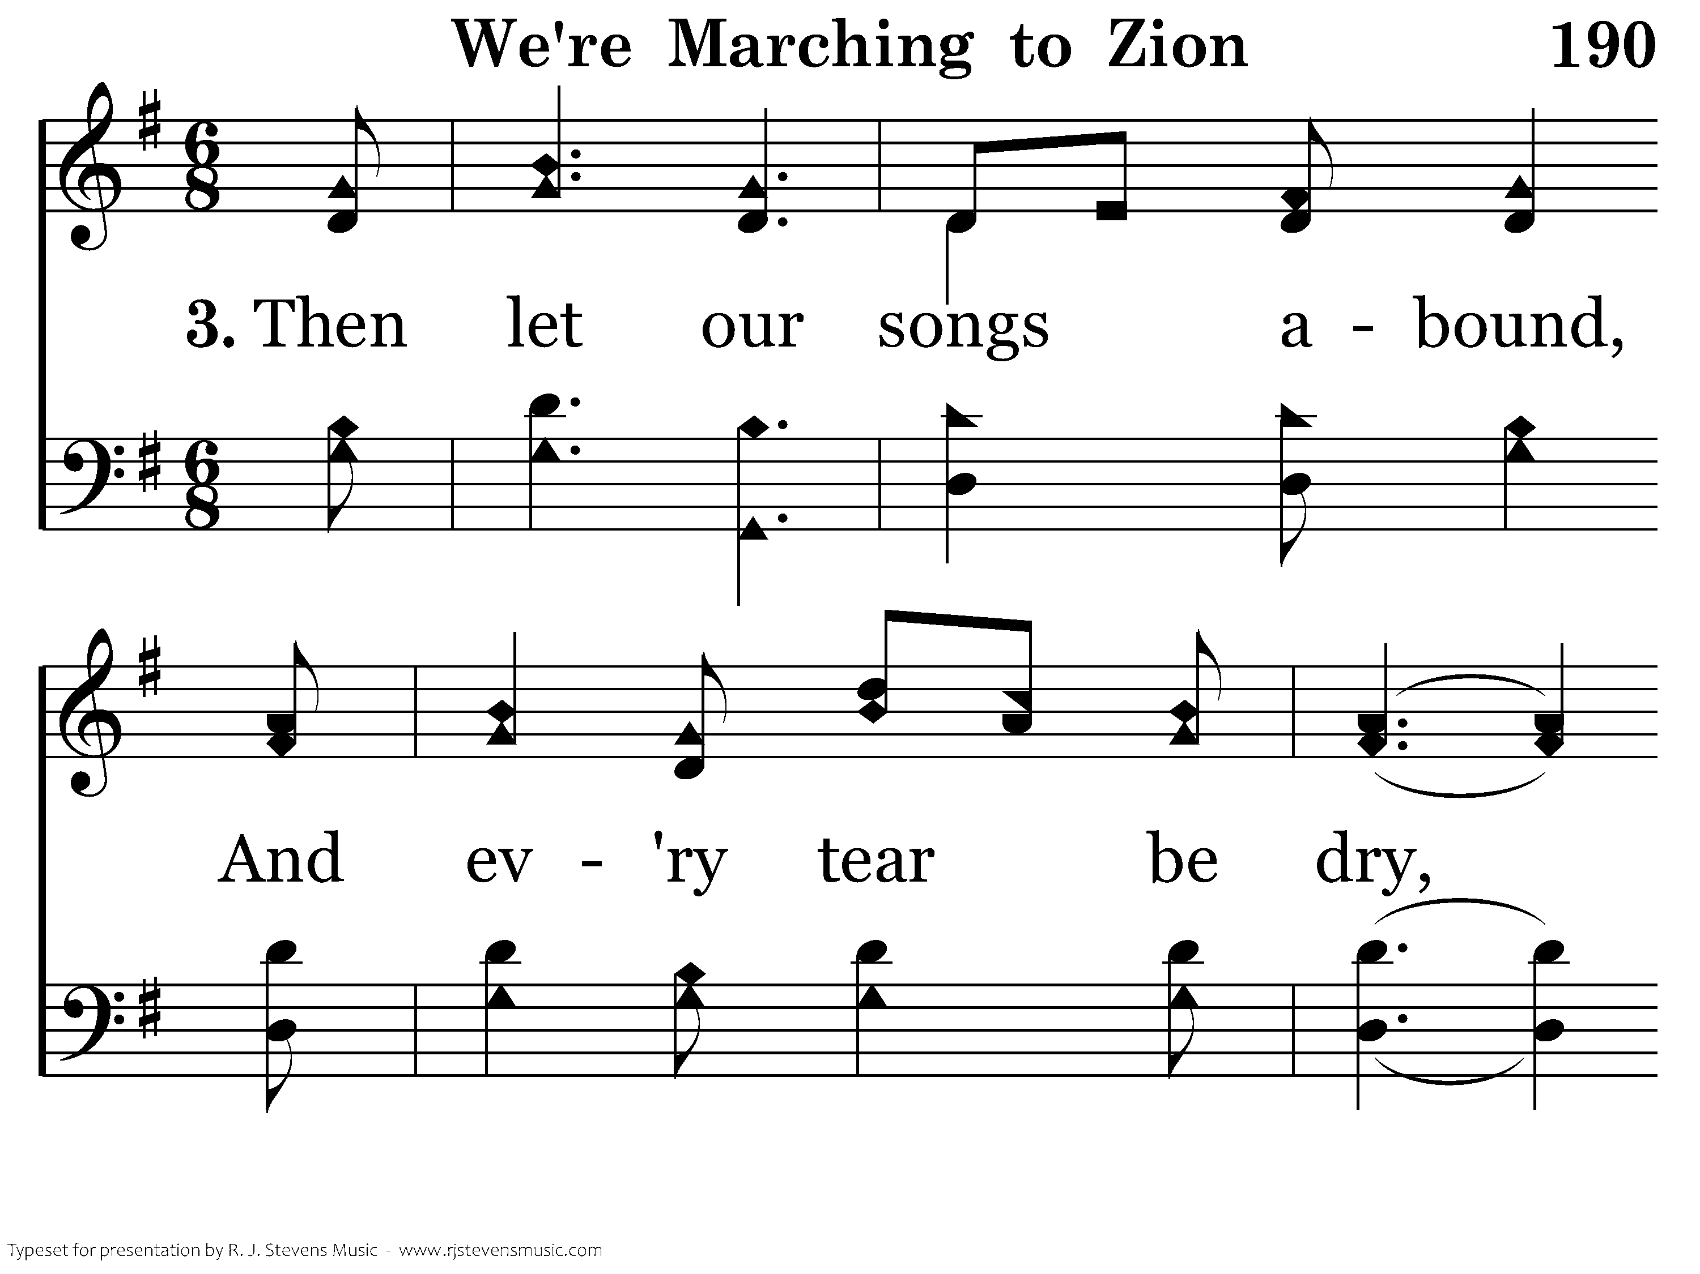
190 - We're Marching To Zion - 3.1

Slide 25
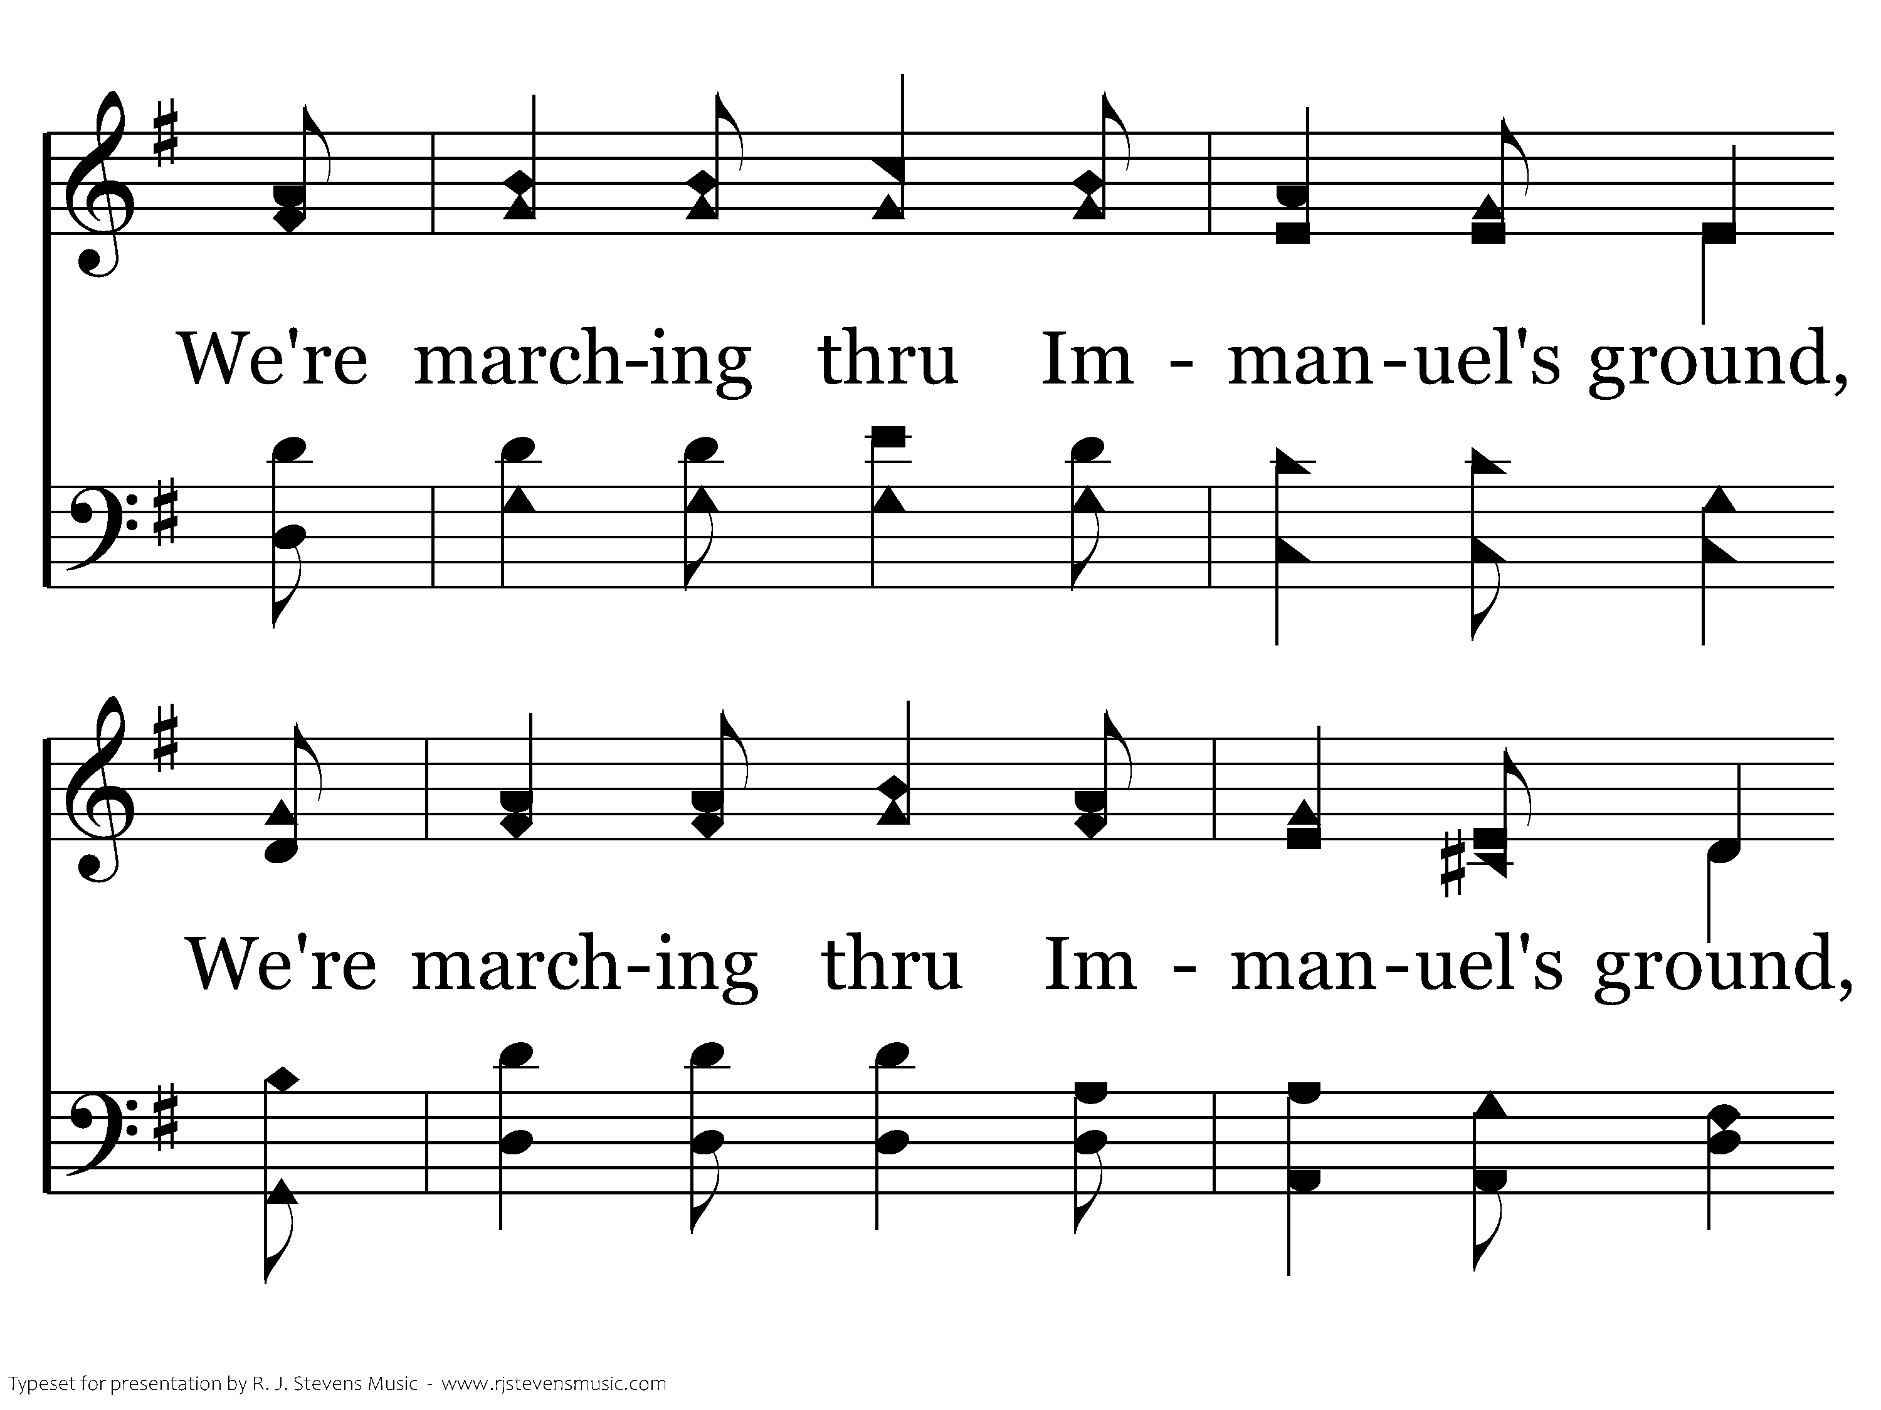
190 - We're Marching To Zion - 3.2

Slide 26
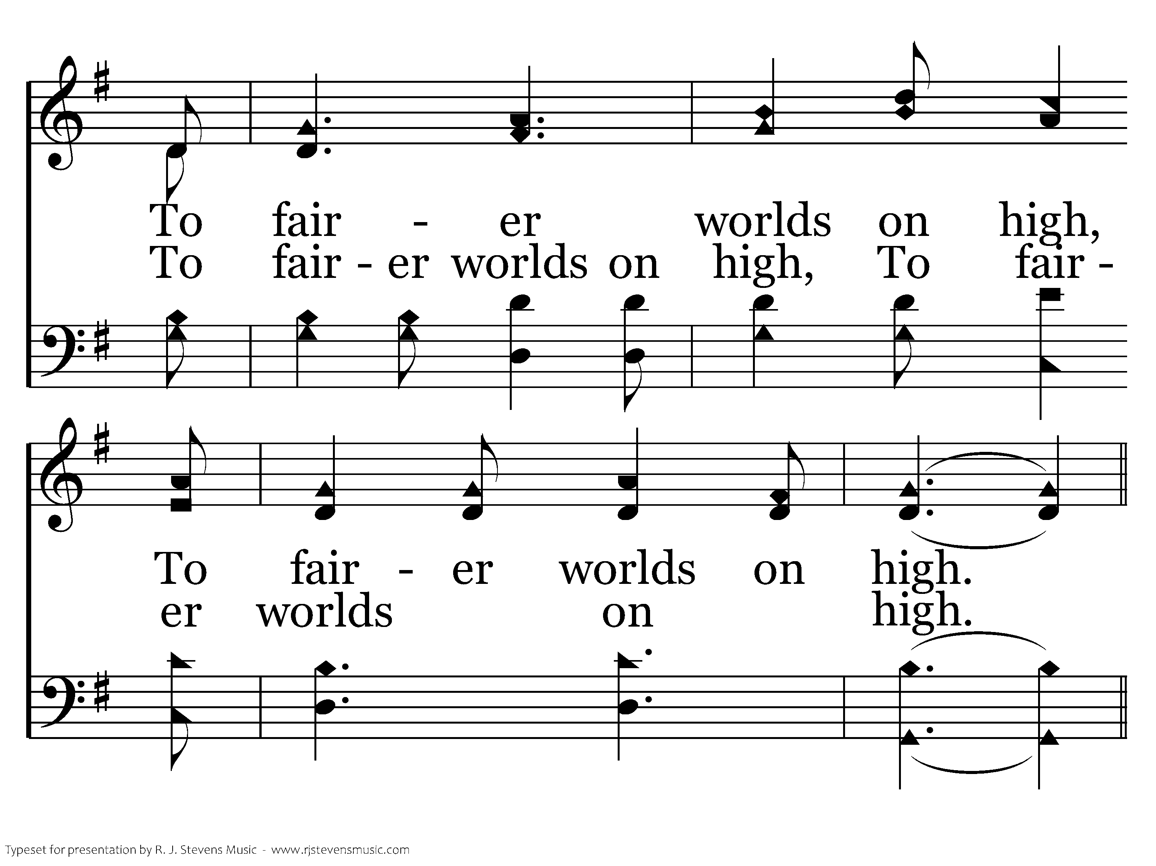
190 - We're Marching To Zion - 3.3

Slide 27
190 - We're Marching To Zion - C.1

Slide 28
190 - We're Marching To Zion - C.2
End of Song

Slide 30
The why and how of song worship

Slide 31
The Goal of Unity
I Cor. 1:10— I appeal to you, brothers, by the name of our Lord Jesus Christ, that all of you agree, and that there be no divisions among you, but that you be united in the same mind and the same judgment.

Slide 32

The Goal of Unity
Distraction!
The enemy of communication, edification, and unity

Slide 33
The Goal of Unity
How do we achieve unity in song worship?

Slide 34
The Goal of Unity
We want to enable saints to worship intentionally and meaningfully
  I Cor. 14:15— What am I to do? I will pray with my spirit, but I will pray with my mind also; I will sing praise with my spirit, but I will sing with my mind also.

Slide 35
The Goal of Unity
We accomplish our goal of unity with forethought and planning
  I Cor. 14:40— But all things should be done decently and in order.
  Do things well!

Slide 36
The Goal of Unity
The addiction and curse is called “mediocrity.” It stands diametrically opposed to everything God is and to everything God calls us to do. It means settling for less that our best. It is happy with half-hearted efforts and results. It is a disgrace to the God we serve.

Slide 37
The Goal of Unity
While some brethren may settle for “good enough,” where would we go in Scripture to find that “good enough” pleases God?—Max Dawson, “The Pursuit of Excellence,” Doing Things Well, 7

Slide 38
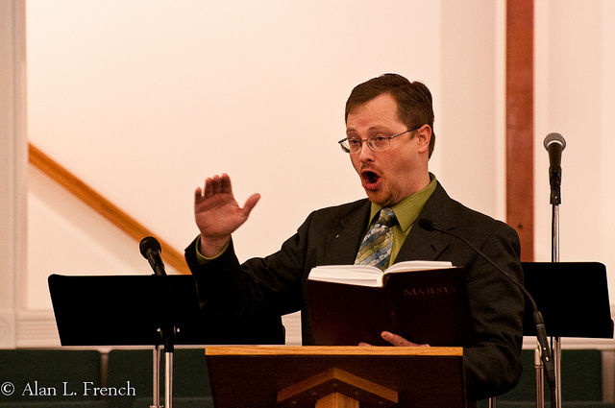
The Goal of Unity
Song worship leader—an expedient
Webster: suitability, practicality, and efficiency in achieving a particular end

Slide 39
The Goal of Unity
“A song leader is supposed to have the ability to effectively lead congregations in singing. If he is not effective, he is not expedient.”—Matthew Bassford, Do Things Well, 42
“The best the individual can do is not the standard for the church and what it can do. Does the church want to or can it follow? Who benefits? Who suffers?”—John Kilgore

Slide 40
The Goal of Unity
We want to make every effort to pursue excellence in edification
  I Cor. 14:12b— strive to excel in building up the church.

Slide 41
The Goal of Unity
Of first importance in leadership: example
  • Tit. 2:7-8— Show yourself in all respects to be a model of good works, and in your teaching show integrity, dignity, 8 and sound speech that cannot be condemned,
  • I Tim. 4:12— Let no one despise you for your youth, but set the believers an example in speech, in conduct, in love, in faith, in purity.

Slide 42
The Goal of Unity
Of first importance in leadership: example
  • I Cor. 11:1— Be imitators of me, as I am of Christ.

Slide 43
The Goal of Unity
Of second importance: preparation
  • “If you would learn the fine art of worship, then, live close to God, prepare carefully for every occasion of worship, and participate thoughtfully in every service.” – Stafford North

Slide 44
The Goal of Unity
Of second importance: preparation
  • “All song services should be carefully and prayerfully arranged. Its purpose demands it; its possible benefits command it. We depend on the leader for the well planned service.” – Lloyd O. Sanderson

Slide 45
The Goal of Unity
Of second importance: preparation
  • Remember, we do not lead songs but we lead thoughts found in verses and choruses
  • This will affect when and how we use them

Slide 46
The Goal of Unity
be united in the same mind and the same judgment
Coordinate our efforts in an expedient manner—suitable, practical, and efficient

Slide 47
The Goal of Unity
May we in the very gentlest whisper beg you to think very much of God, much of singing, and extremely little of yourself. The best sermon is that in which the theme absorbs the preacher and hearers, and leaves no one either time or desire to think about the speaker;

Slide 48
The Goal of Unity
so in the best congregational singing, the leader is forgotten because he is too successful in his leadership to be noticed as a solitary person. The head leads the body, but it is not parted from it, nor is it spoken of separately; the best leadership stands in the same position.— Charles H. Spurgeon

Slide 49
The Goal of Unity
Song starter?
Song leader?
Cheerleader?
Song worship leader!

Slide 50
The Goal of Unity
Learning the science of song worship leading and the art of song worship will equip us for the right kind of leadership

Slide 51
The Goal of Unity
Tune the heart and the voice
How can I better enable myself to do and offer my thoughtful best?

Slide 52
The Goal of Unity
I can improve and I am going to improve my ability to worship my God and encourage my brethren in song.— R. J. Stevens

Slide 53
Song Worship Leader’s Role
NOT to lead singing
NOT to lead songs
BUT to lead worship!
What is our source of worship?
The WORD
Song worship is first, last, and always a ministry of the Word of God
We lead the “melody of the message”

Slide 54
The Goal of Song Worship Leading
Minister of the Word: Col. 3:16— Let the word of Christ dwell in you richly, teaching and admonishing one another in all wisdom, singing psalms and hymns and spiritual songs, with thankfulness in your hearts to God.

Slide 55
The Goal of Song Worship Leading
Minister of the Word: Col. 1:28— Him we proclaim, warning everyone and teaching everyone with all wisdom, that we may present everyone mature in Christ.

Slide 56
The Goal of Song Worship Leading
Lead to enable the worshiping assembly to sing a complete thought with the spirit and the understanding
In practical terms, to be able to start, stay, and stop together with the least amount of distraction and with the most edification

Slide 57
This is only the beginning!
Follow-up is essential!

Slide 58
We will start at the beginning

Slide 59
Song Worship Leading
Remember—don’t be overwhelmed by the amount of information you’ll receive
Start at your ability and skill level and take one step at a time

Slide 60
What are the components of song worship?

Slide 61
Common Words
They are the means of . . .
  making melody in our hearts to the Lord
  expressing our thoughts and emotions
  teaching, admonishing, and communicating God’s truth
  affirming our beliefs and common faith
  uniting us in worship and work

Slide 62

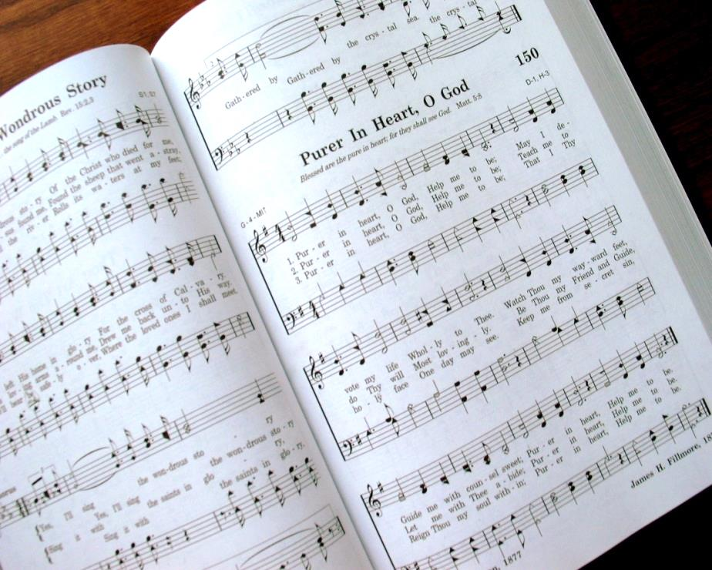
Common Words
Special attention needed!

Slide 63
Common Words
Select songs that relate to a unifying thought or progression of thought
An appropriate Scripture is most helpful
Have a specific reason for what is sung
The goal is to increase understanding and edification
Identify and explain unfamiliar words
Study songs and lyrics to express their meaning

Slide 64
Common Pitch
Songs are based on a specific tone
The keytone is needed before singing and worship can begin

Slide 65
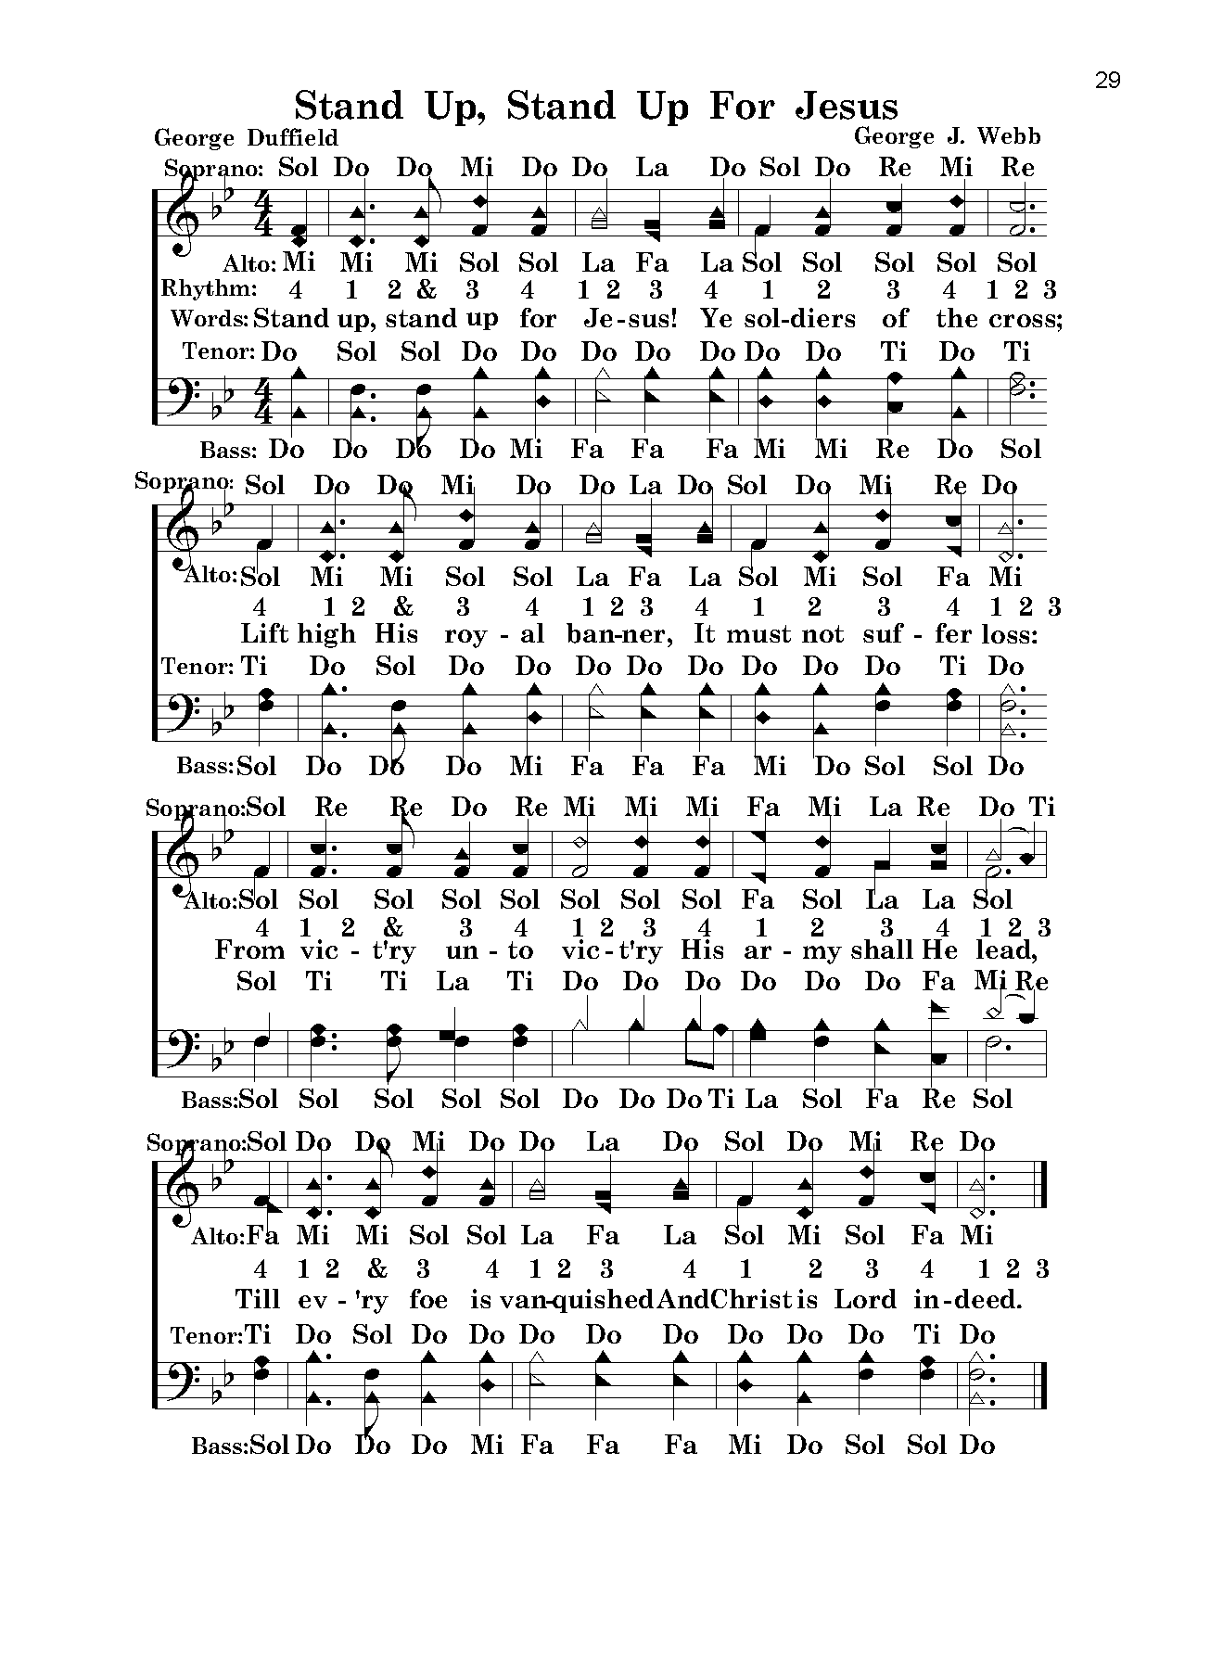
Common Pitch

Slide 66
Our Goal
Increase edification
Eliminate distraction and confusion
Sing a complete thought with the spirit and understanding in an orderly manner
How? Start, stay, and stop together
Necessary to follow a song worship leader

Slide 67
Common Pitch
Starting together on the first word creates a greater sense of…
  Attentiveness, awareness, and involvement
  Anticipation and readiness
  Purpose and meaning
  Dignity and respect
  Unity and order
  Fulfillment and completeness

Slide 68
Common Beat
To start and stay together we must follow a common beat

Slide 69
Common Beat
Order and unity are accomplished with a directed beat
The beat can be anticipated
Prevents “dragging”
Expresses the “speed” of the message

Slide 70
Common Effort
Eph. 4:15-16: Rather, speaking the truth in love, we are to grow up in every way into Him who is the head, into Christ, 16 from whom the whole body, joined and held together by every joint with which it is equipped, when each part is working properly, makes the body grow so that it builds itself up in love.

Slide 71
Examining Conducting Patterns
Order and unity are accomplished with a directed beat

Slide 72
Examining Conducting Patterns
Challenge: effective conducting is about communicating the energy of the message and music along with the voice
Effective conducting skills benefit song worship

Slide 73
Purpose of Beat Patterns
Patterns help to know in advance
They show the logical arrangements of strong and weak beats
We are able to anticipate the beat
They unite the congregation with a steady beat and accurate rhythm

Slide 74
Examining Conducting Patterns
Three basic beat patterns
  Duple
  Triple
  Quadruple

Slide 75
Examining Conducting Patterns
The more expedient the beat pattern, the more effective it will be in leading worship

Slide 76
Beat-plane Conducting
Primary
Secondary
Secondary
3 Points on Beat Plane

Slide 77
Duple Conducting Pattern
1 Point on Beat Plane

Slide 78
Memory Songs: Simple/Duple
“God is so good” (47) E♭DO

Slide 79
Triple Conducting Pattern
2 Points on Beat Plane

Slide 80
Memory Songs: Simple/Triple
“When my love to Christ grows weak” (159) C MI↑

Slide 81
Quadruple Conducting Pattern
3 Points on Beat Plane

Slide 82
Memory Songs: Simple/Quad
“Soldiers of Christ arise” (231) G DO

Slide 83
Memory Songs: Compound/Duple
“More about Jesus” (406) A♭ SOL↓

Slide 84
Memory Songs: Compound/Triple
“Blessed assurance” (4) D MI↑

Slide 85
Memory Songs: Compound/Quad
“Jesus, name above all names” (563) E♭ MI↑

Slide 86
Song Worship Leader’s Role
Keep the steady beat: 2-6, 3-9, 4-12

Slide 87
Song Worship Leader’s Guide
Announce number, title, number, other info
Give pitch (start with DO)
Think starting tempo/first phrase
Ready position/eye contact
Wait !
Preparatory breath & beat to begin on first word
Continue conducting/eye contact/expression
Hold final note and give cut-off

Slide 88
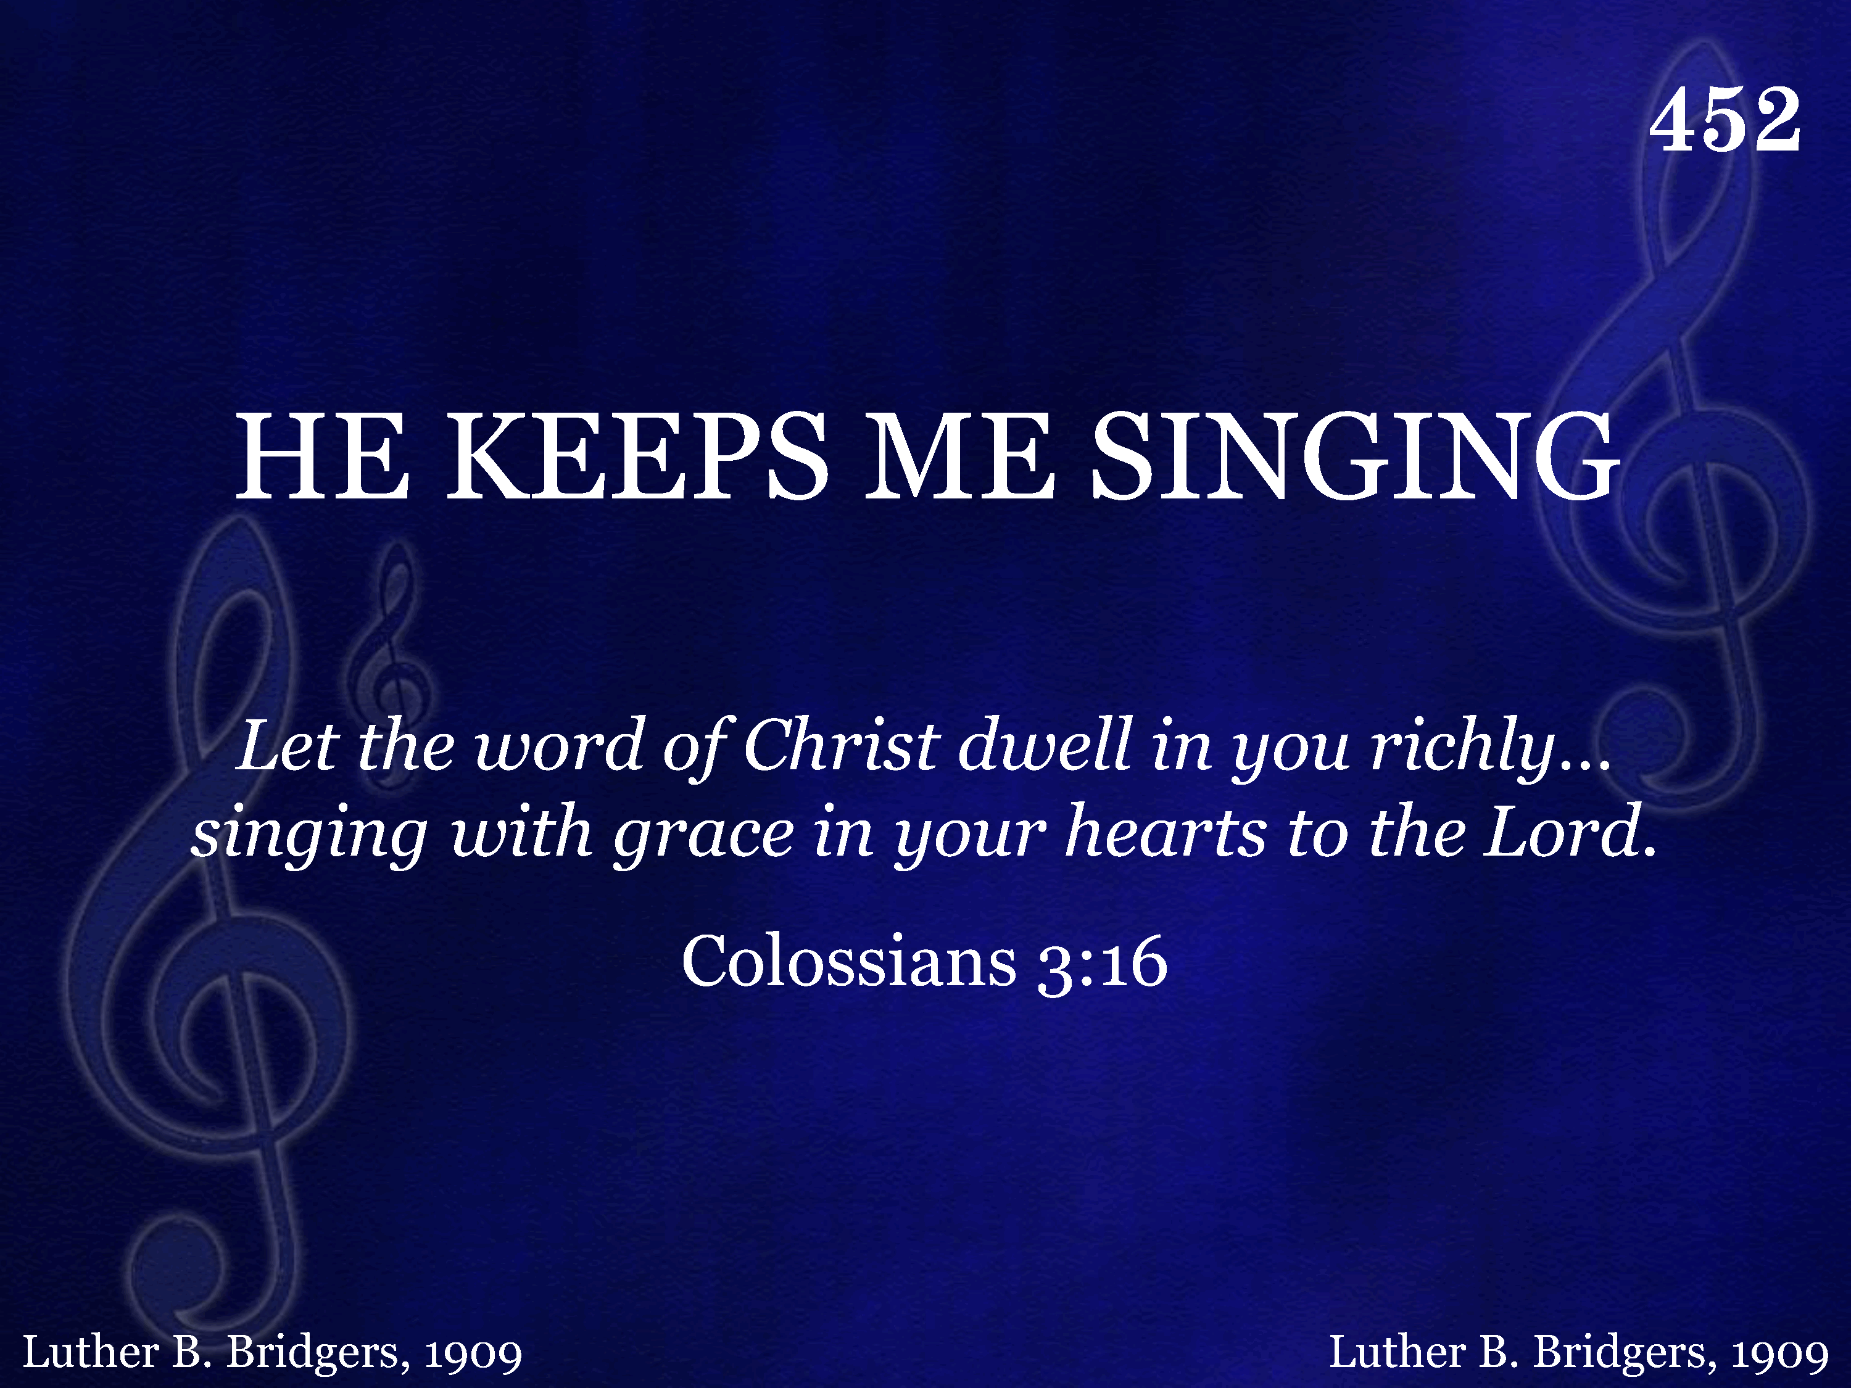
452 - He Keeps Me Singing - Title

Slide 89
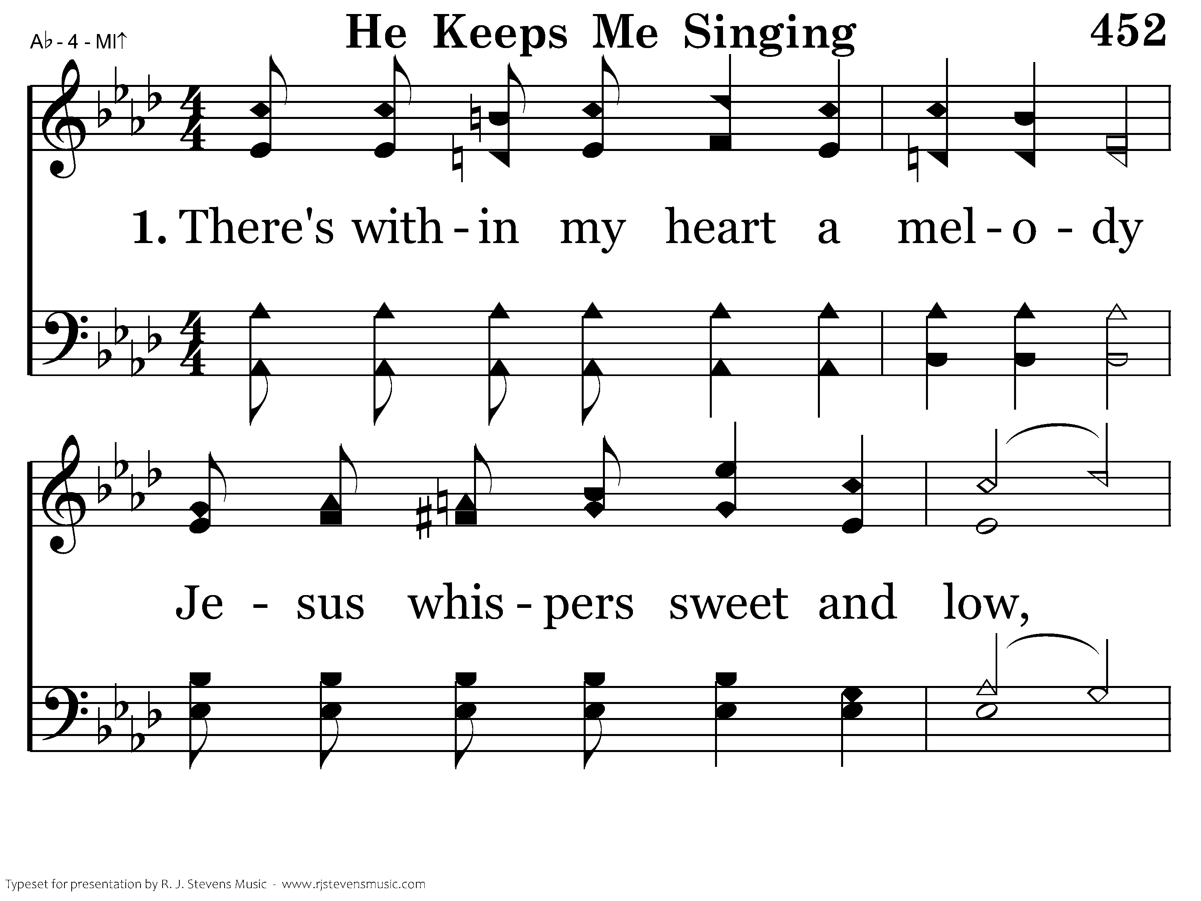
452 - He Keeps Me Singing - 1.1

Slide 90
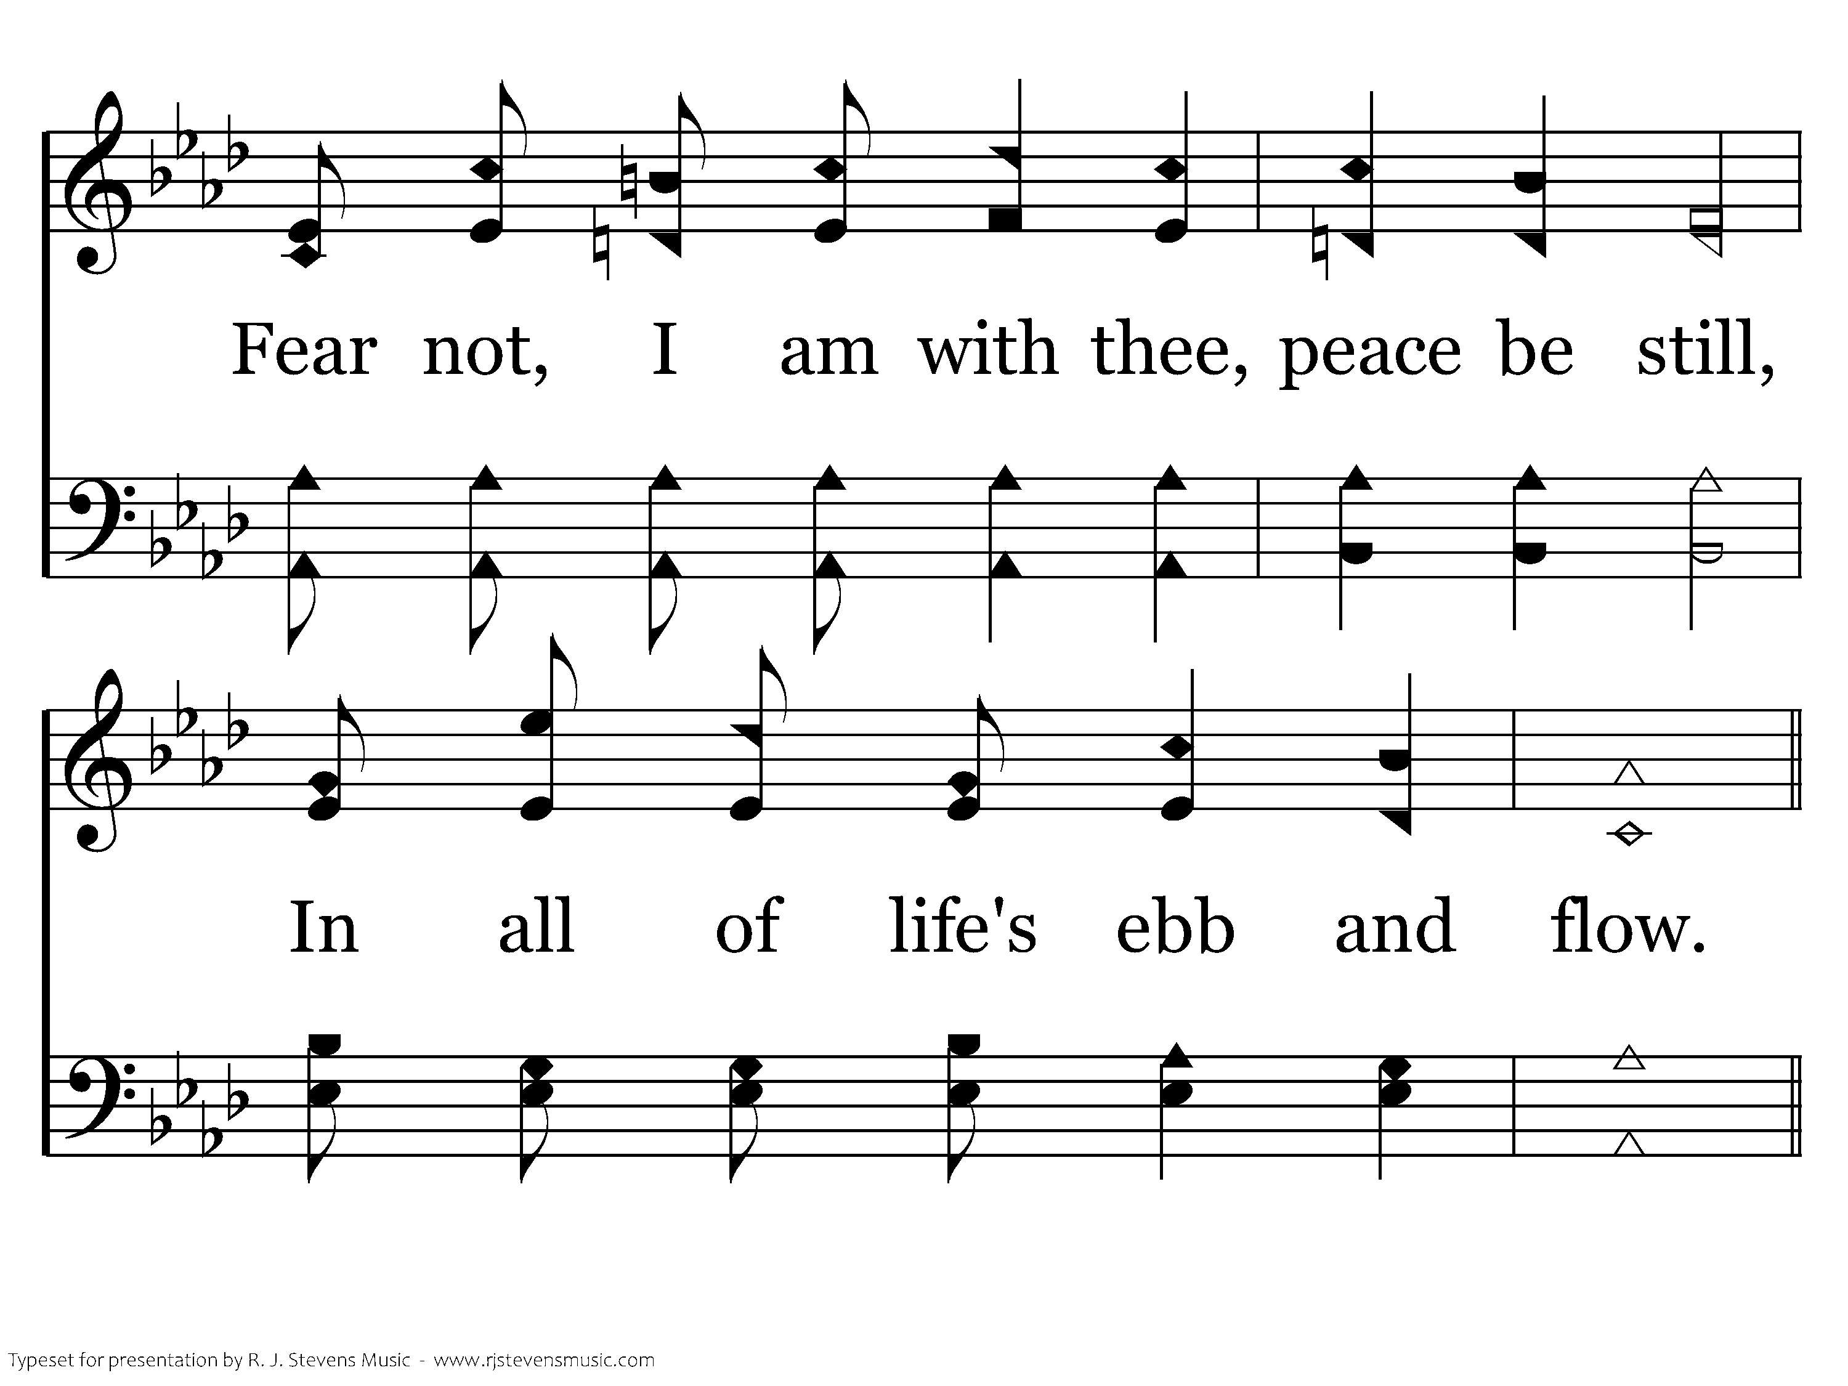
452 - He Keeps Me Singing - 1.2

Slide 91
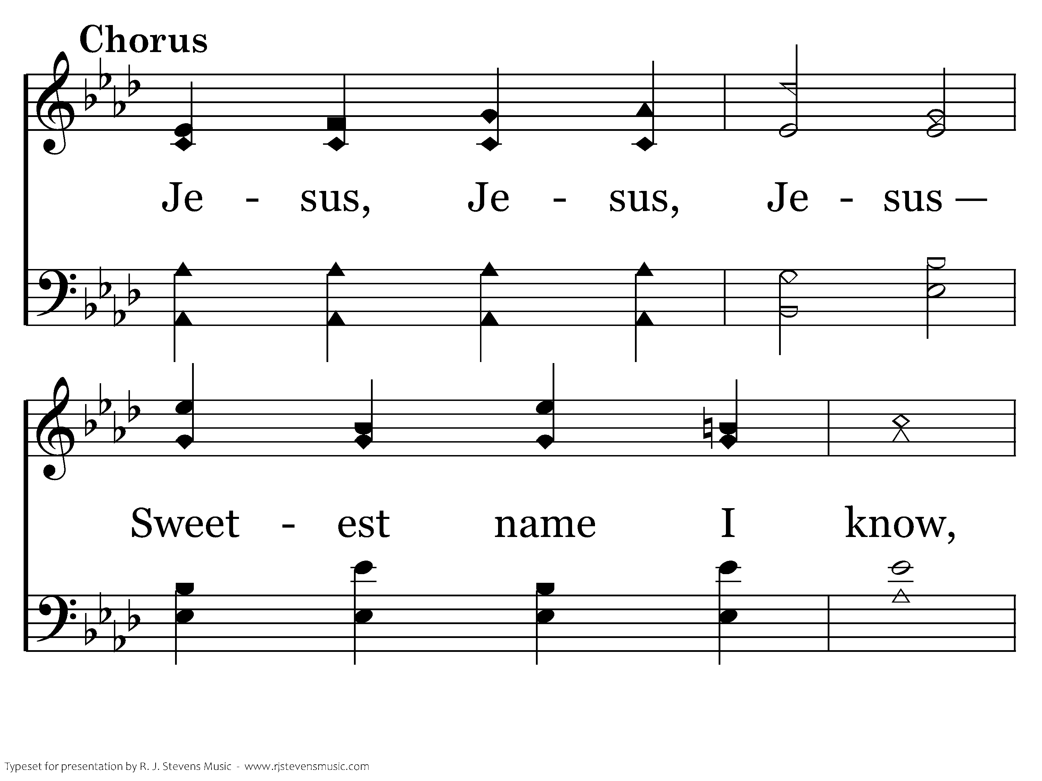
452 - He Keeps Me Singing - C.1

Slide 92
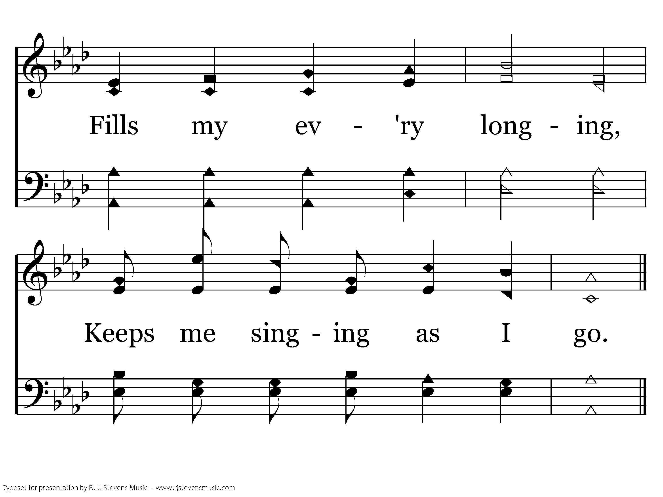
452 - He Keeps Me Singing - C.2
End of Verse 1

Slide 93
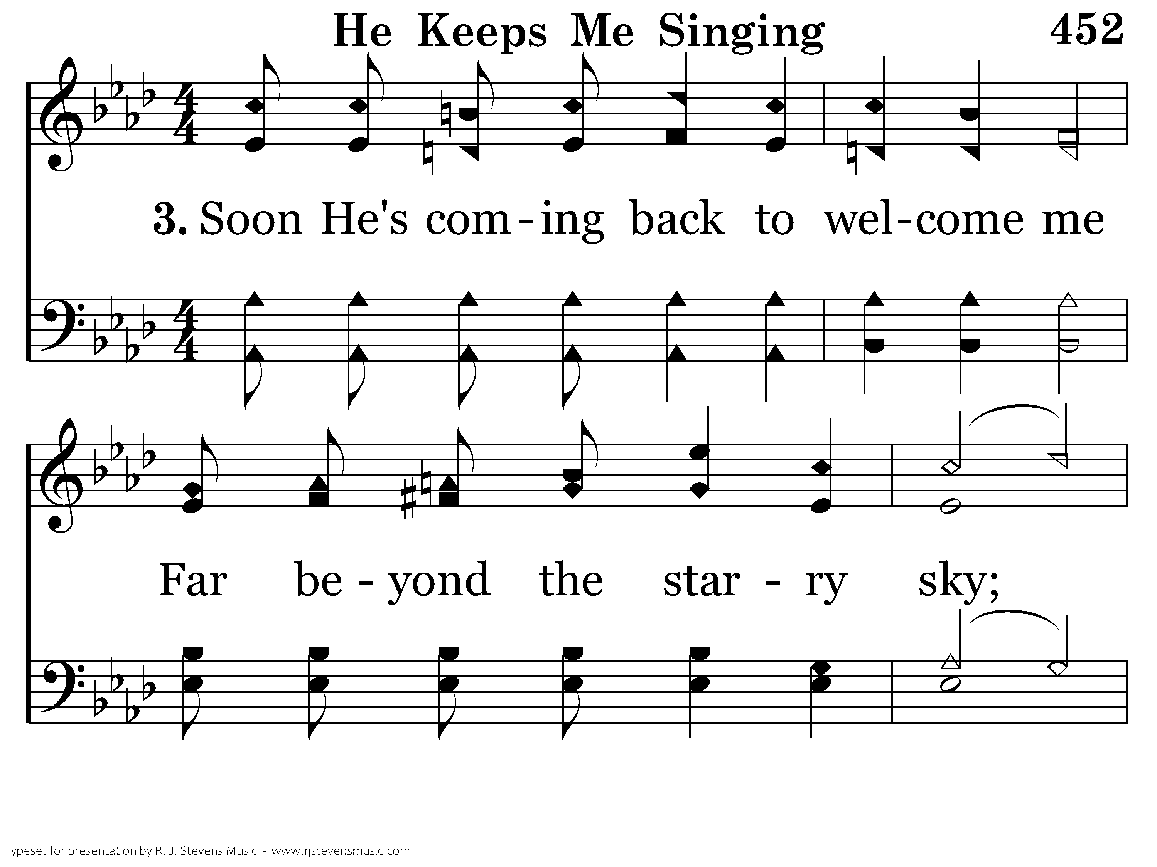
452 - He Keeps Me Singing - 3.1

Slide 94
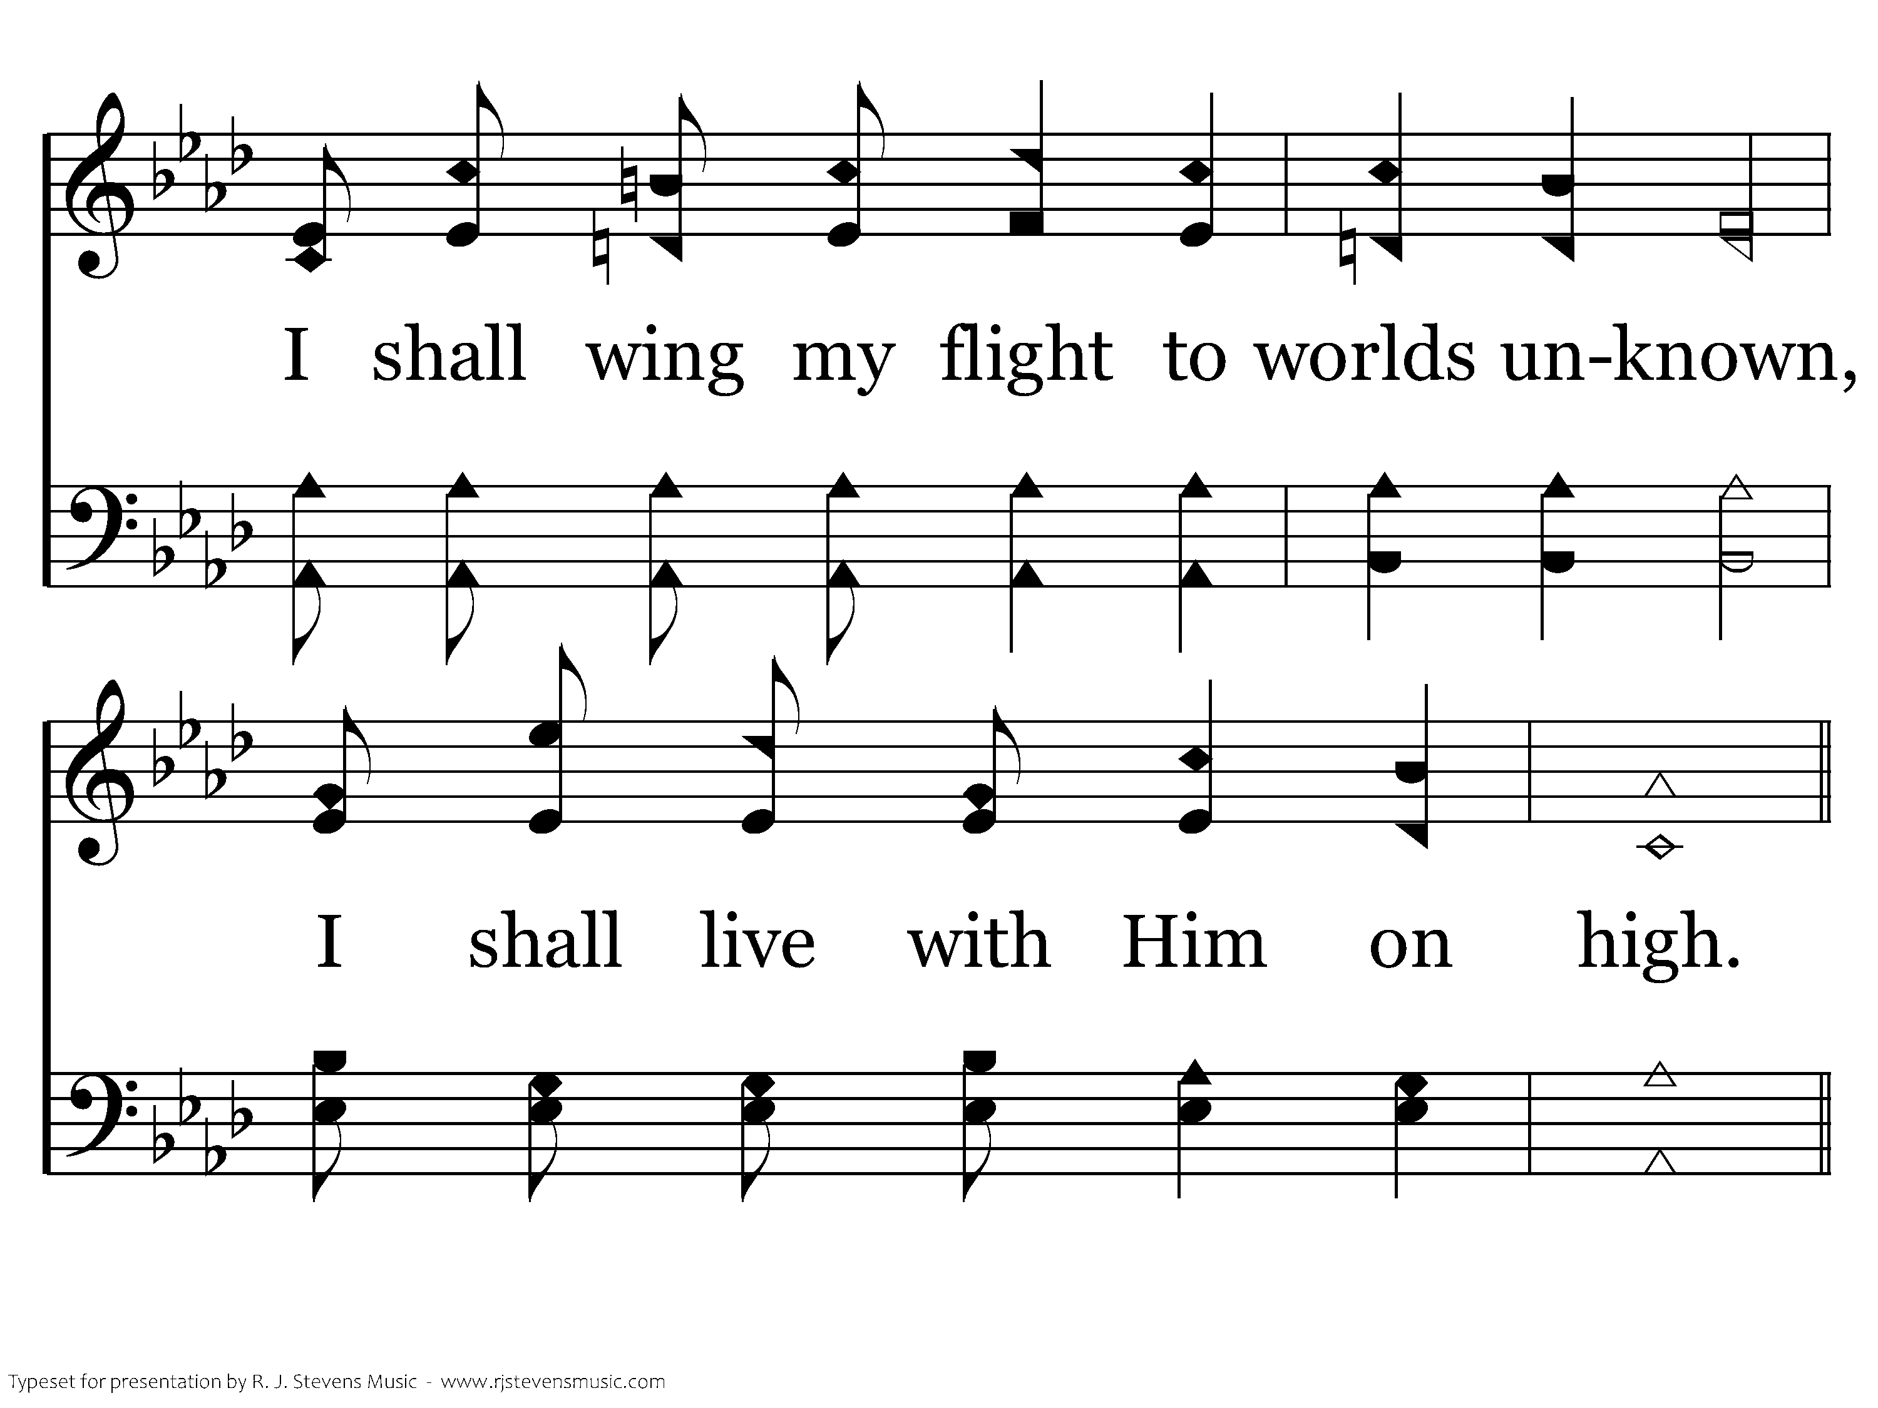
452 - He Keeps Me Singing - 3.2

Slide 95
452 - He Keeps Me Singing - C.1

Slide 96
452 - He Keeps Me Singing - C.2
End of Song

Slide 98
Songs starting on beat one and “Do” (HFWR)
#1 Holy, Holy, Holy (Eb-4)
#17 Sun of my soul (F-3)
#24 For the beauty of the earth (Ab-4)
#41 Fairest Lord Jesus (E-4)
#47 God is so good (Eb-2)
#68 Lord, we come before Thee (G-4)
#144 My faith looks up (Eb-4)
#180 Wonderful story of love (C-2c)
#189 When I Survey (F-2)
#213 Here we are but straying (G-2 or 4)
#214 No tears in heaven (F-4)
#231 Soldiers of Christ arise (G-4)
#272 Jesus, the loving (F-2c)
#412 God is love (D-4)
#480 Dare to stand like Joshua (Bb-4)
#498 Where He leads I’ll follow (E-4)
#502 True-hearted, whole-hearted (F-2c)
#538 Majesty (Bb-2)

Slide 99
Songs starting on beat one and “Do” (HFWS)
#54 Savior and Friend (G-3)
#105 Jesus Is Lord (E-4)
#6 Magnify, O Magnify (G-4)
#48 Thy Word (G-4)
#110 I Will Call Upon the Lord (D-4)
#15 Exalted (G-4)
#64 The Greatest Commands (C-3)
#72 Hilltops of Glory (Db-4)

Slide 100

R.J. Stevens Singing School
July 14-19, 2019
Eastern Oklahoma State College
Song Worship
Song Worship Leading
Sight Singing
Hymn Writing
www.singingschool.net

