Slide 1
download lessons at
www.builtbyhim.com

Slide 2
“Yet the LORD warned Israel and Judah through all His prophets and every seer, saying, ‘Turn from your evil ways and keep My commandments, My statutes according to all the law which I commanded your fathers, and which I sent to you through My servants the prophets.’ However, they did not listen, but stiffened their neck like their fathers, who did not believe in the LORD their God.” (2 Kings 17:13–14, NASB95)

Slide 3
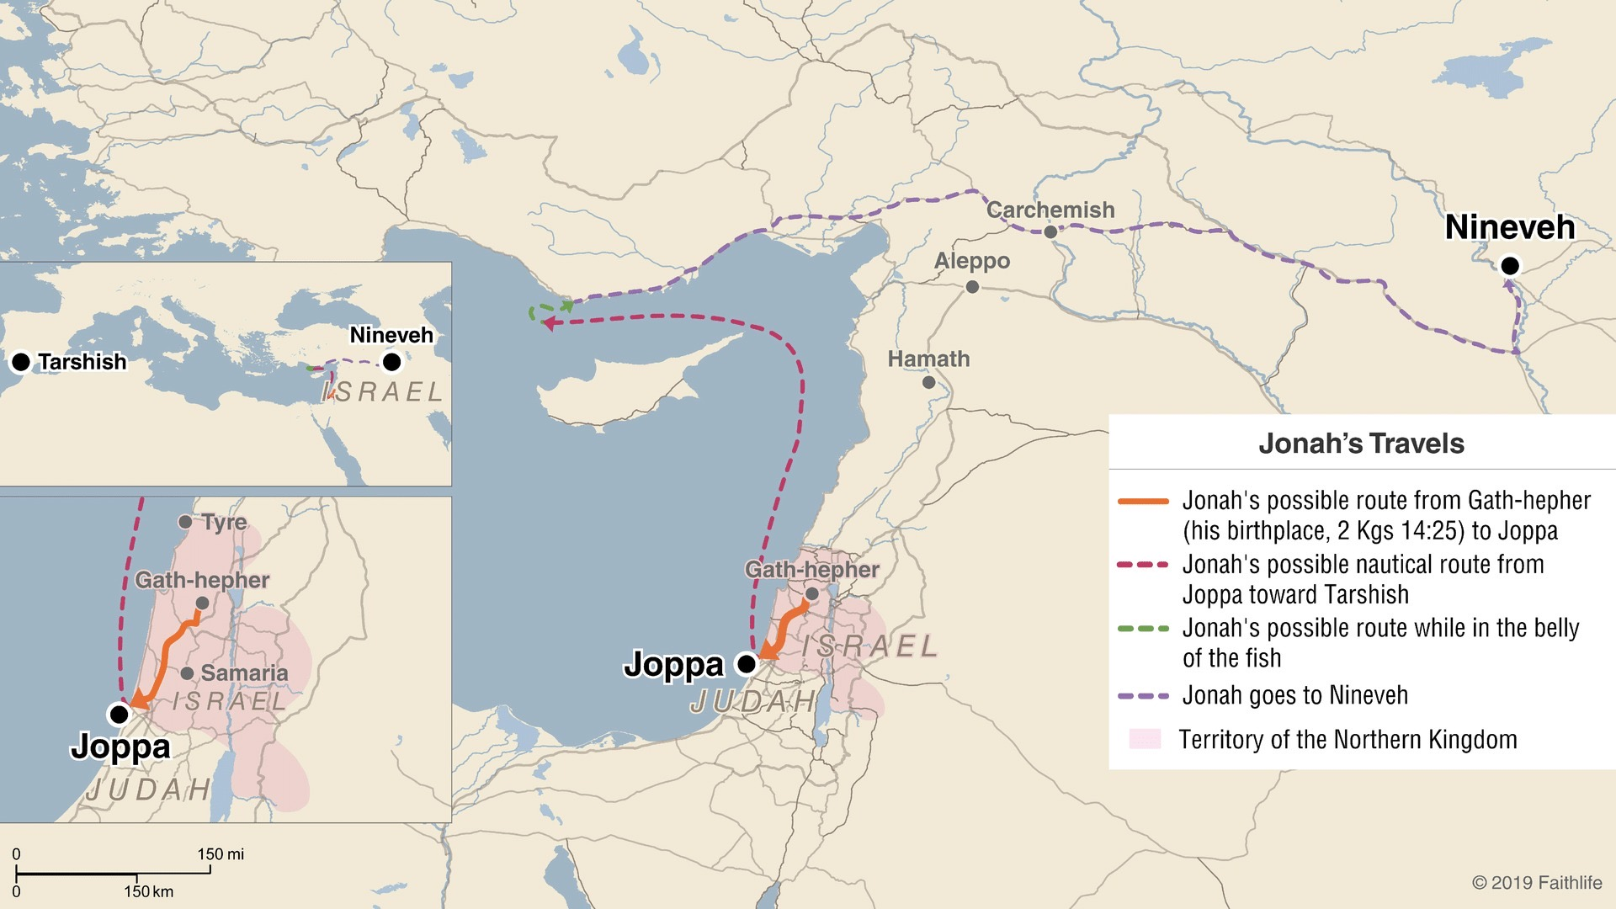
Jonah

Slide 4
The Lord is God of the nations
The Lord is a God who saves the repentant
Jonah

Slide 5
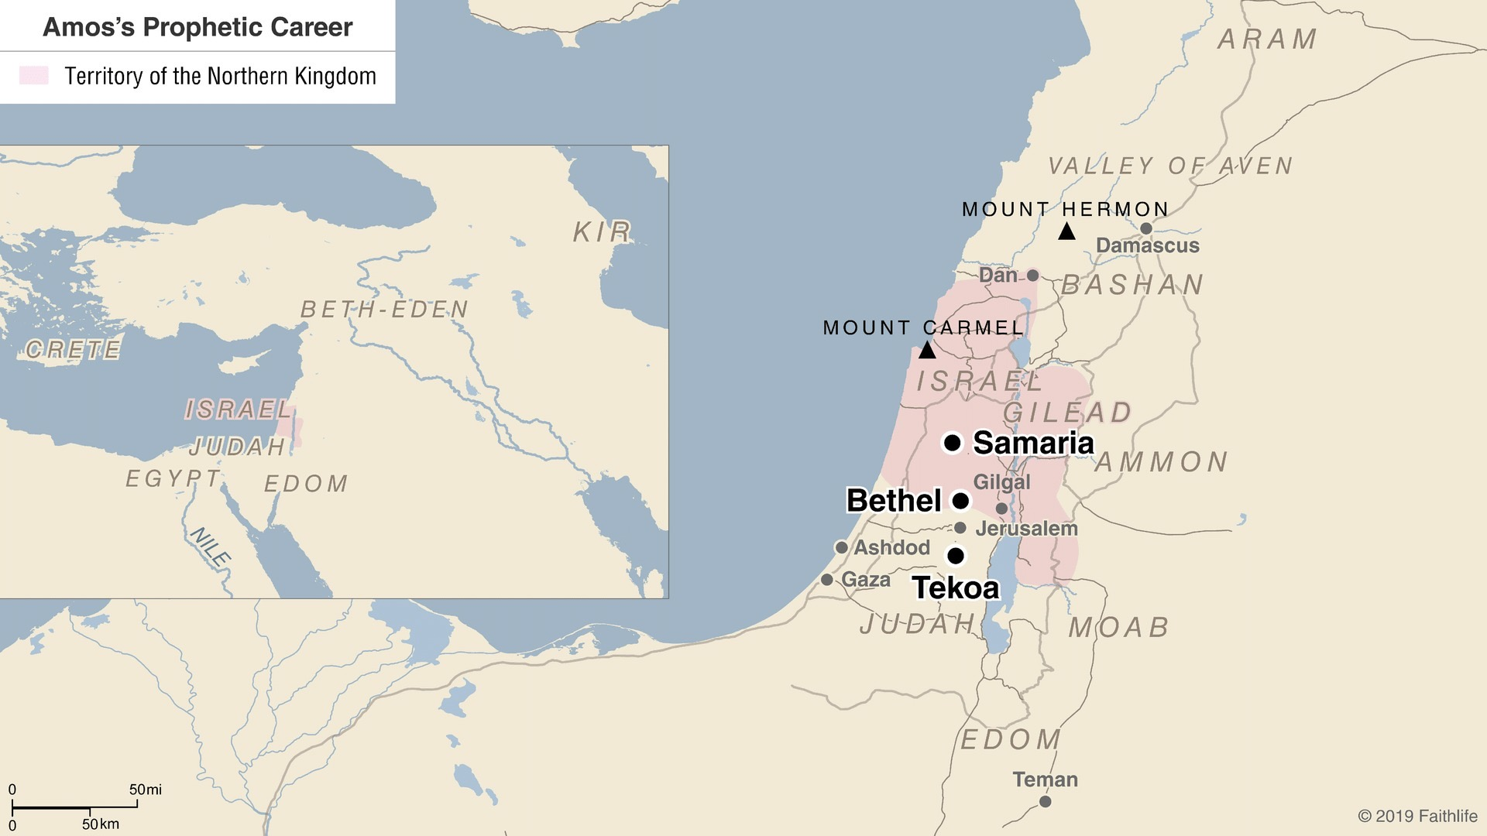
Amos

Slide 6
Do not equate prosperity with being blessed by the Lord
Compassion is of everlasting importance to the Lord
Future hope
Amos

Slide 7
Violation of our covenant is adultery
God’s judgment against the unfaithful is justified
Our God is willing to redeem the unfaithful
Hosea

Slide 8
download lessons at
www.builtbyhim.com

