Slide 1
Love is: Kind
1 Corinthians 13

Slide 2
Am I a loving person?

Slide 3
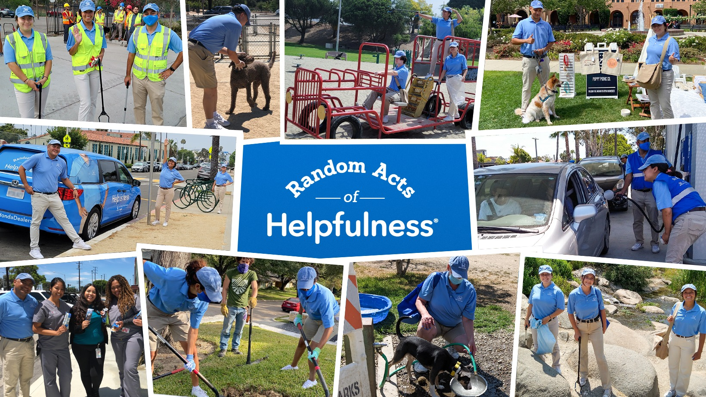
Kind: useful, gentle, pleasant, helpful, nice, kind.
Kindness is not random it’s a constant choice.
Kindness is who we ought to become.

Slide 4
Ephesians 4:32-5:2 NASB95 (p.569)
[32] Be kind to one another, tender-hearted, forgiving each other, just as God in Christ also has forgiven you. [5:1] Therefore be imitators of God, as beloved children; [2] and walk in love, just as Christ also loved you and gave Himself up for us, an offering and a sacrifice to God as a fragrant aroma.

Slide 5
Jesus’ kindness (p.483-484)
Matthew 23:15 NASB95 “Woe to you, scribes and Pharisees, hypocrites, because you travel around on sea and land to make one proselyte; and when he becomes one, you make him twice as much a son of hell as yourselves.
Matthew 23:27 NASB95 “Woe to you, scribes and Pharisees, hypocrites! For you are like whitewashed tombs which on the outside appear beautiful, but inside they are full of dead men’s bones and all uncleanness.

Slide 6
Jesus’ kindness
(p.552) Romans 11:22 NASB95-Behold then the kindness and severity of God; to those who fell, severity, but to you, God’s kindness, if you continue in His kindness; otherwise you also will be cut off.

Slide 7
The Challenge of Kindness
(p.548) Romans 3:10-12 NASB95- as it is written, “THERE IS NONE RIGHTEOUS, NOT EVEN ONE; [11] THERE IS NONE WHO UNDERSTANDS, THERE IS NONE WHO SEEKS FOR GOD; [12] ALL HAVE TURNED ASIDE, TOGETHER THEY HAVE BECOME USELESS; THERE IS NONE WHO DOES GOOD, THERE IS NOT EVEN ONE.”

Slide 8
Kindness in the Bible
(p.503) Luke 6:35 NASB95- But love your enemies, and do good, and lend, expecting nothing in return; and your reward will be great, and you will be sons of the Most High; for He Himself is kind to ungrateful and evil men.

Slide 9
Kindness in the Bible
(p.562) 2 Corinthians 6:3-6 NASB95- giving no cause for offense in anything, so that the ministry will not be discredited, [4] but in everything commending ourselves as servants of God, in much endurance, in afflictions, in hardships, in distresses, [5] in beatings, in imprisonments, in tumults, in labors, in sleeplessness, in hunger, [6] in purity, in knowledge, in patience, in kindness, in the Holy Spirit, in genuine love,

Slide 10
Kindness in the Bible
(p.567) Galatians 5:22 NASB95- But the fruit of the Spirit is love, joy, peace, patience, kindness, goodness, faithfulness,

Slide 11
Kindness in the Bible
(p.569) Ephesians 4:30-32 NASB95- Do not grieve the Holy Spirit of God, by whom you were sealed for the day of redemption. [31] Let all bitterness and wrath and anger and clamor and slander be put away from you, along with all malice. [32] Be kind to one another, tender-hearted, forgiving each other, just as God in Christ also has forgiven you.

Slide 12
Kindness in the Bible
(p.573) Colossians 3:10-12 NASB95- and have put on the new self who is being renewed to a true knowledge according to the image of the One who created him— [11] a renewal in which there is no distinction between Greek and Jew, circumcised and uncircumcised, barbarian, Scythian, slave and freeman, but Christ is all, and in all. [12] So, as those who have been chosen of God, holy and beloved, put on a heart of compassion, kindness, humility, gentleness and patience;

Slide 13
Kindness in the Bible
(p.580) Titus 3:3-4 NASB95-[3] For we also once were foolish ourselves, disobedient, deceived, enslaved to various lusts and pleasures, spending our life in malice and envy, hateful, hating one another. [4] But when the kindness of God our Savior and His love for mankind appeared
Greek word chréstos

Slide 14
Love is: Kind
Benefit of being Kind
Makes us like God (Lk.6:35; Eph. 4:30-5:2)
Shows us as the people of God (2 Cor. 6:3-6)
Proves the Spirit is bearing fruit (Gal. 5:22)
Renews us to Christs’ image (Col.3:10-12)
(p.308) Proverbs 11:17 NASB95- The merciful man does himself good, But the cruel man does himself harm.

Slide 15
Love is: Kind
1 Corinthians 13

