Slide 1
Patience

Slide 2
Patience when angry.
Romans 12:12 Rejoice in hope, be patient in tribulation and be constant in prayer.
Proverbs 14:29 whoever is slow to anger has great understanding, but he who has a hasty temper exalts folly
Ephesians 4:26-27 Be angry and do not sin; do not let the sun go down on your anger and give no opportunity to the devil.
Stay Calm and Rely on God
This Photo by Unknown Author is licensed under CC BY-NC-ND

Slide 3
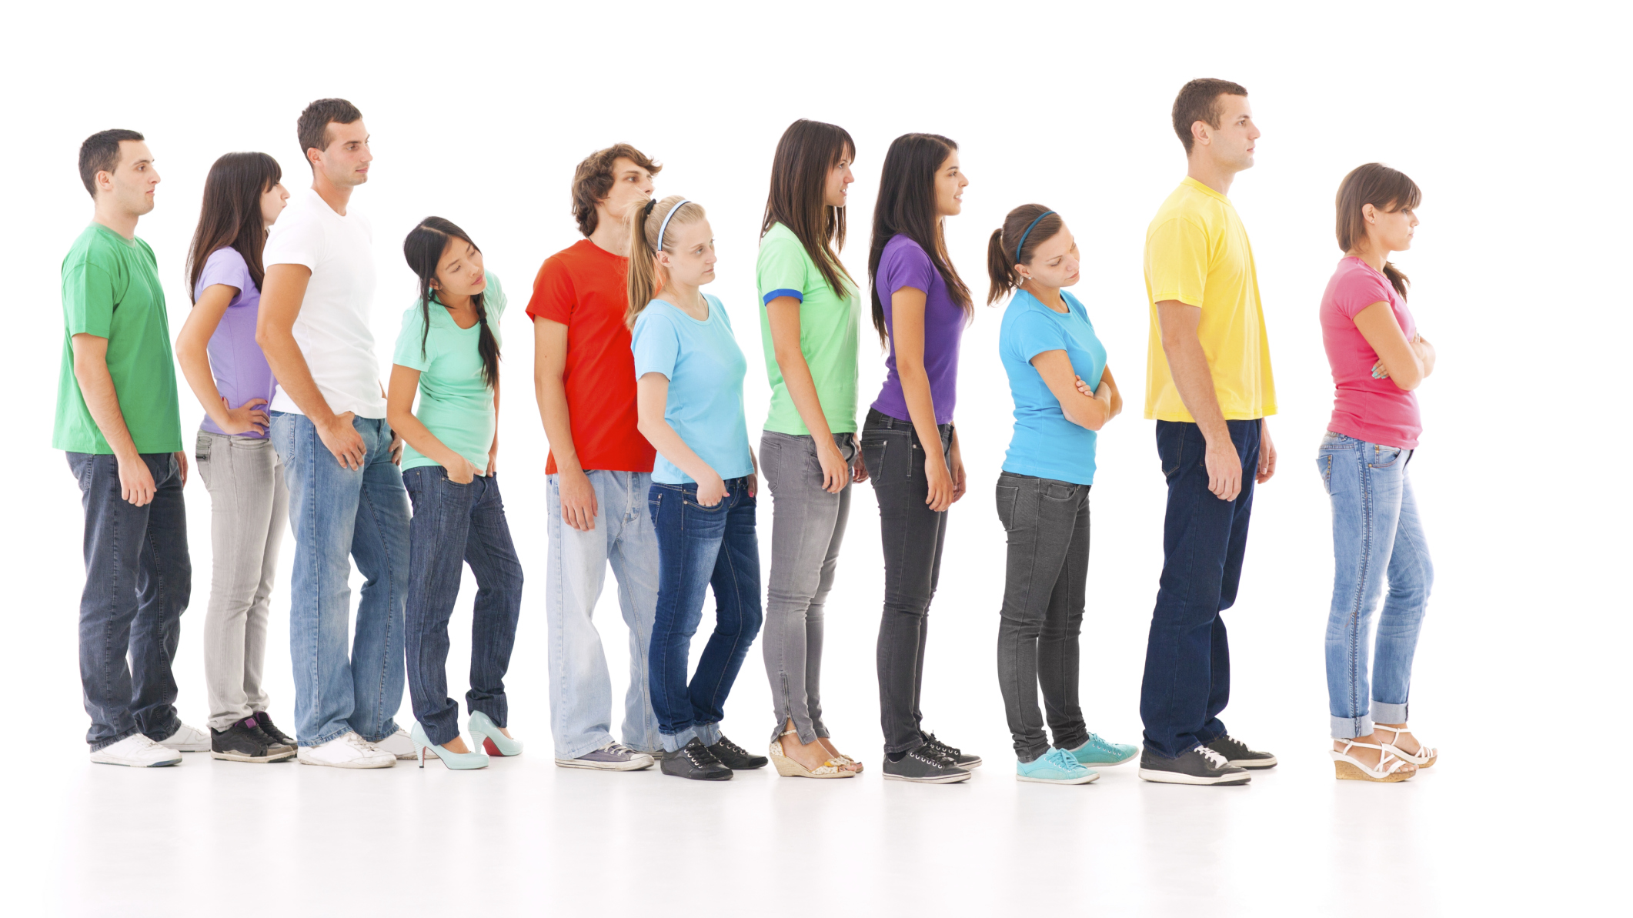
Patience with others
Galatians 5:22-23 But the fruit of the Spirit is love, joy, peace, patience, kindness, goodness, faithfulness, gentleness, and self-control; against such things, there is no law.
Hebrews 12:15 Strive for peace with everyone, and for the holiness without which no one will see the Lord.
1 Corinthians 13:4 Love is patient and kind; love does not envy or boast; it is not arrogant
The Lord is patient with you so do the same to others

Slide 4
Patience with yourself
Hebrews 12:1 Therefore, since we are surrounded by so great a cloud of witnesses, let us also lay aside every weight, and the sin which clings so closely, and let us run with endurance the race that is set before us,
Luke 8:5 As for that in the good soil, they are those who, hearing the word, hold it fast in an honest and good heart, and bear fruit with patience.
James 5:7-8 Be patient, therefore, brothers, until the coming of the Lord. See how the farmer waits for the precious fruit of the earth, being patient about it until it receives the early and the late rains. You also, be patient. Establish your hearts, for the coming of the Lord, is at hand.
Learn to be patient for the Lord is coming

