Slide 1
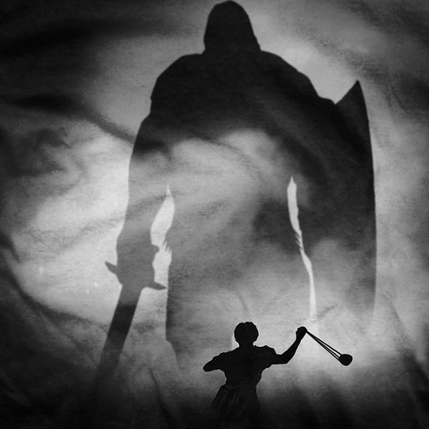
“The Battle Belongs the Lord”
1 Samuel 17
David vs. Goliath

Slide 2
Realizing the Enemy
V. 4-11 - And there came out from the camp of the Philistines a champion named Goliath of Gath…
V. 26 - And David said to the men who stood by him, "What shall be done for the man who kills this Philistine and takes away the reproach from Israel? For who is this uncircumcised Philistine, that he should defy the armies of the living God?"

Slide 3
Facing the Ridicule
V. 31-36 - “…You are not able to go against this Philistine to fight with him, for you are but a youth, and he has been a man of war from his youth...”
V. 39-40 - David strapped his sword over his armor. ….David said to Saul, "I cannot go with these, for I have not tested them." So David put them off. 40 Then he took his staff in his hand and chose five smooth stones from the brook and put them in his shepherd's pouch. His sling was in his hand, and he approached the Philistine.

Slide 4
Facing the Intimidation
V. 43-44 - And the Philistine said to David, "Am I a dog, that you come to me with sticks?“ And the Philistine cursed David by his gods…
V. 45-47 - Then David said to the Philistine, "You come to me with a sword and with a spear and with a javelin, but I come to you in the name of the Lord of hosts, the God of the armies of Israel, whom you have defied….

Slide 5
Engaging the Enemy
V. 48-49 - When the Philistine arose and came and drew near to meet David, David ran quickly toward the battle line to meet the Philistine. 49 And David put his hand in his bag and took out a stone and slung it and struck the Philistine on his forehead. The stone sank into his forehead, and he fell on his face to the ground.

Slide 6
What would you do?

