Slide 1
The Atheist’s Guide to Reality

Slide 2
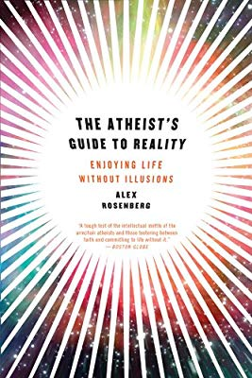
What is real?
“The physical facts fix all the facts.”
MATERIALISM
Notes:
Not just philosophers…

Slide 3
How do we know?
“The methods of science are the only reliable ways to secure knowledge of anything.”
SCIENTISM
Notes:
Not just philosophers…

Slide 4
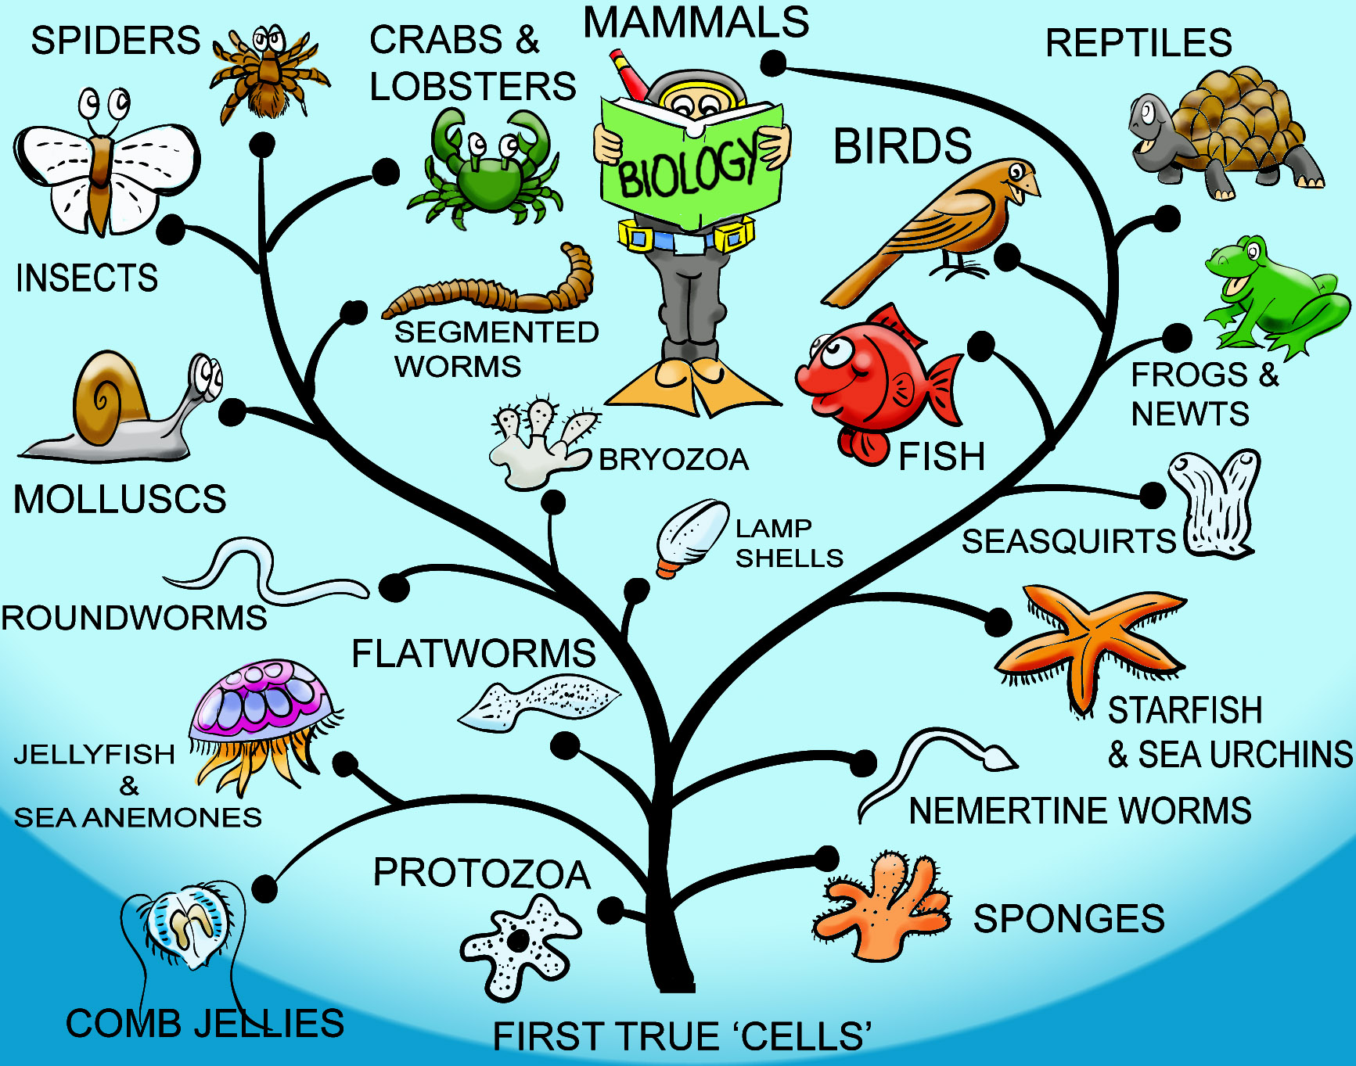
The Argument for Scientism

Slide 5
Right and wrong do not exist.
Notes:
1. Morality doesn’t exist.
If there is no right and wrong, on what basis should people be held accountable for their actions? Atheism says we don’t choose our actions because

Slide 6
Atheism “rejects the distinction between acts that are morally permitted, morally forbidden, and morally required” (p. 97).
Notes:
Not just philosophers…

Slide 7
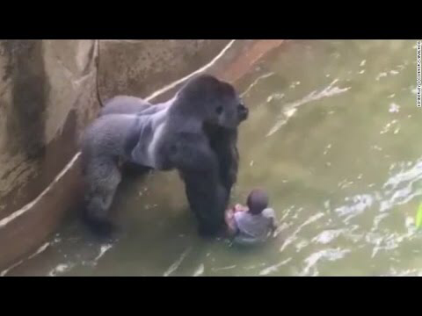
Notes:
Why? Christian point of view - Gen 1:26-27; 9:3, 6-7.

Slide 8
You defend your tribe, and sapiens sapiens we be…The only obligations that would seem to exist are within one's own tribe.

Slide 9
Brotherhood of man is social construct - ahem, much like religion, forgive me - that unites the tribe, the society, and provides for stability and growth. It's a force for good, or can be, should be. But it seems to me that the value of human life, any life, any thing, comes from that social stability and security, the social norm.

Slide 10
To assign value to one life over another - the original question, right? - is relative to each situation and society.

Slide 11
Notes:
But wait - there is no objective morality. You said so yourself - it is a matter of "relativism." So may I ask you, WHY is it wrong to exploit someone else in this ugly way, given what you said previously in the thread about the relativism of morality and the social construct of the brotherhood of man?

Slide 12
Maybe I didn't take enough - ok, any - philosophy classes because I don't see these questions as the same category or topic.

Slide 13
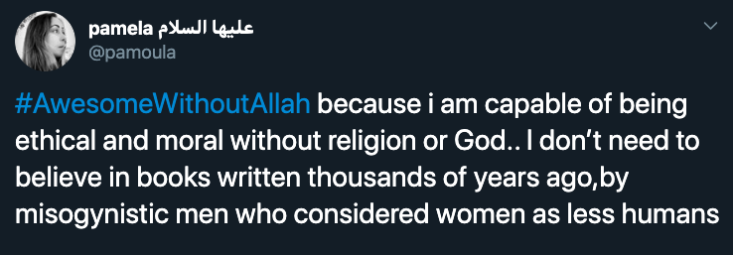

Slide 14
Many atheists live better moral values than professed “Christians”.
The issue is how to explain why some things are right or wrong.
Notes:
1 Cor 5:1
Evolution random selection

Slide 15
Right and wrong do not exist.
Notes:
1. Morality doesn’t exist.
If there is no right and wrong, on what basis should people be held accountable for their actions? Atheism says we don’t choose our actions because

Slide 16
Free will doesn’t exist.
Notes:
2. Free will doesn’t exist.
“Of course free will exists – I’m thinking about something I want to do and then choose to do it.”

Slide 17
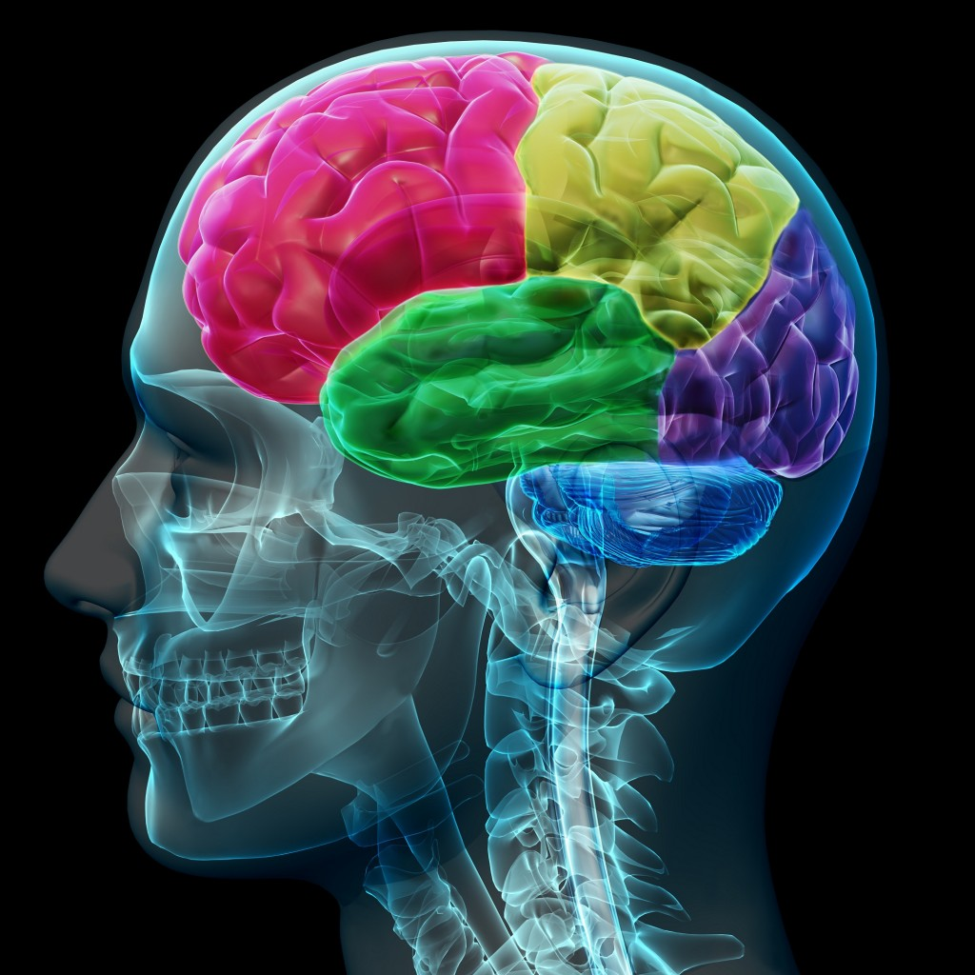
Notes:
Christianity teaches that we are not just our physical bodies – also have a soul that has the power of reasoning, and free will, can choose to act in accord with what we know. Brain and mind – obviously close connection. But different – Rom. 7:22-23.
But if all that exists is matter, then the mind simply IS the brain. Thinking is brain states DETERMINED by the laws of physics.
Throw wadded paper – no choice, laws of phsyics.

Slide 18
“Every state of my brain is fixed by physical facts…
No free will, just the feeling, the illusion of introspection”
(p. 236-237).

Slide 19
Free will doesn’t exist.
Notes:
2. Free will doesn’t exist.
“Of course free will exists – I’m thinking about something I want to do and then choose to do it.”

Slide 20
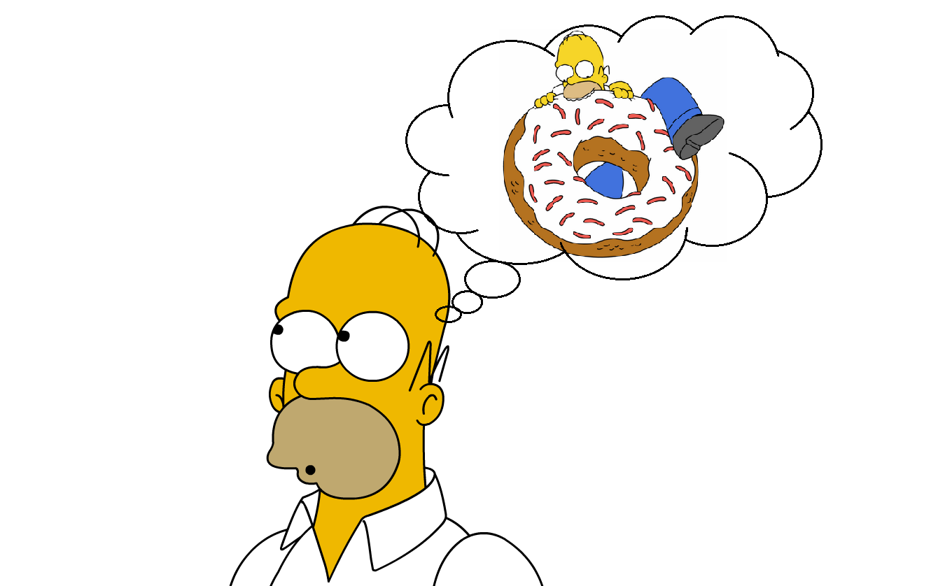
Notes:
Mind = brain = physical stuff so is the donut

Slide 21
“How can one clump of stuff anywhere in the universe be about some other clump of stuff anywhere else in the universe?”
(p. 173-174)​.
Notes:
What’s your book about? Nothing!

Slide 22
Thinking doesn’t exist.
It gets worse.
Notes:
3. Thinking
(next consciousness) Of course I’m thinking – I’m consciously aware that I’m thinking.

Slide 23
Notes:
Mind = brain = physical stuff so is the donut
Donut is not conscious. Neither is Homer.

Slide 24
Consciousness doesn’t exist.
Notes:
#5

Slide 25
“So, when consciousness assures us that we have thoughts about stuff, it has to be wrong.”
(p. 179)​.
Notes:
The things of our conscious experience, color, taste, pain, are just an illusion.

Slide 26
“There is no self, soul, person. Scientism must firmly deny its existence. The self, as conveyed to us by introspection, is a fiction. It doesn’t exist” (p. 223-224).
Notes:
The things of our conscious experience, color, taste, pain, are just an illusion.

Slide 27
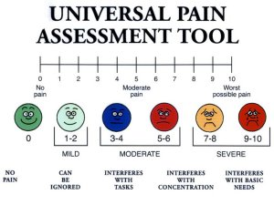
Notes:
There is no conscious self to experience pain.

Slide 28
The absurdity of saying “Nobody has ever felt a pain” is no greater than that of saying “Nobody has ever seen a demon”…It would make it simpler for us if you would…say “My C-fibers are firing” instead of saying “I’m in pain.”

Slide 29
Consciousness doesn’t exist.
Notes:
#5

Slide 30
The Argument for Scientism
“Science must deny the basic notion that we ever really think about the past and the future.”
(p. 165).

Slide 31
Scientism is self-refuting.
Notes:
#5

Slide 32
I am reflecting on whether I should have chosen to cause pain to John Brooks to get the colored crayons.
Notes:
No morality SHOULD

Slide 33
I am reflecting on whether I should have chosen to cause pain to John Brooks to get the colored crayons.
Notes:
No free will

Slide 34
I am reflecting on whether I should have chosen to cause pain to John Brooks to get the colored crayons.
Notes:
No thinking

Slide 35
I am reflecting on whether I should have chosen to cause pain to John Brooks to get the colored crayons.
Notes:
No consciousness sensation of pain

Slide 36
I am reflecting on whether I should have chosen to cause pain to John Brooks to get the colored crayons.
Notes:
No conscious sensation of color

Slide 37
I am reflecting on whether I should have chosen to cause pain to John Brooks to get the colored crayons.
Notes:
All that’s left is colorless crayons.

