Slide 2
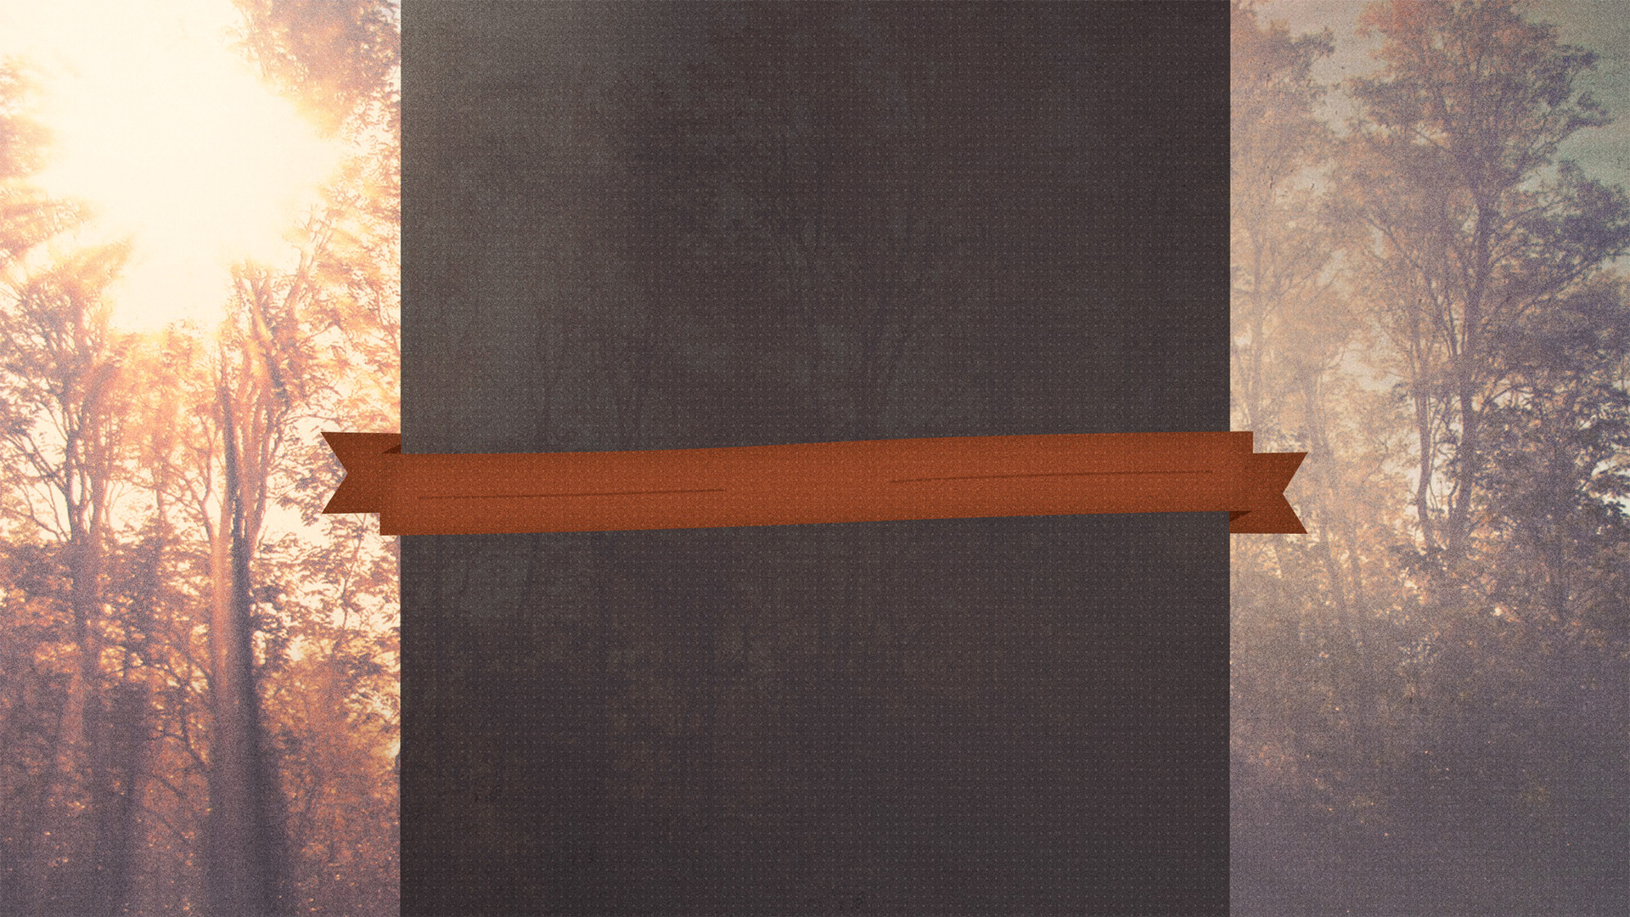
God’s People
Should Be A
Grateful
People

Slide 3
God’s People
Should Be A
Grateful
… because of Who God is
People

Slide 4
God is the Creator
God is the Father
God loves us and shows patience
God sustains us and provides life
God’s People
Should Be A
Grateful
… because of Who God is
People

Slide 5
God’s People
Should Be A
… because of What God has Provided
Grateful
People

Slide 6
Prayer
Family
Love and Patience
Life
God’s People
Should Be A
… because of What God has Provided
Grateful
People

Slide 7
God’s People
Should Be A
… because Ingratitude Leads to Sin
Grateful
People

Slide 8
When we are not grateful…
We focus on what we do not have
Pride manifests
It is easy to forget about God
We cannot serve God
God’s People
Should Be A
… because Ingratitude Leads to Sin
Grateful
People

Slide 9
“Ingratitude is a crime more despicable than revenge, which is only returning evil for evil, while ingratitude returns evil for good.” – William George Jordan
God’s People
Should Be A
… because Ingratitude is Worse than Revenge
Grateful
People

Slide 10
God’s People
Should Be A
Grateful
People

