Slide 1
The evidence of creation is in man himself
Gen 1:26-27 Then God said, "Let us make man in our image, after our likeness. And let them have dominion over the fish of the sea and over the birds of the heavens and over the livestock and over all the earth and over every creeping thing that creeps on the earth." (27) So God created man in his own image...

Slide 2
Naturalism or Theism
2Pe 3:3-4 scoffers will come in the last days with scoffing, … They will say, "Where is the promise of his coming? For ever since the fathers fell asleep, all things are continuing as they were from the beginning of creation."
Col 1:16 For by Him all things were created, both in the heavens and on earth, visible and invisible, whether thrones or dominions or rulers or authorities--all things have been created through Him and for Him
2Co 4:18 …. look not at the things which are seen, but at the things which are not seen: for the things which are seen are temporal; but the things which are not seen are eternal.

Slide 3
The Fundamental Argument
Naturalism demands a natural explanation for everything
If one thing exists that is not continuous with nature, then naturalism is not the whole story.
Man is discontinuous with nature, being made of the dust of the earth but also made in the image of God.
There is no natural explanation for cognition, communication, or consciousness

Slide 4
Man, Himself Is the Best Evidence of a Creator
What is man that you are mindful of him? Psa 8:4
Made of the dust of the earth Gen 2:7
But Created in His image Gen 1:27
Cognition, Communication, Consciousness

Slide 5
COGNITION
Job 38:36 “Who has put wisdom in the mind? Or who has given understanding to the heart?”

Slide 6
Tell Me a Riddle

Slide 7
Cognition
We understand, remember and think. Eph 3:4
Thinking is mental manipulation.
Computers have to be programmed.
Children can't be stopped.
Animals do so on a very limited basis.
God calls only us to reason with Him. Isa 1:18
We are unique in our ability to reason.

Slide 8
Naturalism
Denies thought except as a chemical process.
Just movement of meat between the ears.
Reason is thus meaningless.
C.S. Lewis: If naturalism is true then it leaves us with no reasons to believe that it is true
G. K. Chesterton's writes of the "great and possible peril . . . that the human intellect is free to destroy itself....

Slide 9
You Choose
Naturalism
Reason does not exist except as some kind of deterministic chemical processes.
Theism
We can reason and reason with one another.

Slide 10
Communication
Isa_1:18 “Come now, let us reason together, says the LORD

Slide 11
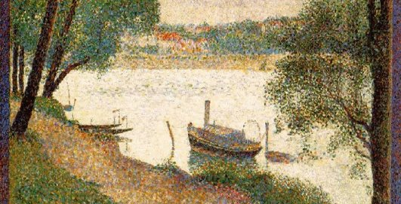
Describe this picture
We can create a common understanding.

Slide 12
Communication
We can share information. Eph 3:4
Computers can exchange information.
But we share understanding. Psa 25:4
We create an idea in common.
Animals share limited information.
But animals can't share understanding.
We can lie. Rev 21:8

Slide 13
Naturalism Has No Explanation
Chomsky: “Human language appears to be a unique phenomenon, without significant analogue in the animal world.
Dawkins: “My clear example is language. Nobody knows how it began..…. I am biased towards thinking it was gradual, but it is not obvious it had to be.
Lieberman: “with speech came a capacity for thought that had never existed before, and that has transformed the world. In the beginning was the word.”
“EX 4:11-12 And the Lord said unto him, Who hath made man's mouth? . . . have not I the Lord? Now therefore go, and I will be with your mouth, and teach you what you shall say"

Slide 14
You Choose
Naturalism
Animal signaling systems are the same as language or developed into language
Theism
In the image of God we can create common understanding between ourselves and with God

Slide 15
Consciousness
1Co 2:11 For who knows a person's thoughts except the spirit of that person, which is in him?

Slide 16
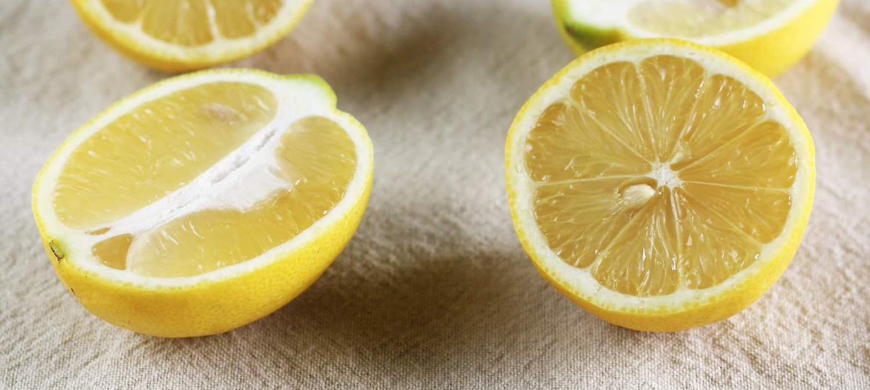
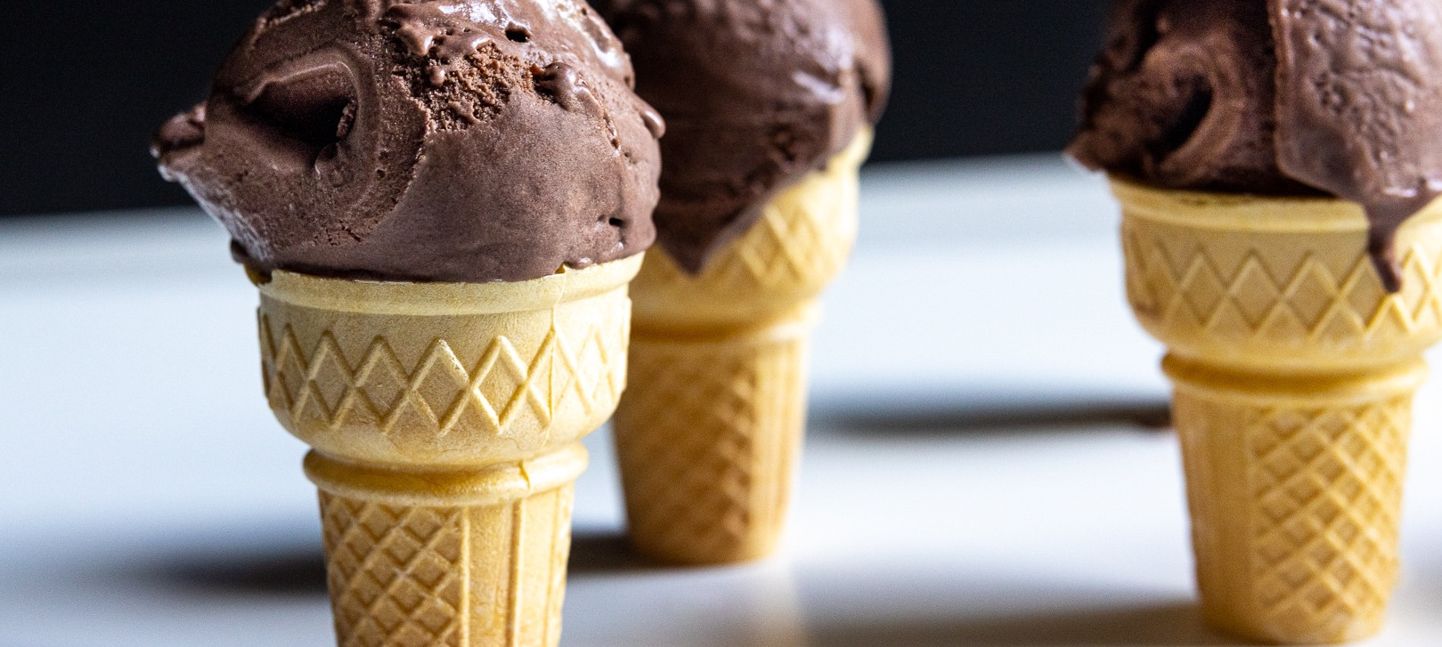
What Does This Taste Like?

Slide 17
What is Blue?

Slide 18
Consciousness
Computers process information.
We process information.
But we know that we are doing so.
We have awareness.
Computers have no awareness and animals very little.
Awareness is inexplicable without a Creator!

Slide 19
Naturalism
The hard problem of consciousness.
David Chalmers: "Materialism is a beautiful and compelling view of the world, but to account for consciousness, we have to go beyond materialism."
Descartes's skepticism: I think therefore I am.
William James: “Consciousness, however small, is an illegitimate birth in any philosophy that starts without it."
Morality is more than reasoning it is an awareness of right and wrong
Indignation at evil!!
Either there is a creator or might makes right.

Slide 20
You Choose
Naturalism
Our awareness of the world and of our own minds is an illusion
Theism
We are sentient, aware, conscious creatures in the image of our God

Slide 21
We Are Created In His Image: We Are His Evidence
We can reason.
We can communicate.
We are conscious that we do so.
Therefore we can choose. Jos 24:15
Therefore we are responsible.
We are the best evidence of a Creator.
Nothing else in nature is similar.

Slide 22
You Choose
Jos 24:15 And if it is evil in your eyes to serve the LORD, choose this day whom you will serve, whether the gods your fathers served in the region beyond the River, or the gods of the Amorites in whose land you dwell. But as for me and my house, we will serve the LORD."

