Slide 2
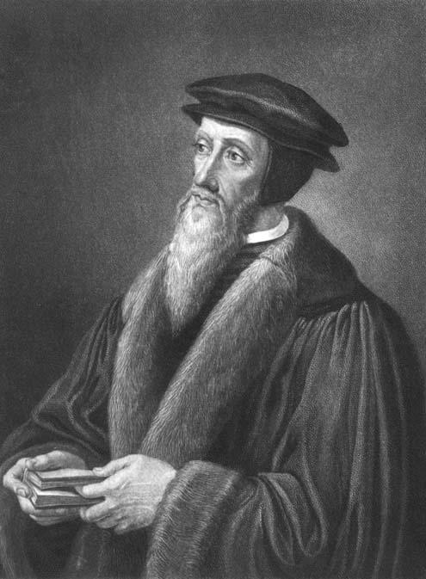
Total depravity
Unconditional election
Limited atonement
Irresistible grace
Preservation of the saints

Slide 3
Total depravity
Unconditional election
Limited atonement
Irresistible grace
Preservation of the saints

Slide 4
certainty?

Slide 5
¹³ Brethren, I do not regard myself as having laid hold of it yet; but one thing I do: forgetting what lies behind and reaching forward to what lies ahead, ¹⁴ I press on toward the goal for the prize of the upward call of God in Christ Jesus.
Philippians 3.13-14
certainty?

Slide 6
⁷ I have fought the good fight, I have finished the course, I have kept the faith; ⁸ in the future there is laid up for me the crown of righteousness, which the Lord, the righteous Judge, will award to me on that day; and not only to me, but also to all who have loved His appearing.
2Timothy 4.7-8
certainty?

Slide 7
because God is on our side (2Peter 1.4)
certainty

Slide 8
Matthew 25:34 “Then the King will say to those on His right, ‘Come, you who are blessed of My Father, inherit the kingdom prepared for you from the foundation of the world.
Matthew 25:41 “Then He will also say to those on His left, ‘Depart from Me, accursed ones, into the eternal fire which has been prepared for the devil and his angels;
certainty

Slide 9
Matthew 25:34 “Then the King will say to those on His right, ‘Come, you who are blessed of My Father, inherit the kingdom prepared for you from the foundation of the world.
Matthew 25:41 “Then He will also say to those on His left, ‘Depart from Me, accursed ones, into the eternal fire which has been prepared for the devil and his angels;
certainty

Slide 10
because God is on our side (2Peter 1.4)
note: our assurance is active, not passive (2Peter 1.8-9)
because we are becoming like Him (2Peter 1.10-11)
certainty

