Slide 2
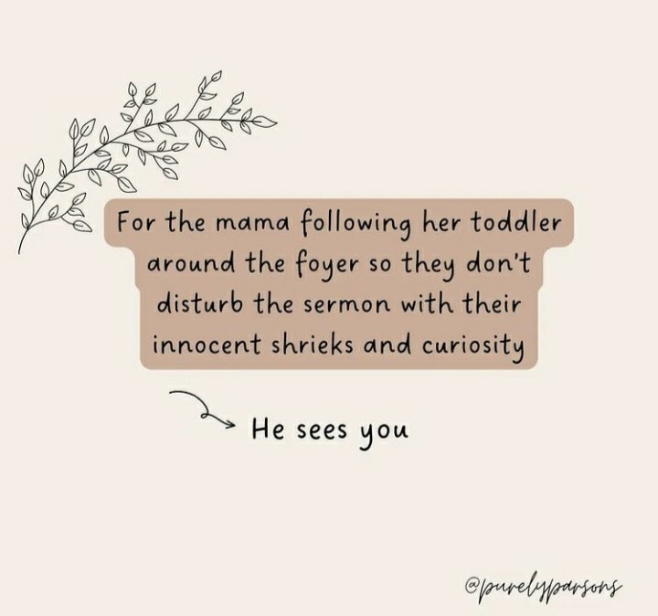

Slide 4
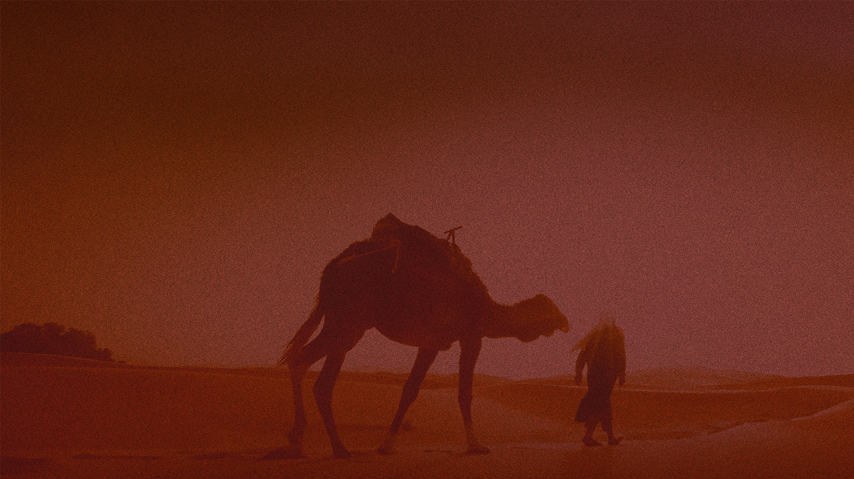
Certainty
for parents
Genesis 28.1-5

Slide 5
Certainty
for children
Genesis 28.10-22

Slide 7
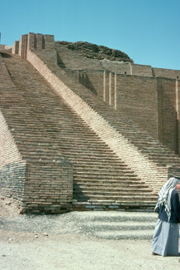

Slide 8
Certainty
for children
Genesis 28.10-22

Slide 9
“Truly, truly, I say to you, you will see the heavens opened and the angels of God ascending and descending on the Son of Man.”
John 1:51, NASB95

