Slide 1

Bear One Another’s Burdens
Galatians 6:1-2

Slide 2

Galatians 5:25-6:1 NASB95- If we live by the Spirit, let us also walk by the Spirit. [26] Let us not become boastful, challenging one another, envying one another. [1] Brethren, even if anyone is caught in any trespass, you who are spiritual, restore such a one in a spirit of gentleness; each one looking to yourself, so that you too will not be tempted.
John 13:34-35 AMP- [34] I am giving you a new commandment, that you love one another. Just as I have loved you, so you too are to love one another. [35] By this everyone will know that you are My disciples, if you have love and unselfish concern for one another.”
Bear One Another’s Burdens

Slide 3
1 John 3:11,14, 16-17 NASB95- [11] For this is the message which you have heard from the beginning, that we should love one another;[14] We know that we have passed out of death into life, because we love the brethren. He who does not love abides in death…[16] We know love by this, that He laid down His life for us; and we ought to lay down our lives for the brethren. [17] But whoever has the world’s goods, and sees his brother in need and closes his heart against him, how does the love of God abide in him? [18] Little children, let us not love with word or with tongue, but in deed and truth.
Bear One Another’s Burdens

Slide 4
1 John 3:23 NASB95- This is His commandment, that we believe in the name of His Son Jesus Christ, and love one another, just as He commanded us.
1 John 4:7-8,11-12 NASB95- Beloved, let us love one another, for love is from God; and everyone who loves is born of God and knows God. [8] The one who does not love does not know God, for God is love. [11] Beloved, if God so loved us, we also ought to love one another. [12] No one has seen God at any time; if we love one another, God abides in us, and His love is perfected in us.
Bear One Another’s Burdens

Slide 5
1 John 5:1 NASB95- Whoever believes that Jesus is the Christ is born of God, and whoever loves the Father loves the child born of Him.
1 Peter 1:22-23 NASB95- Since you have in obedience to the truth purified your souls for a sincere love of the brethren, fervently love one another from the heart, [23] for you have been born again not of seed which is perishable but imperishable, that is, through the living and enduring word of God.
Loving God’s people isn’t what you do it’s who you are!
Is there anything uniquely special about the way you love Christians?
Bear One Another’s Burdens

Slide 6
Galatians 5:13-15 NASB95- For you were called to freedom, brethren; only do not turn your freedom into an opportunity for the flesh, but through love serve one another. [14] For the whole Law is fulfilled in one word, in the statement, “YOU SHALL LOVE YOUR NEIGHBOR AS YOURSELF.”
Galatians 6:2 NASB95-[2] Bear one another’s burdens, and thereby fulfill the law of Christ.
Bear One Another’s Burdens

Slide 7
Matthew 5:17-18 NASB95- “Do not think that I came to abolish the Law or the Prophets; I did not come to abolish but to fulfill. [18] For truly I say to you, until heaven and earth pass away, not the smallest letter or stroke shall pass from the Law until all is accomplished.
Matthew 22:36-40 NASB95- “Teacher, which is the great commandment in the Law?” [37] And He said to him, “‘YOU SHALL LOVE THE LORD YOUR GOD WITH ALL YOUR HEART, AND WITH ALL YOUR SOUL, AND WITH ALL YOUR MIND.’ [38] This is the great and foremost commandment. [39] The second is like it, ‘YOU SHALL LOVE YOUR NEIGHBOR AS YOURSELF.’ [40] On these two commandments depend the whole Law and the Prophets.”
Bear One Another’s Burdens

Slide 8
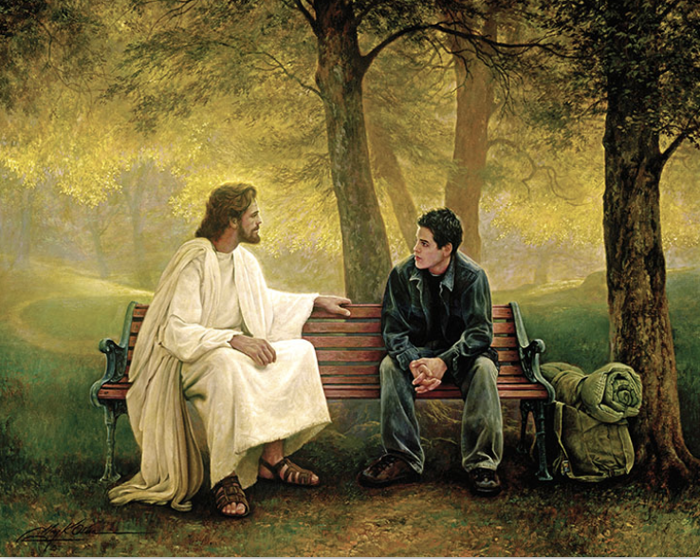
“Wow…that’s crazy. I hear you brother.”

Slide 9
When did Jesus accomplish the law?
John 19:30 NASB95- Therefore when Jesus had received the sour wine, He said, “It is finished!” And He bowed His head and gave up His spirit.
1 John 3:16 NASB95- We know love by this, that He laid down His life for us; and we ought to lay down our lives for the brethren.
1 John 3:17-18 NASB95- But whoever has the world’s goods, and sees his brother in need and closes his heart against him, how does the love of God abide in him? [18] Little children, let us not love with word or with tongue, but in deed and truth.
Bear One Another’s Burdens

Slide 10
Galatians 6:9-10 NASB95- Let us not lose heart in doing good, for in due time we will reap if we do not grow weary. [10] So then, while we have opportunity, let us do good to all people, and especially to those who are of the household of the faith.
Galatians 6:1-2 NASB- Brethren, even if anyone is caught in any trespass, you who are spiritual, restore such a one in a spirit of gentleness; each one looking to yourself, so that you too will not be tempted. [2] Bear one another’s burdens, and thereby fulfill the law of Christ.
Bear One Another’s Burdens

Slide 11
Bear One Another’s Burdens
Galatians 6:1-2

