Slide 2
Saved by
John 3.16

Slide 3
Saved by
Alone?
John 3.16

Slide 4
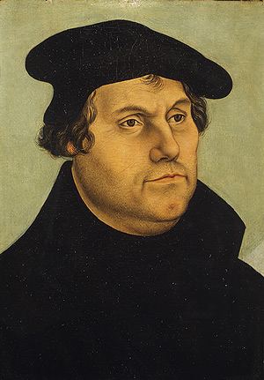
“For we maintain that a man is justified by faith alone apart from works of the Law” (Translation of Romans 3.28)
“St. James is an epistle full of straw, because it contains nothing evangelical.” (Preface to New Testament 1522)

Slide 5
John 3.1-2

Slide 6
John 3.3-17

Slide 7
John 3.18-21

Slide 8
“Faith is a living restless thing. It cannot be inoperative. We are not saved by works; but if there be no works, there must be something amiss with faith.”
"Of Baptism they teach that it is necessary to salvation, and that by Baptism the grace of God is offered..." (Augsburg Confession, 1530)

Slide 9
Saved by
John 3.16

Slide 11
Confess
Repent
Hear
Faith
Baptism
Any Command

Slide 12
Saved by
John 3.16

