Slide 2
God is in Sight

Slide 3
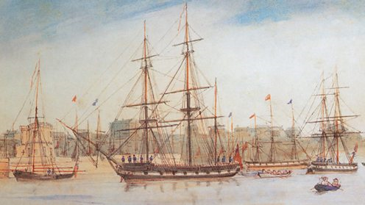
http://www.bbc.co.uk/timelines/zq8gcdm

Slide 4
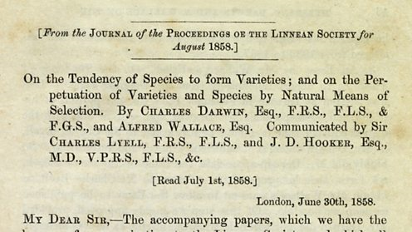
http://www.bbc.co.uk/timelines/zq8gcdm

Slide 5
Darwin’s Key Idea
Populations change over time due to natural selection.

Slide 6
http://thegalapagosguide.net/wp-content/uploads/2014/08/galapagos-islands-ecuador-lg.jpg

Slide 7
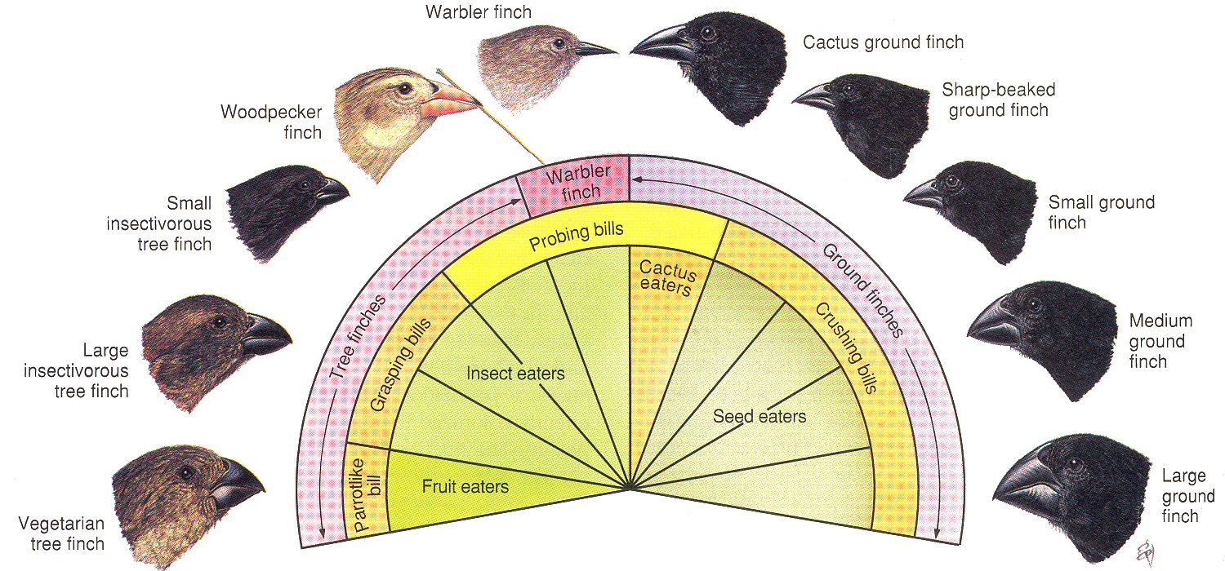

Slide 8
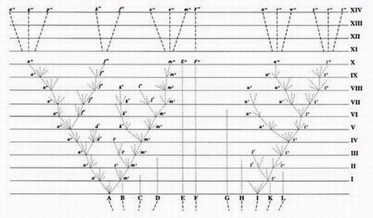

Slide 9
"To suppose that the eye with all its inimitable contrivances for adjusting the focus to different distances, for admitting different amounts of light, and for the correction of Spherical and chromatic aberration, could have been formed by natural selection, seems, I freely confess, absurd in the highest degree.”
(Charles Darwin)

Slide 10
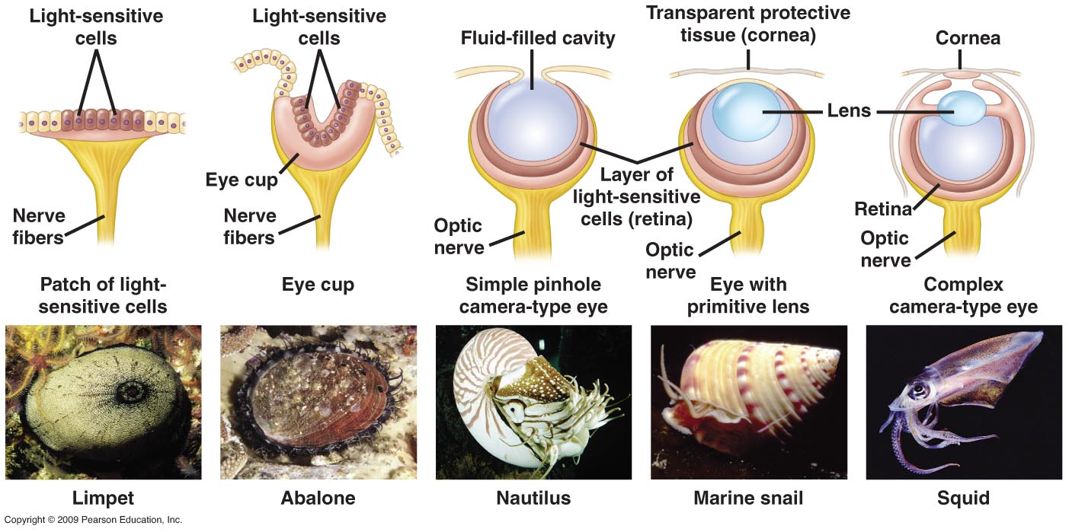

Slide 11
Sensing Light
To have an advantage, an organism must:
Sense light and/or dark
Communicate that information to itself
Integrate the information with other information from environment
React to the communication
Maintain this system

Slide 12
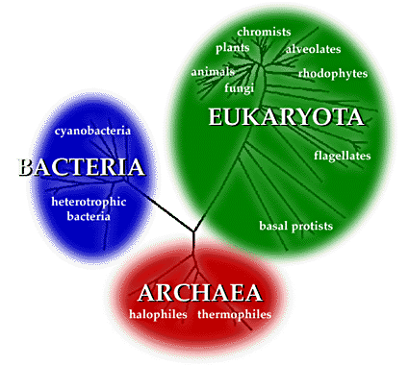

Slide 13
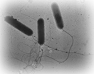
Halobacteria

Slide 14
Bacteria Tumbling
Absence of stimulus from environment
Presence of stimulus from environment

Slide 15
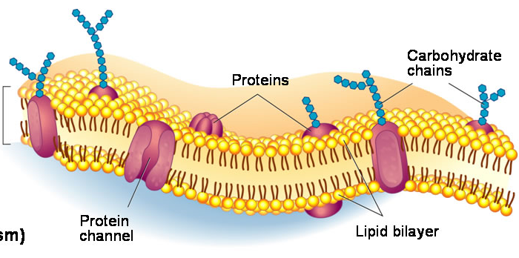

Slide 16
Retinal

Slide 17
Sensory Rhodopsin II (SRII)

Slide 18
SRII Photocycle
chizhov et al. Biophys. J. 75, 999 (1998)

Slide 19
Htr protein
Sensory Rhodopsin II (SRII)

Slide 20
SRII - HtrII
Gordeliy, et. al.

Slide 21
SRII - HtrII
Gordeliy, et. al.

Slide 22
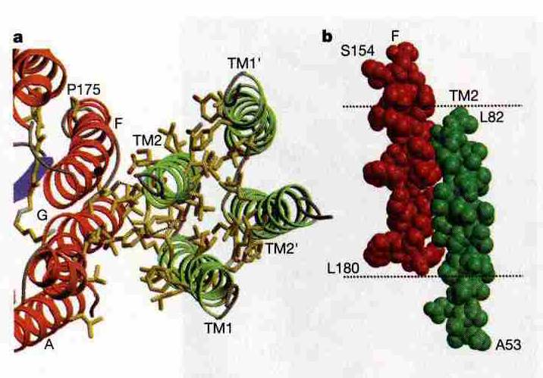
SRII - HtrII
Gordeliy, et. al.

Slide 23
Harmful light
Light sensitivity in Halobacteria
Htr
SRII
Cell Membrane
CheW
ATP
ADP
CheR
CheA
CheA-P
CheB-P
CheB
CheY
CheY-P
CheZ?
Flagellar Motor Switch
Change in tumbling motion of the cell
(Adapted from The Physiology and Biochemistry of Prokaryotes, David White, 2000.)

Slide 24
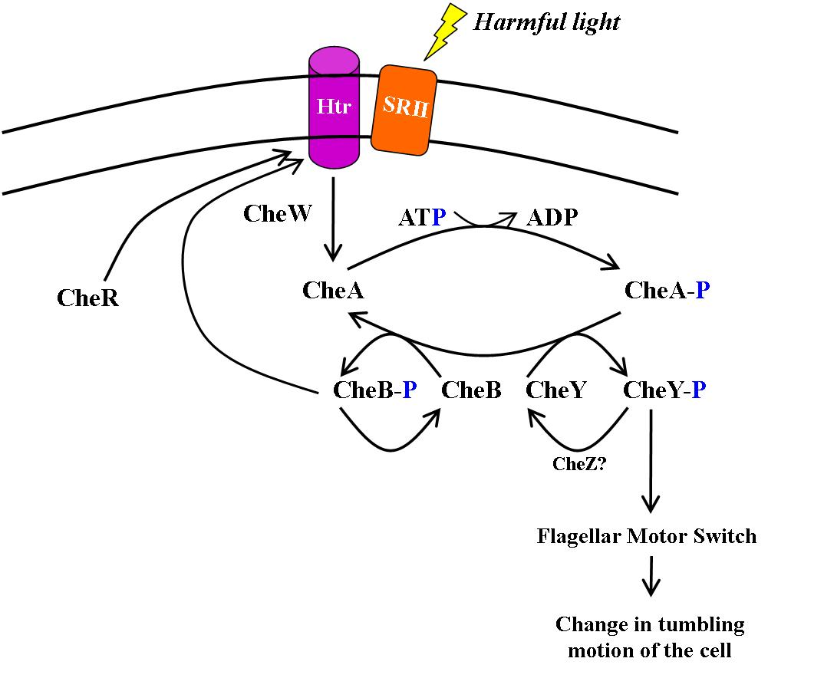
In Addition…
Reset the system
Integrate all signals
Proteins must target correct molecules
Proteins must be in right location
All proteins must be present

Slide 25
So we hear, “Some simple cells developed light sensitive spots on the membrane that could detect the presence of light…”

Slide 28
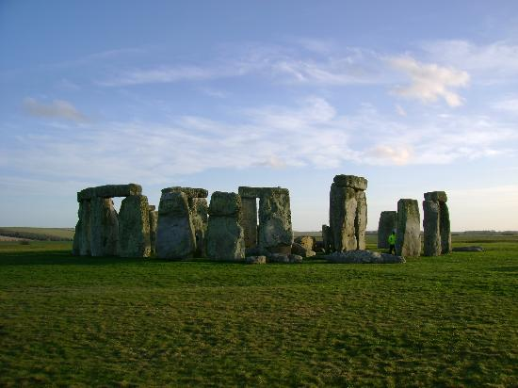

Slide 29
“Yet design theorists do not infer design just because natural processes cannot explain the origin of biological systems, but because these systems manifest the distinctive hallmarks of intelligently designed systems – that is, they possess features that in any other realm of experience would trigger the recognition of an intelligent cause.”
(Signs of Intelligence, Dembski and Kushiner, pg. 116)

Slide 30
God is in Sight. Why not see Him?
“Even if there were no actual evidence in favor of the Darwinian theory… we should still be justified in preferring it over all rival theories.”
(The Blind Watchmaker, pg. 287)

Slide 31
We take the side of science in spite of the patent absurdity of some of its constructs, in spite of its failure to fulfill many of its extravagant promises of health and life, in spite of the tolerance of the scientific community for unsubstantiated just-so stories, because we have a prior commitment, a commitment to materialism.
-Richard Lewontin, The New York Review of Books, Jan. 9, 1997. A review of The Demon-Haunted World: Science as a Candle in the Dark

Slide 32
It is not that the methods and institutions of science somehow compel us to accept a material explanation of the phenomenal world, but, on the contrary, that we are forced by our a priori adherence to material causes to create an apparatus of investigation and a set of concepts that produce material explanations, no matter how counterintuitive, no matter how mystifying to the uninitiated.
-Richard Lewontin, The New York Review of Books, Jan. 9, 1997. A review of The Demon-Haunted World: Science as a Candle in the Dark

Slide 33
Moreover, that materialism is absolute, for we cannot allow a Divine Foot in the door. The eminent Kant scholar Lewis Beck used to say that anyone who could believe in God could believe in anything. To appeal to an omnipotent deity is to allow that at any moment the regularities of nature may be ruptured, that miracles may happen.
-Richard Lewontin, The New York Review of Books, Jan. 9, 1997. A review of The Demon-Haunted World: Science as a Candle in the Dark

Slide 34
God is in Sight. Why not see Him?
Luke 12:54-56
John 8:31-32; 43-45

Slide 35
By faith we understand that the worlds were framed by the word of God, so that the things which are seen were not made of things which are visible.
-Heb. 11:3

