Slide 2
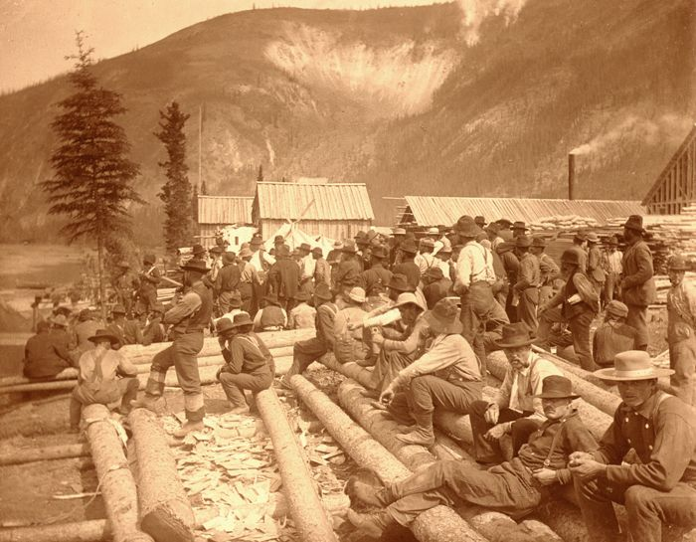
“Neither law nor order prevailed, honest persons had no protection from the gangs of rascals who plied their nefarious trade.
Might was right.”
Lt. Col. Samuel Steele

Slide 4
• God’s Authoritative Expectations in the OT and NT
• The Catastrophic Consequences of Lawlessness
• The Nature of God’s Written Revelation to Mankind
• Heavenly Authority and Everyday Life
• When It’s Time to Make a Judgment Call
• When God Hasn’t Said Anything About It
• Traveling the Ancient Paths in a Postmodern Age
along with other topics…

Slide 5
In the most basic of terms, how would you describe authority?

Slide 6
Authority:
“the power or right to determine, control, command, judge, or prohibit the action of others; dominion; jurisdiction.”

Slide 7
Why does it matter?
What happens when standards of authority are disregarded?

Slide 8
So why, then, do we find and encounter throughout history a disrespect for authority?

Slide 9
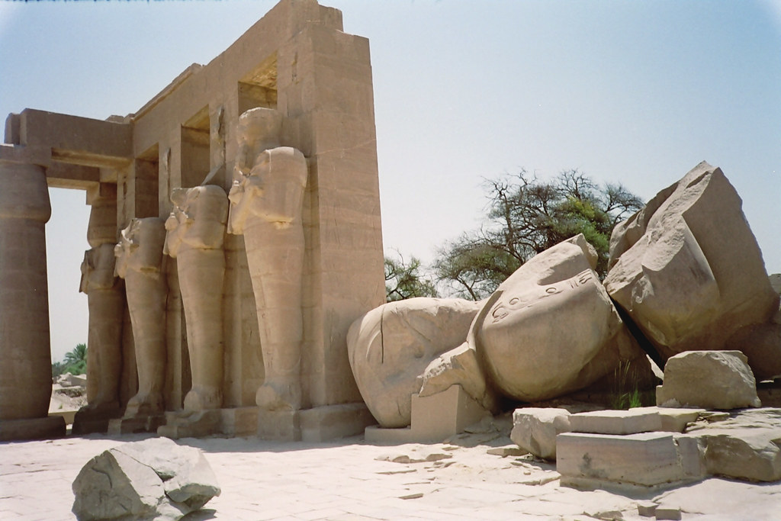
"My name is Ozymandias, King of Kings;
Look on my Works, ye Mighty, and despair!"

Slide 10
What is sovereignty and what does it have to do with authority?

Slide 11
⁵ “I am the Lord, and there is no other;
Besides Me there is no God.
I will gird you, though you have not known Me;
⁶ That men may know from the rising to the setting of the sun
That there is no one besides Me.
I am the Lord, and there is no other,
⁷ The One forming light and creating darkness,
Causing well-being and creating calamity;
I am the Lord who does all these.
Isaiah 45.5-7

Slide 12
So, why is the doctrine of the sovereignty of God not eagerly embraced by the world today, or even by many professing Christians?

Slide 13
“The kings of the earth take their stand, and the rulers conspire together against the Lord and against His Anointed, saying, ‘Let’s tear their shackles apart, and throw their ropes away from us!’”
Psalm 2.2-3

Slide 14
The basic reason why women and men don’t like the doctrine of God’s sovereignty is that they do not want a sovereign God. They wish to be autonomous.
James Montgomery Boice

Slide 15
What exactly is the nature of sovereignty?
What does it mean to say that God is sovereign?

Slide 16
Sovereignty is not a property of the divine nature, but a prerogative arising out of the perfections of a Supreme Being.
Charles Hodge

Slide 17
When God describes Himself as “the LORD,” what is He communicating?

Slide 18
The sovereignty of God can be summed up as absolute Lordship.
Divine sovereignty means that God is the absolute and sole Ruler in the universe.
Sovereignty is lordship.
Lordship is ownership.
Ownership is control.

Slide 19
God’s lordship is absolute in the sense that it is eternal. (Jer 10.10; 1 Tim 1.17; Psm 145.13)
It is absolute, because it is universal. Nothing is outside the scope of His sovereign rule. (Isaiah 54.5; Psm 97.9; Eph 1.21-22)

Slide 20
¹¹ Yours, O Lord, is the greatness and the power and the glory and the victory and the majesty, indeed everything that is in the heavens and the earth; Yours is the dominion, O Lord, and You exalt Yourself as head over all. ¹² Both riches and honor come from You, and You rule over all, and in Your hand is power and might; and it lies in Your hand to make great and to strengthen everyone. ¹³ Now therefore, our God, we thank You, and praise Your glorious name.
1 Chronicles 29.11-13

Slide 21
What ground or basis does God have for His extravagant claim to sovereignty?

Slide 22
The fact that He has created all things from nothing. The fact of creation is the ground of divine sovereignty. (1 Cor. 11.12; Psm 24.1-2)
True sovereignty rests not just upon sheer power, but also on the right to rule.
He must not only have the power to rule, but the authority to rule.

Slide 23
He who has the power to do whatever he will, can do whatever he will; and that is the definition of a sovereign and absolute will.
William Sherlock

Slide 24
All authority resides ultimately in Him.
He may delegate a measure of authority to some of His creatures if He chooses (parents, elders, civil rulers), but such authority is not absolute.
It is relative and derived.

Slide 25
God’s Immanence
To say that God is transcendent does NOT mean that He is outside of the universe. It simply means He is qualitatively different from it.
To say that He is immanent means He is present within the world; present to every part of creation.
He is close to His creatures. He maintains an intimate relationship with them.
God is near, and not far off.

Slide 26
²⁷ that they would seek God, if perhaps they might grope for Him and find Him, though He is not far from each one of us; ²⁸ for in Him we live and move and exist, as even some of your own poets have said, ‘For we also are His children.’
Acts 17.27-28

Slide 27
²³ “Am I a God who is near,” declares the Lord, “And not a God far off? ²⁴ “Can a man hide himself in hiding places so I do not see him?” declares the Lord. “Do I not fill the heavens and the earth?” declares the Lord.
Jeremiah 23.23-24

Slide 28
I have set the Lord continually before me;
Because He is at my right hand, I will not be shaken.
Psalm 16.8

Slide 29
Faulty Standards of Authority
My feelings and hunches and goals... (Prov 14.12)
My past personal experiences... (Mtt 7.21-23)
My relatives... (Mtt 10.37)

Slide 30
Vox pouli, vox dei is a famous Latin phrase that means, “The voice of the people is the voice of God.”
Why is treating the majority as the ultimate standard of authority never a good idea?

Slide 31
Faulty Standards of Authority
My feelings and hunches and goals... (Prov 14.12)
My past personal experiences... (Mtt 7.21-23)
My relatives... (Mtt 10.37)
The majority... (Mtt 7.13)
Religious leaders… (Mk 7.6-8)
My own conscience… (Acts 26.9)

Slide 32
God is sovereign, but God is near.
The truth of both of these statements is a marvel beyond comprehension.
And with Him, and Him alone, rests all authority.

Slide 33
¹⁶ All Scripture is inspired by God and profitable for teaching, for reproof, for correction, for training in righteousness; ¹⁷ so that the man of God may be adequate, equipped for every good work.
2 Timothy 3.16-17

