Slide 3
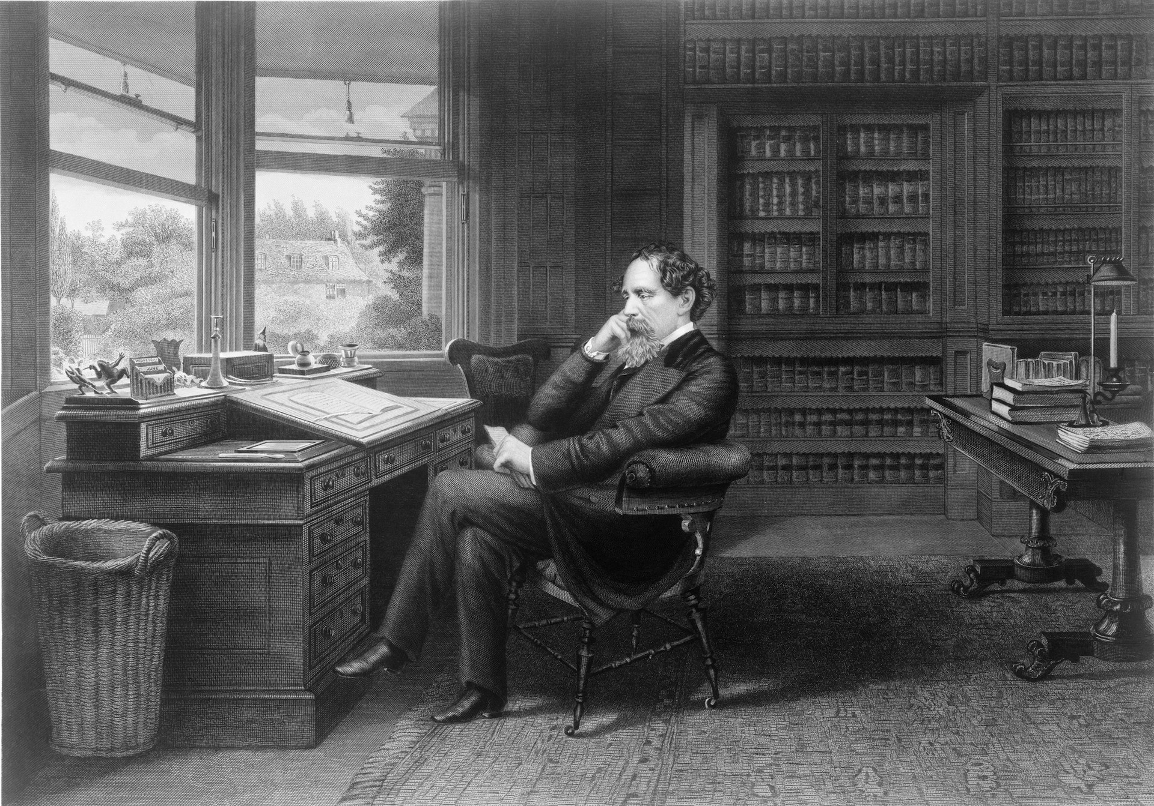
“Take nothing on its looks; take everything on evidence. There’s no better rule.”

Slide 4
What is meant by the word “expectations”?

Slide 5
God’s Authoritative Expectations

Slide 6
² Grace and peace be multiplied to you in the knowledge of God and of Jesus our Lord; 3 seeing that His divine power has granted to us everything pertaining to life and godliness, through the true knowledge of Him who called us by His own glory and excellence. 4 For by these He has granted to us His precious and magnificent promises, so that by them you may become partakers of the divine nature, having escaped the corruption that is in the world by lust. 5 Now for this very reason also, applying all diligence, in your faith supply moral excellence,
2 Peter 1.2-5a

Slide 7
And do not be conformed to this world, but be transformed by the renewing of your mind, so that you may prove what the will of God is, that which is good and acceptable and perfect.
Romans 12.2

Slide 8
In your own words, what is the point for Christians in Romans 15.4?

Slide 9
For whatever was written in earlier times was written for our instruction, so that through perseverance and the encouragement of the Scriptures we might have hope.
Romans 15.4

Slide 10
What “instruction” should be taken away from the following narratives?
Noah (Gen 6)
Abel (Gen 4)
Abraham (Gen 12)
Cain (Gen 4)
Nadab and Abihu (Lev 10)
A man gathering sticks (Num 15)

Slide 11
³² Now while the sons of Israel were in the wilderness, they found a man gathering wood on the sabbath day. ³³ Those who found him gathering wood brought him to Moses and Aaron and to all the congregation; ³⁴ and they put him in custody because it had not been declared what should be done to him. ³⁵ Then the Lord said to Moses, “The man shall surely be put to death; all the congregation shall stone him with stones outside the camp.” ³⁶ So all the congregation brought him outside the camp and stoned him to death with stones, just as the Lord had commanded Moses.
Numbers 15.32-36

Slide 12
A Man Gathering Sticks
Was to do no work nor kindle a fire on the Sabbath (Ex 20.10; 35.3)
Gathered sticks on the Sabbath (Num 15.32)
Was stoned to death by commandment of the LORD (Num 15.35)

Slide 13
What simple pattern do we find in each of these examples?

Slide 14
Expectations of God
Actions of people
Consequences of action

Slide 15
What should we, as Christians, take away from this pattern that is repeated over and over again throughout the Old Testament?

Slide 16
God created all.
Therefore all creation is His.
With creation comes expectations.
With expectations comes responsibility.
With responsibility comes accountability.
With accountability comes consequences.

Slide 17
9 for the Lord will again rejoice over you for good, just as He rejoiced over your fathers; 10 if you obey the Lord your God to keep His commandments and His statutes which are written in this Book of the Law, if you turn to the Lord your God with all your heart and soul. 11 For this commandment which I am commanding you today is not too difficult for you, nor is it far away.
Deuteronomy 30.9b-11

Slide 18
God takes delight in his people who obey His commandments.
God expects His people to obey His commandments that He has given to them.

Slide 19
Does this weary us?
Has God done so little that we cannot be bothered to listen to God’s ways and follow in God’s paths?
Has God done so little that we cannot be bothered to pay attention to the details of God’s law?
Has God done so little that we ignore doing right to others, showing mercy to others, and walking humbly with the Lord? (Micah 6.8)
Does God have a case against us?
Have we followed in the path of Israel and are worthy of judgment because our lives do not reflect what God desires?

Slide 20
God is not asking for us to do the impossible.

