Slide 1

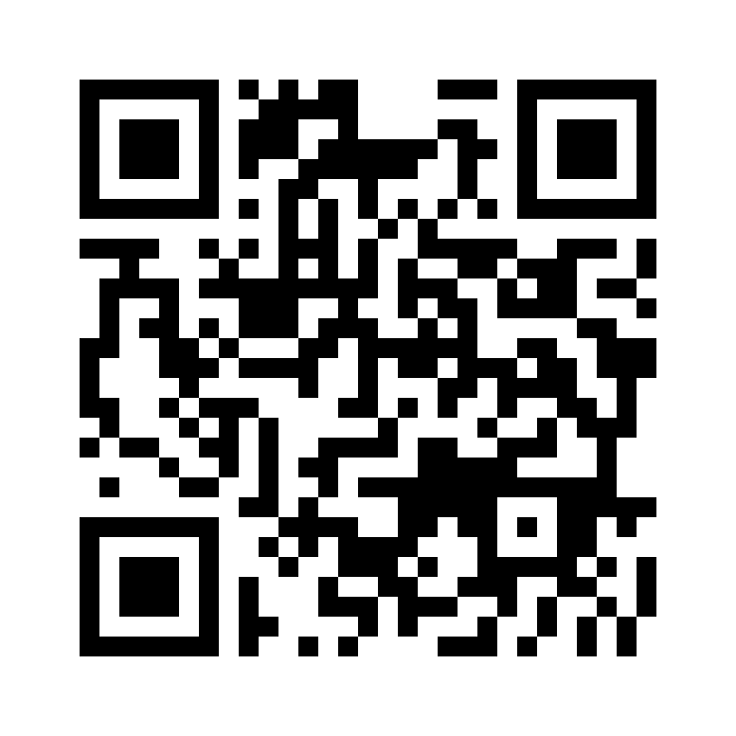
To our guests, we would like to know more about you! Scan the QR code to share your contact info with us.
A nuestros invitados, ¡nos gustaría saber más sobre ustedes! Escanee el código QR para compartir su información de contacto con nosotros.

Slide 2

<none>

Slide 3
Song Leader
Luke Stevens

Slide 4
<none>

Slide 5
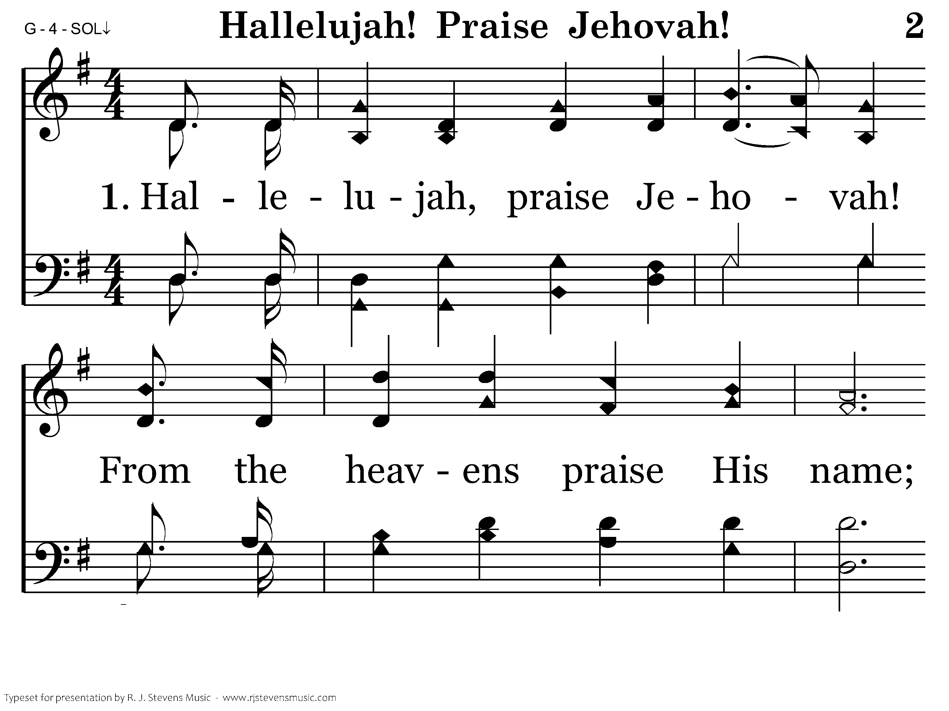
002 - Hallelujah! Praise Jehovah - 1.1

Slide 6
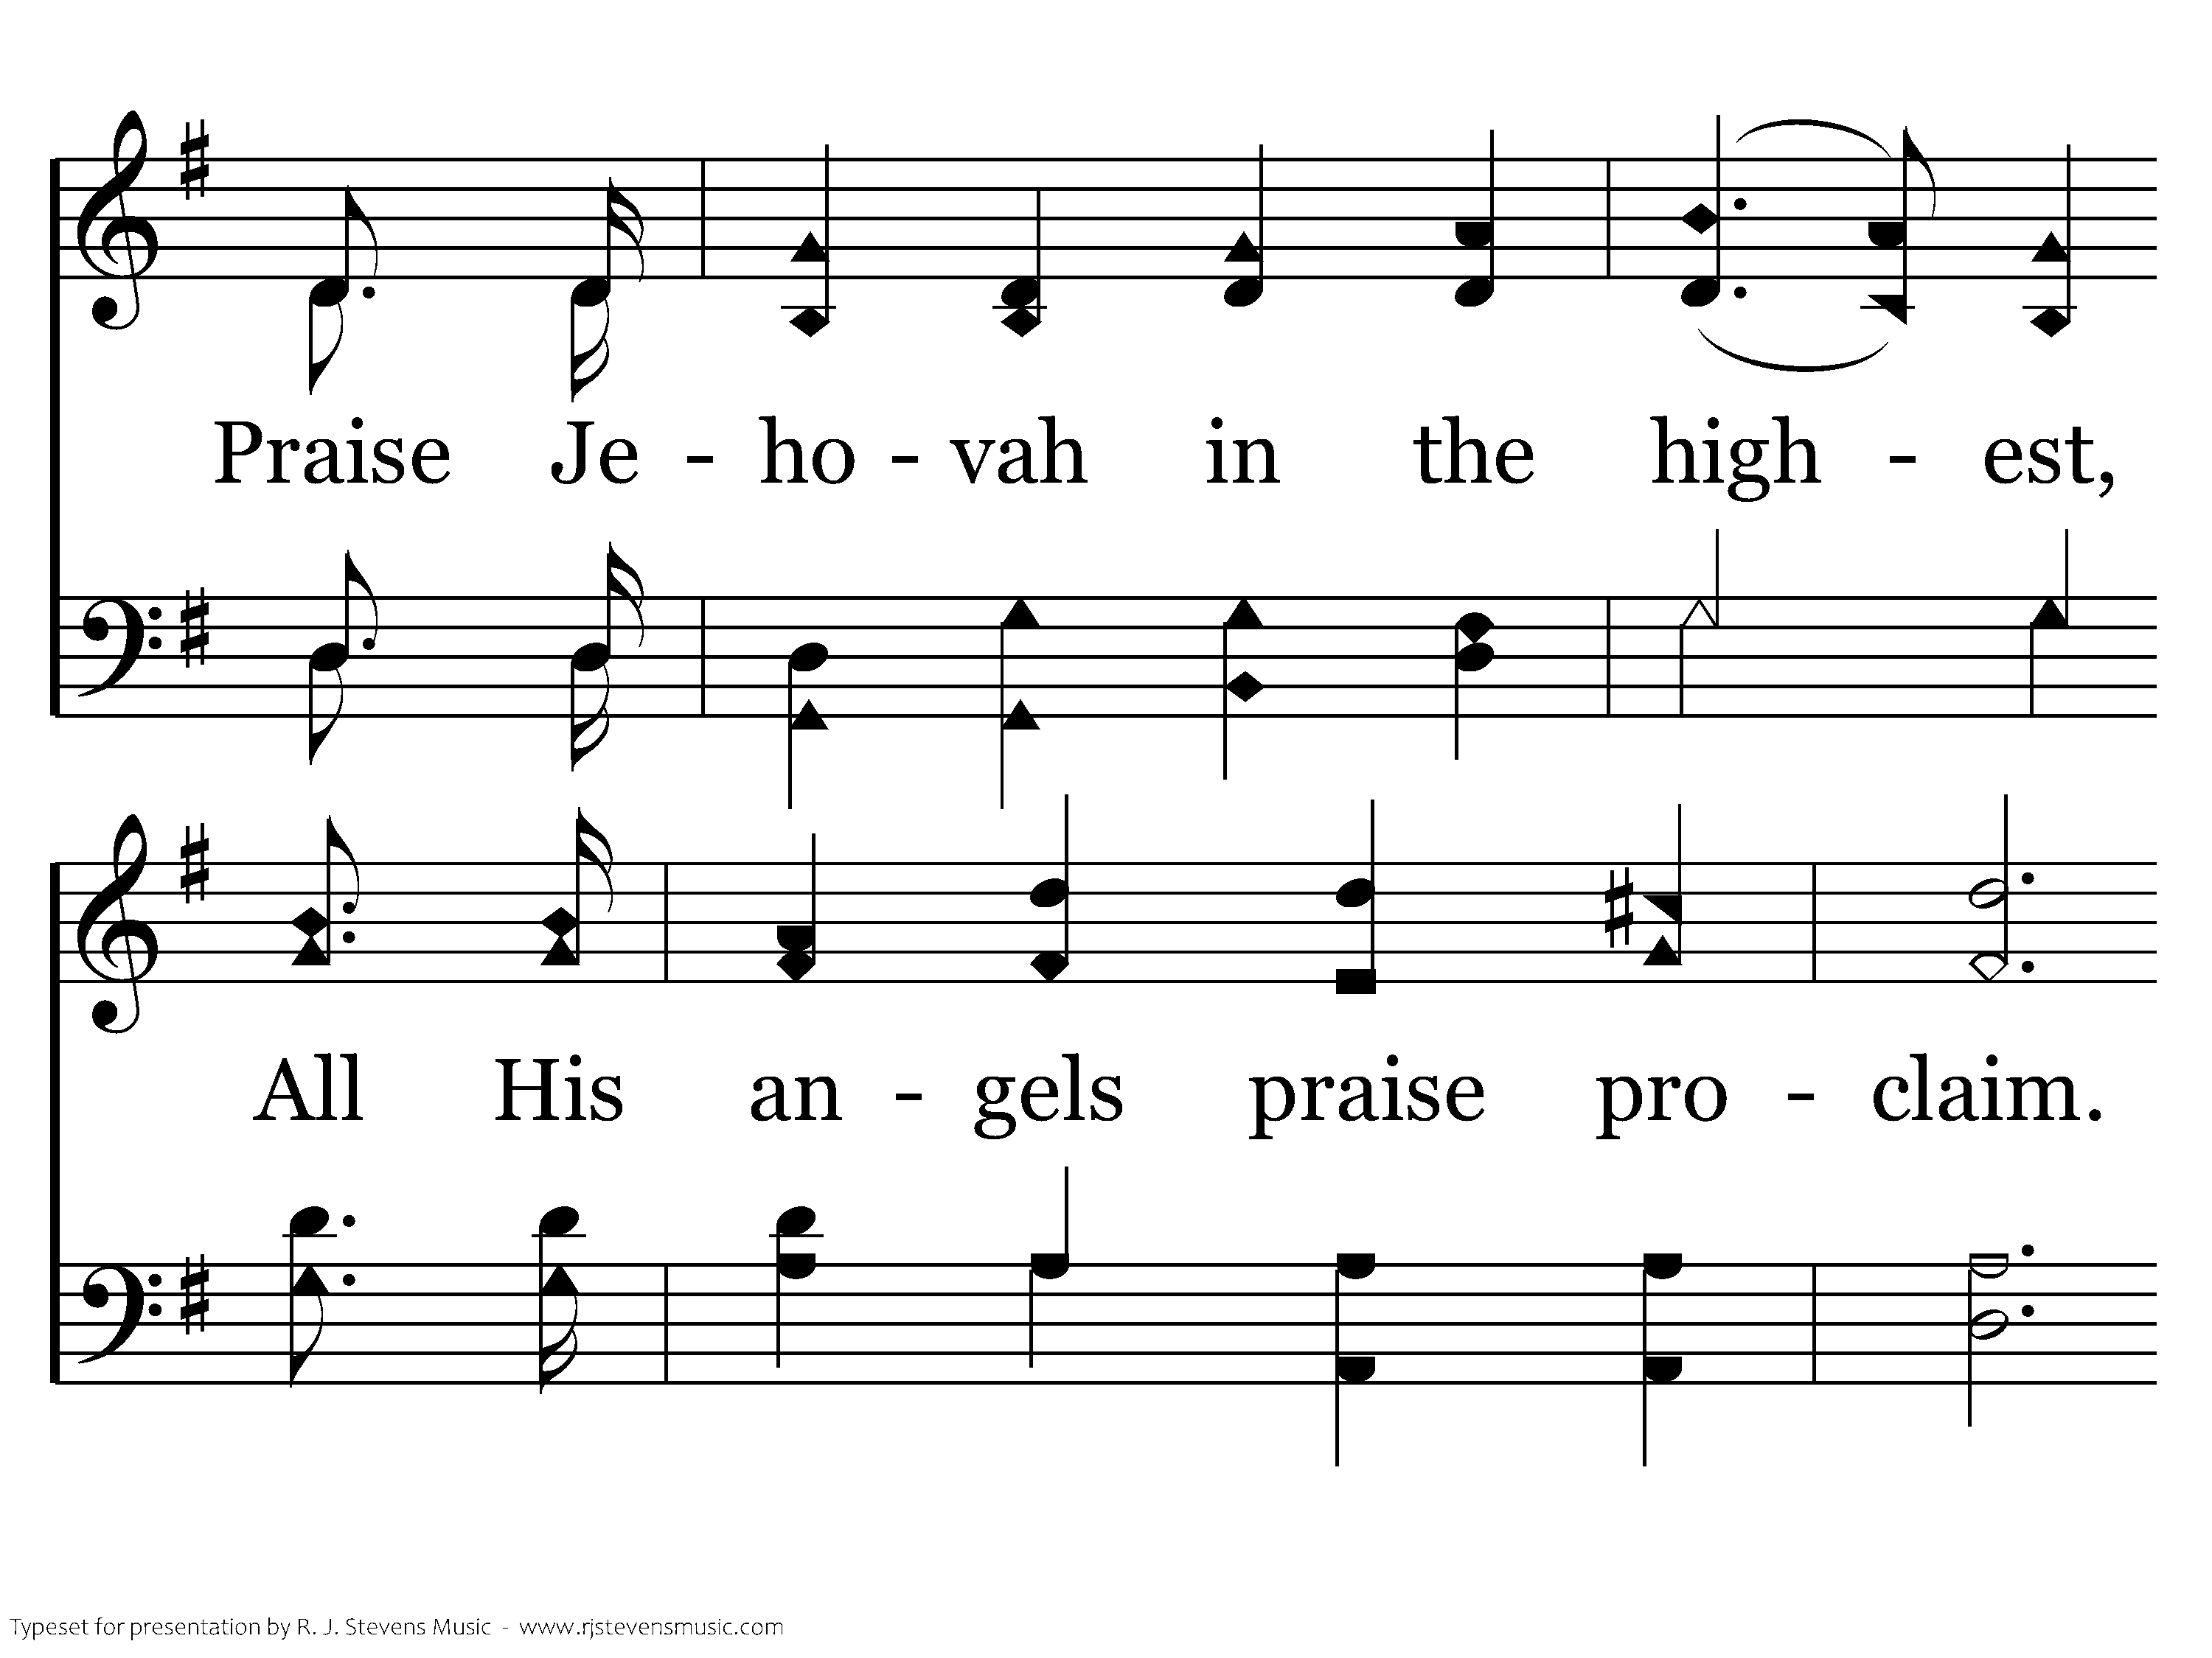
002 - Hallelujah! Praise Jehovah - 1.2

Slide 7
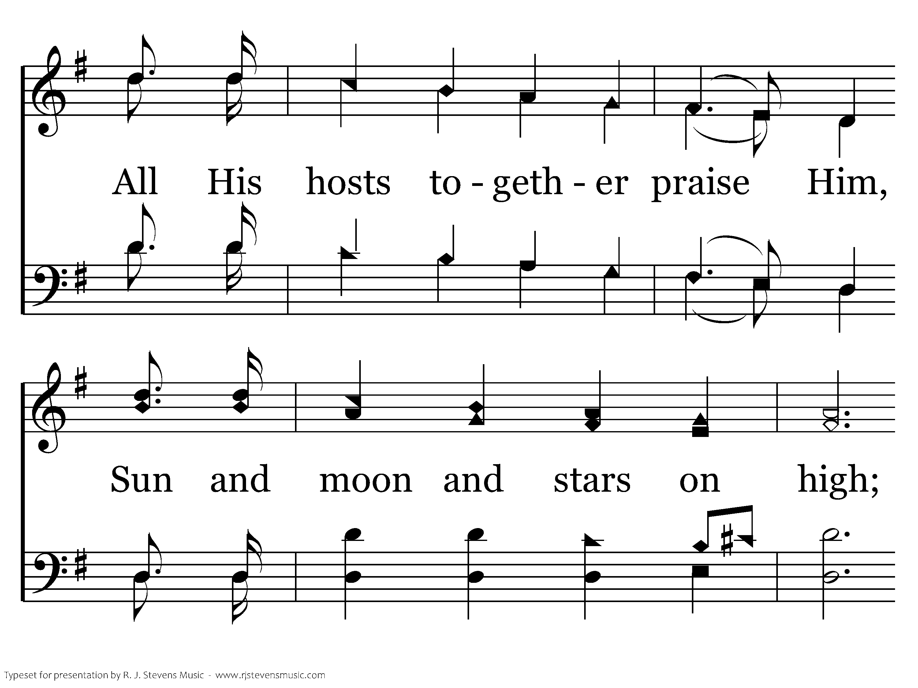
002 - Hallelujah! Praise Jehovah - 1.3

Slide 8
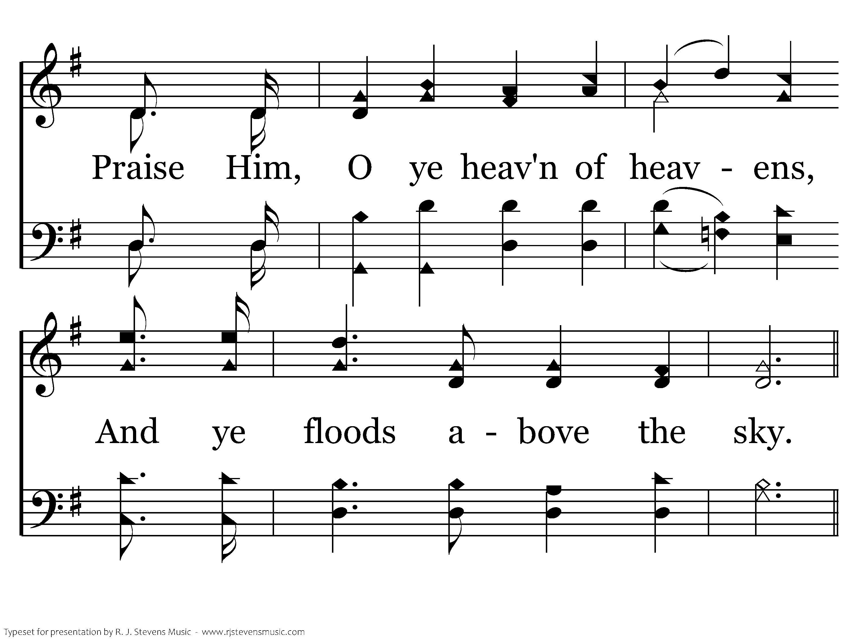
002 - Hallelujah! Praise Jehovah - 1.4

Slide 9
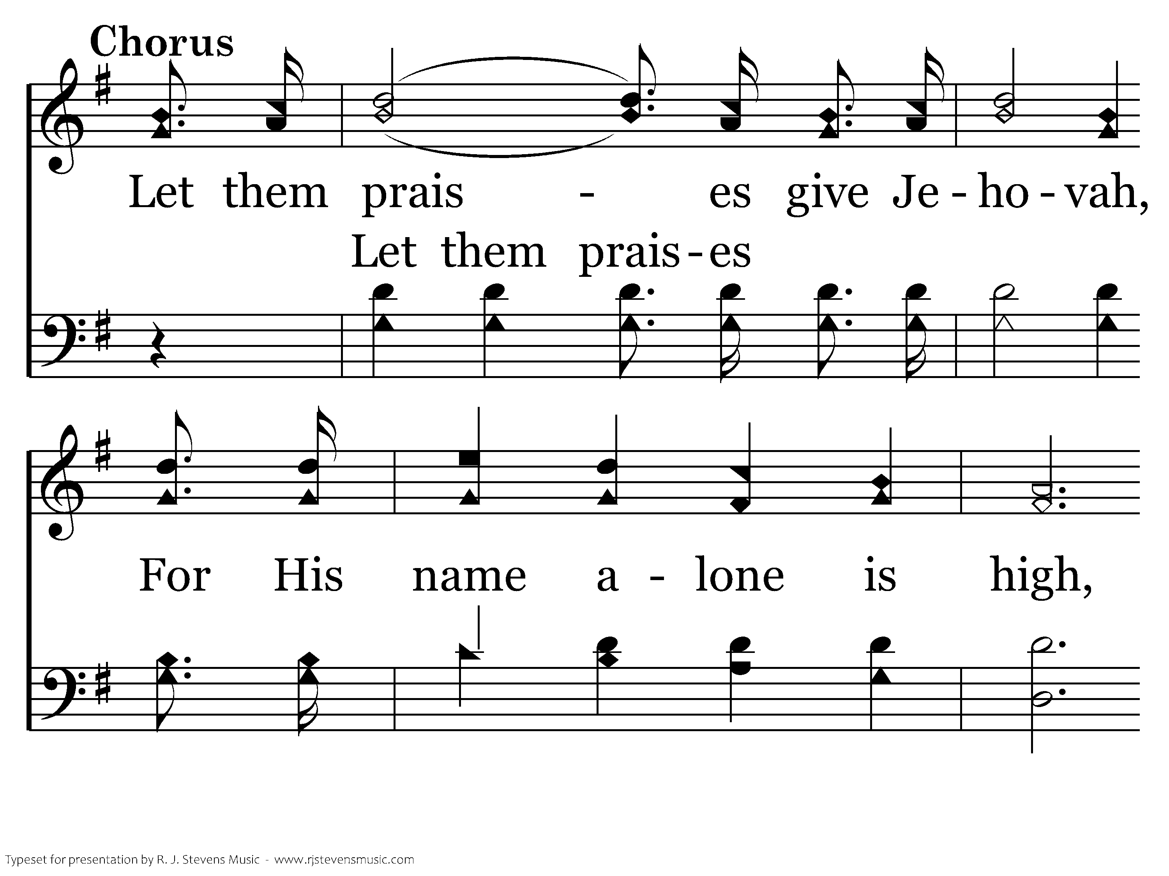
002 - Hallelujah! Praise Jehovah - C.1

Slide 10
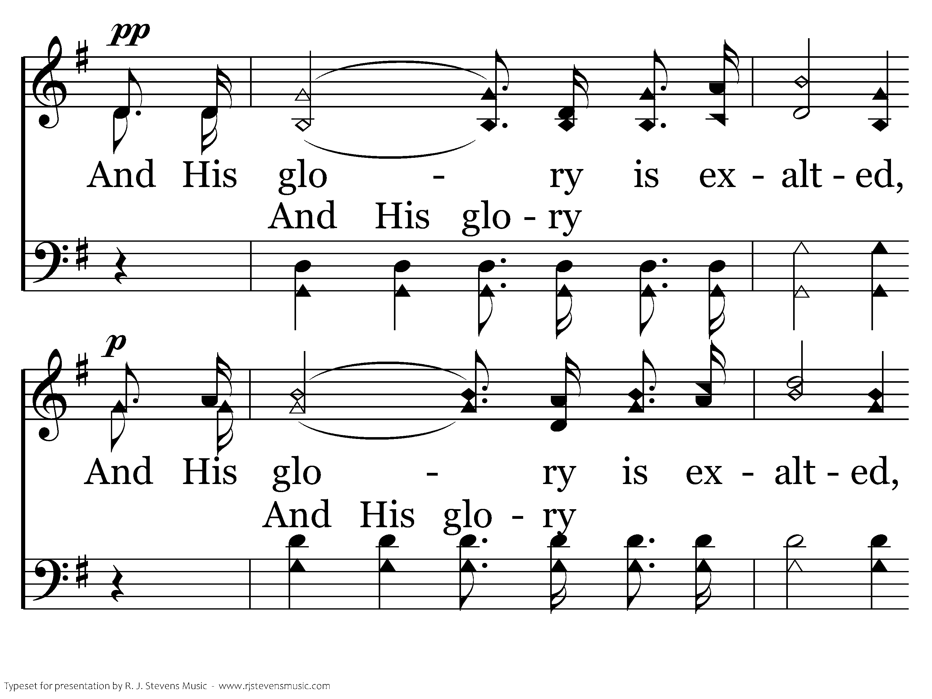
002 - Hallelujah! Praise Jehovah - C.2

Slide 11
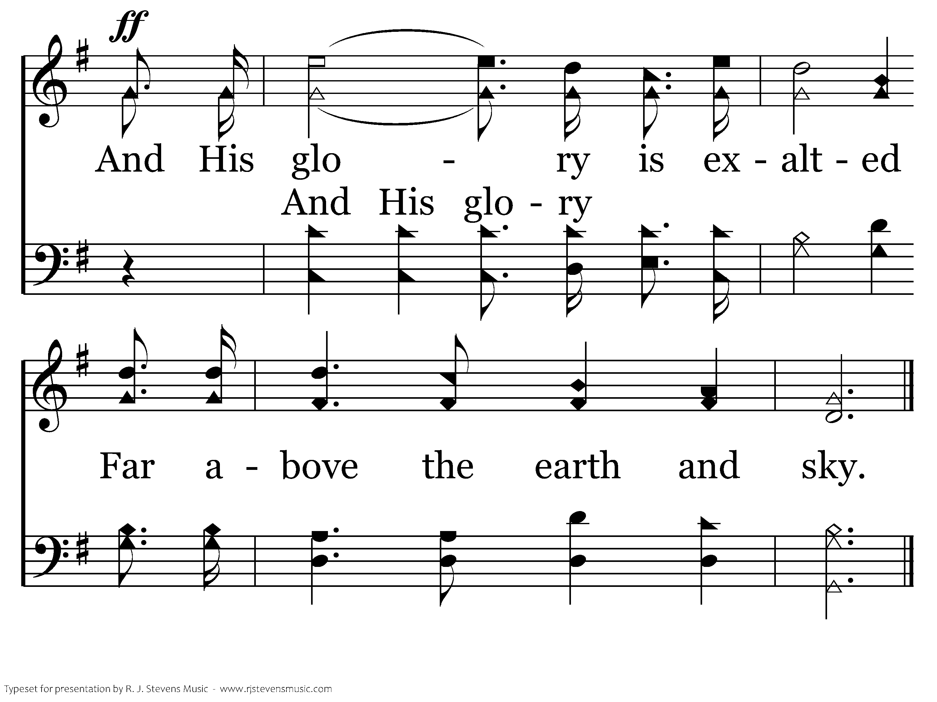
002 - Hallelujah! Praise Jehovah - C.3
End of Verse 1

Slide 12
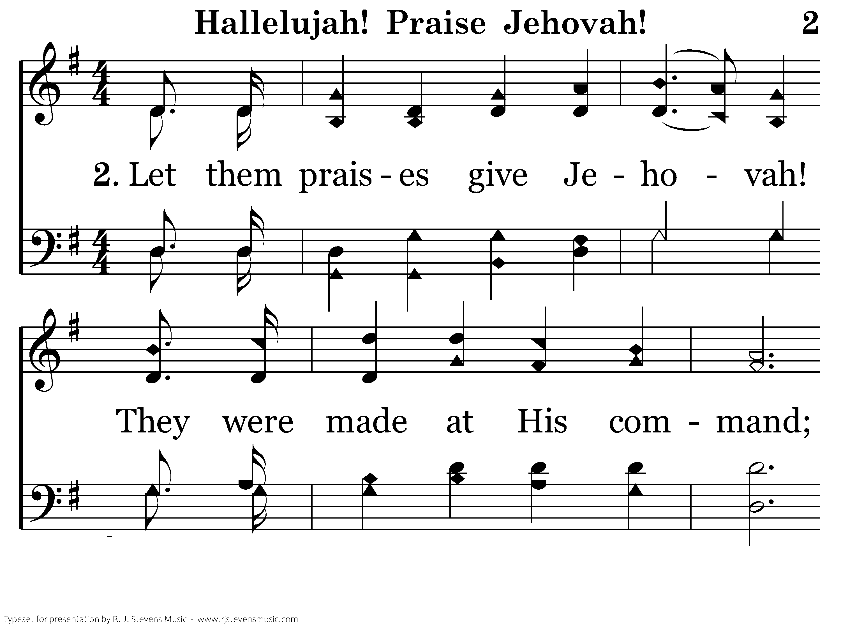
002 - Hallelujah! Praise Jehovah - 2.1

Slide 13
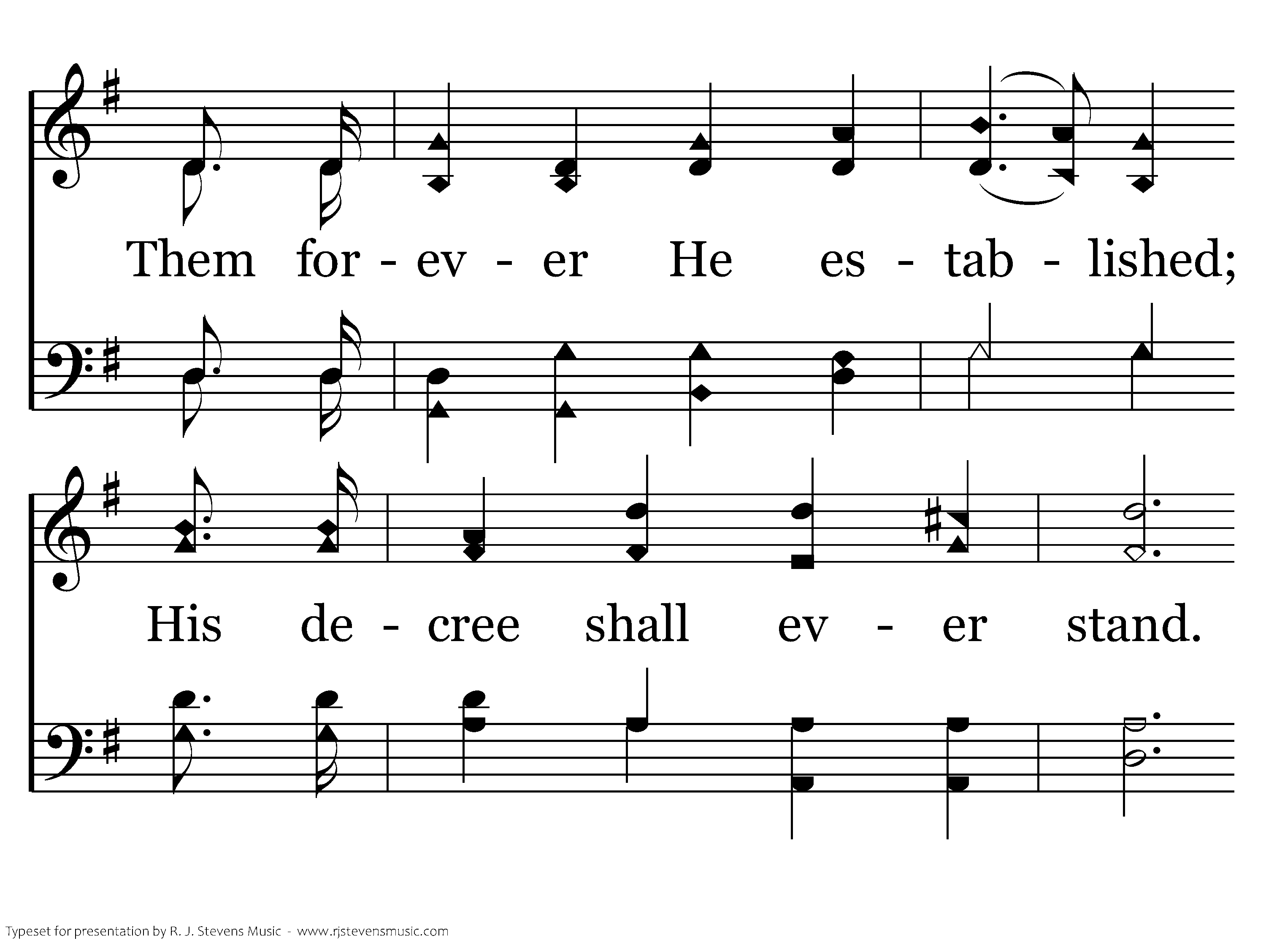
002 - Hallelujah! Praise Jehovah - 2.2

Slide 14
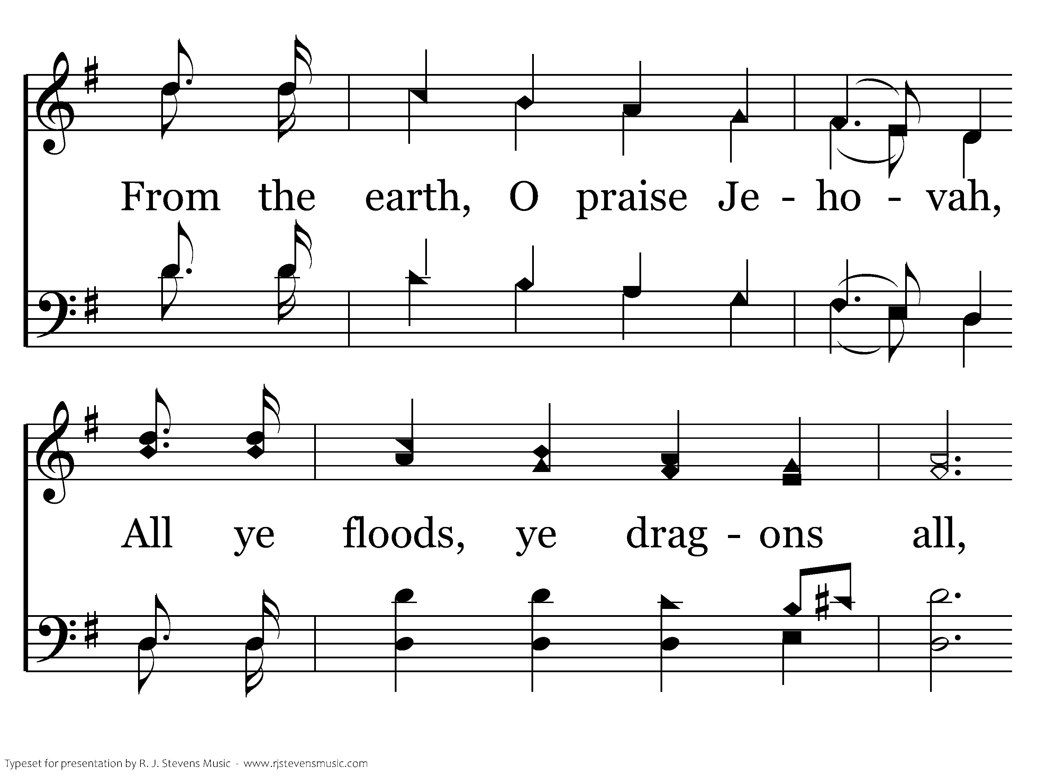
002 - Hallelujah! Praise Jehovah - 2.3

Slide 15
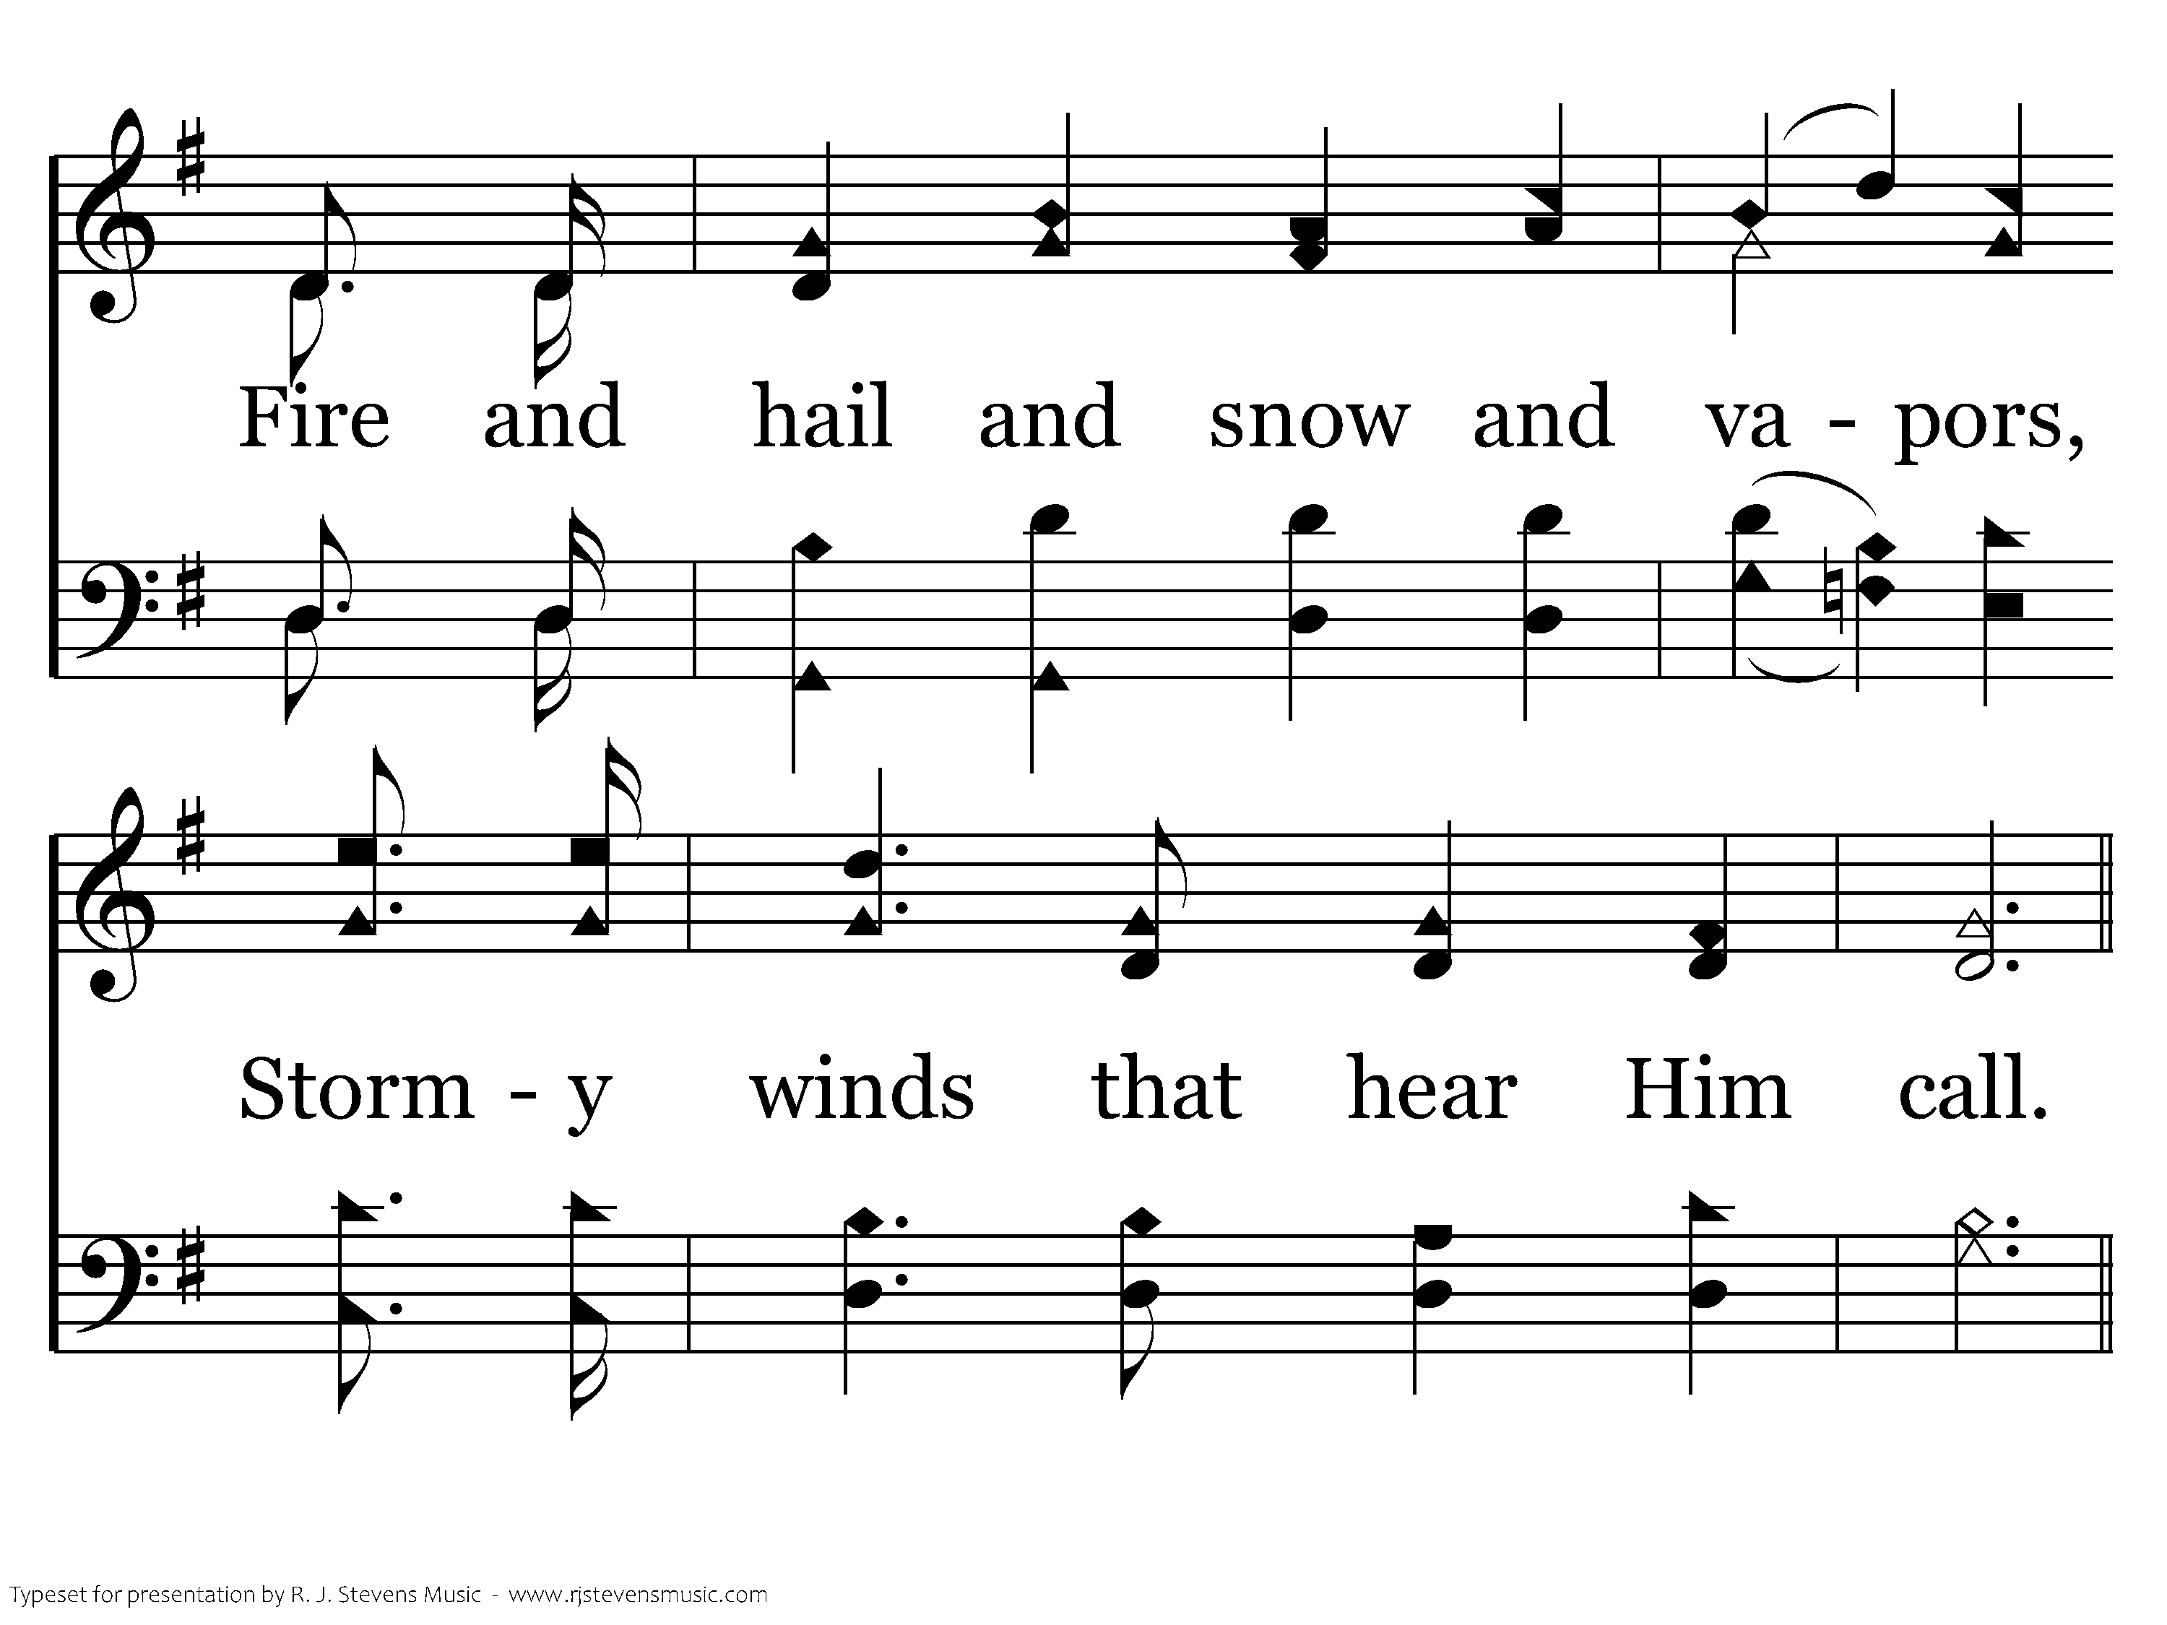
002 - Hallelujah! Praise Jehovah - 2.4

Slide 16
002 - Hallelujah! Praise Jehovah - C.1

Slide 17
002 - Hallelujah! Praise Jehovah - C.2

Slide 18
002 - Hallelujah! Praise Jehovah - C.3
End of Verse 2

Slide 19
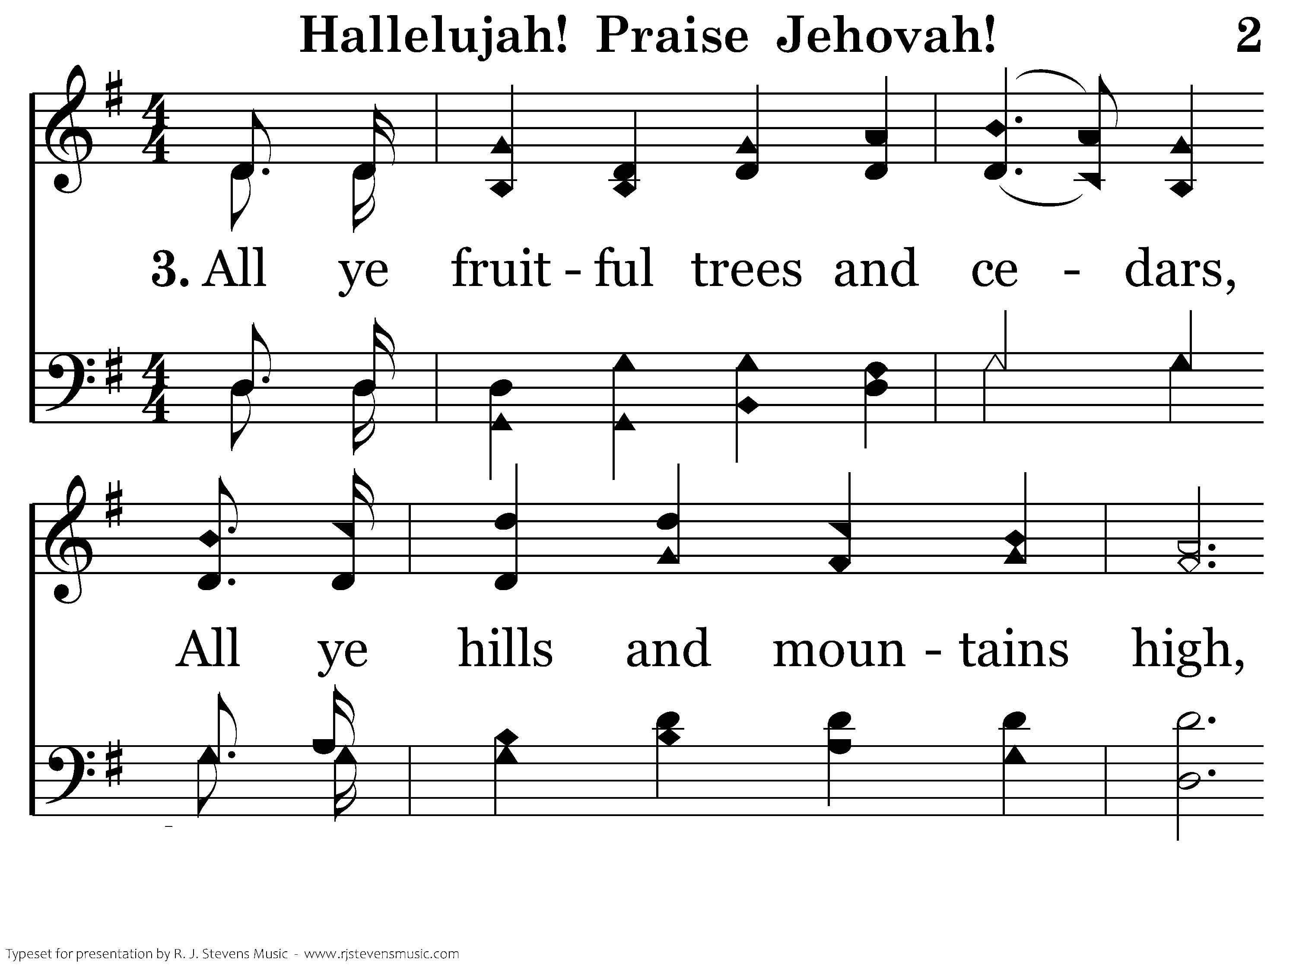
002 - Hallelujah! Praise Jehovah - 3.1

Slide 20
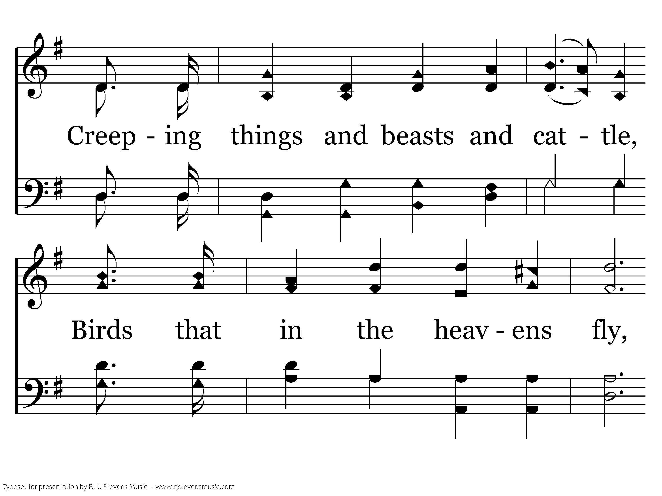
002 - Hallelujah! Praise Jehovah - 3.2

Slide 21
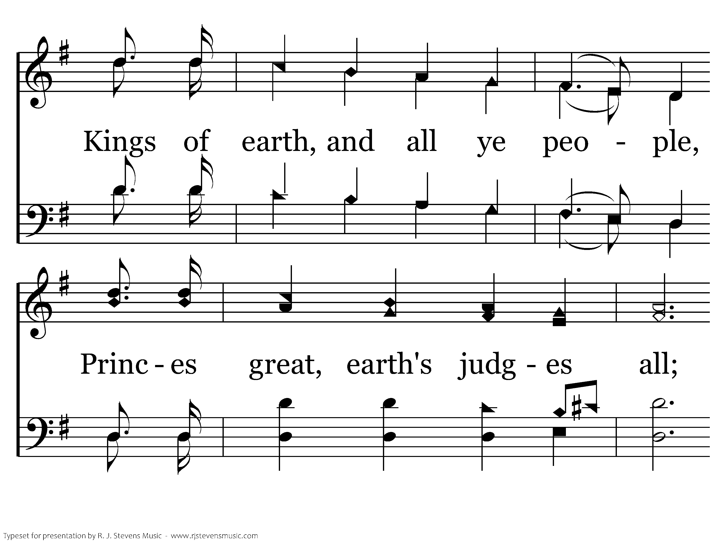
002 - Hallelujah! Praise Jehovah - 3.3

Slide 22
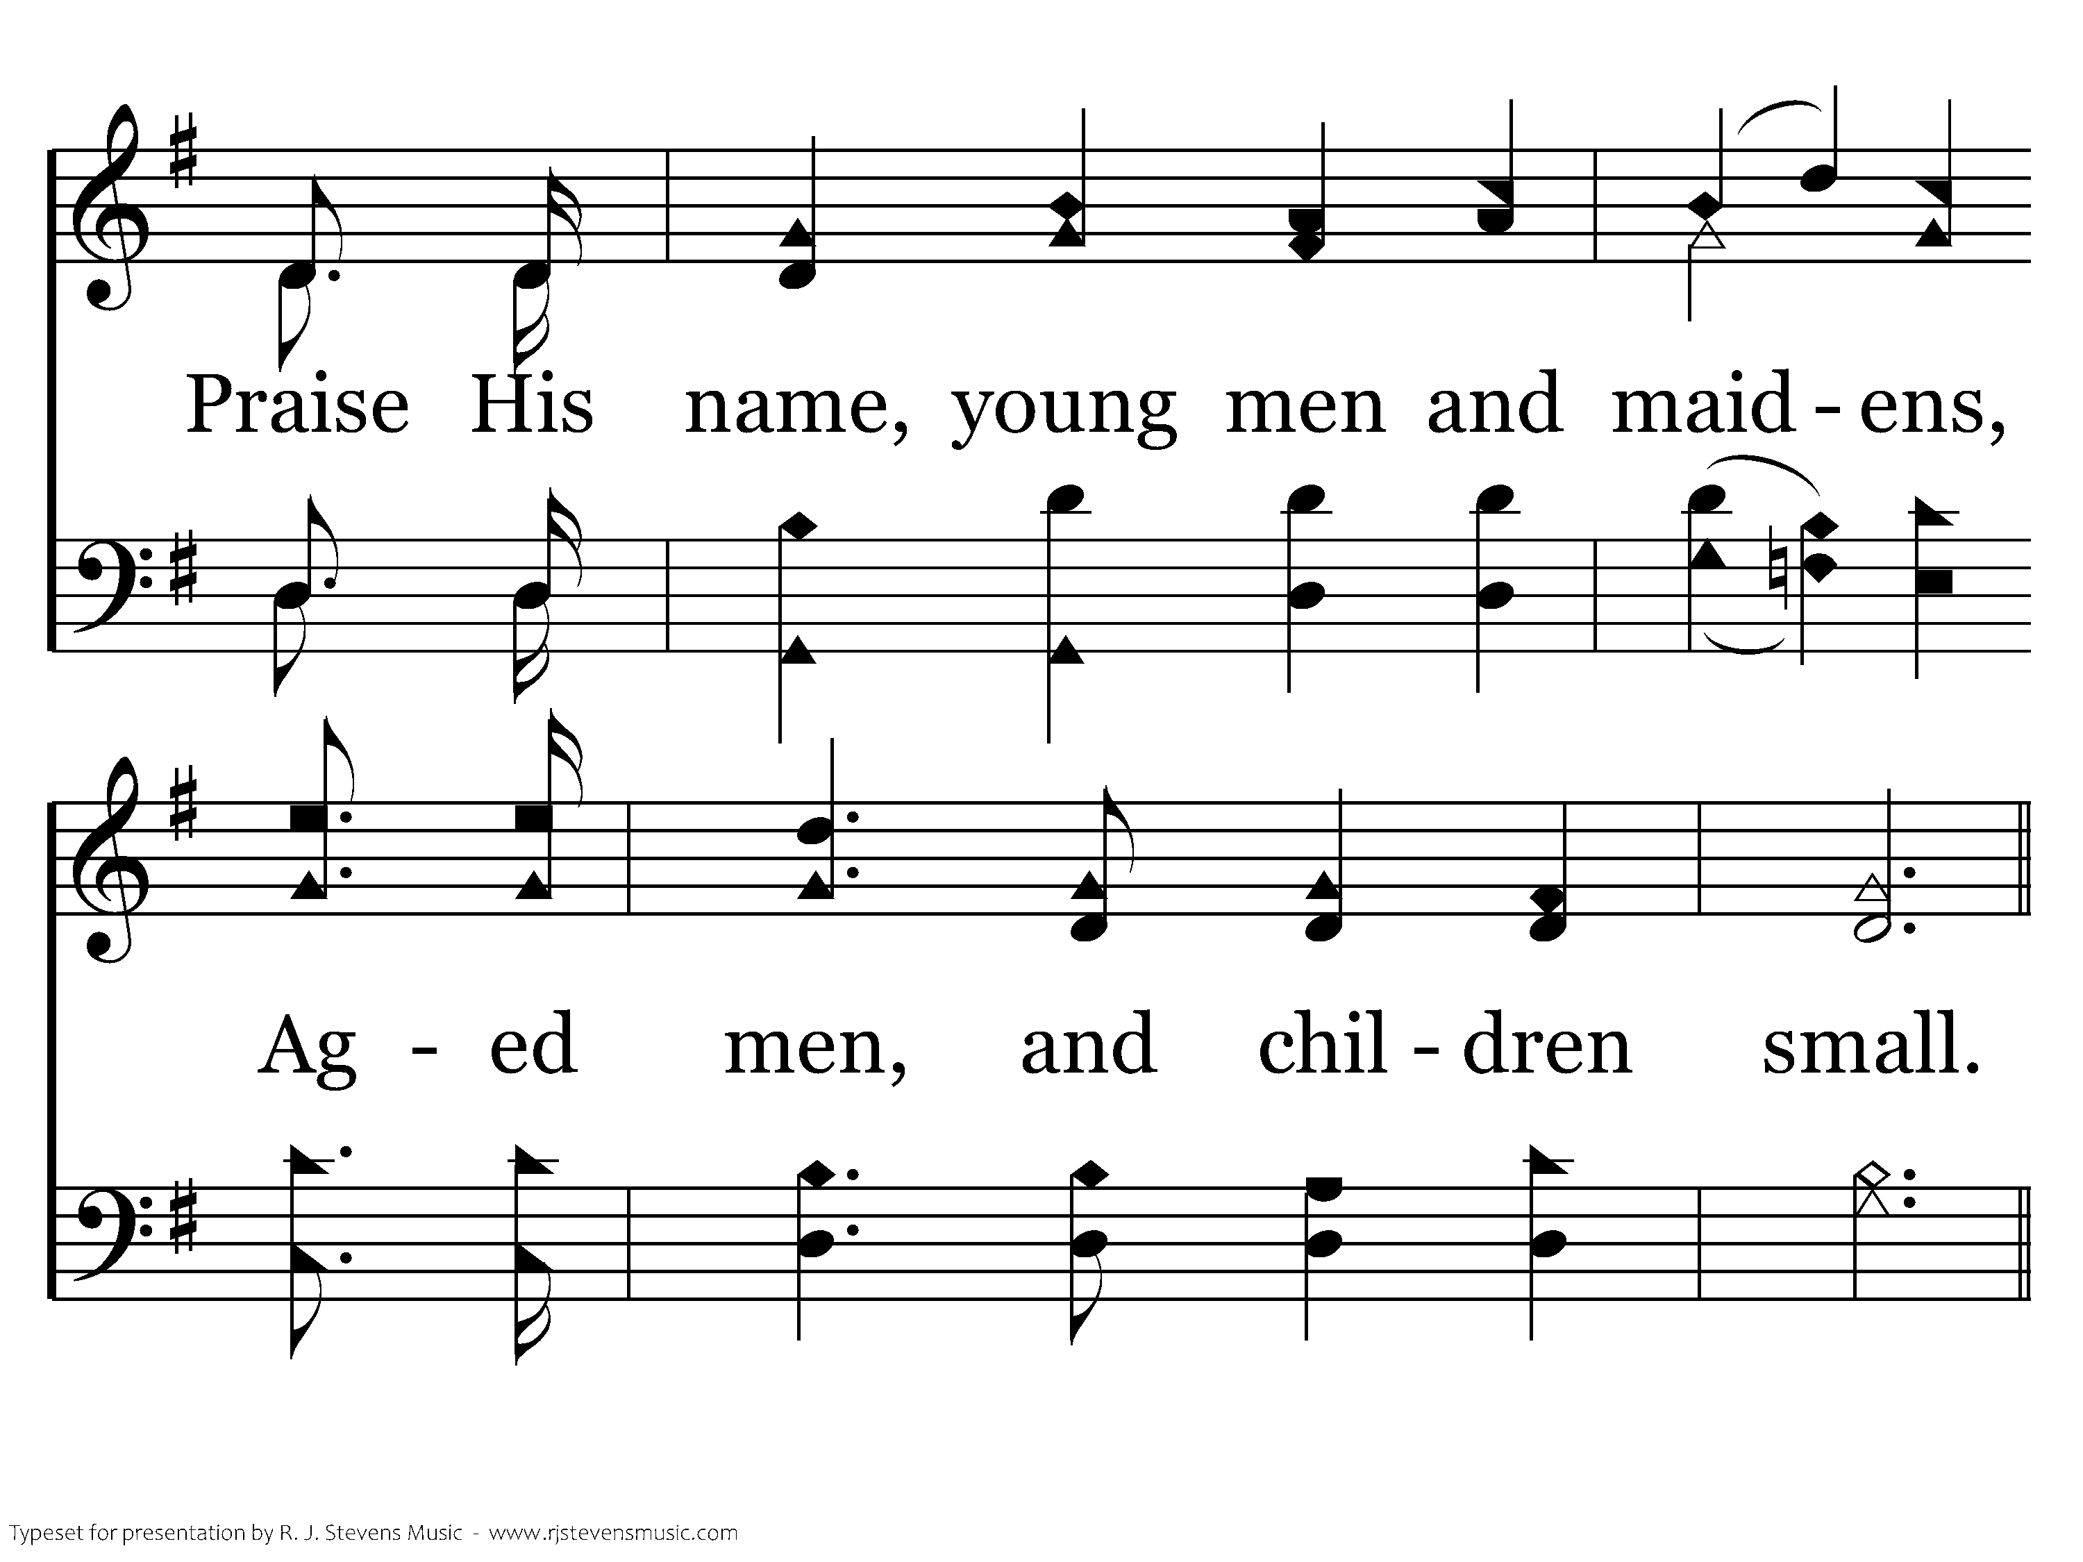
002 - Hallelujah! Praise Jehovah - 3.4

Slide 23
002 - Hallelujah! Praise Jehovah - C.1

Slide 24
002 - Hallelujah! Praise Jehovah - C.2

Slide 25
002 - Hallelujah! Praise Jehovah - C.3
End of Song

Slide 26
<none>

Slide 27
Opening Prayer
Brenden Winslett

Slide 28
<none>

Slide 29
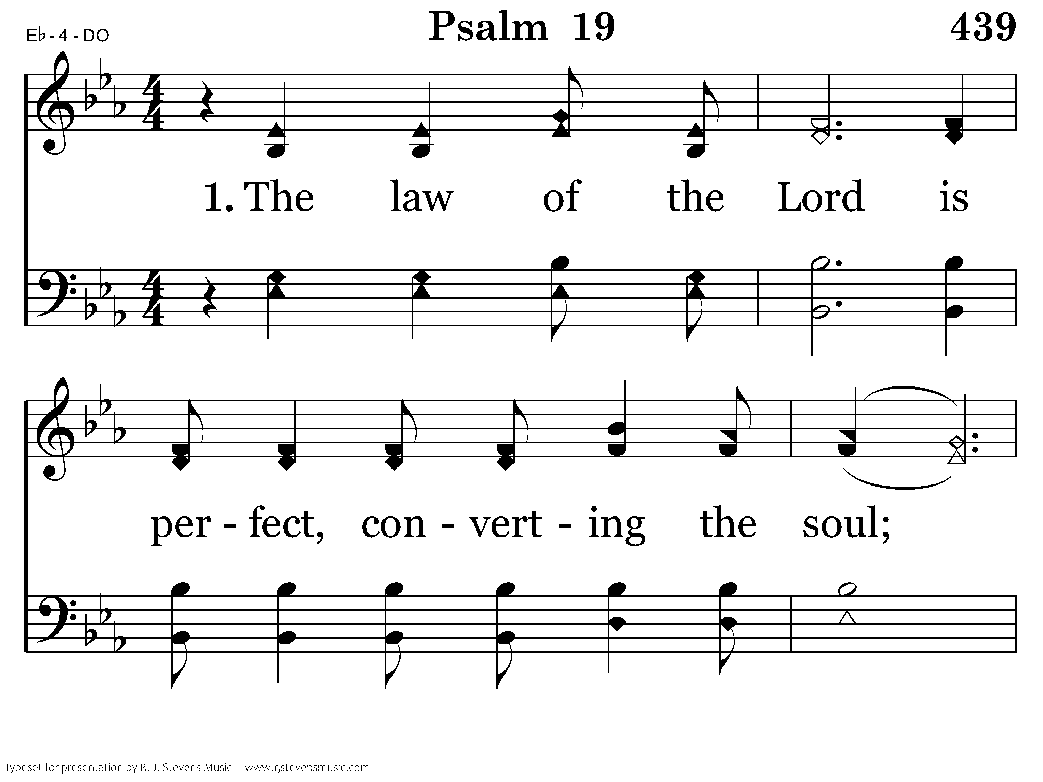
439 - Psalm 19 - 1.1

Slide 30
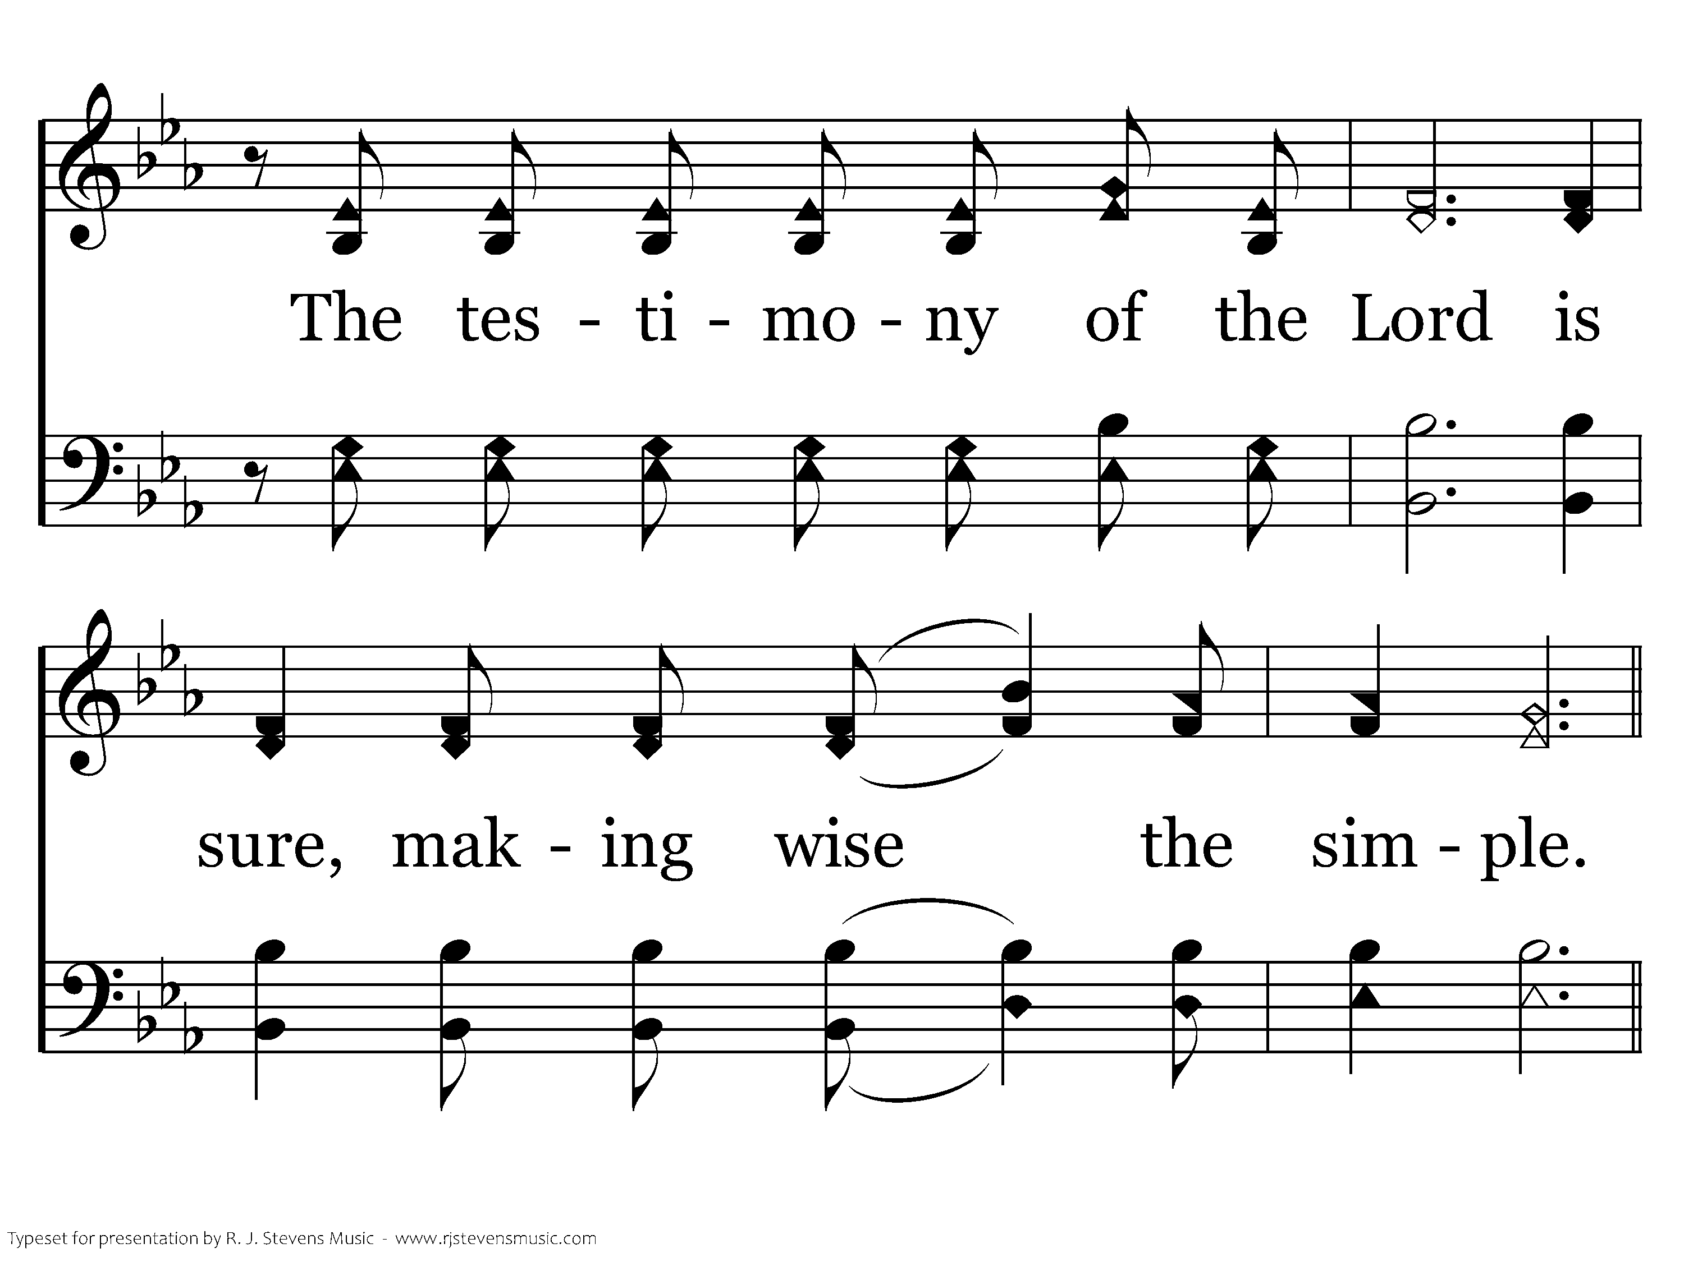
439 - Psalm 19 - 1.2

Slide 31
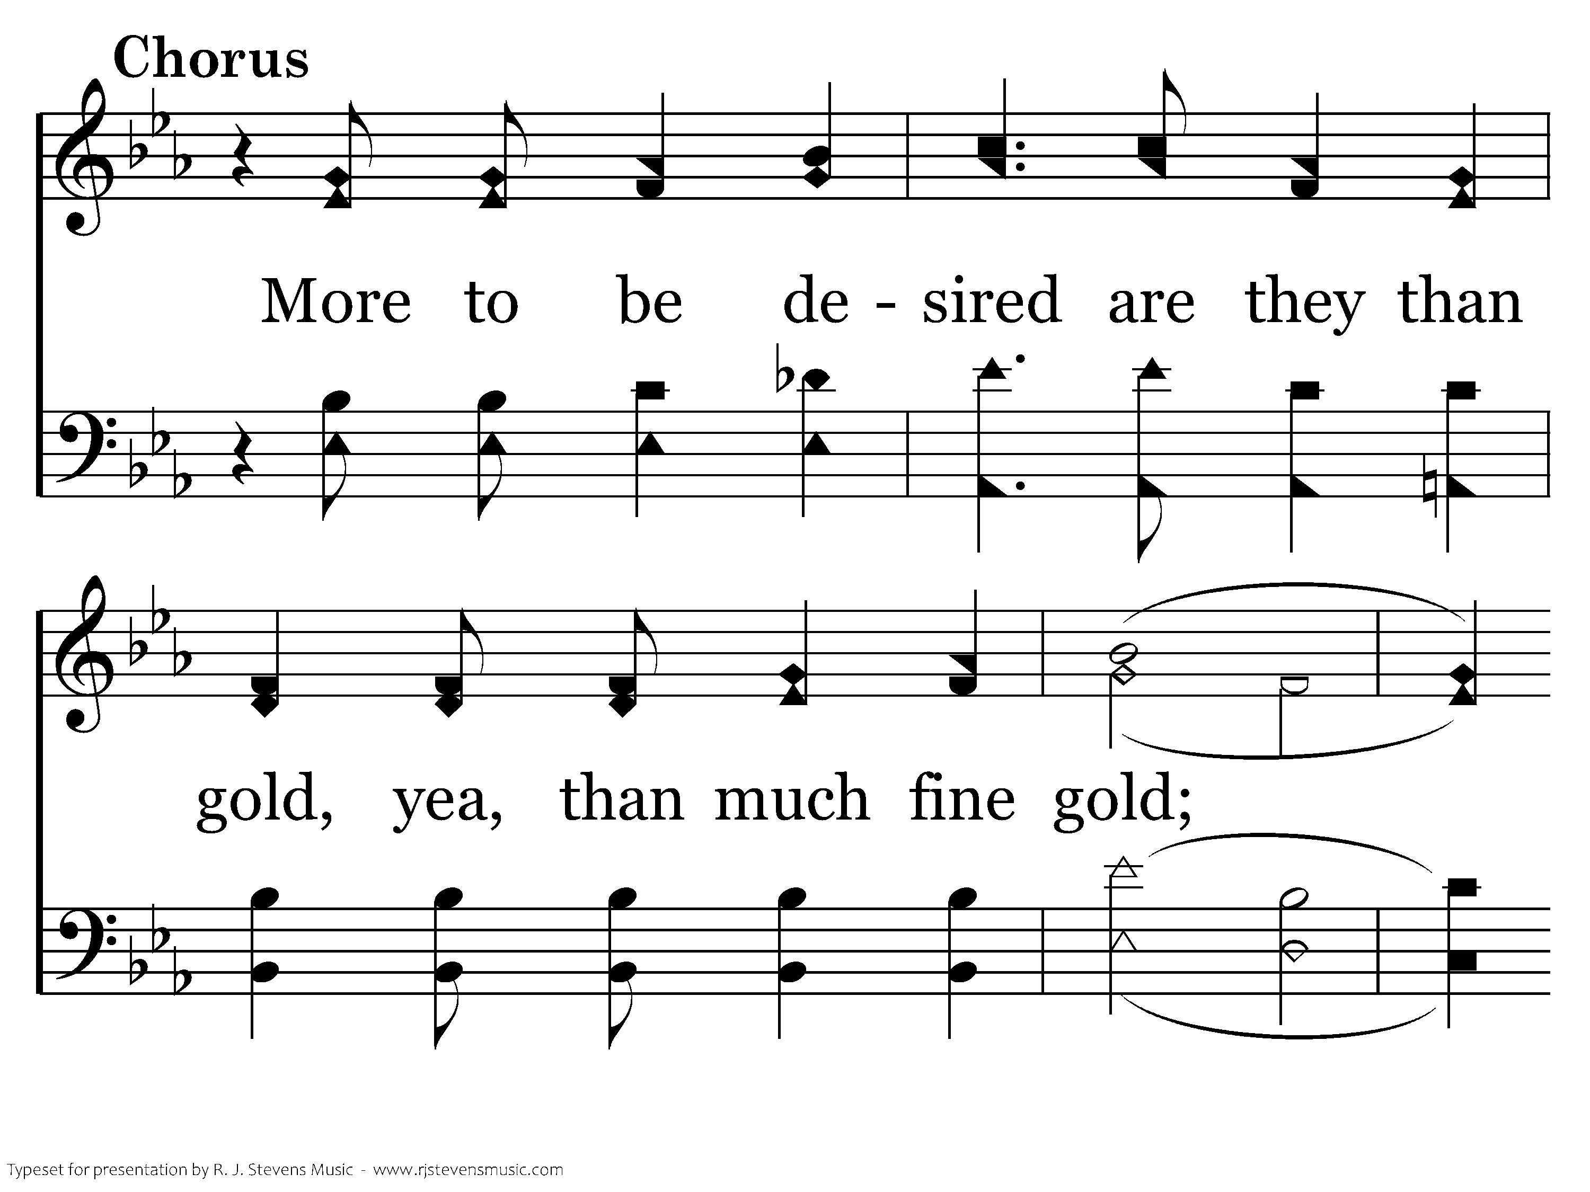
439 - Psalm 19 - C.1

Slide 32
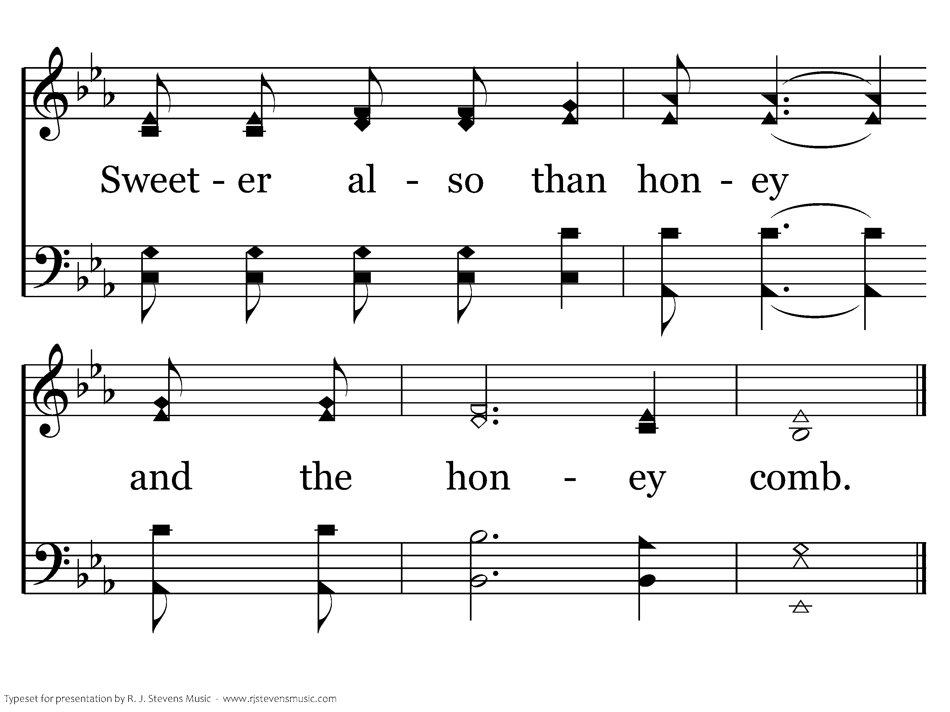
439 - Psalm 19 - C.2
End of Verse 1

Slide 33
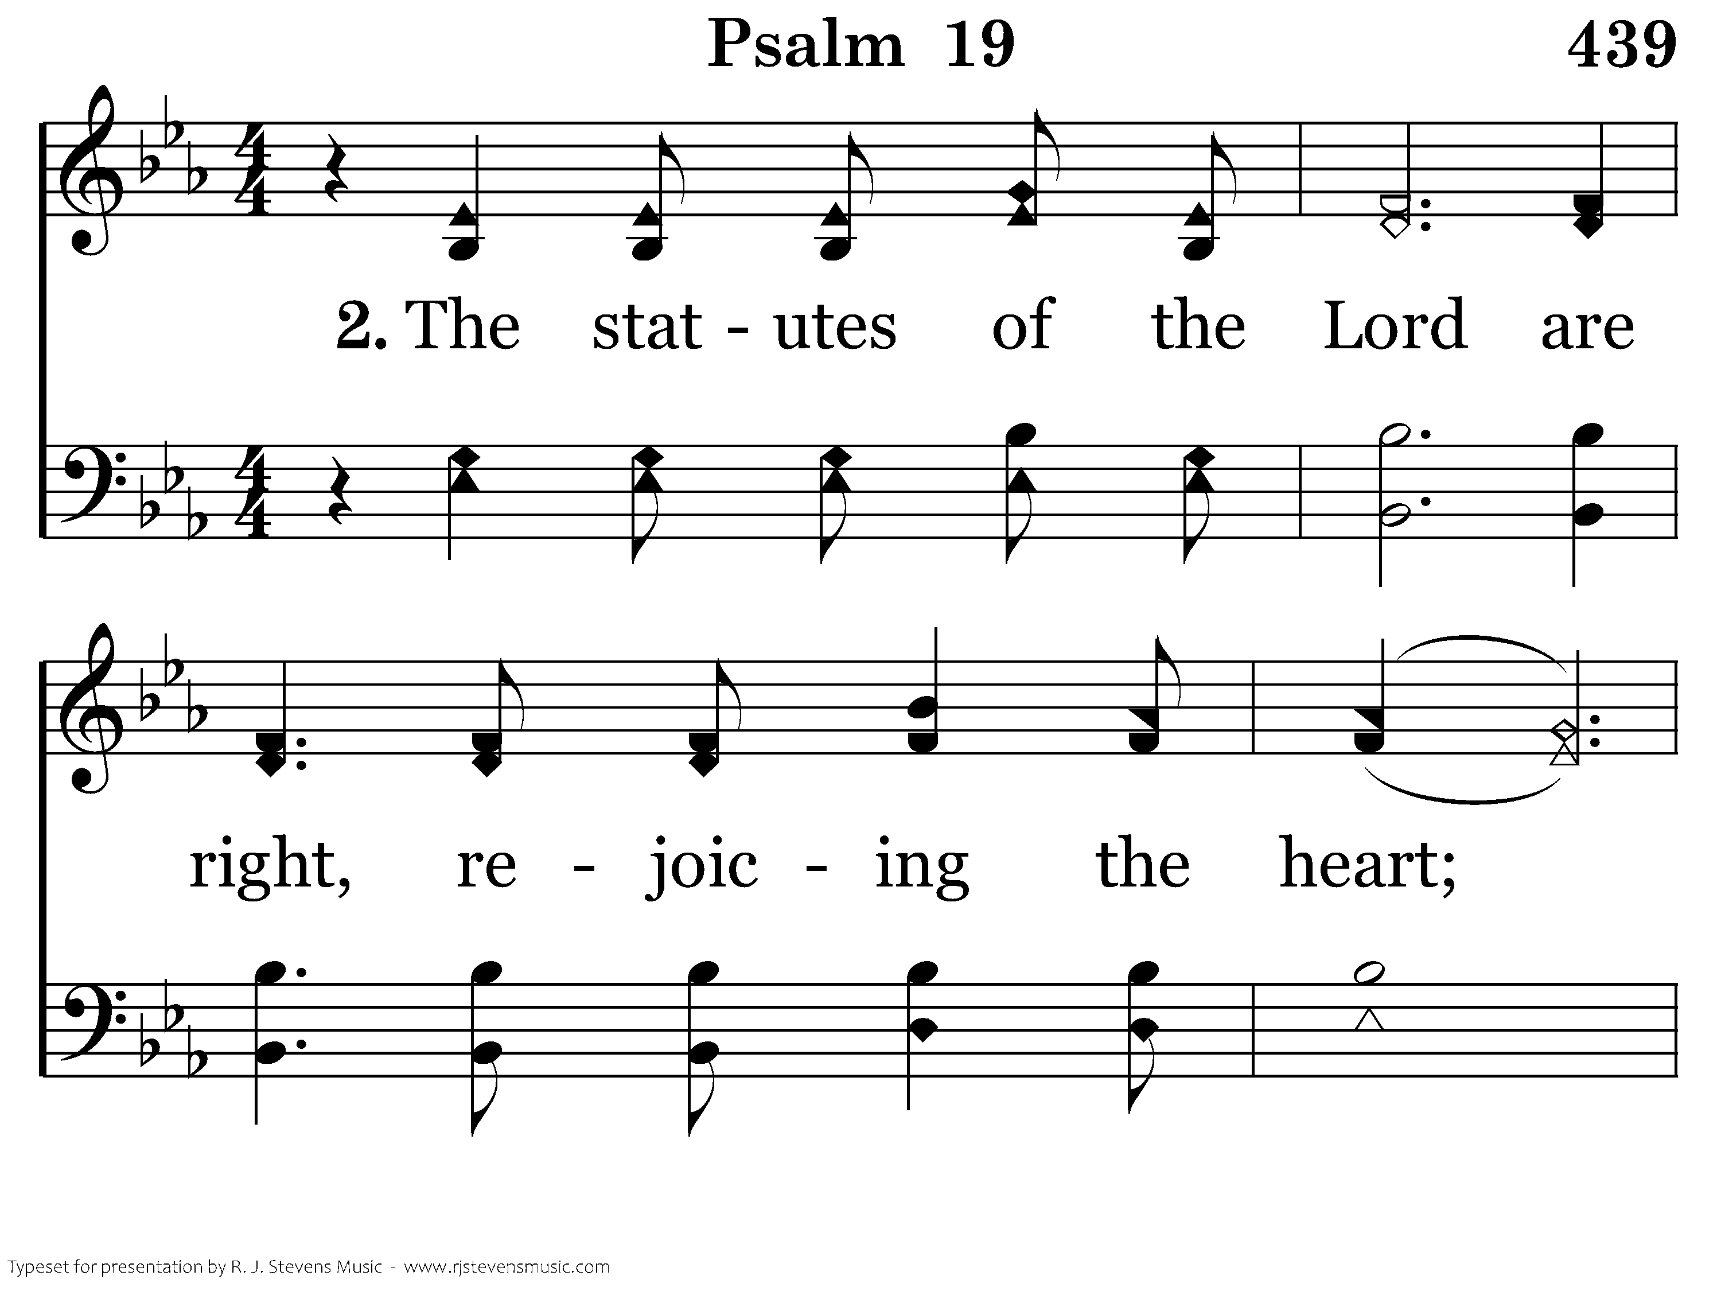
439 - Psalm 19 - 2.1

Slide 34
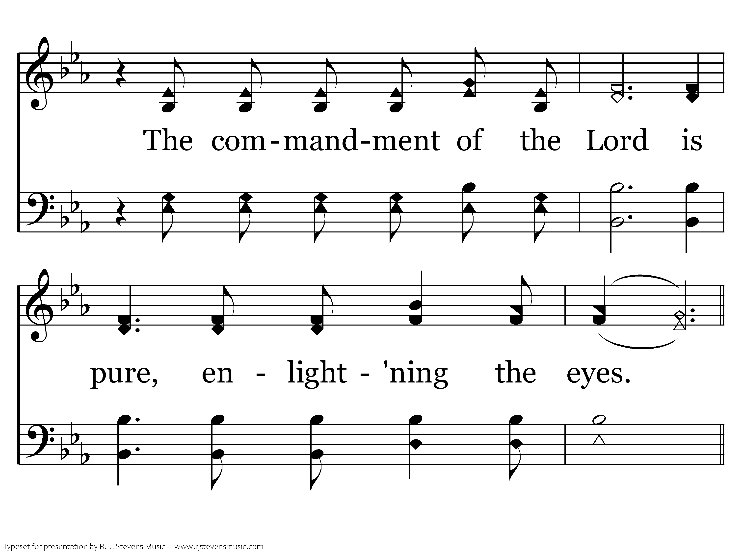
439 - Psalm 19 - 2.2

Slide 35
439 - Psalm 19 - C.1

Slide 36
439 - Psalm 19 - C.2
End of Verse 2

Slide 37
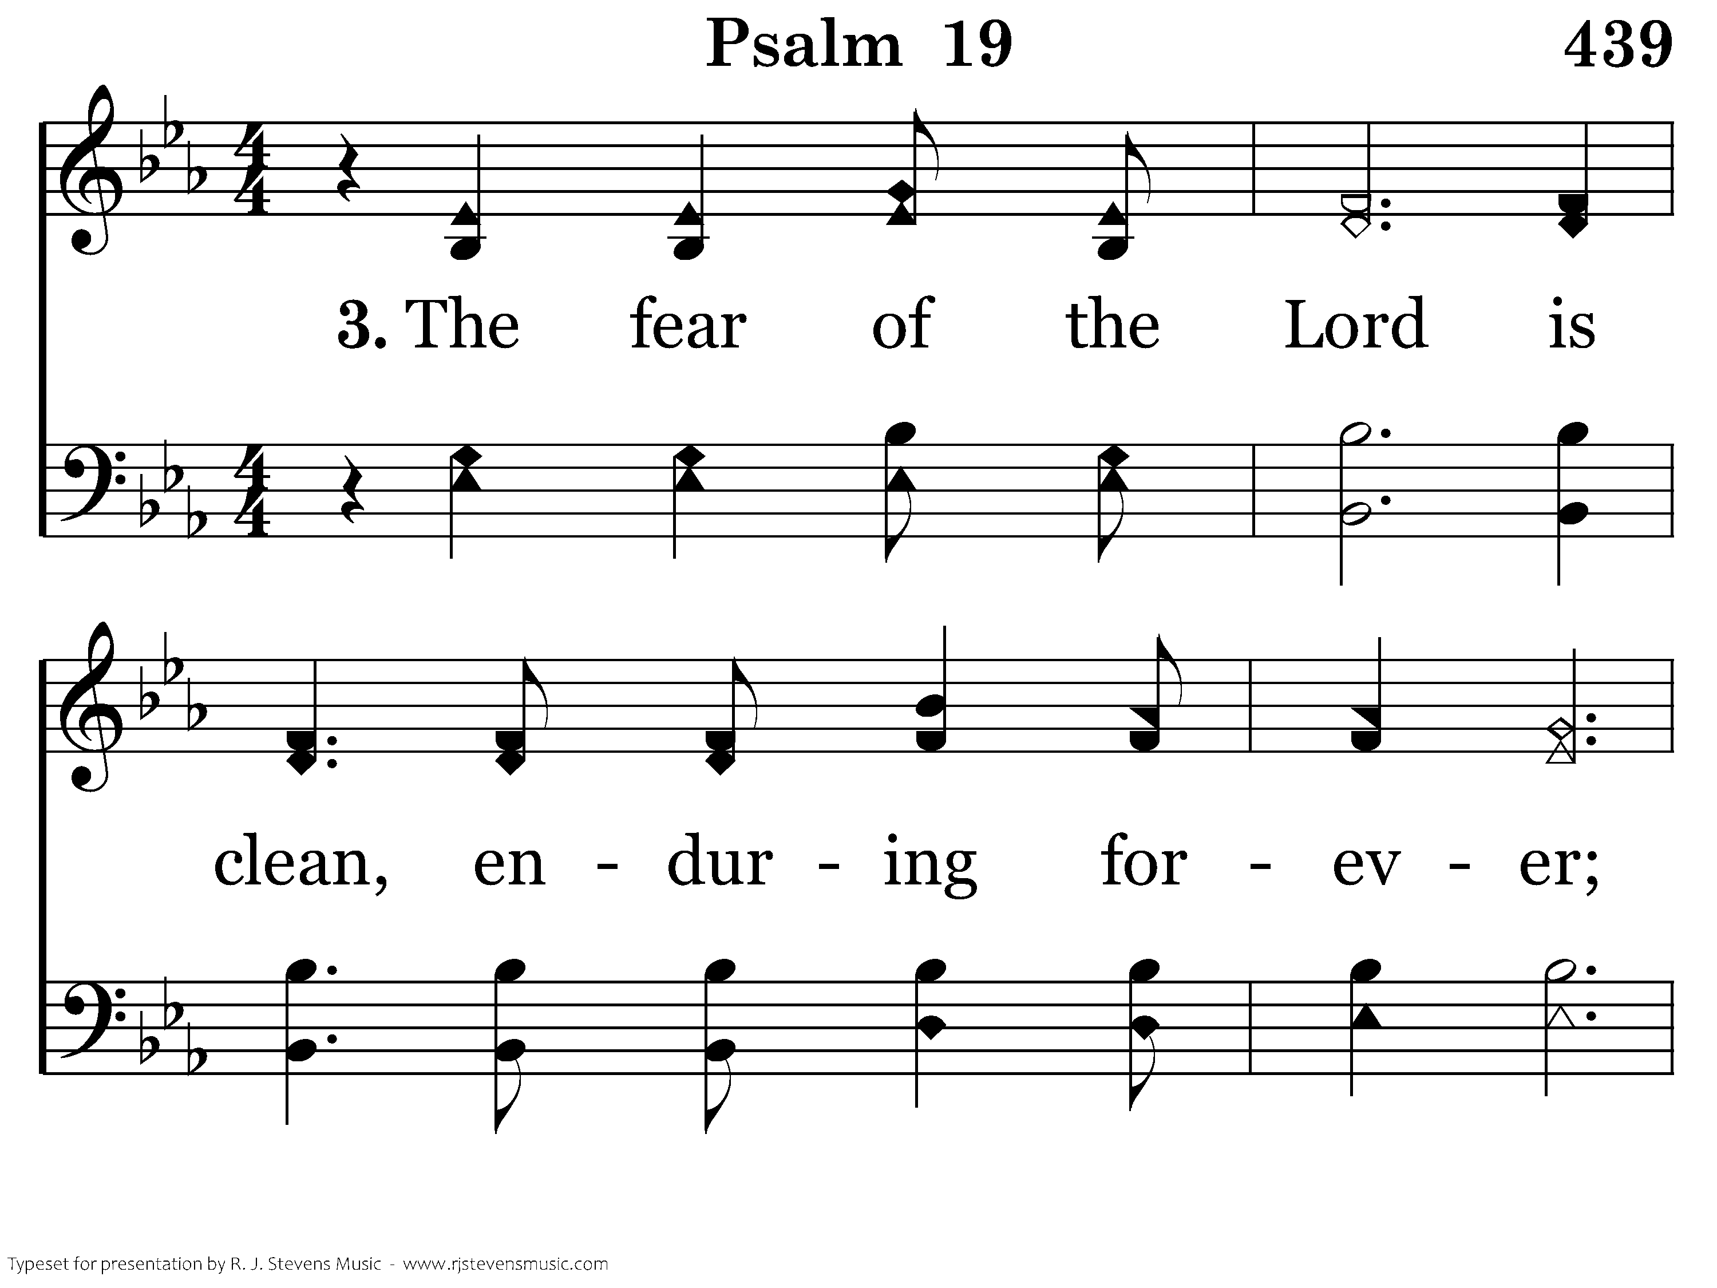
439 - Psalm 19 - 3.1

Slide 38
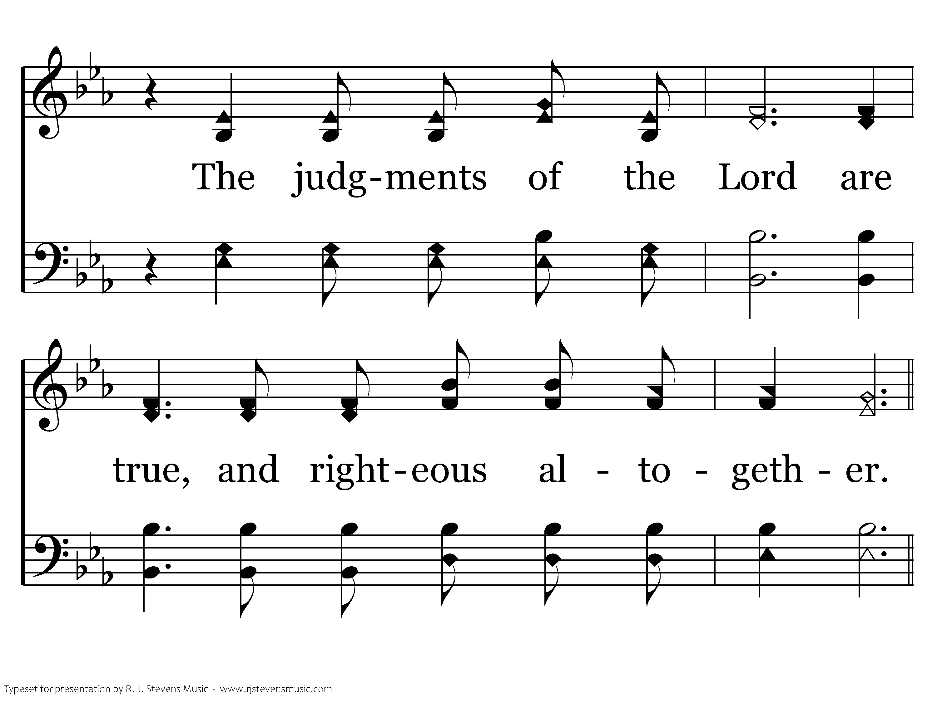
439 - Psalm 19 - 3.2

Slide 39
439 - Psalm 19 - C.1

Slide 40
439 - Psalm 19 - C.2
End of Song

Slide 41
<none>

Slide 42
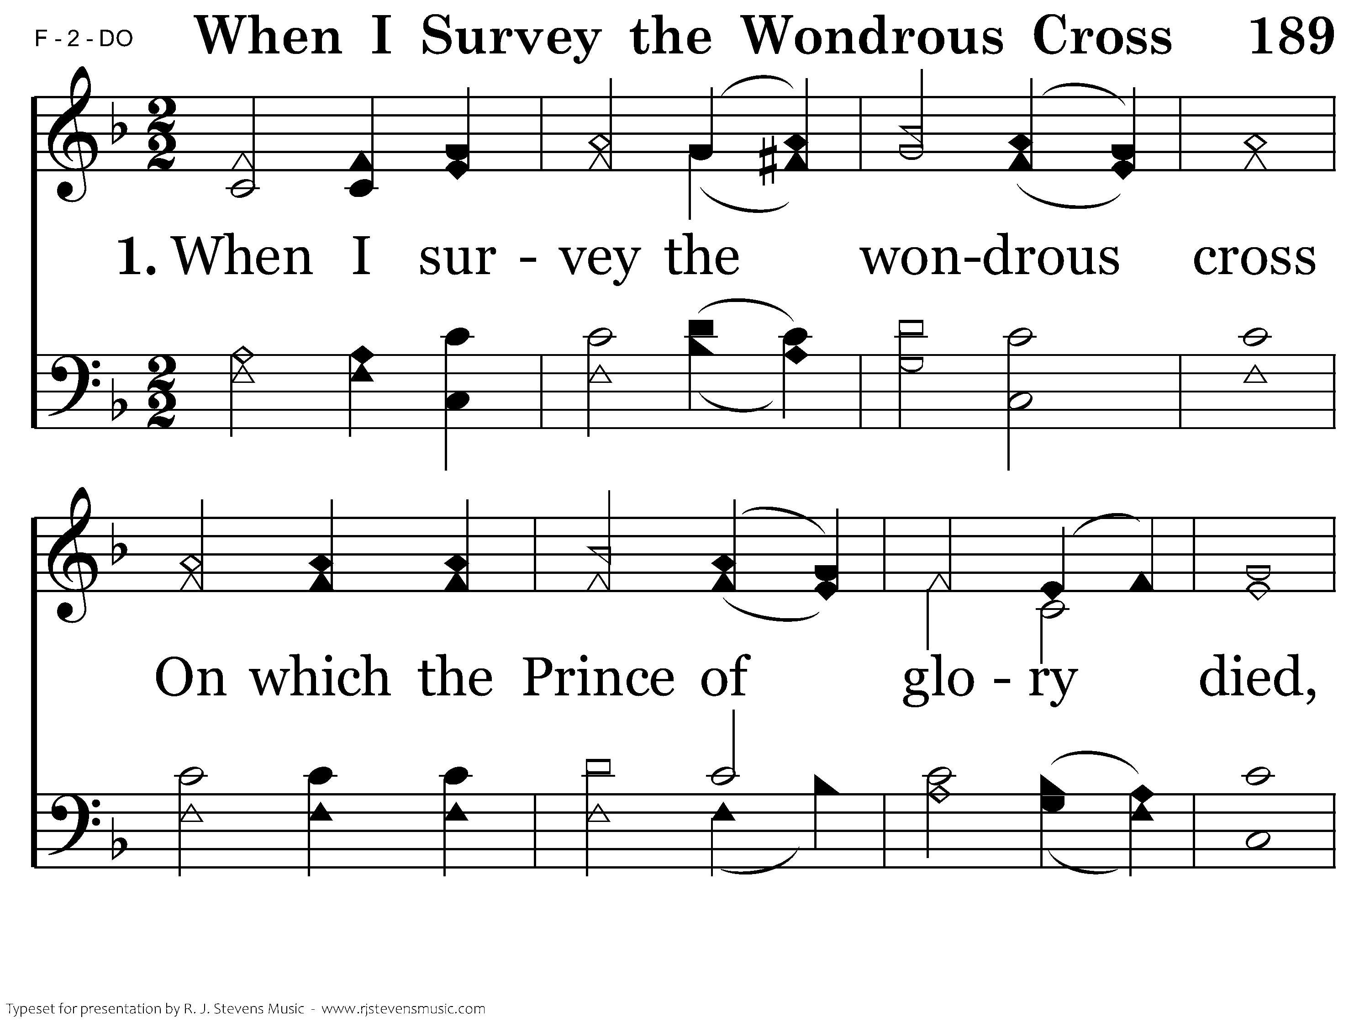
189 - When I Survey The Wondrous Cross - 1.1

Slide 43
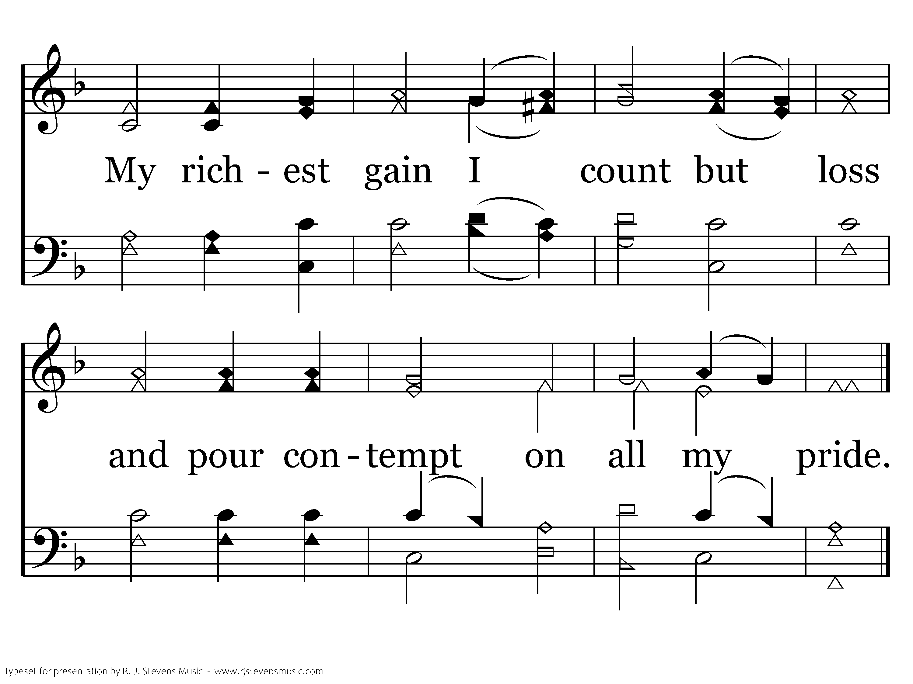
189 - When I Survey The Wondrous Cross - 1.2
End of Verse 1

Slide 44
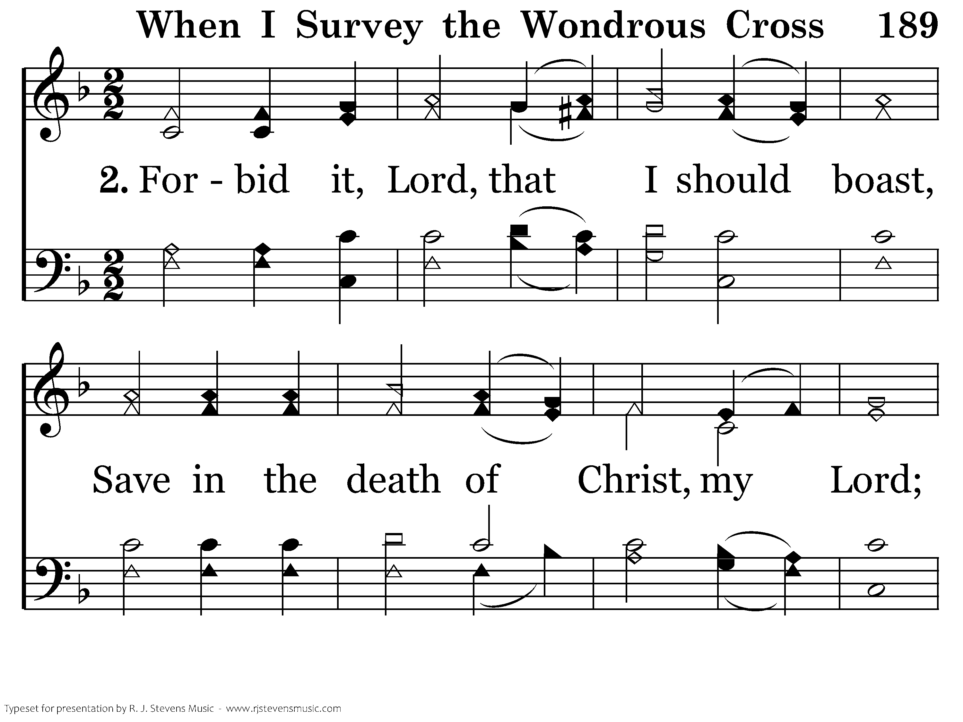
189 - When I Survey The Wondrous Cross - 2.1

Slide 45
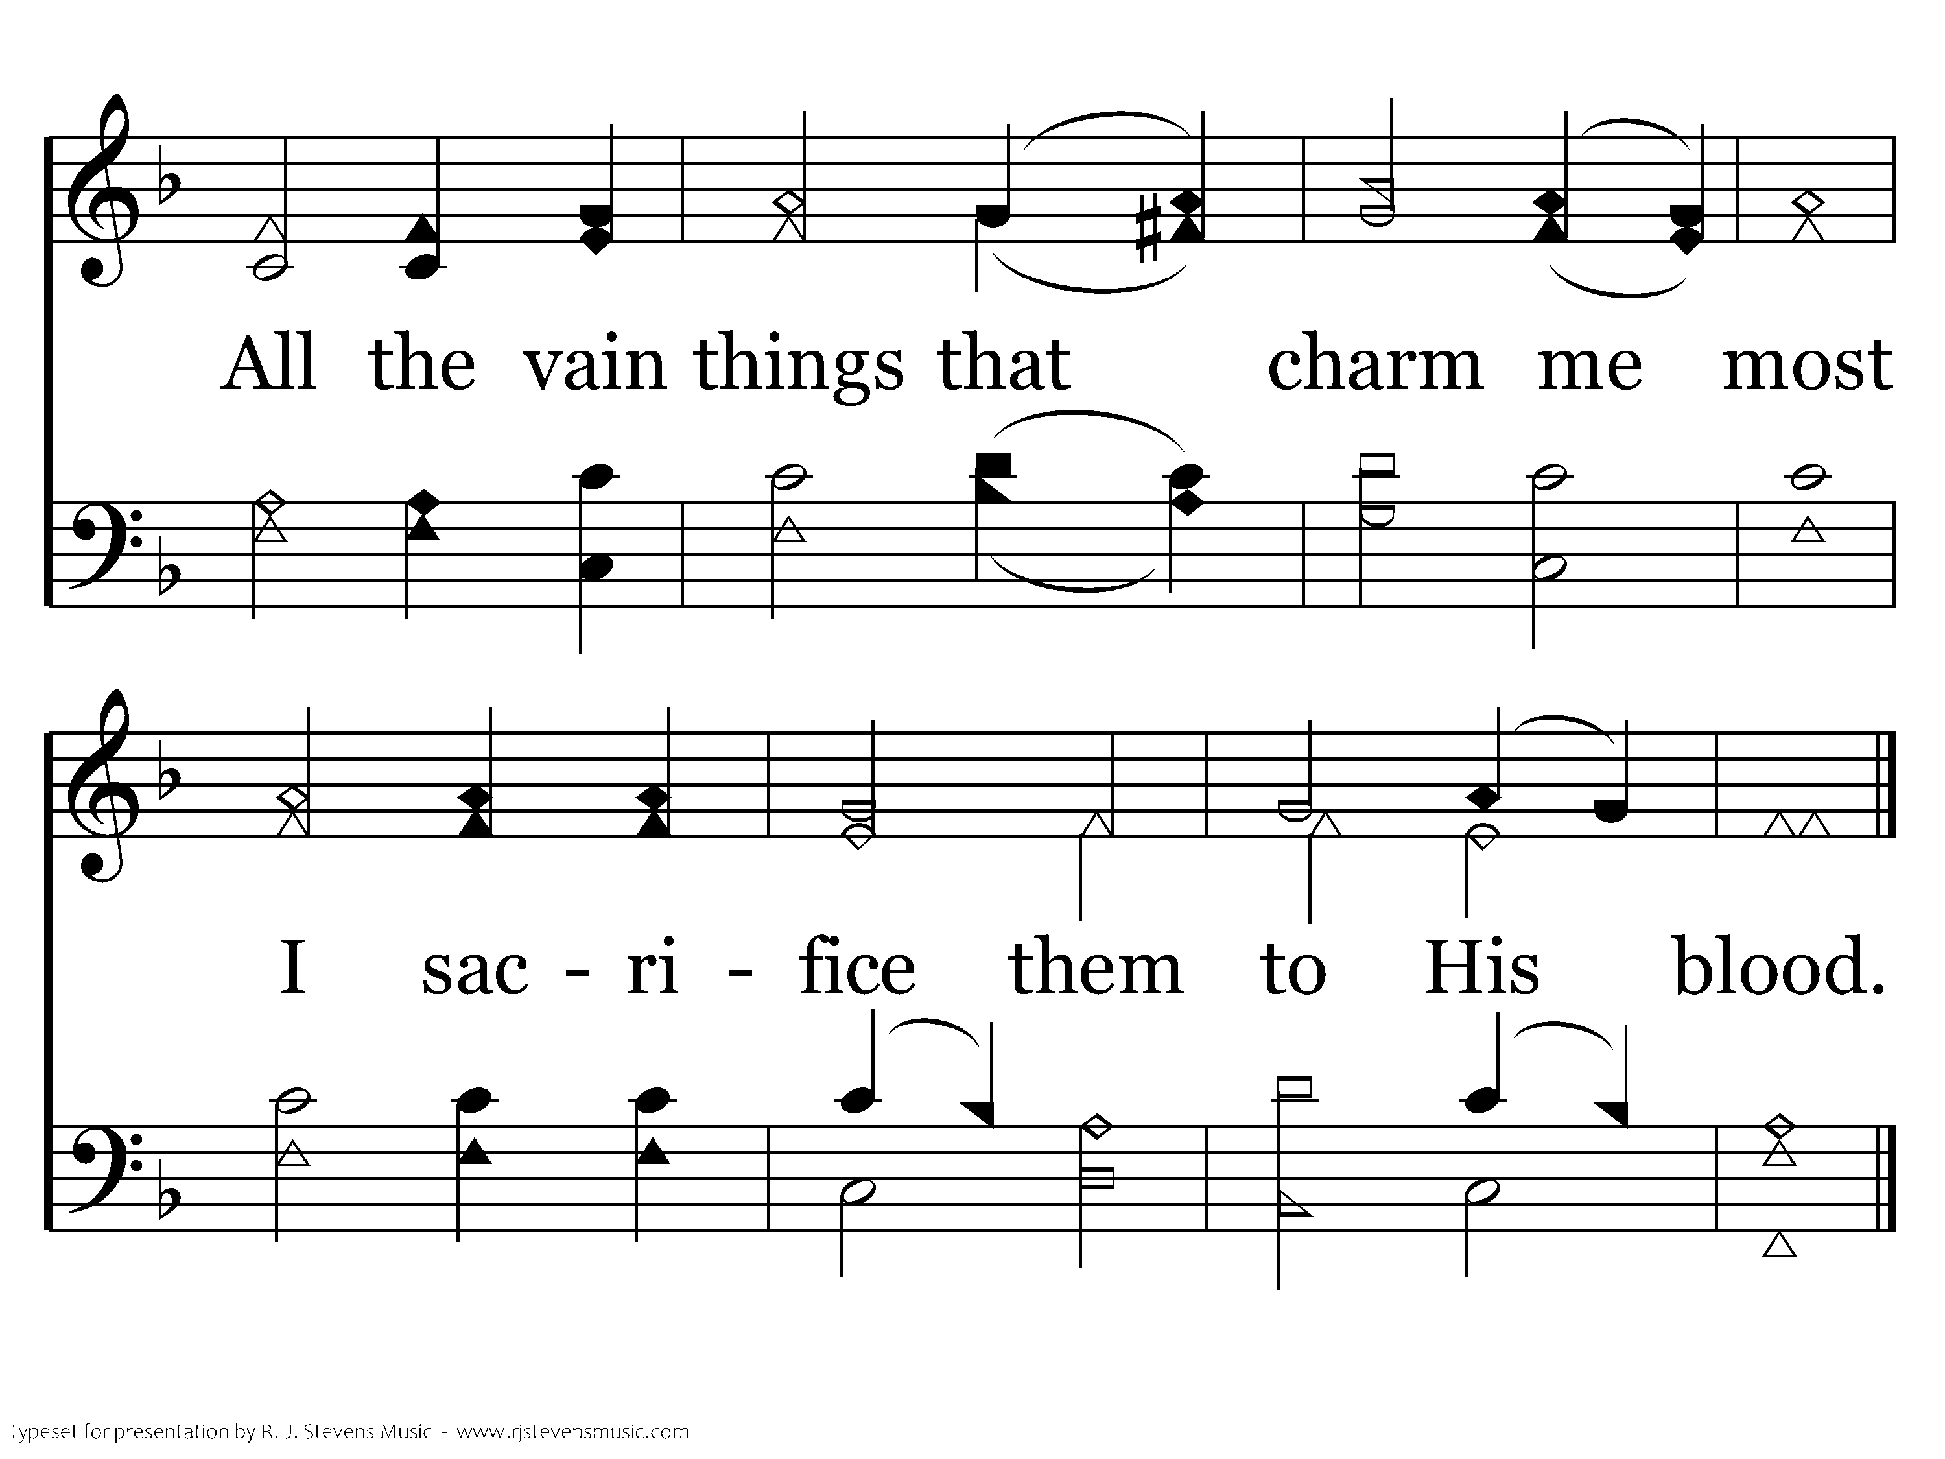
189 - When I Survey The Wondrous Cross - 2.2
End of Verse 2

Slide 46
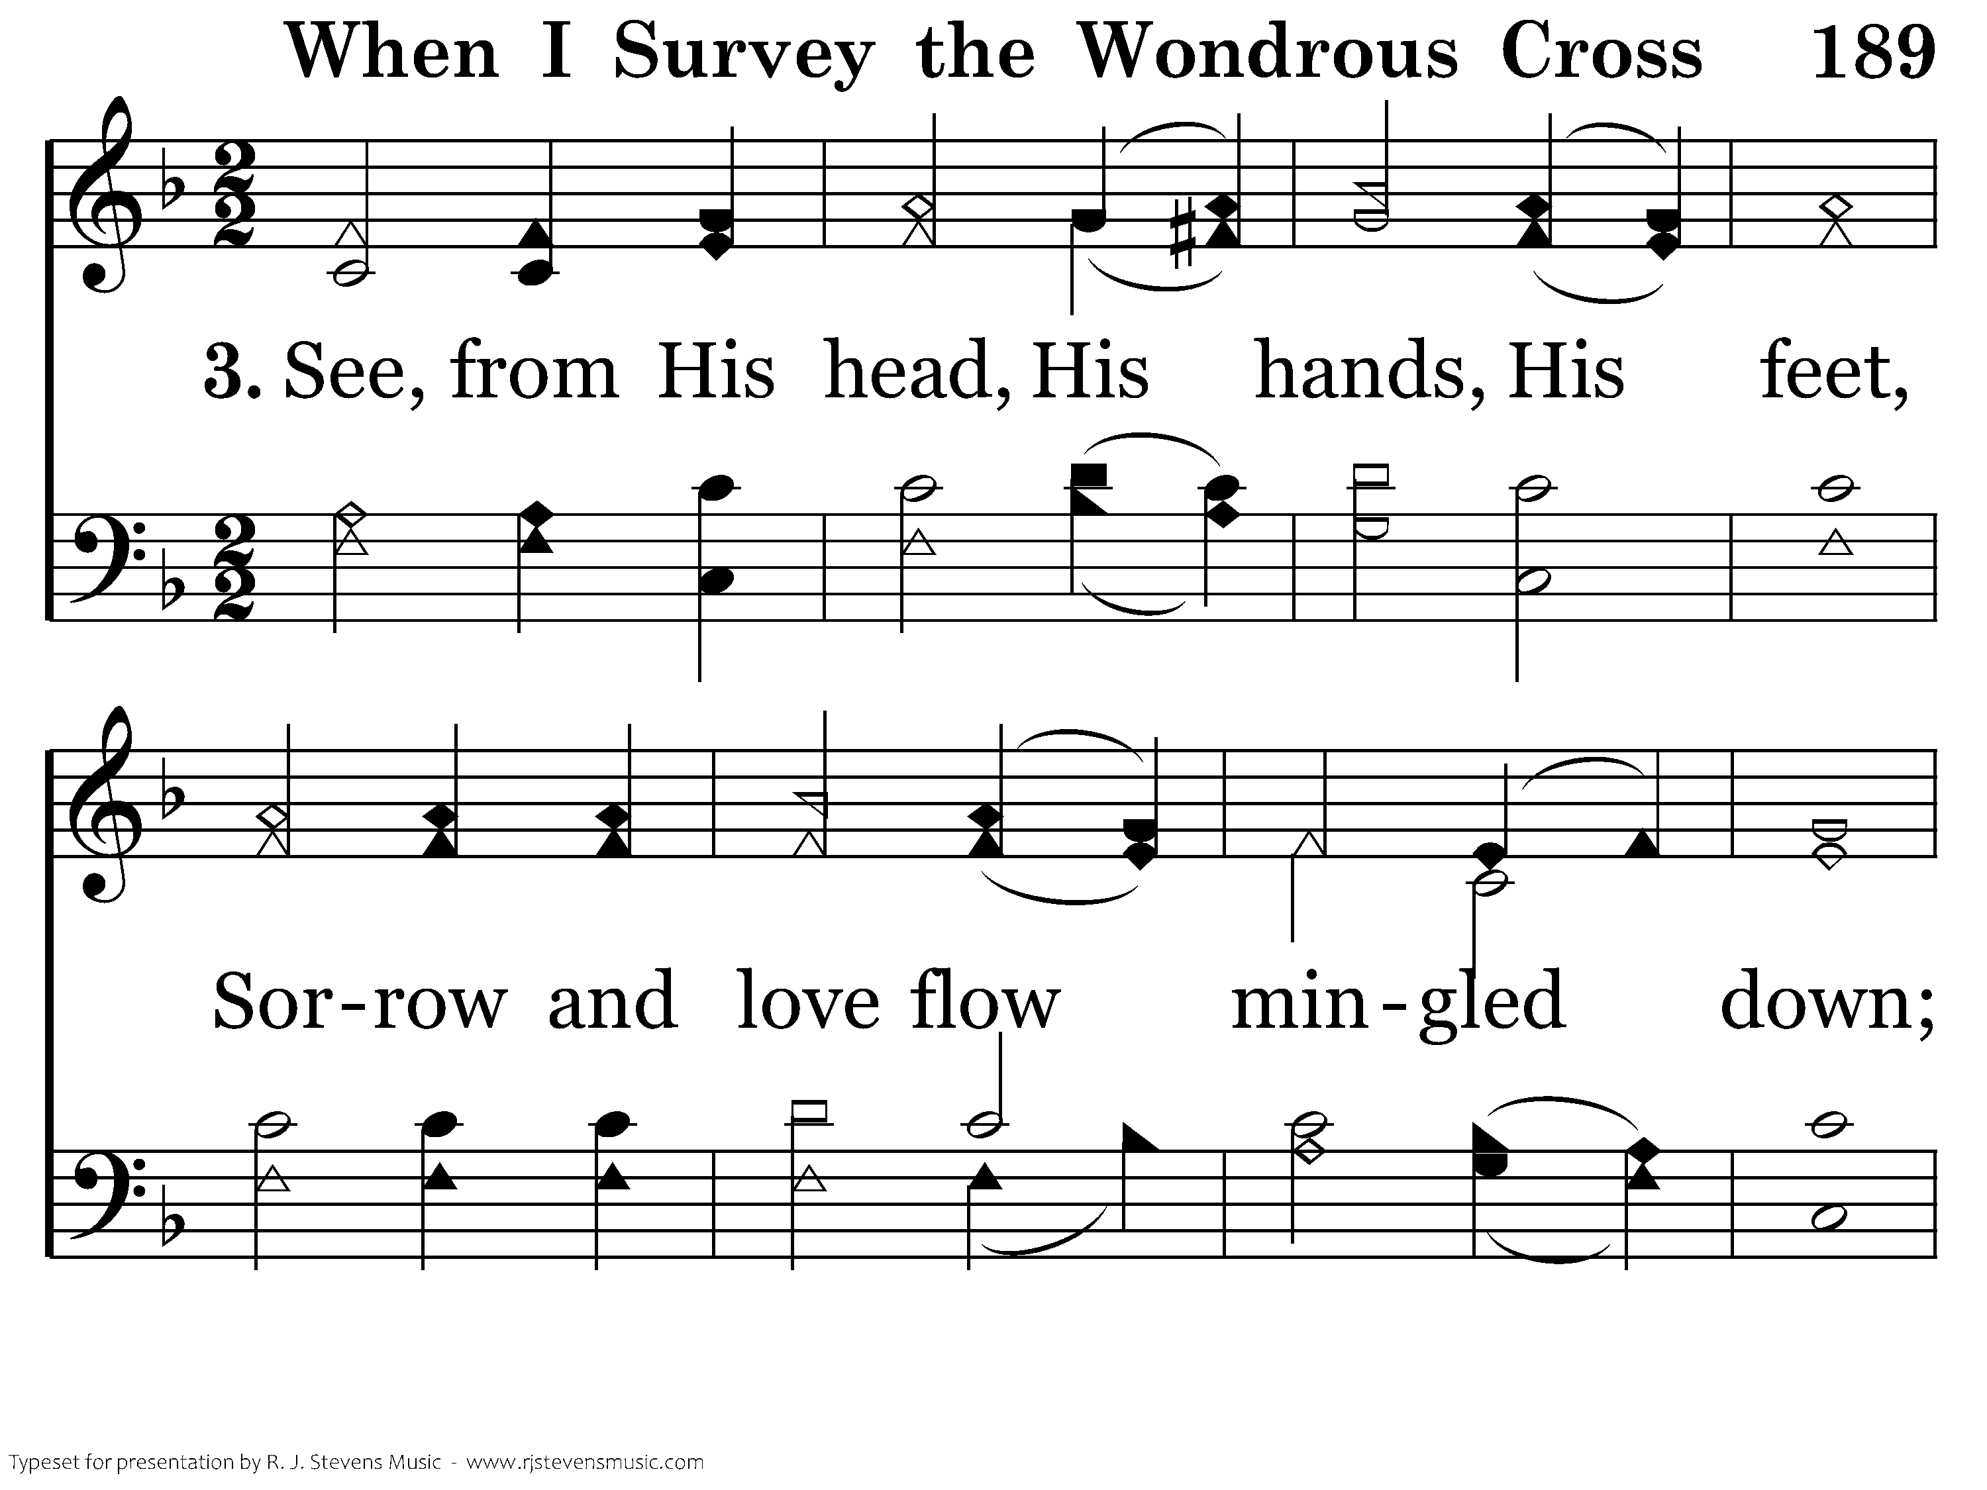
189 - When I Survey The Wondrous Cross - 3.1

Slide 47
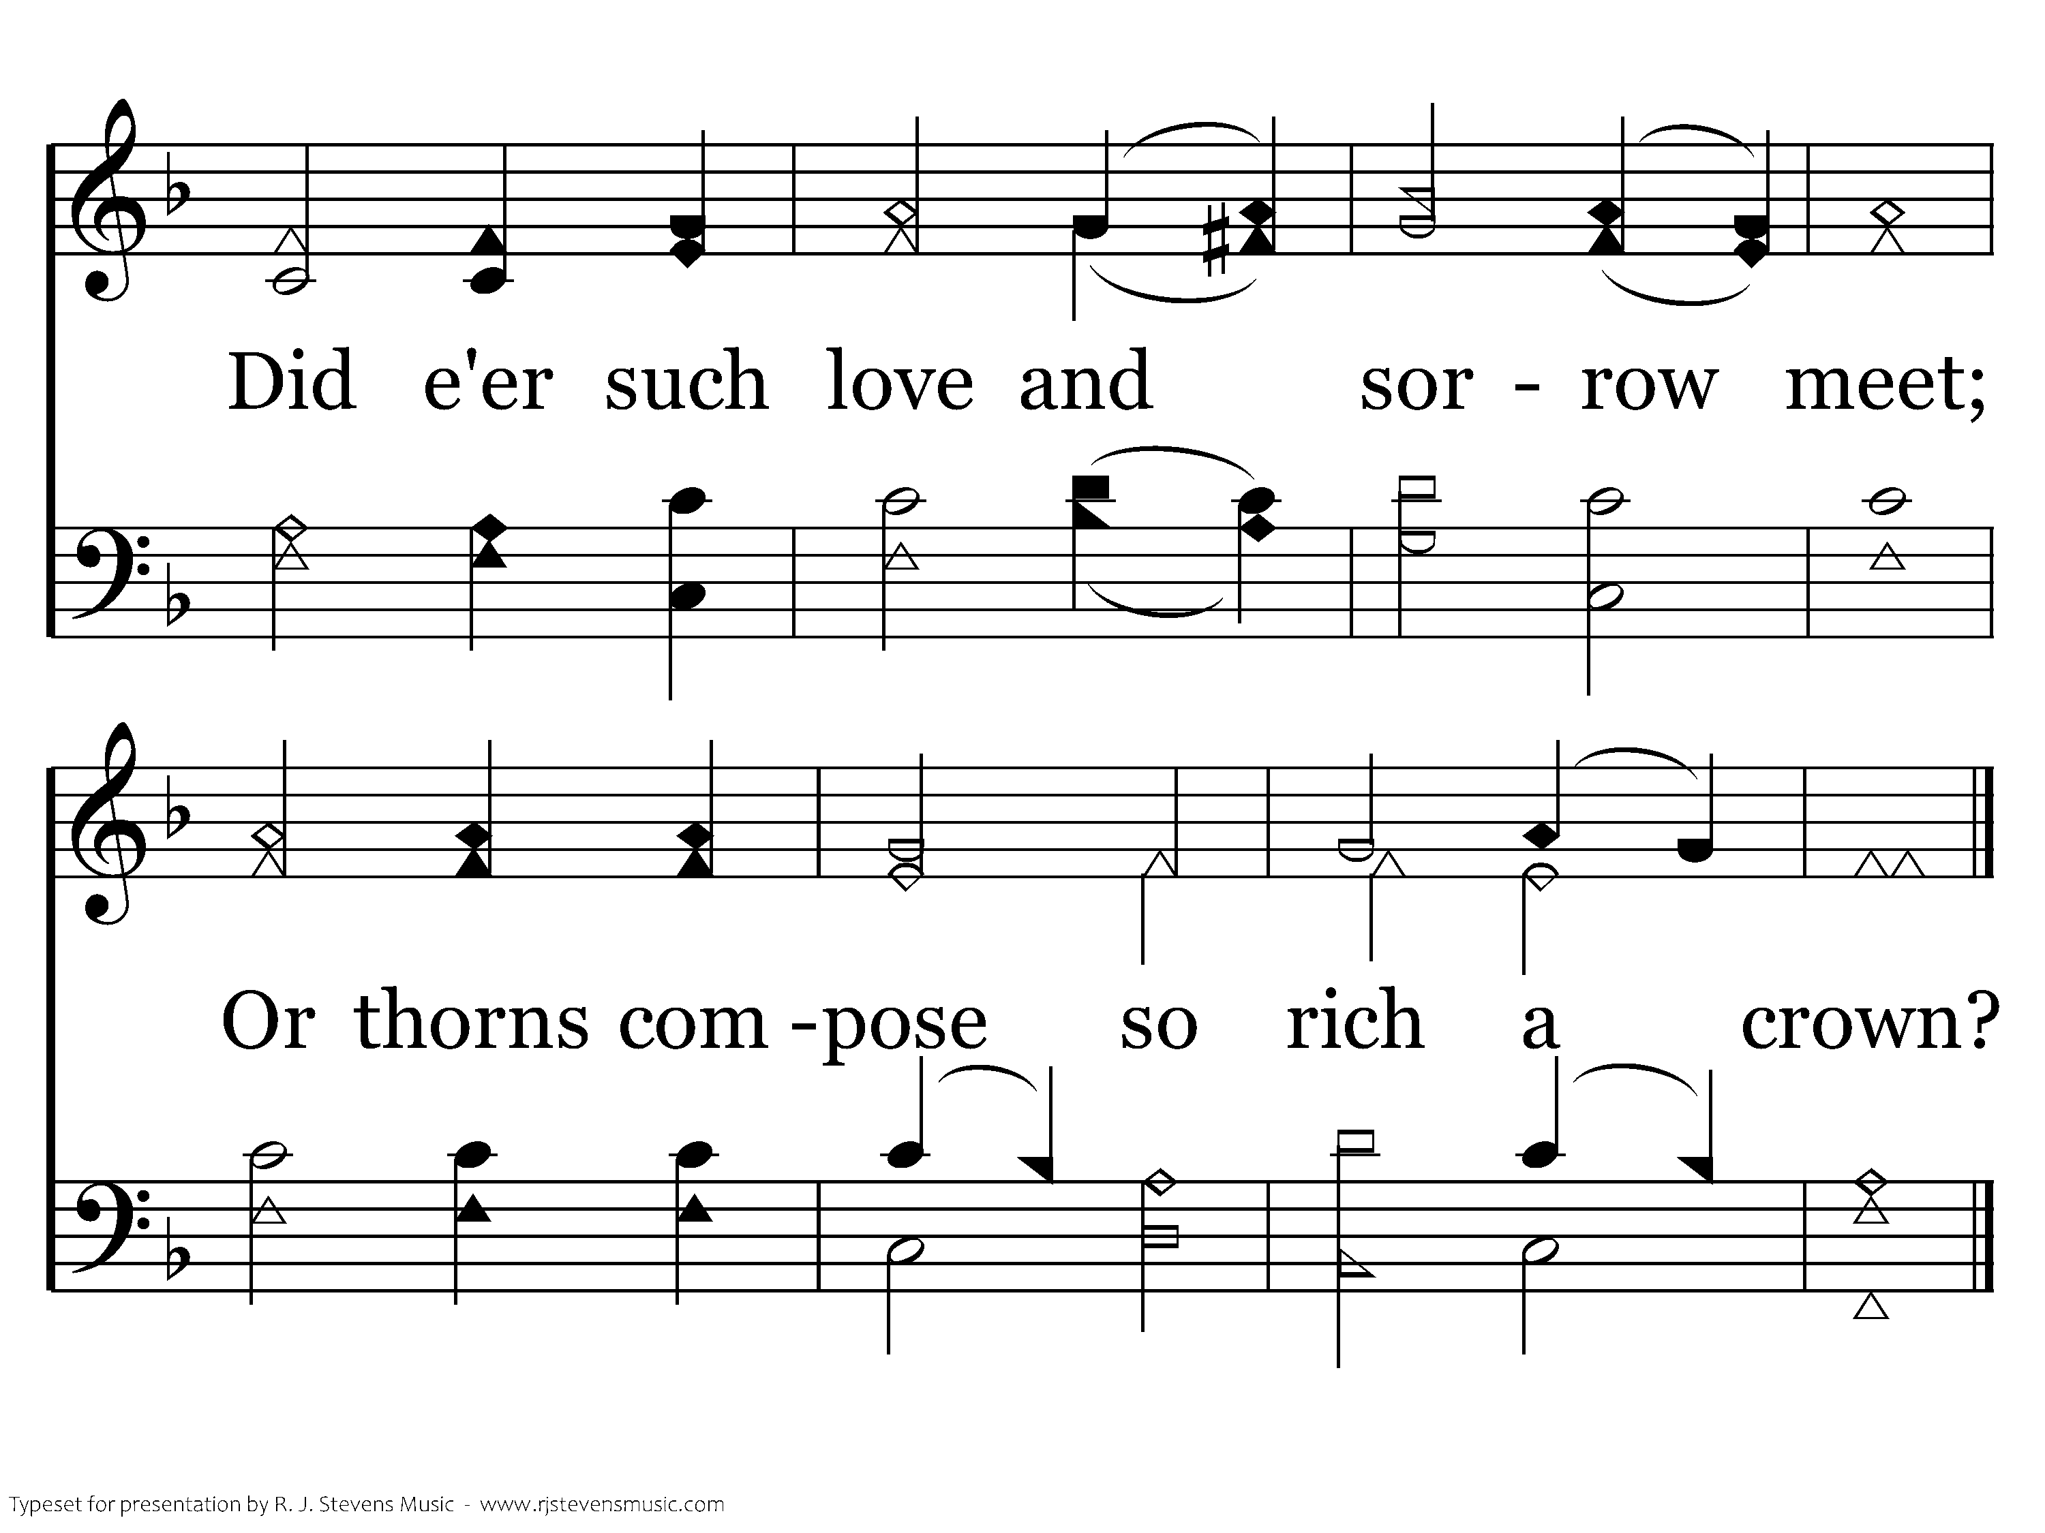
189 - When I Survey The Wondrous Cross - 3.2
End of Verse 3

Slide 48
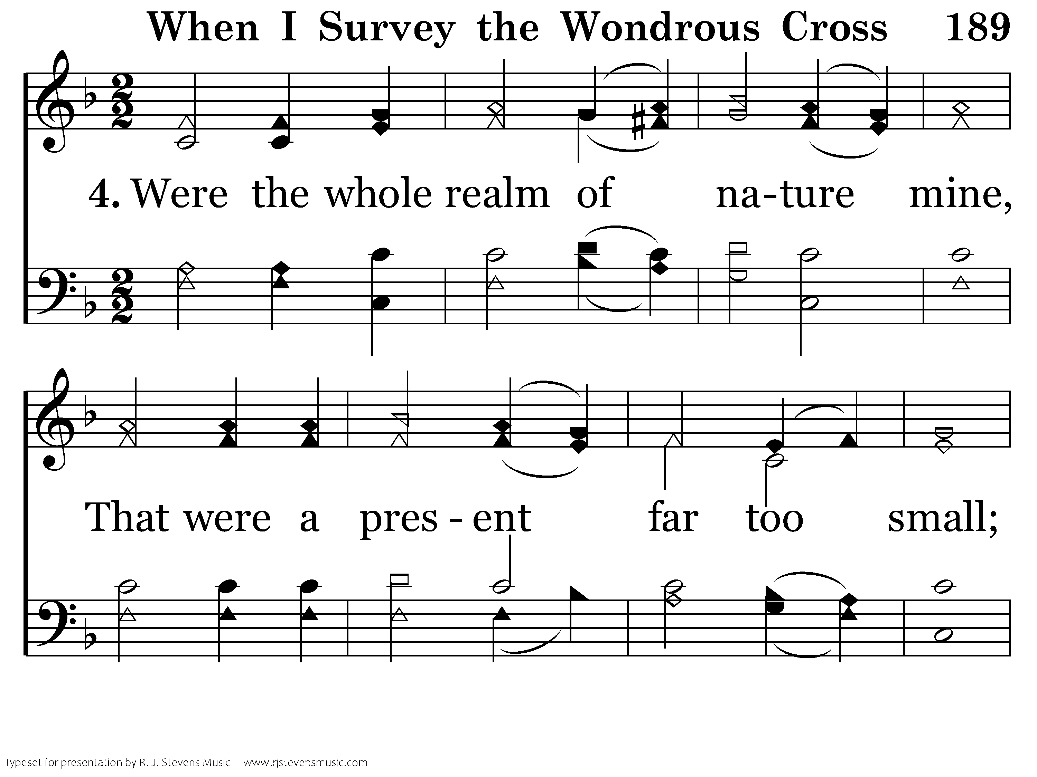
189 - When I Survey The Wondrous Cross - 4.1

Slide 49
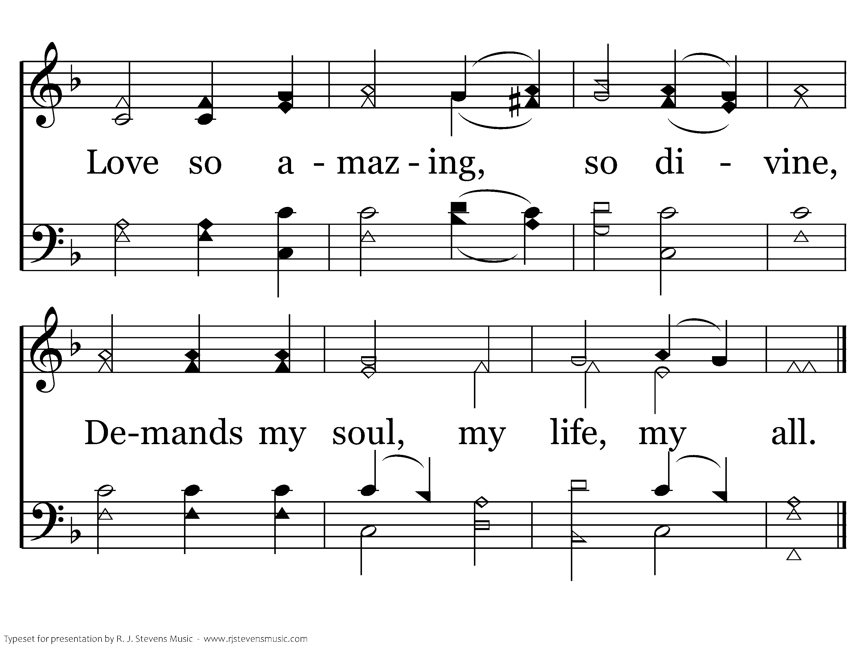
189 - When I Survey The Wondrous Cross - 4.2
End of Song

Slide 50
<none>

Slide 51
Lord’s Supper
Chase Clark

Slide 52
<none>

Slide 53

But He was pierced for our transgressions, He was crushed for our iniquities; the punishment that brought us peace was on Him, and by His wounds we are healed.
Isaiah 53:5

Slide 54
<none>

Slide 55
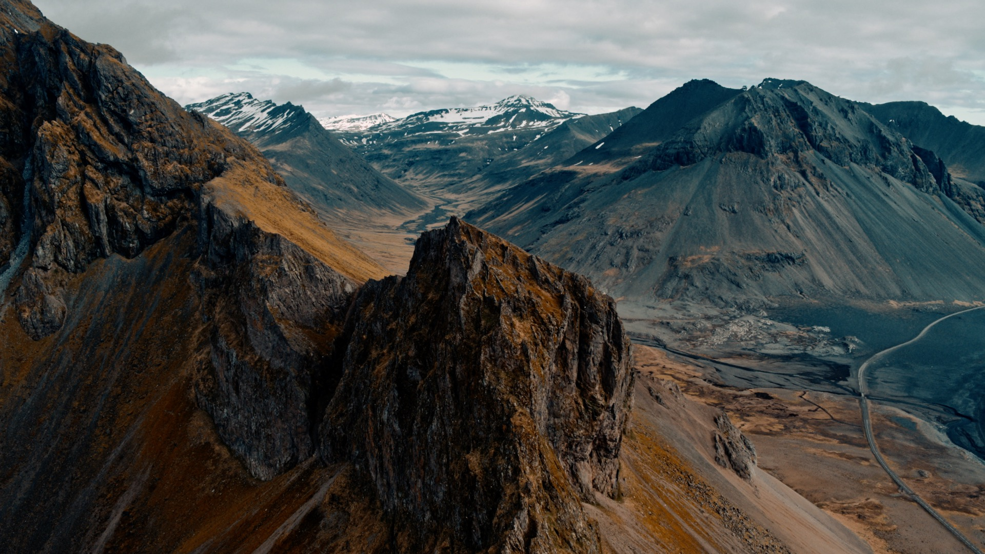
Now may our Lord Jesus Christ Himself, and God our Father, who loved us and gave us eternal comfort and good hope through grace, comfort your hearts and establish them in every good work and word.
2 Thes 2:16-17

Slide 56
<none>

Slide 57
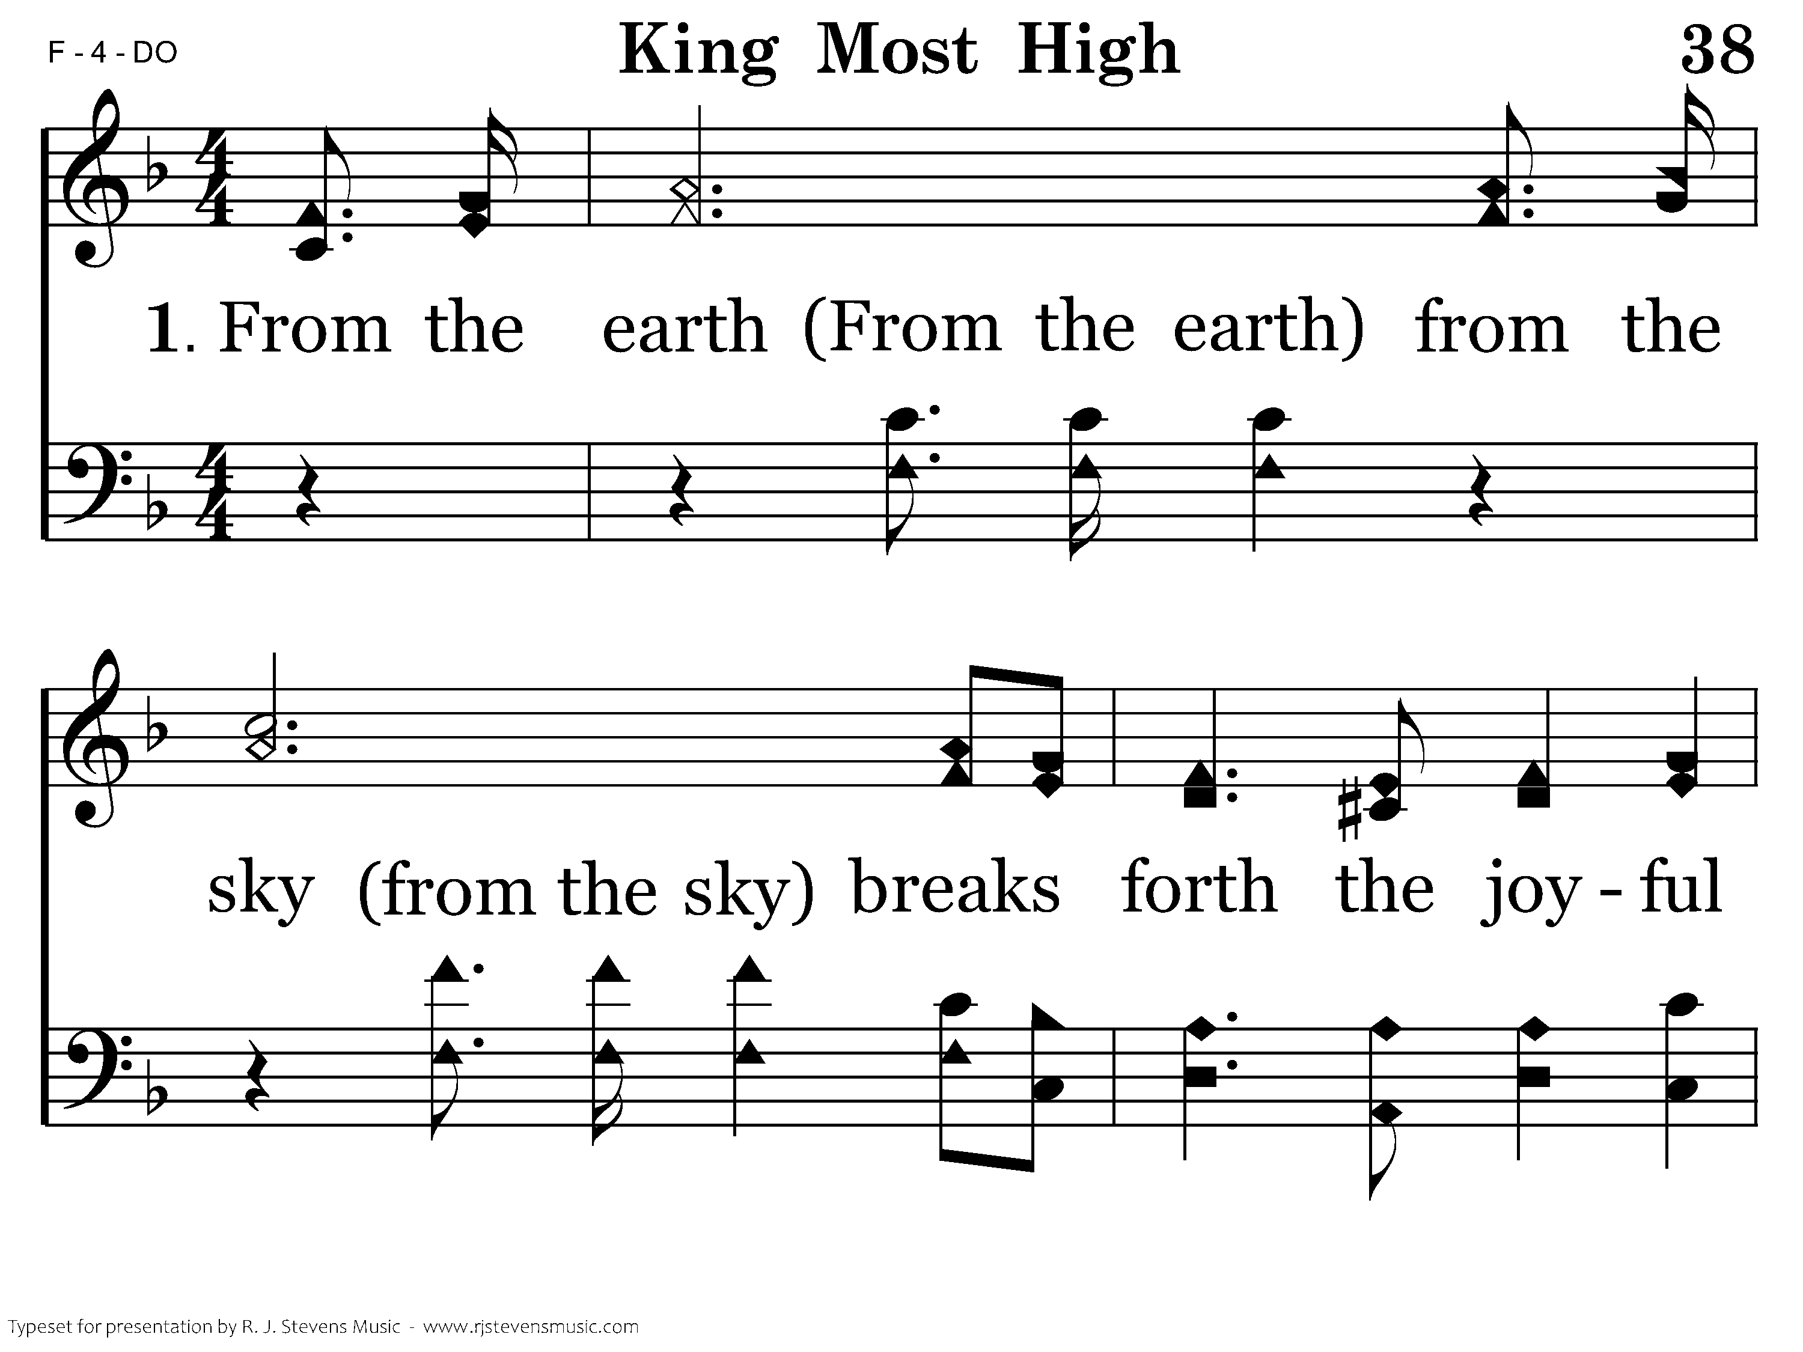
038 - King Most High - 1.1

Slide 58
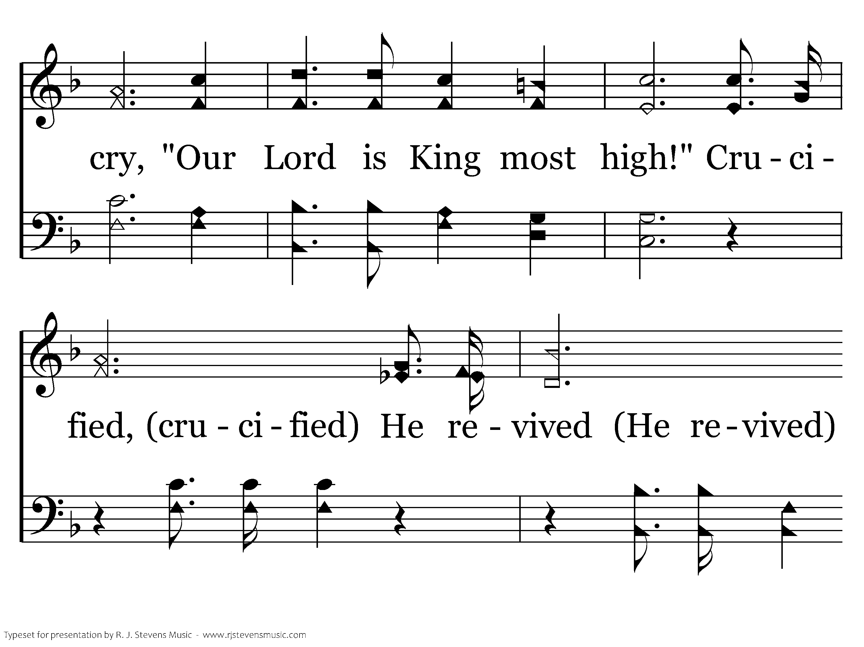
038 - King Most High - 1.2

Slide 59
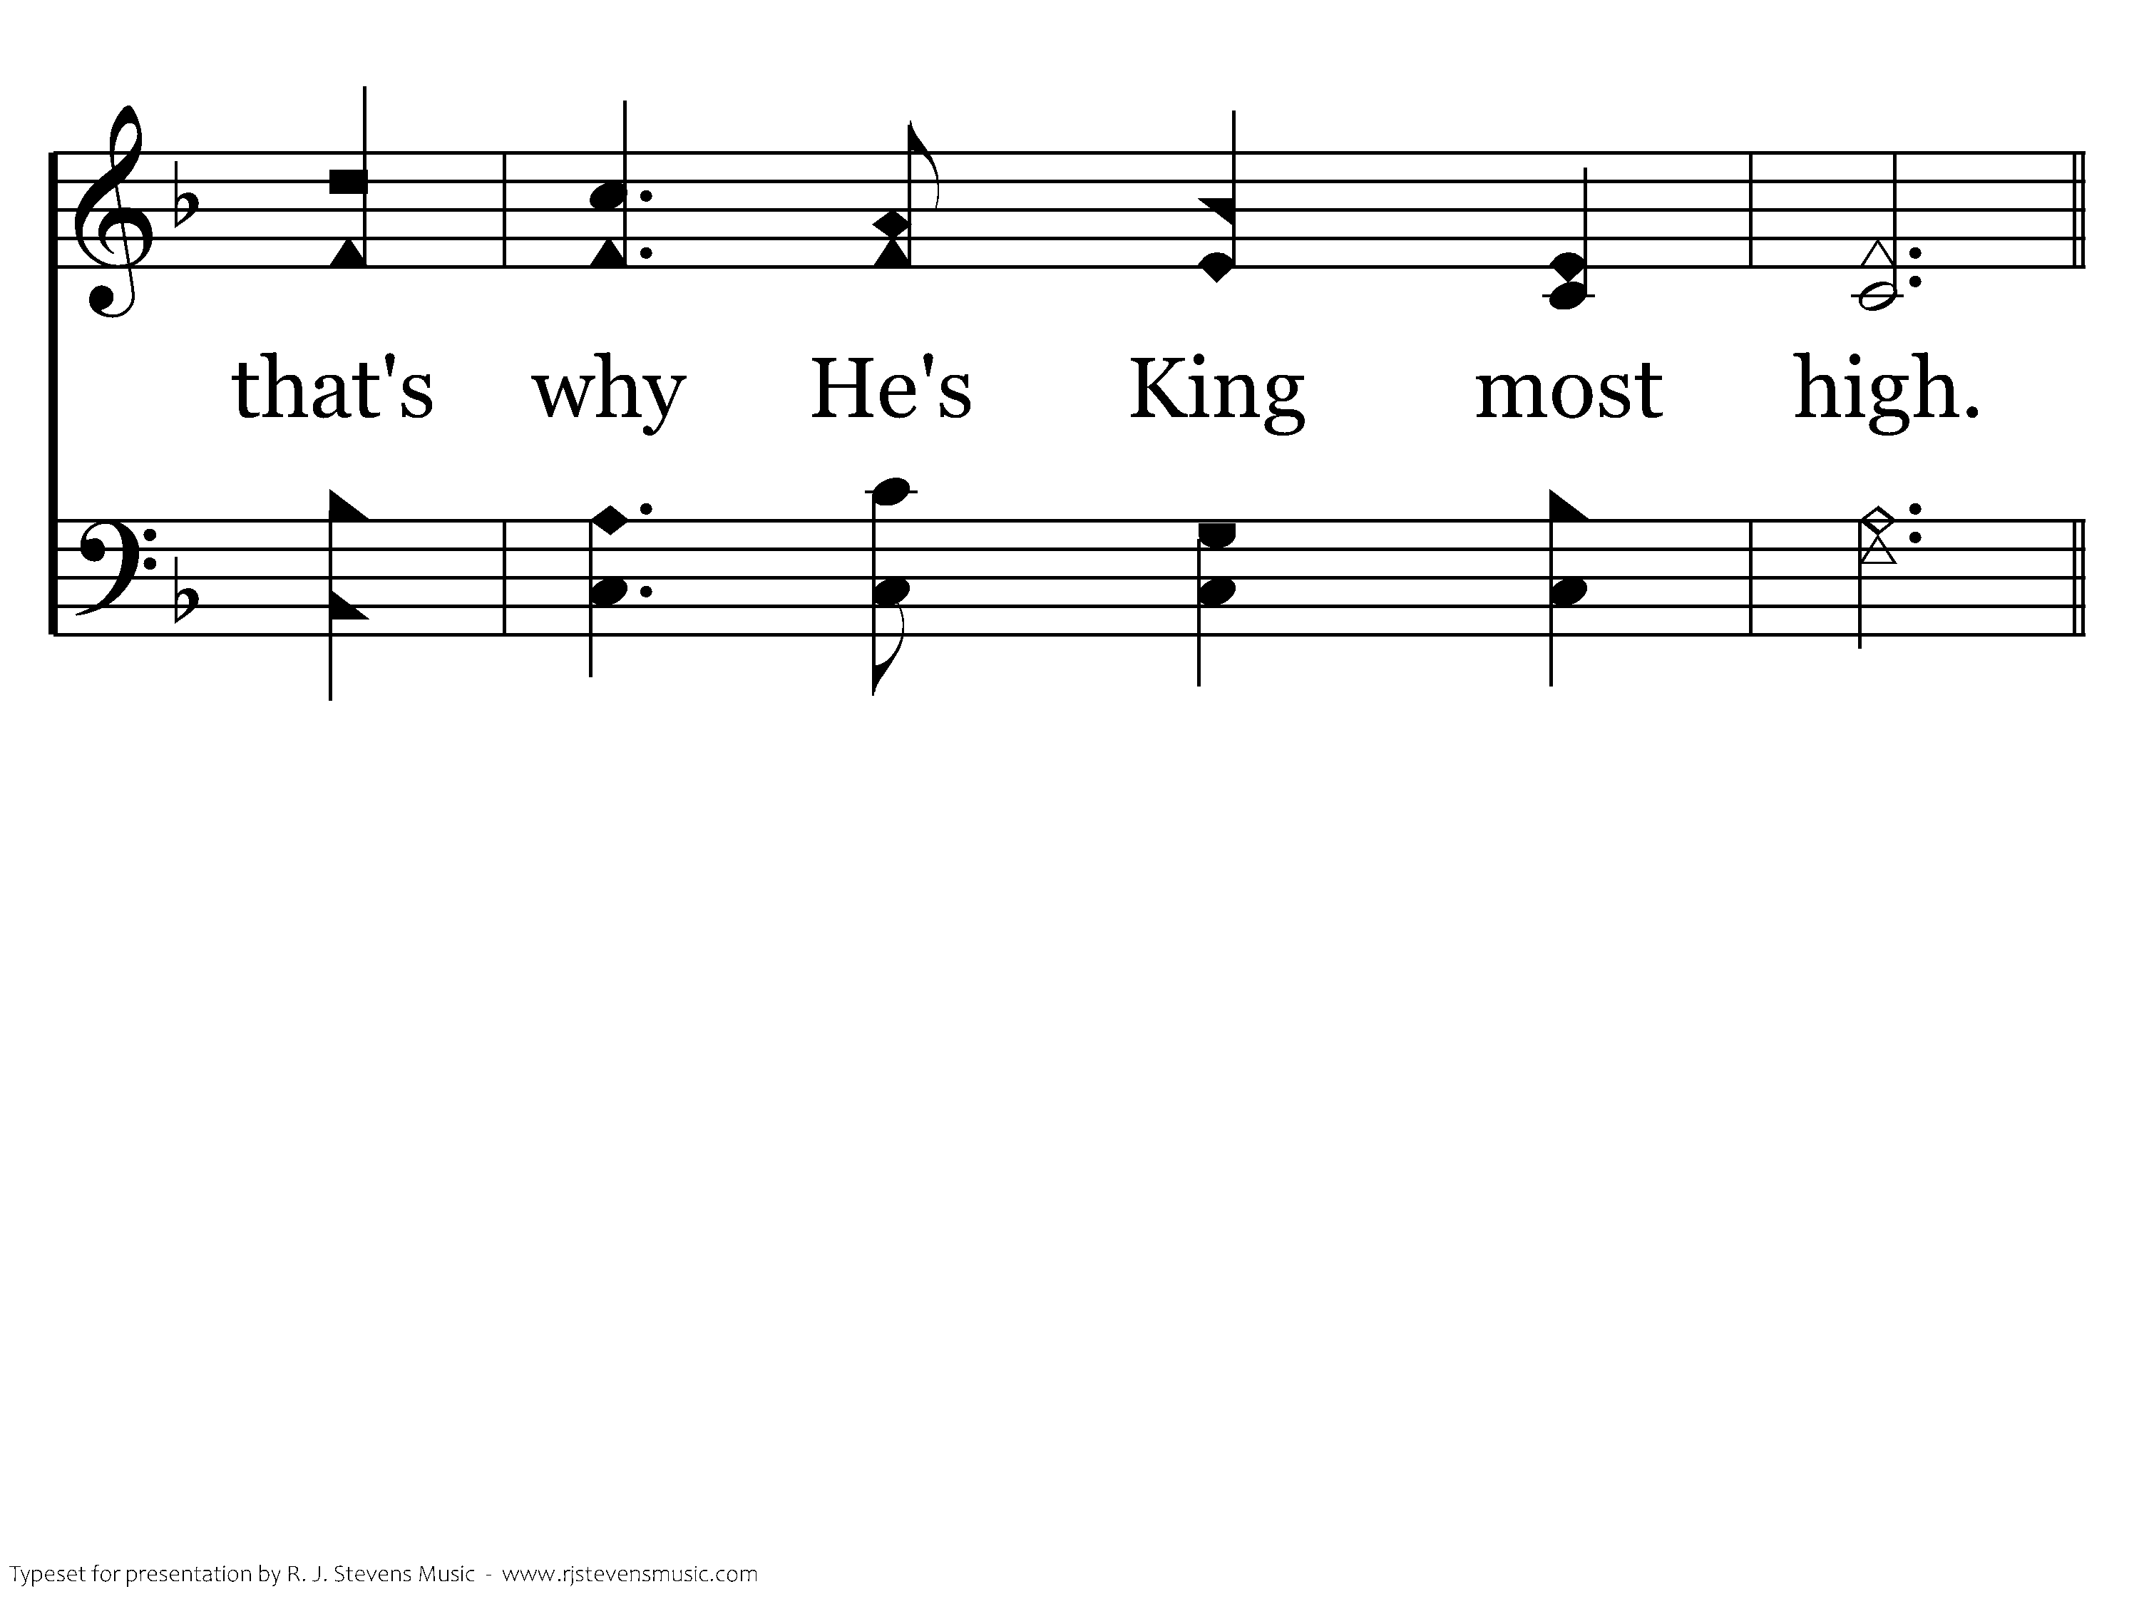
038 - King Most High - 1.3

Slide 60
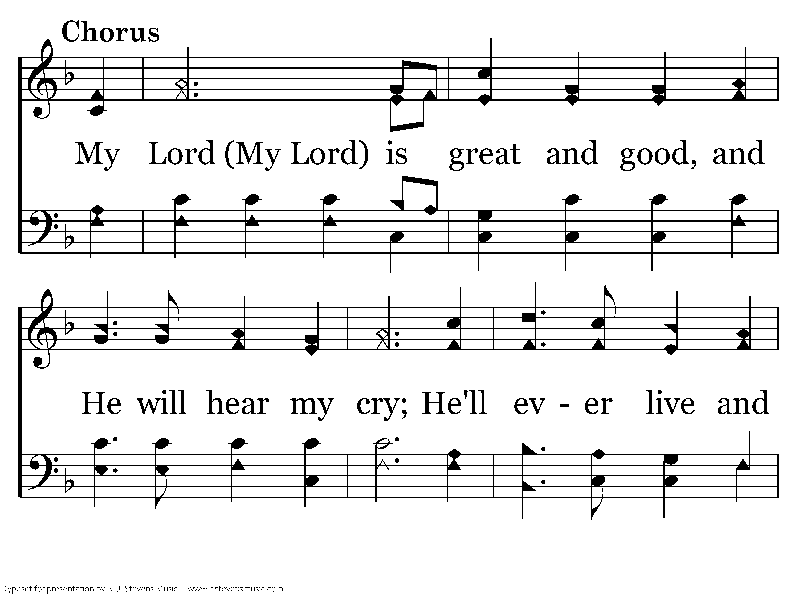
038 - King Most High - C.1

Slide 61
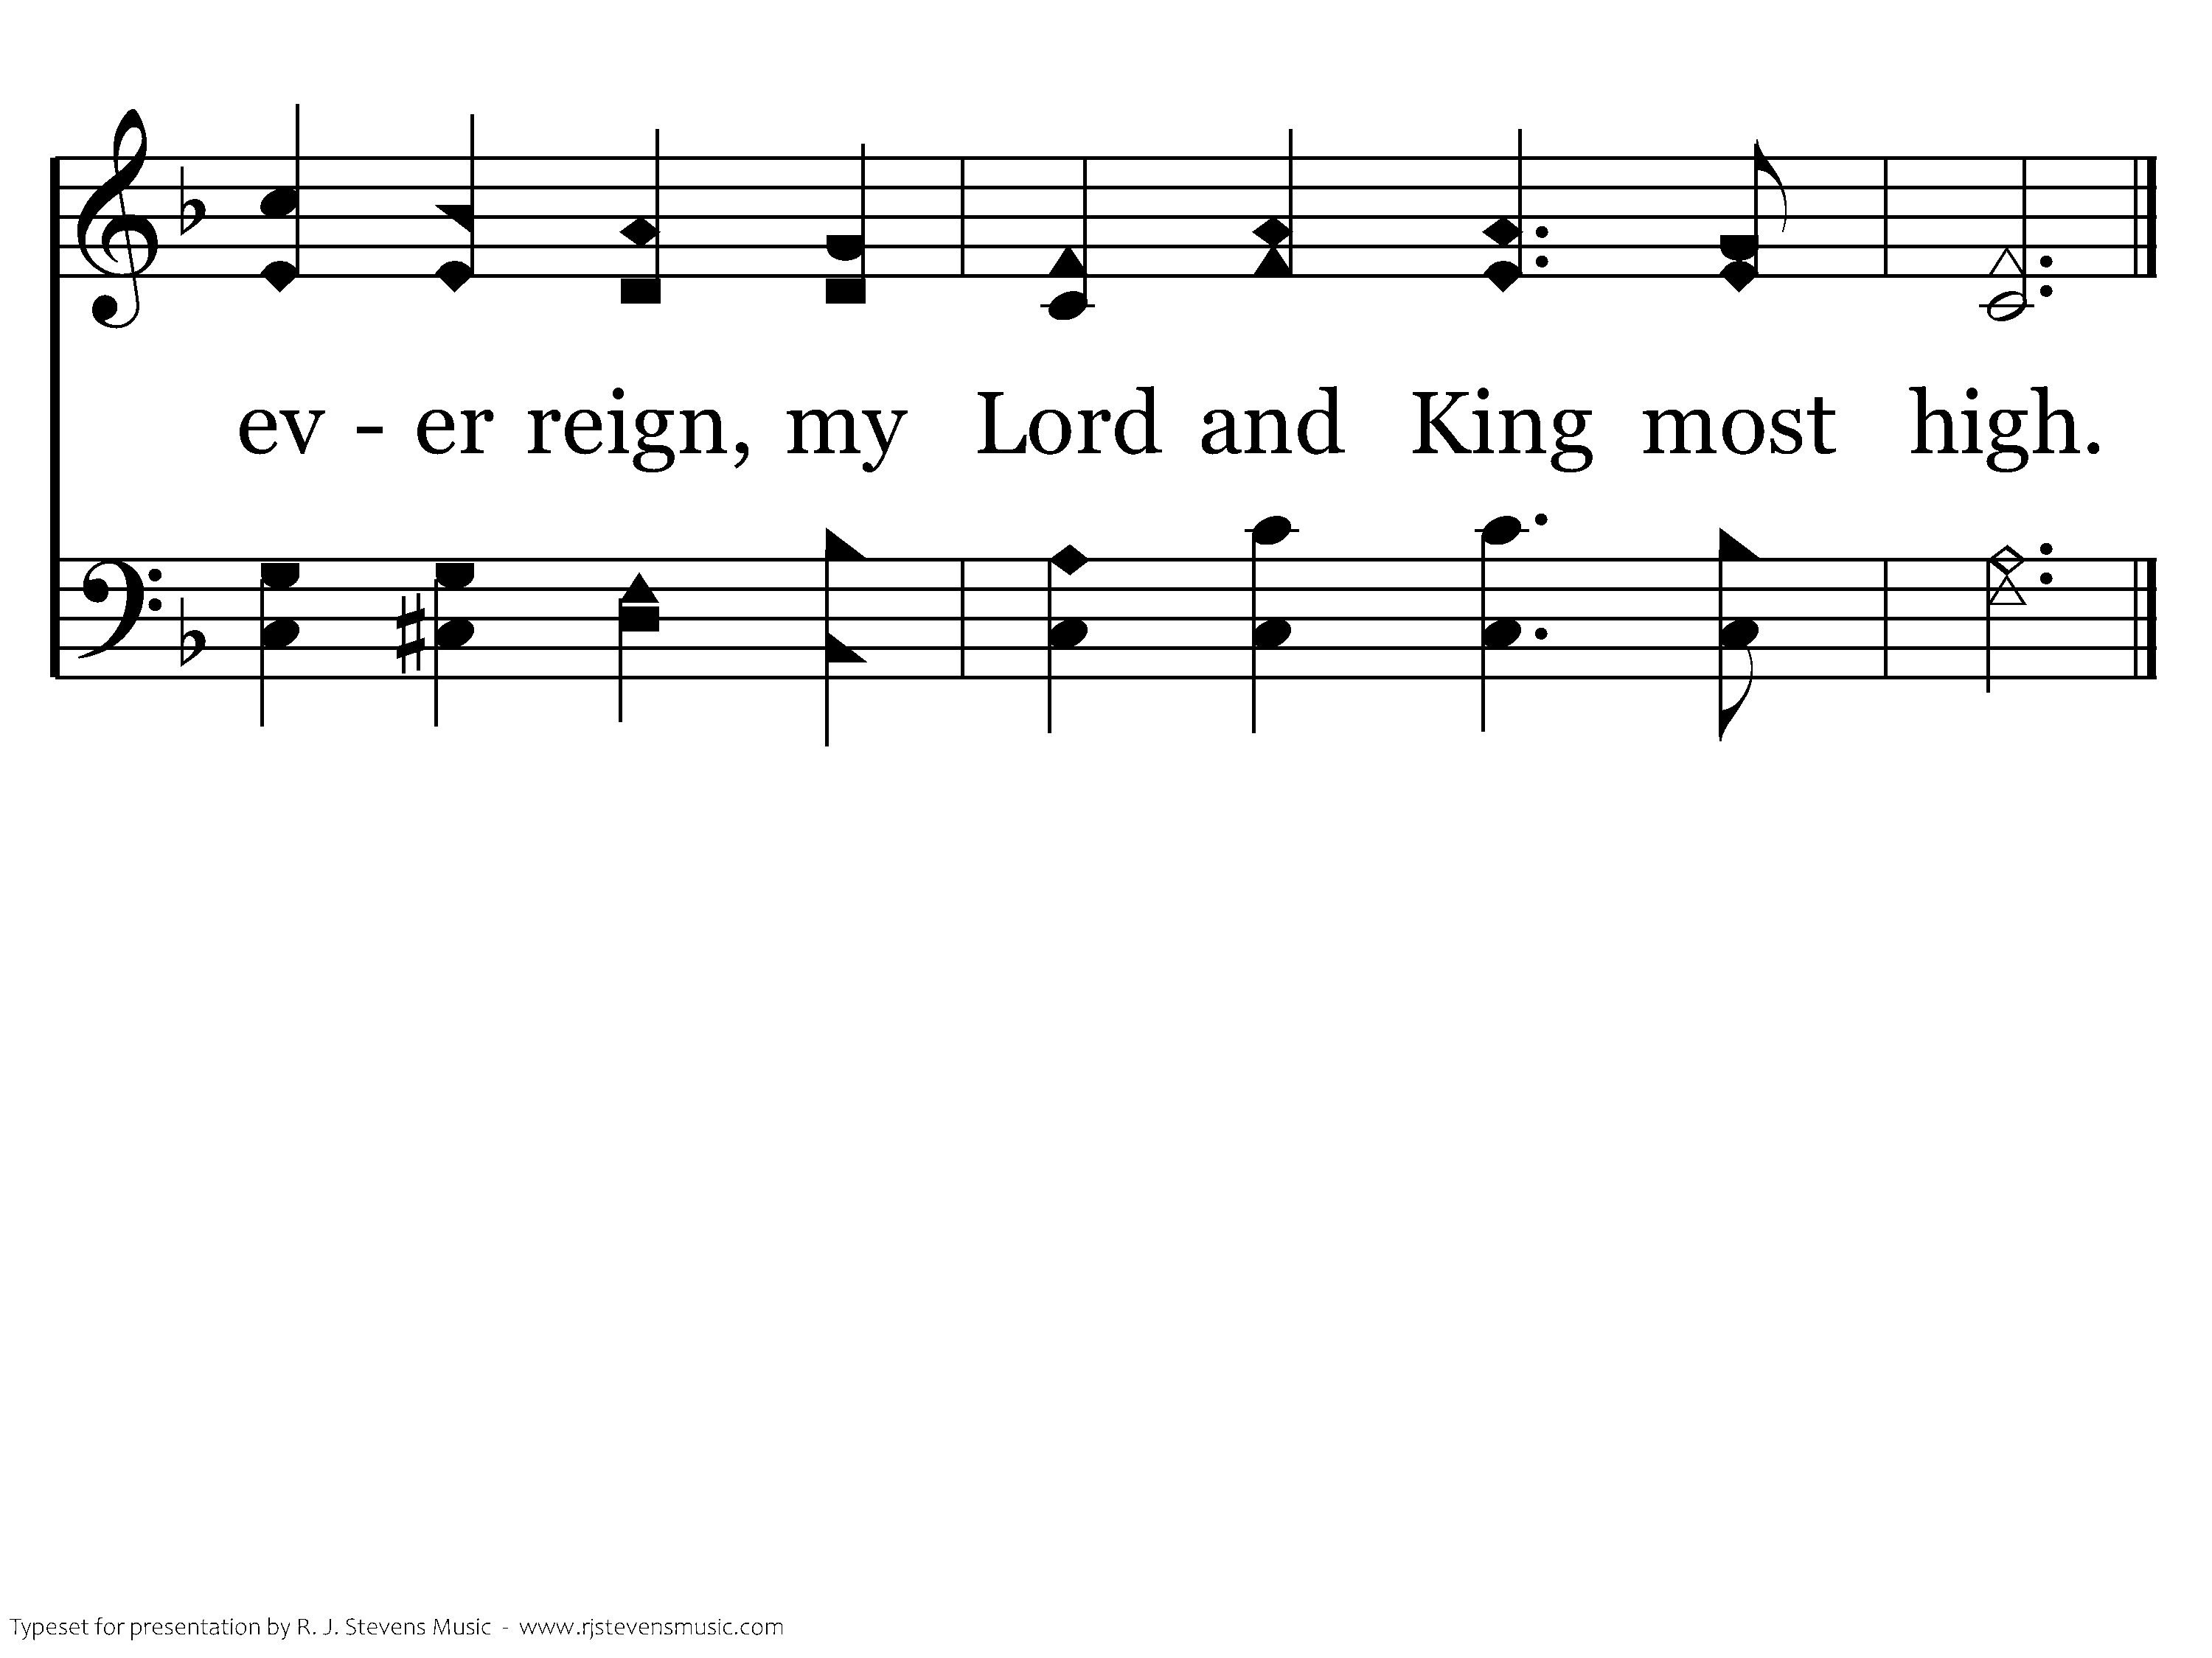
038 - King Most High - C.2
End of Verse 1

Slide 62
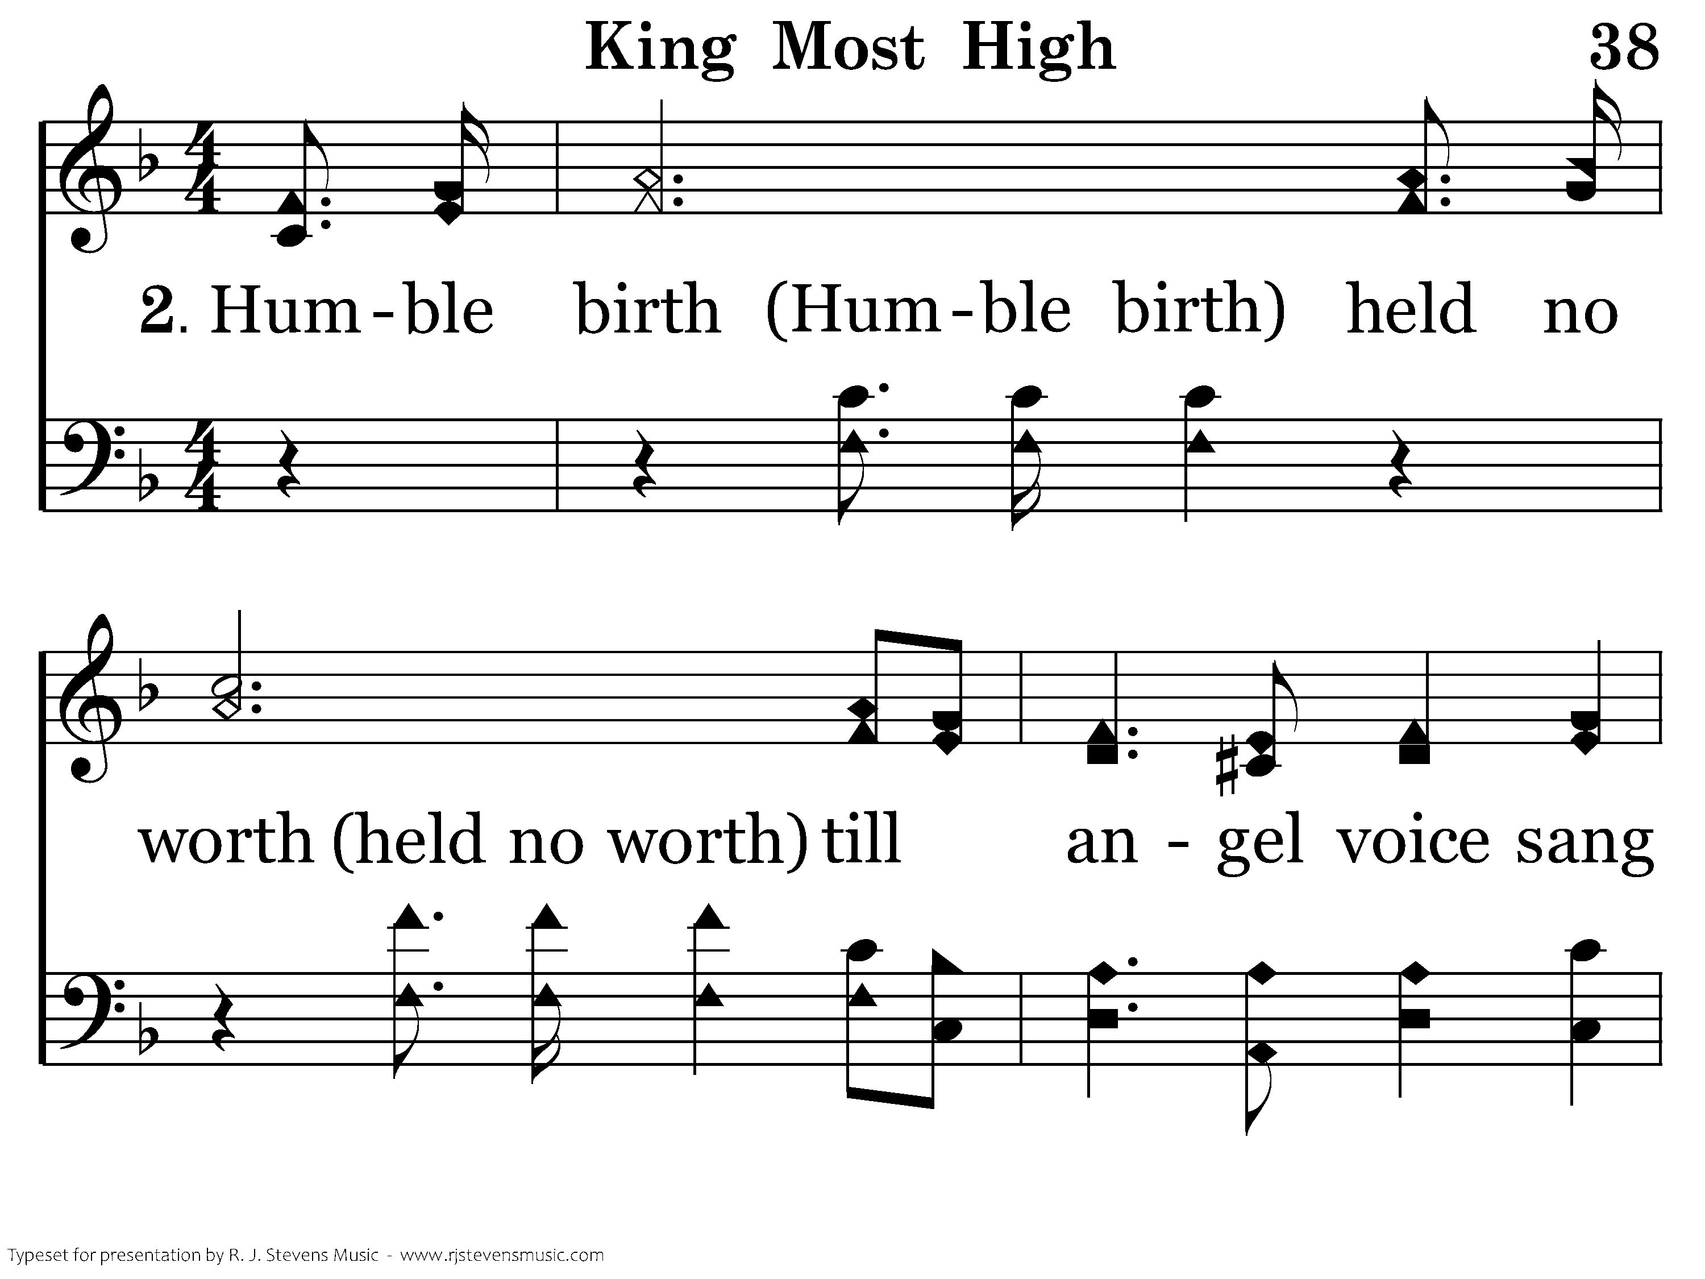
038 - King Most High - 2.1

Slide 63
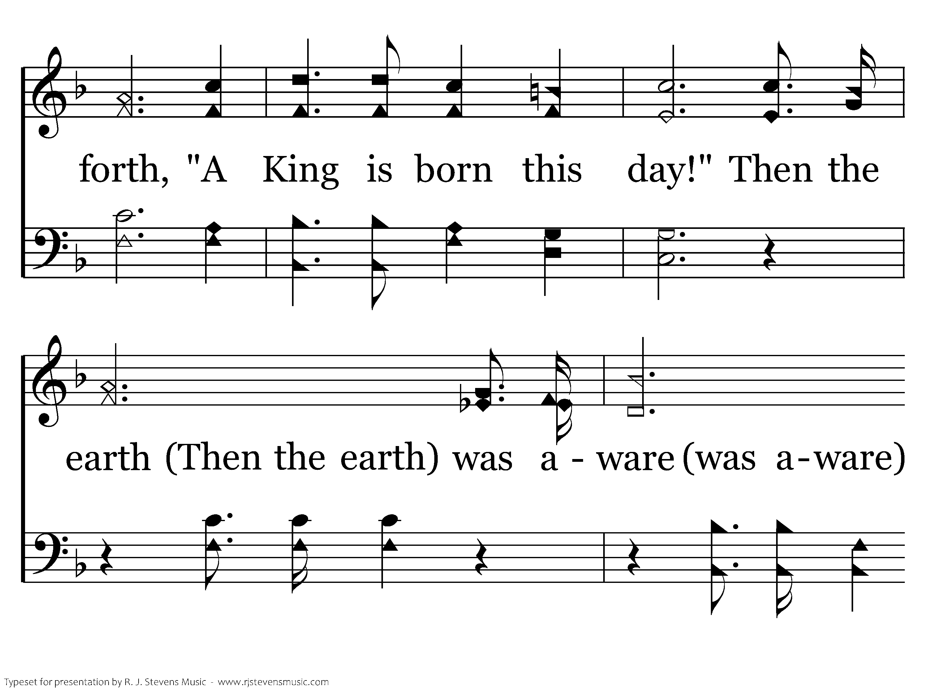
038 - King Most High - 2.2

Slide 64
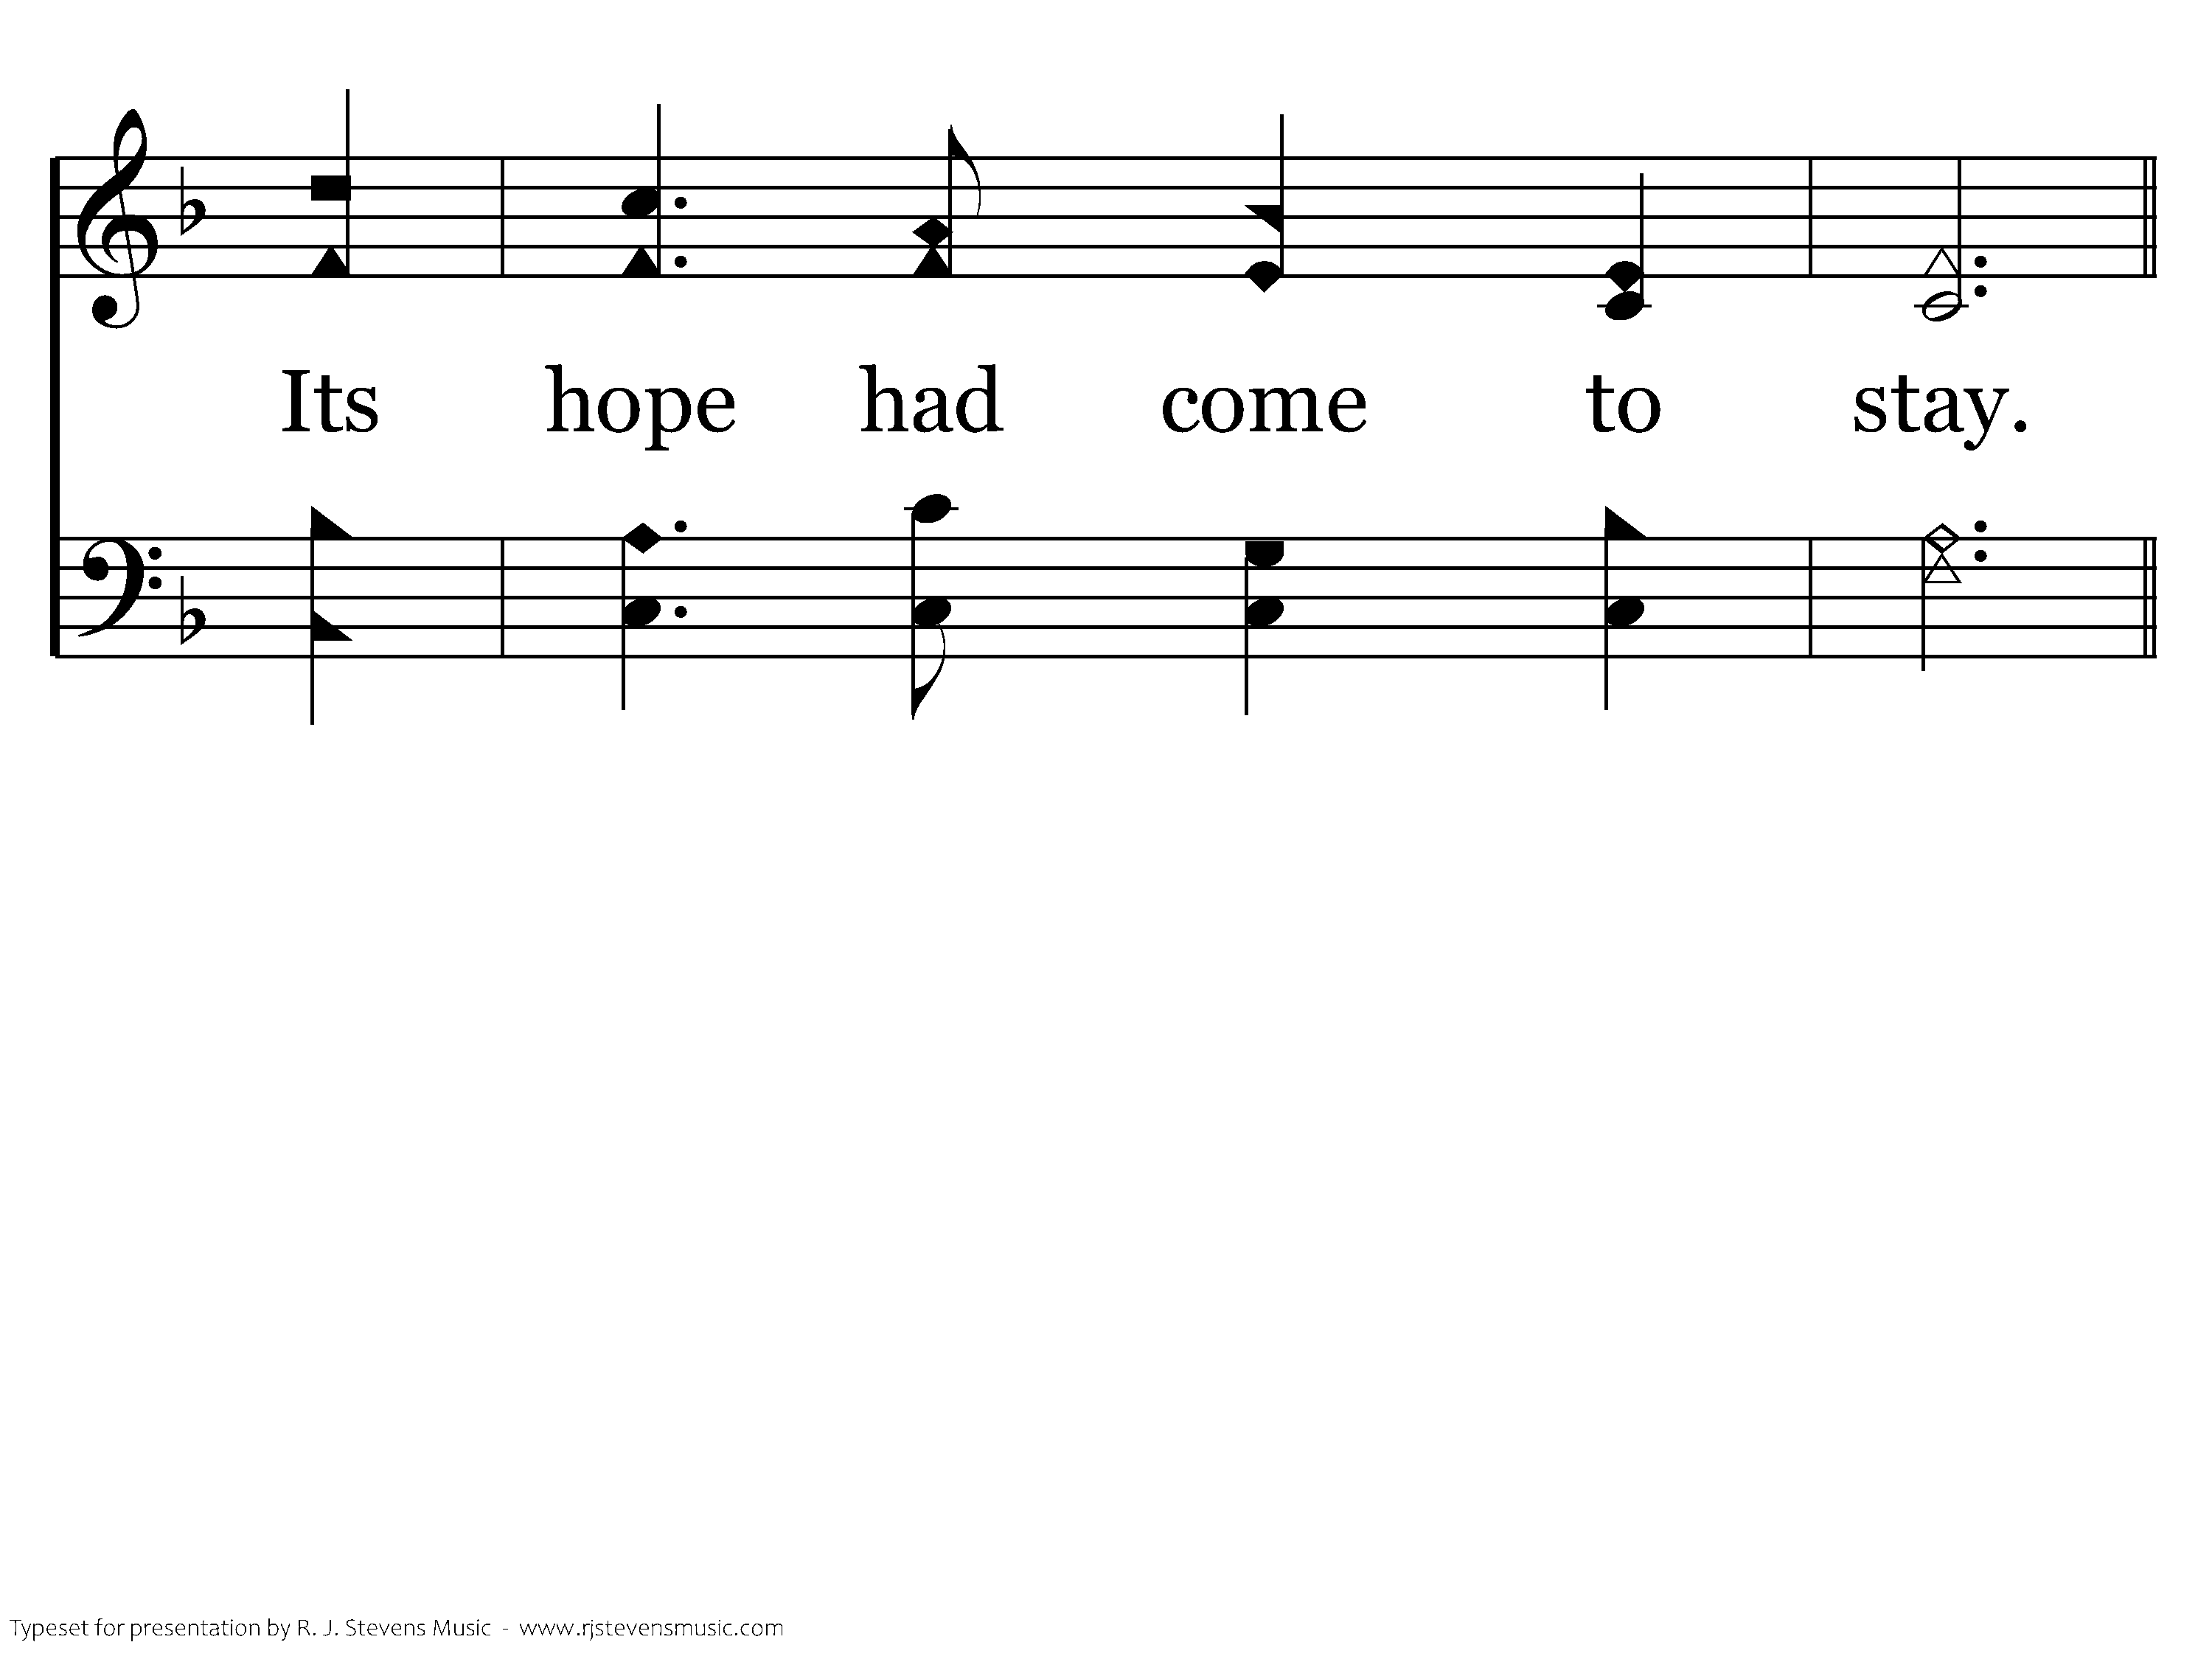
038 - King Most High - 2.3

Slide 65
038 - King Most High - C.1

Slide 66
038 - King Most High - C.2
End of Verse 2

Slide 67
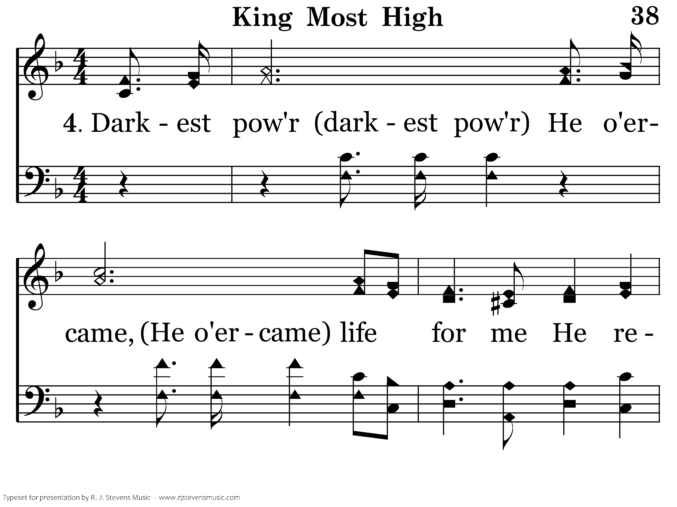
038 - King Most High - 4.1

Slide 68
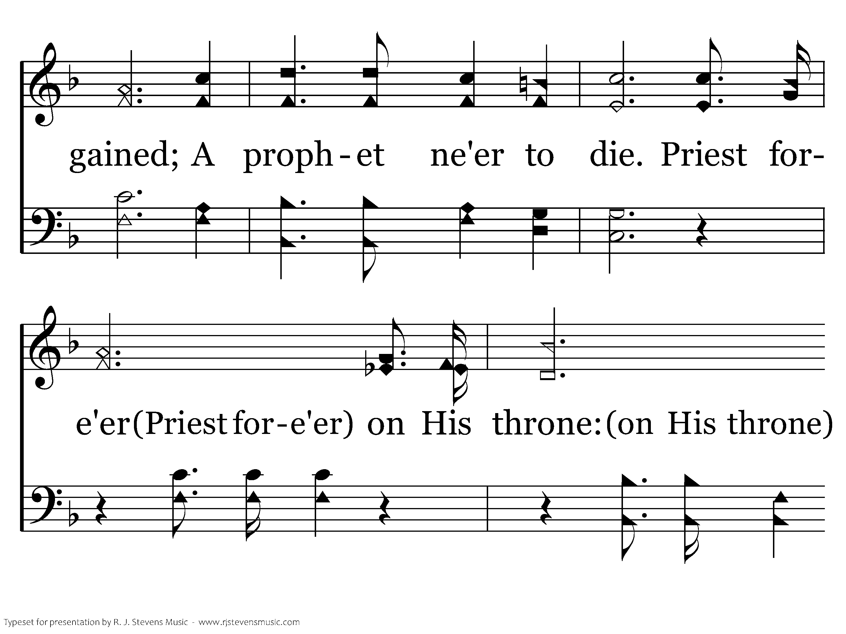
038 - King Most High - 4.2

Slide 69
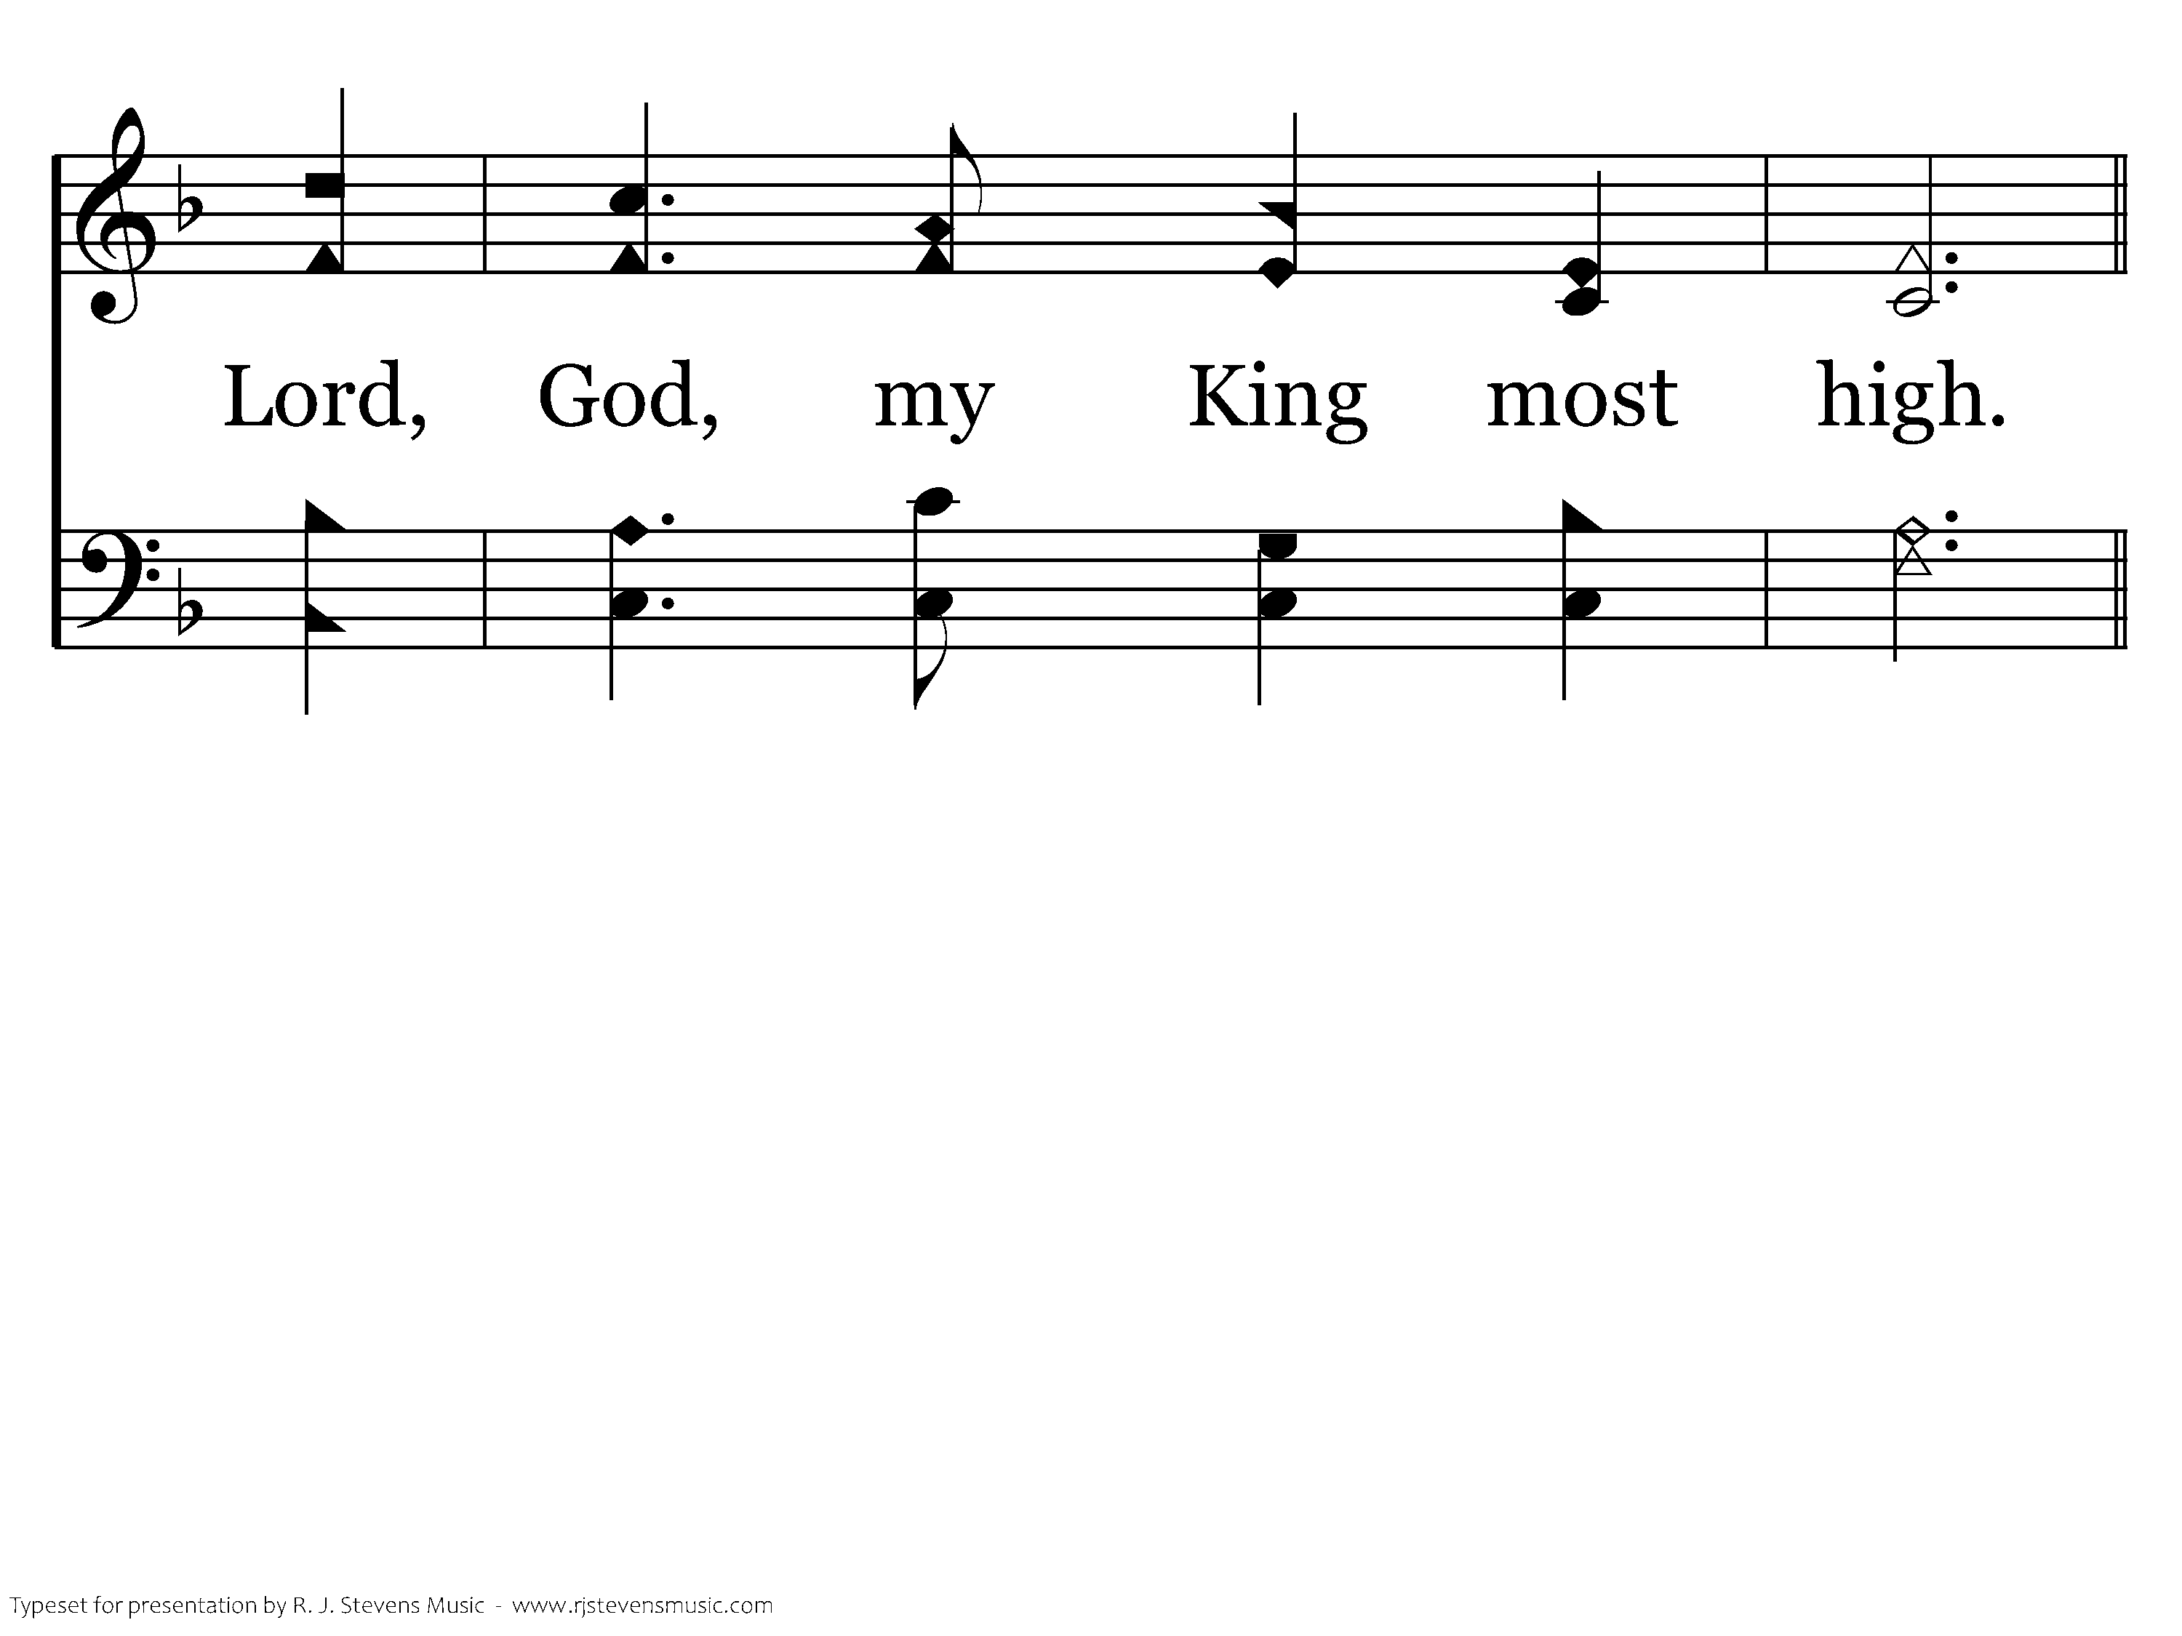
038 - King Most High - 4.3

Slide 70
038 - King Most High - C.1

Slide 71
038 - King Most High - C.2
End of Song

Slide 72
<none>

Slide 73
Scripture Reading
Chad Allen

Slide 75


Slide 76

“Then in that day The nations will resort to the root of Jesse, Who will stand as a signal for the peoples; And His resting place will be glorious.”
(Isaiah 11:10, NASB95)
Is comprised of different people

Slide 77
Barnabas accepted…
those who had nothing to offer in return (Acts 4.32-37)
a former enemy (Acts 9.26-28)
the lost (Acts 11.19-24)
those who’d failed him (Acts 15.36-39)
Is comprised of different people

Slide 80
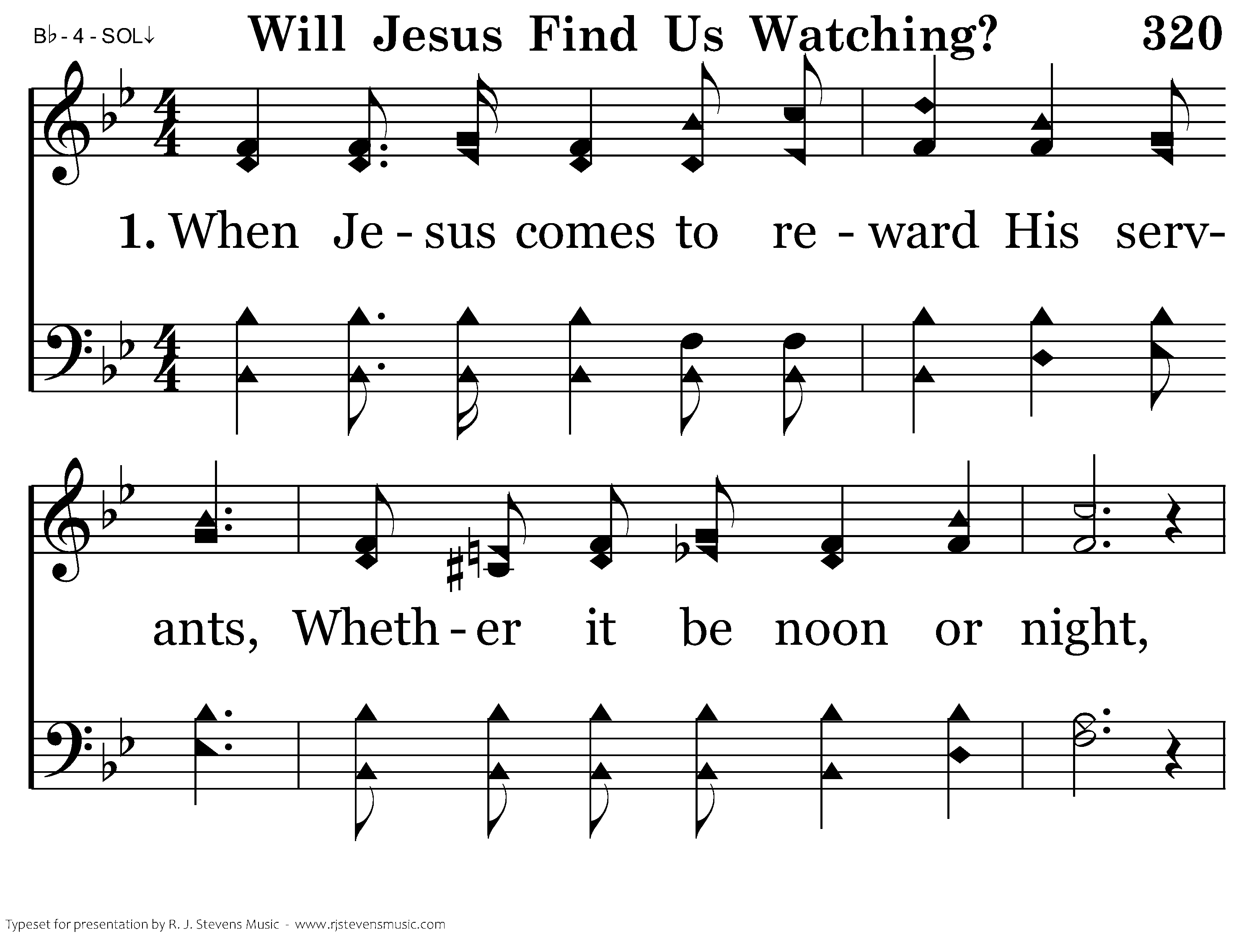
320 - Will Jesus Find Us Watching - 1.1

Slide 81
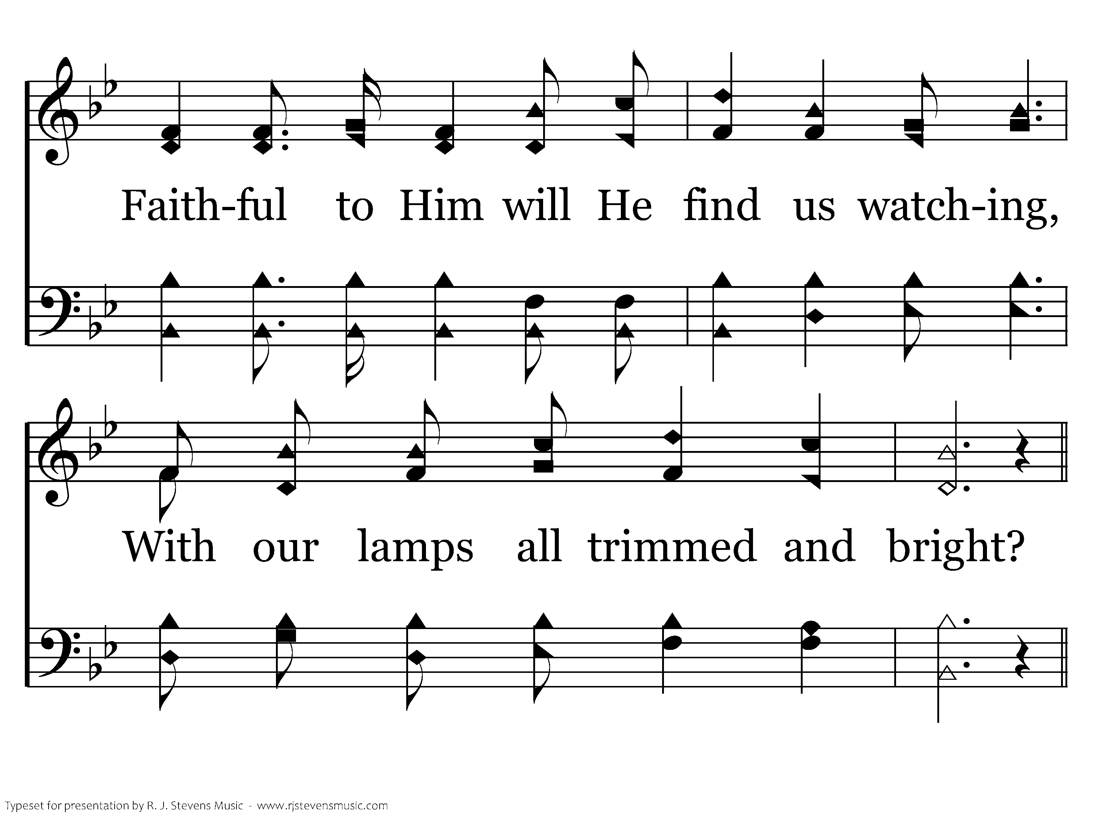
320 - Will Jesus Find Us Watching - 1.2

Slide 82
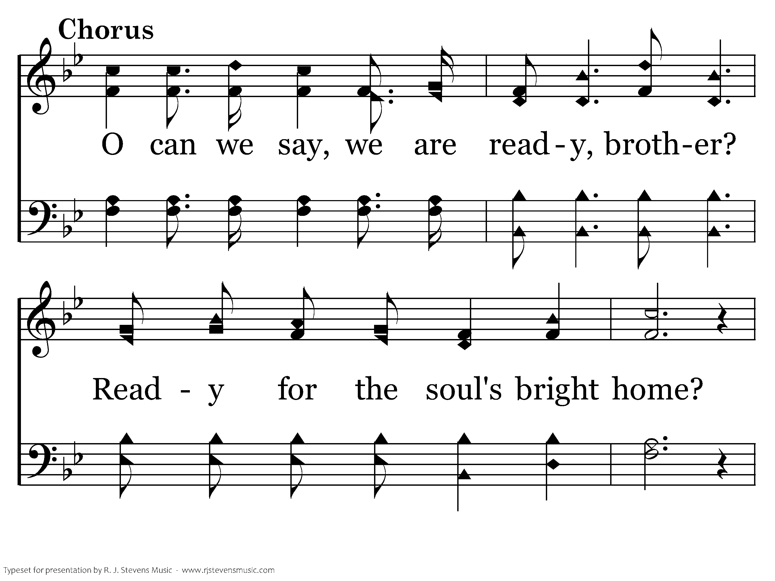
320 - Will Jesus Find Us Watching - C.1

Slide 83
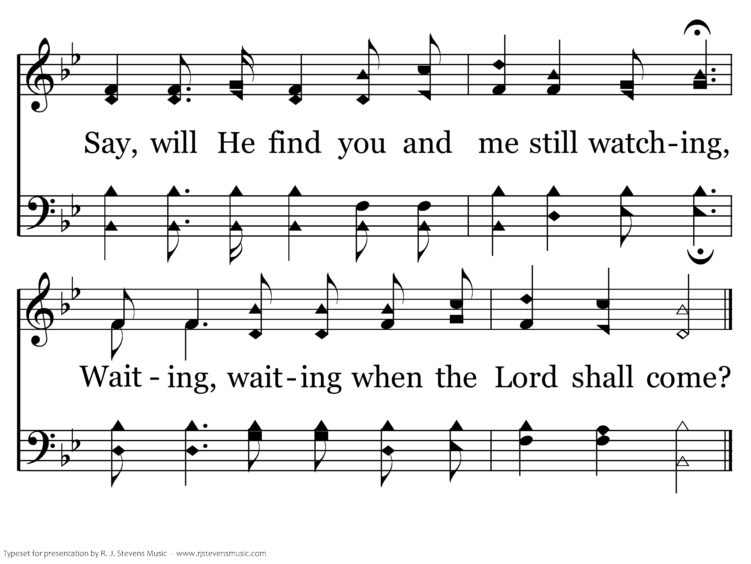
320 - Will Jesus Find Us Watching - C.2
End of Verse 1

Slide 84
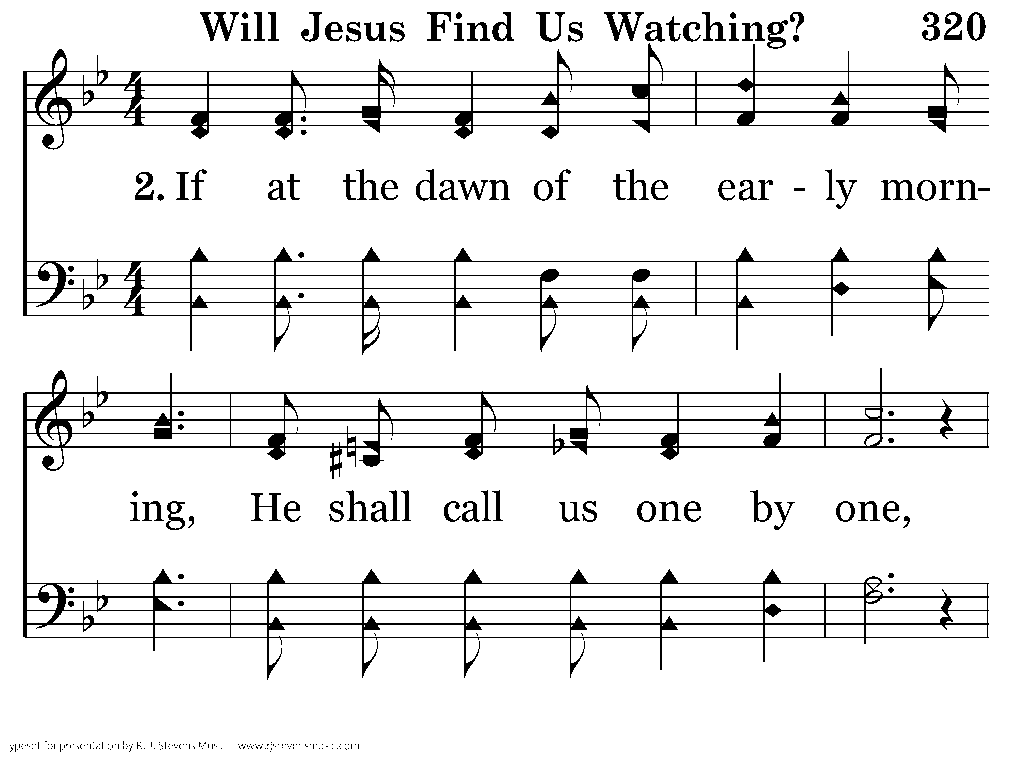
320 - Will Jesus Find Us Watching - 2.1

Slide 85
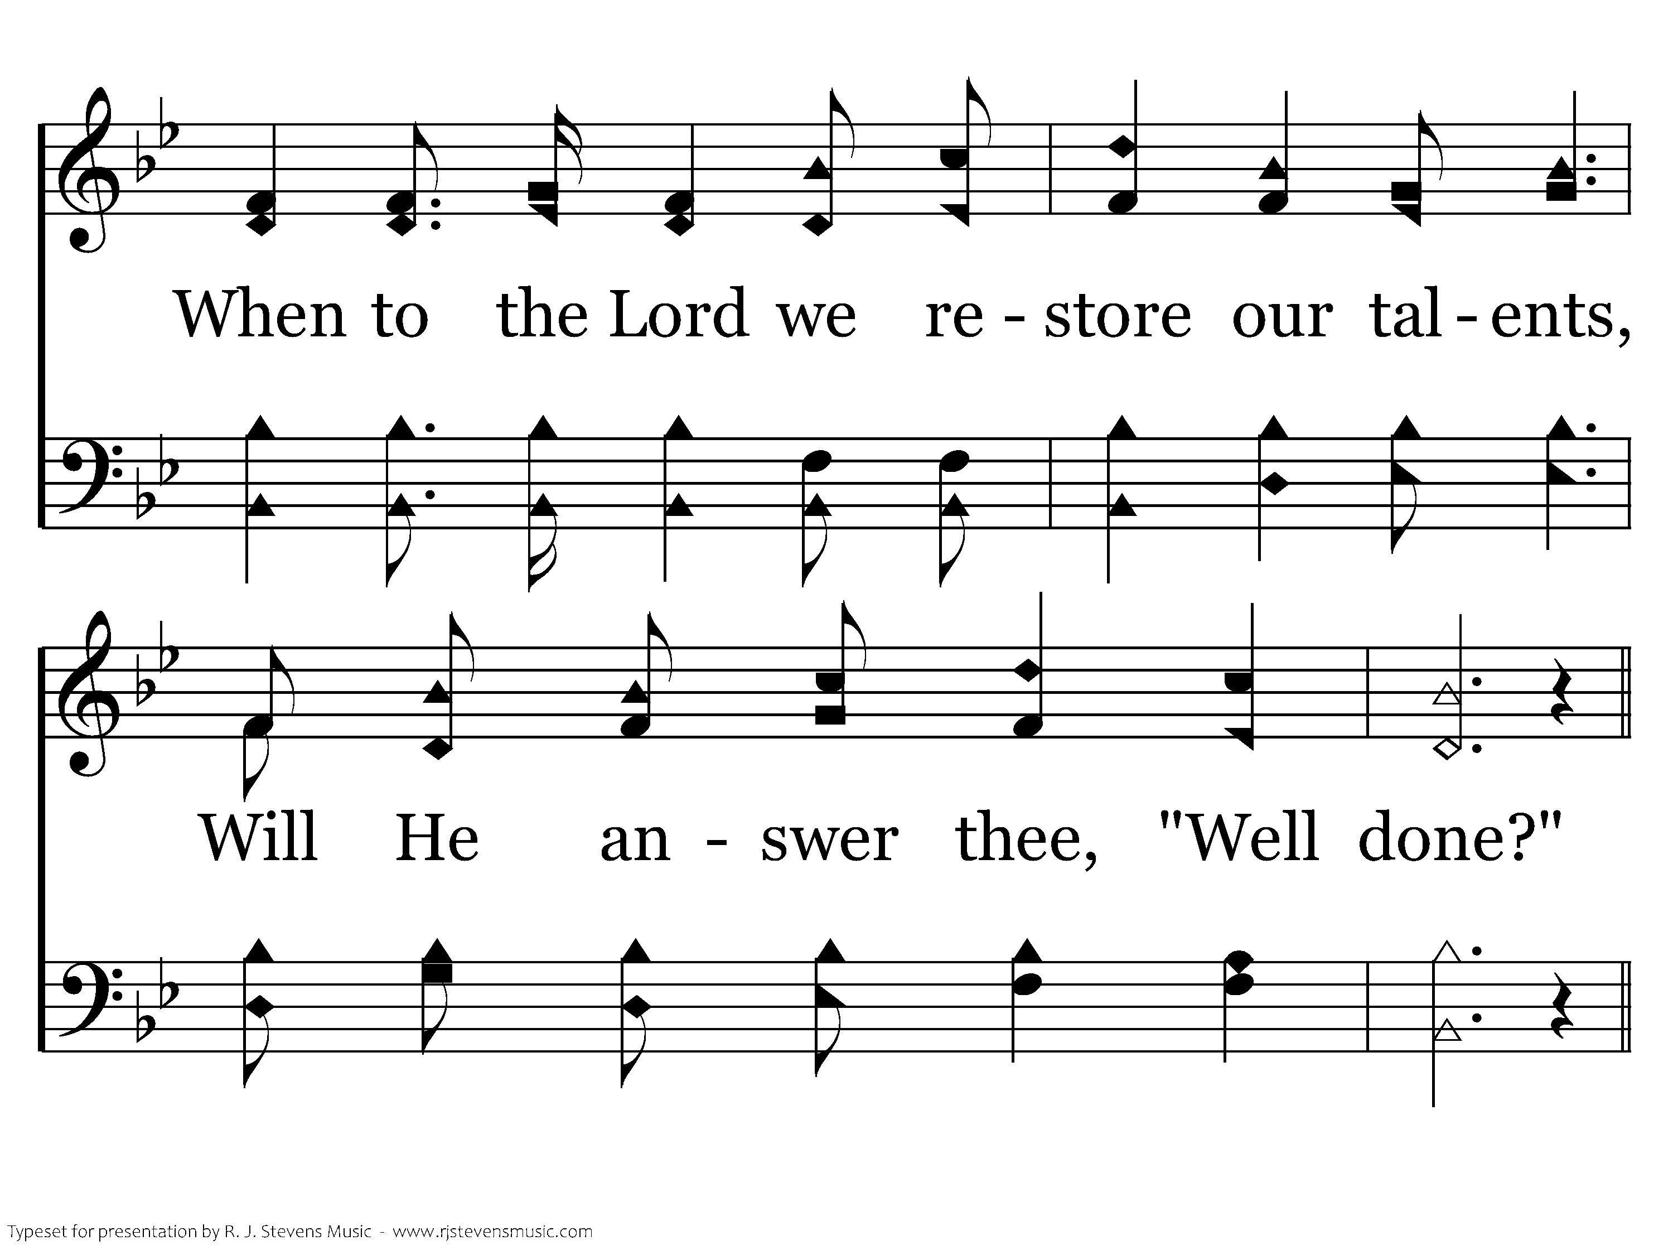
320 - Will Jesus Find Us Watching - 2.2

Slide 86
320 - Will Jesus Find Us Watching - C.1

Slide 87
320 - Will Jesus Find Us Watching - C.2
End of Verse 2

Slide 88

320 - Will Jesus Find Us Watching - 3.1

Slide 89

320 - Will Jesus Find Us Watching - 3.2

Slide 90
320 - Will Jesus Find Us Watching - C.1

Slide 91
320 - Will Jesus Find Us Watching - C.2
End of Song

Slide 92
<none>

Slide 93
Closing Prayer
Mike Wilkes

Slide 94
<none>

Slide 95

To our guests, thank you for your visit! Scan the QR code to share your contact info with us.
A nuestros invitados, ¡gracias por su visita! Escanee el código QR para compartir su información de contacto con nosotros.

