Slide 2
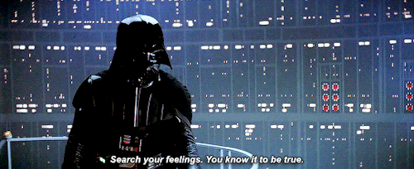

Slide 3
Search Your Feelings?

Slide 4
Search For Truth

Slide 5
¹⁶ For I am not ashamed of the gospel, for it is the power of God for salvation to everyone who believes, to the Jew first and also to the Greek. ¹⁷ For in it the righteousness of God is revealed from faith to faith; as it is written, “But the righteous man shall live by faith.”
(Romans 1:16–17 NASB95)
Affirm Truth, Not Feelings

Slide 6
“Stand by the ways and see and ask for the ancient paths, Where the good way is, and walk in it; And you will find rest for your souls.” (Jeremiah 6.16)

Slide 7
Romans 1.19-20, the truth about God could be known
Romans 1.18, truth was suppressed
Romans 1.24,26,28, man relied on the lusts of his heart…
Romans 1.25, man followed a lie instead of truth
Romans 1.22, result was that man became a fool
Where Our Feelings Have Gotten Us…

Slide 8
³¹ So Jesus was saying to those Jews who had believed Him, “If you continue in My word, then you are truly disciples of Mine; ³² and you will know the truth, and the truth will make you free.”
(John 8:31–32 NASB95)
Our Feelings Are Often Wrong, So Search For Truth

Slide 9
“and although they know the ordinance of God, that those who practice such things are worthy of death, they not only do the same, but also give hearty approval to those who practice them.”
(Romans 1:32 NASB95)
Affirm Truth, Not Feelings

