Slide 2
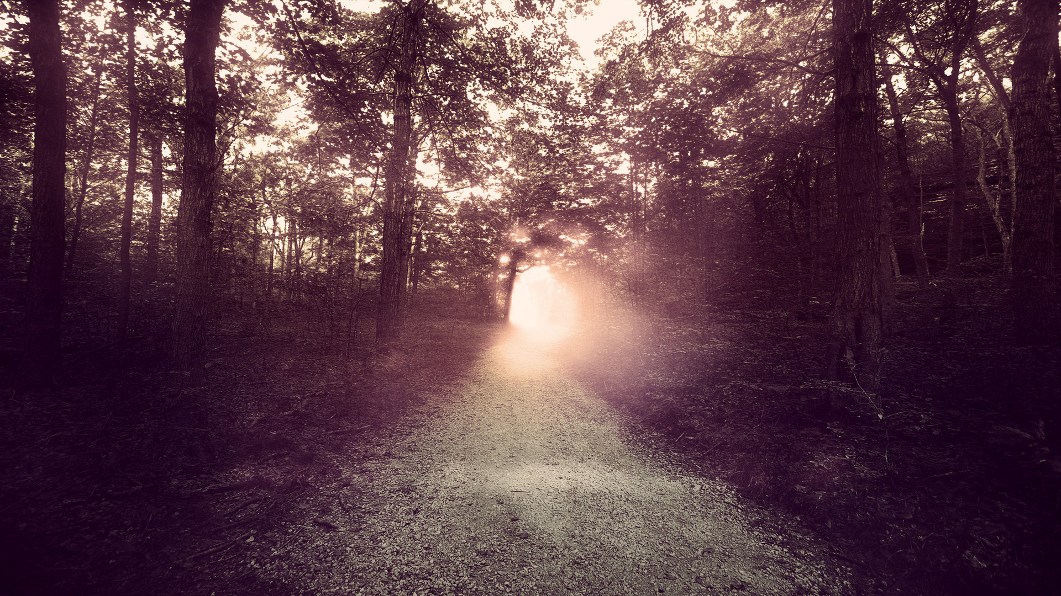
“Stand by the ways and see and ask for the ancient paths, Where the good way is, and walk in it; And you will find rest for your souls.” (Jeremiah 6.16)

Slide 3
Good Bodies
1Cor. 6.12-20

Slide 4
The Lie: You Are Not Your Body
1Cor. 6.12-13

Slide 5
we are created body AND soul (vs. 13)
Jesus has a body (vs. 14)
our bodies will be raised (vs. 14)
our bodies are members of Christ’ body (vs. 15)
our bodies are meant to be used for good (vss. 19-20)
The Truth: We Have Good Bodies
1Cor. 6.13-20

Slide 6
it matters what you do with the body
TAKEAWAYS

Slide 7
let God define your self-image
TAKEAWAYS

