Slide 1
El amor no es ofensivo
Love is not rude
1 Cor. 13

Slide 2
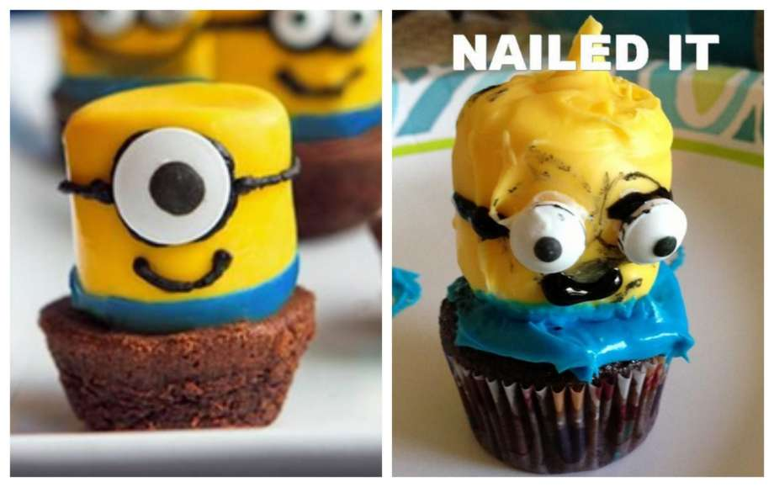

Slide 3
1 Corinthians 13:1-5 NASB95- If I speak with the tongues of men and of angels, but do not have love, I have become a noisy gong or a clanging cymbal. [2] If I have the gift of prophecy, and know all mysteries and all knowledge; and if I have all faith, so as to remove mountains, but do not have love, I am nothing. [3] And if I give all my possessions to feed the poor, and if I surrender my body to be burned, but do not have love, it profits me nothing. [4] Love is patient, love is kind and is not jealous; love does not brag and is not arrogant, [5] does not act unbecomingly;

Slide 4
New International Version- It does not dishonor others
King James Bible- Doth not behave itself unseemly
New King James Version does not behave rudely
NASB 2020- It does not act disgracefully
Christian Standard Bible is not rude
Holman Christian Standard Bibledoes not act improperly
Being rude is unloving b/c you’re not taking time to consider the other person

Slide 5
The Corinthian Church’s Struggle
They were rude and unloving in the way they :
spoke of their teachers (1)
dealt with sin in the church and just accepted immorality (5)
took one another to court (6)
treated intimacy in marriage (7)
expressed their Christian liberties and disregarded one another (8-10)
partook of the Lord’s Supper (11)
expressed their spiritual gifts (12-14)

Slide 6
1 Corinthians 14:9 MSG- So if you speak in a way no one can understand, what’s the point of opening your mouth? There are many languages in the world and they all mean something to someone. But if I don’t understand the language, it’s not going to do me much good. It’s no different with you. Since you’re so eager to participate in what God is doing, why don’t you concentrate on doing what helps everyone in the church?

Slide 7
Don’t be less rude, BE LOVE.
Matthew 7:12 NASB95- “In everything, therefore, treat people the same way you want them to treat you, for this is the Law and the Prophets.
Titus 3:1-7 NASB95- Remind them to be subject to rulers, to authorities, to be obedient, to be ready for every good deed, [2] to malign no one, to be peaceable, gentle, showing every consideration for all men.

Slide 8
Love learns and adapts and strives to understand and show consideration for others
El amor aprende y se adapta y se esfuerza por comprender y mostrar consideración por los demás.

Slide 9
Love vs. Rudeness
1 Samuel 25:18-20 NASB95- Then Abigail hurried and took two hundred loaves of bread and two jugs of wine and five sheep already prepared and five measures of roasted grain and a hundred clusters of raisins and two hundred cakes of figs, and loaded them on donkeys.

Slide 10
Love vs. Rudeness
1 Samuel 25:18-20 NASB95- [19] She said to her young men, “Go on before me; behold, I am coming after you.” But she did not tell her husband Nabal. [20] It came about as she was riding on her donkey and coming down by the hidden part of the mountain, that behold, David and his men were coming down toward her; so she met them.

Slide 11
Love vs. Rudeness
1 Samuel 25:32-35 NASB95- Then David said to Abigail, “Blessed be the LORD God of Israel, who sent you this day to meet me, [33] and blessed be your discernment, and blessed be you, who have kept me this day from bloodshed and from avenging myself by my own hand.

Slide 12
Love vs. Rudeness
1 Samuel 25:32-35 NASB95- [34] Nevertheless, as the LORD God of Israel lives, who has restrained me from harming you, unless you had come quickly to meet me, surely there would not have been left to Nabal until the morning light as much as one male.” [35] So David received from her hand what she had brought him and said to her, “Go up to your house in peace. See, I have listened to you and granted your request.”

Slide 13
Love is not rude
Love vs. Rudeness
Philippians 2:5-11 NASB95- Have this attitude in yourselves which was also in Christ Jesus, [6] who, although He existed in the form of God, did not regard equality with God a thing to be grasped, [7] but emptied Himself, taking the form of a bond-servant, and being made in the likeness of men.

Slide 14
Love is not rude
Love vs. Rudeness
Philippians 2:5-11 NASB95- [8] Being found in appearance as a man, He humbled Himself by becoming obedient to the point of death, even death on a cross. [9] For this reason also, God highly exalted Him, and bestowed on Him the name which is above every name,

Slide 15
Love is not rude
Love vs. Rudeness
Philippians 2:5-11 NASB95- [10] so that at the name of Jesus EVERY KNEE WILL BOW, of those who are in heaven and on earth and under the earth, [11] and that every tongue will confess that Jesus Christ is Lord, to the glory of God the Father.

Slide 16
El amor no es ofensivo
Love is not rude
1 Cor. 13

