Slide 3
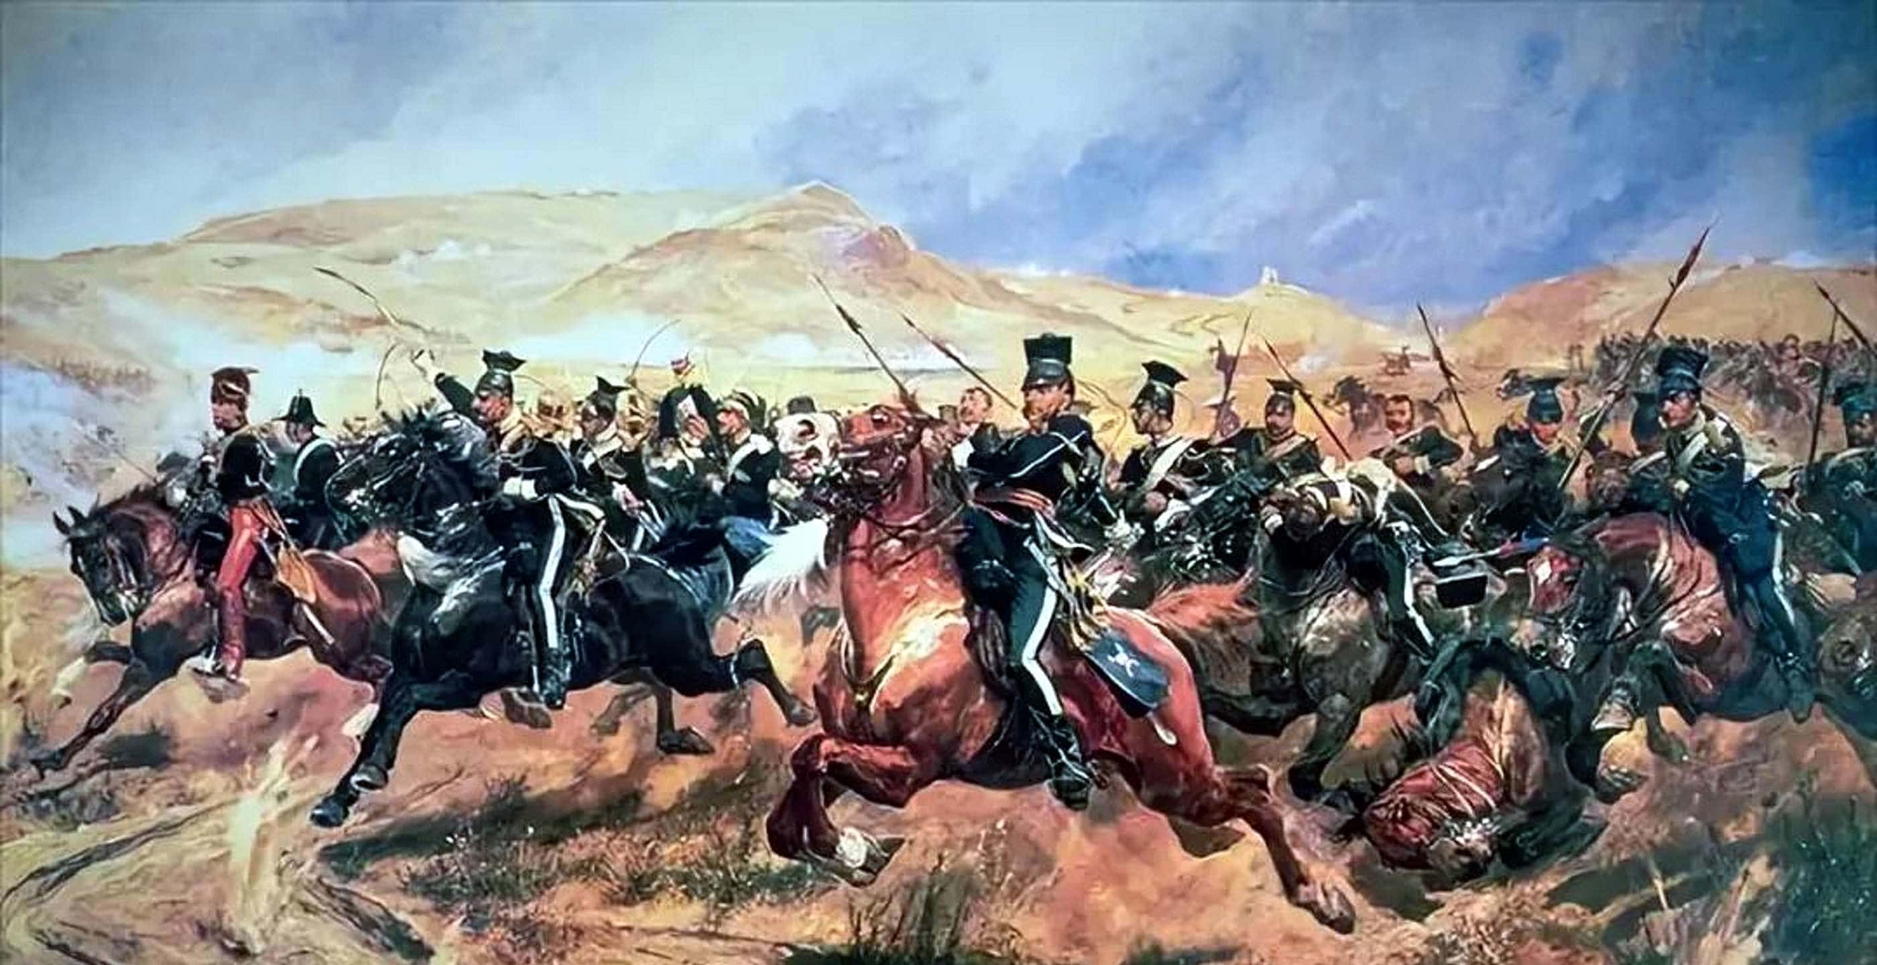
Theirs not to make reply,
Theirs not to reason why,
Theirs but to do and die.
Into the valley of Death
Rode the six hundred.

Slide 4
The God of Covenants

Slide 5
1 Then the word of the Lord came to me, saying, 2 “Son of man, make known to Jerusalem her abominations 3 and say, ‘Thus says the Lord God to Jerusalem, “Your origin and your birth are from the land of the Canaanite, your father was an Amorite and your mother a Hittite. 4 As for your birth, on the day you were born your navel cord was not cut, nor were you washed with water for cleansing; you were not rubbed with salt or even wrapped in cloths. 5 No eye looked with pity on you to do any of these things for you, to have compassion on you. Rather you were thrown out into the open field, for you were abhorred on the day you were born.
Ezekiel 16.1-5

Slide 6
6 “When I passed by you and saw you squirming in your blood, I said to you while you were in your blood, ‘Live!’ Yes, I said to you while you were in your blood, ‘Live!’ 7 I made you numerous like plants of the field. Then you grew up, became tall and reached the age for fine ornaments; your breasts were formed and your hair had grown. Yet you were naked and bare. 8 “Then I passed by you and saw you, and behold, you were at the time for love; so I spread My skirt over you and covered your nakedness. I also swore to you and entered into a covenant with you so that you became Mine,” declares the Lord God.
Ezekiel 16.6-8

Slide 7
15 “But you trusted in your beauty and played the harlot because of your fame, and you poured out your harlotries on every passer-by who might be willing. 16 You took some of your clothes, made for yourself high places of various colors and played the harlot on them, which should never come about nor happen.
32 You adulteress wife, who takes strangers instead of her husband!
Ezekiel 16.15-16, 32

Slide 8
59 For thus says the Lord God, “I will also do with you as you have done, you who have despised the oath by breaking the covenant. 60 “Nevertheless, I will remember My covenant with you in the days of your youth, and I will establish an everlasting covenant with you. 61 Then you will remember your ways and be ashamed when you receive your sisters, both your older and your younger; and I will give them to you as daughters, but not because of your covenant. 62 Thus I will establish My covenant with you, and you shall know that I am the Lord, 63 so that you may remember and be ashamed and never open your mouth anymore because of your humiliation, when I have forgiven you for all that you have done,” the Lord God declares.
Ezekiel 16.59-63

Slide 9
What is God looking for from His people and how does He feel when covenants are forsaken?

Slide 10
What then? If some did not believe, their unbelief will not nullify the faithfulness of God, will it?
Romans 3.3

Slide 11
God Who Promised a New & Better Covenant

Slide 12
How does Jeremiah 31 enhance our understanding of what God means when He describes a covenant?

Slide 13
31 “Behold, days are coming,” declares the Lord, “when I will make a new covenant with the house of Israel and with the house of Judah, 32 not like the covenant which I made with their fathers in the day I took them by the hand to bring them out of the land of Egypt, My covenant which they broke, although I was a husband to them,” declares the Lord. 33 “But this is the covenant which I will make with the house of Israel after those days,” declares the Lord, “I will put My law within them and on their heart I will write it; and I will be their God, and they shall be My people. 34 They will not teach again, each man his neighbor and each man his brother, saying, ‘Know the Lord,’ for they will all know Me, from the least of them to the greatest of them,” declares the Lord, “for I will forgive their iniquity, and their sin I will remember no more.”
Jeremiah 31.31-34

Slide 14
2 Views Some Have Regarding God’s Covenant
We either think that our relationship with God is conditional on our perfect obedience to God’s law.
We think that our relationship with God is simply a relationship of love where we don’t really need to follow God’s law.

Slide 15
God Who Establishes an Eternal Covenant

Slide 16
In your own words, what is the writer of Hebrews communicating to us? (Hebrews 6.13-18)

Slide 17
13 For when God made the promise to Abraham, since He could swear by no one greater, He swore by Himself, 14 saying, “I will surely bless you and I will surely multiply you.” 15 And so, having patiently waited, he obtained the promise. 16 For men swear by one greater than themselves, and with them an oath given as confirmation is an end of every dispute. 17 In the same way God, desiring even more to show to the heirs of the promise the unchangeableness of His purpose, interposed with an oath, 18 so that by two unchangeable things in which it is impossible for God to lie, we who have taken refuge would have strong encouragement to take hold of the hope set before us.
Hebrews 6.13-18

Slide 18
Hebrews has one key word: BETTER
Jesus is a better messenger than either the prophets or the angels (Heb 1).
As the apostle and high priest of our confession, He is better than Moses (Heb 3).
He provides a better rest than was provided by Joshua (Heb 4).
He is a better priest than were the Levites (Heb 5-7).

Slide 19
so much the more also Jesus has become the guarantee of a better covenant.
Hebrews 7.22
But now He has obtained a more excellent ministry, by as much as He is also the mediator of a better covenant, which has been enacted on better promises.
Hebrews 8.6

Slide 20
“In speaking of a new covenant, He makes the first one obsolete. And what is becoming obsolete and growing old is ready to vanish away.” (Heb 8.13)
Why is this passage pivotal to Christians?

Slide 21
It’s a Different Covenant.
The Law with its Levitical system did not provide the access to the Lord that we need.
Further, the Lord finds fault with His people. (Heb 8.8)
We need a covenant that can overcome our disobedience.

Slide 22
Under this new covenant “Israel” would no longer be a physical lineage, but a spiritual one (Rom 2.28-29; Phil 3.3).
What do you think are the practical implications? And how does this relate to our study of authority?

Slide 23
Born of a Certain Lineage vs Choosing
The people who are in relationship with God in the new covenant are not going to see the covenant as duty and obligation.
The covenant is going to be their hearts’ desire. No one in this covenant will see the laws of God as a burden.
No one in the covenant will be teaching another person in the covenant to know the Lord (Heb 8.11)
Belonging to the Lord is far more than an awareness of God’s laws.
Belonging to the covenant is far more than understanding the obligations of the covenant.

Slide 24
We do not belong to the covenant of Christ because we have been baptized.
We do not belong to the covenant because we come to worship on Sundays.
We do not belong to the covenant because we sit on the pews.
We do not belong to the covenant because we are always here when the doors are open.
We belong to the covenant when the desires of our heart are to obey the Lord.
We belong to the covenant when we see God’s laws in our hearts and in our minds.
We belong to the covenant when we know the Lord.

Slide 25
But we all, with unveiled face, beholding as in a mirror the glory of the Lord, are being transformed into the same image from glory to glory, just as from the Lord, the Spirit.
2 Corinthians 3.18

Slide 26
God Who Raises Us to Walk in Newness of Life

Slide 27
11 But when Christ appeared as a high priest of the good things to come, He entered through the greater and more perfect tabernacle, not made with hands, that is to say, not of this creation; 12 and not through the blood of goats and calves, but through His own blood, He entered the holy place once for all, having obtained eternal redemption. 13 For if the blood of goats and bulls and the ashes of a heifer sprinkling those who have been defiled sanctify for the cleansing of the flesh, 14 how much more will the blood of Christ, who through the eternal Spirit offered Himself without blemish to God, cleanse your conscience from dead works to serve the living God?
Hebrews 9.11-14

Slide 28
An eternal covenant has been made available to mankind by God
The blood of God’s own Son was shed in order to make reconciliation possible.
By means of this blood, an eternal redemption has been secured for those who are sanctified.
The blood of Christ sanctifies under this new and better covenant, purifying our consciences from dead works in order that we might serve the God of peace.

Slide 29
Therefore walk in Him…
under His authority.

