Slide 3
“You see, but you do not observe.”

Slide 4
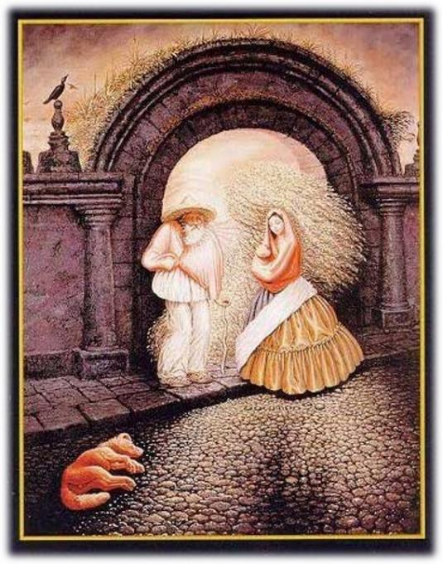
How many people can you spot?

Slide 5
Open my eyes, that I may behold wonderful things from Your law.
Psalm 119.18

Slide 6
Can Man Worship as He Pleases?

Slide 7
How would you describe worship in your own words?

Slide 8
Then I fell at his feet to worship him. But he said to me, “Do not do that; I am a fellow servant of yours and your brethren who hold the testimony of Jesus; worship God. For the testimony of Jesus is the spirit of prophecy.”
Revelation 19.10
But he said to me, “Do not do that. I am a fellow servant of yours and of your brethren the prophets and of those who heed the words of this book. Worship God.”
Revelation 22.9

Slide 9
I know, O Lord, that a man’s way is not in himself,
Nor is it in a man who walks to direct his steps.
Jeremiah 10.23

Slide 10
Jesus rebuked vain worship. (Mtt. 15.7-9)
When Paul came to Athens and saw that the city was full of idols, he began to address the shortcomings of ignorant worship. (Acts 17.22-23)
Paul warned Christians to avoid the pitfall of self-made worship. (Col 2.20-23)

Slide 11
Are people still guilty of “ignorant” worship?
If so, in what ways?
What’s the big deal with “self-made” worship?
Why is that something to be zealously guarded against?

Slide 12
“Worship is a life given in obedience to God. It’s not a when or where proposition, but a what. It’s what we are. You can’t go to it or leave it, dress for it or from it, and you can’t start it or stop it… it doesn’t open and close with a prayer, and it doesn’t have human leader or a special day.”
Mike Root, Unbroken Bread

Slide 13
The NT clearly teaches that a Christian is to present his body as “a living sacrifice” to God (Rom 12.1-2) and to do everything to the glory of God (1 Cor 10.31).
But does this mean, as some like Mike Root proposes, that all of life is worship?

Slide 14
“While there is no doubt that we live our lives in such a way as to glorify God, and that every realm of our life ought to reflect our relationship to God as submissive and obedient servants, there is some distinction to be made between a life of faithful service to God and the more specific acts of focusing intently on God, whether privately in our own prayer closet or collectively in the assembly.”
David Thomley, In Spirit and Truth

Slide 15
1 I beseech you therefore, brethren, by the mercies of God, that you present your bodies a living sacrifice, holy, acceptable to God, which is your reasonable service. 2 And do not be conformed to this world, but be transformed by the renewing of your mind, that you may prove what is that good and acceptable and perfect will of God.
Romans 12.1-2 (NKJV)

Slide 16
What is God calling for us to do and to be in Romans 12.1-2?

Slide 17
Being transformed means being changed.
You have crucified self and now you carry the role of a servant.
The man of God is driven by the Word of God.
When we renew our minds…
We will be able to test and approve what is the will of God.
We will discern and and know what is the good, well-pleasing, and perfect will of God.

Slide 18
Worshiping in Spirit and Truth as Disciples of Jesus

Slide 19
19 The woman said to Him, “Sir, I perceive that You are a prophet. 20 Our fathers worshiped in this mountain, and you people say that in Jerusalem is the place where men ought to worship.” 21 Jesus said to her, “Woman, believe Me, an hour is coming when neither in this mountain nor in Jerusalem will you worship the Father. 22 You worship what you do not know; we worship what we know, for salvation is from the Jews. 23 But an hour is coming, and now is, when the true worshipers will worship the Father in spirit and truth; for such people the Father seeks to be His worshipers. 24 God is spirit, and those who worship Him must worship in spirit and truth.”
John 4.19-24

Slide 20
What does it mean to “worship in spirit and truth”?

Slide 21
Two Concepts God is Looking For
Proper Attitudes
Proper Actions
What is the outcome then? I will pray with the spirit and I will pray with the mind also; I will sing with the spirit and I will sing with the mind also.
1 Corinthians 14.15
The mind must always be engaged and fully aware of what is being offered to God.

Slide 22
O magnify the Lord with me,
And let us exalt His name together.
Psalm 34.3

Slide 23
Why do you call Me, ‘Lord, Lord,’ and do not do what I say?
Luke 6.46

Slide 24
Worship in the New Testament

Slide 25
The writer of Hebrews gives a powerful description of the type of worship expected by the Lord.
What is all of this supposed to mean for us?

Slide 26
28 Therefore let us be grateful for receiving a kingdom that cannot be shaken, and thus let us offer to God acceptable worship, with reverence and awe, 29 for our God is a consuming fire.
Hebrews 12.28-29 (ESV)

Slide 27
Consider All We Have Come To (Heb 12.22-24)
We have come to the city of the living God.
We have come to innumerable angels.
We have come to heavenly Jerusalem.
We have come to God, the judge of all.
We have come to Jesus, the mediator of the new covenant.
We have come to sprinkled blood.

Slide 28
In light of passages like Luke 24.1 and Acts 2.1, why do you think the first day of the week came to carry great significance for the earliest disciples of Jesus?

Slide 29
The First Day of the Week:
Women came to the empty tomb. (Lk 24.1)
Many gathered together for Pentecost. (Acts 2.1)
Gathered together to break bread and listen to Paul. (Acts 20.7)
Collection for the saints. (1 Cor 16.1-2)

Slide 30
Assemblies of Christians:
Assembled in the name of the Lord. (1 Cor 5.4)
When you come together. (1 Cor 11.17)
The whole church comes together. (1 Cor 14.23)
Not neglecting to meet together. (Heb 10.24-25)

Slide 31
God is to be glorified.
Disciples are to be built up.
Offer up a sacrifice of praise to God. (Heb 13.15)
Let all things be done for building up. (1 Cor 14.26)

Slide 32
How are these ideals accomplished?
Prayer (Acts 2.42)
Singing (Eph 5.18-21; Col 3.16-17)
Preaching (Acts 2.42; 2 Tim 3.16-17; 4.1-2)
The observance of the Lord’s Supper (1 Cor 11.17-34)

Slide 33
Outside of divine revelation, we have no basis for faith or religious action.
If we are discontent with Bible-directed worship, we can certainly introduce our own preferences as creatures of free choice.
But we’d best not expect our actions to have the approval of heaven.
If our aim is “acceptable worship,” we must submit ourselves to the authority of our heavenly King.

