Slide 3
Church
Two main uses of ekklesia when referring to the church
A worldwide, universal, time spanning group
A specific local group of believers
We learn what the ekklesia is from the context.
A common term, not a religious one – Acts 19:39-41
The University church is an ekklesia that meets in the University area.

Slide 4
What Role Does This Local Body of Believers Play in God’s Plan?

Slide 5
The Local Church in the New Testament
It has oversight
It has deacons
Evangelists worked with the local group
It has responsibilities
Worship and edify
Support the preaching of the gospel
Support one another with daily necessities

Slide 6
United Methodist Church National Organization
General Conference is the top policy-making body of The United Methodist Church. The assembly typically meets at the beginning of each quadrennium to consider revisions to church law, as well as adopt resolutions on current moral, social, public policy and economic issues. It also approves plans and budgets for church-wide programs for the next four years.

Slide 7
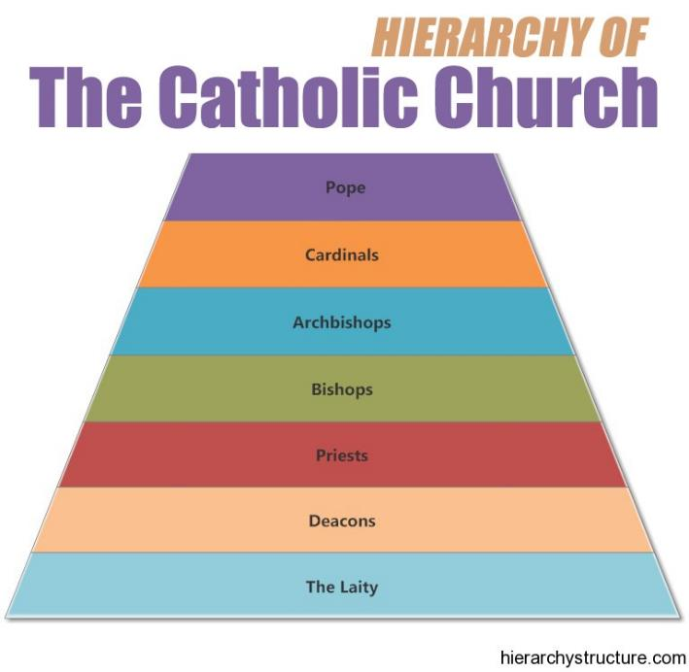

Slide 8
Each congregation is independent and autonomous.
Notes:
Such local organization is simple and keeps each local church independent and autonomous, with no ties to any other church.

Slide 9
"Having turned away from the knowledge given by God, man has now lost the whole Christian culture. In Europe, including England, it took many years, in the United States only a few decades. In the United States in the short span from the Twenties to the Sixties, we have seen a complete shift. Of course, in the United States in the Twenties not everyone was a Christian, but in general there was a Christian consensus. Now that consensus is completely gone. Ours is a post-Christian world in which Christianity, not only in the number of Christians but in cultural emphasis and cultural result, is now in the absolute minority. To ask young people to maintain the status quo is folly. The status quo is no longer ours. In the last four decades the change has come in every portion and in every part of life.” (Frances Shaeffer, Death in the City, pg. 14).

Slide 10
Differing Views on Inspiration of Scripture
Conservative – Scripture is verbally inspired and inerrant.
Catholic – Authority rests in the “protector of scripture
Denominational – Creeds
Modernist – No such thing as inspiration
Neo-Orthodox
Bible contains truths about Jesus but only as observations made by men.

Slide 11
Challenge to Biblical Authority
Abandon NT as a pattern or blueprint
We must abandon establishing authority with command, example, inference
We must not make silence prohibitive
Quit using NT as a book of case law or as a constitution
We must quit using deductive reasoning and logic on NT
We must quit claiming to know the truth

Slide 12
Motive for a New Hermeneutic
Some may honestly believe they are seeking a “deeper understanding”
Getting around plain statements of scripture
The culture in which we live

Slide 13
Results of Implementing a New Hermeneutic
It will destroy the very basis of Christianity: the truth of the Gospel Story
The first step on the road to rand modernism
The accommodation of the church to the world has never strengthened it.
The church loses it unique identity that is taught in the New Testament

