Slide 3
God’s Authority Over His Church

Slide 4
All Scripture Authorizes
Unauthorized
To put it in the circle you have to have a scripture

Slide 5
What is the Mission of the Church

Slide 6
Church
Gk., Ekklesia
Group; assembly
What kind of group?
Determined by modifiers of the term
Church – of God; of Christ; His body; of the firstborn ones
“I will build my church” - Mt. 16:18
A worldwide, universal, time spanning group

Slide 7
Church
What does it mean to be a member of the church?
Can you be a Christian without being a member of a local church?
Paul in Jerusalem – Acts 9:26
“And when he had come to Jerusalem, he attempted to join the disciples. And they were all afraid of him, for they did not believe that he was a disciple. 27 But Barnabas took him and brought him to the apostles and declared to them how on the road he had seen the Lord, who spoke to him, and how at Damascus he had preached boldly in the name of Jesus. 28 So he went in and out among them at Jerusalem, preaching boldly in the name of the Lord.”

Slide 8
Church
Two main uses of ekklesia
A worldwide, universal, time spanning group
A specific local group of believers
We learn what the ekklesia is from the context.
A common term, not a religious one – Acts 19:39-41
The University church is an ekklesia that meets in the University area.

Slide 9
What Role Does This Local Body of Believers Play in God’s Plan?

Slide 10
The Local Church in the New Testament
It has oversight
It has deacons
Evangelists worked with the local group
It has responsibilities
Worship and edify
Support the preaching of the gospel
Support one another with daily necessities

Slide 11
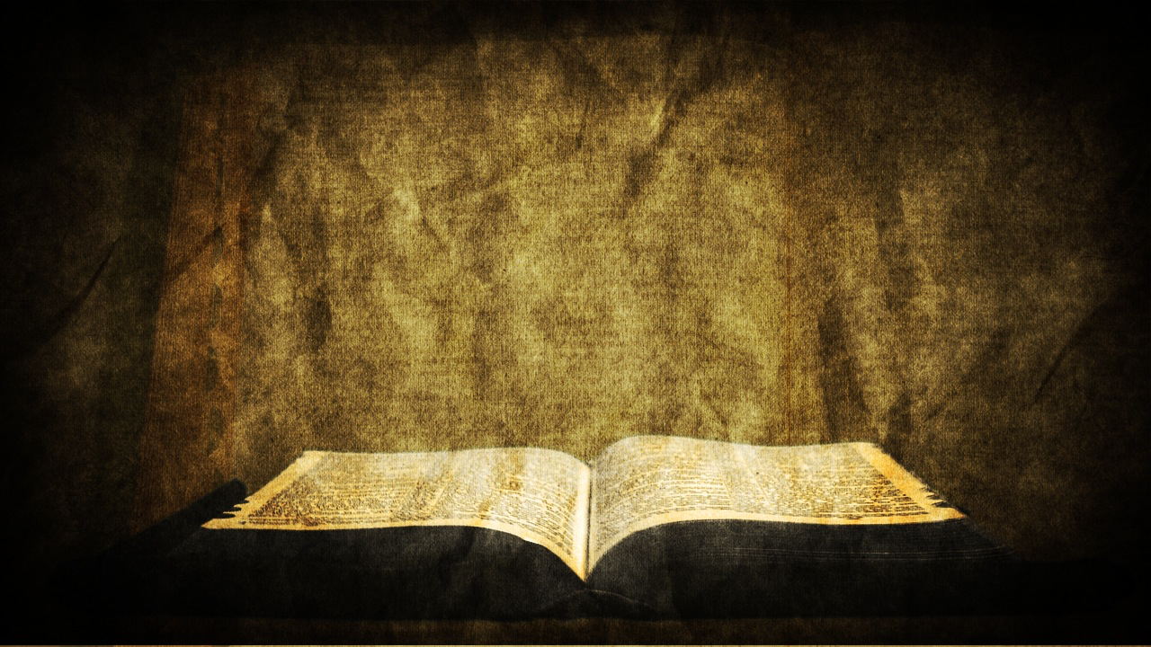
Each congregation is independent and autonomous.
Notes:
Such local organization is simple and keeps each local church independent and autonomous, with no ties to any other church.

Slide 12
United Methodist Church National Organization
General Conference is the top policy-making body of The United Methodist Church. The assembly typically meets at the beginning of each quadrennium to consider revisions to church law, as well as adopt resolutions on current moral, social, public policy and economic issues. It also approves plans and budgets for church-wide programs for the next four years.

Slide 13
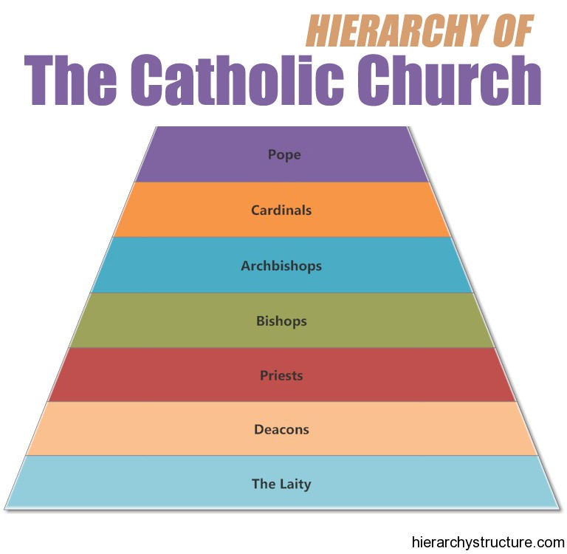

Slide 14
Each congregation is independent and autonomous.
Notes:
Such local organization is simple and keeps each local church independent and autonomous, with no ties to any other church.

