Slide 2
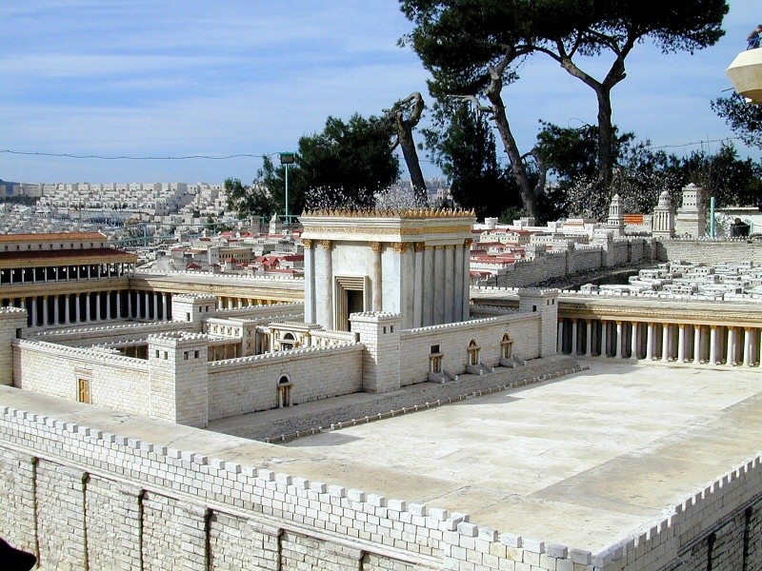

Slide 3
that Jesus would bring salvation (vss. 28-32)
that Jesus would divide humanity (vs. 34)
that Jesus would be opposed (vss. 34-35)
that Jesus is enough (vs. 29)
What Simeon Knew
Luke 2.25-35

