Slide 1
Revelation
Chapter 2

Slide 2
"Do not be afraid"
Revelation 1:17 When I saw him, I fell at his feet as though dead. But he placed his right hand on me, saying, ‘Do not be afraid; I am the first and the last, ¹⁸ and the living one. I was dead, and see, I am alive for ever and ever; and I have the keys of Death and of Hades. ¹⁹ Now write what you have seen, what is, and what is to take place after this. ²⁰ As for the mystery of the seven stars that you saw in my right hand, and the seven golden lampstands: the seven stars are the angels of the seven churches, and the seven lampstands are the seven churches.

Slide 3
"I am"
Matthew (5x)
Mark (3x)
Luke (4x)
John (24x)
Acts (6x)
Revelation (5x)
1:8 (God)
1:17 (Christ)
2:23 (Christ)
21:6 (God)
22:16 (Christ)

Slide 4
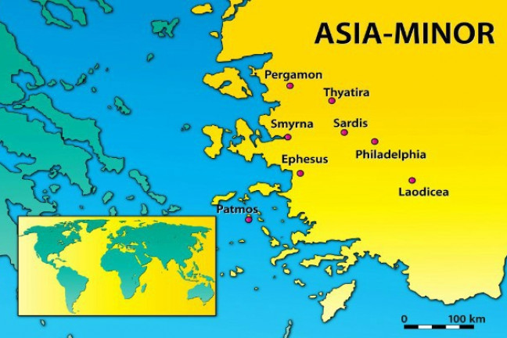
The letters to the seven churches
Each letter was read by all seven.
Why these seven?
Methodology?

Slide 5
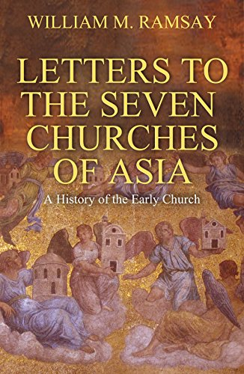

Slide 6
Structure of the Letters
Adscriptio (destination)
Command to write
"Thus says" formula
Christological proclamations
Narratio
Dispositio
Final proclamation

Slide 7
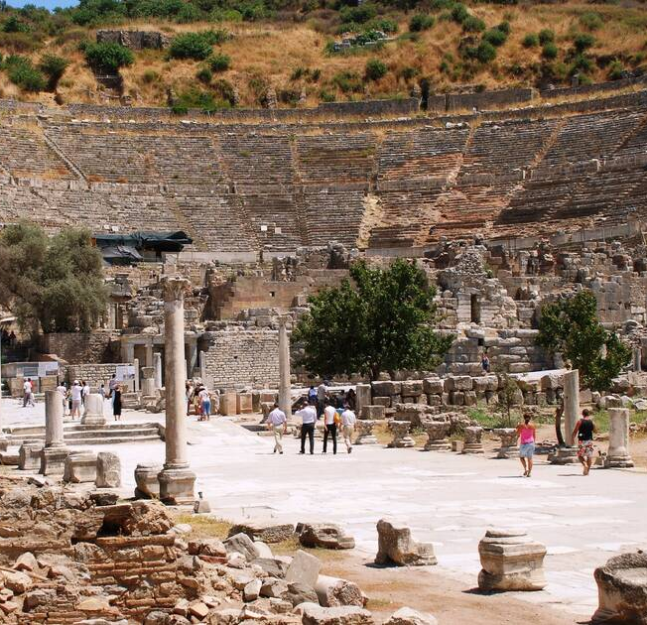
The city of Ephesus
One of the greatest cities in Roman Asia
Had several temples built (including one for Domitian)
Was an important center for Christianity

Slide 8
Positive remarks
Revelation 2:2 I know your works, your toil and your patient endurance. I know that you cannot tolerate evildoers; you have tested those who claim to be apostles but are not, and have found them to be false. ³ I also know that you are enduring patiently and bearing up for the sake of my name, and that you have not grown weary.

Slide 9
Negative remarks
Revelation 2:4 But I have this against you, that you have abandoned the love you had at first. 5 Remember then from what you have fallen; repent, and do the works you did at first. If not, I will come to you and remove your lampstand from its place, unless you repent. 6 Yet this is to your credit: you hate the works of the Nicolaitans, which I also hate. 7 Let anyone who has an ear listen to what the Spirit is saying to the churches. To everyone who conquers, I will give permission to eat from the tree of life that is in the paradise of God.

Slide 10
Who were the Nicolaitans?
2:15- eating meat sacrificed to idols and fornication
"Let us eat meat"
"Conqueror of people"
Highly speculative
Acts 6:5 What they said pleased the whole community, and they chose Stephen, a man full of faith and the Holy Spirit, together with Philip, Prochorus, Nicanor, Timon, Parmenas, and Nicolaus, a proselyte of Antioch

Slide 11
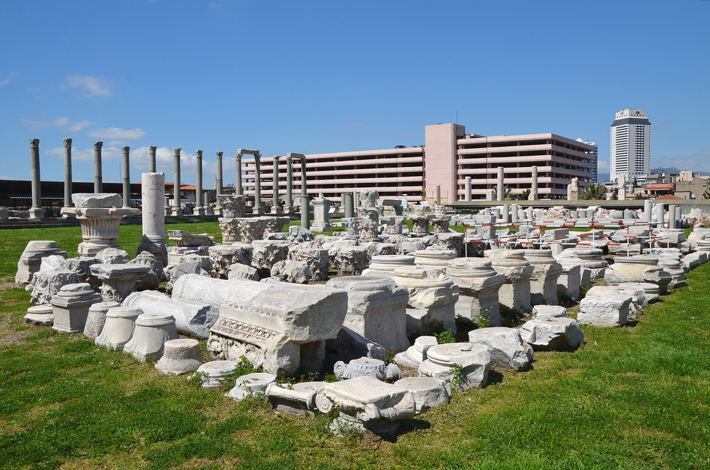
Ancient Smyrna
Important port city
Renowned for its wealth
Homer is supposedly from here

Slide 12
Poor, but rich
Revelation 2:9 ‘I know your affliction and your poverty, even though you are rich. I know the slander on the part of those who say that they are Jews and are not, but are a synagogue of Satan. ¹⁰ Do not fear what you are about to suffer. Beware, the devil is about to throw some of you into prison so that you may be tested, and for ten days you will have affliction. Be faithful until death, and I will give you the crown of life. ¹¹ Let anyone who has an ear listen to what the Spirit is saying to the churches. Whoever conquers will not be harmed by the second death.

Slide 13
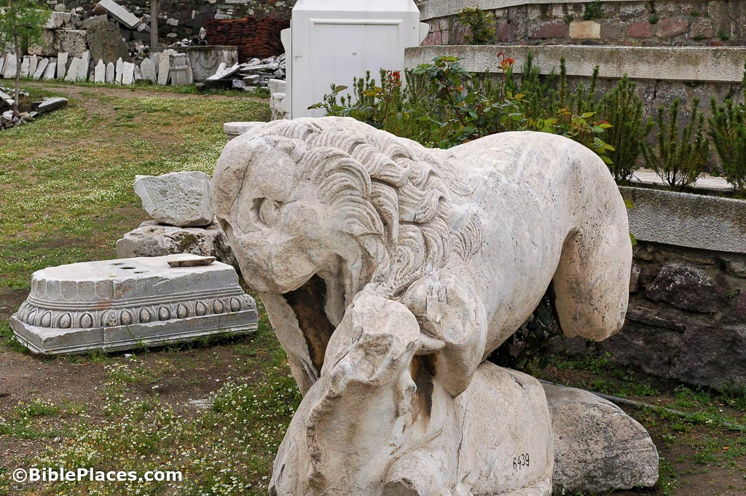
Poverty and slander
Poor probably because of their staunch beliefs
False Jews were perhaps delatores and accused Christians of illegal actions

Slide 14
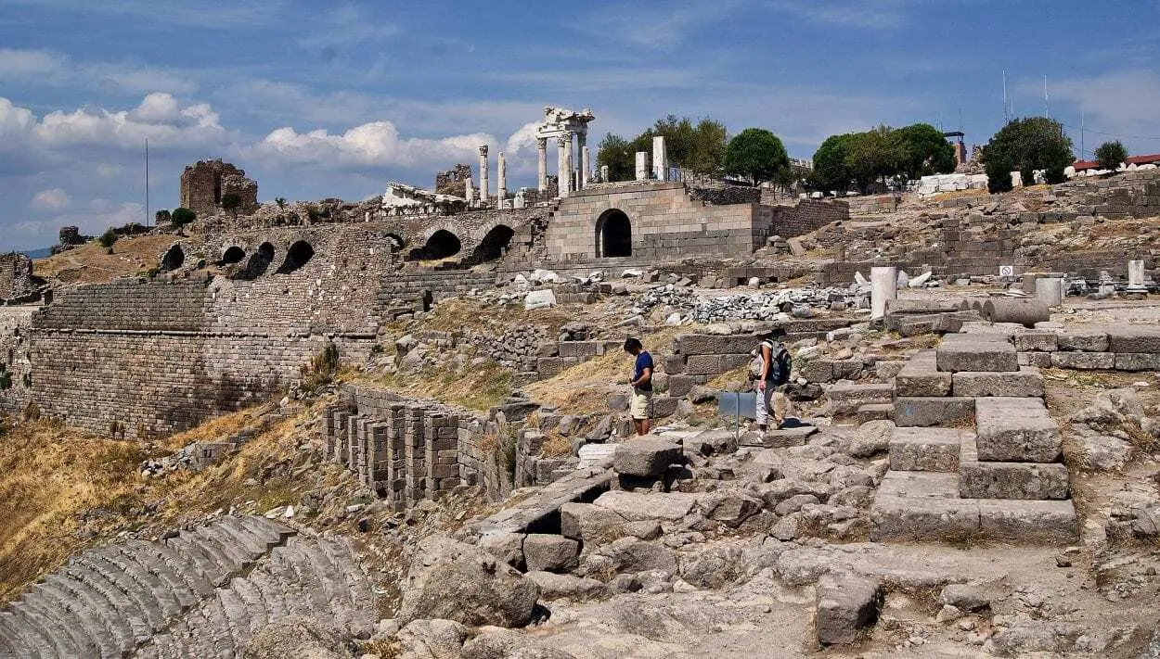
Ancient Pergamum
Had a great library
A temple to Octavian was there
There was a Jewish presence

Slide 15
Satan's throne
Revelation 2:13 ‘I know where you are living, where Satan’s throne is. Yet you are holding fast to my name, and you did not deny your faith in me even in the days of Antipas my witness, my faithful one, who was killed among you, where Satan lives. ¹⁴ But I have a few things against you: you have some there who hold to the teaching of Balaam, who taught Balak to put a stumbling-block before the people of Israel, so that they would eat food sacrificed to idols and practice fornication. ¹⁵ So you also have some who hold to the teaching of the Nicolaitans.

Slide 16
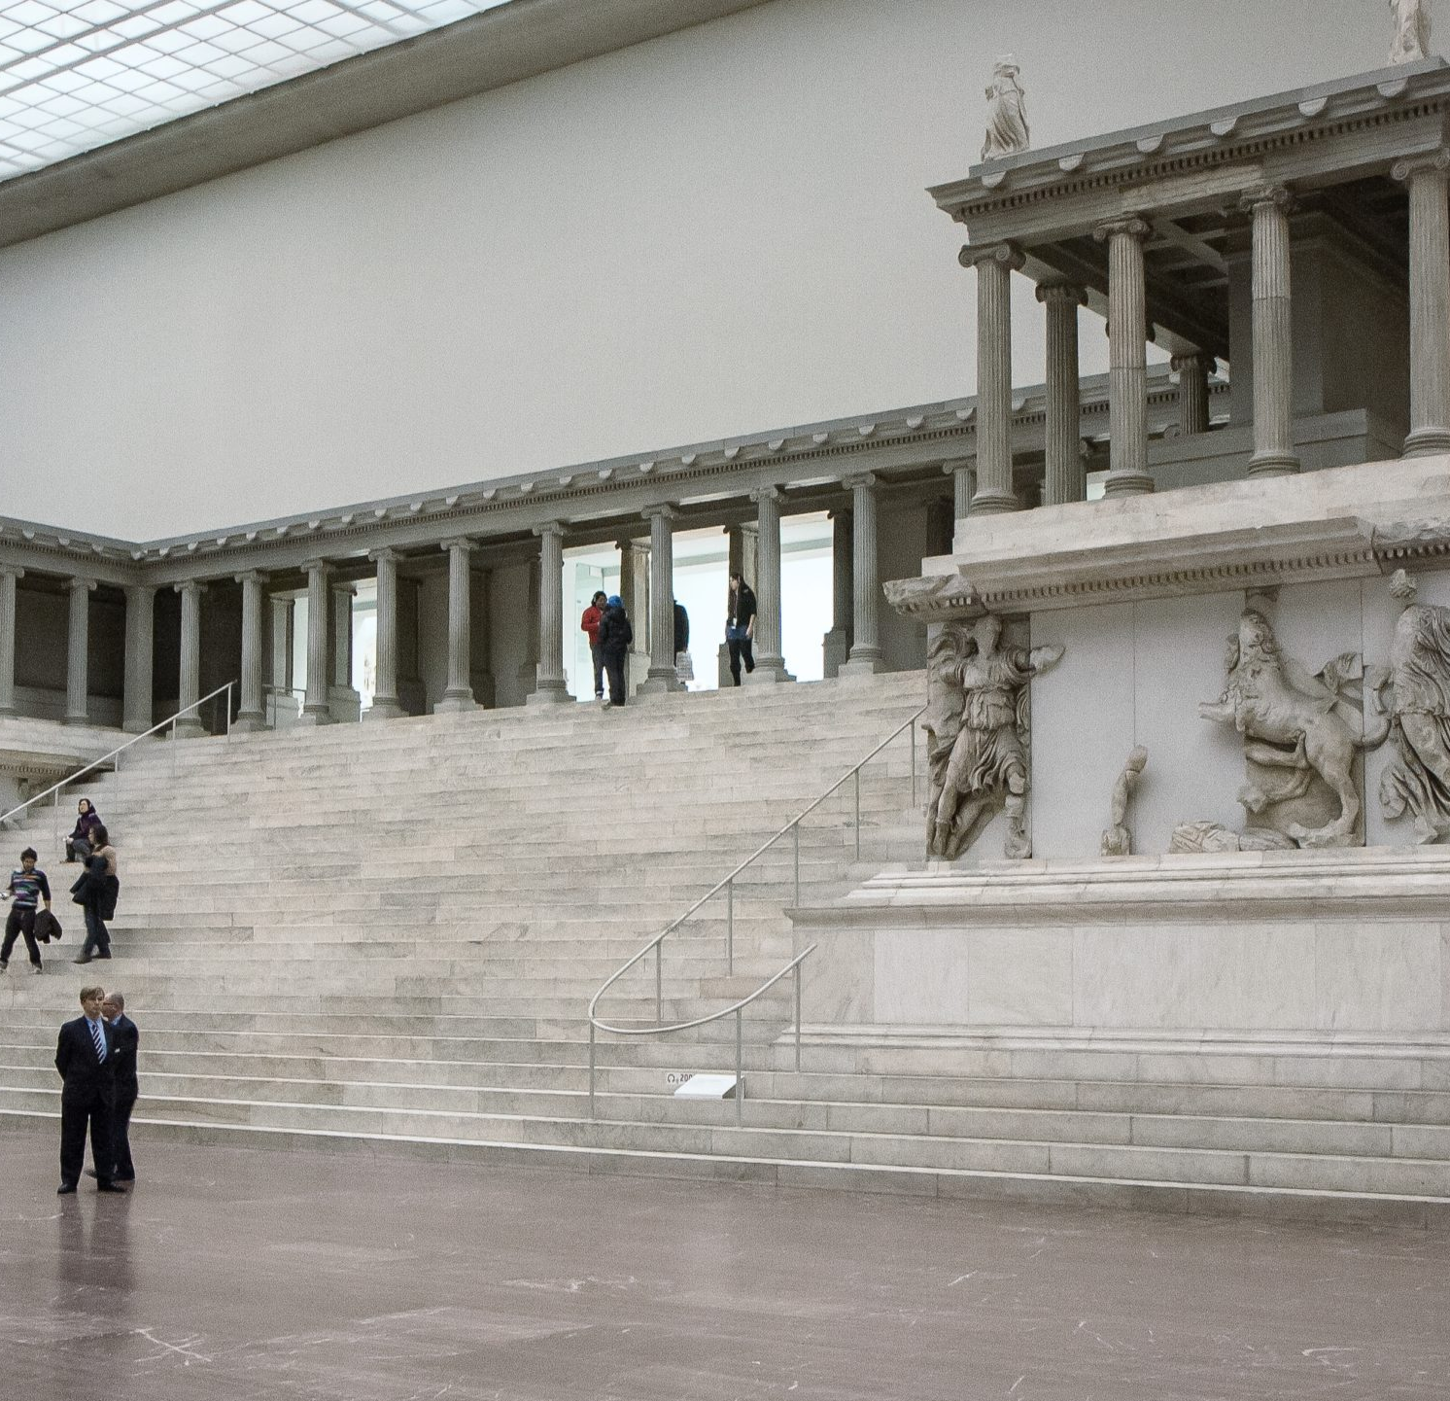
Satan's throne
Perhaps a temple or other architectural feature
Perhaps a metaphor for Greco/Roman religion or persecution

Slide 17
Satan's throne
Revelation 2:13 ‘I know where you are living, where Satan’s throne is. Yet you are holding fast to my name, and you did not deny your faith in me even in the days of Antipas my witness, my faithful one, who was killed among you, where Satan lives. ¹⁴ But I have a few things against you: you have some there who hold to the teaching of Balaam, who taught Balak to put a stumbling-block before the people of Israel, so that they would eat food sacrificed to idols and practice fornication. ¹⁵ So you also have some who hold to the teaching of the Nicolaitans.

Slide 18
Balaam and Balak
"Then Balaam said to Balak: 2 Come and let us advise what you will do to them. Choose out the most beautiful women that are among you and that are in Midian and set them before them naked, and adorned with gold and jewels, and it shall be when they shall see them and lie with them, they will sin against their Lord and fall into your hands, for otherwise you cannot subdue them," Ps.-Philo, Bib. Ant. 18.13.

