Slide 1
Revelation
Chapter 2

Slide 2
"Do not be afraid"
Revelation 1:17 When I saw him, I fell at his feet as though dead. But he placed his right hand on me, saying, ‘Do not be afraid; I am the first and the last, ¹⁸ and the living one. I was dead, and see, I am alive for ever and ever; and I have the keys of Death and of Hades. ¹⁹ Now write what you have seen, what is, and what is to take place after this. ²⁰ As for the mystery of the seven stars that you saw in my right hand, and the seven golden lampstands: the seven stars are the angels of the seven churches, and the seven lampstands are the seven churches.

Slide 3
"I am"
Matthew (5x)
Mark (3x)
Luke (4x)
John (24x)
Acts (6x)
Revelation (5x)
1:8 (God)
1:17 (Christ)
2:23 (Christ)
21:6 (God)
22:16 (Christ)

Slide 4
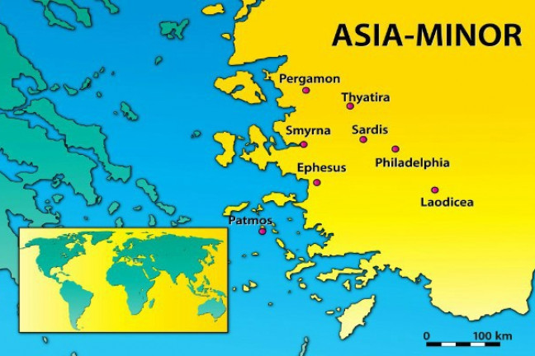
The letters to the seven churches
Each letter was read by all seven.
Why these seven?
Methodology?

Slide 5
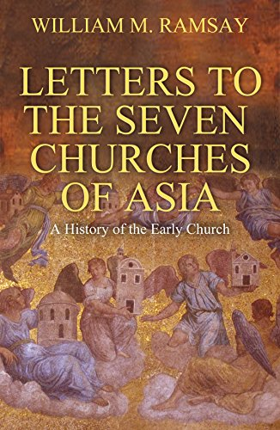

Slide 6
Structure of the Letters
Adscriptio (destination)
Command to write
"Thus says" formula
Christological proclamations
Narratio
Dispositio
Final proclamation

Slide 7
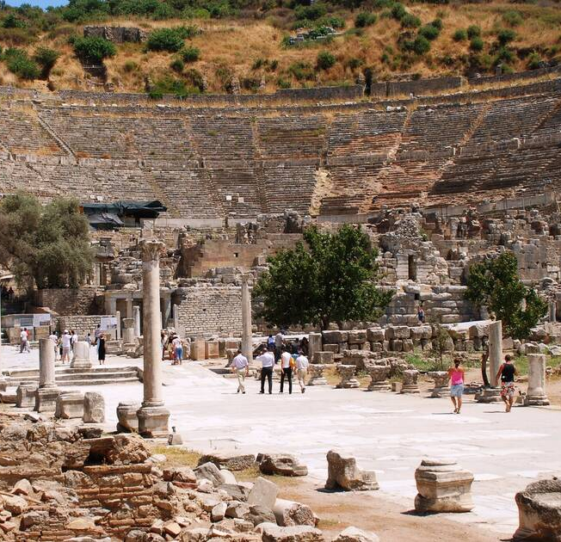
The city of Ephesus
One of the greatest cities in Roman Asia
Had several temples built (including one for Domitian)
Was an important center for Christianity

Slide 8
Positive remarks
Revelation 2:2 I know your works, your toil and your patient endurance. I know that you cannot tolerate evildoers; you have tested those who claim to be apostles but are not, and have found them to be false. ³ I also know that you are enduring patiently and bearing up for the sake of my name, and that you have not grown weary.

Slide 9
Negative remarks
Revelation 2:4 But I have this against you, that you have abandoned the love you had at first. 5 Remember then from what you have fallen; repent, and do the works you did at first. If not, I will come to you and remove your lampstand from its place, unless you repent. 6 Yet this is to your credit: you hate the works of the Nicolaitans, which I also hate. 7 Let anyone who has an ear listen to what the Spirit is saying to the churches. To everyone who conquers, I will give permission to eat from the tree of life that is in the paradise of God.

Slide 10
Who were the Nicolaitans?
2:15- eating meat sacrificed to idols and fornication
"Let us eat meat"
"Conqueror of people"
Highly speculative
Acts 6:5 What they said pleased the whole community, and they chose Stephen, a man full of faith and the Holy Spirit, together with Philip, Prochorus, Nicanor, Timon, Parmenas, and Nicolaus, a proselyte of Antioch

Slide 11
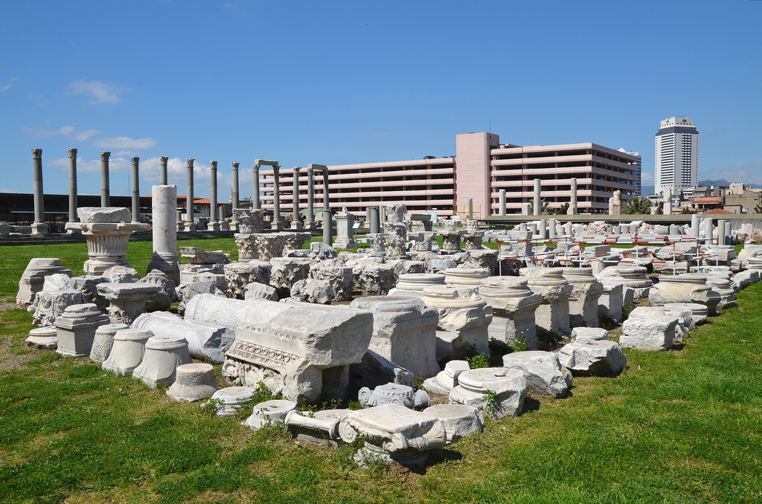
Ancient Smyrna
Important port city
Renowned for its wealth
Homer is supposedly from here

Slide 12
Poor, but rich
Revelation 2:9 ‘I know your affliction and your poverty, even though you are rich. I know the slander on the part of those who say that they are Jews and are not, but are a synagogue of Satan. ¹⁰ Do not fear what you are about to suffer. Beware, the devil is about to throw some of you into prison so that you may be tested, and for ten days you will have affliction. Be faithful until death, and I will give you the crown of life. ¹¹ Let anyone who has an ear listen to what the Spirit is saying to the churches. Whoever conquers will not be harmed by the second death.

Slide 13
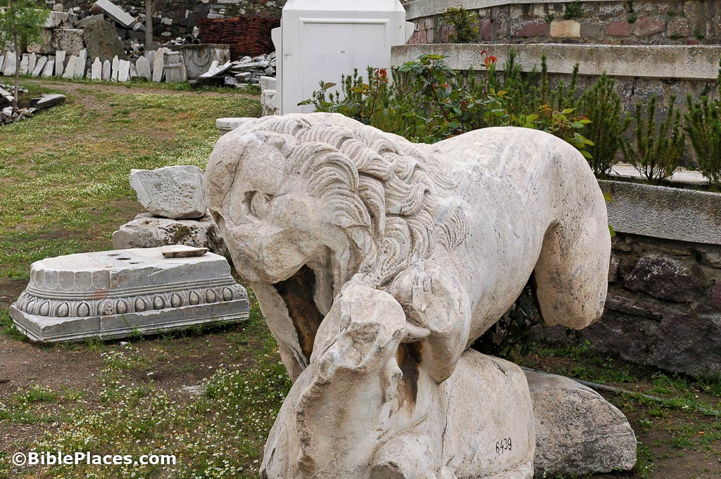
Poverty and slander
Poor probably because of their staunch beliefs
False Jews were perhaps delatores and accused Christians of illegal actions

Slide 14
The crown of life
Revelation 2:9 ‘I know your affliction and your poverty, even though you are rich. I know the slander on the part of those who say that they are Jews and are not, but are a synagogue of Satan. ¹⁰ Do not fear what you are about to suffer. Beware, the devil is about to throw some of you into prison so that you may be tested, and for ten days you will have affliction. Be faithful until death, and I will give you the crown of life. ¹¹ Let anyone who has an ear listen to what the Spirit is saying to the churches. Whoever conquers will not be harmed by the second death.

Slide 15
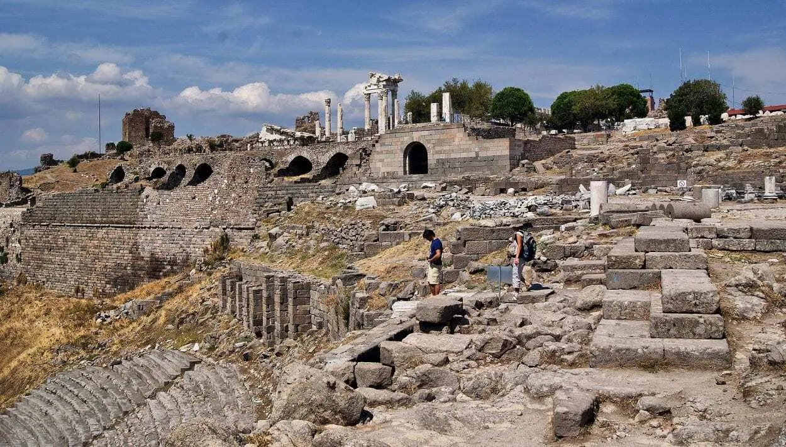
Ancient Pergamum
Had a great library
A temple to Octavian was there
There was a Jewish presence

Slide 16
Satan's throne
Revelation 2:13 ‘I know where you are living, where Satan’s throne is. Yet you are holding fast to my name, and you did not deny your faith in me even in the days of Antipas my witness, my faithful one, who was killed among you, where Satan lives. ¹⁴ But I have a few things against you: you have some there who hold to the teaching of Balaam, who taught Balak to put a stumbling-block before the people of Israel, so that they would eat food sacrificed to idols and practice fornication. ¹⁵ So you also have some who hold to the teaching of the Nicolaitans.

Slide 17
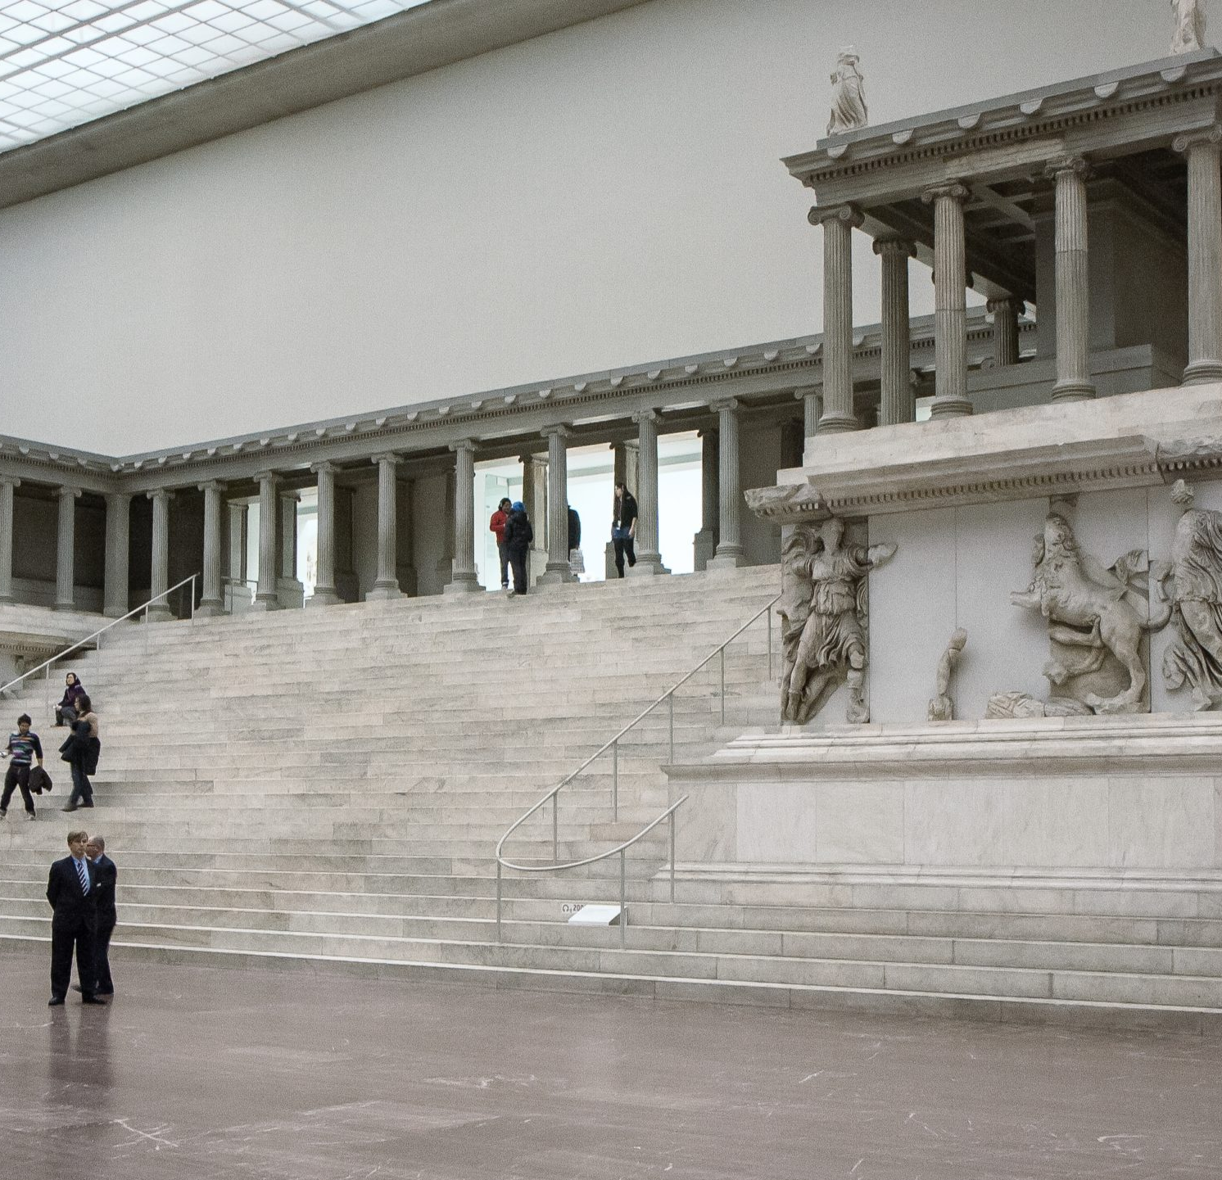
Satan's throne
Perhaps a temple or other architectural feature
Perhaps a metaphor for Greco/Roman religion or persecution

Slide 18
The teaching of Balaam
Revelation 2:13 ‘I know where you are living, where Satan’s throne is. Yet you are holding fast to my name, and you did not deny your faith in me even in the days of Antipas my witness, my faithful one, who was killed among you, where Satan lives. ¹⁴ But I have a few things against you: you have some there who hold to the teaching of Balaam, who taught Balak to put a stumbling-block before the people of Israel, so that they would eat food sacrificed to idols and practice fornication. ¹⁵ So you also have some who hold to the teaching of the Nicolaitans.

Slide 19
Balaam and Balak
"Then Balaam said to Balak: 2 Come and let us advise what you will do to them. Choose out the most beautiful women that are among you and that are in Midian and set them before them naked, and adorned with gold and jewels, and it shall be when they shall see them and lie with them, they will sin against their Lord and fall into your hands, for otherwise you cannot subdue them," Ps.-Philo, Bib. Ant. 18.13.

Slide 20
Meat sacrificed to idols
Mentioned several times in the NT (1 Cor. 8, 10; Acts 15)
What was the issue?
  Participation in a sacral meal
  Eating formerly sacrificial meat purchased at the meat market
  Accepting meat at a religious festival

Slide 21
A white stone with a new name
Revelation 2:15 So you also have some who hold to the teaching of the Nicolaitans. ¹⁶ Repent then. If not, I will come to you soon and make war against them with the sword of my mouth. ¹⁷ Let anyone who has an ear listen to what the Spirit is saying to the churches. To everyone who conquers I will give some of the hidden manna, and I will give a white stone, and on the white stone is written a new name that no one knows except the one who receives it.

Slide 22
Hidden manna
2 Baruch 29:3 And it shall come to pass when all is accomplished that was to come to pass in those parts, that the Messiah shall then begin to be revealed. 4 And Behemoth shall be revealed from his place and Leviathan shall ascend from the sea, those two great monsters which I created on the fifth day of creation, and shall have kept until that time; and then they shall be for food for all that are left... 8 And it shall come to pass at that self-same time that the treasury of manna shall again descend from on high, and they will eat of it in those years, because these are they who have come to the consummation of time.
Manna= "What is it?"
"Hidden" as in only reserved to those who overcome

Slide 23
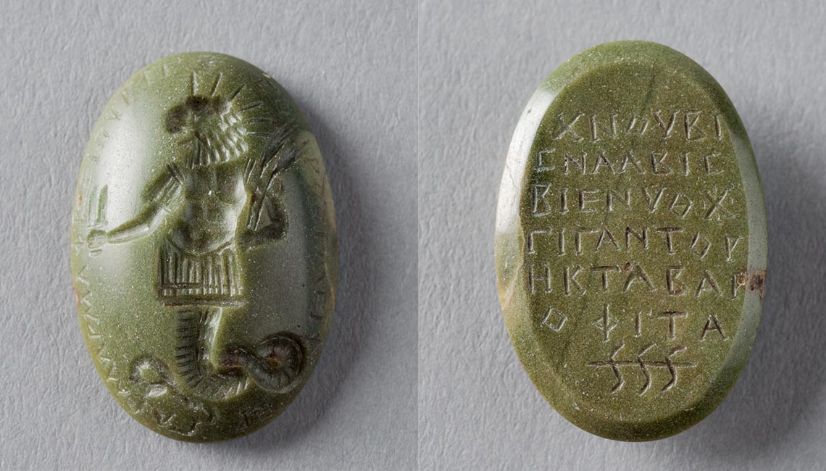
The white stone with a new name
"And the Lord Yahweh will slay with the second death, but his servants, the righteous, he will call by a different name," Targum to Isaiah 65:15.

Slide 24
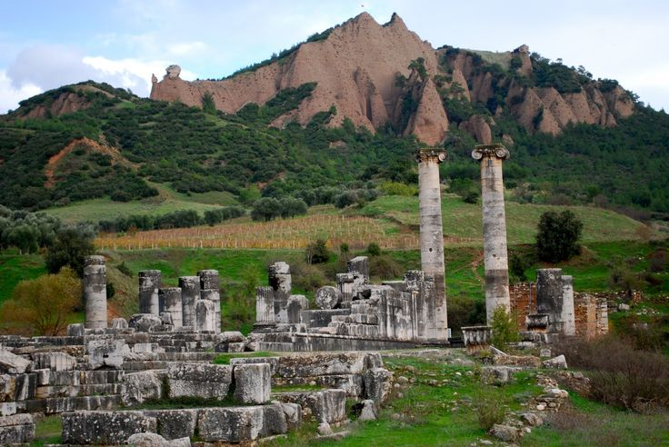
Ancient Thyatira
Various trade guilds
Lydia perhaps learned her trade here
Least remarkable of all the cities

Slide 25
Jezebel
Revelation 2:19 ‘I know your works—your love, faith, service, and patient endurance. I know that your last works are greater than the first. ²⁰ But I have this against you: you tolerate that woman Jezebel, who calls herself a prophet and is teaching and beguiling my servants to practice fornication and to eat food sacrificed to idols. ²¹ I gave her time to repent, but she refuses to repent of her fornication. ²² Beware, I am throwing her on a bed, and those who commit adultery with her I am throwing into great distress, unless they repent of her doings; ²³ and I will strike her children dead.

Slide 26
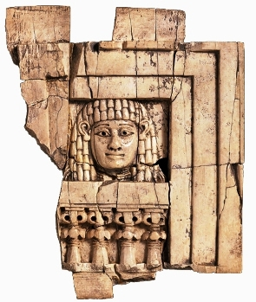
"Jezebel"
A prophetess who taught some to eat meat sacrificed to idols
Perhaps a patroness
Women could occupy important leadership positions in Greco-Roman society

Slide 27
"I will give the morning star"
Revelation 2:24 But to the rest of you in Thyatira, who do not hold this teaching, who have not learned what some call “the deep things of Satan”, to you I say, I do not lay on you any other burden; ²⁵ only hold fast to what you have until I come. ²⁶ To everyone who conquers and continues to do my works to the end, I will give authority over the nations;
27 to rule them with an iron rod,
as when clay pots are shattered—²⁸ even as I also received authority from my Father. To the one who conquers I will also give the morning star. ²⁹ Let anyone who has an ear listen to what the Spirit is saying to the churches.

