Slide 1
Love Does Not Seek it’s own
1 Corinthians 13

Slide 2
El Amor No Busca Lo Suyo
1 Corintios 13

Slide 3
1 Corintios 13:4-5 RV60
El amor es sufrido, es benigno; el amor no tiene envidia, el amor no es jactancioso, no se envanece; [5] no hace nada indebido, no busca lo suyo…
1 Corinthians 13:4-5 NASB95- Love is patient, love is kind and is not jealous; love does not brag and is not arrogant, [5] does not act unbecomingly; it does not seek its own…

Slide 4
“The greatest of love is to learn to love yourself.”

Slide 5
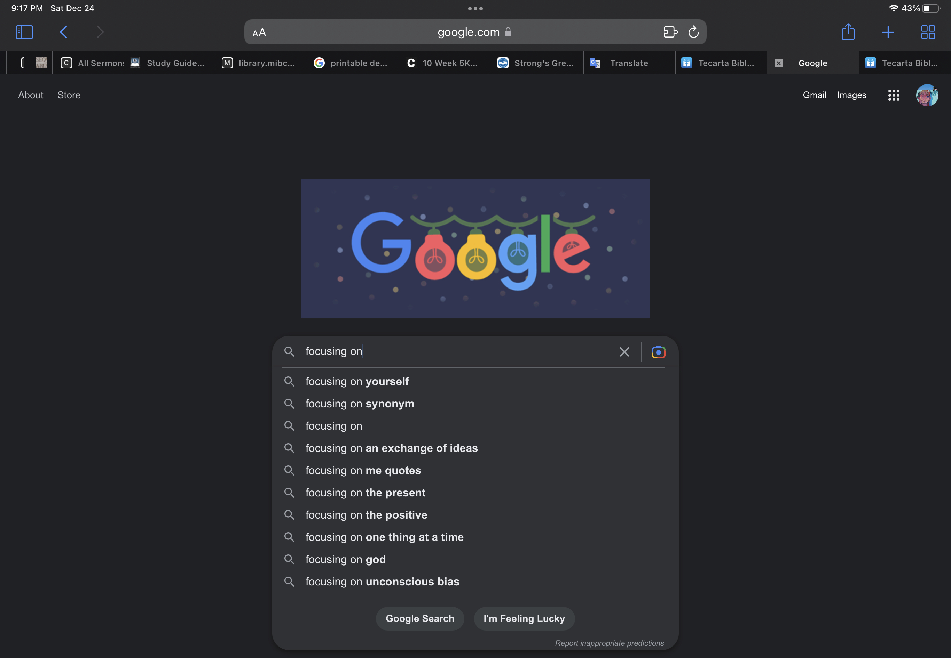

Slide 6
Seeking the Good of Others/ Buscando el bien de los demás
1 Corinthians 10:23-24 NASB95- All things are lawful, but not all things are profitable. All things are lawful, but not all things edify. [24] Let no one seek his own good, but that of his neighbor.
1 Corintios 10:23-24 RV60- Todo me es lícito, pero no todo conviene; todo me es lícito, pero no todo edifica. [24] Ninguno busque su propio bien, sino el del otro.

Slide 7
Seeking the Good of Others/ Buscando el bien de los demás
1 Corinthians 10:33 NASB95- just as I also please all men in all things, not seeking my own profit but the profit of the many, so that they may be saved.
1 Corintios 10:33 RV60- como también yo en todas las cosas agrado a todos, no procurando mi propio beneficio, sino el de muchos, para que sean salvos.

Slide 8
Seeking the Good of Others/ Buscando el bien de los demás
Romans 15:1-8 NASB95- Now we who are strong ought to bear the weaknesses of those without strength and not just please ourselves. [2] Each of us is to please his neighbor for his good, to his edification. [3] For even Christ did not please Himself; but as it is written, “THE REPROACHES OF THOSE WHO REPROACHED YOU FELL ON ME.”

Slide 9
Seeking the Good of Others/ Buscando el bien de los demás
Romans 15:1-8 NASB95- [4] For whatever was written in earlier times was written for our instruction, so that through perseverance and the encouragement of the Scriptures we might have hope. [5] Now may the God who gives perseverance and encouragement grant you to be of the same mind with one another according to Christ Jesus,

Slide 10
Seeking the Good of Others/ Buscando el bien de los demás
Romans 15:1-8 NASB95- [6] so that with one accord you may with one voice glorify the God and Father of our Lord Jesus Christ. [7] Therefore, accept one another, just as Christ also accepted us to the glory of God. [8] For I say that Christ has become a servant to the circumcision on behalf of the truth of God to confirm the promises given to the fathers

Slide 11
Seeking the Good of Others/ Buscando el bien de los demás
Philippians 2:19-21 NASB95- But I hope in the Lord Jesus to send Timothy to you shortly, so that I also may be encouraged when I learn of your condition. [20] For I have no one else of kindred spirit who will genuinely be concerned for your welfare. [21] For they all seek after their own interests, not those of Christ Jesus.

Slide 13
Seeking the Good of Others/ Buscando el bien de los demás
Philippians 2:3-8 NASB95- Do nothing from selfishness or empty conceit, but with humility of mind regard one another as more important than yourselves;

Slide 14
Seeking the Good of Others/ Buscando el bien de los demás
Philippians 2:3-8 NASB95- Do nothing from selfishness or empty conceit, but with humility of mind regard one another as more important than yourselves; [4] do not merely look out for your own personal interests, but also for the interests of others. [5] Have this attitude in yourselves which was also in Christ Jesus,

Slide 15
Seeking the Good of Others/ Buscando el bien de los demás
Philippians 2:3-8 NASB95- [6] who, although He existed in the form of God, did not regard equality with God a thing to be grasped, [7] but emptied Himself, taking the form of a bond-servant, and being made in the likeness of men. [8] Being found in appearance as a man, He humbled Himself by becoming obedient to the point of death, even death on a cross.

Slide 16
Attitude determines our love/ La actitud determina nuestro amor
True love is demonstrated in selfless giving.
El amor verdadero se demuestra en actos de servicio.
Proverbs 15:1 NASB95- A gentle answer turns away wrath, But a harsh word stirs up anger.
Proverbios 15:1 RV60- La blanda respuesta quita la ira; Mas la palabra áspera hace subir el furor.

Slide 17
Love Does Not Seek it’s own
1 Corinthians 13

