Slide 1
Revelation 5

Slide 2
Important questions
How can we overcome our obstacle?
How can we maintain our identity despite external and internal challenges?
Answer= The one who sits on the throne and the Lion of Judah
This will be accomplished by opening the seals of the scroll
Rev. 6 –21

Slide 3
The sealed scroll
Revelation 5:1 Then I saw in the right hand of the one seated on the throne a scroll written on the inside and on the back, sealed with seven seals; ² and I saw a mighty angel proclaiming with a loud voice, ‘Who is worthy to open the scroll and break its seals?’ ³ And no one in heaven or on earth or under the earth was able to open the scroll or to look into it. ⁴ And I began to weep bitterly because no one was found worthy to open the scroll or to look into it. ⁵ Then one of the elders said to me, ‘Do not weep. See, the Lion of the tribe of Judah, the Root of David, has conquered, so that he can open the scroll and its seven seals.’

Slide 4
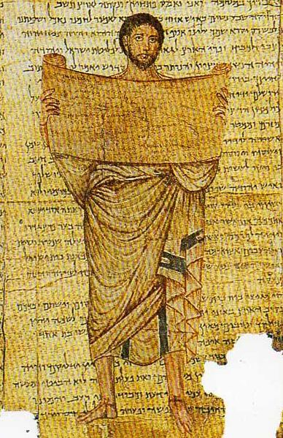

Slide 5
The sealed scroll
Ezekiel 2:8 But you, mortal, hear what I say to you; do not be rebellious like that rebellious house; open your mouth and eat what I give you. ⁹ I looked, and a hand was stretched out to me, and a written scroll was in it. ¹⁰ He spread it before me; it had writing on the front and on the back, and written on it were words of lamentation and mourning and woe.

Slide 6
The sealed scroll
Revelation 5:1 Then I saw in the right hand of the one seated on the throne a scroll written on the inside and on the back, sealed with seven seals; ² and I saw a mighty angel proclaiming with a loud voice, ‘Who is worthy to open the scroll and break its seals?’ ³ And no one in heaven or on earth or under the earth was able to open the scroll or to look into it. ⁴ And I began to weep bitterly because no one was found worthy to open the scroll or to look into it. ⁵ Then one of the elders said to me, ‘Do not weep. See, the Lion of the tribe of Judah, the Root of David, has conquered, so that he can open the scroll and its seven seals.’

Slide 7
The Lion of Judah
4 Ezra 12:31 And as for the lion whom you saw... [32] this is the Messiah whom the Most High has kept until the end of days, who will arise from the posterity of David, and will come and speak to them; he will denounce them for their ungodliness and for their wickedness, and will cast up before them their contemptuous dealings. [33] For first he will set them living before his judgment seat, and when he has reproved them, then he will destroy them. [34] But he will deliver in mercy the remnant of my people, those who have been saved throughout my borders, and he will make them joyful until the end comes, the day of judgment, of which I spoke to you at the beginning.
Genesis 49:8 Judah is a lion’s whelp; from the prey, my son, you have gone up. He crouches down, he stretches out like a lion, like a lioness—who dares rouse him up?

Slide 8
The root of David
Isaiah 11:1 A shoot shall come out from the stock of Jesse, and a branch shall grow out of his roots. The spirit of the Lord shall rest on him, the spirit of wisdom and understanding, the spirit of counsel and might, the spirit of knowledge and the fear of the Lord.
"A ruler shall not depart from Judah while Israel has dominion...until the coming of the Messiah of righteousness, the Branch of David, for to him and to his offspring has been given the covenant of kingship over his people for everlasting generations," 4QPatriarchalBlessings

Slide 9
A Lamb standing
Revelation 5:6 Then I saw between the throne and the four living creatures and among the elders a Lamb standing as if it had been slaughtered, having seven horns and seven eyes, which are the seven spirits of God sent out into all the earth. ⁷ He went and took the scroll from the right hand of the one who was seated on the throne. ⁸ When he had taken the scroll, the four living creatures and the twenty-four elders fell before the Lamb, each holding a harp and golden bowls full of incense, which are the prayers of the saints.

Slide 10
A Lamb standing
The term translated "lamb" is used 29x in Revelation (28x it is used of Jesus)
It only occurs one other time in the NT (John 21:15)
The Lamb is enthroned (7:17)
He receives worship (7:9-10)
He is a shepherd (7:17)
He is a mighty warrior (17:14)
New Jerusalem is his bride (21:9)
He is the light of the New Jerusalem (21:22-23)

Slide 11
A sacrifice that conquers
Colossians 2:13 And when you were dead in trespasses and the uncircumcision of your flesh, God made you alive together with him, when he forgave us all our trespasses, ¹⁴ erasing the record that stood against us with its legal demands. He set this aside, nailing it to the cross. ¹⁵ He disarmed the rulers and authorities and made a public example of them, triumphing over them in it.

Slide 12
Incense= prayers
Revelation 5:6 Then I saw between the throne and the four living creatures and among the elders a Lamb standing as if it had been slaughtered, having seven horns and seven eyes, which are the seven spirits of God sent out into all the earth. ⁷ He went and took the scroll from the right hand of the one who was seated on the throne. ⁸ When he had taken the scroll, the four living creatures and the twenty-four elders fell before the Lamb, each holding a harp and golden bowls full of incense, which are the prayers of the saints.

Slide 13
Incense= Prayers
Psalm 141:2 Let my prayer be counted as incense before you; the lifting up my hands as an evening sacrifice
"Our altars are the mind of each righteous person, from which true and intelligible incense with a sweet savor is sent up, prayers from a pure conscience. This is why it is said by John in the Apocalypse, 'The incense is the prayers of the saints,' and by the Psalmist, 'Let my prayer be counted as incense before you,'" Origen, Contra Celsus 8.17.

Slide 14
A new song
Revelation 5:9 They sing a new song:‘You are worthy to take the scroll and to open its seals, for you were slaughtered and by your blood you ransomed for God saints from every tribe and language and people and nation; ¹⁰ you have made them to be a kingdom and priests serving our God, and they will reign on earth.’

Slide 15
A new song
Used for celebrating a very special event or occasion
Psalms 33, 40, 96, 98, 144, 149
Isaiah 49:10
Mekhilta de-Rabbi Ishmael Shirata 1, “The tenth song will be recited in the future as it is said, ‘Sing unto Yahweh a new song, and his praise unto the end of the earth (Is. 49:10),’ and it also says, ‘Sing unto Yahweh a new song, and his praise in the assembly of the saints,’” (Ps. 149:1).

Slide 16
"Amen!"
Revelation 5:13 Then I heard every creature in heaven and on earth and under the earth and in the sea and all that is in them, singing,“To the one seated on the throne and to the Lamb be blessing and honor and glory and might forever and ever!”¹⁴ And the four living creatures said, “Amen!” And the elders fell down and worshiped.

Slide 17
The effect of the scene
Tension
Awe
Gratitude

