Slide 1
Revelation 6

Slide 2
"Amen!"
Revelation 5:13 Then I heard every creature in heaven and on earth and under the earth and in the sea and all that is in them, singing,“To the one seated on the throne and to the Lamb be blessing and honor and glory and might forever and ever!”¹⁴ And the four living creatures said, “Amen!” And the elders fell down and worshiped.

Slide 3
The effect of the scene
Tension
Awe
Gratitude
Tranquility

Slide 4
The seven seals
Four horsemen- Conquering, peace removed, famine, death
Fifth seal- martyred saints
Sixth seal- cosmic disruption
Seventh seal- silence?

Slide 5
How should we interpret these judgments?
Specific historical referents? (e.g., The white horsemen with a bow = Parthians)
Precise and specific chronology of events?
General referents using biblical imagery
Why use biblical imagery?
“This is like that or even greater”
E.g., The four horsemen

Slide 6
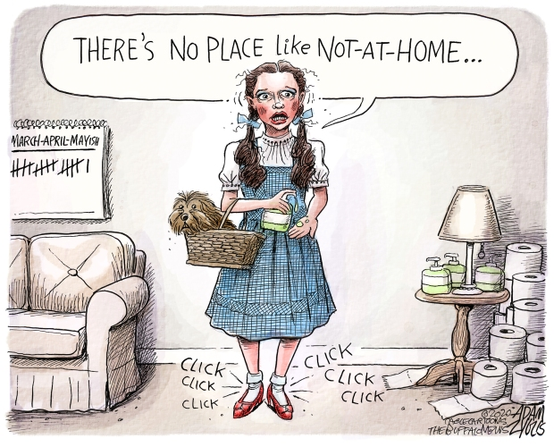

Slide 7
The four horsemen
Zechariah 1:8-11 In the night I saw a man riding on a red horse! He was standing among the myrtle trees in the glen; and behind him were red, sorrel, and white horses. ⁹ Then I said, ‘What are these, my lord?’ The angel who talked with me said to me, ‘I will show you what they are.’ ¹⁰ So the man who was standing among the myrtle trees answered, ‘They are those whom the Lord has sent to patrol the earth.’ ¹¹ Then they spoke to the angel of the Lord who was standing among the myrtle trees, ‘We have patrolled the earth, and lo, the whole earth remains at peace.’

Slide 8
The four horsemen= the white horse
Revelation 6:1 Then I saw the Lamb open one of the seven seals, and I heard one of the four living creatures call out, as with a voice of thunder, ‘Come!’ ² I looked, and there was a white horse! Its rider had a bow; a crown was given to him, and he came out conquering and to conquer.

Slide 9
The four horsemen= the white horse
Revelation 6:1 Then I saw heaven opened, and there was a white horse! Its rider is called Faithful and True, and in righteousness he judges and makes war. ¹² His eyes are like a flame of fire, and on his head are many diadems; and he has a name inscribed that no one knows but himself. ¹³ He is clothed in a robe dipped in blood, and his name is called The Word of God…15 from his mouth comes a sharp sword

Slide 10
The four horsemen= the white horse
“For they had voted that sacrifices should be offered for his victory during forty days, and had granted him permission to ride, in the triumph already voted him, in a chariot drawn by white horses and to be accompanied by all the lictors who were then with him, and by as many others as he had employed in his first dictator­ship, together with as many more as he had in his second,” Cassius Dio, 43.14.3.

Slide 11
The four horsemen= the white horse
Revelation 6:1 Then I saw the Lamb open one of the seven seals, and I heard one of the four living creatures call out, as with a voice of thunder, ‘Come!’ ² I looked, and there was a white horse! Its rider had a bow; a crown was given to him, and he came out conquering and to conquer.

Slide 12
The four horsemen= the red horse
Revelation 6:3 When he opened the second seal, I heard the second living creature call out, ‘Come!’ ⁴ And out came another horse, bright red; its rider was permitted to take peace from the earth, so that people would slaughter one another; and he was given a great sword.

Slide 13
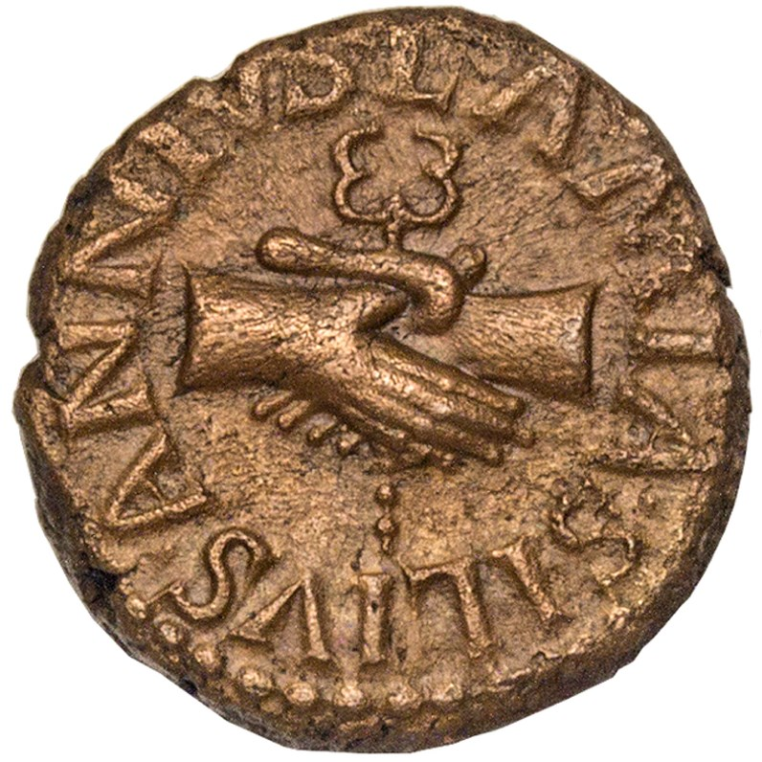
Pax Romana
27 BC- 180 AD
“Remember O Roman, these will be your arts: to teach peace to those you conquer, to spare the defeated, and to humble the proud,” Aeneid 6.851-853.

Slide 14
The four horsemen= the black horse
Revelation 6:5 When he opened the third seal, I heard the third living creature call out, ‘Come!’ I looked, and there was a black horse! Its rider held a pair of scales in his hand, ⁶ and I heard what seemed to be a voice in the midst of the four living creatures saying, ‘A quart of wheat for a day’s pay, and three quarts of barley for a day’s pay, but do not damage the olive oil and the wine!’

Slide 15
The four horsemen= the black horse
Denarius= A day’s wage (normal circumstances)
Denarius= a day’s wage (the time of the black horse)
Wheat= 16 quarts
Barley= 8 quarts
Wheat= 1 quart
Barley= 2 quarts

Slide 16
The four horsemen= the black horse
Revelation 6:5 When he opened the third seal, I heard the third living creature call out, ‘Come!’ I looked, and there was a black horse! Its rider held a pair of scales in his hand, ⁶ and I heard what seemed to be a voice in the midst of the four living creatures saying, ‘A quart of wheat for a day’s pay, and three quarts of barley for a day’s pay, but do not damage the olive oil and the wine!’

Slide 17
Domitian’s vine edict
“Once upon the occasion of a plenti­ful wine crop, attended with a scarcity of grain, thinking that the fields were neglected through too much attention to the vineyards, he made an edict forbidding anyone to plant more vines in Italy and ordering that the vineyards in the provinces be cut down, or but half of them at most be left standing; but he did not persist in carrying out the measure,” Suetonius, Domitian 7.2.

Slide 18
The four horsemen= the pale horse
Revelation 6:7 When he opened the fourth seal, I heard the voice of the fourth living creature call out, ‘Come!’ ⁸ I looked and there was a pale green horse! Its rider’s name was Death, and Hades followed with him; they were given authority over a fourth of the earth, to kill with sword, famine, and pestilence, and by the wild animals of the earth.

Slide 19
How long?
Revelation 6:9 When he opened the fifth seal, I saw under the altar the souls of those who had been slaughtered for the word of God and for the testimony they had given; ¹⁰ they cried out with a loud voice, ‘Sovereign Lord, holy and true, how long will it be before you judge and avenge our blood on the inhabitants of the earth?’ ¹¹ They were each given a white robe and told to rest a little longer, until the number would be complete (lit. “they are fulfilled”) both of their fellow-servants and of their brothers and sisters, who were soon to be killed as they themselves had been killed.

Slide 20
The sixth seal= cosmic upheaval
Revelation 6:12 When he opened the sixth seal, I looked, and there came a great earthquake; the sun became black as sackcloth, the full moon became like blood, ¹³ and the stars of the sky fell to the earth as the fig tree drops its winter fruit when shaken by a gale. ¹⁴ The sky vanished like a scroll rolling itself up, and every mountain and island was removed from its place. ¹⁵ Then the kings of the earth and the magnates and the generals and the rich and the powerful, and everyone, slave and free, hid in the caves and among the rocks of the mountains, ¹⁶ calling to the mountains and rocks, ‘Fall on us and hide us from the face of the one seated on the throne and from the wrath of the Lamb; ¹⁷ for the great day of their wrath has come, and who is able to stand?’

Slide 21
Practical takeaways
World governments are thought to be institutes responsible for peace and economic security.
What limits the governments abilities?
Internal corruption
Factors beyond their control

