Slide 1
Revelation 7

Slide 2
The sixth seal= cosmic upheaval
Revelation 6:12 When he opened the sixth seal, I looked, and there came a great earthquake; the sun became black as sackcloth, the full moon became like blood, ¹³ and the stars of the sky fell to the earth as the fig tree drops its winter fruit when shaken by a gale. ¹⁴ The sky vanished like a scroll rolling itself up, and every mountain and island was removed from its place. ¹⁵ Then the kings of the earth and the magnates and the generals and the rich and the powerful, and everyone, slave and free, hid in the caves and among the rocks of the mountains, ¹⁶ calling to the mountains and rocks, ‘Fall on us and hide us from the face of the one seated on the throne and from the wrath of the Lamb; ¹⁷ for the great day of their wrath has come, and who is able to stand?’

Slide 3
Practical takeaways
World governments are thought to be institutes responsible for peace and economic security.
What limits the governments abilities?
Internal corruption
Factors beyond their control

Slide 4
Difficulties of chapter 7
“Rev 7:1-17 is a literary diptych in which both scenes present similar interpretive problems: Who are the 144,000 sealed in 7:4-8? Who constitute the innumerable multitude described in 7:9-17? What is the temporal setting of these scenes, the present or the future?...This passage has proven to be one of the most difficult to interpret in Revelation, and each of the questions posed above has been answered in a variety of ways, often with few, if any, supporting arguments,” Aune, Revelation 6-16, 439-440.

Slide 5
Who are the 144,000?
Revelation 7:4 And I heard the number of those who were sealed, one hundred and forty-four thousand, sealed out of every tribe of the people of Israel:⁵ From the tribe of Judah twelve thousand sealed, from the tribe of Reuben twelve thousand, from the tribe of Gad twelve thousand, ⁶ from the tribe of Asher twelve thousand, from the tribe of Naphtali twelve thousand, from the tribe of Manasseh twelve thousand, ⁷ from the tribe of Simeon twelve thousand, from the tribe of Levi twelve thousand, from the tribe of Issachar twelve thousand, ⁸ from the tribe of Zebulun twelve thousand, from the tribe of Joseph twelve thousand, from the tribe of Benjamin twelve thousand sealed.

Slide 6
Who are the 144,000?
Revelation 7:9 After this I looked, and there was a great multitude that no one could count, from every nation, from all tribes and peoples and languages, standing before the throne and before the Lamb, robed in white, with palm branches in their hands

Slide 7
Who are the 144,000?
Revelation 14:1 Then I looked, and there was the Lamb, standing on Mount Zion! And with him were one hundred and forty-four thousand who had his name and his Father’s name written on their foreheads. ² And I heard a voice from heaven like the sound of many waters and like the sound of loud thunder; the voice I heard was like the sound of harpists playing on their harps, ³ and they sing a new song before the throne and before the four living creatures and before the elders. No one could learn that song except the one hundred forty-four thousand who have been redeemed from the earth. ⁴ It is these who have not defiled themselves with women, for they are virgins; these follow the Lamb wherever he goes. They have been redeemed from humankind as first fruits for God and the Lamb, ⁵ and in their mouth no lie was found; they are blameless.

Slide 8
Who are the 144,000?
Jews or Jewish Christians
Gentile or all Christians
Martyrs/Messianic army
Christians who survive the eschatological conflicts

Slide 9
The seal on the forehead
Revelation 7:1 After this I saw four angels standing at the four corners of the earth, holding back the four winds of the earth so that no wind could blow on earth or sea or against any tree. ² I saw another angel ascending from the rising of the sun, having the seal of the living God, and he called with a loud voice to the four angels who had been given power to damage earth and sea, ³ saying, ‘Do not damage the earth or the sea or the trees, until we have marked the servants of our God with a seal on their foreheads.’

Slide 10
The seal on the forehead
Ezekiel 9:1 Now the glory of the God of Israel had gone up, from the cherub on which it rested, to the threshold of the house. The Lord called to the man clothed in linen, who had the writing-case at his side, ⁴ and said to him, ‘Go through the city, through Jerusalem, and put a mark on the foreheads of those who sigh and groan over all the abominations that are committed in it.’ ⁵ To the others he said in my hearing, ‘Pass through the city after him, and kill; your eye shall not spare, and you shall show no pity.

Slide 11
Sealing or marking
Exodus 12:13- The blood shall be a sign for you on the houses where you live: when I see the blood, I will pass over you, and no plague shall destroy you when I strike the land of Egypt.
Genesis 4:15- Then the Lord said to him, “Not so! Whoever kills Cain will suffer a sevenfold vengeance.” And the Lord put a mark on Cain, so that no one who came upon him would kill him
The seal will have the name of the Lamb and of God
It indicates possession

Slide 12
The 144,000
Revelation 7:4 And I heard the number of those who were sealed, one hundred and forty-four thousand, sealed out of every tribe of the people of Israel:⁵ From the tribe of Judah twelve thousand sealed, from the tribe of Reuben twelve thousand, from the tribe of Gad twelve thousand, ⁶ from the tribe of Asher twelve thousand, from the tribe of Naphtali twelve thousand, from the tribe of Manasseh twelve thousand, ⁷ from the tribe of Simeon twelve thousand, from the tribe of Levi twelve thousand, from the tribe of Issachar twelve thousand, ⁸ from the tribe of Zebulun twelve thousand, from the tribe of Joseph twelve thousand, from the tribe of Benjamin twelve thousand sealed.

Slide 13
The 144,000
Changes to the usual list
Why 144,000?
Joseph= Ephraim
Levi= Dan
12 apostles x 12 tribes= 144 x 1000
Revelation 21:12 It has a great, high wall with twelve gates, and at the gates twelve angels, and on the gates are inscribed the names that are the names of the twelve tribes of the Israelites: ¹³ on the east three gates, on the north three gates, on the south three gates, and on the west three gates. ¹⁴ And the wall of the city has twelve foundations, and on them are the twelve names of the twelve apostles of the Lamb.

Slide 14
The Great Multitude
Revelation 7:9 After this I looked, and there was a great multitude that no one could count, from every nation, from all tribes and peoples and languages, standing before the throne and before the Lamb, robed in white, with palm branches in their hands. ¹⁰ They cried out in a loud voice, saying,‘Salvation belongs to our God who is seated on the throne, and to the Lamb!’¹¹ And all the angels stood around the throne and around the elders and the four living creatures, and they fell on their faces before the throne and worshipped God, ¹² singing,‘Amen! Blessing and glory and wisdom and thanksgiving and honour and power and might be to our God for ever and ever! Amen.’

Slide 15
“No one could count”
Genesis 13:16 I will make your offspring like the dust of the earth, so that if one can count the dust of the earth, your offspring also can be counted.
15:5 He brought him outside and said, “Look toward heaven and count the stars, if you are able to count them.” Then he said to him, “So shall your descendants be.”
What was the Christian population at the end of the first century?
50,000- 320,000? (out of 59-76 million inhabitants of the Roman empire)
All figures are speculative

Slide 16
The Great Multitude
Revelation 7:9 After this I looked, and there was a great multitude that no one could count, from every nation, from all tribes and peoples and languages, standing before the throne and before the Lamb, robed in white, with palm branches in their hands. ¹⁰ They cried out in a loud voice, saying,‘Salvation belongs to our God who is seated on the throne, and to the Lamb!’¹¹ And all the angels stood around the throne and around the elders and the four living creatures, and they fell on their faces before the throne and worshipped God, ¹² singing,‘Amen! Blessing and glory and wisdom and thanksgiving and honour and power and might be to our God for ever and ever! Amen.’

Slide 17
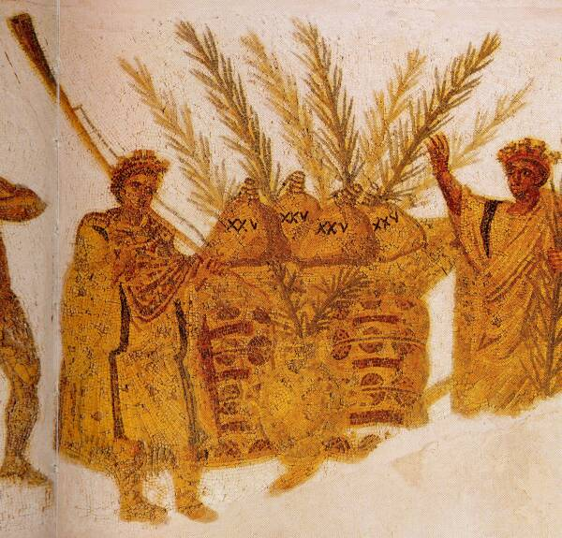
Palm branches?
Palmae, pretium victoribus, Aeneid 6.111.
They celebrate Sukkoth by “carrying a bouquet composed of myrtle and willow with a palm branch,” Josephus, Ant. 3.245.

Slide 18
He will shelter them
Revelation 7:13 Then one of the elders addressed me, saying, ‘Who are these, robed in white, and where have they come from?’ ¹⁴ I said to him, ‘Sir, you are the one that knows.’ Then he said to me, ‘These are they who have come out of the great ordeal; they have washed their robes and made them white in the blood of the Lamb.¹⁵ For this reason they are before the throne of God, and worship him day and night within his temple, and the one who is seated on the throne will shelter them ¹⁶ They will hunger no more, and thirst no more; the sun will not strike them, nor any scorching heat; ¹⁷ for the Lamb at the centre of the throne will be their shepherd, and he will guide them to springs of the water of life, and God will wipe away every tear from their eyes.’

