Slide 1
Revelation 9-10

Slide 2
The seven seals, trumpets and bowls of wrath
Repetitions (sea turns to blood, the heavenly bodies become dark)
Incongruities (sun is dark, stars have fallen and the sky has vanished in 6:12-17 yet they are darkened again in 8:12)
Differing responses to judgment
  7 seals= the redeemed stand in God's presence
  7 trumpets= people refuse to repent
  7 bowls of wrath= God's adversaries intensify their rebellion and Babylon is finally judged

Slide 3
The seven trumpets (8:6-11:19)
Hail and fire mixed with blood (1/3 earth, trees, grass burned up)
Burning mountain into the sea (1/3 of sea becomes blood, 1/3 sea life dies, 1/3 ships destroyed)
Star falls on 1/3 of rivers and fountains (1/3 of waters poisened and many people die)
1/3 of sun, moon, and stars are darkened (1/3 of day and night kept from shining)
Star falls from heaven and opens the abyss (locusts emerge)
Large cavalry kills 1/3 humans (rest of humankind does not repent)
Kingdom of the world becomes the kingdom of Christ

Slide 4
The star is wormwood
Revelation 8:10 The third angel blew his trumpet, and a great star fell from heaven, blazing like a torch, and it fell on a third of the rivers and on the springs of water. ¹¹ The name of the star is Wormwood. A third of the waters became wormwood, and many died from the water, because it was made bitter.¹² The fourth angel blew his trumpet, and a third of the sun was struck, and a third of the moon, and a third of the stars, so that a third of their light was darkened; a third of the day was kept from shining, and likewise the night.¹³ Then I looked, and I heard an eagle crying with a loud voice as it flew in mid-heaven, ‘Woe, woe, woe to the inhabitants of the earth, at the blasts of the other trumpets that the three angels are about to blow!’

Slide 5
Wormwood
Proverbs 5:3 For the lips of a loose woman drip honey,
and her speech is smoother than oil;
4 but in the end she is bitter as wormwood,
sharp as a two-edged sword.
Jeremiah 9:15 Therefore, thus says the Lord of hosts, the God of Israel: I am feeding this people with wormwood, and giving them poisonous water to drink.

Slide 6
A star fell from heaven
Revelation 9:1 And the fifth angel blew his trumpet, and I saw a star that had fallen from heaven to earth, and he was given the key to the shaft of the bottomless pit; ² he opened the shaft of the bottomless pit, and from the shaft rose smoke like the smoke of a great furnace, and the sun and the air were darkened with the smoke from the shaft. ³ Then from the smoke came locusts on the earth, and they were given authority like the authority of scorpions of the earth.

Slide 7
The abyss or bottomless pit
A place where demonic beings inhabit and is ruled by Abaddon (9:11)
Locustlike creatures emerge and torture people (9:3-10)
The beast that persecutes the saints comes from here (11:7; 17:8)
Satan is confined there for a 1000 years before being thrown into the lake of fire (20:1-3)
Seems to be different from Hades and the lake of fire
The demonic realm

Slide 8
The king of the Abyss
Revelation 9:7 In appearance the locusts were like horses equipped for battle. On their heads were what looked like crowns of gold; their faces were like human faces, ⁸ their hair like women’s hair, and their teeth like lions’ teeth; ⁹ they had scales like iron breastplates, and the noise of their wings was like the noise of many chariots with horses rushing into battle. ¹⁰ They have tails like scorpions, with stings, and in their tails is their power to harm people for five months. ¹¹ They have as king over them the angel of the bottomless pit; his name in Hebrew is Abaddon, and in Greek he is called Apollyon

Slide 9
The king of the Abyss, Abaddon
"[Cursed be you Ange]l of the Pit, and Spir[it of Aba]ddon," 4Q280 10 ii 7.
Job 26:6 Sheol is naked before God;
Abaddon lies uncovered.

Slide 10
The response?
Revelation 9:20 The rest of humankind, who were not killed by these plagues, did not repent of the works of their hands or give up worshipping demons and idols of gold and silver and bronze and stone and wood, which cannot see or hear or walk. ²¹ And they did not repent of their murders or their sorceries or their fornication or their thefts.

Slide 11
Interlude: The angel and the scroll
Revelation 10:1 And I saw another mighty angel coming down from heaven, wrapped in a cloud, with a rainbow over his head; his face was like the sun, and his legs like pillars of fire. ² He held a little scroll open in his hand. Setting his right foot on the sea and his left foot on the land, ³ he gave a great shout, like a lion roaring. And when he shouted, the seven thunders sounded. ⁴ And when the seven thunders had sounded, I was about to write, but I heard a voice from heaven saying, ‘Seal up what the seven thunders have said, and do not write it down.’

Slide 12
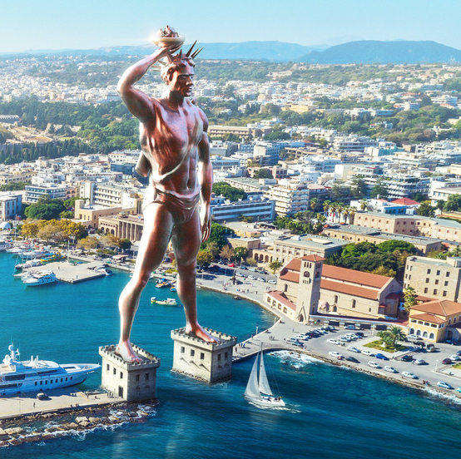
Colossus of Rhodes
"The best is the Colossus of Helios...(which is) around 105 feet tall...it is by common agreement one of the 7 wonders," Strabo, Geography 14.2.5.

Slide 13
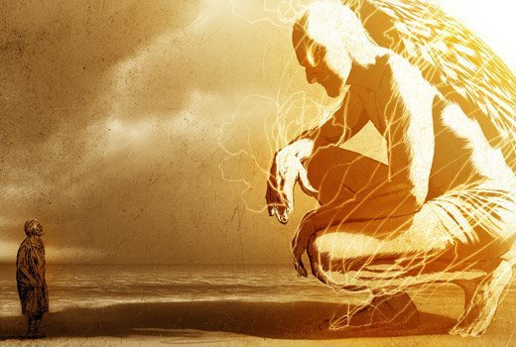

Slide 14
Interlude: The angel and the scroll
Revelation 10:1 And I saw another mighty angel coming down from heaven, wrapped in a cloud, with a rainbow over his head; his face was like the sun, and his legs like pillars of fire. ² He held a little scroll open in his hand. Setting his right foot on the sea and his left foot on the land, ³ he gave a great shout, like a lion roaring. And when he shouted, the seven thunders sounded. ⁴ And when the seven thunders had sounded, I was about to write, but I heard a voice from heaven saying, ‘Seal up what the seven thunders have said, and do not write it down.’

Slide 15
"Do not write it down"
Daniel 8:26 The vision of the evenings and the mornings that has been told is true. As for you, seal up the vision, for it refers to many days from now.’
Daniel 12:4 But you, Daniel, keep the words secret and the book sealed until the time of the end. Many shall be running back and forth, and evil shall increase.’

Slide 16
"Do not write it down"
4 Ezra 14:5 Then I commanded him saying, 'These words you shall publish openly, and these you shall keep secret...26 When you have finished, some things you will make public, and some you will deliver in secret to the wise.'"

Slide 17
The mystery will be revealed
Revelation 10:5 Then the angel whom I saw standing on the sea and the land raised his right hand to heaven
6 and swore by him who lives for ever and ever, who created heaven and what is in it, the earth and what is in it, and the sea and what is in it: ‘There will be no more delay, ⁷ but in the days when the seventh angel is to blow his trumpet, the mystery of God will be fulfilled, as he announced to his servants the prophets.’

Slide 18
The mystery will be revealed
Revelation 10:8 Then the voice that I had heard from heaven spoke to me again, saying, ‘Go, take the scroll that is open in the hand of the angel who is standing on the sea and on the land.’ ⁹ So I went to the angel and told him to give me the little scroll; and he said to me, ‘Take it, and eat; it will be bitter to your stomach, but sweet as honey in your mouth.’ ¹⁰ So I took the little scroll from the hand of the angel and ate it; it was sweet as honey in my mouth, but when I had eaten it, my stomach was made bitter.¹¹ Then they said to me, ‘You must prophesy again about many peoples and nations and languages and kings.’

