Slide 2
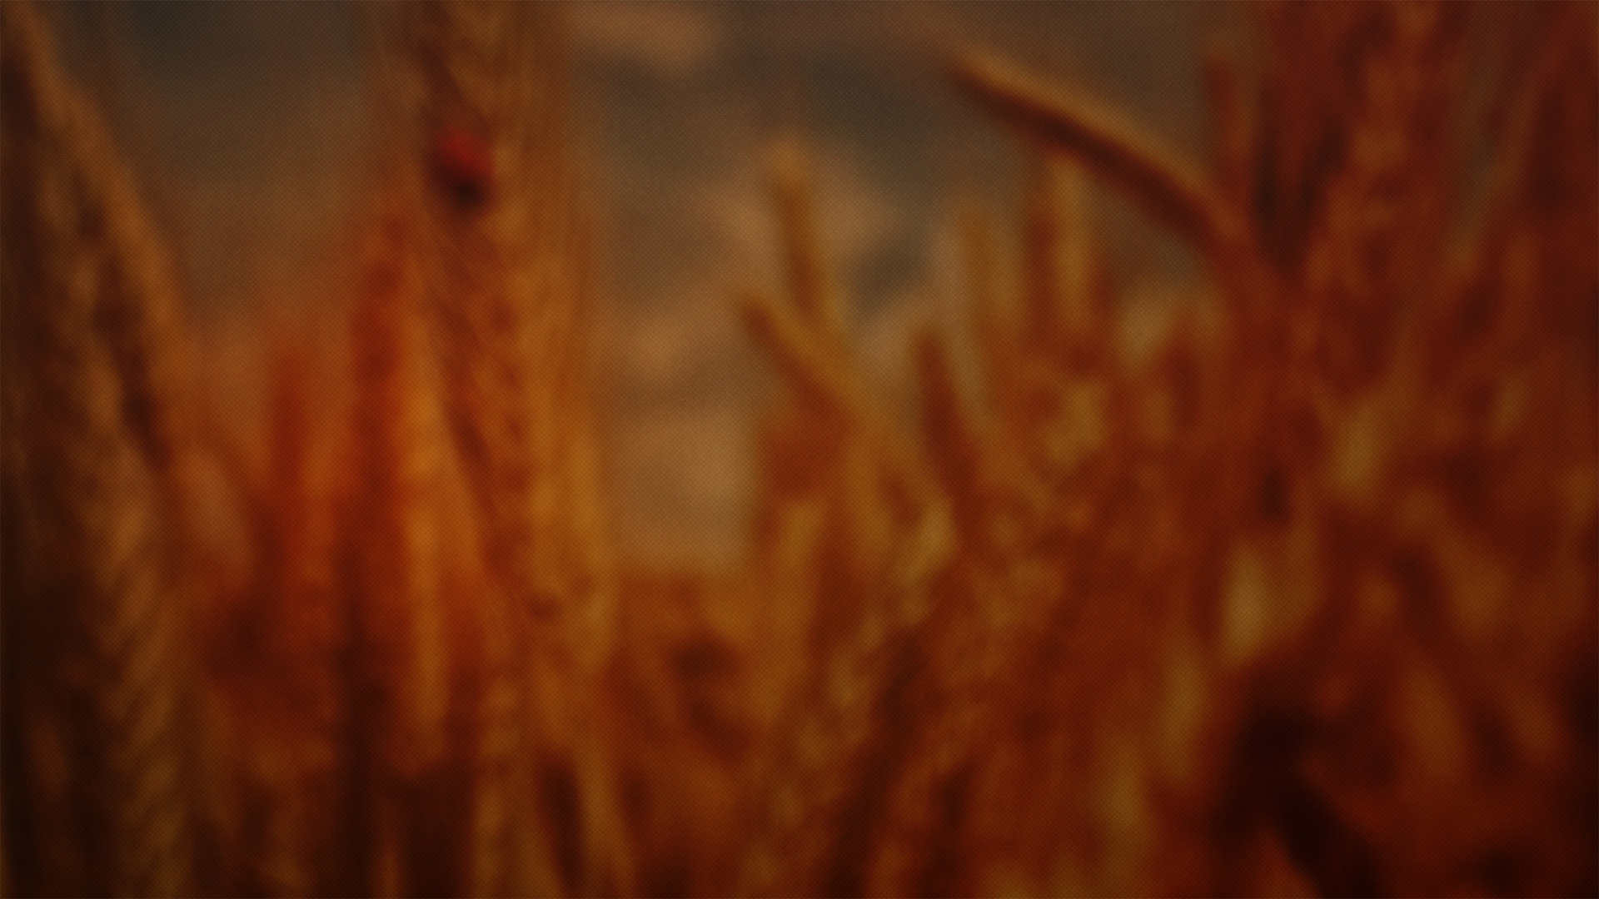
“However, there will be no poor among you, since the Lord will surely bless you in the land which the Lord your God is giving you as an inheritance to possess, if only you listen obediently to the voice of the Lord your God, to observe carefully all this commandment which I am commanding you today.”
(Deuteronomy 15:4–5, NASB95)

Slide 3
“Now it came about in the days when the judges governed, that there was a famine in the land. And a certain man of Bethlehem in Judah went to sojourn in the land of Moab with his wife and his two sons.”
(Ruth 1:1, NASB95)

Slide 4
differences make kindness essential
KINDNESS
RUTH 2

Slide 5
“To sum up, all of you be harmonious, sympathetic, brotherly, kindhearted, and humble in spirit;”
(1 Peter 3:8, NASB95)

Slide 6
differences make kindness essential
‌knowledge prompts kindness
‌kindness is seen in small actions, not grand gestures
‌our kindness brings glory to God
KINDNESS
RUTH 2

Slide 7
“May the Lord reward your work, and your wages be full from the Lord, the God of Israel, under whose wings you have come to seek refuge.”
(Ruth 2:12, NASB95)

