Slide 1
Revelation 12

Slide 2
The Seventh Trumpet
Revelation 11:15 Then the seventh angel blew his trumpet, and there were loud voices in heaven, saying,‘The kingdom of the world has become the kingdom of our Lord
and of his Messiah, and he will reign forever and ever.
¹⁶ Then the twenty-four elders who sit on their thrones before God fell on their faces and worshipped God, ¹⁷ singing,‘We give you thanks, Lord God Almighty,
who are and who were,
for you have taken your great power
and begun to reign.
18 The nations raged,
but your wrath has come,
and the time for judging the dead,
for rewarding your servants, the prophets
and saints and all who fear your name,
both small and great,
and for destroying those who destroy the earth.’

Slide 3
The temple and the ark of the covenant
Revelation 11:19 Then God’s temple in heaven was opened, and the ark of his covenant was seen within his temple; and there were flashes of lightning, rumblings, peals of thunder, an earthquake, and heavy hail.

Slide 4
Links between the seventh trumpet (11:15-18) and the seven bowls of wrath (15:1-16:21)
The birth of the child and the defeat of the dragon (11:19-12:17)
The sea beast and the land beast appear (13)
The 144,000 with the Lamb on Mount Zion (14:1-5)
The fall of Babylon and judgment upon unbelievers (14:6-20)

Slide 5
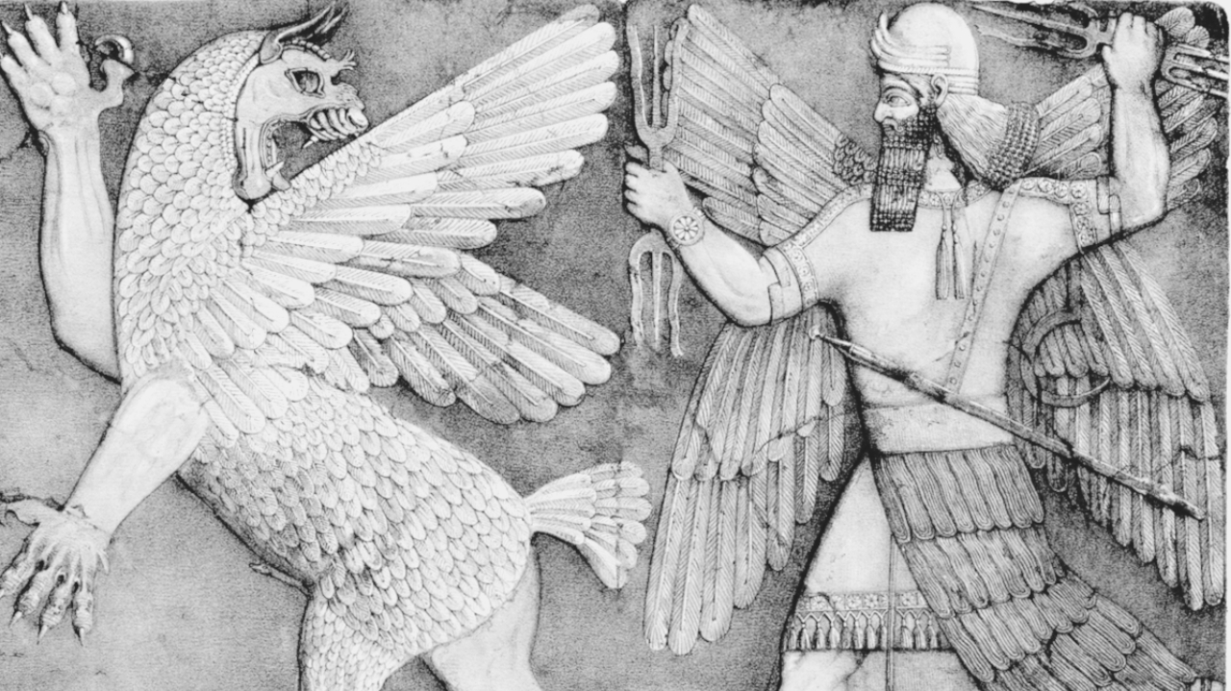
The Combat Motif
Many cultures have some version of a combat story between order and chaos
The antagonist is often described as a snake, monster or dragon
The OT has several references to this motif

Slide 6
The Combat Motif
Job 7:21 Am I the Sea or the Dragon
that you set a guard over me?
Isaiah 27:1 On that day the Lord with his cruel and great and strong sword will punish Leviathan the fleeing serpent, Leviathan the twisting serpent, and he will kill the dragon that is in the sea.

Slide 7
Dramatis Personae of Revelation 12
The woman- Gives birth to a child and flees to the wilderness
The dragon- Foiled in his effort to devour the child, he makes war with Michael before being cast down to earth
The child- Will rule the nations; was taken to heaven by God

Slide 8
The Woman
Revelation 12:1 A great portent appeared in heaven: a woman clothed with the sun, with the moon under her feet, and on her head a crown of twelve stars. ² She was pregnant and was crying out in birth pangs, in the agony of giving birth.

Slide 9
The identity of the woman
Mary
The church
The heavenly Jerusalem of 19:7-8 and 21:9-10
Israel
A certain constellation

Slide 10
The Dragon
Revelation 12:3 Then another portent appeared in heaven: a great red dragon, with seven heads and ten horns and seven diadems on his heads. ⁴ His tail swept down a third of the stars of heaven and threw them to the earth. Then the dragon stood before the woman who was about to deliver a child, so that he might devour her child as soon as it was born. ⁵ And she gave birth to a son, a male child, who is to rule all the nations with a scepter of iron. But her child was snatched away and taken to God and to his throne, ⁶ and the woman fled into the wilderness, where she has a place prepared by God, so that there she can be nourished for one thousand two hundred sixty days.

Slide 11
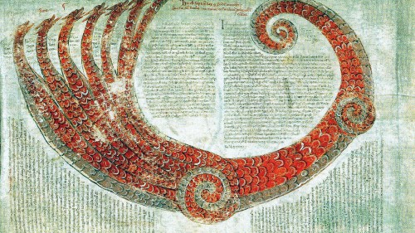

Slide 12
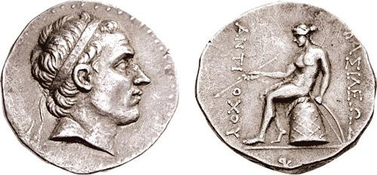
Diadem= Illegitimacy
"He also gave him all the other authority of a king, but with these only injunctions, that he should not wear the diadem, nor be injurious to the queen, the mother of his children, and that he should not meddle with the other concubines of the king; while he made an expedition against Cyprus, and Phoenicia, and besides against the Assyrians and the Medes," Josephus, Against Apion, 1.17.99.

Slide 13
The Dragon
Revelation 12:3 Then another portent appeared in heaven: a great red dragon, with seven heads and ten horns and seven diadems on his heads. ⁴ His tail swept down a third of the stars of heaven and threw them to the earth. Then the dragon stood before the woman who was about to deliver a child, so that he might devour her child as soon as it was born. ⁵ And she gave birth to a son, a male child, who is to rule all the nations with a scepter of iron. But her child was snatched away and taken to God and to his throne, ⁶ and the woman fled into the wilderness, where she has a place prepared by God, so that there she can be nourished for one thousand two hundred sixty days.

Slide 14
War in Heaven
Revelation 12:7 And war broke out in heaven; Michael and his angels fought against the dragon. The dragon and his angels fought back, ⁸ but they were defeated, and there was no longer any place for them in heaven. ⁹ The great dragon was thrown down, that ancient serpent, who is called the devil and Satan, the deceiver of the whole world—he was thrown down to the earth, and his angels were thrown down with him.

Slide 15
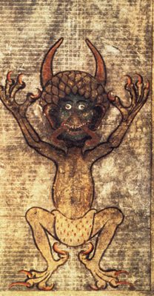
A brief history of Satan
Name means "the accuser"
Only explicitly mentioned a handful of times in the OT
Is Rev. 12 his "origin story?"

Slide 16
Satan's expulsion from heaven?
Isaiah 14:12 How you are fallen from heaven,
O Day Star, son of Dawn!
How you are cut down to the ground,
you who laid the nations low!
Luke 10:17 The seventy returned with joy, saying, ‘Lord, in your name even the demons submit to us!’ ¹⁸ He said to them, ‘I watched Satan fall from heaven like a flash of lightning. ¹⁹ See, I have given you authority to tread on snakes and scorpions, and over all the power of the enemy; and nothing will hurt you. ²⁰ Nevertheless, do not rejoice at this, that the spirits submit to you, but rejoice that your names are written in heaven.’

Slide 17
The accuser is thrown down
Revelation 12:10 Then I heard a loud voice in heaven proclaiming,“Now have come the salvation and the power
and the kingdom of our God and the authority of his Messiah,
for the accuser of our brothers and sisters has been thrown down,
who accuses them day and night before our God.11 But they have conquered him by the blood of the Lamb
and by the word of their testimony,
for they loved not their lives unto the death. 12 Rejoice then, you heavens
and those who dwell in them!
But woe to the earth and the sea,
for the devil has come down to you
with great wrath
because he knows that his time is short!”

Slide 18
Not everyone kept the faith
"Those who denied that they were or had been Christians, when they invoked the gods in words dictated by me, offered prayer with incense and wine to your image, which I had ordered to be brought for this purpose together with statues of the gods, and also cursed Christ – none of which those who are really Christians can, it is said, be forced to do — these I thought should be discharged. Others named by the informer declared that they were Christians, but then denied it, asserting that they had been but had ceased to be, some three years before, others many years, some as much as twenty-five years," Pliny, Letter to Trajan, circa 112.

