Slide 1
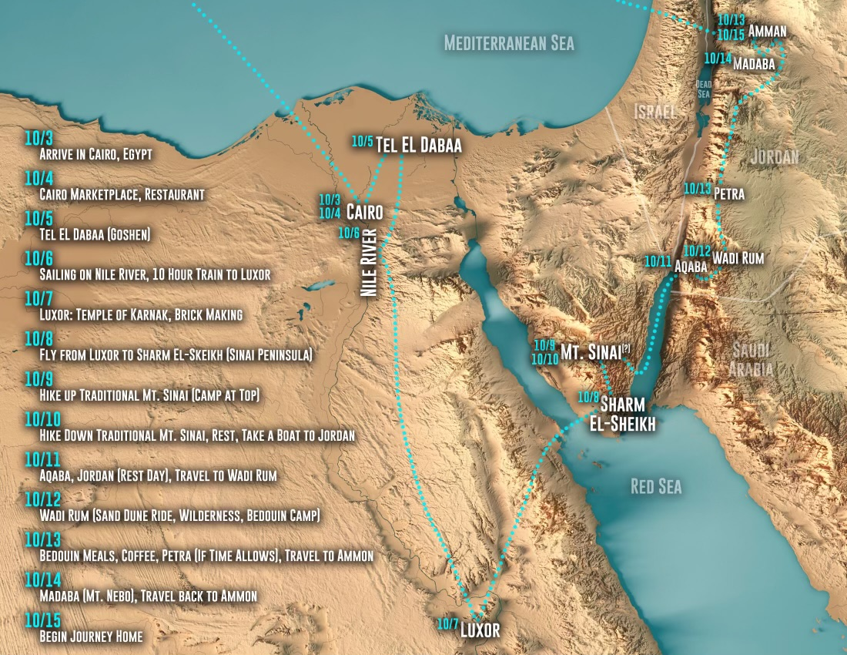

Slide 12
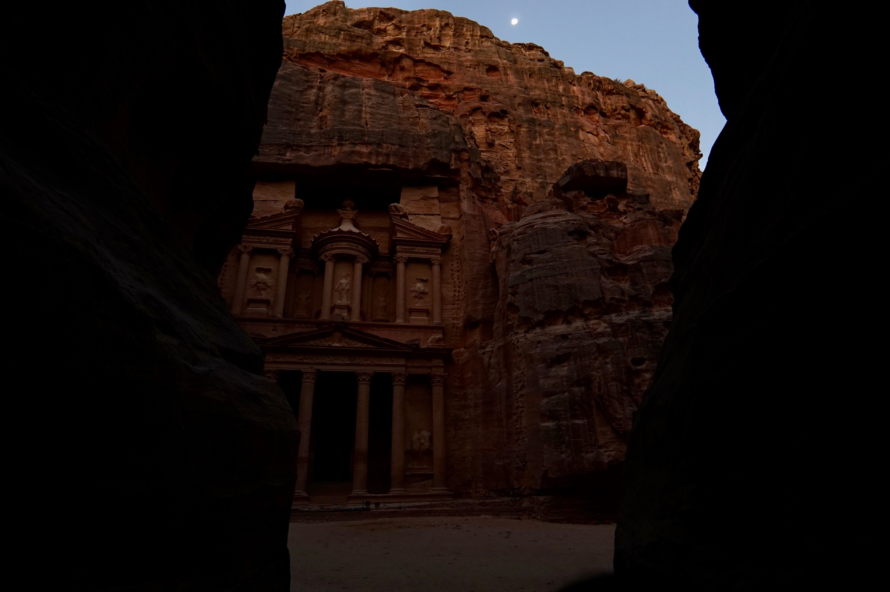

Slide 15
LESSONS FROM THE
LOST CHAPTER

Slide 16
¹ Now the tax collectors and sinners were all drawing near to hear him. ² And the Pharisees and the scribes grumbled, saying, “This man receives sinners and eats with them.”
³ So he told them this parable: ⁴ “What man of you, having a hundred sheep, if he has lost one of them, does not leave the ninety-nine in the open country, and go after the one that is lost, until he finds it? ⁵ And when he has found it, he lays it on his shoulders, rejoicing. ⁶ And when he comes home, he calls together his friends and his neighbors, saying to them, ‘Rejoice with me, for I have found my sheep that was lost.’ ⁷ Just so, I tell you, there will be more joy in heaven over one sinner who repents than over ninety-nine righteous persons who need no repentance.

Slide 17
THE SHEPHERD
LK. 15:1-7
Lost 1 sheep (1%)
Searched diligently
Found the sheep
The shepherd rejoiced!
Invited others to rejoice with him!

Slide 18
“Or what woman, having ten silver coins, if she loses one coin, does not light a lamp and sweep the house and seek diligently until she finds it? ⁹ And when she has found it, she calls together her friends and neighbors, saying, ‘Rejoice with me, for I have found the coin that I had lost.’ ¹⁰ Just so, I tell you, there is joy before the angels of God over one sinner who repents.”

Slide 19
THE SHEPHERD
LK. 15:1-7
THE WOMAN
LK. 15:8-10
Lost 1 sheep (1%)
Searched diligently
Found the sheep
The shepherd rejoiced!
Invited others to rejoice with him!
Lost 1 coin (10%)
Searched diligently
Found the coin
The woman rejoiced!
Invited others to rejoice with her!

Slide 20
THE SHEPHERD
LK. 15:1-7
THE WOMAN
LK. 15:8-10
THE FATHER
LK. 15:11-32
Lost 1 sheep (1%)
Searched diligently
Found the sheep
The shepherd rejoiced!
Invited others to rejoice with him!
Lost 1 coin (10%)
Searched diligently
Found the coin
The woman rejoiced!
Invited others to rejoice with her!
Lost 1 son (50%)
Graciously let him go. Hoped in his return.
The son “came to himself” & humbly returned
The father rejoiced!
Invited others to rejoice with him!
The self-righteous, older brother was rebuked.

Slide 21
APPLICATION:
Every soul is precious to God and should be precious to us.
God expends great effort, goes out of His way and risks rejection in order to reach one person. We need to learn to do the same.
The main point of Luke 15 is learning to have a humble and grateful attitude so we can rejoice over every person who is reconciled with God! We need to remember how much mercy we have received from the Father.

