Slide 2
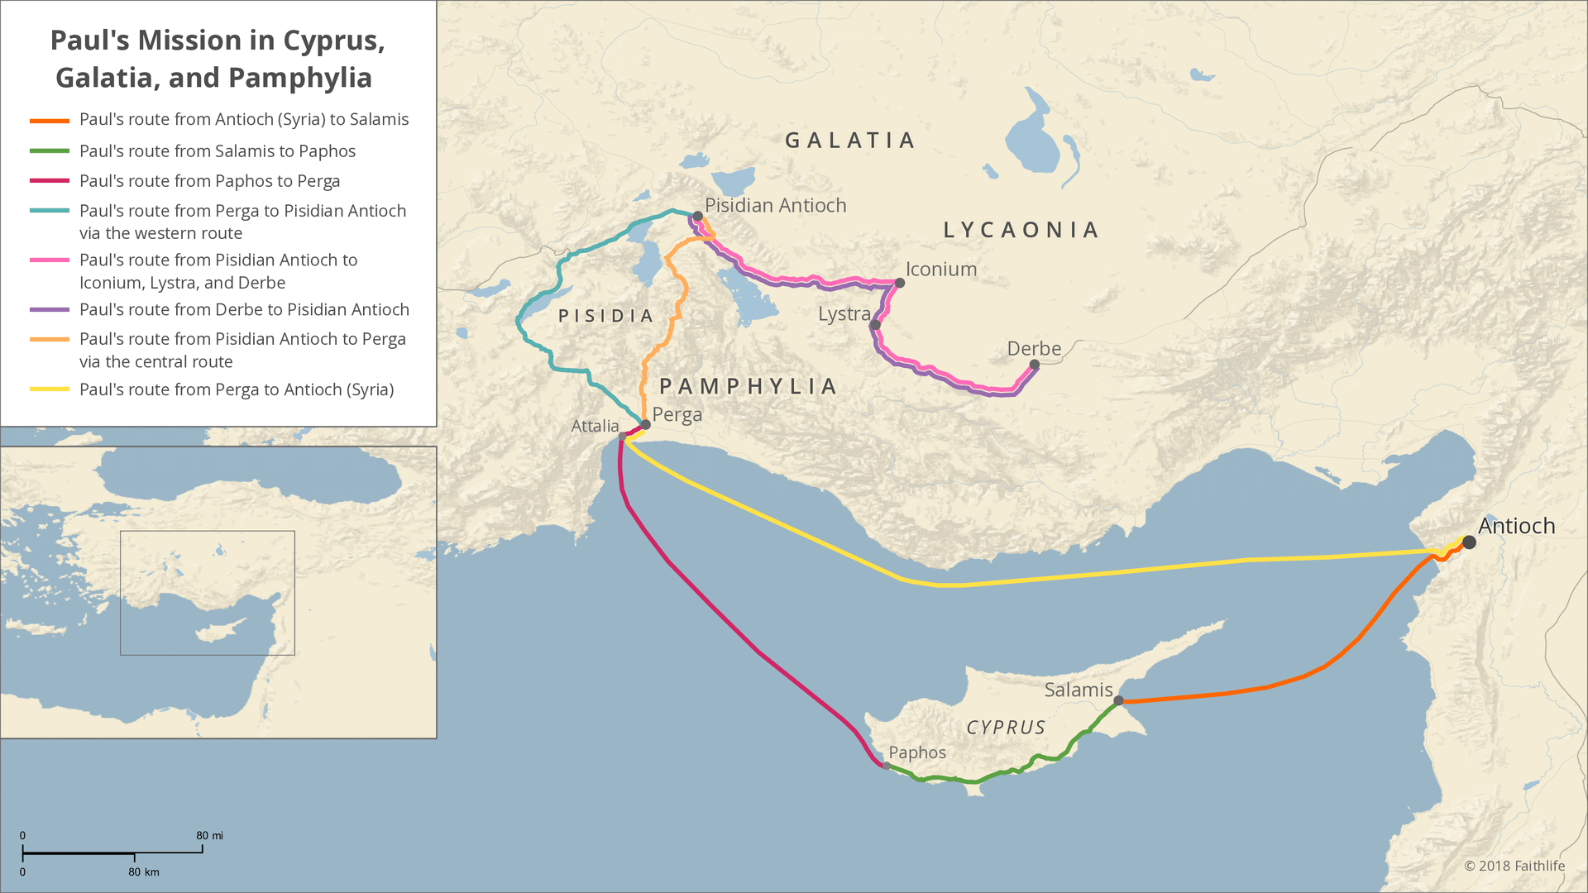

Slide 7
???
“For God so loved the world, that He gave His only begotten Son, that whoever believes in Him shall not perish, but have eternal life.”
(John 3:16, NASB95)
“He who has believed and has been baptized shall be saved; but he who has disbelieved shall be condemned.”
(Mark 16:16, NASB95)

Slide 8
Truth amid Confusion

Slide 9
The Lack of Biblical Literacy
<50% can name the four gospels.
60% cannot name 5 of the 10 commandments
82% believe “God helps those who help themselves” is a Bible verse.

Slide 10
The Lack of Biblical Literacy
20% of Americans have read the entire Bible once
22% read the Bible each day

Slide 11
Results of Biblical Illiteracy
more susceptible to error

Slide 12
Galatians 1:6–9 (NASB95)
⁶ I am amazed that you are so quickly deserting Him who called you by the grace of Christ, for a different gospel; ⁷ which is really not another; only there are some who are disturbing you and want to distort the gospel of Christ. ⁸ But even if we, or an angel from heaven, should preach to you a gospel contrary to what we have preached to you, he is to be accursed! ⁹ As we have said before, so I say again now, if any man is preaching to you a gospel contrary to what you received, he is to be accursed!

Slide 13
Galatians 1:6–9 (NASB95)
⁶ I am amazed that you are so quickly deserting Him who called you by the grace of Christ, for a different gospel; ⁷ which is really not another; only there are some who are disturbing you and want to distort the gospel of Christ. ⁸ But even if we, or an angel from heaven, should preach to you a gospel contrary to what we have preached to you, he is to be accursed! ⁹ As we have said before, so I say again now, if any man is preaching to you a gospel contrary to what you received, he is to be accursed!

Slide 14
Galatians 1:6–9 (NASB95)
⁶ I am amazed that you are so quickly deserting Him who called you by the grace of Christ, for a different gospel; ⁷ which is really not another; only there are some who are disturbing you and want to distort the gospel of Christ. ⁸ But even if we, or an angel from heaven, should preach to you a gospel contrary to what we have preached to you, he is to be accursed! ⁹ As we have said before, so I say again now, if any man is preaching to you a gospel contrary to what you received, he is to be accursed!

Slide 15
Galatians 1:6–9 (NASB95)
⁶ I am amazed that you are so quickly deserting Him who called you by the grace of Christ, for a different gospel; ⁷ which is really not another; only there are some who are disturbing you and want to distort the gospel of Christ. ⁸ But even if we, or an angel from heaven, should preach to you a gospel contrary to what we have preached to you, he is to be accursed! ⁹ As we have said before, so I say again now, if any man is preaching to you a gospel contrary to what you received, he is to be accursed!

Slide 16
Results of Biblical Illiteracy
more susceptible to error
mistakenly believe that multiple gospels can be true

Slide 17
Galatians 1:6–9 (NASB95)
⁶ I am amazed that you are so quickly deserting Him who called you by the grace of Christ, for a different gospel; ⁷ which is really not another; only there are some who are disturbing you and want to distort the gospel of Christ. ⁸ But even if we, or an angel from heaven, should preach to you a gospel contrary to what we have preached to you, he is to be accursed! ⁹ As we have said before, so I say again now, if any man is preaching to you a gospel contrary to what you received, he is to be accursed!

Slide 18
Galatians 1:6–9 (NASB95)
⁶ I am amazed that you are so quickly deserting Him who called you by the grace of Christ, for a different gospel; ⁷ which is really not another; only there are some who are disturbing you and want to distort the gospel of Christ. ⁸ But even if we, or an angel from heaven, should preach to you a gospel contrary to what we have preached to you, he is to be accursed! ⁹ As we have said before, so I say again now, if any man is preaching to you a gospel contrary to what you received, he is to be accursed!

Slide 19
Galatians 1:6–9 (NASB95)
⁶ I am amazed that you are so quickly deserting Him who called you by the grace of Christ, for a different gospel; ⁷ which is really not another; only there are some who are disturbing you and want to distort the gospel of Christ. ⁸ But even if we, or an angel from heaven, should preach to you a gospel contrary to what we have preached to you, he is to be accursed! ⁹ As we have said before, so I say again now, if any man is preaching to you a gospel contrary to what you received, he is to be accursed!

Slide 20
Results of Biblical Illiteracy
more susceptible to error
mistakenly believe that multiple gospels can be true
what you thought was “good news” brings a curse

Slide 21
Developing Biblical Literacy

