Slide 1
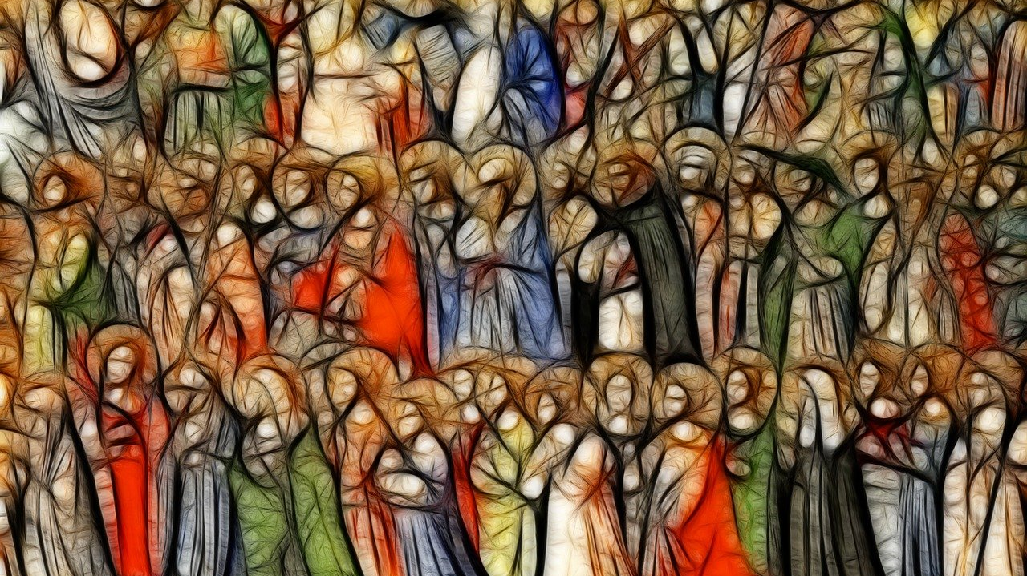
Revelation 14
Notes:
NOTE: Want a different image on this slide? Select the picture and delete it. Now click the Pictures icon in the placeholder to insert your own image.

Slide 2
Why would anyone choose the losing side?

Slide 3
The two beast of ch. 13
The sea beast (Roman empire)- Given its power by the beast, utters blasphemous names, and makes war with the saints
The land beast (Imperial cult or similar)- It performs great signs, gives life to images, gives a mark to everyone, its number is 666

Slide 4
The 144,000 pt. 1
Revelation 7:2 I saw another angel ascending from the rising of the sun, having the seal of the living God, and he called with a loud voice to the four angels who had been given power to damage earth and sea, ³ saying, ‘Do not damage the earth or the sea or the trees, until we have marked the servants of our God with a seal on their foreheads.’⁴ And I heard the number of those who were sealed, one hundred and forty-four thousand, sealed out of every tribe of the people of Israel:

Slide 5
The 144,000 pt. 2
Revelation 14:1 Then I looked, and there was the Lamb, standing on Mount Zion! And with him were one hundred and forty-four thousand who had his name and his Father’s name written on their foreheads. ² And I heard a voice from heaven like the sound of many waters and like the sound of loud thunder; the voice I heard was like the sound of harpists playing on their harps, ³ and they sing a new song before the throne and before the four living creatures and before the elders. No one could learn that song except the one hundred forty-four thousand who have been redeemed from the earth.

Slide 6
Mount Zion
Joel 2:32 Then everyone who calls on the name of the Lord shall be saved; for in Mount Zion and in Jerusalem there shall be those who escape, as the Lord has said, and among the survivors shall be those whom the Lord calls.

Slide 7
Mount Zion
Micah 4:6 On that day, says the Lord,
I will assemble the lame
and gather those who have been driven away,
and those whom I have afflicted.
7 The lame I will make the remnant,
and those who were cast off, a strong nation;
and the Lord will reign over them in Mount Zion
now and for evermore.

Slide 8
Mount Zion
The last leader of that time will be left alive, when the multitude of his hosts will be put to the sword, and he will be bound, and they will take him up to Mount Zion, and My Messiah will convict him of all his impieties, and will gather and set before him all the works of his hosts. 2 And afterwards he will put him to death, and protect the rest of My people which shall be found in the place which I have chosen. 3 And his principate will stand for ever, until the world of corruption is at an end, and until the times aforesaid are fulfilled. 4 This is your vision, and this is its interpretation.' (2 Baruch 40:1-4).

Slide 9
The 144,000 pt. 2
Revelation 14:1 Then I looked, and there was the Lamb, standing on Mount Zion! And with him were one hundred and forty-four thousand who had his name and his Father’s name written on their foreheads. ² And I heard a voice from heaven like the sound of many waters and like the sound of loud thunder; the voice I heard was like the sound of harpists playing on their harps, ³ and they sing a new song before the throne and before the four living creatures and before the elders. No one could learn that song except the one hundred forty-four thousand who have been redeemed from the earth.

Slide 10
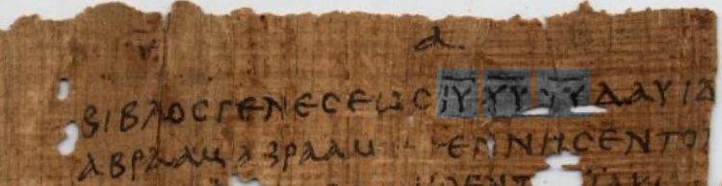
The names of the Father and the Son
Possibly John has in mind the nomina sacra
Otherwise, it is difficult to imagine how both names would fit

Slide 11
The 144,000 pt. 2
Revelation 14:1 Then I looked, and there was the Lamb, standing on Mount Zion! And with him were one hundred and forty-four thousand who had his name and his Father’s name written on their foreheads. ² And I heard a voice from heaven like the sound of many waters and like the sound of loud thunder; the voice I heard was like the sound of harpists playing on their harps, ³ and they sing a new song before the throne and before the four living creatures and before the elders. No one could learn that song except the one hundred forty-four thousand who have been redeemed from the earth.

Slide 12
They have not defiled themselves with women
Revelation 14:4 It is these who have not defiled themselves with women, for they are virgins; these follow the Lamb wherever he goes. They have been redeemed from humankind as first fruits for God and the Lamb, ⁵ and in their mouth no lie was found; they are blameless.

Slide 13
Male Celibacy?
Probably a reference to purity in contrast to those who worship the beast
Otherwise, it is a completely unprecedented description of God's people
Jeremiah 3:1 You have played the whore with many lovers;
and would you return to me?
says the Lord.2 Look up to the bare heights, and see!
Where have you not been lain with? By the waysides you have sat waiting for lovers, like a nomad in the wilderness. You have polluted the land with your whoring and wickedness.

Slide 14
Message of the first angel
Revelation 14:6 Then I saw another angel flying in mid-heaven, with an eternal gospel to proclaim to those who live on the earth—to every nation and tribe and language and people. ⁷ He said in a loud voice, ‘Fear God and give him glory, for the hour of his judgement has come; and worship him who made heaven and earth, the sea and the springs of water.’

Slide 15
Message of the second angel
Revelation 14:8 Then another angel, a second, followed, saying, ‘Fallen, fallen is Babylon the great! She has made all nations drink of the wine of the wrath of her fornication.’

Slide 16
Fallen is Babylon the great
Mentioned 6x in Revelation (14:8; 16:19; 17:6; 18:2, 10, 21)
Refers to Rome as in Jewish apocalyptic works (4 Ezra; 2 Baruch)
Based on the parallels between the destruction of the first temple by the Babylonians (586 BC), and the destruction of the second temple by Rome (70 AD).
Isaiah 21:9 Look, there they come, riders,
horsemen in pairs!’
Then he responded,
‘Fallen, fallen is Babylon;
and all the images of her gods
lie shattered on the ground.’

Slide 17
Message of the third angel
Revelation 14:9 Then another angel, a third, followed them, crying with a loud voice, ‘Those who worship the beast and its image, and receive a mark on their foreheads or on their hands, ¹⁰ they will also drink the wine of God’s wrath, poured unmixed into the cup of his anger, and they will be tormented with fire and sulphur in the presence of the holy angels and in the presence of the Lamb. ¹¹ And the smoke of their torment goes up for ever and ever. There is no rest day or night for those who worship the beast and its image and for anyone who receives the mark of its name.’

Slide 18
Blessed are the dead
Revelation 14:12 Here is a call for the endurance of the saints, those who keep the commandments of God and hold fast to the faith of Jesus.¹³ And I heard a voice from heaven saying, ‘Write this: Blessed are the dead who from now on die in the Lord.’ ‘Yes,’ says the Spirit, ‘they will rest from their labours, for their deeds follow them.’

