Slide 1
Revelation 20

Slide 2
The Rider on a White Horse
Revelation 19:11 Then I saw heaven opened, and there was a white horse! Its rider is called Faithful and True, and in righteousness he judges and makes war. ¹² His eyes are like a flame of fire, and on his head are many diadems; and he has a name inscribed that no one knows but himself. ¹³ He is clothed in a robe dipped in blood, and his name is called The Word of God. ¹⁴ And the armies of heaven, wearing fine linen, white and pure, were following him on white horses. ¹⁵ From his mouth comes a sharp sword with which to strike down the nations, and he will rule them with a rod of iron; he will tread the wine press of the fury of the wrath of God the Almighty. ¹⁶ On his robe and on his thigh he has a name inscribed, ‘King of kings and Lord of lords’.

Slide 3
A robe dipped in blood
Death on the cross?
Also, the heavenly warrior whose garment is stained with blood
Isaiah 63:1 ‘Who is this that comes from Edom, from Bozrah in garments stained crimson?
Who is this so splendidly robed,
marching in his great might?’ ‘It is I, announcing vindication,
mighty to save.’ ² ‘Why are your robes red,
and your garments like theirs who tread the wine press?’³ ‘I have trodden the wine press alone,
and from the peoples no one was with me;
I trod them in my anger
and trampled them in my wrath;
their juice spattered on my garments,
and stained all my robes.

Slide 4
The Logos of God
A title for the pre-incarnate Jesus in John 1
Here, it is used for Jesus at his return.
Refers to his Word as being judgment.
Wisdom 18:15 "Your all-powerful word leapt from heaven, from the royal throne,into the midst of the land that was doomed,
a stern warrior 16 carrying the sharp sword of your authentic command,
and stood and filled all things with death,
and touched heaven while standing on the earth.

Slide 5
What about the Dragon?
Revelation 20:1 Then I saw an angel coming down from heaven, holding in his hand the key to the bottomless pit and a great chain. ² He seized the dragon, that ancient serpent, who is the devil and Satan, and bound him for a thousand years ³ and threw him into the pit and locked and sealed it over him, so that he would deceive the nations no more, until the thousand years were ended. After that he must be let out for a little while.

Slide 6
Punishment of the angels
Isaiah 24:21 On that day the Lord will punish
the host of heaven in heaven
and on earth the kings of the earth.
22 They will be gathered together
like prisoners in a pit;
they will be shut up in a prison,
and after many days they will be punished.
1 Enoch 10:4 And again the Lord said to Raphael: 'Bind Azâzêl hand and foot, and cast him into the darkness: and make an opening in the desert, which is in Dûdâêl, and cast him therein. 5. And place upon him rough and jagged rocks, and cover him with darkness, and let him abide there for ever, and cover his face that he may not see light. 6. And on the day of the great judgement he shall be cast into the fire

Slide 7
Punishment of the angels
Jude 6 And the angels who did not keep their own position but deserted their proper dwelling, he has kept in eternal chains in deepest darkness for the judgment of the great day.

Slide 8
The 1000 year reign
Revelation 20:4 Then I saw thrones, and those seated on them were given authority to judge. I also saw the souls of those who had been beheaded for their testimony to Jesus and for the word of God. They had not worshiped the beast or its image and had not received its brand on their foreheads or their hands. They came to life and reigned with Christ a thousand years. ⁵ (The rest of the dead did not come to life until the thousand years were ended.) This is the first resurrection. ⁶ Blessed and holy are those who share in the first resurrection. Over these the second death has no power, but they will be priests of God and of Christ, and they will reign with him a thousand years.

Slide 9
The 1000 year reign
Amillenialism- 1000 year period of the church
Postmillenialism- The kingdom is in the hearts of believers and refers to the quality of time, not quantity
Premillenialism- The return of Christ will occur before a literal period of 1000 years

Slide 10

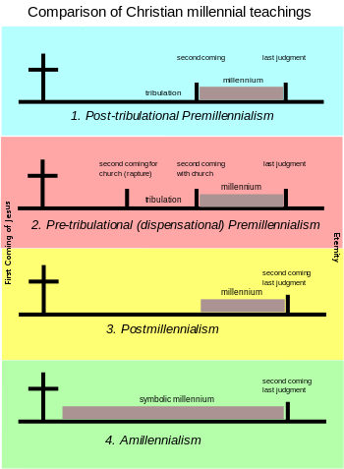

Slide 11
The 1000 year reign
Probably metaphorical
Martyrdom is not the end of their story
Psalm 90:4 For a thousand years in your sight
are like yesterday when it is past
or like a watch in the night.

Slide 12
The 1000 year reign
Revelation 20:4 Then I saw thrones, and those seated on them were given authority to judge. I also saw the souls of those who had been beheaded for their testimony to Jesus and for the word of God. They had not worshiped the beast or its image and had not received its brand on their foreheads or their hands. They came to life and reigned with Christ a thousand years. ⁵ (The rest of the dead did not come to life until the thousand years were ended.) This is the first resurrection. ⁶ Blessed and holy are those who share in the first resurrection. Over these the second death has no power, but they will be priests of God and of Christ, and they will reign with him a thousand years.

Slide 13
Gog and Magog
Revelation 20:7 When the thousand years are ended, Satan will be released from his prison ⁸ and will come out to deceive the nations at the four corners of the earth, Gog and Magog, in order to gather them for battle; they are as numerous as the sands of the sea. ⁹ They marched up over the breadth of the earth and surrounded the camp of the saints and the beloved city. And fire came down from heaven and consumed them. ¹⁰ And the devil who had deceived them was thrown into the lake of fire and sulfur, where the beast and the false prophet were, and they will be tormented day and night forever and ever.

Slide 14
Gog and Magog
Mentioned in Ezekiel 38-39
There, they are enemies of God's people who will attack in "the last days."
Here they are evil forces against God's people.
"At the very end of the days Gog and Magog ascend on Jerusalem and they fall at the hand of King Messiah, and for seven years the children of Israel will kindle fires from their implements of war and the carpenter(s) will not have to go out," Targum Neofiti Numbers 11:26.

Slide 15
The White Throne
Revelation 20:11 Then I saw a great white throne and the one who sat on it; the earth and the heaven fled from his presence, and no place was found for them. ¹² And I saw the dead, great and small, standing before the throne, and books were opened. Also another book was opened, the book of life. And the dead were judged according to their works, as recorded in the books. ¹³ And the sea gave up the dead who were in it, Death and Hades gave up the dead who were in them, and all were judged according to what they had done. ¹⁴ Then Death and Hades were thrown into the lake of fire. This is the second death, the lake of fire, ¹⁵ and anyone whose name was not found written in the book of life was thrown into the lake of fire.

Slide 16
The Death of Death
1 Corinthians 15:54 When this perishable body puts on imperishability and this mortal body puts on immortality, then the saying that is written will be fulfilled: “Death has been swallowed up in victory.”
55 “Where, O death, is your victory? Where, O death, is your sting?” ⁵⁶ The sting of death is sin, and the power of sin is the law. ⁵⁷ But thanks be to God, who gives us the victory through our Lord Jesus Christ.
Hebrews 2:14 Since, therefore, the children share flesh and blood, he himself likewise shared the same things, so that through death he might destroy the one who has the power of death, that is, the devil, ¹⁵ and free those who all their lives were held in slavery by the fear of death.

Slide 17
The Second Death
Revelation 20:11 Then I saw a great white throne and the one who sat on it; the earth and the heaven fled from his presence, and no place was found for them. ¹² And I saw the dead, great and small, standing before the throne, and books were opened. Also another book was opened, the book of life. And the dead were judged according to their works, as recorded in the books. ¹³ And the sea gave up the dead who were in it, Death and Hades gave up the dead who were in them, and all were judged according to what they had done. ¹⁴ Then Death and Hades were thrown into the lake of fire. This is the second death, the lake of fire, ¹⁵ and anyone whose name was not found written in the book of life was thrown into the lake of fire.

Slide 18
The Second Death
Does not occur elsewhere in the NT
It does occur in two sources close to the time of Revelation and in ancient Egyptian literature
"Where the range of the earth's shadow ends, this he set as the term and boundary of the earth. To this point rises no one who is evil or unclean, but the good are conveyed thither after death and there continue to lead a life most easy to be sure though not blesséd or divine until their second death," Plutarch, Concerning the Face of the Moon 942F.

Slide 19
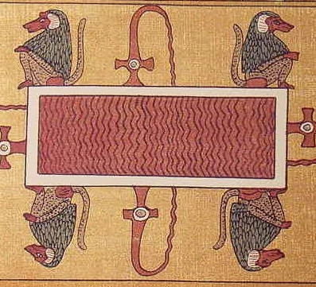
The Second Death
"My place of hiding is opened, my place of hiding revealed...I am your son, O great one, and I have seen the hidden things which belong to you. I am crowned king of the underworld. I will not die a second death in the underworld," Book of the Dead (Papyrus of Ani).

