Slide 2

demystifying Evangelism

Slide 3

2 Cor. 4:1- New Living Translation- Therefore, since God in his mercy has given us this new way, we never give up.
Amplified Bible- Therefore, since we have this ministry, just as we received mercy [from God, granting us salvation, opportunities, and blessings], we do not get discouraged nor lose our motivation.

Slide 4
Why don’t YOU evangelize to every single person you meet?

Slide 5
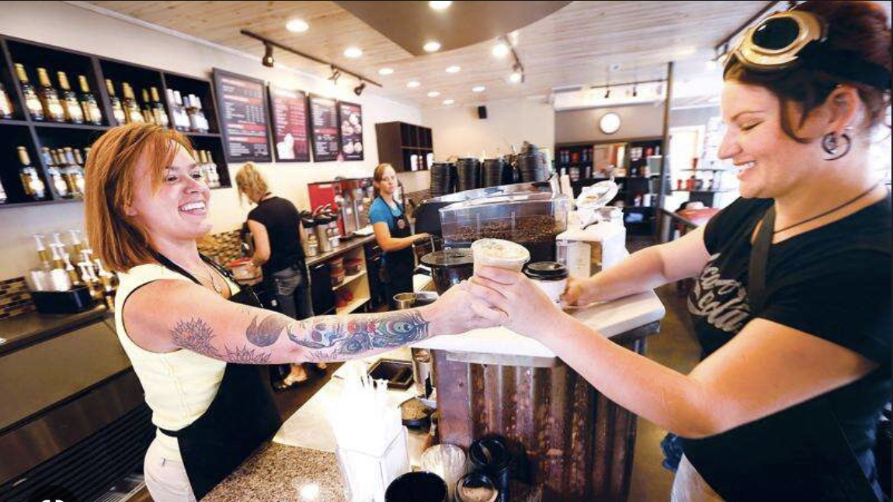

Slide 6
“Talk to me about ___________”
Where do you worship?

Slide 7
2 Corinthians 5:18-20 NASB95- Now all these things are from God, who reconciled us to Himself through Christ and gave us the ministry of reconciliation, [19] namely, that God was in Christ reconciling the world to Himself, not counting their trespasses against them, and He has committed to us the word of reconciliation. [20] Therefore, we are ambassadors for Christ, as though God were making an appeal through us; we beg you on behalf of Christ, be reconciled to God.

Slide 8
2 Corinthians 1:3-7 NASB95- Blessed be the God and Father of our Lord Jesus Christ, the Father of mercies and God of all comfort, [4] who comforts us in all our affliction so that we will be able to comfort those who are in any affliction with the comfort with which we ourselves are comforted by God. [5] For just as the sufferings of Christ are ours in abundance, so also our comfort is abundant through Christ.

Slide 9
2 Corinthians 1:3-7 NASB95- [6] But if we are afflicted, it is for your comfort and salvation; or if we are comforted, it is for your comfort, which is effective in the patient enduring of the same sufferings which we also suffer; [7] and our hope for you is firmly grounded, knowing that as you are sharers of our sufferings, so also you are sharers of our comfort.

Slide 10


Slide 11
2 Corinthians 2:15-17 NASB95- For we are a fragrance of Christ to God among those who are being saved and among those who are perishing; [16] to the one an aroma from death to death, to the other an aroma from life to life. And who is adequate for these things? [17] For we are not like many, peddling the word of God, but as from sincerity, but as from God, we speak in Christ in the sight of God.

Slide 12
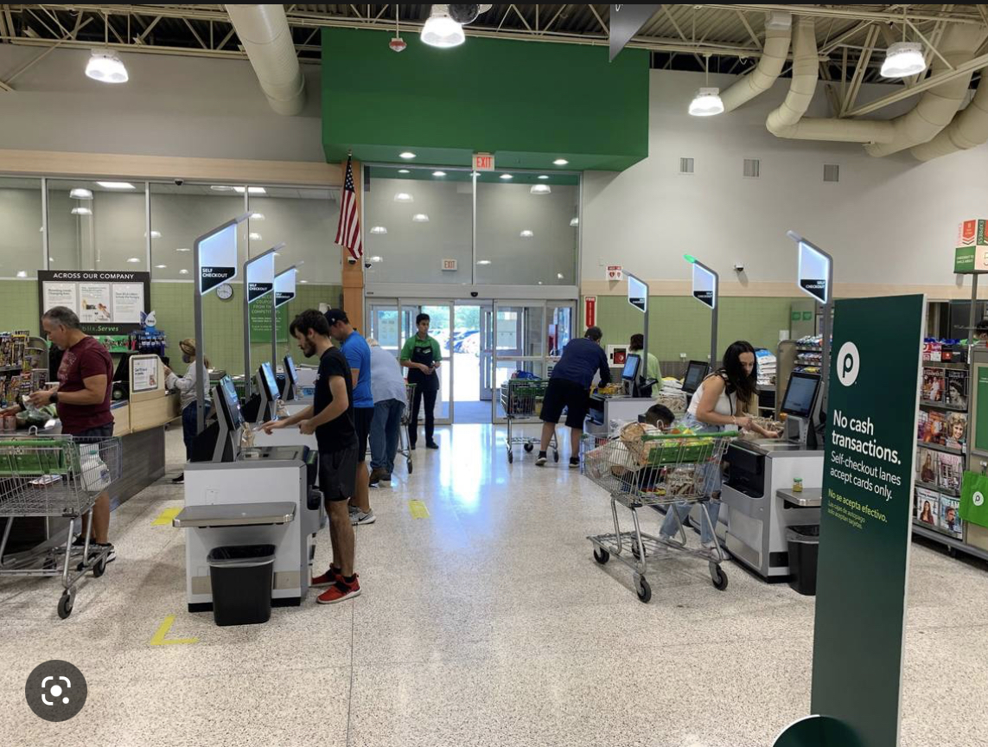

Slide 13
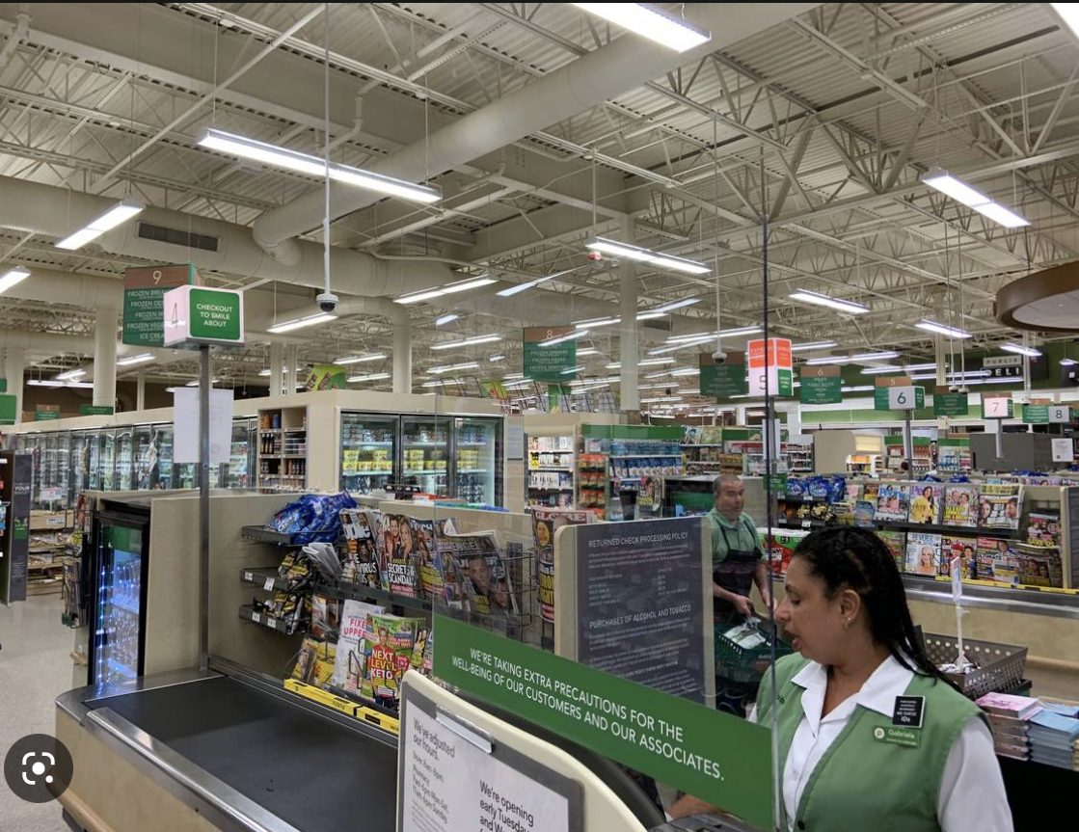

Slide 14
2 Corinthians 4:13-14 NASB95- But having the same spirit of faith, according to what is written, "I BELIEVED, THEREFORE I SPOKE," we also believe, therefore we also speak, [14] knowing that He who raised the Lord Jesus will raise us also with Jesus and will present us with you.

Slide 15
2 Corinthians 5:1-6 NASB95- For we know that if the earthly tent which is our house is torn down, we have a building from God, a house not made with hands, eternal in the heavens. [2] For indeed in this house we groan, longing to be clothed with our dwelling from heaven, [3] inasmuch as we, having put it on, will not be found naked.

Slide 16
2 Corinthians 5:1-6 NASB95- [4] For indeed while we are in this tent, we groan, being burdened, because we do not want to be unclothed but to be clothed, so that what is mortal will be swallowed up by life. [5] Now He who prepared us for this very purpose is God, who gave to us the Spirit as a pledge. [6] Therefore, being always of good courage, and knowing that while we are at home in the body we are absent from the Lord

Slide 17
2 Corinthians 5:1-5 NASB95- [4] For indeed while we are in this tent, we groan, being burdened, because we do not want to be unclothed but to be clothed, so that what is mortal will be swallowed up by life. [5] Now He who prepared us for this very purpose is God, who gave to us the Spirit as a pledge.

Slide 18
2 Corinthians 5:6-9 NASB95- Therefore, being always of good courage, and knowing that while we are at home in the body we are absent from the Lord- [7] for we walk by faith, not by sight- [8] we are of good courage, I say, and prefer rather to be absent from the body and to be at home with the Lord. [9] Therefore we also have as our ambition, whether at home or absent, to be pleasing to Him.

Slide 19
1 Corinthians 15:8-10 NASB95- and last of all, as to one untimely born, He appeared to me also. [9] For I am the least of the apostles, and not fit to be called an apostle, because I persecuted the church of God. [10] But by the grace of God I am what I am, and His grace toward me did not prove vain; but I labored even more than all of them, yet not I, but the grace of God with me

Slide 20
Grace vs. Guilt
  I want to vs. I have to
  Permanent vs. Temporary
  Doesn’t care about tangible results vs. wants results
  Focuses on God vs. focuses on self
  Cares more about Others vs. cares about self
  Willing to suffer vs. Easily Discouraged
  Excited to share vs. excited to finish

Slide 21
With the grace of god evangelism becomes an everyday thing, guilt makes evangelism something we do once in a blue moon

