Slide 1
Love is: not resentful
1 Corinthians 13

Slide 2
El Amor No guarda rencor
1 Corintios 13

Slide 3
Love is: not resentful
1 Corinthians 13

Slide 4
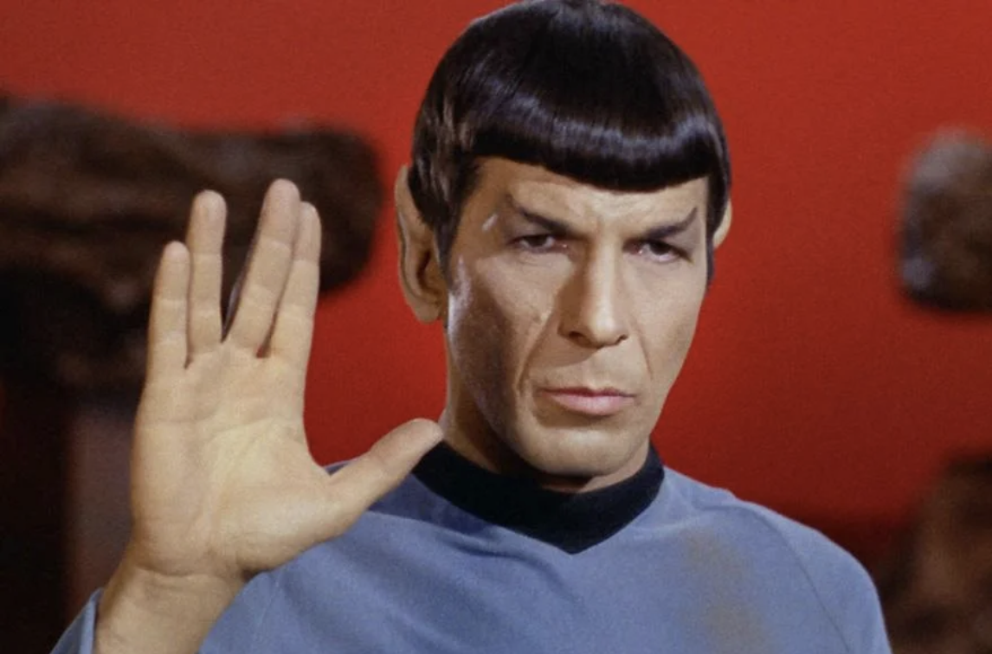

Slide 5
How would you feel if you had the power to not be affected by what other people said or did?
¿Cómo te sentirías si tuvieras el poder de no ser afectado por lo que otras personas dijeron o hicieron?

Slide 6
1 Corinthians 13:5 NASB95 (p.559 in the pew bible) - does not act unbecomingly; it does not seek its own, is not provoked, does not take into account a wrong suffered
1 Corintios 13:5 RV60- no hace nada indebido, no busca lo suyo, no se irrita, no guarda rencor;

Slide 7
Logizomai: to keep a mental record of events for the sake of some future action.
Logizomai: mantener un registro mental de eventos para alguna acción futura.

Slide 8
2 Timothy 4:14-16 NASB95(p.552)
Alexander the coppersmith did me much harm; the Lord will repay him according to his deeds. [15] Be on guard against him yourself, for he vigorously opposed our teaching. [16] At my first defense no one supported me, but all deserted me; may it not be counted against them.

Slide 9
How to let go of an account
Learn Mercy (Aprende la misericordia)- Matthew 9:10-13; 12:7
Be Self-aware (Sea conscientes de nosotros mismos) - Titus 3:1-3
Trust God (Debemos confiar en Dios)- 1 Peter 2:23
Desire to Imitate God (Desear imitar a Dios)- Romans 4:8
“Take Account” of Better Things (“Toma en cuenta” las cosas mejores)- Philippians 4:8

Slide 10
Learn Mercy: Matthew 9:10-13 NASB95 (p.475)
Then it happened that as Jesus was reclining at the table in the house, behold, many tax collectors and sinners came and were dining with Jesus and His disciples. [11] When the Pharisees saw this, they said to His disciples, “Why is your Teacher eating with the tax collectors and sinners?” [12] But when Jesus heard this, He said, “It is not those who are healthy who need a physician, but those who are sick. [13] But go and learn what this means: ‘ I DESIRE COMPASSION, AND NOT SACRIFICE,’ for I did not come to call the righteous, but sinners.”

Slide 11
Learn Mercy: Matthew 12:7 NASB95 (p.477)
But if you had known what this means, ‘ I DESIRE COMPASSION, AND NOT A SACRIFICE,’ you would not have condemned the innocent.

Slide 12
Be Self-aware: Titus 3:1-3 NASB95 (p.580)
Remind them to be subject to rulers, to authorities, to be obedient, to be ready for every good deed, [2] to malign no one, to be peaceable, gentle, showing every consideration for all men. [3] For we also once were foolish ourselves, disobedient, deceived, enslaved to various lusts and pleasures, spending our life in malice and envy, hateful, hating one another.

Slide 13
Trust God: 1 Peter 2:23 NASB95 (p.589)
and while being reviled, He did not revile in return; while suffering, He uttered no threats, but kept entrusting Himself to Him who judges righteously;

Slide 14
Desire to Imitate God: Romans 4:7-8 NASB95 (p.548)
[7] “BLESSED ARE THOSE WHOSE LAWLESS DEEDS HAVE BEEN FORGIVEN, AND WHOSE SINS HAVE BEEN COVERED. [8] “BLESSED IS THE MAN WHOSE SIN THE LORD WILL NOT TAKE INTO ACCOUNT.”

Slide 15
“Take Account” of Better Things: Philippians 4:8-9 NASB95 (p.571)
Finally, brethren, whatever is true, whatever is honorable, whatever is right, whatever is pure, whatever is lovely, whatever is of good repute, if there is any excellence and if anything worthy of praise, dwell on these things. [9] The things you have learned and received and heard and seen in me, practice these things, and the God of peace will be with you.

Slide 16
Love is: Kind
Don’t be less resentful, be love.

Slide 17
Love is: not resentful
1 Corinthians 13

Slide 18
El Amor: No Guarda Rencor
1 Corintios 13

